Slide 1
Tibbles and data import

Slide 2
From now on: Simplified syntax for ggplot
ggplot(data = diamonds, mapping = aes(x = price)) + geom_freqpoly(mapping = aes(colour = cut), binwidth = 500)
ggplot(diamonds, aes(price)) + geom_freqpoly(aes(colour = cut), binwidth = 500)

Slide 3
Tibbles
“Opinionated data.frames”
Never changes the type of the inputs (e.g. it never converts strings to factors!)
Never changes the names of variables
Never creates row names
Never partial matching to variable names

Slide 4
Subsetting
With tibbles: primarily with dplyr::filter() and dplyr::select()
‘[’ always returns a tibble
In data.frames: primarily with ‘[’
‘[’ an either return a data.frame or a vector

Slide 5
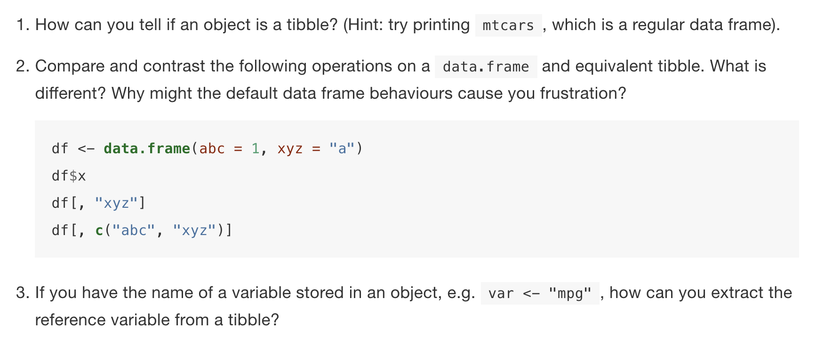
Exercises

Slide 6
