Slide 1

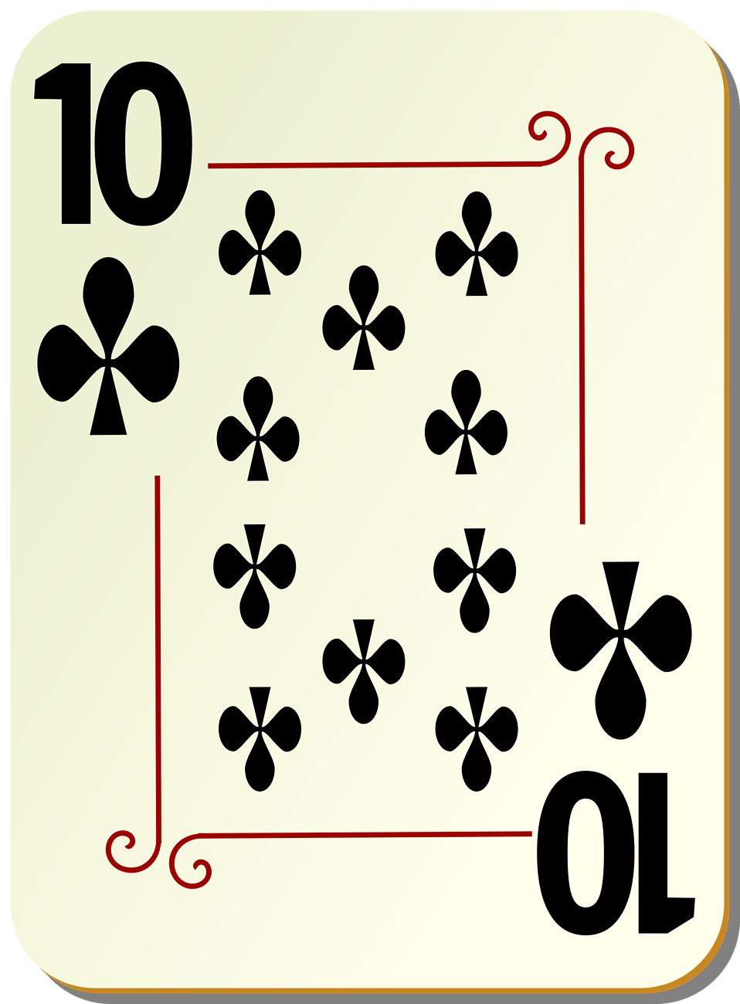
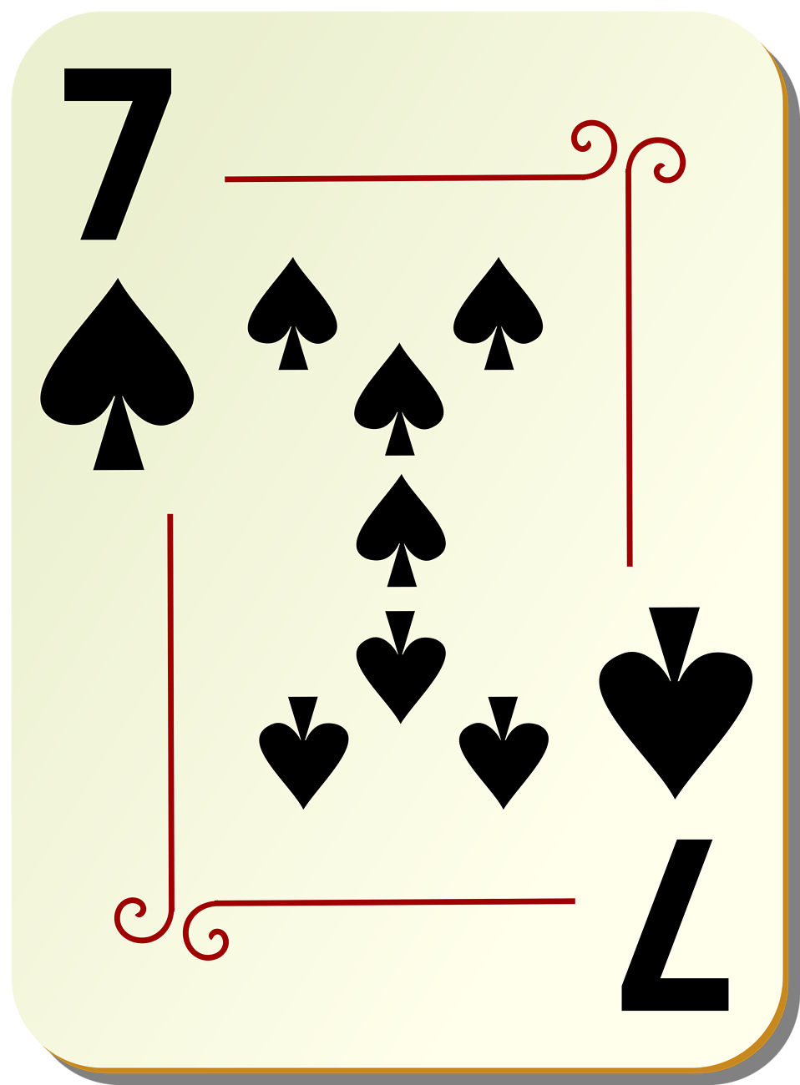
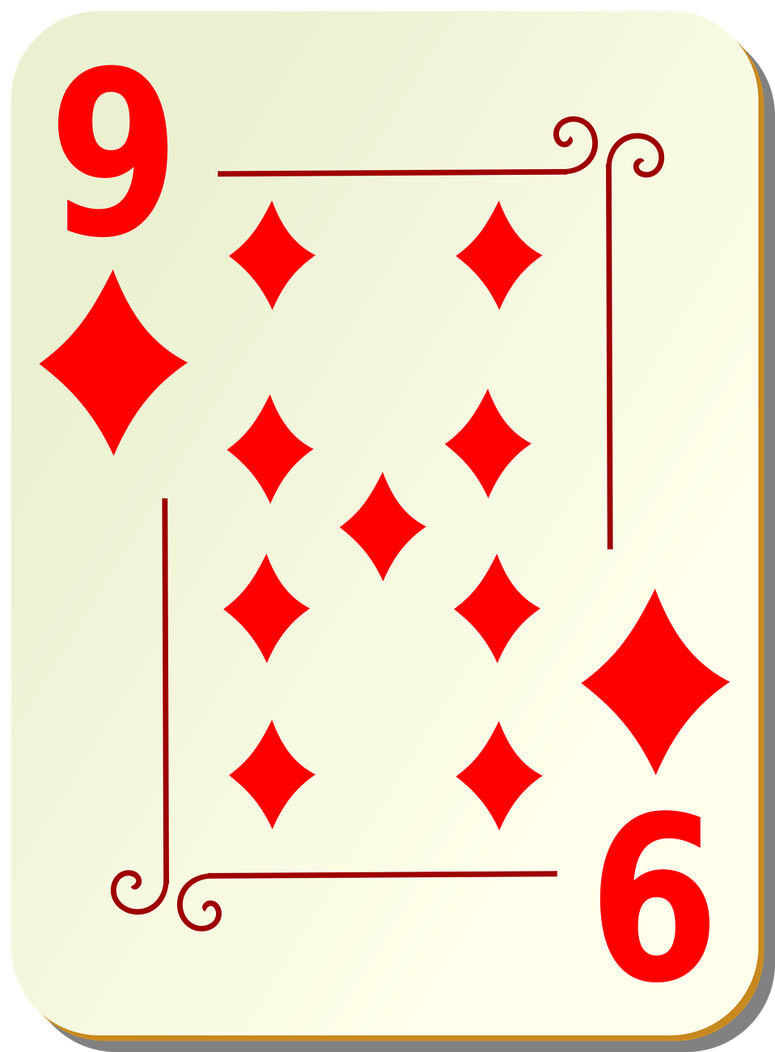
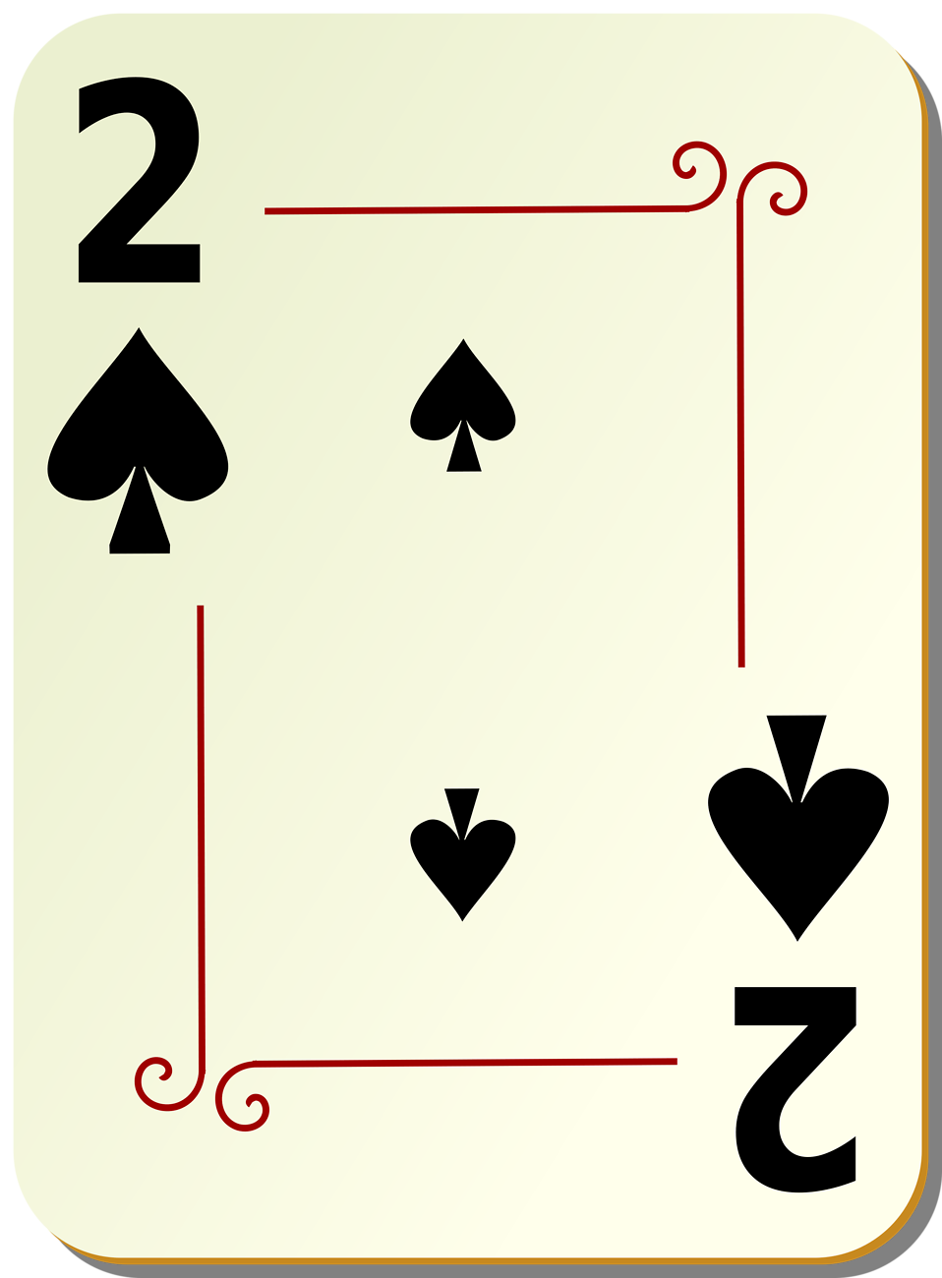
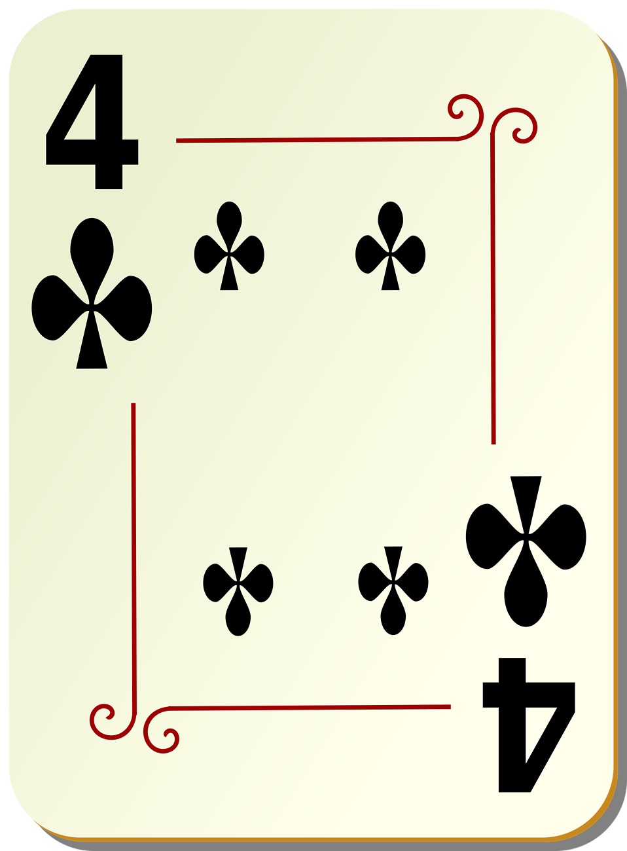
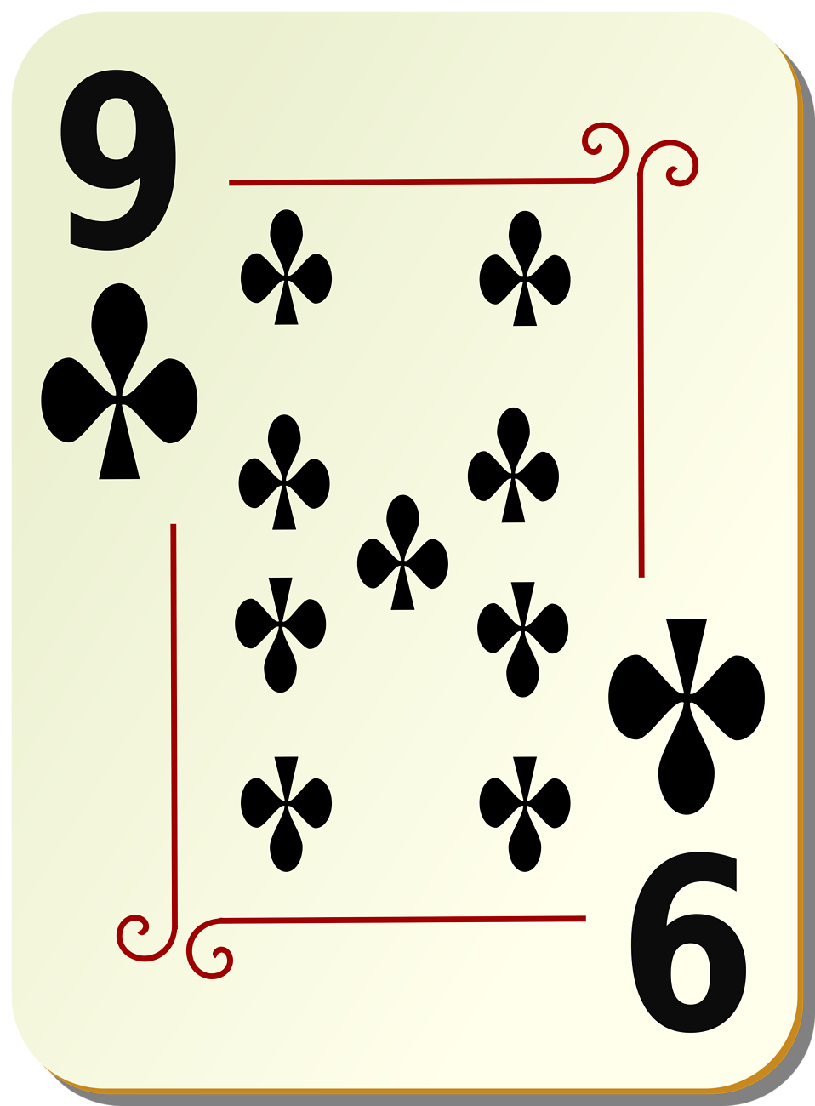
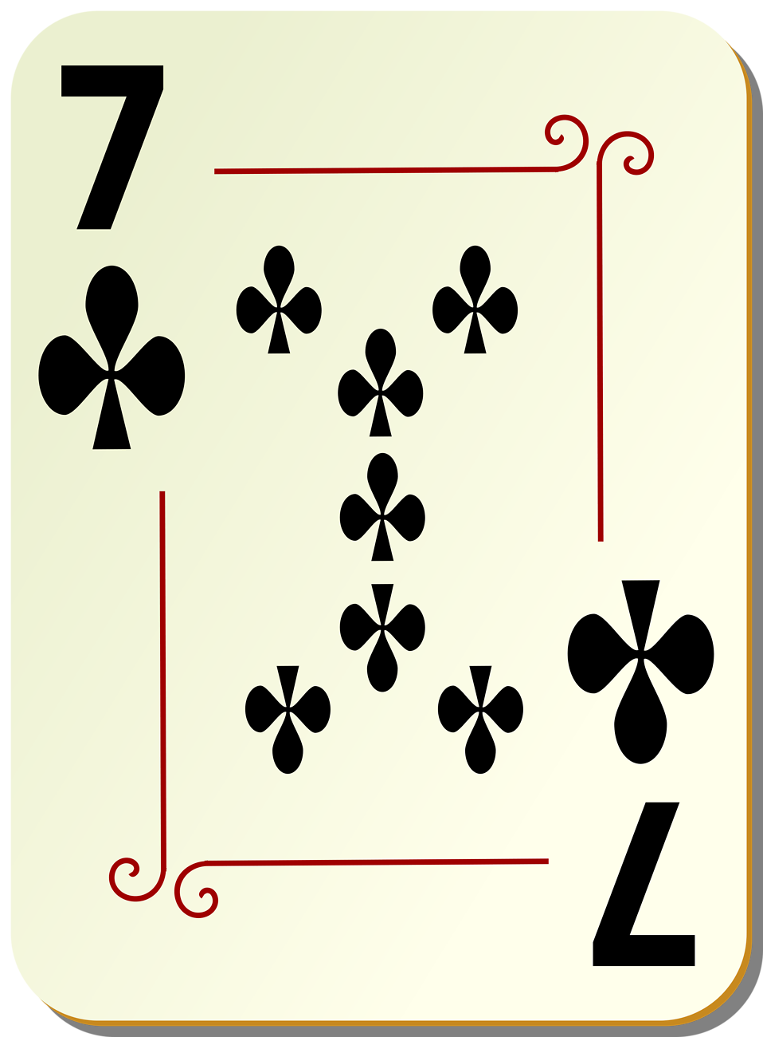
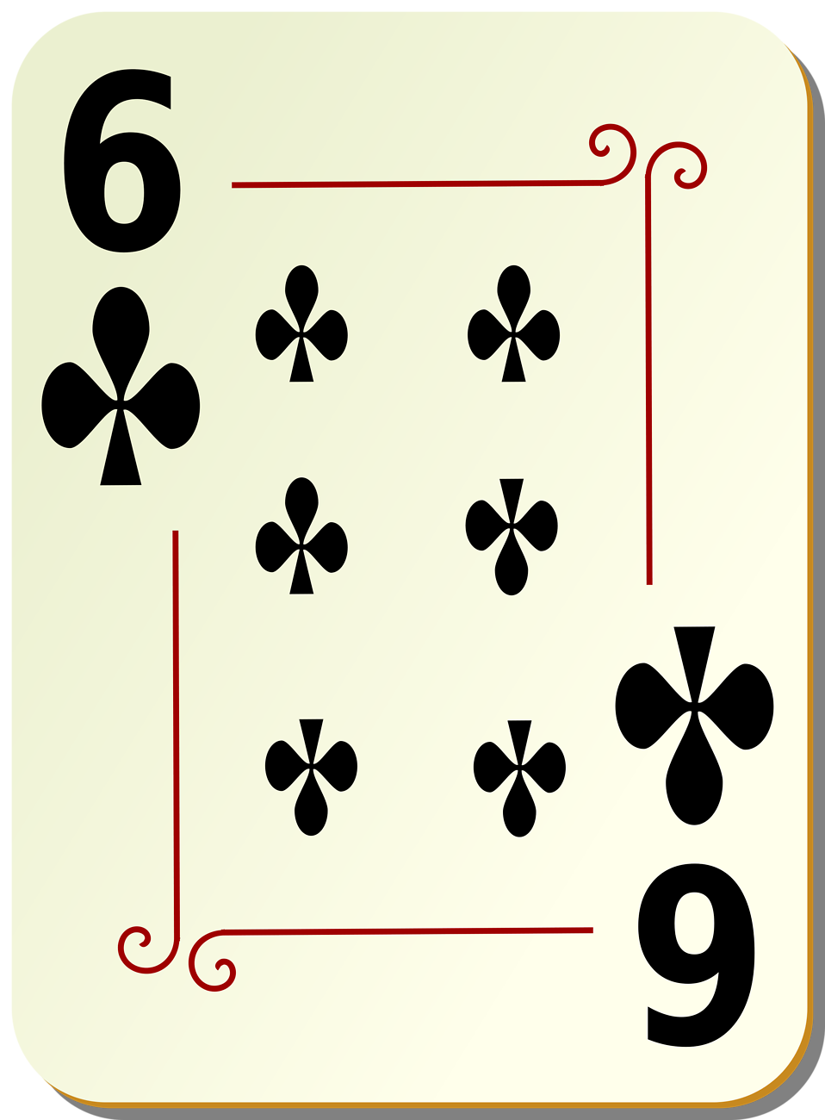

Simple Sort
1- for(i=1; i<n; i++)
2- {
3- SHORT_RES = arr[i];
4- j=i-1;
5- while((j >= 0) && (arr[j] > SHORT_RES))
6- {
7- arr[j+1] = arr[j];
8- j = j-1;
9- }
10- arr[j+1] = SHORT_RES;
11- }
SHORT_RES

