Slide 1
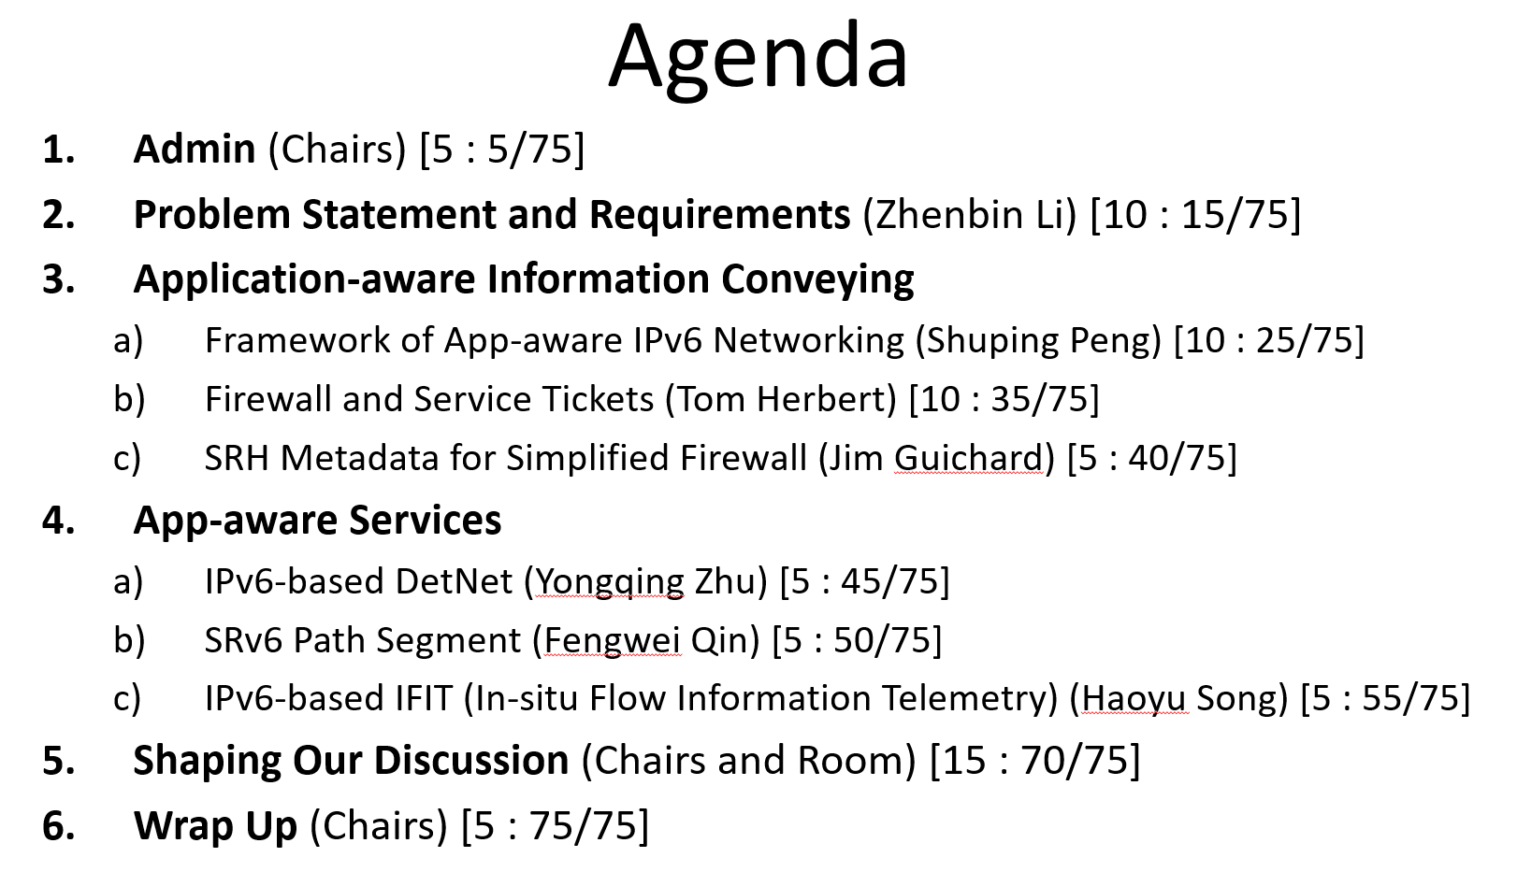
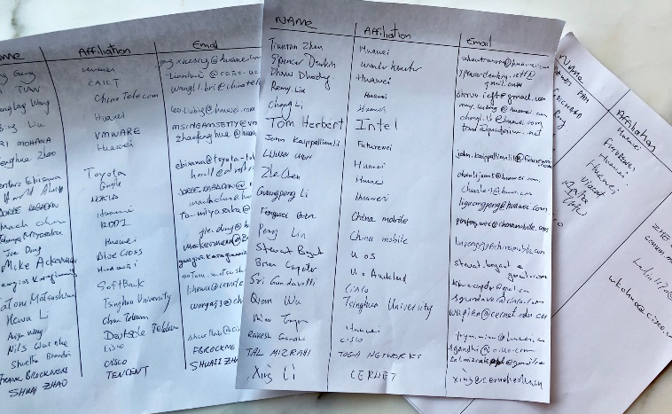

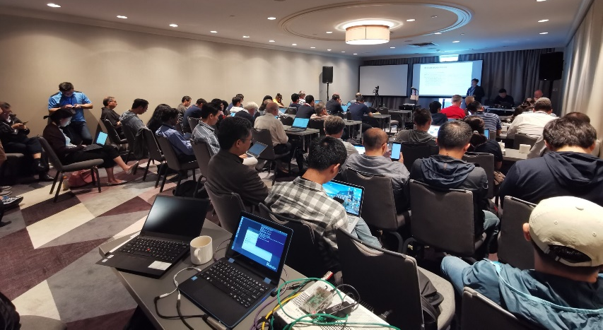
Summary of APN6 Side Meeting
Thursday Morning @Notre Dame
Attendee: 50+
Discussion points:
App-aware Info conveying
App-aware services
Security issues/boundary
Application identification
Policy enforcement
Relationship with the PANRG
Investigation and Consensus:
There is a value of the work
Next Step:
Setup Mailing list to continue discussions
https://github.com/shupingpeng/IETF105-Side-Meeting-APN6

