Slide 1
3-D Locations : A Coordinate System for Telepresence
T.M. Eubanks

Slide 2
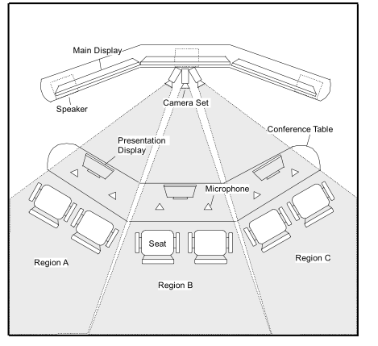
I submit that Telepresence Systems have a natural reference frame, and thus a natural coordinate system. Consider :

Slide 3
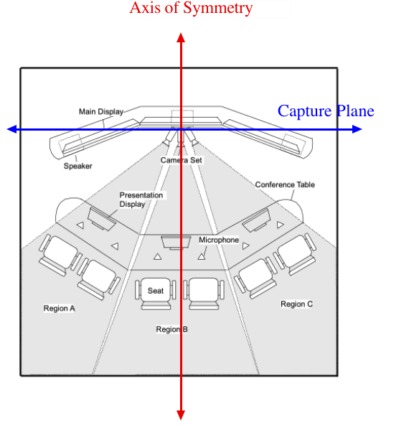
I think that this is the natural reference system for the most common Telepresence Units.
X Axis
Y Axis

Slide 4
What do we need ?
The fundamental goal is to make descriptions as simple as possible, but no simpler.
A framework where full fine-grained detail is possible, but not required.
Polar coordinates may be better for cameras.
BTW, the documents need a clear definition of stage-left and stage-right versus camera-left and camera-right.

Slide 5
Implications
I think that the zero of the reference system should be set by the axis of symmetry.
If you use far left (say) as your zero point then you have to specify where that is, and confusion is likely to result.
Angles should be measured (in the x-y plane) in a right angled system from the x axis.
The most detailed information would include
the location, orientation and size of each camera
the location, orientation, dimension and resolution of each display screen.

Slide 6
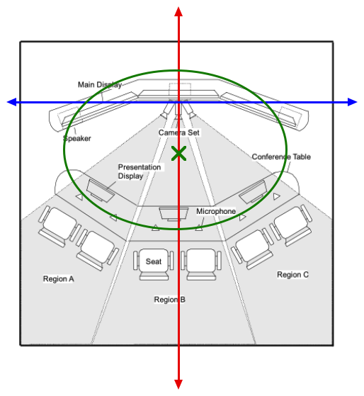
In Practice, many systems arrange things in arcs (segments of circles of ellipses). These can We could allow for descriptions of these (in terms of radii and foci), but I think that this is unnecessary.
6

