Slide 1
Examples
Brian Baldino

Slide 2
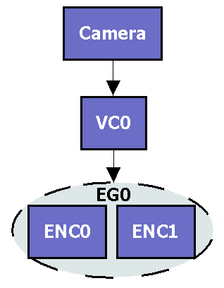
Single Camera Endpoint
Notes:
A 1 camera endpoint which output 2 forms of its video (high-def and low-def) would have a single capture with a single encode group with two encodes (HD and LD, for example)

Slide 3
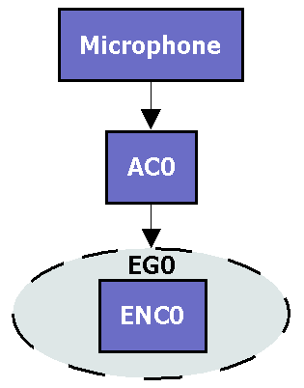
Single Camera Endpoint
Notes:
The endpoint has a single microphone, single audio capture, single encode group and a single encode (AAC, for example) (audio format=mono)

Slide 4
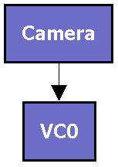
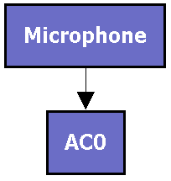
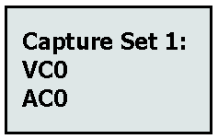
Single Camera Endpoint
Notes:
Because the endpoint is limited, its capture set is simple. There is only a single audio and video view of the capture scene, as shown by there being only a single row for audio and a single row for video in the capture set. Each of those rows only has a single capture, showing that the entire scene is being represented by the lone audio and video captures.
Selection:
How would a 1 screen receiver select captures/streams from an endpoint that had described itself this way?
The example is simple but the important part is that a 1 screen receiver would like to get the entire capture scene within a single capture it could select. VC0 and AC0 provide that.

Slide 5
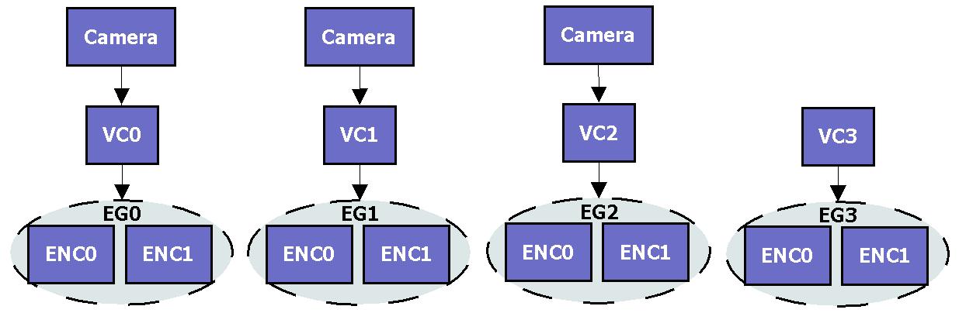
Three Camera Endpoint
Notes:
Similar to the 1 screen endpoint but this example introduces a new concept: a pre-composed video stream. Although captures often derive from physical devices, it’s not always the case. Here VC3 represents a composed form of the video from VC0, VC1 and VC2. VC3 would have an attribute of ‘video composed=true’

Slide 6
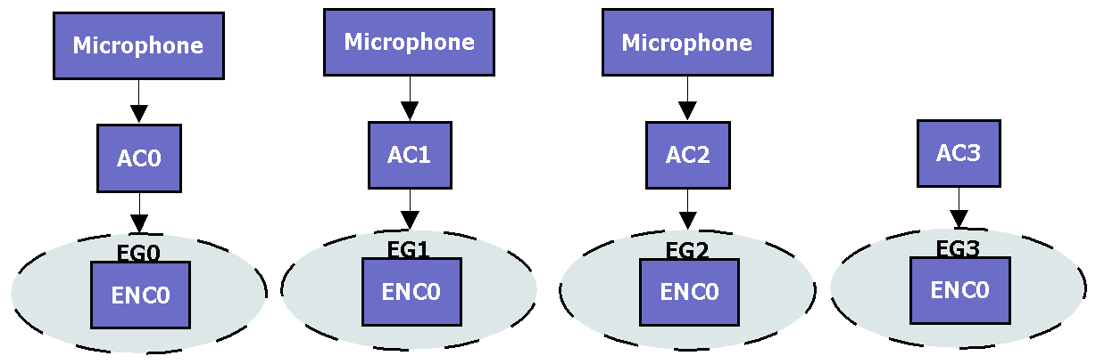
Three Camera Endpoint
Notes:
This introduces yet another concept: a pre-mixed audio stream. Much like the video, rather than AC3 being driven by a physical device it’s a representation of a mixture of captures AC0, AC1 and AC2 and would use the attribute ‘audio mixed=true’
AC0, AC1 and AC2 are individual microphones arranged spatially and would use the attribute ‘audio channel format=linear array’

Slide 7
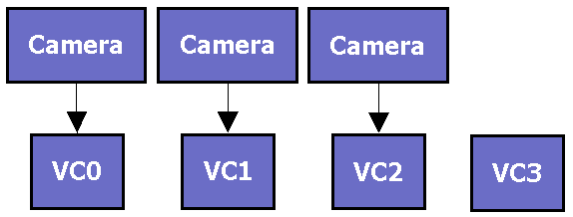
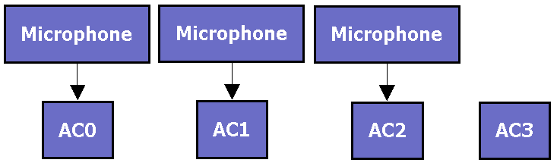
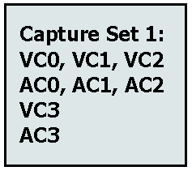
Three Camera Endpoint
Notes:
Capture set looks different here:
Because of the composed video and mixed audio there is more than one ‘view’ of the capture scene.
Discuss the spatial implications of the captures both within a single row and across rows.
Discuss the association of audio and video captures
High level selection:
How would a 3 screen endpoint choose captures here?
Ideally it will choose a view of the capture scene that is composed of 3 captures (VC0, VC1 and VC2 here)
How would a 1 screen endpoint choose captures here?
Ideally it will choose a view of the capture scene that is composed of 1 capture (VC3 here)
NOTE: Could choose VC0, VC1 and VC2 but also AC3 (nothing preventing it)
What about a 2 screen endpoint? Would be totally up to that endpoint depending on the experience it wants—it has to choose between two ‘non-ideal’ options

Slide 8
MCU Scenarios
Notes:
Discuss what an MCU must accomplish (must accommodate all endpoints connected to it)
High level selection:
Which captures would an MCU select here? (As many as it could to best accommodate all endpoints connected to it)

Slide 9
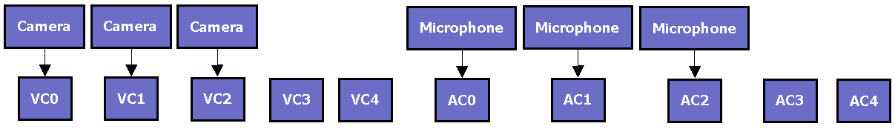
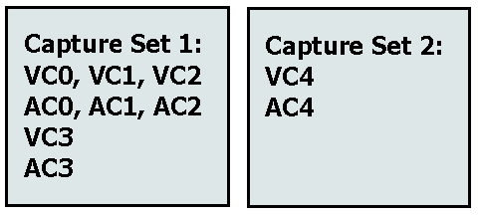
Three Camera Endpoint with Presentation
Notes:
Presentation video and audio have attributes which designate them as such
Presentation video and audio have no spatial relationship with the main video and audio, they are in a different capture scene
Different capture scenes are modeled in different capture sets
An endpoint would decide if it wanted main audio/video and presentation audio/video, then select an appropriate view of the scene (row of captures) from each capture set

Slide 10
QUESTIONS

