Slide 1
MPTCP Proxy Support
Costin Raiciu

Slide 2
Explicit Proxies
The MPTCP host knows about the proxy (e.g. via DHCP)
All connections are made to the proxy
Signaling to tell real destination
Ideal solution: put address in SYN options
No space even for IPv4
IPv6 – don’t even mention it

Slide 3
Application Explicit Proxies
Use SOCKS for HTTP, etc.
Not ideal, but gets the job done

Slide 4
Implicit Proxies
Proxy is on-path for the first subflow
3G operators could deploy a proxy on path of traffic

Slide 5


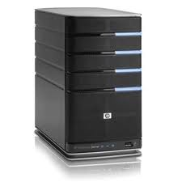
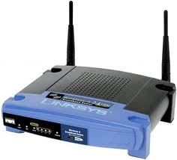
Implicit Proxy: Server Speaks MPTCP
3G celltower
MPTCP
Proxy

Slide 6
Implicit Proxy: Server Speaks MPTCP
3G celltower
MPTCP
Proxy

Slide 7
Implicit Proxy: Server Does Not Speak MPTCP
3G celltower
MPTCP
Proxy

Slide 8
Implicit Proxy: Server Does Not Speak MPTCP
3G celltower
MPTCP
Proxy
128.15.1.1
193.231.233.1

Slide 9
Implicit Proxy: Server Does Not Speak MPTCP
3G celltower
MPTCP
Proxy
128.15.1.1
193.231.233.1

Slide 10
Implicit Proxy: Server Does Not Speak MPTCP
3G celltower
MPTCP
Proxy
128.15.1.1
193.231.233.1

Slide 11
Implicit Proxy: Server Does Not Speak MPTCP
3G celltower
ADD_ADDR
128.15.1.1
MPTCP
Proxy
128.15.1.1
193.231.233.1

Slide 12
Implicit Proxy: Server Does Not Speak MPTCP
3G celltower
MPTCP
Proxy
128.15.1.1
193.231.233.1

Slide 13
Implicit Proxy: Server Does Not Speak MPTCP
3G celltower
REMOVE_ADDR
193.231.233.1
MPTCP
Proxy
128.15.1.1
193.231.233.1

Slide 14
Implicit Proxy: Server Does Not Speak MPTCP
3G celltower
MPTCP
Proxy
128.15.1.1
193.231.233.1

Slide 15
Implicit Proxy Address Signaling
We could optimize this
I am a proxy bit could stop additional subflow setup
But still need add_address
Could avoid three way handshake?

