Slide 1
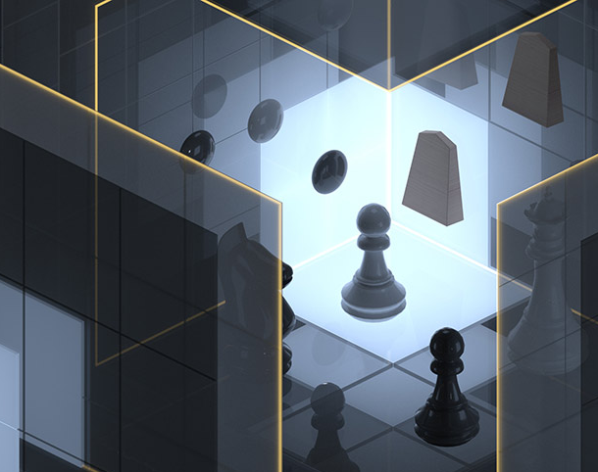
ChessMaster: A Java-based Chess Game with GUI
Vansh Pratap Chauhan (12110117)
Anubhav Chambyal (12106411)
Saksham Mishra (12111129)

Slide 2

INTRODUCTION:
Chess is a classic and popular game that has been played for centuries.
Our project aims to create a modern and dynamic version of chess using Java programming.
We wanted to provide a user-friendly graphical interface and an artificial intelligence opponent for a challenging experience.
We used object-oriented programming principles
Testing was conducted to ensure a smooth and bug-free experience for the user.
In this presentation, we will cover the main features of our chess game, including its architecture, implementation details, user interface, testing, and future work.

Slide 3
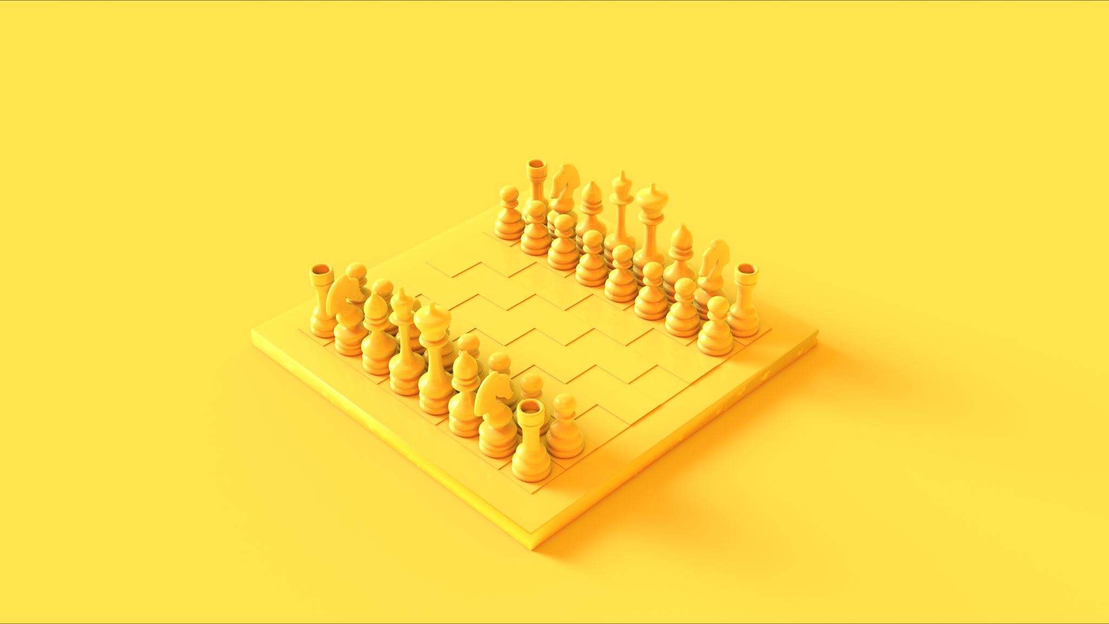
IMPLEMENTATION DETAILS:
We implemented our chess game using Java programming language and the standard Java Development Kit (JDK).
We utilized the Java FX to create the game's graphical user interface (GUI). This allowed us to create a visually appealing and user-friendly interface for the game.
To implement the game's logic and rules, we followed the standard rules of chess and utilized object-oriented programming principles.
We created classes to represent each chess piece and implemented their movement rules and interactions with other pieces on the board.

Slide 4

USER INTERFACE:
We created a user-friendly graphical user interface (GUI) for our chess game using the Java FX.
The GUI features a classic chessboard layout with intuitive controls that allow the user to easily move pieces and interact with the game.
We included visual feedback to indicate valid moves and possible captures, which helps the user understand the game's rules and mechanics.
The GUI displays useful information such as captured pieces, turn order, and game status, which helps the user keep track of the game's progress and make strategic decisions.

Slide 5
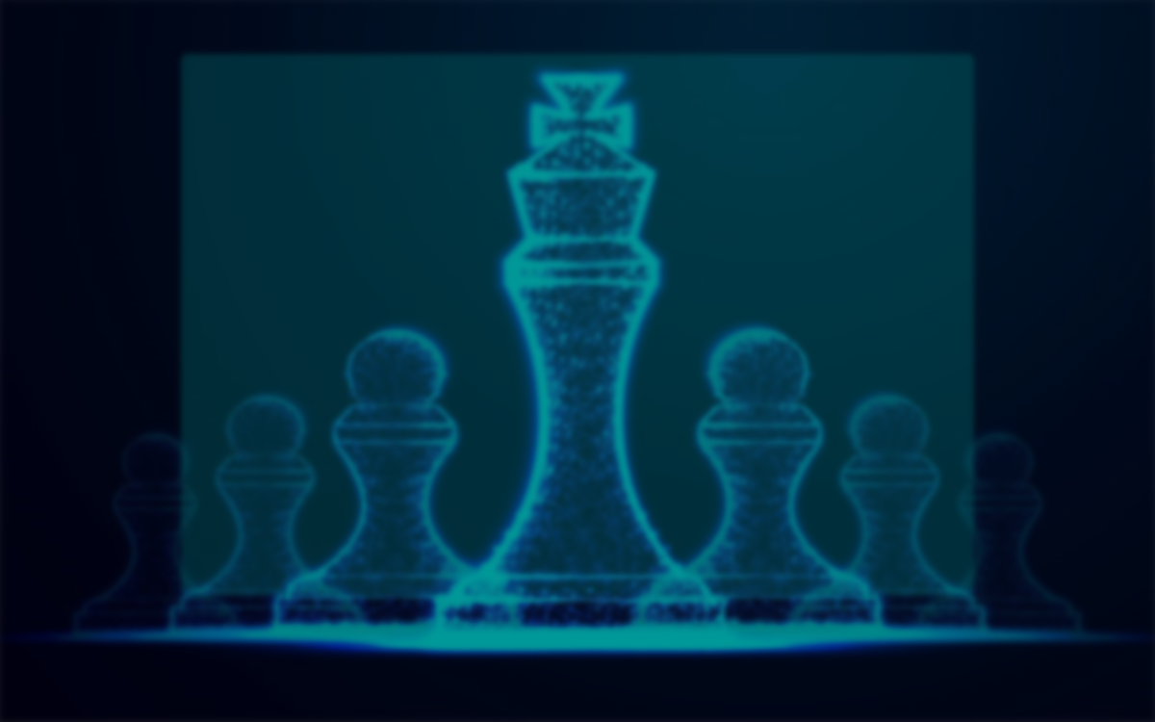
LET’S GO TO CODE >

