Slide 1


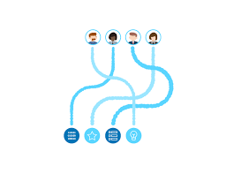







Experts committee
Data loader
Natural Language processing solution
Technical
analytics portal
digitaltwins.info
Rule check
engine

