Slide 1
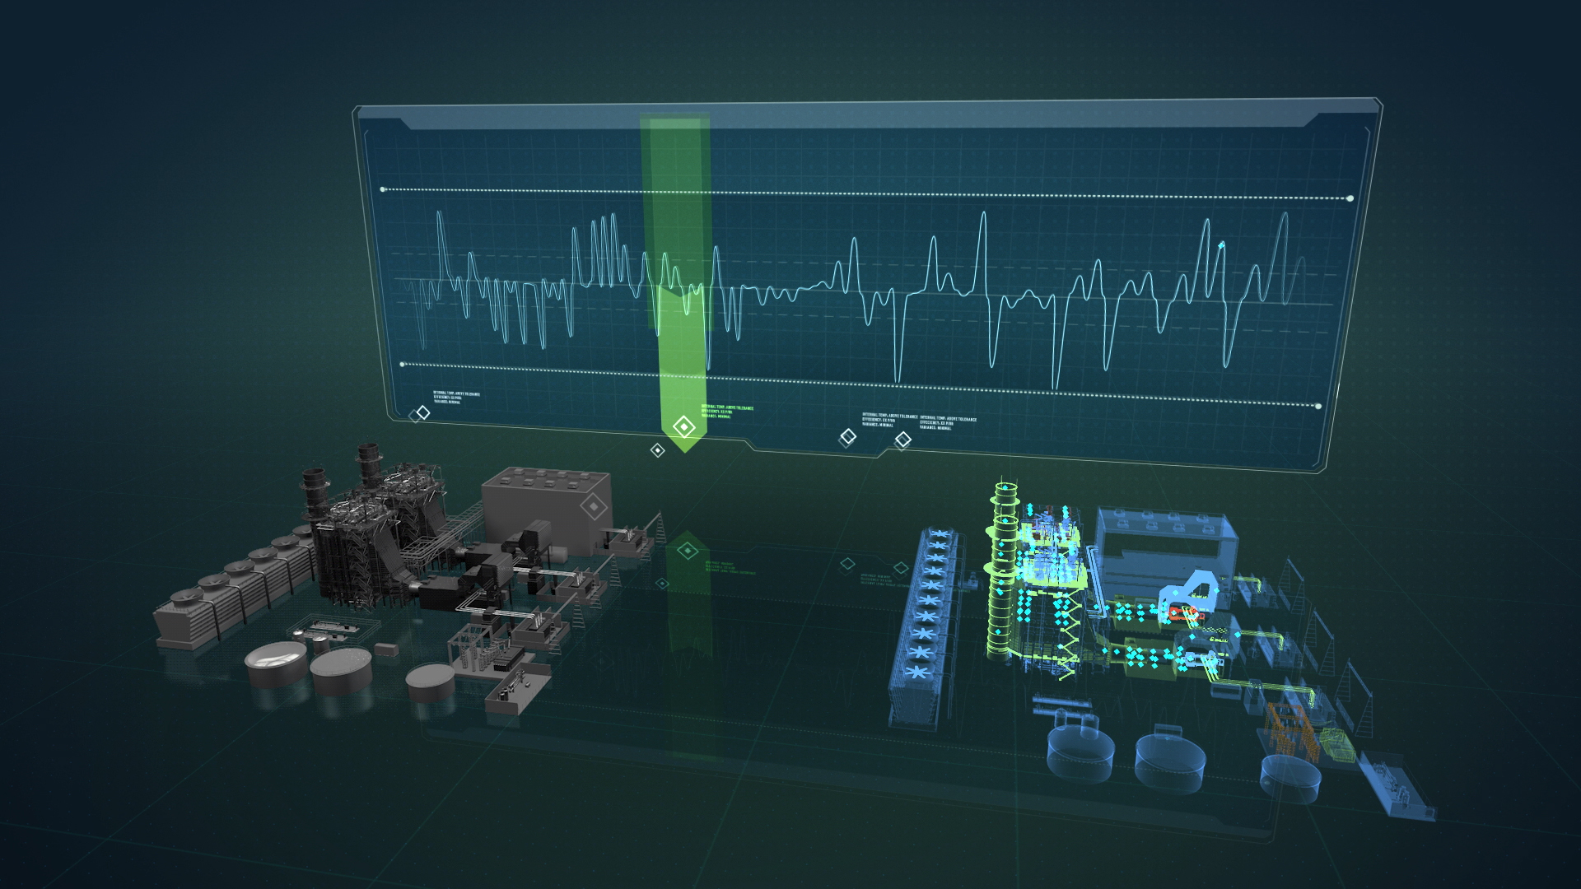
DigitalTwins.Info
DIGITAL TWINS FOR PROCUREMENT
DIGITAL TWINS BASED ON OPEN STANDARDS
Notes:
Cover Page

Slide 2
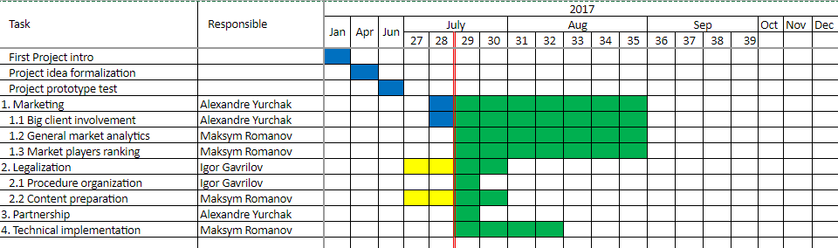
http://DigitalTwins.Info project
Begin date: 15.01.2017
Team: 3 members
Website: http://digitaltwins.info
Notes:
Summary - overall summary of your project and progress

Slide 3
Procurement of "simple" products and "raw" materials on digital market at digital age - "simplification" is an umbrella for "manipulation" and "incompetence"
Informal way of describing procurement item can be the source of manipulation and unfair competition (disqualifying proposals and suppliers as an major influence instrument). In the same time ignoring general technical policies can significantly influence on quality, TCO and even on successful and legal operations of procured equipment.
Notes:
Problem - what is the problem that your project is trying to solve? What is the scale of this problem?

Slide 4
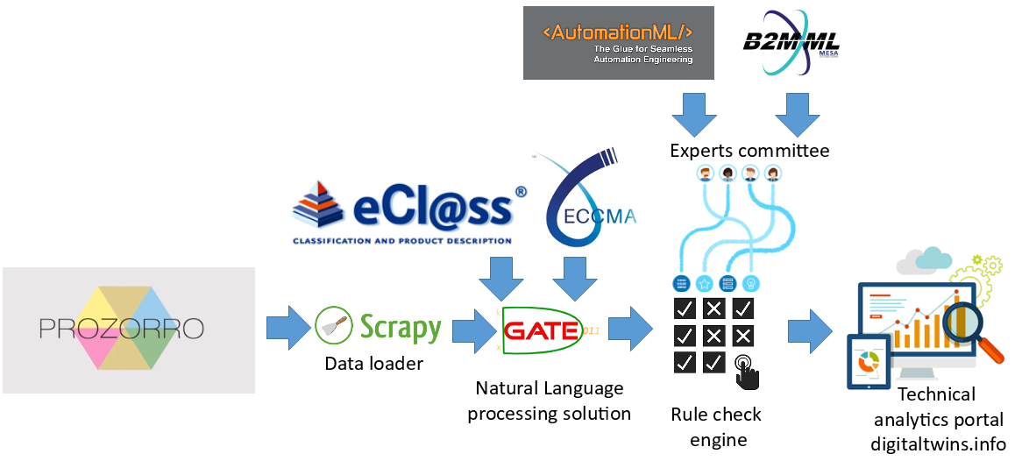
Notes:
Solution - how does your project solve the problem you have outlined? What is the user journey (if relevant)?

Slide 5
Notes:
Innovation - why is this project innovative? How does it improve on the competition (if there is any)?

Slide 6
Notes:
Data - how is data central to your proposition? What data have you used? What contribution have you made to the data ecosystem?

Slide 7
Notes:
Progress - What progress have you made in the incubation period?

Slide 8
According to AIAEU data near 50% of industrial automation tenders at prozorro system are going with violation of technical policies. Ignoring quality and long term impacts during tenders, and focusing on the price criteria is pushing out most of the big market players from procedure. Therefore tenders are usially arranged between small noname companies. Possible direct measurements of the quality of digitalized descriptions: percentage of "direct model" illegal descriptions ("iPhone 7" instead of "mobile phone") percentage of "double meaning" descriptions ("Notebook" - with no technical description) percentage and cost estimation of "price before quality" procurement decisions. percentage and cost estimation of "hidden costs" in procurement items ( services, software, regulation requirements which are not mentioned) Indirect measurements, estimated on the model basis: estimated TCO reduction, ROI increasing estimated budget savings on avoiding "worldwide recognized brand" illness estimated "productivity" increasing estimated "asset lifetime" increasing
Notes:
Impact - What is your theory of change (NGOs only) .

Slide 9
Last 10 years we unite community, which is responsible for technical policies at corporate sector. "Technical policy" is an instrument, which allow big companies to drive their investments effectiveness and TCO goals.
Idea is based on new combination of existing technologies and practices. Most of them are already sustainable and recognized on market. Moreover - open standards are used as an basis of informational model of proposed system, open Product Catalogs and CodeLists. As an continuation of "prozorro" system - our project will also be open sourced and developed with wide public discussion with most stakeholder groups.
Notes:
Impact - Exploration. What quantitative and qualitative effect has your project had so far in economic, environmental or social terms?

Slide 10
Notes:
Sustainability/reproducibility - how could your project be sustainable and/or reproduced? What is the underlying business model (enterprise only) if you have one?

Slide 11
Notes:
Rules standard content

Slide 12
Notes:
Simple story example

