Slide 1
Digital transformation of production plant
Industry 4.0 solutions for production
Based on: "Current Standards Landscape for Smart Manufacturing Systems"
http://dx.doi.org/10.6028/NIST.IR.8107

Slide 2
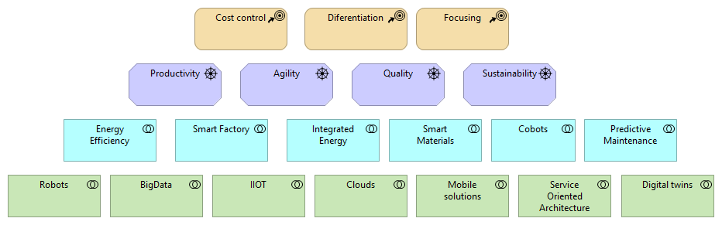
Enterprise strategy defines digitalization projects portfolio

Slide 3
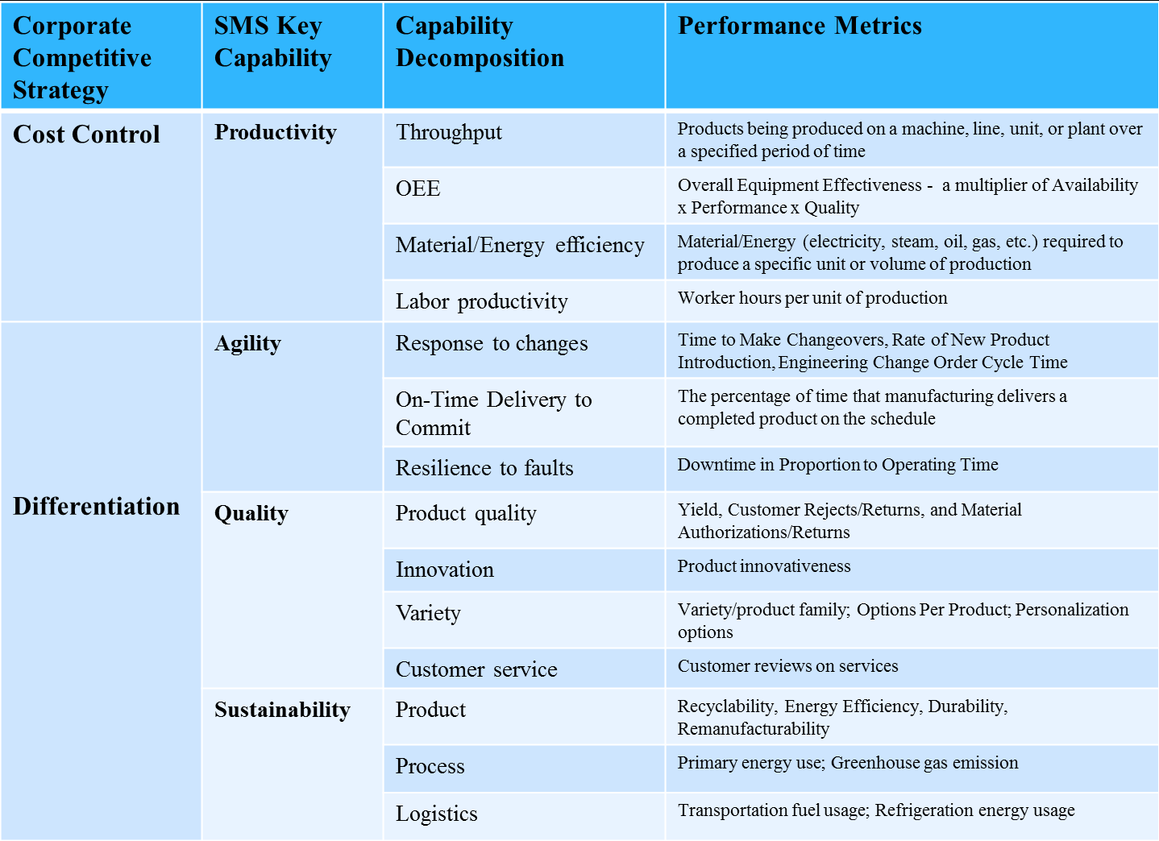
Strategy -> Capabilities -> KPIs -> Solutions Old rationale approving way for new technologies

Slide 4
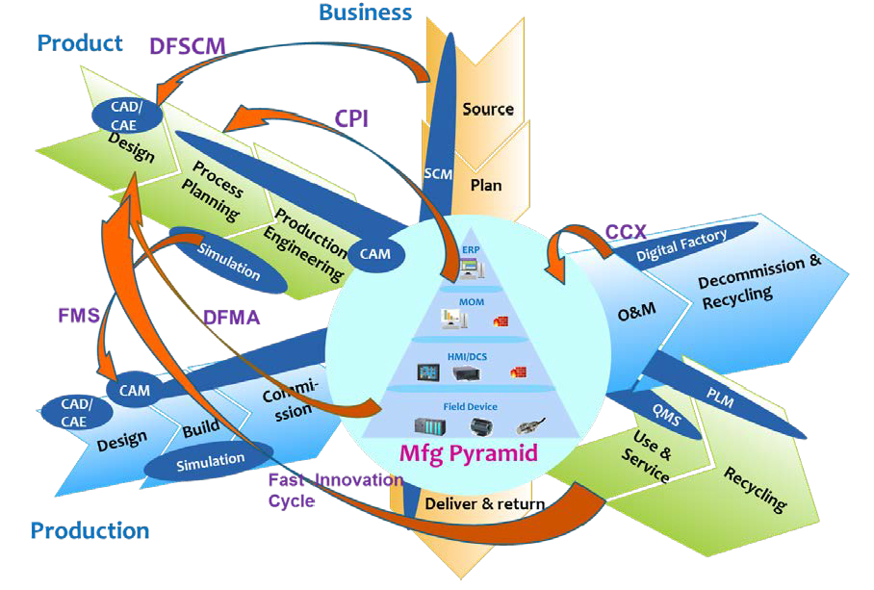
Three major dimensions of DX program

Slide 5
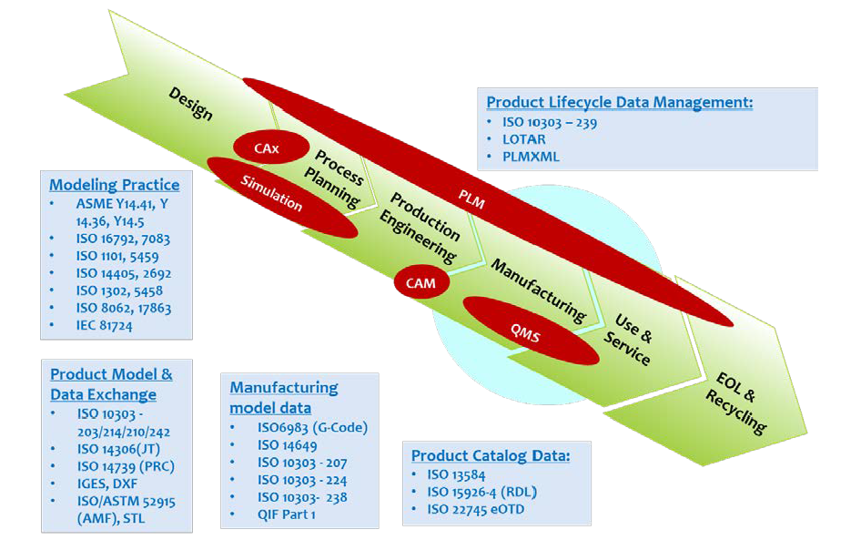
Product dimension – for differentiation and focusing strategies

Slide 6
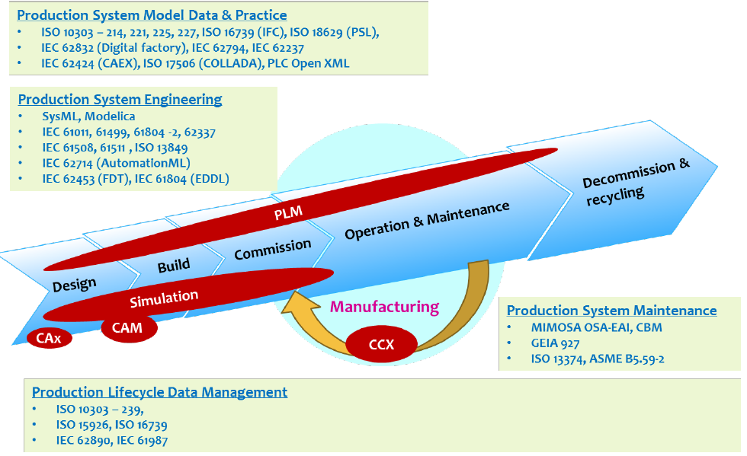
Any kind of production enterprise needs appropriate equipment digitalization

Slide 7
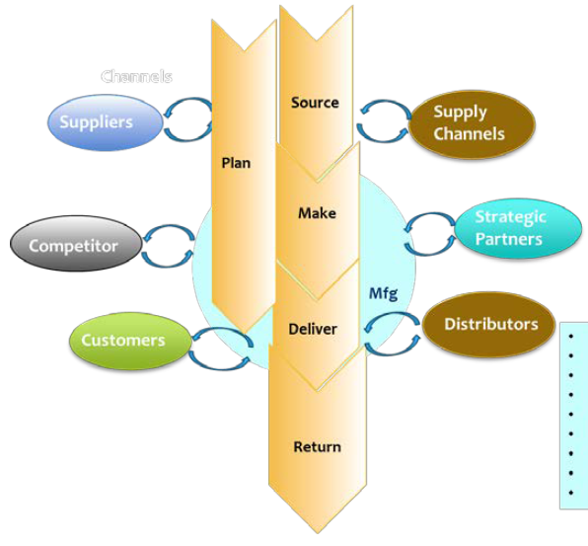
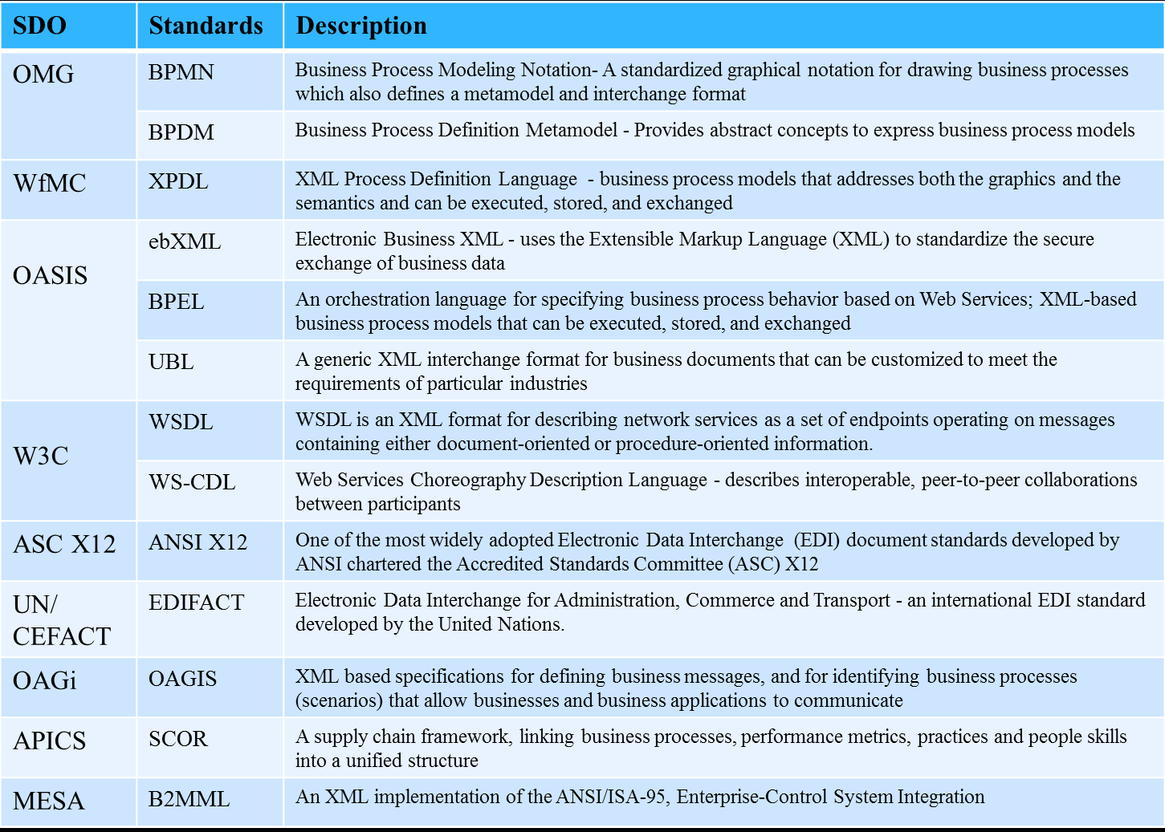
Connected enterprise – standards set for horizontal integration

Slide 8
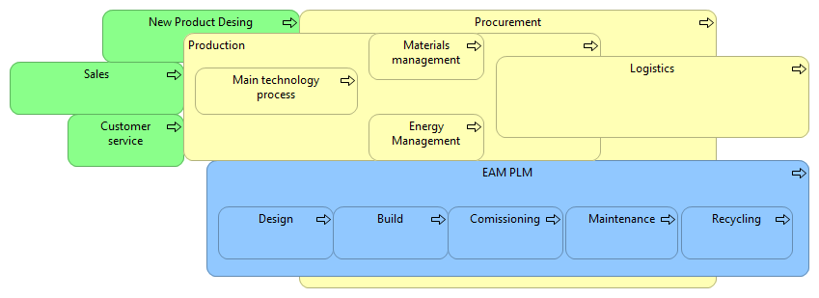
Mapping above to generalized business processes of production plant we see possible applications for I4.0 at production plant

Slide 9
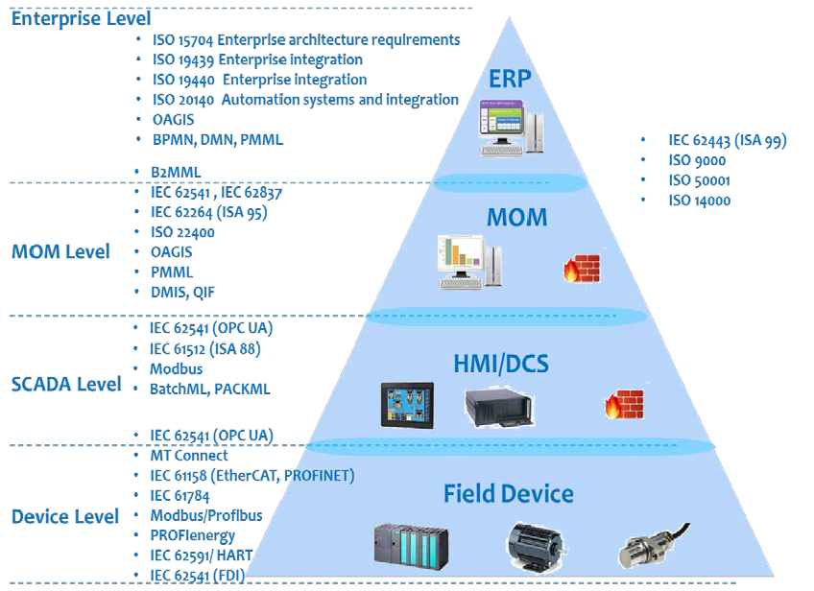
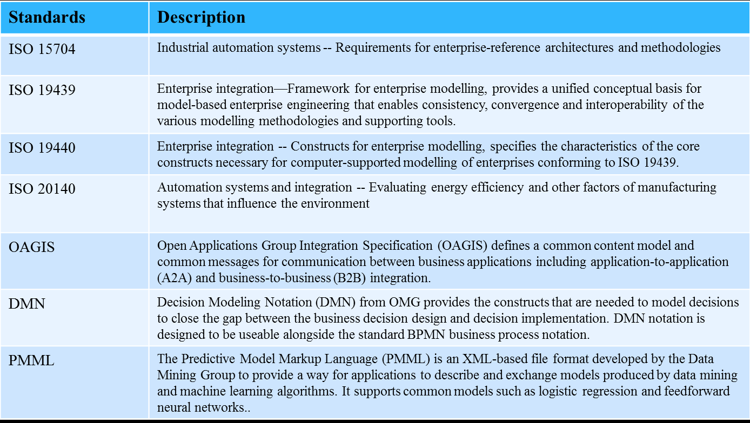
Standards set for vertical integration allow us to connect any solution one to another

Slide 10
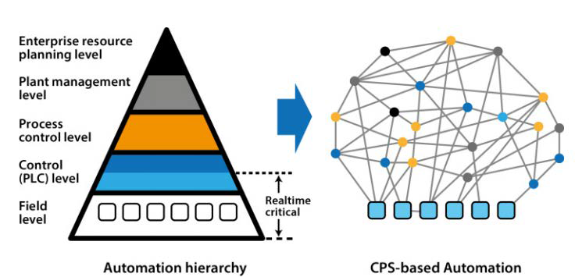
IIOT assumes movement to decentralized net-style connection architecture (SOA enabled)

Slide 11
Integration bring us to new "service" economy – Products as Services.

