Slide 1


Crafting Your Life: Are You Living Consistent
With What Matters Most to You?
Leslie Perlow Konosuke Matsushita Professor of Leadership
[DATE]
Copyright © Leslie Perlow
Notes:
What are the key insights we hope they will take away
What are the fun facts?
Are we getting across… pause, are you living with intentionality

Slide 2
Internal note Add: 1. slides with over time (including life sat) 2. slides with comparison of JAM type (with donuts)

Slide 3
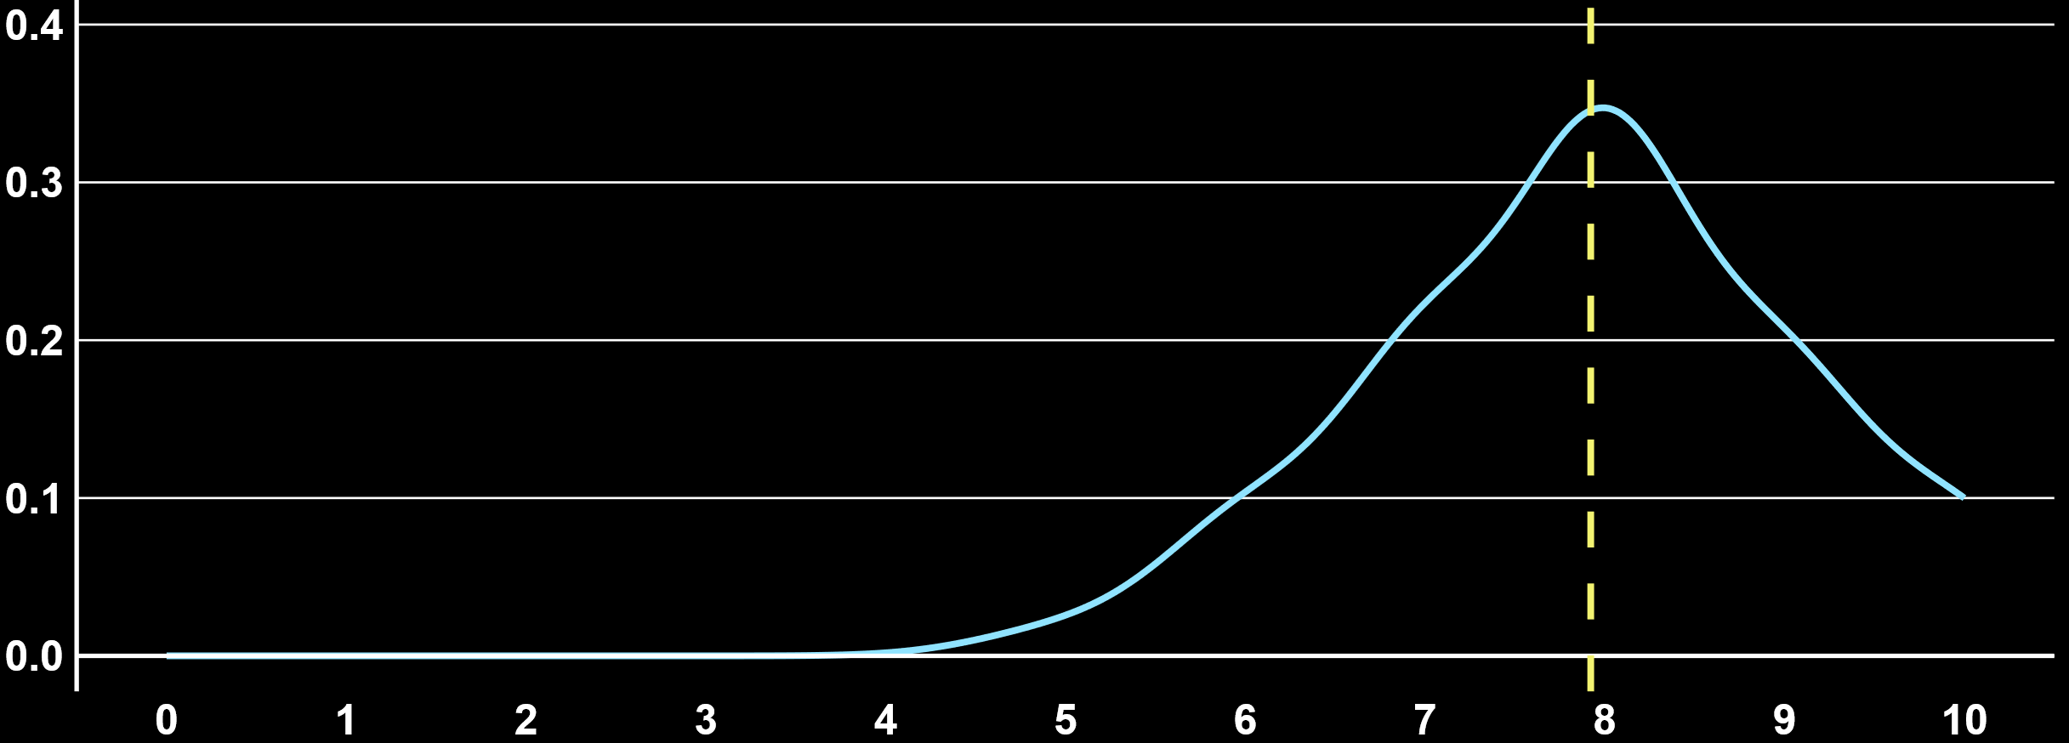
We should have versions of this that compare
To HBS men & HBS women and HBS overall
And we can set the conditions… age, committed relationship, work status,
LIFE SATISFACTION
Avg. = 7.9
Density
Life Satisfaction
Notes:
All Xilio

Slide 4
LIFE SATISFACTION
HBS Avg. = 7.5
Avg. = 7.9
Density
Life Satisfaction
Notes:
All Xilio

Slide 5
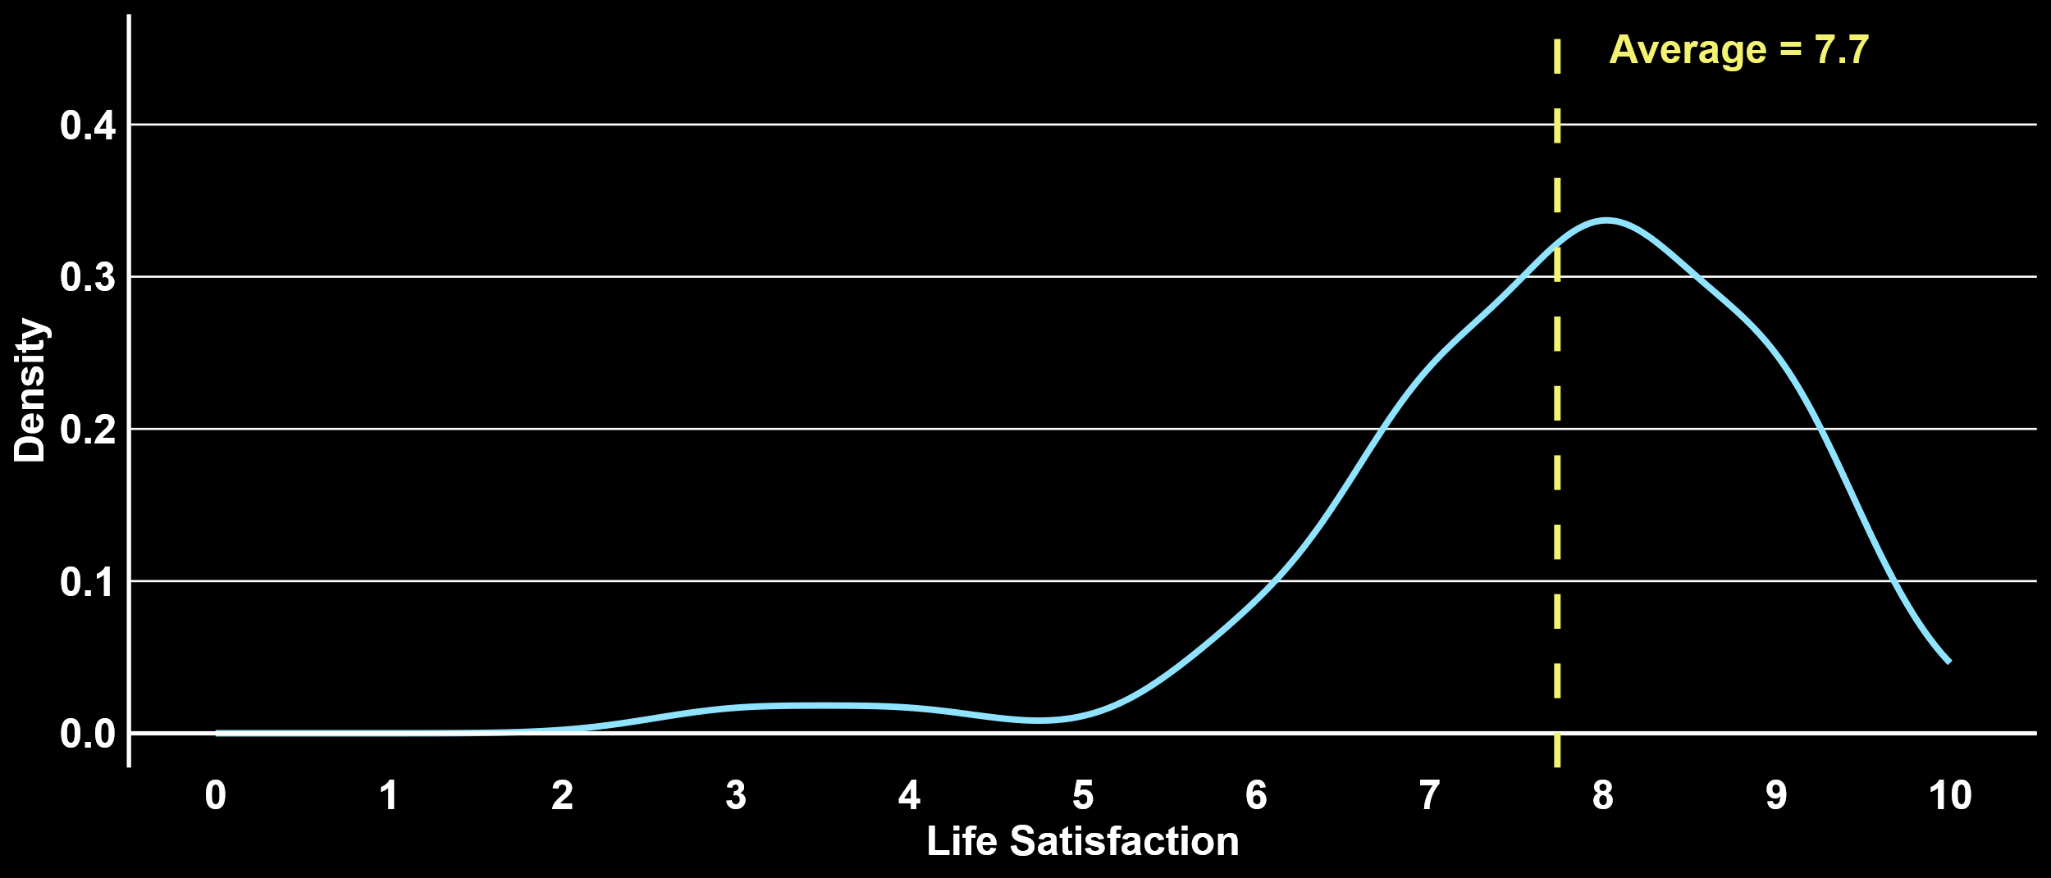
LIFE SATISFACTION
HBS Women Avg. = 7.5
HBS Men Avg. = 7.8
Avg. = 7.7
Density
Life Satisfaction
Notes:
Data: IWF (need to update)

Slide 6
JAM TYPE DISTRIBUTION
Joy
Seeker
Striver
Triumvirate
Purpose
Seeker
Joyful
Striver
19%
Purposeful
Striver
Flourisher
Notes:
Data: IWF (need to update)

Slide 7
JAM TYPE DISTRIBUTION
1ST REUNION CLASS
HBS ALUMS
Joy Seeker
Striver
Purpose Seeker
Joyful
Striver
Flourisher
Purposeful
Striver
Triumvirate

Slide 8
IMPORTANCE OF JAM
One version that is just the group
One version that compares to HBS overall
One version that compares to HBS men &women
% High Importance
Notes:
DATA : HBS population

Slide 9

IMPORTANCE OF JAM
% High Importance
Notes:
Xilio + HBS

Slide 10
IMPORTANCE OF JAM
% High Importance
Notes:
Xilio + HBS

Slide 11
IMPORTANCE OF JAM
% High Importance
Notes:
Xilio + HBS

Slide 12
IMPORTANCE OF JAM
% High Importance
Notes:
Xilio + HBS

Slide 13
IMPORTANCE OF JAM
% High Importance
Notes:
IWF (Need to update) + HBS

Slide 14
MEETING MINIMUMS
One version that is just the group
One version that compares to HBS overall
One version that compares to HBS men &women
% Meeting the Minimum
Notes:
DATA : HBS FT workers 5-30 reunion – NEED to update to only 10-40

Slide 15
IMPORTANCE OF JAM
64%
62%
51%
% High Importance
Notes:
DATA : alumni board (please update Sari)

Slide 16
MEETING MINIMUMS
% Meeting the Minimum
Notes:
Xilio + HBS FT workers 5-30 reunion

Slide 17
MEETING MINIMUMS
% Meeting the Minimum
Notes:
Xilio + HBS FT workers 5-30 reunion

Slide 18
IMPORTANCE OF JAM
64%
64%
66%
62%
57%
51%
% High Importance
Notes:
Xilio + HBS

Slide 19
MEETING MINIMUMS
% Meeting the Minimum
Notes:
IWF (Need to update); HBS Women and Men working 40+ hours, 10+ reunion

Slide 20
MEETING MINIMUMS
% Meeting the Minimum
Notes:
IWF (Need to update); HBS Women and Men working 40+ hours, 10+ reunion

Slide 21
MEETING MINIMUMS
% Meeting the Minimum
Notes:
IWF (Need to update); HBS Women and Men working 40+ hours, 10+ reunion

Slide 22
IMPORTANCE OF JAM
72%
72%
68%
65%
65%
62%
62%
56%
52%
% High Importance
Notes:
IWF (Need to update) + HBS

Slide 23
MOST COMMON HIGH VALUE ACTIVITIES
One version that is just the group (missing)
One version that compares to HBS overall
One version that compares to HBS men &women
1
6 hrs
Catching up
2
Exercising 5 hrs
3
4 hrs
Partying/hosting
4
4 hrs
Eating with others
5
2 hrs
Eating with family
Notes:
Data: 1st year class FT

Slide 24
MOST COMMON HIGH VALUE ACTIVITIES
Xilio
HBS
Caregiving
with family
Caregiving
with family
8 hrs
7 hrs
Eating
with family
Eating
with family
4 hrs
5 hrs
Watching TV
with family
Catching up
4 hrs
3 hrs
Catching up
Eating
with others
3 hrs
2 hrs
Eating
with others
Partying
with others
1 hr
2 hrs
Notes:
Data: All xilio; HBS working 40+ hours, 5-30 reunion, all population

Slide 25
MOST COMMON HIGH VALUE ACTIVITIES
IWF
HBS Women
HBS Men
Catching up
Caregiving
with family
Eating
with family
4 hrs
9 hrs
5 hrs
Eating
with others
Eating
with family
Watching TV
with family
4 hrs
4 hrs
3 hrs
Partying
with others
Catching up
Catching up
3 hrs
3 hrs
3 hrs
Eating
with family
Eating
with others
Eating
with others
2 hrs
2 hrs
2 hrs
Board
with others
Partying
with others
Partying
with others
1 hr
2 hrs
2 hrs
Notes:
Data: IWF (need to update); HBS Women and Men working 40+ hours, 10+ reunion

Slide 26
MOST COMMON LOW VALUE ACTIVITIES
One version that is just the group (missing)
One version that compares to HBS overall
One version that compares to HBS men &women
1
Social Media 7 hrs
2
Eating Alone 4 hrs
3
3 hrs
Hanging Out Alone
4
Watching TV Alone
3 hrs
5
Chores Alone 3 hrs
Notes:
Data: 1st year class FT

Slide 27
MOST COMMON LOW VALUE ACTIVITIES
Xilio
HBS
Chores alone
Social media
alone
5 hrs
4 hrs
Eating alone
Chores alone
4 hrs
3 hrs
Social media
alone
Eating alone
4 hrs
3 hrs
Watching TV
alone
Commuting
alone
4 hrs
3 hrs
Commuting
alone
Watching TV
alone
4 hrs
2 hrs
Notes:
Data: All xilio; HBS working 40+ hours, 5-30 reunion, all population

Slide 28
MOST COMMON LOW VALUE ACTIVITIES
IWF
HBS Women
HBS Men
Eating alone
Chores alone
Social media
alone
4 hrs
4 hrs
4 hrs
Social media
alone
Social media
alone
Commuting
alone
4 hrs
4 hrs
3 hrs
Chores alone
Eating alone
Chores alone
3 hrs
3 hrs
3 hrs
Commuting
alone
Commuting
alone
Eating alone
3 hrs
3 hrs
2 hrs
Watching TV
alone
Watching TV
alone
Watching TV
alone
2 hrs
2 hrs
2 hrs
Notes:
Data: IWF (need to update); HBS Women and Men working 40+ hours, 10+ reunion

Slide 29
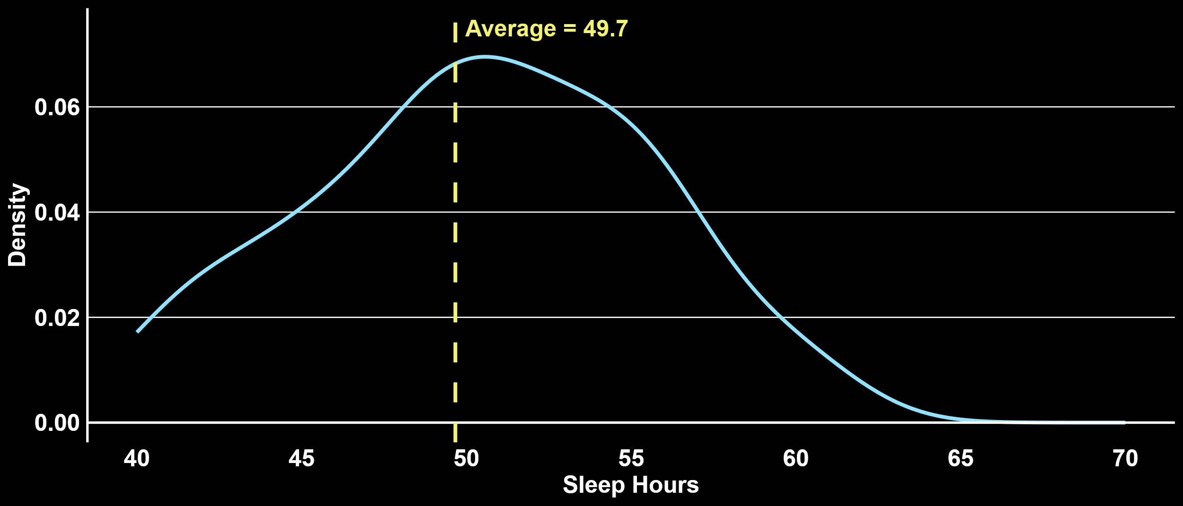
One version that is just the group (no comparison)
One version that compares to HBS overall
One version that compares to HBS men &women
We should do this for all the activities so we have it for each
DISTRIBUTION OF HOURS - SLEEP
Avg. = 49.7
Density
Sleep Hours
Notes:
Sample: Pillar

Slide 30
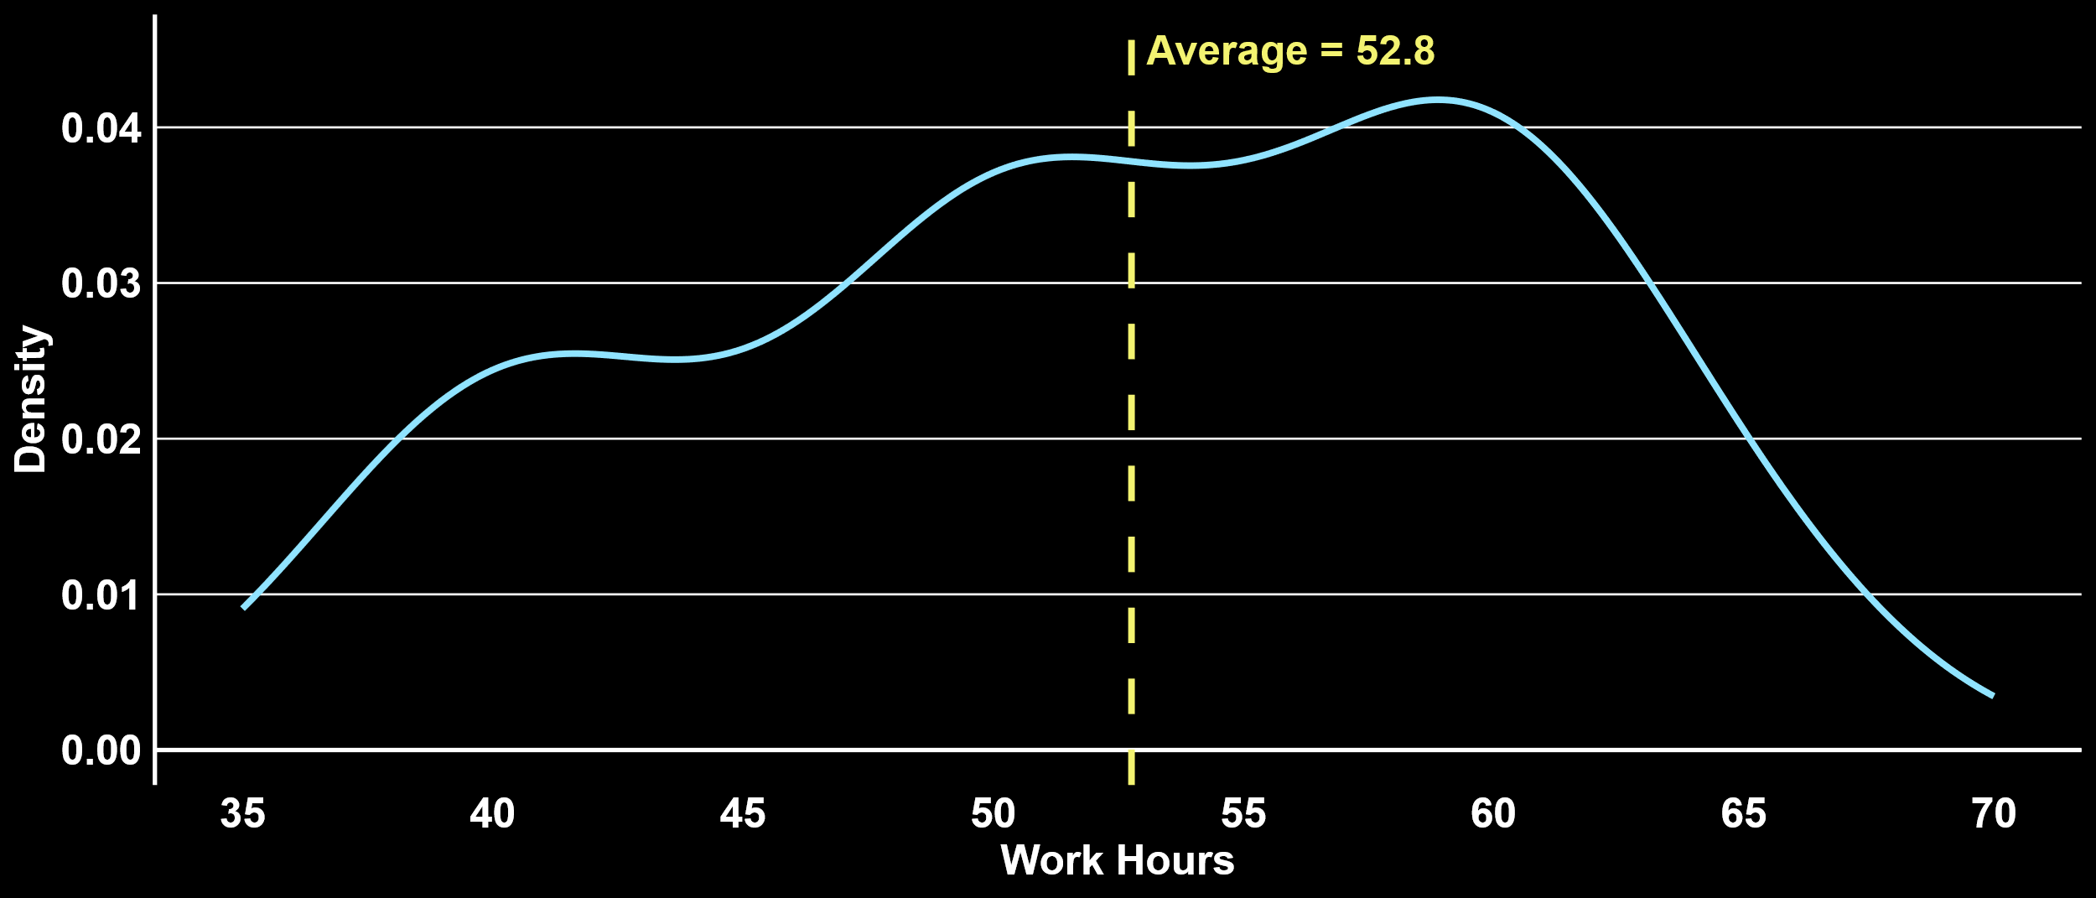
DISTRIBUTION OF HOURS - WORK
Avg. = 52.8
Density
Work Hours
Notes:
Sample: Pillar

Slide 31
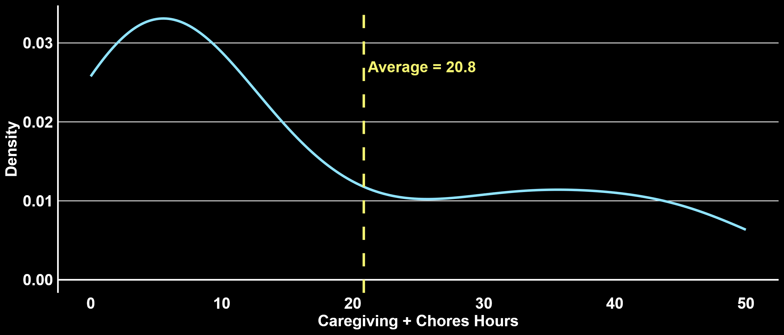
DISTRIBUTION OF HOURS - CAREGIVING & CHORES
Avg. = 20.8
Density
Caregiving & Chores Hours
Notes:
Sample: Pillar

Slide 32
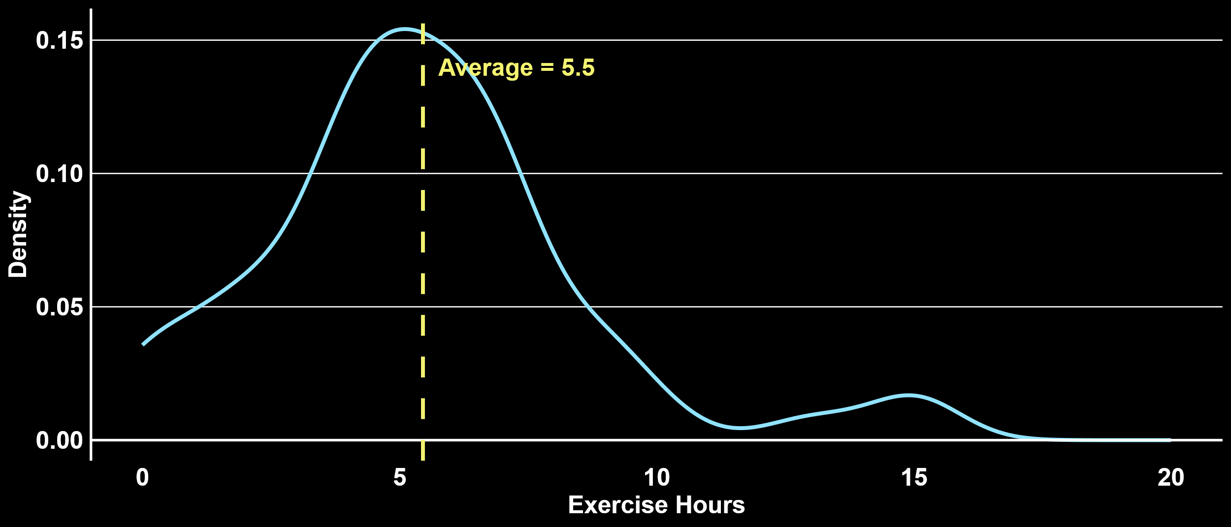
DISTRIBUTION OF HOURS – EXERCISE
Avg. = 5.6
Density
Exercise Hours
Notes:
Sample: Pillar

Slide 33
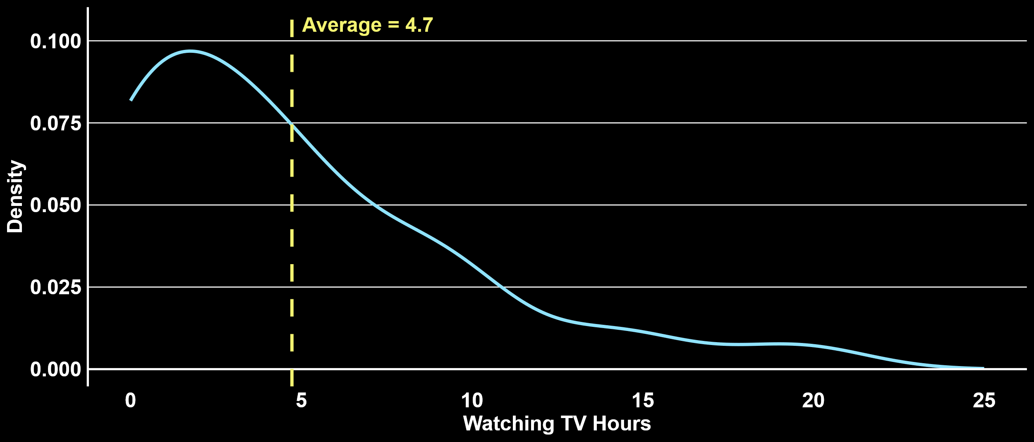
DISTRIBUTION OF HOURS – WATCHING TV
Avg. = 4.7
Density
Watching TV Hours
Notes:
Sample: Pillar

Slide 34
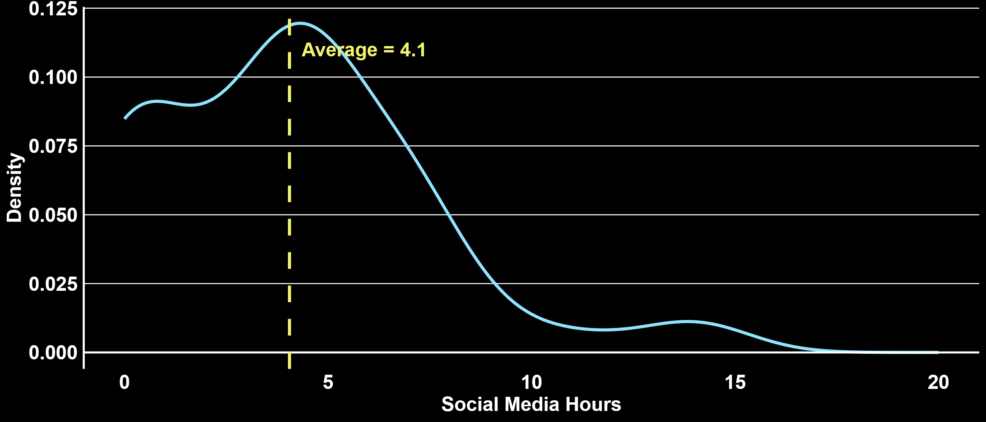
DISTRIBUTION OF HOURS – SOCIAL MEDIA
Avg. = 4.1
Density
Social Media Hours
Notes:
Sample: Pillar

Slide 35
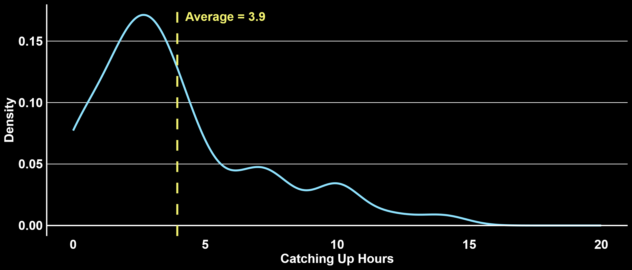
DISTRIBUTION OF HOURS – CATCHING UP
Avg. = 3.9
Density
Catching Up Hours
Notes:
Data: Pillar

Slide 36
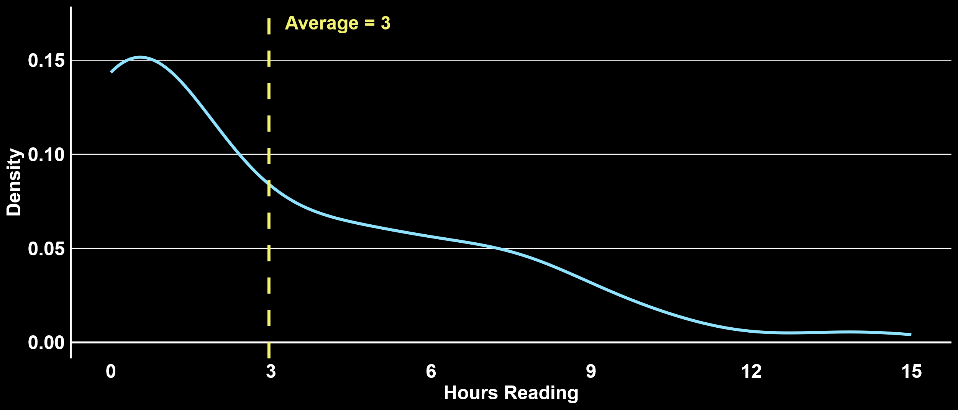
DISTRIBUTION OF HOURS – READING
Avg. = 3
Density
Reading Hours
Notes:
Data: Pillar

Slide 37
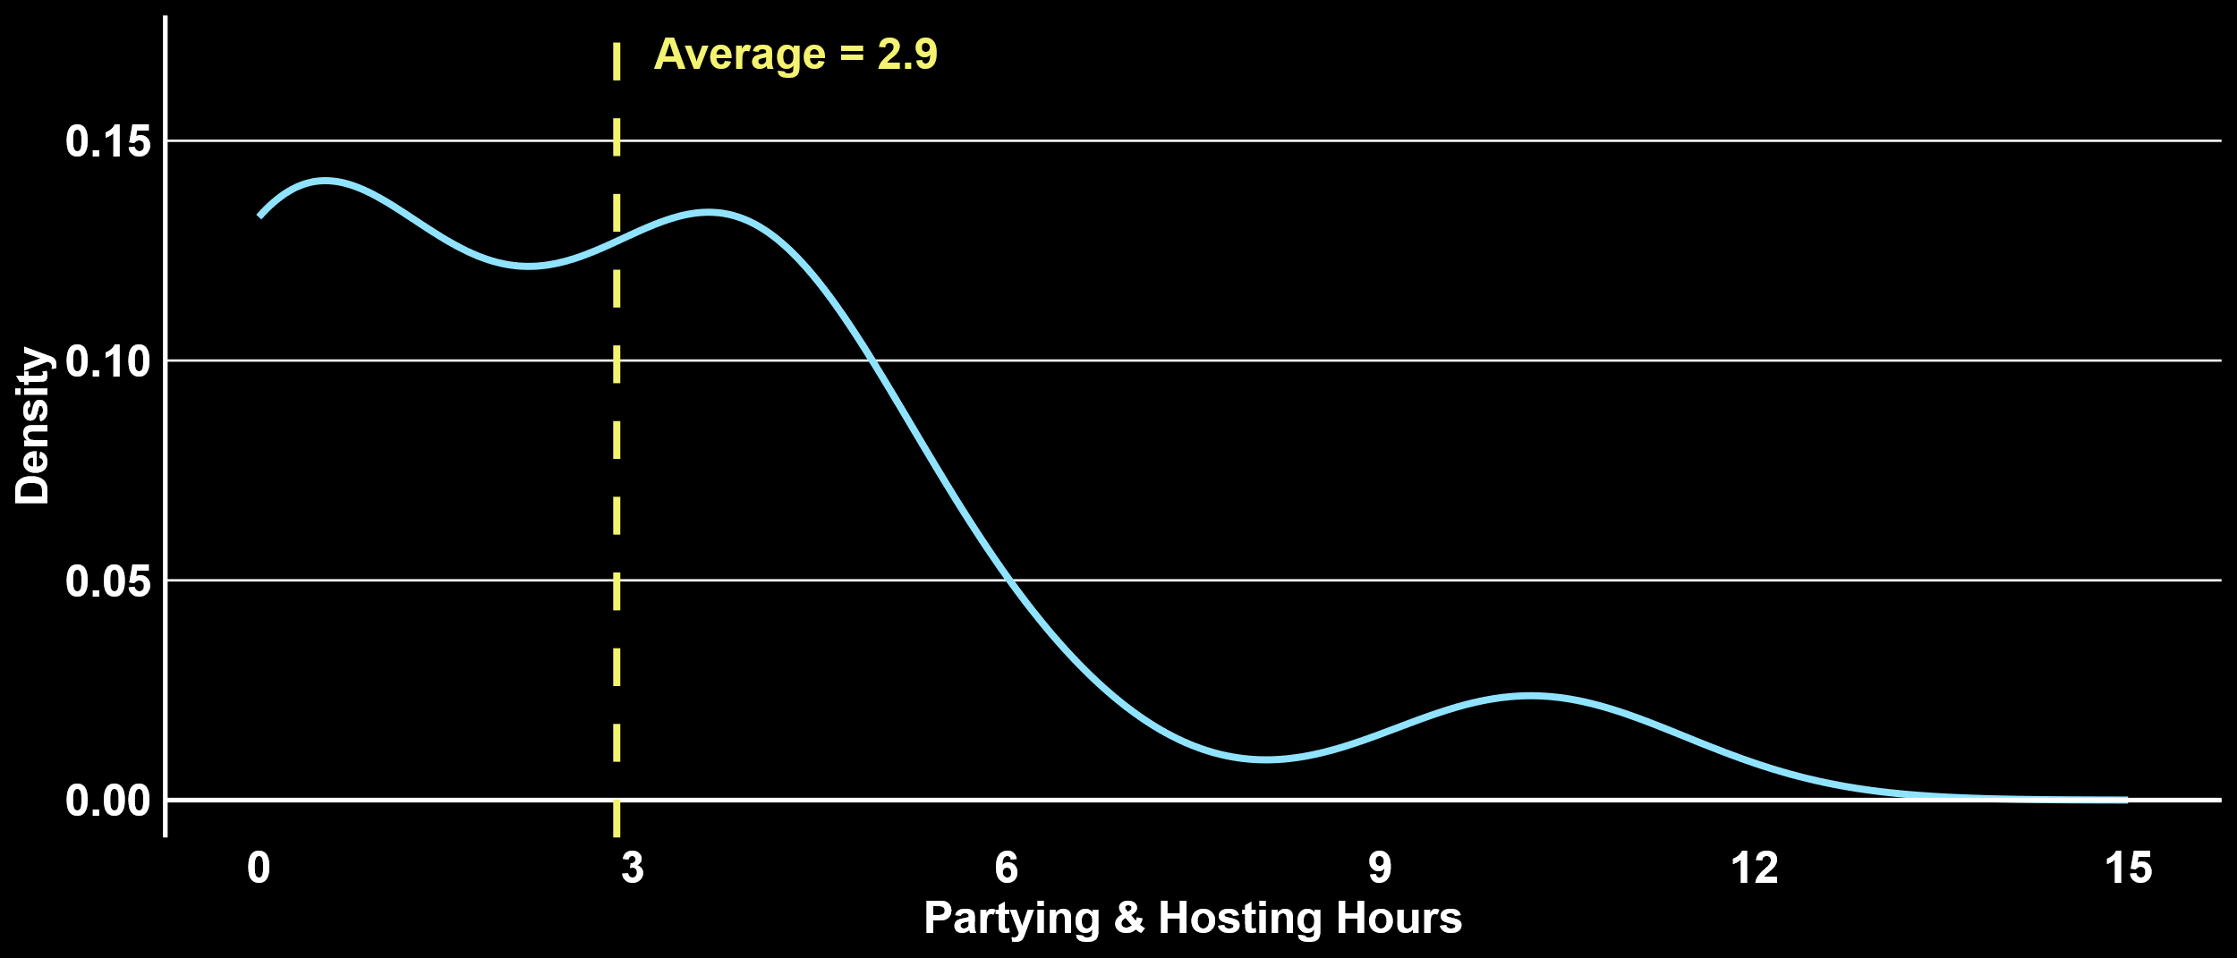
DISTRIBUTION OF HOURS – PARTYING & HOSTING
Avg. = 2.9
Density
Partying and Hosting Hours
Notes:
Data: Pillar

Slide 38
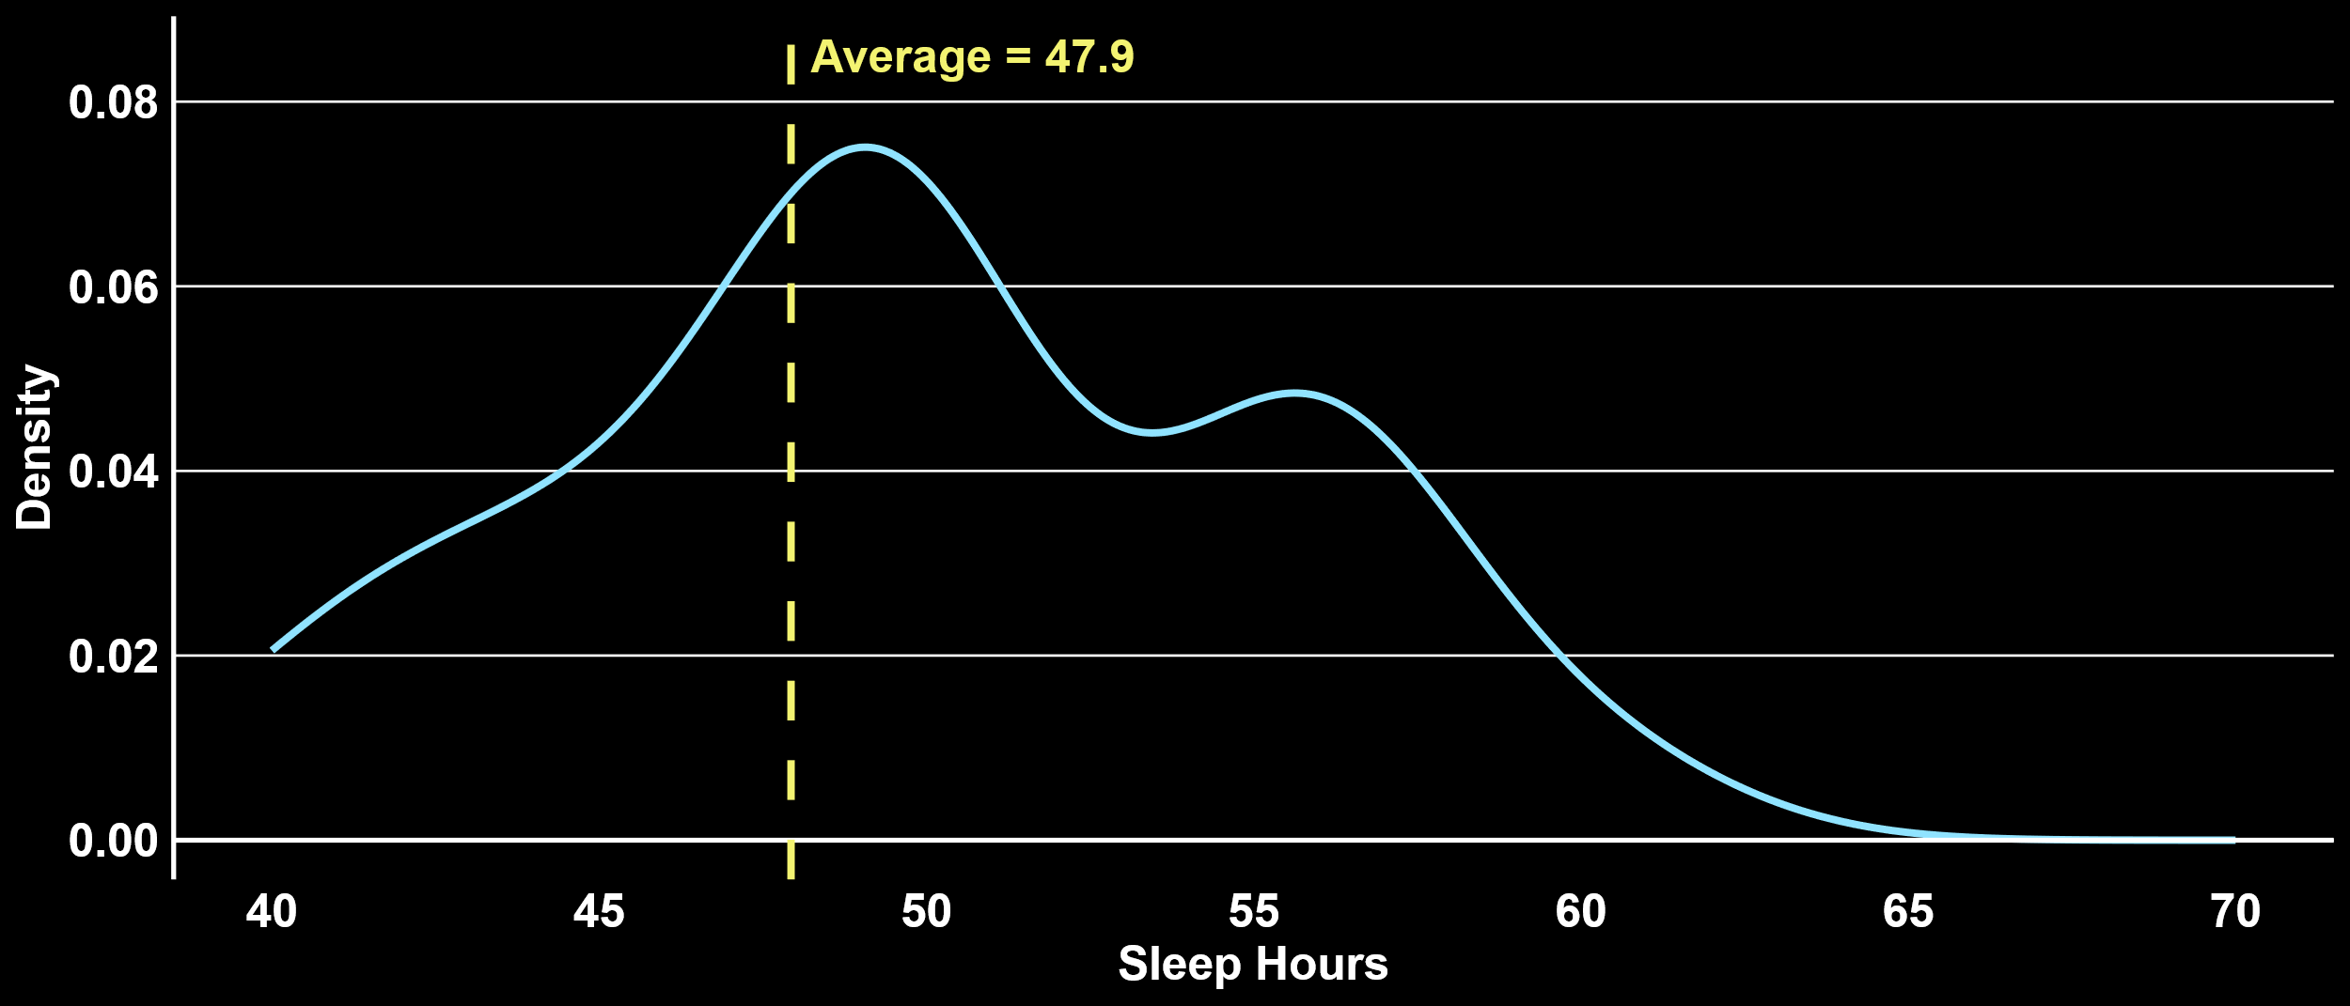
DISTRIBUTION OF HOURS - SLEEP
HBS Avg. = 50.1
Avg. = 47.9
Density
Sleep Hours
Notes:
Sample: Xilio

Slide 39
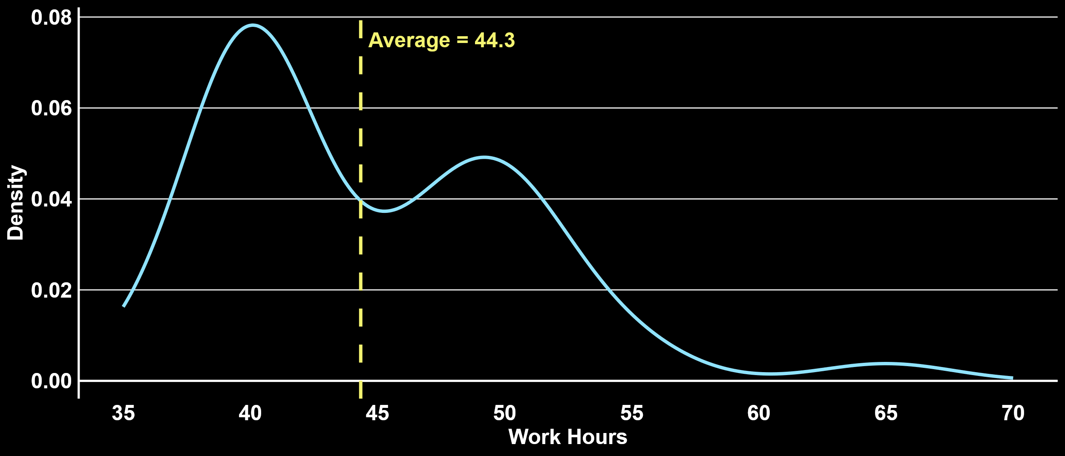
DISTRIBUTION OF HOURS - WORK
Avg. = 44.3
HBS Avg. = 51.2
Density
Work Hours
Notes:
Sample: Xilio

Slide 40
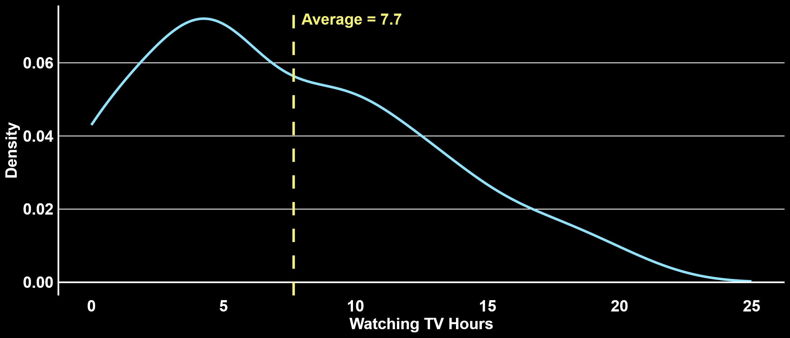
DISTRIBUTION OF HOURS – WATCHING TV
HBS Avg. = 5.1
Avg. = 7.7
Density
Watching TV Hours
Notes:
Sample: Xilio

Slide 41
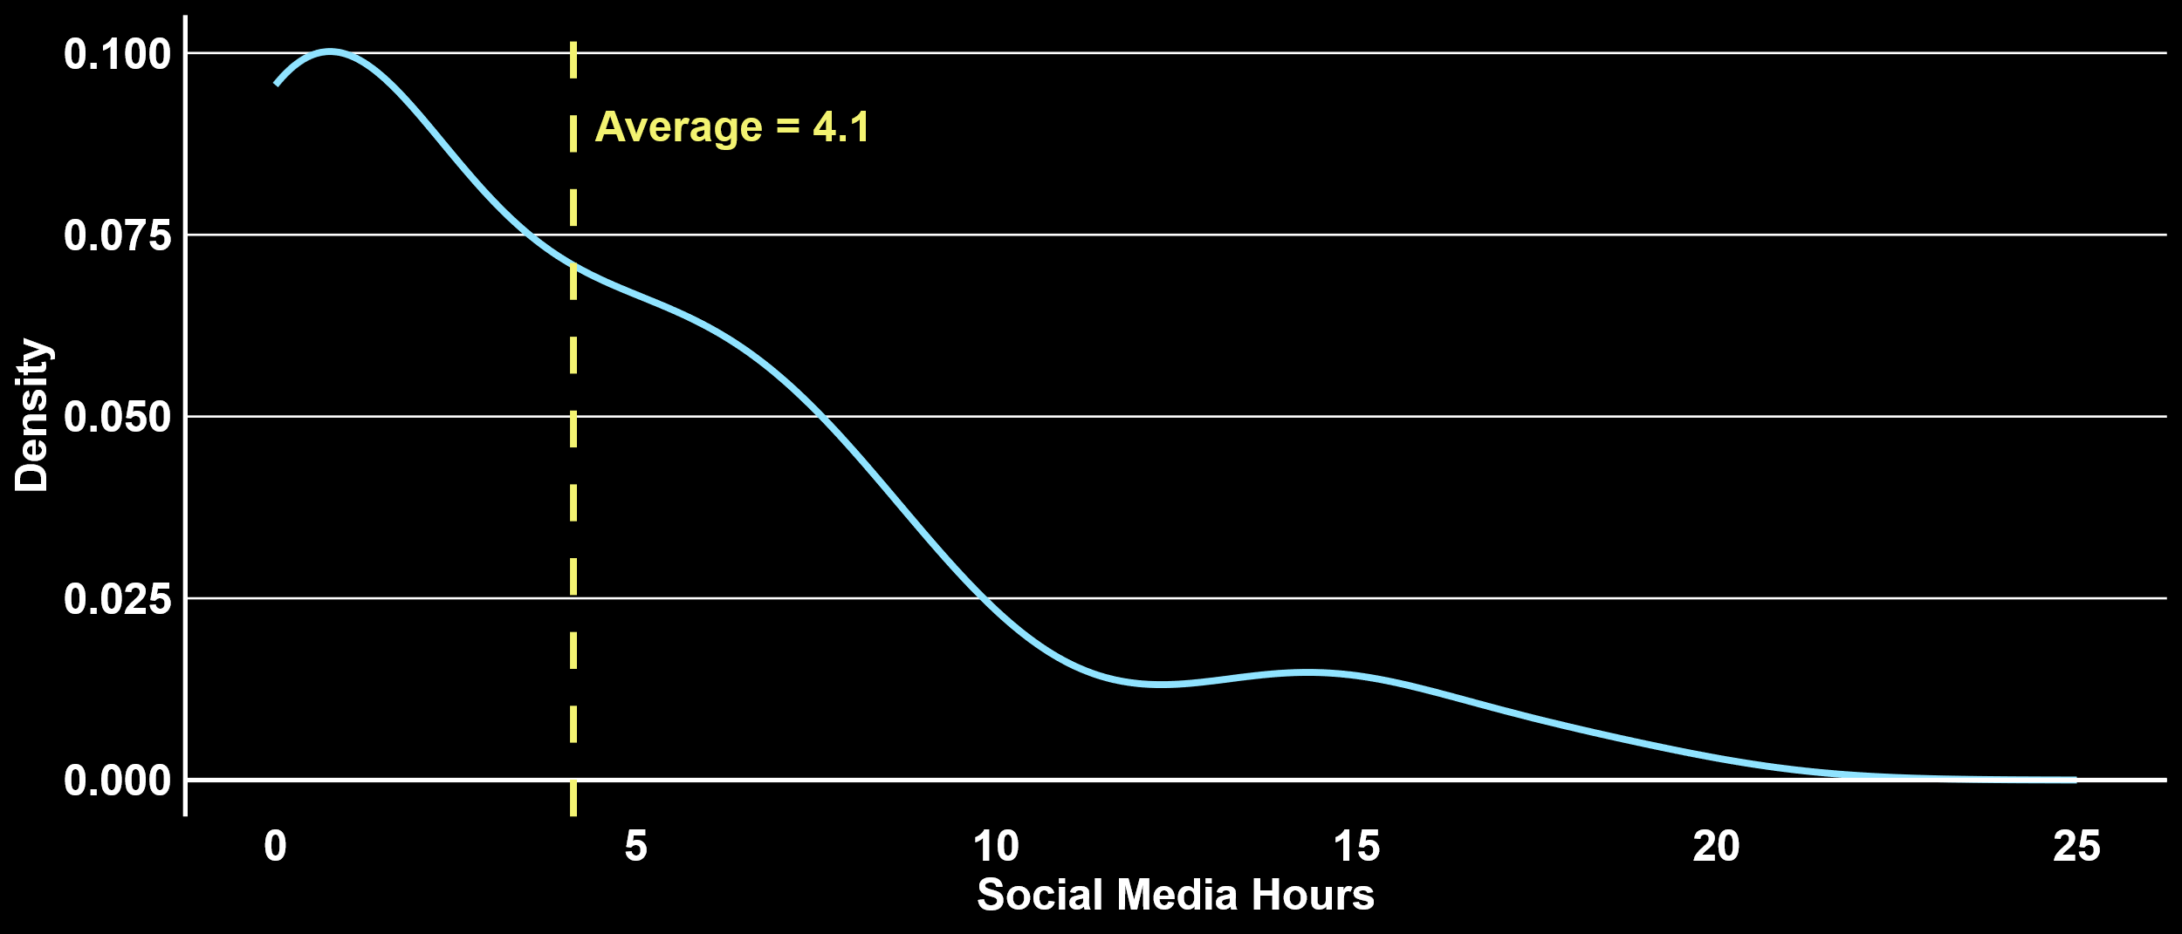
DISTRIBUTION OF HOURS – SOCIAL MEDIA
HBS Avg. = 4.4
Avg. = 4.1
Density
Social Media Hours
Notes:
Sample: Xilio

Slide 42
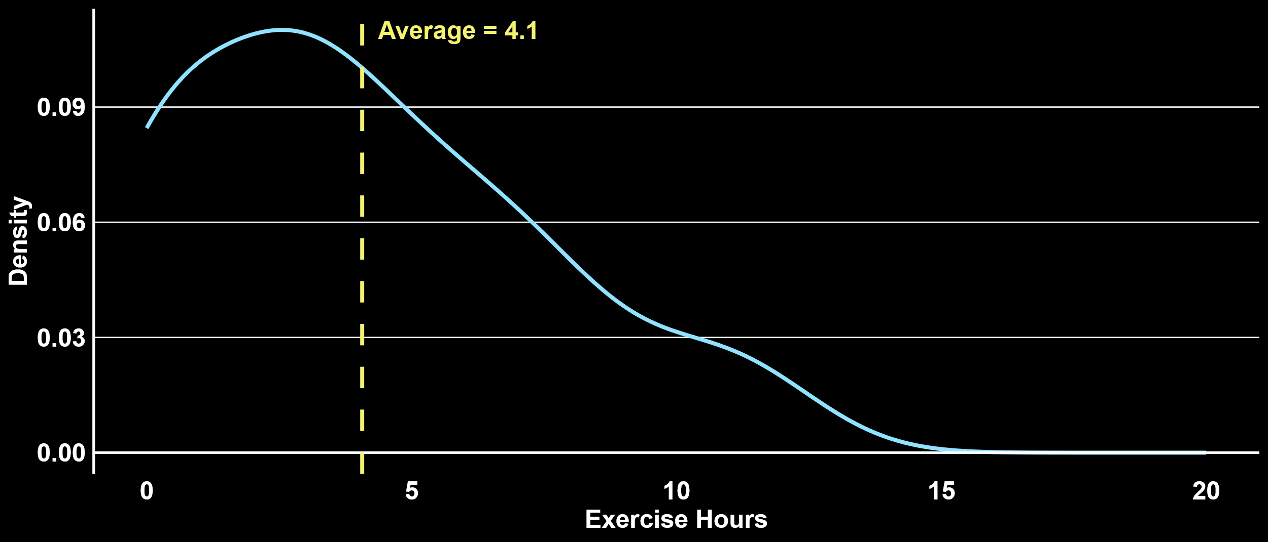
DISTRIBUTION OF HOURS – EXERCISE
HBS Avg. = 4.7
Avg. = 4.1
Density
Exercise Hours
Notes:
Sample: Xilio

Slide 43
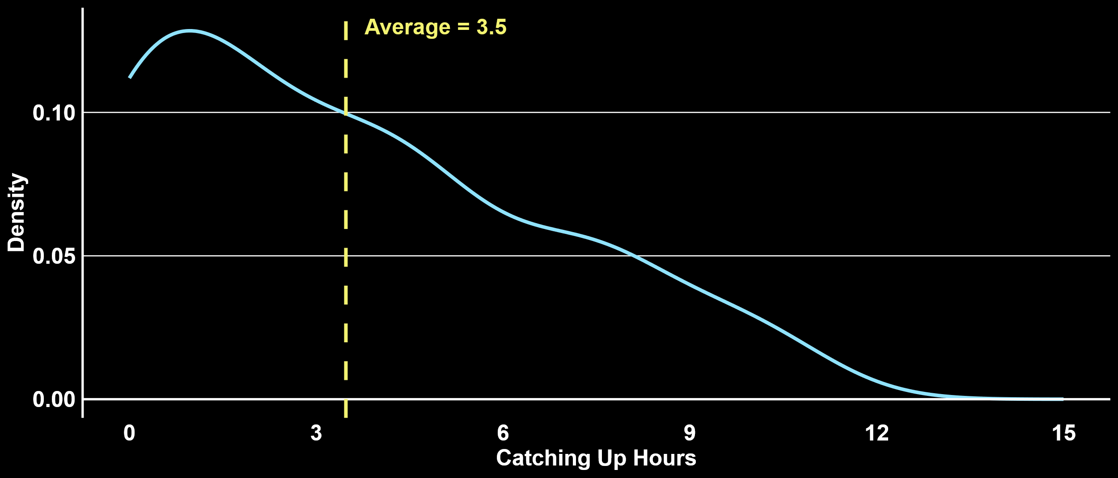
DISTRIBUTION OF HOURS – CATCHING UP
HBS Avg. = 3.2
Avg. = 3.5
Density
Catching Up Hours
Notes:
Data: Xilio

Slide 44
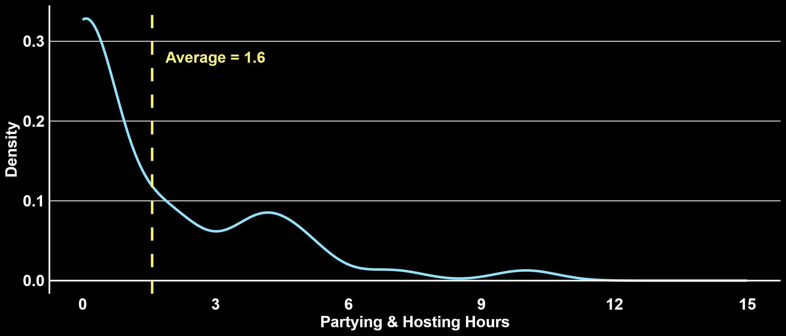
DISTRIBUTION OF HOURS – PARTYING & HOSTING
HBS Avg. = 2.5
Avg. = 1.6
Density
Partying and Hosting Hours
Notes:
Data: Xilio

Slide 45
DISTRIBUTION OF HOURS - SLEEP
HBS Women Avg. = 50.0
HBS Men Avg. = 49.8
Avg. = 49.7
Density
Sleep Hours
Notes:
Sample: IWF (need to update)

Slide 46
DISTRIBUTION OF HOURS - WORK
HBS Women Avg. = 50.2
HBS Men Avg. = 51.5
Avg. = 52.8
Density
Work Hours
Notes:
Sample: IWF (need to update)

Slide 47
DISTRIBUTION OF HOURS - CAREGIVING & CHORES
HBS Women Avg. = 17.7
HBS Men Avg. = 10.6
Avg. = 20.8
Density
Caregiving & Chores Hours
Notes:
Sample: IWF (need to update)

Slide 48
DISTRIBUTION OF HOURS – EXERCISE
HBS Women Avg. = 4.5
HBS Men Avg. = 5.0
Avg. = 5.6
Density
Exercise Hours
Notes:
Sample: IWF (need to update)

Slide 49
DISTRIBUTION OF HOURS – WATCHING TV
HBS Women Avg. = 4.8
HBS Men Avg. = 5.3
Avg. = 4.7
Density
Watching TV Hours
Notes:
Sample: IWF (need to update)

Slide 50
DISTRIBUTION OF HOURS – SOCIAL MEDIA
Avg. = 4.1
HBS Women Avg. = 4.3
HBS Men Avg. = 3.9
Density
Social Media Hours
Notes:
Sample: IWF (need to update)

Slide 51
DISTRIBUTION OF HOURS – CATCHING UP
HBS Women Avg. = 3.4
HBS Men Avg. = 3.0
Avg. = 3.9
Density
Catching Up Hours
Notes:
Data: IWF (need to update)

Slide 52
DISTRIBUTION OF HOURS – PARTYING & HOSTING
HBS Women Avg. = 2.5
HBS Men Avg. = 2.4
Avg. = 2.9
Density
Partying and Hosting Hours
Notes:
Data: IWF (need to update)

Slide 53
DISCRETIONARY TIME – ACTIVITIES
Activity
Avg. Hours Per Week
Notes:
Data: IWF (need to update)

Slide 54
DISCRETIONARY TIME – ACTIVITIES
Activity
Avg. Hours Per Week
Avg. Subjective Value
Notes:
Data: IWF (need to update)

Slide 55
TIME VS VALUE FROM DISCRETIONARY ACTIVITIES
Subjective Value
Hours/Week
Notes:
Data: IWF (need to update)

Slide 56
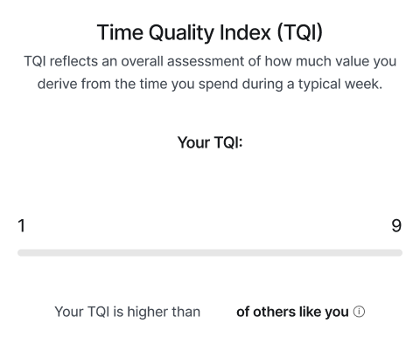
TIME QUALITY INDEX (TQI)
Insert the average TQI for the group
6.6
Notes:
IWF (need to update)

Slide 57
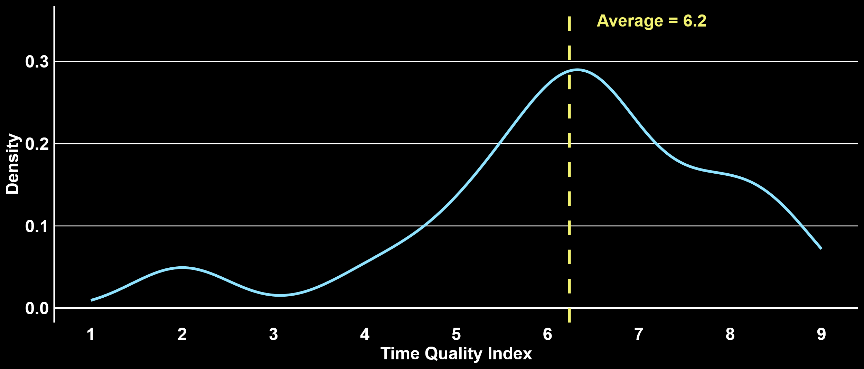
TQI DISTRIBUTION
One version that is just the group (no comparison)
One version that compares to HBS overall
One version that compares to HBS men &women
HBS Avg. = 6.8
Avg. = 6.2
Density
Time Quality Index
Notes:
Sample: Xilio

Slide 58
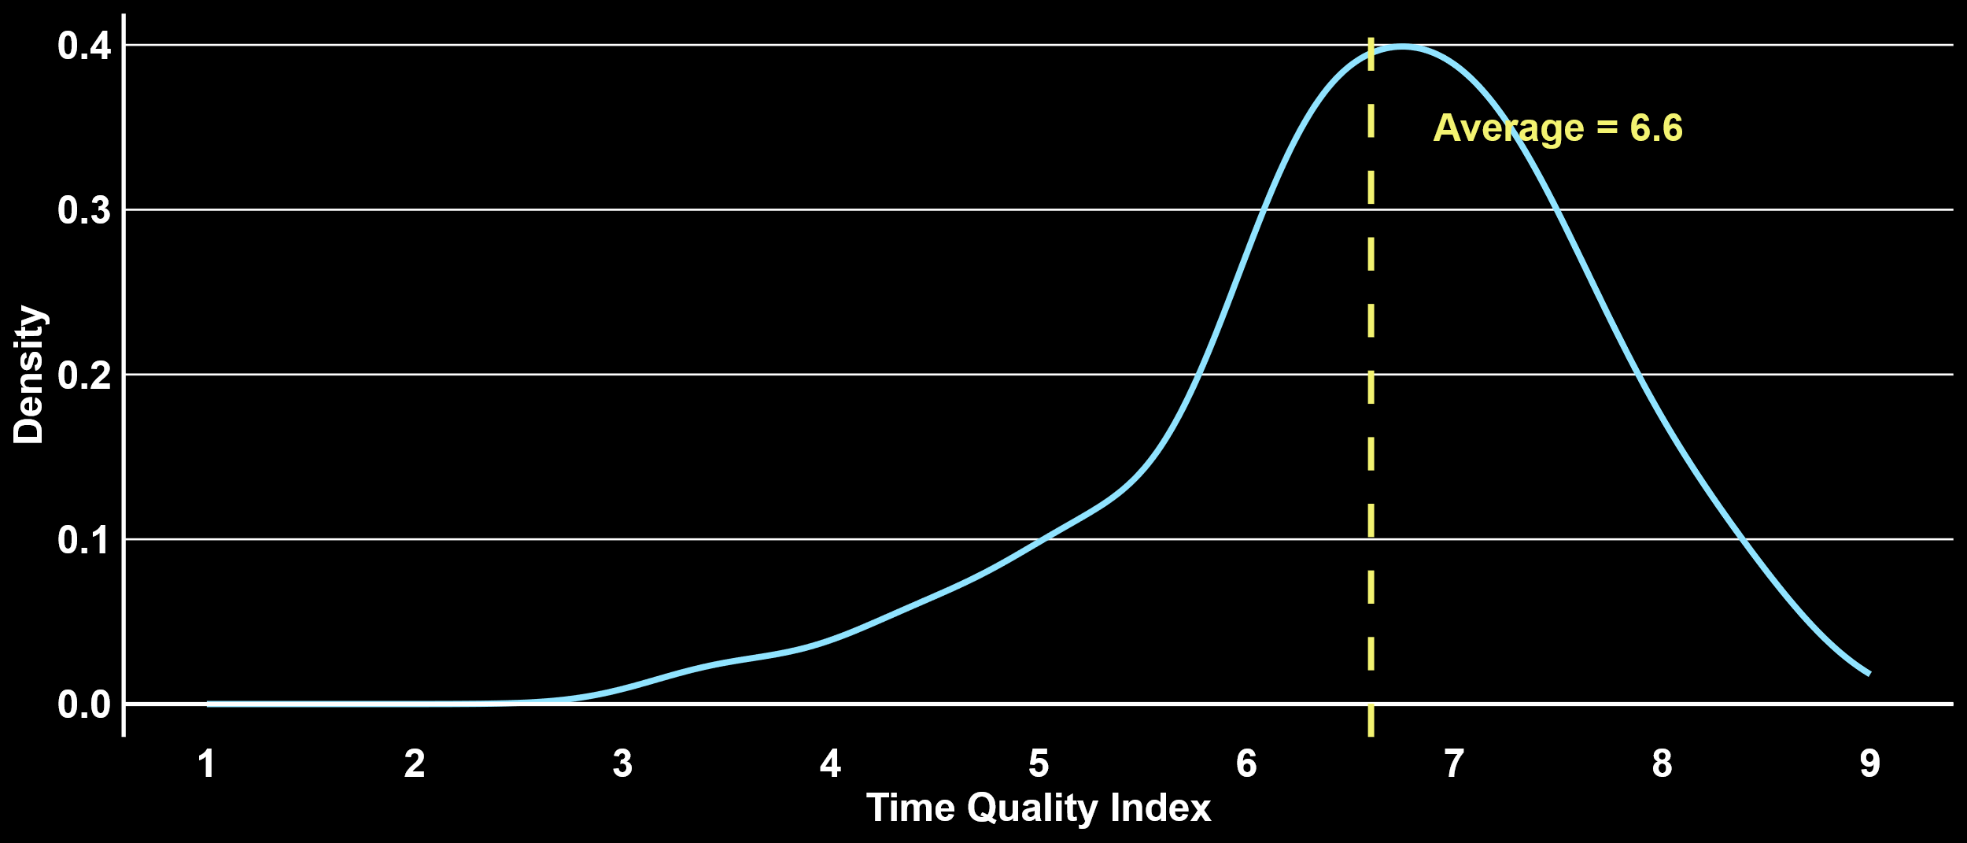
TQI DISTRIBUTION
Avg. = 6.6
HBS Women Avg. = 6.9
HBS Men Avg. = 6.9
Density
Time Quality Index
Notes:
Sample: IWF (need to update)

Slide 59
HOW WE SPEND OUR TIME
Discretionary
Activities
Work
Non-Work
Responsibilities
Sleep &
Hygiene
Notes:
Data: IWF (need to update)

Slide 60
PERCENT GETTING HIGH WORK JAM
Percent Getting High
Notes:
Data: 1st year working FT alumni

Slide 61
PERCENT WITH HIGH VALUE AT WORK
High Value at Work

Slide 62
PERCENT MEETING MEANINGFULNESS+ AT WORK
One version that is just the group (no comparison)
One version that compares to HBS overall
One version that compares to HBS men &women
Alumni Board
Notes:
Data: alumni board (need to update)

Slide 63
PERCENT MEETING MEANINGFULNESS+ AT WORK
% Meeting Meaningfulness+
Notes:
Xilio + HBS

Slide 64
PERCENT MEETING MEANINGFULNESS+ AT WORK
% Meeting Meaningfulness+
Notes:
Xilio + HBS

Slide 65
PERCENT MEETING MEANINGFULNESS+ AT WORK
IWF
HBS Women
HBS Men
Notes:
Data: IWF (need to update)
HBS Men and women 10+ reunion working 40+ hours

Slide 66
RELATIONSHIP STATUS
1ST
5TH
10TH
15TH
20TH
25TH
30TH
35TH
40TH+
In a committed relationship
Single
Notes:
Data: ALL HBS ALUMNI

Slide 67
LIFE SATISFACTION AND INCOME
Income ($)
Notes:
Updated
Correlation not causation!
For 10+15 reunion: We assume people have 0 kids if they left the kids question blank on the demographics but did enter their gender. By entering their gender but not kids, it suggests they were intentional in not answering the kids question because they have 0 children.

Slide 68
INDUSTRY
5TH REUNION
10TH REUNION
15TH REUNION
20TH REUNION
45TH + REUNION
Graduation
Now
Graduation
Now
Graduation
Now
Graduation
Now
Now
Finance
Consulting
Tech
Health Care
Other
Notes:
Updated

Slide 69
GENDER AND WORK HOURS (5th - 20th)
Hours/Week
Notes:
Updated

Slide 70

GENDER AND WORK HOURS (5th - 20th)
No Kids
Female
Kids
No Kids
Male
Kids
Hours/Week
Notes:
Updated

Slide 71
PERCENT WHO HAVE KIDS
1ST
5TH
10TH
15TH
20TH
25TH
30TH
35TH
40TH+
Notes:
Data: ALL HBS ALUMNI

Slide 72
KIDS - AVERAGE NUMBER
1ST
5TH
10TH
15TH
20TH
25TH
30TH
35TH
40TH+
Notes:
Data: ALL HBS ALUMNI

Slide 73
LIFE SATISFACTION & NUMBER OF KIDS
Number of Kids
Notes:
Data: ALL HBS ALUMNI

Slide 74
PERCENT MEETING MEANINGFULNESS+ AT WORK
Reunion Class
Notes:
Data: ALL HBS ALUMNI working FT

Slide 75
CURRENT SAMPLE
1st
5th
10th
15th
20th
25th
30th
35th
40th +
275
354
760
682
332
273
251
162
332
Notes:
Data: ALL HBS ALUMNI

Slide 76
LIFE SATISFACTION
1st
5th
10th
15th
20th
25th
30th
35th
40th +
7.2
7.2
7.6
7.6
7.8
7.8
7.8
8.2
8.2
Notes:
Data: ALL HBS ALUMNI

Slide 77
Update all TQI numbers
TQI
1st
5th
10th
15th
20th
25th
30th
35th
40th
3.9
4.8
5.3
5.5
5.5
5.5
5.8
5.5
6.0
Notes:
Data: ALL HBS ALUMNI working FT, based on old calculttion (need to update)

Slide 78
Update numbers
PERCENT MEETING MEANINGFULNESS+ AT WORK
Show two versions
By year 1-40
And a slide with just the data
From the alumni board
1st
5th
10th
15th
20th
25th
30th
35th
40th
XX%
XX%
XX%
XX%
XX%
XX%
XX%
XX%
XX%
Notes:
Data: ALL HBS ALUMNI working FT, (need to update)

Slide 79
HBS Women vs HBS men
HOW YOU SPEND YOUR TIME
HBS Women
HBS Men
Work &
Commute
Sleep &
Hygiene
Non-Work
Responsibilities
Discretionary
Activities
Notes:
Data: HBS Men and women 10+ reunion working 40+ hours

Slide 80
WORK HOURS
Avg hrs. =
50
47
44
44
44
37
30
26
16
1st
5th
10th
15th
20th
25th
30th
35th
40th +
Notes:
Data: ALL HBS ALUMNI

Slide 81
JAM TYPE DISTRIBUTION
1ST REUNION CLASS
Joy Seeker
Striver
Purpose Seeker
Joyful
Striver
Flourisher
Purposeful
Striver
Triumvirate

Slide 82
JAM TYPE DISTRIBUTION
1ST REUNION CLASS
HBS ALUMS
Joy Seeker
Striver
Purpose Seeker
Joyful
Striver
Flourisher
Purposeful
Striver
Triumvirate

Slide 83
JAM TYPE DISTRIBUTION
Women Leaders (Pillar)
HBS Women
HBS Men
Joy Seeker
Striver
Purpose Seeker
Joyful
Striver
Flourisher
Purposeful
Striver
Triumvirate
Notes:
Data: All pillar; HBS Women and Men working 40+ hours, 10+ reunion

Slide 84
PERCEIVED VS BEHAVIORAL ACHIEVEMENT
Achievement Rating
Less than
$75,000
$75,000 –
$149,999
$150,000 –
$249,999
$250,000 –
$499,999
$500,000 –
$1 million
$1 million –
$5 million
Over
$5 million
Perceived Achievement
Behavioral Achievement
Notes:
Data: ALL HBS ALUMNI working FT

Slide 85
GAP IN PERCEIVED VS BEHAVIORAL JAM
Gap
Less than
$75,000
$75,000 –
$149,999
$150,000 –
$249,999
$250,000 –
$499,999
$500,000 –
$1 million
$1 million –
$5 million
Over
$5 million
Achievement
Meaningfulness
Joy
Notes:
Data: ALL HBS ALUMNI working FT

Slide 86
PEOPLE HOURS AND LIFE SATISFACTION
We insert the variable
5th - 20th Reunion Classes
Notes:
Updated
This shows family hours OUTSIDE OF work
A third major finding is about time alone…

Slide 87
TIME SPENT ON ACTIVITIES THAT BRING “VERY MUCH”…
Notes:
Updated

