Slide 1
GoPro Pilot Par 003

Slide 2
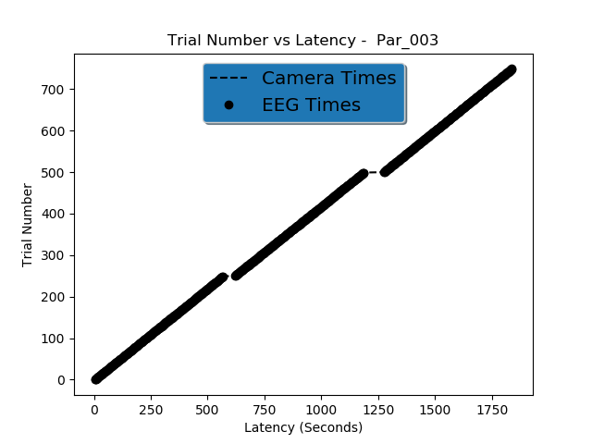

Slide 3
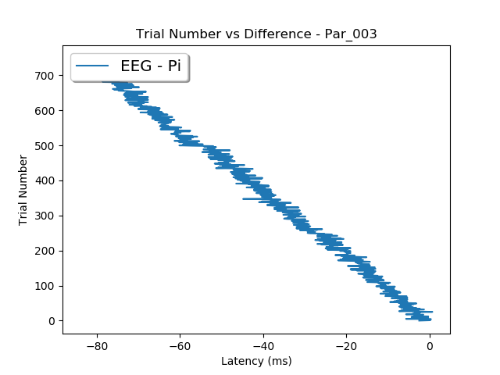
Drift over experiment between camera and EEG

Slide 4
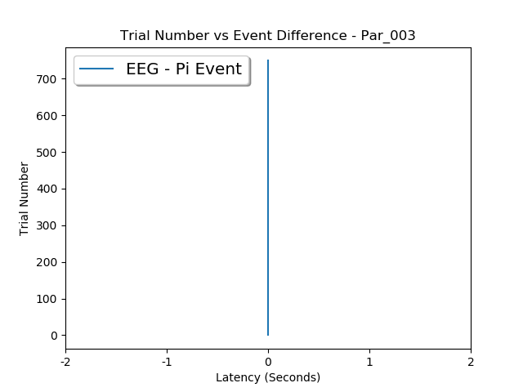
Demonstrates the accuracy of detecting event type over the experiment

Slide 5
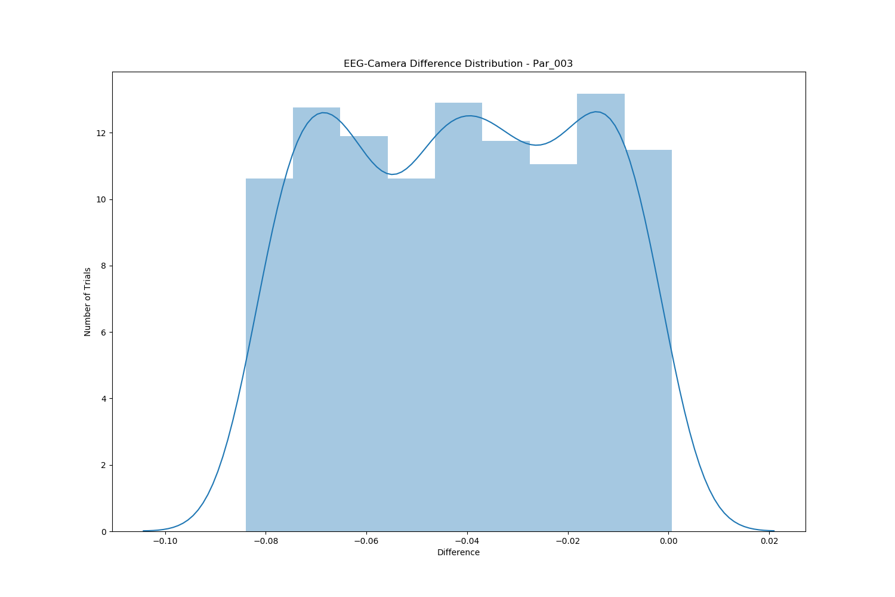

Slide 6
