Slide 1
Linearly Coupled Quantum Harmonic Oscillators and their Quantum Entanglement:
by D.N. Makarov, K.A. Makarova
Mahan Mohseni
July 2024

Slide 2
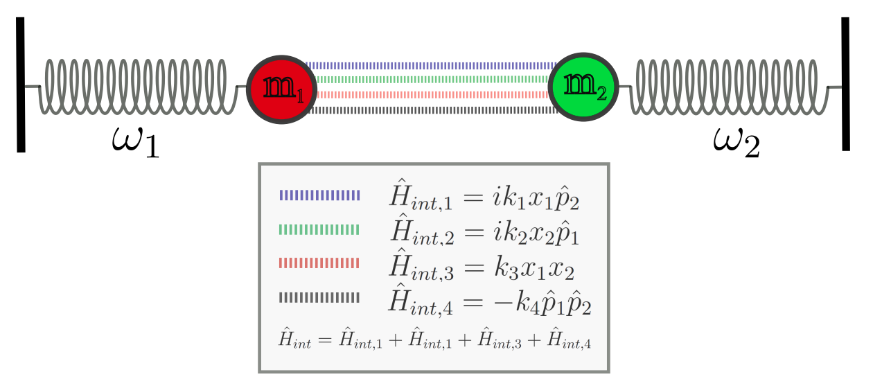
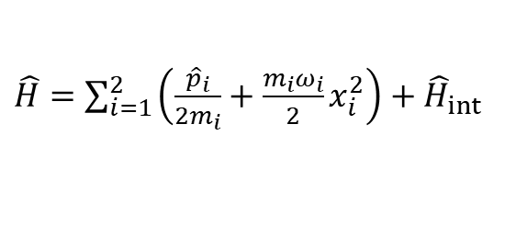
Introduction to the System
The system to be considered is two quantum harmonic oscillators linearly coupled in coordinates and momenta:
$\hat{H}=\sum_{i=1}^{2}{\left(\frac{{\hat{p}}_{i}}{2m_{i}}+\frac{m_{i}ω_{i}}{2}x_{i}^{2}\right)}+{\hat{H}}_{int}$
$${\hat{H}}_{int}=ik_{1}x_{1}{\hat{p}}_{2}+ik_{2}x_{2}{\hat{p}}_{1}+k_{3}x_{1}x_{2}−k_{4}{\hat{p}}_{1}{\hat{p}}_{2}$$
The goal is to solve the $\hat{H}ψ=iℏ∂_{t}ψ$ to find the energy spectrum, and to compute the quantum entanglement.

Slide 3
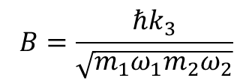


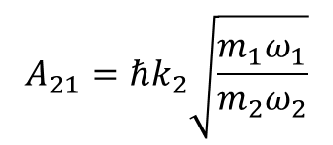
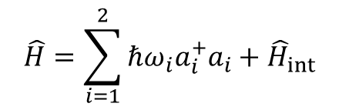
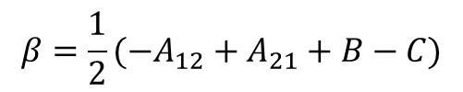
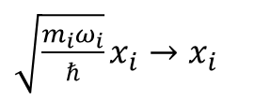
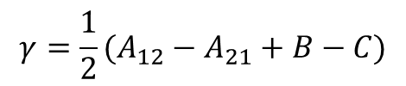
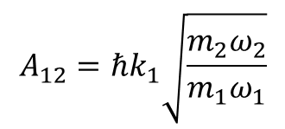
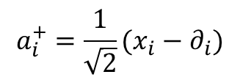
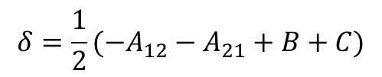
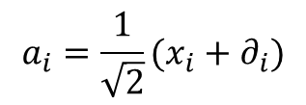
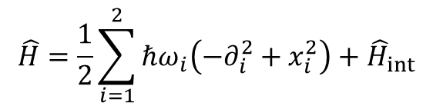

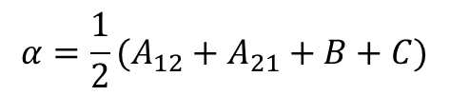
Solution
First, we make the Hamiltonian dimensionless:
$\sqrt{\frac{m_{i}ω_{i}}{ℏ}}x_{i}→x_{i}$
$${\hat{p}}_{j}=−iℏ∂_{j}$$
$$\hat{H}=\frac{1}{2}\sum_{i=1}^{2}{ℏω_{i}\left(−∂_{i}^{2}+x_{i}^{2}\right)}+{\hat{H}}_{int}$$
$${\hat{H}}_{int}=A_{12}x_{1}∂_{2}+A_{21}x_{2}∂_{1}+Bx_{1}x_{2}+C∂_{1}∂_{2}$$
$$A_{12}=ℏk_{1}\sqrt{\frac{m_{2}ω_{2}}{m_{1}ω_{1}}}$$
$$A_{21}=ℏk_{2}\sqrt{\frac{m_{1}ω_{1}}{m_{2}ω_{2}}}$$
$$B=\frac{ℏk_{3}}{\sqrt{m_{1}ω_{1}m_{2}ω_{2}}}$$
$$C=ℏk_{4}\sqrt{m_{1}ω_{1}m_{2}ω_{2}}$$
$$α=\frac{1}{2}(A_{12}+A_{21}+B+C)$$
Then, we define the creation and annihilation operators:
$$a_{i}=\frac{1}{\sqrt{2}}(x_{i}+∂_{i})$$
$$a_{i}^{+}=\frac{1}{\sqrt{2}}(x_{i}−∂_{i})$$
$$β=\frac{1}{2}(−A_{12}+A_{21}+B−C)$$
$$\hat{H}=\sum_{i=1}^{2}{ℏω_{i}a_{i}^{+}a_{i}}+{\hat{H}}_{int}$$
$$γ=\frac{1}{2}(A_{12}−A_{21}+B−C)$$
$${\hat{H}}_{int}=αa_{1}a_{2}+βa_{1}a_{2}^{+}+γa_{1}^{+}a_{2}+δa_{1}^{+}a_{2}^{+}$$
$$δ=\frac{1}{2}(−A_{12}−A_{21}+B+C)$$

Slide 4

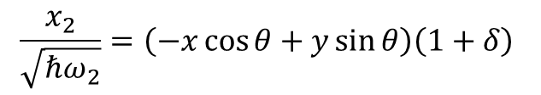

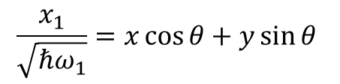





Solution
We take the solution with the initial condition to be:
$$|ψ(t=0)⟩=|s_{1}⟩|s_{2}⟩$$
$s_{1},s_{2}$ are the quantum numbers of the first and second oscillator before interaction, respectively:
$${\hat{H}}_{int}=0$$
$$a_{i}^{+}a_{i}|ψ(t=0)⟩=s_{i}|ψ(t=0)⟩$$
Change of variables:
$$\frac{x_{1}}{\sqrt{ℏω_{1}}}=x\cos{θ}+y\sin{θ}$$
$$\frac{x_{2}}{\sqrt{ℏω_{2}}}=\left(−x\cos{θ}+y\sin{θ}\right)\left(1+δ\right)$$
Carry out a unitary transformation:
$$ψ^{′}=Sψ$$
$${\hat{H}}^{′}=S \hat{H}\left(x,y\right)S^{−1}$$
$$\hat{H}ψ=Eψ$$
$${\hat{H}}^{′}ψ^{′}=Eψ^{′}$$

Slide 5

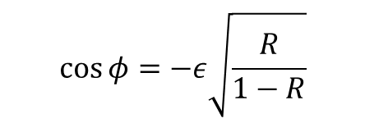
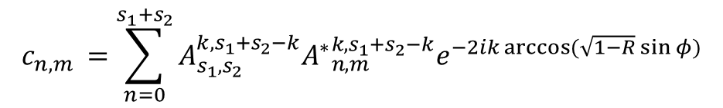

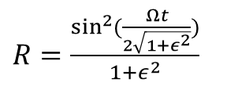
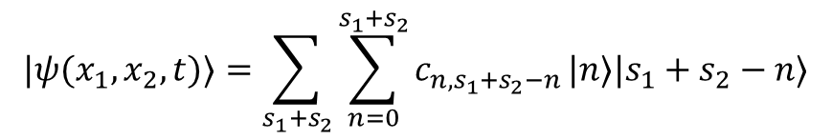

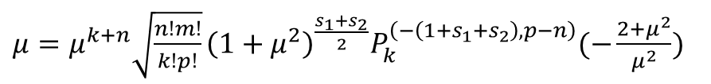
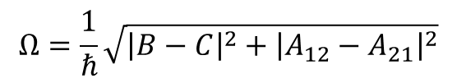
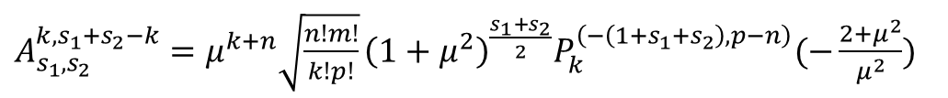
Solution
After diagonalizing the Hamiltonian:
$$|ψ(x_{1},x_{2},t)⟩=\sum_{s_{1}+s_{2}}{\sum_{n=0}^{s_{1}+s_{2}}{c_{n,s_{1}+s_{2}−n}}}|n⟩|s_{1}+s_{2}−n⟩$$
$$c_{n,m }=\sum_{n=0}^{s_{1}+s_{2}}{A_{s_{1},s_{2}}^{k,s_{1}+s_{2}−k}{A^{∗}}_{n,m}^{k,s_{1}+s_{2}−k}e^{−2ik\arccos{(\sqrt{1−R}\sin{φ})}}}$$
$A_{s_{1},s_{2}}^{k,s_{1}+s_{2}−k}=μ^{k+n}\sqrt{\frac{n!m!}{k!p!}}{\left(1+μ^{2}\right)}^{\frac{s_{1}+s_{2}}{2}}P_{k}^{\left(−\left(1+s_{1}+s_{2}\right),p−n\right)}(−\frac{2+μ^{2}}{μ^{2}})$
$μ=μ^{k+n}\sqrt{\frac{n!m!}{k!p!}}{\left(1+μ^{2}\right)}^{\frac{s_{1}+s_{2}}{2}}P_{k}^{\left(−\left(1+s_{1}+s_{2}\right),p−n\right)}(−\frac{2+μ^{2}}{μ^{2}})$
$P_{γ}^{α,β}(x)$ are Jacobi polynomials and $n+m=s_{1}+s_{2}$ (conservation of total quantum numbers)
$$|n⟩=C_{n}e^{−\frac{x_{1}^{2}}{2}}H_{n}(x_{1})$$
$$|s_{1}+s_{2}−n⟩=C_{s_{1}+s_{2}−n}e^{−\frac{x_{2}^{2}}{2}}H_{s_{1}+s_{2}−n}(x_{2})$$
$H_{n}(x)$ are Hermite polynomials and $C_{n}$ is the normalization factor.
$R=\frac{\sin^{2}{(\frac{Ωt}{2\sqrt{1+ε^{2}}})}}{1+ε^{2}}$
$$\cos{φ}=−ε\sqrt{\frac{R}{1−R}}$$
$$Ω=\frac{1}{ℏ}\sqrt{{\left|B−C\right|}^{2}+{\left|A_{12}−A_{21}\right|}^{2}}$$
$ε=\frac{ω_{2}−ω_{1}}{Ω}$
The entire dependence in the wave function is reduced to two variables $R$ and $φ$

Slide 6

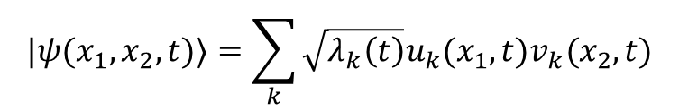
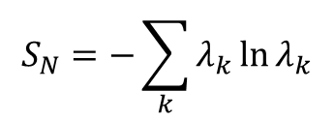
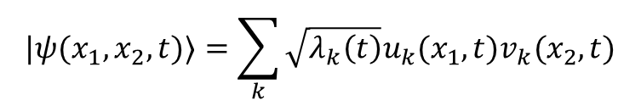
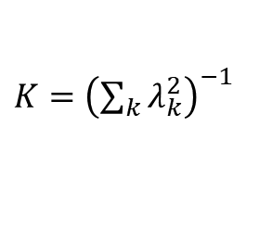
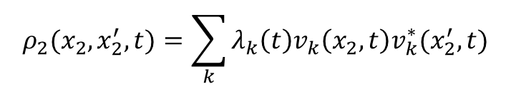
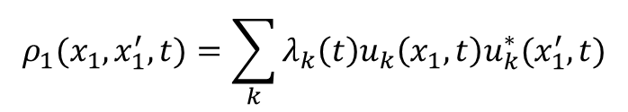

Quantum Entanglement of Oscillators
To find the quantum entanglement of the system, we need to decompose the solution into Schmidt modes.
$$|ψ(x_{1},x_{2},t)⟩=\sum_{k}{\sqrt{λ_{k}\left(t\right)}u_{k}(x_{1},t)v_{k}(x_{2},t)}$$
$$|ψ(x_{1},x_{2},t)⟩=\sum_{k}{\sqrt{λ_{k}\left(t\right)}u_{k}(x_{1},t)v_{k}(x_{2},t)}$$
$$ρ_{1}(x_{1},x_{1}^{′},t)=\sum_{k}{λ_{k}\left(t\right)u_{k}\left(x_{1},t\right)u_{k}^{∗}(x_{1}^{′},t)}$$
$$ρ_{2}(x_{2},x_{2}^{′},t)=\sum_{k}{λ_{k}\left(t\right)v_{k}\left(x_{2},t\right)v_{k}^{∗}(x_{2}^{′},t)}$$
Schmidt parameters:
Von Neumann entropy:
$K={\left(\sum_{k}{λ_{k}^{2}}\right)}^{−1}$
$$S_{N}=−\sum_{k}{λ_{k}\ln{λ_{k}}}$$
$$λ_{n}={\left|c_{n,s_{1}+s_{2}−n}\right|}^{2}$$
Only depends on $R∈[0,1]$

Slide 7
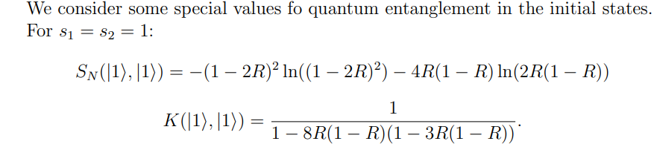
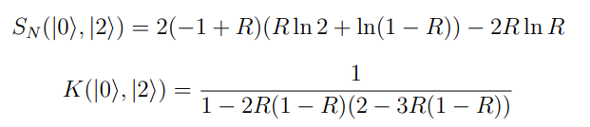
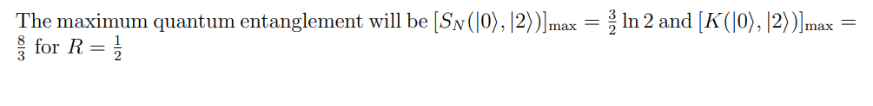

Slide 8
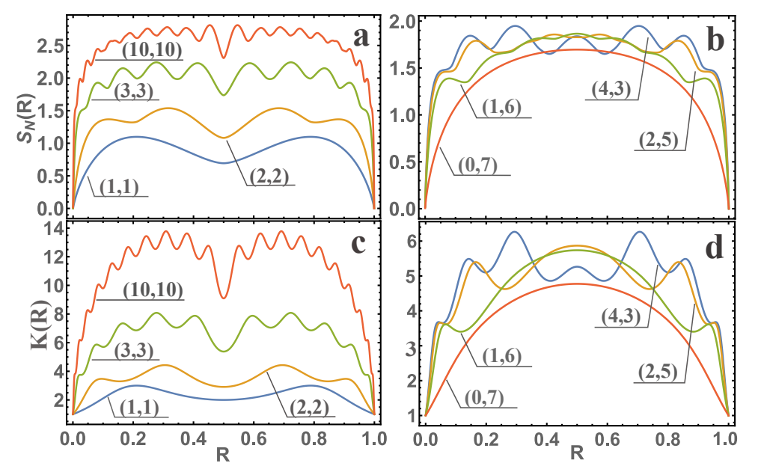

Slide 9
What to do next?
As we are interested in a neural network approach:
-What will be the system? Are we keeping the interaction?
-Are we switching to a many-body system?
-Are we looking for energy levels, or wave functions?

