Slide 1
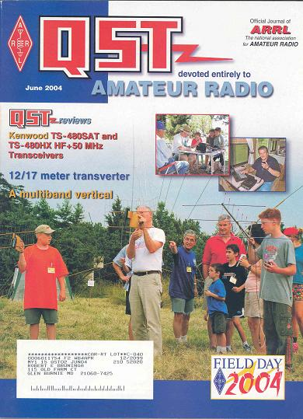
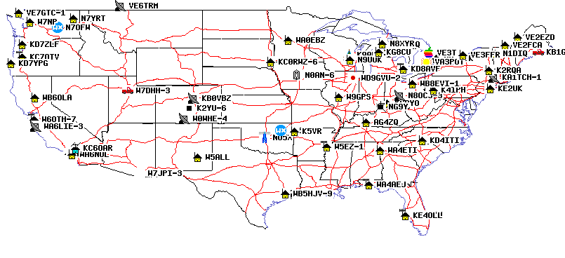
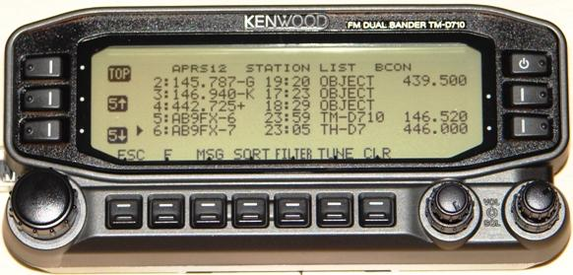
APRS via Space
APRS space frequency is 145.825 MHz
Also via GO-32 on 435.225 downlink, 145.85 MHz up
Cubesat 2008

Slide 2
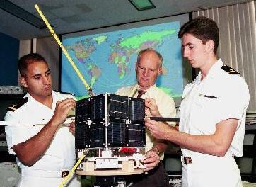

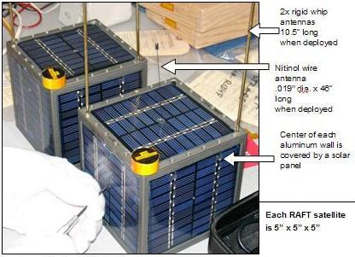
APRS Space Applications
PCSAT-1 (Prototype Communications Satellite) is a US Naval Academy Aerospace student project.
ANDE and RAFT in Dec 2006-2007
APRS space frequency is published as 145.825
Cubesat 2008

Slide 3
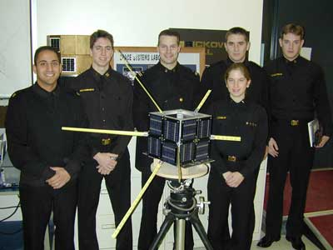
PCSAT Satellite
Launched Sept 2001 from Kodiak Alaska
The first APRS satellite, and has since been joined by 5 other such satellites
It still works during mid-day sunny passes.
Can capture Emergency /Priority messages from THD7 / D700 radios anywhere on the globe and retransmit these signals on the USA VHF 144.39 APRS frequency.
See live downlink on http://pcsat.aprs.org

Slide 4
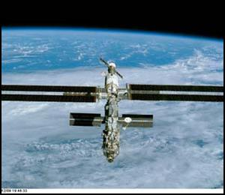
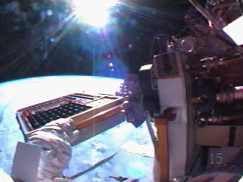
APRS on ISS!
ARISS supports APRS on 145.825 too!
Use digipeater path VIA ARISS.
PCSAT2 was also on ISS 2005-2006
PCSAT2, was the second APRS digipeater satellite.
See live downlink on www.ariss.net

Slide 5
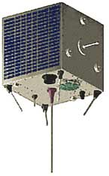
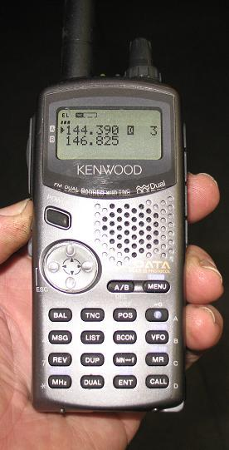
Now GO-32
TECHSAT-1b
GO-32 now supports APRS on its 435.225/145.85 packet system.
APRS up on 145.85 (PC’s and messages)
Mic-E up on 145.93 (D7 and D700’s)
9600 Baud!
See live downlink on www.ariss.net

Slide 6
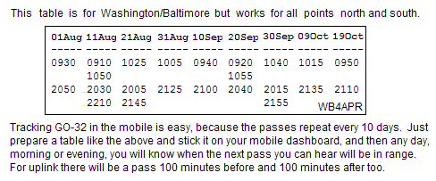
GO32 -EZ - MOBILE Satellite
Prediction and Tracking
No computer needed
Two or more solid TX/RX passes every day
Two additional TX passes 100m before and after!
Thurs 14 Aug is shown

Slide 7
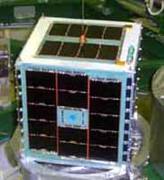
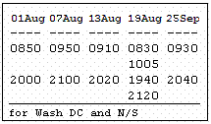
Tracking ECHO (AO51) too!
Thurs, 14 August
No computer needed
Two or more solid passes every day

Slide 8
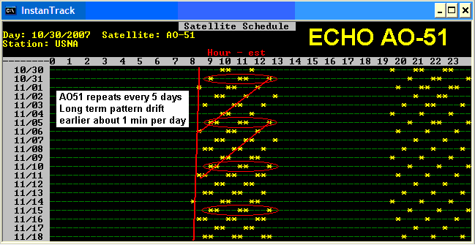
Tracking ECHO (AO51) too!
Thurs 14 August
No computer needed
Two or more solid passes every day

Slide 9
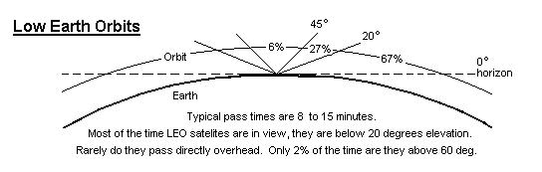
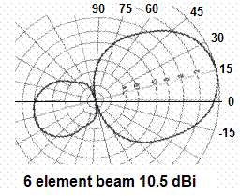
LEO Pass Geometry
Bottom line:
10 dB gain Horizon-to-horizon
98% of all in-view times
Using $75 TV rotator only

Slide 10
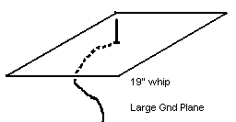
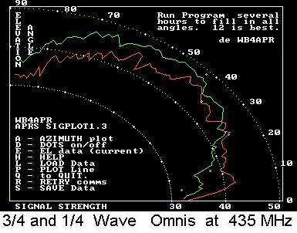
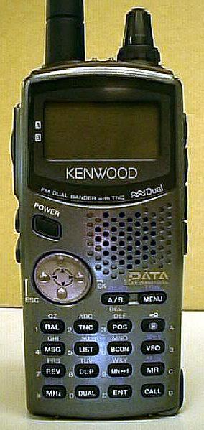
Omni Antenna Gain 7 dBi !
1%
30%
70%
SATgate!

Slide 11
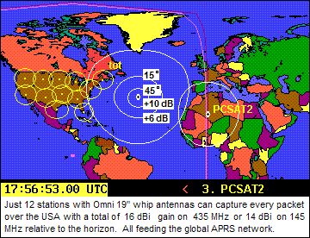
Combined Path/Antenna Gain !
SATgate!

Slide 12
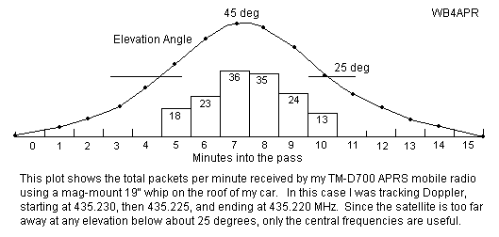
Omni SatGates

Slide 13
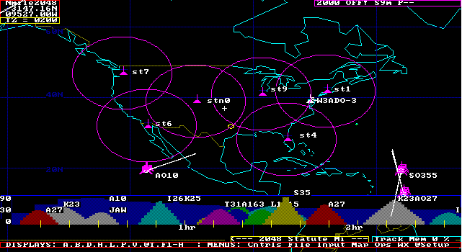
Omni SatGates

Slide 14
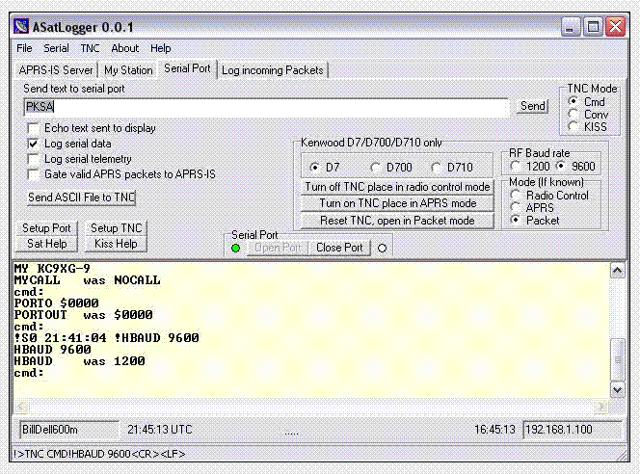
Omni SatGates (Alogger)

Slide 15
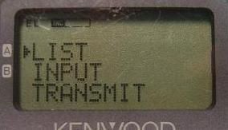
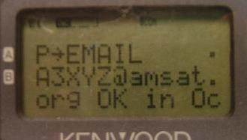
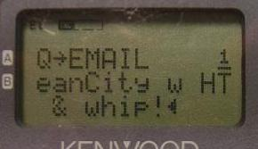
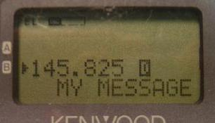
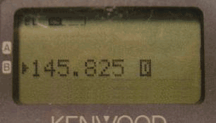
APRS Satellite operations
Email
Sset
When Successful
You see MY MESSAGE
Flash on display

Slide 16
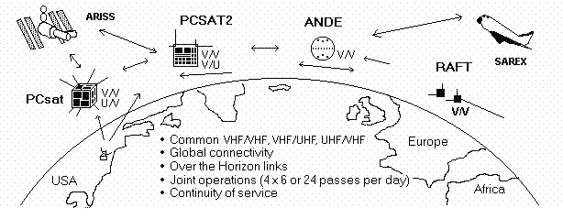
APRS Satellite Constellation

Slide 17
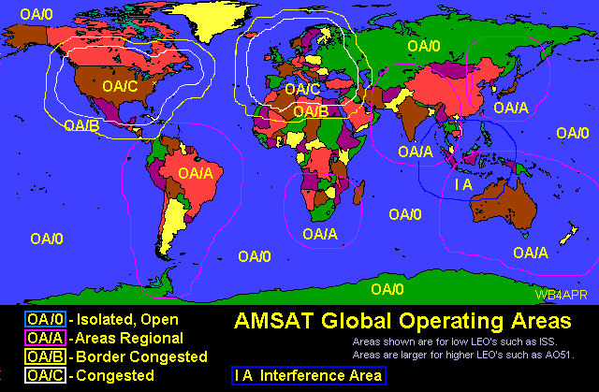
AMSAT Operating Areas

Slide 18
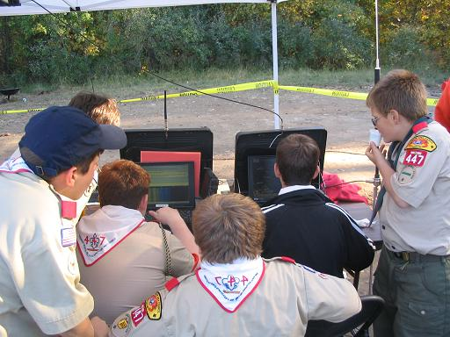
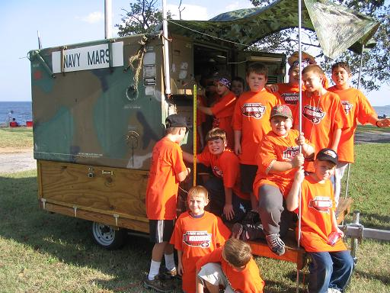
What is APRS?
APRS = Automatic Packet Reporting System
APRS was developed in the early 1990's for local tactical digital communications, situational awareness and TWO-WAY information exchange using Amateur radio.
Not just Vehicle Tracking!

Slide 19
What is APRS all about?
Immediate local digital and graphical information exchange between all participants in a local area or event. This includes:
  Positions of all stations and objects
  Status of all stations
  Messages, Bulletins and Announcements
  Weather data and telemetry
  DF bearings and signal strengths for quick transmitter hunting
  RF Connectivity plots of all stations
  Local OBJECTS on a common map display for all users
  Local Freqs, Nets, Meetings
Typical applications are:
  Routine local awareness of all ham radio events and assets around you
  Marathons, races, events and public service
  Search and rescue
  Family communications and tracking and one-line emails
  Mobile-to-mobile global messaging
  Weather data exchange and display
  Efficient multi-user Satellite communications

Slide 20
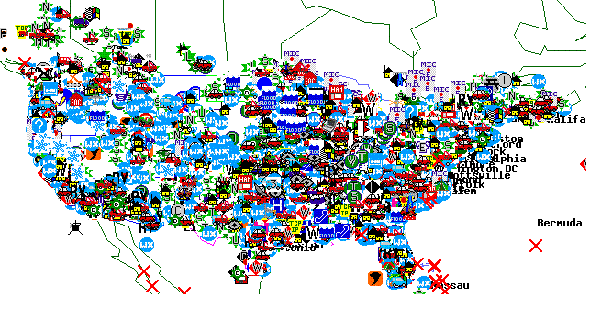
Scope of APRS
APRS consists of a very large land based wireless network. Almost 30,000 users around the world.
This network works via RELAYS every 20-30 miles called “digipeaters.” And Globally via IGates to the internet.
APRS is also used via some of the Amateur Satellites.
It is also used to monitor telemetry values of weather stations for the National Weather Service (NWS)
APRS has the capability to quickly relay telemetry values to research centers without the Internet.
But, only 2% of local situation…
(a side show)…

Slide 21
APRS MisConceptions!
See APRS-tactical.html
That APRS is just Vehicle Tracking instead of a Real-Time Information Distribution System.
That APRS is dependent on GPS for its value (GPS is not needed. See Objects).
Failure to use the APRS built-in Mile-Marks for tracking all other non-APRS mobiles.
Using APRS clients that only do maps and ignored too many of the APRS fundamentals.
Ignored the fundamental Decay Algorithm to accelerate new data, and decay old data!
Failure to understand the importance of OBJECTS: . See Objects 101 and Operations
Failure to use real-time messaging: . See Messages 101 and Message Operations
Failure to implement the original APRS Centralized Common Bulletin Board concept.
Not understanding the APRS operator’s role as a Data Input (Objects, Bulletins and Messages)
Not using the D7 and D700 as data entry and clipboard display units at field events.
Too much focus on Large Screen Displays –vs- Individual Operator displays for events.
Failure to display APRS symbols with all their attributes and colors without clicking them
Failure to manage the network by adjusting the local digipeater for the situation at hand.
Not realizing the importance of Voice Operating frequencies in APRS.

Slide 22
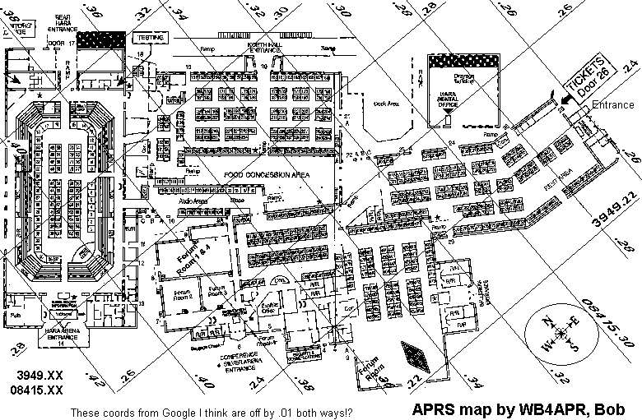
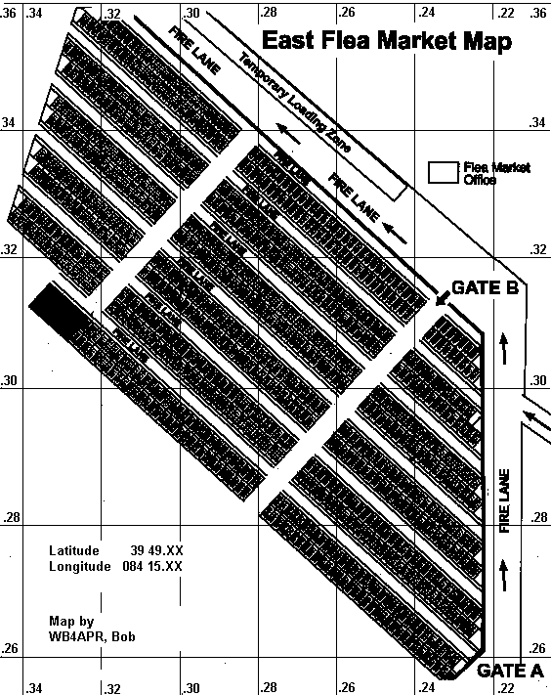
APRS, maps and events
That APRS is dependent on GPS for its value
(GPS is not required to put things on maps).

Slide 23

APRS missing Opportunities!
APRStt (APRS touchtone decoding)
Simple DTMF memory- One button reports Position, Frequency and Status!
  On every voice repeater
  On every IRLP node
  On every Echolink node
  Any where on .52!!
  ONLY NEEDS local software upgrade!
AVRS (Automatic Voice Relay System) Global VOIP via APRS
  Uses APRS message to set up call
  Automatically links to Echolink or IRLP
  Radio auto-QSY’s to make link (Ham Radio Cell phone from Mobile)
See APRS-tactical.html

Slide 24
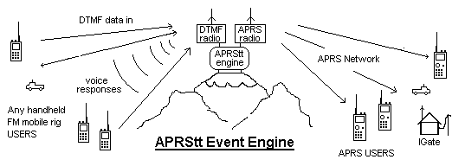
APRStt (Touchtone) or any other source(Dstar)
See aprstt.html
& DSTAR users!
Simple DTMF memory - One button puts you in APRS (Position, Frequency and Status)!
  DTMF on voice freq translated to packet on APRS channel (or direct to APRS-IS)
  Position is 10 mile ambiguity using repeater posit (or 60 mile ambiguity out west)
  Frequency in packet is Frequency of Repeater
  If Echolink or IRLP, APRS packet includes node number!

Slide 25
APRStt (Touchtone)
See aprstt.html
For WB4APR, the DTMF Sends: #A922444427A77D
This is converted to an APRS packet on the APRS channel as:
WB4APR-11>APRStt,WIDE1-1:!DDM_.__N/DDDM_.__W$146.895MHz T107 IRLP7070
Puts you on global map near Baltimore Maryland, with your immediate calling frequency, your Tone and your IRLP node number.
  That is everything you need to be known to the Global APRS system!
  We have had this since 2001 (in DOS w DTMF chip).
  We need someone to do this with a sound card in windows?
  Build into every Echolink/IRLP node and every Repeater controller with a serial port!
Unless we get APRStt and therefore 100% situational awareness of any Ham mobile or HT then APRS will always be a side show only used by 10% of any club or organization.
How about: #B95*234*2D => Milemark #234 on Route 95, northbound

Slide 26
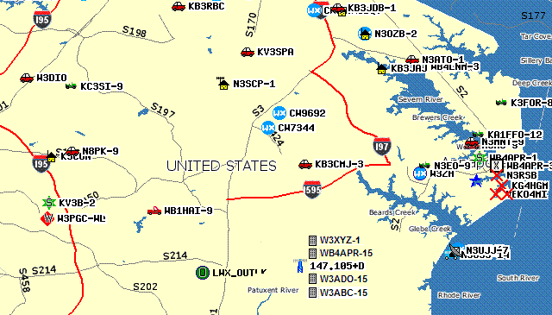
APRStt (Touchtone)
See aprstt.html
DTMF Report shows on APRS!
  CALLSIGN with date and time
  Position in vicinity of repeater or APRStt entry point
  Voice Operating Frequency, Tone and other info
  Node number if Echolink or IRLP, or reverse patch number if Repeater
147.105MHz T107 R30m

Slide 27
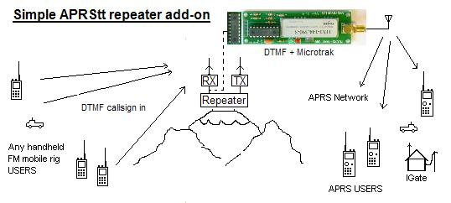
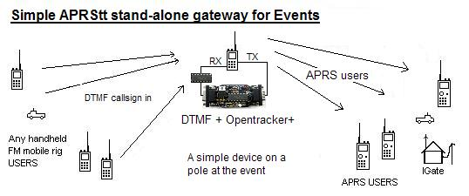
APRStt (Touchtone)
See aprstt.html
As simple as adding a DTMF chip to a Micro-Trak
Or adding a DTMF chip to an OT and HT for use in the field at a special event

Slide 28
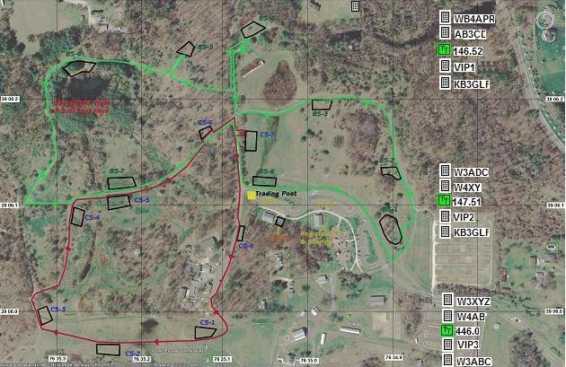
APRStt (Touchtone)
See aprstt.html
For events, put one on each operating frequency and set posits along unused edge of map.
See who is operating where, on what frequency and when

Slide 29
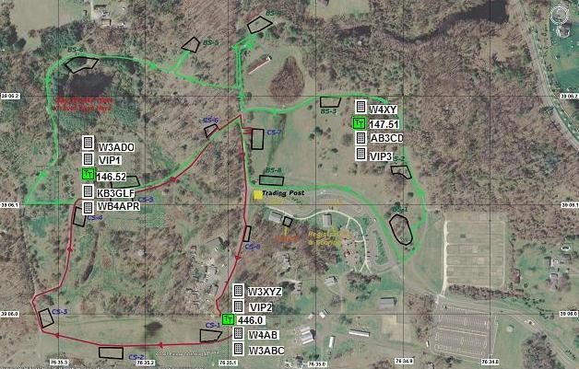
APRStt (Touchtone)
See aprstt.html
For big events, put one at each checkpoint or venue.
See who is operating where, on what frequency and when

Slide 30
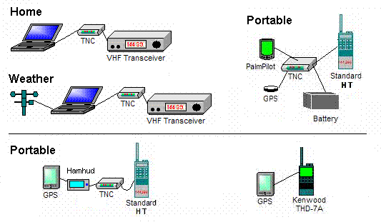
Various APRS Stations (two-way)
ARROW!
APRS is a Network intended for real-time Tactical INFORMATION exchange. This means TWO-WAY.

Slide 31
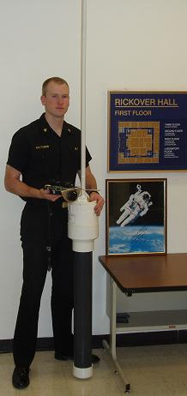
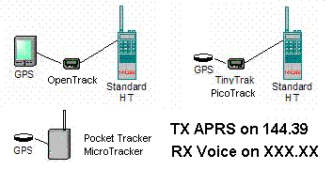
TRACKERS (and Buoys)
One-way APRS is not normally recommended. APRS is a Network. We want good communications among all participants for maximum utility.
But for some very remote applications, APRS is a great way to communicate small data packets from remote locations…
Satellite APRS
On 145.825 MHz

Slide 32
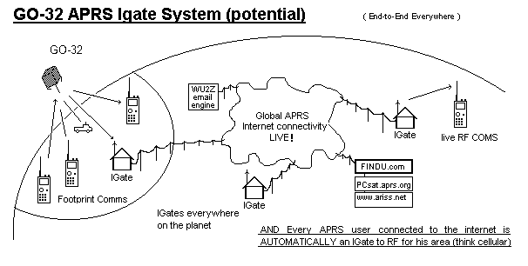
Global Mobile and Portable Satcom

Slide 33
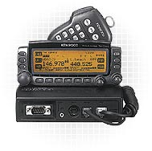
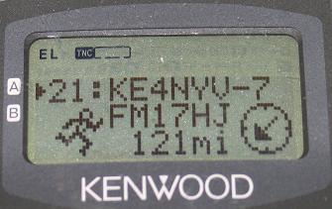
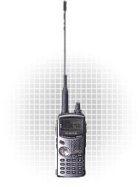
Kenwood TM-D700A
Mobile/Portable Satellite Terminals
Dual band 144/440 MHz 50/35 Watts
Built-in 1200/9600 bps TNC including digipeater
Built-in screen display of other APRS stations and front-panel send/receive messaging.
Other APRS station locations are sent to the attached GPS map for display.
TM-D710
Kenwood TH-D7A(G)
Adds operation Freq to every posit !
Auto tunes to others with Freq!
Shows local Voice Repeaters !

Slide 34
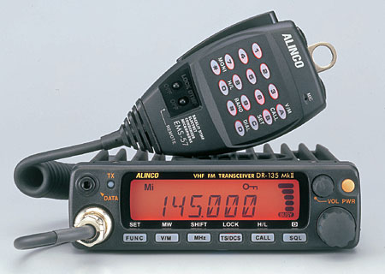
Alinco DR-135T/EJ-41U
Basic 2 M Radio with optional TNC.
(Opentrack makes a drop in tracker module)
Allows direct input from any standard GPS.
Basic 1200/9600 bps TNC
Unlike the Kenwood radios, it requires a PC to set it up, and there is no APRS display directly on the radio.

Slide 35
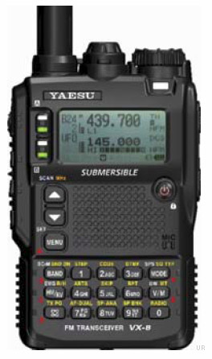
Yeasu VX-8R
“APRS” announced at Dayton?
Optional GPS in spkr-mic
Features of D7

Slide 36
APRS Voice Alert! *
(For all mobiles!)
Voice Alert is effectively 3rd Radio channel for the D7 and D700 APRS radios
By setting the APRS Band, A, to PL-100,
but keeping the volume turned up:
  You wont hear any packets on 144.39 *
  But you will hear a voice call using PL-100 on 144.39
  And you will hear* an occasional Ping packet if another D700 comes in line-of-site to you, like a proximity radar alerting you to local presence.
Great for long haul traveling and meeting other APRS users.

Slide 37



APRS – IS - Local Info!
Last 100 stations!
Mobiles and HT are 100%
compatible
Direction & Distance
Frequency and Tone

Slide 38
The APRS Network
Satellite
Aa
Digipeaters
And to the Internet Gateway
Multiple Hops

Slide 39


Slide 40

APRS (ALOHA circle and digipeater hops)
[Your ALOHA circle is your 100% saturated channel range]

Slide 41

APRS ( DFing by signal strength )

Slide 42

APRS ( Solo DF Fade Circle Technique )

Slide 43

APRS ( Solo DF Fade Circle Technique )

Slide 44

APRS ( Solo DF Fade Circle Technique )

Slide 45

APRS ( Solo DF Fade Circle Technique )

Slide 46

APRS ( Solo DF Fade Circle Technique )

Slide 47

APRS 3D views for Balloon tracking

Slide 48

APRS Tracking with Milemarks

Slide 49




APRS – Traffic Speed Posts
Shows speed of traffic past special points

Slide 50

APRS Event Data Entry
How to use APRS HT’s for keypad entry of Troop data at camporees.
20 stations, 40 troops, 800 scores all day long. Use keypads!

Slide 51




APRS Event Data Entry
Score Message Sent
Score Data Received

Slide 52
APRS IGates (Global APRS!)
An IGATE is a local APRS station that utilizes the APRS-Internet network to pass all packets heard on their local RF back to the Internet.
(Gives global views to local activity.
Also act as two-way gateways for ALL APRS MESSAGES worldwide (Internet ⬄ RF).

Slide 53




Findu.com mapping
Internet tracking developed by Steve Demise – K4HG

Slide 54



APRS-Internet (APRS-IS)
Google for “USNA Buoy” Select USNA-1
& situational awareness
This data is LIVE
http:// Pcsat.aprs.org

Slide 55

APRS-IS (FINDU – Near Range)
Google for “USNA Buoy” Select USNA-1

Slide 56

APRS-IS (FINDU – Near Map)
Google for “USNA Buoy” Select USNA-1

Slide 57

APRS-IS (FINDU - Messages)
Google for “USNA Buoy” Select USNA-1

Slide 58

APRS for Special Uses
Bicycle rallies, races
Walk-a-thons, Parades
Skywarn
Weather Nets
Crime prevention patrols
Damage assessment
Direction Finding – Foxhunts
Voice for communications, APRS for visual mapping
Now integrating into APRN (Automatic Picture Relay Network)

Slide 59



Sensor Buoy Prototype
See Buoy Location and Telemetry at
http://www.ew.unsa.edu/~bruninga/buoy.html
Piggrem

Slide 60

Findu.com Telemetry Plots
Google for
“USNA Buoy”
Select USNA-1

Slide 61





APRS Emergency Comms
Google for “USNA Buoy” Select USNA-1
Satellite-Simulated Emergency Test – SSET
- Send an emergency Email via Satelilite
Meteor-Scatter Monitoring Network (6 meters)
- Dozens of Igates monitoring 50.62 MHz
- Message Throughput in minutes
- Using surplus 110 Watt 6m radios
- Simple 100’ long wire gain antennas

Slide 62



APRS Emergency
Power
200W Solar Power
- Continuous
10 kW gas Generator 220 VDC
- Auto-runs as needed
- lightweight wires
Low Cost

Slide 63
APRS is INFO. not just tracking!
Milemarks?
APRStt?
Field Data?
Voice Alert?
Signal Finding?
Nets? Meetings?
Tracker-Voice?
RF Range?
Frequency?
AVRS (Ham Radio Mobile Cell via APRS=>VOIP)?
Traffic?

