Slide 1
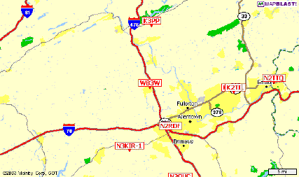
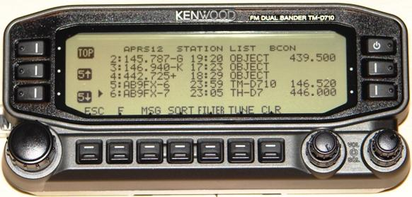
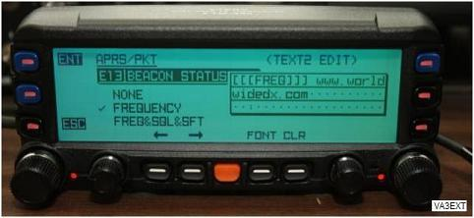
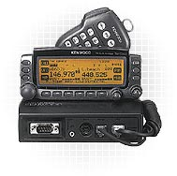
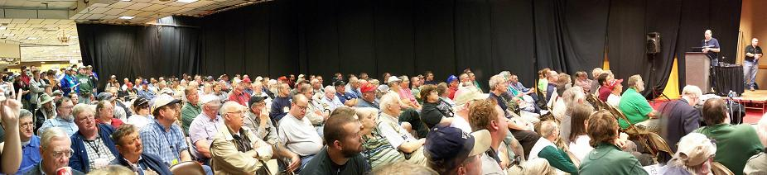
APRS.org
Using Your APRS Mobile
http://aprs.org/D7xx/d700-faq.txt
Human to human info exchange!
DCC 2010

Slide 2
APRS is a communication support system
To facilitate all forms of local HAM Comms
Who, What, When, Where, Why & How!
call Freq now map status msg
Position, course and speed
Information on Antenna and Range
Text Messages, Email, Bulletins
AND Voice!
The maps are just so you can SEE the Network and know how to Communicate!
DCC 2010

Slide 3
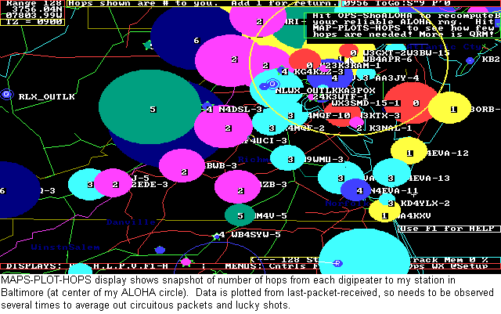
Your “local” APRS RF network
The channel is full with 60 to 120 users. Beyond that, reliability suffers.
The “ALOHA” circle defines your communication range.
Aloha Range:
In Maryland,
about 50 mi
In Wyoming,
about 150 mi
In SoCal,
about 15 mi

Slide 4
Your “local” APRS RF network
The Objective: To see info on EVERYTHING in Ham radio in that area.
  Who is around, Who is moving (operator present!)
  What they are doing.
  What Frequency they are on, and are monitoring
  What Repeaters to use
  What nets, or meetings or Hamfests are happening
  What resources are available? Echolink, IRLP, WinLink
  TO BE ABLE TO TALK TO THEM
    APRS Message
    or Voice!

Slide 5
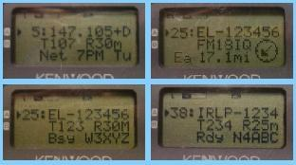
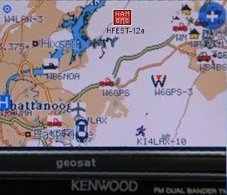
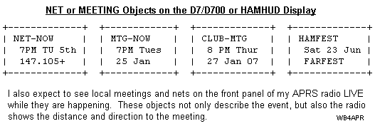
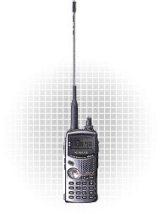
APRS – IS - Local Info!

Slide 6
APRS Voice Alert! *
(Simultaneous Voice and Data channel)
(Automatic Proximity Alert)
Voice Alert is effectively a 3rd & 4th Radio channel for APRS radios with internal TNC’s
Set APRS Band A to CTSS-100, Volume UP!
  All packet-racket is MUTED
  You are available for a voice call using PL-100 on 144.39
  And you will hear* a Ping ALERT if another VA-station comes in line-of-site to you… (a proximity radar alert!)
Great for long haul traveling and meeting other APRS users.
Also great local Backchannel for APRS coordination

Slide 7
APRS Channel MUTE
(Voice alert with personal CTCSS)
Set APRS Band A to CTSS-XXX, Volume UP!
  All packet-racket is MUTED
  All other Voice Alert Proximity pings are muted
  You are available for a voice call using PL-XXX on 144.39
MUTES APRS, but allows for backdoor (PL-XXX) voice contact
Include “V-Alert Txxx…” in your Status Text

Slide 8
Setting up your D700 or D710
Or Yaesu FTM-350
DCC 2010

Slide 9
MOST IMPORTANT SETTINGS !!!
To get even basic APRS functionality you must change TWO radio Defaults!
Configure BUTTONS for APRS
Configure PM’s to save Settings!
Then SAVE these in your PMs!
MENU: RADIO-DISPLAY-KEY_FUNCTION… set MODE 3 (D700 only)
MENU: RADIO-MEMORY-AUTO_PM_STORE… set to OFF (700 & 710)
(This prevents your every button push from auto-saving over your previously saved config!)
SAVE in each APRS PM: Press F then PM-IN, then select PM
DCC 2010

Slide 10
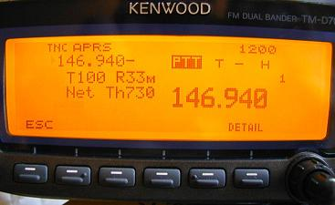
4 Bands/Modes in 1 5 Radios in 1
Side A APRS
Side B Voice
Voice
APRS display
Five
PM’s
TNC
PC
Voice Alert
DCC 2010

Slide 11
4 Bands/Modes in 1
1. VHF/UHF Voice
Side A APRS
Side B Voice
VHF or UHF voice
Or
Broadband RX
Voice
DCC 2010

Slide 12
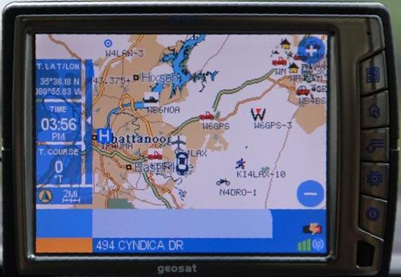
2. APRS
1. VHF/UHF Voice
Side A APRS
Side B Voice
APRS data on front panel display
And
Other stations on attached GPS MAP
Voice
APRS display
TNC
DCC 2010

Slide 13
2b. APRS
1. VHF/UHF Voice
Side A APRS
Side B Voice
APRS on attached PC
OR
Packet Mode with
PC
Voice
TNC
PC
DCC 2010

Slide 14
2. APRS
1. VHF/UHF Voice
Side A APRS
Side B Voice
Voice Alert makes you available 100% anytime for voice call on National APRS channel with PL 100
Voice
APRS display
TNC
CTCSS 100
3.
Voice Alert
DCC 2010

Slide 15
2. APRS
1. VHF/UHF Voice
Voice Alert makes you available 100% for voice call on National APRS channel with PL100
Side A APRS
Side B Voice
Voice Alert Proximity Alarm
Voice
Beeps when any other V.A mobile gets
in simplex range!
APRS display
TNC
CTCSS 100
3.
4.
Voice Alert
DCC 2010

Slide 16
APRS Voice Alert controlled by CHANNEL # *not* Volume Control
Side A APRS
Side B Voice
Ch1: APRS VA
144.39
CTCSS 100
APRS display
TNC
CTCSS 100
Voice Alert PL 100
Proximity Alert PL 100
DCC 2010

Slide 17
APRS Voice Alert controlled by CHANNEL # *not* Volume Control
Side A APRS
Side B Voice
Ch2: APRSmute
144.39
CTCSS xxx
But you can be reached with PL xxx
APRS display
TNC
CTCSS xxx
Voice Alert PL xxx
XXX
QUIET!
Beacon
DCC 2010

Slide 18
APRS Voice Alert controlled by CHANNEL # *not* Volume Control
Side A APRS
Side B Voice
Ch3: APRS raw
144.39
APRS display
TNC
Voice
Hear all packets
DCC 2010

Slide 19
APRS Voice Alert controlled by CHANNEL # *not* Volume Control
Side A APRS
Side B Voice
Call: 146.52
Call
Button
For
Instant
QSY to
52
APRS display
TNC
Voice
DCC 2010

Slide 20
APRS/Voice Alert Operations in PM1
Side A APRS
Side B Voice
PM1
Five
PM’s
APRS display
TNC
Five
PM’s
CTCSS 100
Voice Alert PL 100
Proximity Alert PL 100
DCC 2010

Slide 21
APRS/Packet in PM2
Side A APRS
Side B Voice
PM2
In this PM, you might want to change the
DISPLAY-KEY_FUNCTION back to normal Radio Buttons
(mode-1)
TNC
PC
Five
PM’s
DCC 2010

Slide 22
Dual Band VOICE in PM3
Five
PM’s
Side A voice
Side B Voice
Voice
PM3
In this PM, you might want to change the
DISPLAY-KEY_FUNCTION back to normal Radio Buttons
(mode-1)
Voice
DCC 2010

Slide 23
VOICE and Visual Scan in PM4
Five
PM’s
BAND SCAN
Side B Voice
Voice
PM4
DCC 2010

Slide 24
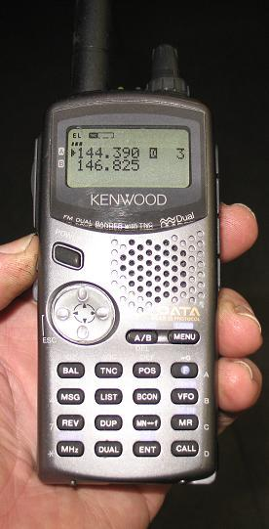
Cross Band Repeater in PM5
Five
PM’s
Side A UHF
Side B VHF
PM5
DCC 2010

Slide 25
The APRS Network
Information exchange between everyone
Aa
Digipeaters
And to the Internet Gateway
2 Hops max

Slide 26
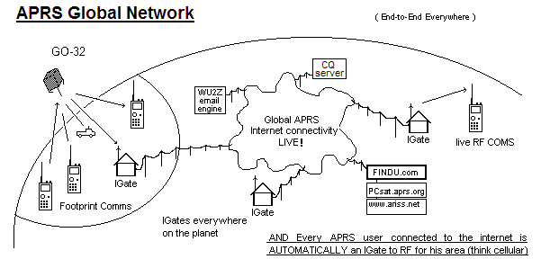
Internet Connectivity
Local RF
Only MSGs go back to RF
Everything goes into the Internet

Slide 27
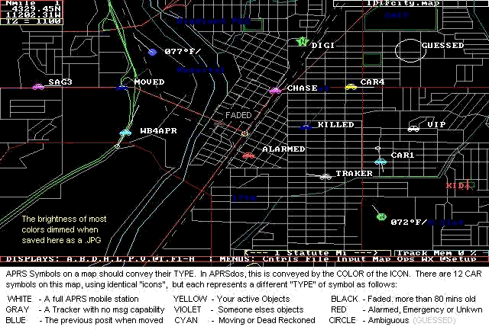
Seeing the Situation (Symbol Atributes)

Slide 28
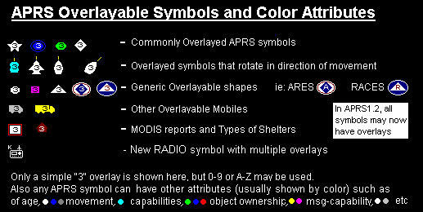
Symbol Atributes
The original Overlayable Symbols
Note, some popular “aprs” programs do not display ANY of these 11 attributes on any map! They show meaningless ICONS instead
Since April 2007, all
alternate symbols
may now have overlays

Slide 29
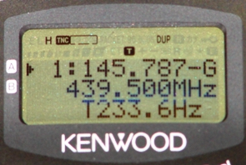
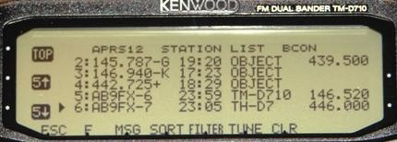
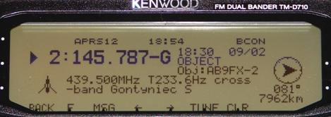
APRS – IS - Local Info!
Last 100 stations!
Direction & Distance
Frequency and Tone

Slide 30
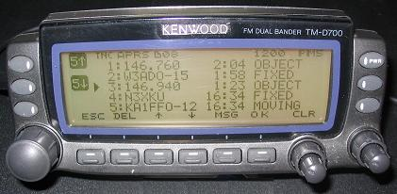
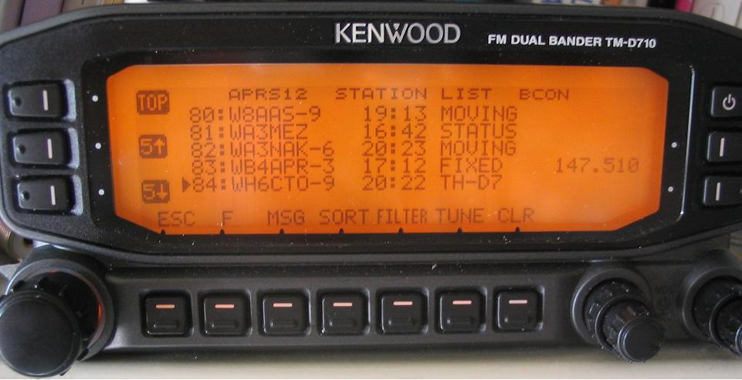
APRS – IS - Local Info!

Slide 31
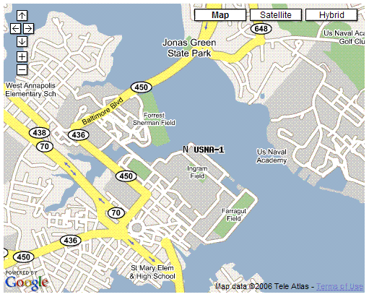
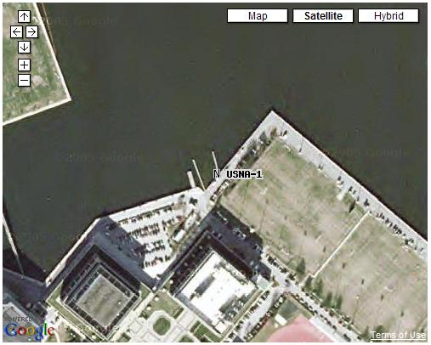
APRS-Internet (APRS-IS)
Google for “USNA Buoy” Select USNA-1
APRS.FI
OpenAPRS.NET
Findu.com
This data is LIVE

Slide 32
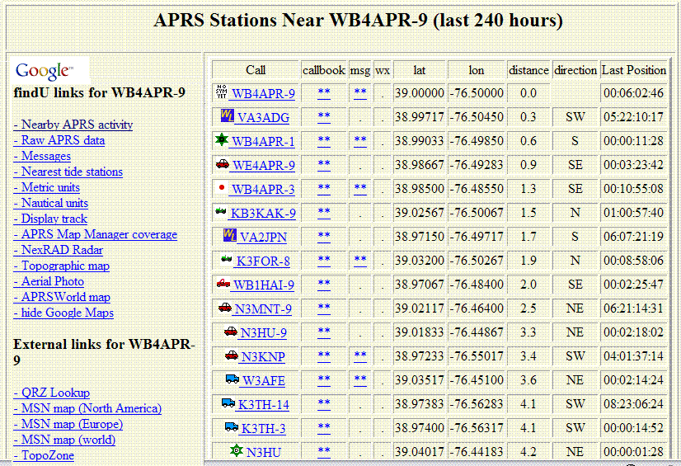
APRS-IS (FINDU – Near)
Google for “USNA Buoy” Select USNA-1
* Click to see all stations on map

Slide 33
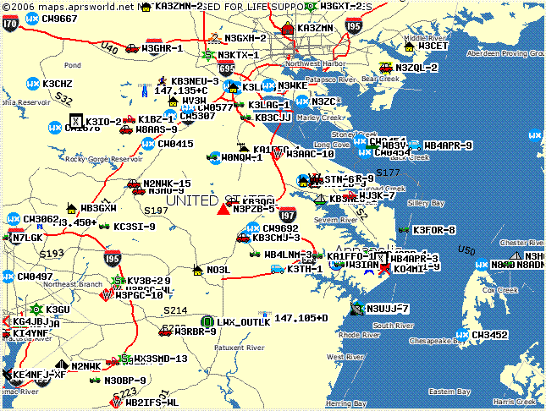
APRS-IS (click to see all stations on map)
Google for “USNA Buoy” Select USNA-1
Also:
APRS.fi
OAPRS.net
Etc…
40 miles

Slide 34
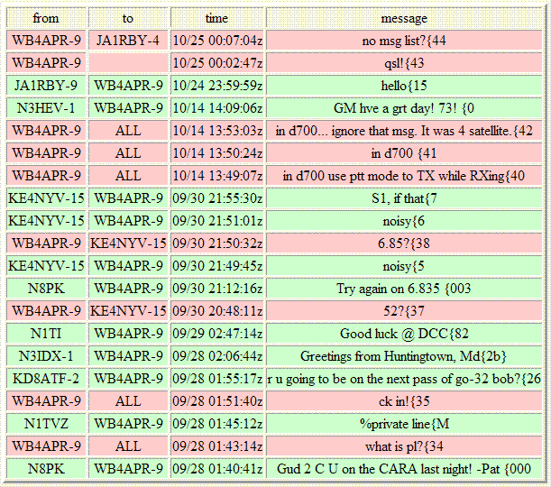
APRS-IS (FINDU - Messages)
Google for “USNA Buoy” Select USNA-1
Also:
APRS.fi
OAPRS.net
Etc…

Slide 35
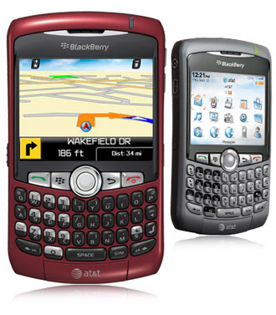
Global APRS Email!
To: EMAIL
MSG: wb4apr@amsat.org ET call home!
APRS Global Text Messaging since 1993; from HT’s since 1998!
Send Email from any APRS radio anywhere to anyone on the planet, anywhere LIVE.
WU2Z Email Engine on the APRS-IS gates it to Internet
Great Demos. Send an Email to a Blackberry in the audience.
New Initiative! Universal Amateur Radio Text Messaging

Slide 36
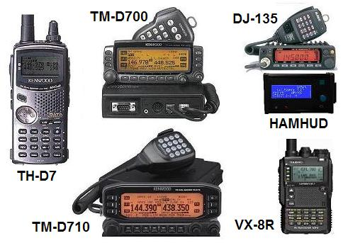
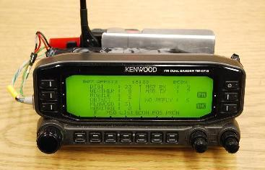

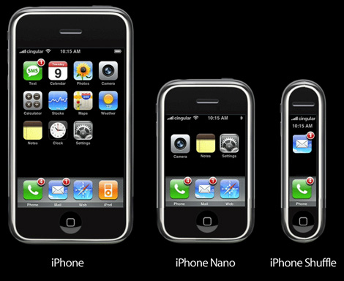


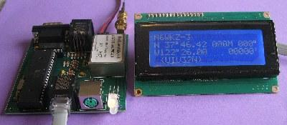
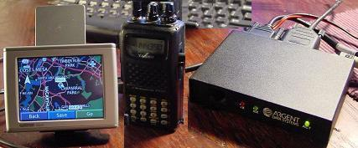






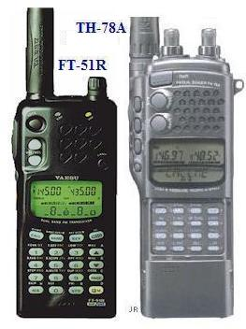
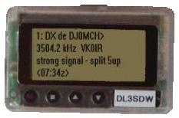

Universal Ham Radio Text Messaging Initiative
cell
wireless
APRS
DTMF
Send/RX anytime, anywhere, any device by callsign
26 separate systems! But ALL CAN EMAIL!

Slide 37
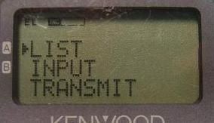
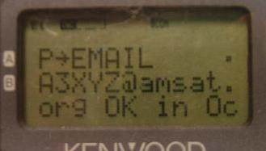
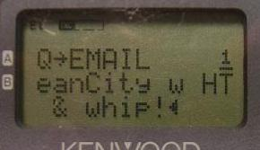
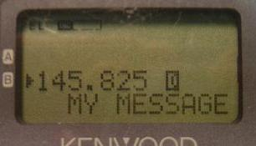
APRS
Msgs/Email
MSG menu
Send/Receive messages or email
Anywhere on the planet via APRS satellite
Confirmation of Relay =>

Slide 38
What is APRS all about?
(Humans communicating INFO with Humans)
Immediate local digital and graphical information exchange between all participants in a local area or event. This includes:
  Positions of all stations and objects
  Status of all stations
  Messages, Bulletins and Announcements
  Weather data and telemetry
  DF bearings and signal strengths for quick transmitter hunting
  RF Connectivity plots of all stations
  Local OBJECTS on a common map display for all users
  Local Freqs, IRLP, ECHOlink, Winlink, Nets, Meetings
Typical applications are:
  Routine local awareness of all ham radio events and assets around you
  Marathons, races, events and public service
  Search and rescue
  Family communications and tracking and one-line emails
  Mobile-to-mobile global text messaging
  Weather data exchange and display
  Efficient multi-user Satellite communications

Slide 39
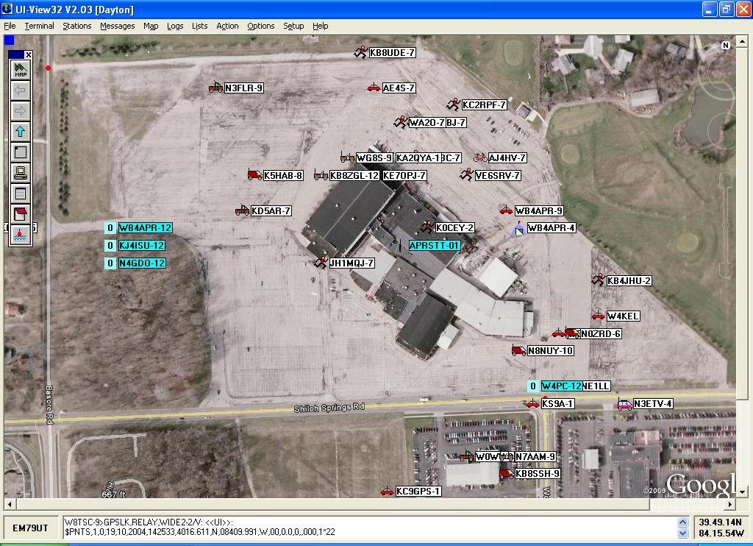
APRS, Maps, Events and Objects!
Dayton Hamvention

Slide 40
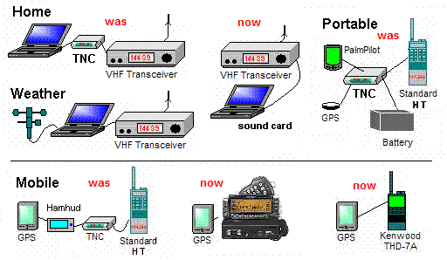

Various APRS Stations (two-way)
APRStt
now
APRS is a Network intended for real-time Tactical INFORMATION exchange. This means TWO-WAY.

Slide 41
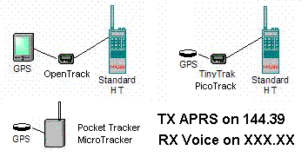
TRACKERS (should be two-way)
One-way APRS is not recommended. APRS is a Network.
Use the Receiver to receive calls!
The Beacon should include the receiver Voice frequency so the operator can be involved in the Net!
One-way trackers are good for non-manned assets at large movement events.. Not as the only APRS asset for a ham.
Trackers may be his 2nd, 3rd or 4th unit for APRS support… not his 1st!

Slide 42
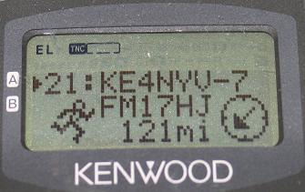
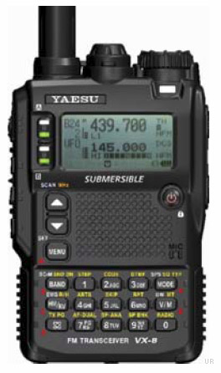
Kenwood TM-D700A
Mobile/Portable APRS Terminals
Dual band 144/440 MHz 50/35 Watts
Built-in 1200/9600 bps TNC including digipeater
Built-in APRS Displays and messaging.
Other APRS stations show on attached GPS map
TM-D710
Kenwood D7 Yaesu VX8R
Adds operation Freq to every posit !
Auto tunes to others with Freq!
Shows local Voice Repeaters !

Slide 43
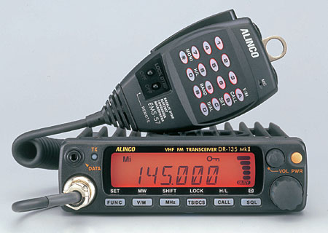
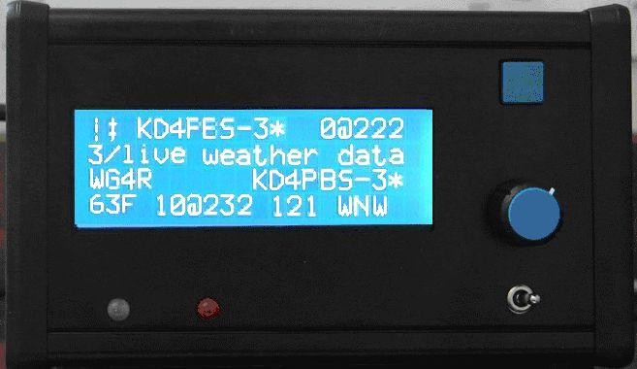
Other APRS radios
Alinco DR-135T/EJ-41U
2 M Radio with optional TNC.
N1VG Scott makes an OT tracker module
No messaging/data display
But OT adds GPS map display
VX8R available since Dec 08.
VX8G GPS built-in (2010)
Or HAMHUD on any radio!

Slide 44
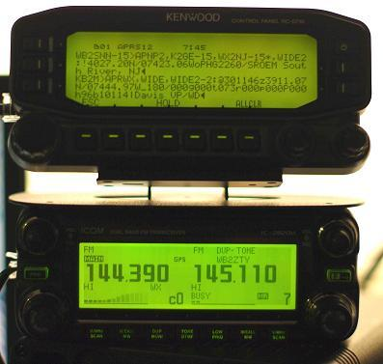
APRS on ANY radio! (using the RC-D710)
RC-D710 DISPLAY
Plug-n-play Audio Connection
Jeff KB2M
APRS channel DSTAR channel
On IC-2820 DSTAR

Slide 45
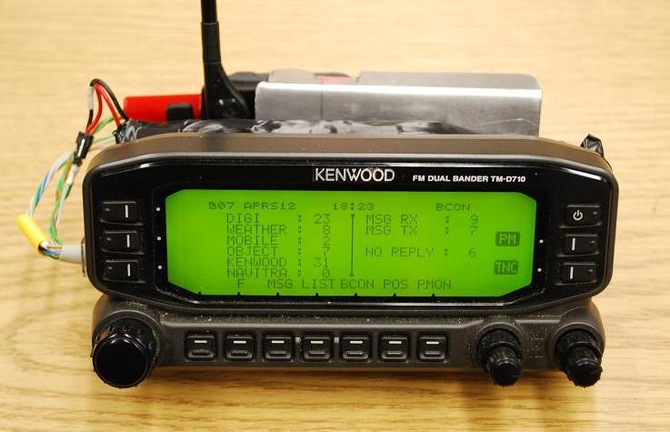
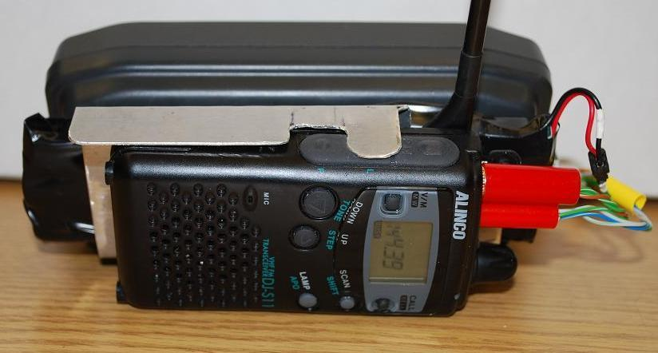
APRS on ANY radio! (using the RC-D710)
Attached to an ALINCO HT
Simple SPKR/Mic connections
NiCd Battery Pack

Slide 46
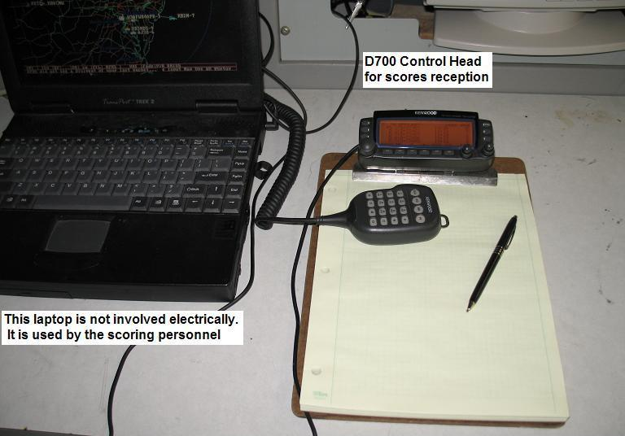
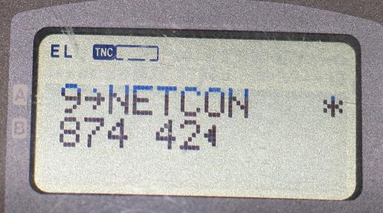


APRS Event Data Entry
Ops send scores
Net Control
Score Message Sent
Score Data Received

Slide 47

Event Data Entry (DTMF)
Using ANY Radio with a DTMF keypad
Troop Number and
Score received at
Net Control

Slide 48



APRS (RFID)
See aprs-rfid.html
Hot Spot
For big events, put one at each checkpoint or venue.
Every clubhouse/EOC door
See who is operating where, on what frequency and when

Slide 49

APRS (RFID)
Hot Spot
See aprs-rfid.html
Was demonstrated with door mats at Dayton

Slide 50


Slide 51


Slide 52

APRS Range circles and Path tracing

Slide 53

APRS ( DFing by signal strength )

Slide 54

APRS Tracking with Milemarks

Slide 55




APRS – Traffic Speed Posts
Shows speed of traffic past special points

Slide 56

APRS is INFO. not just tracking!
Milemarks?
APRStt?
Field Data?
Voice Alert?
Signal Finding?
Nets? Meetings?
Tracker-Voice?
RF Range?
Frequency?
AVRS (Ham Radio Mobile Cell via APRS=>VOIP)?
Traffic?

