Slide 1
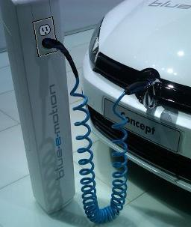
Federal Initiatives for EV’s
EXECUTIVE ORDER 13514 Orders “a clean energy economy” and … “involving Federal employees in achievement of these goals”. Specifically, by “using low green house gas emitting vehicles,” by “actively supporting lower-carbon commuting,”… and by “implementing innovative practices to address green house gas emissions…” http://www.epa.gov/oaintrnt/practices/eo13514.htm
Further, 80% of federal government transportation emissions come from employee commuting!
Conundrum: Employees are taking the initiative (buying Evs) – Yet agencies are blocking progress by too broadly interpreting the GAO ruling
Bob Bruninga, PE
IEEE Transportation Committee
http://aprs.org/payin-to-plugin.html

Slide 2
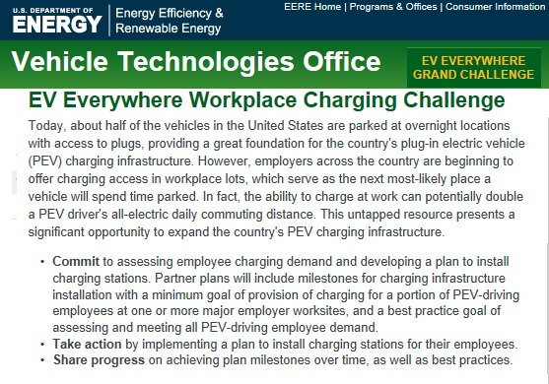
options
options
Bob Bruninga, PE
IEEE Transportation Committee
http://aprs.org/payin-to-plugin.html

Slide 3

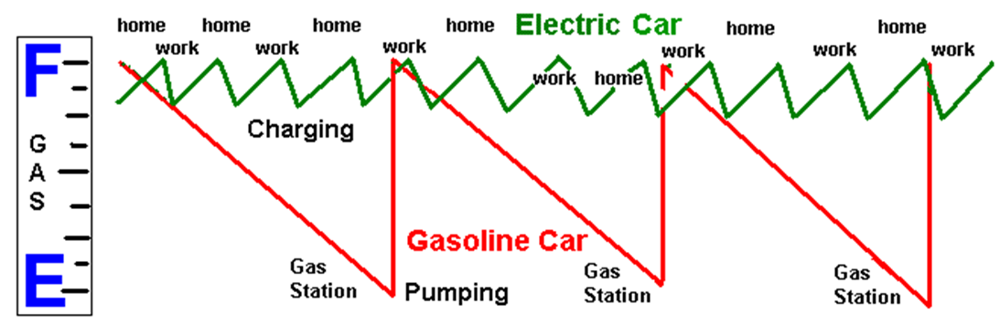
Background: A Battery is not a TANK!
The Complete Paradigm Shift:
Gas cars drive-to-empty, then fill-to-full at Public Stations
EV’s charge daily at home and at work while parked
Bob Bruninga, PE
IEEE Transportation Committee
http://aprs.org/payin-to-plugin.html

Slide 4
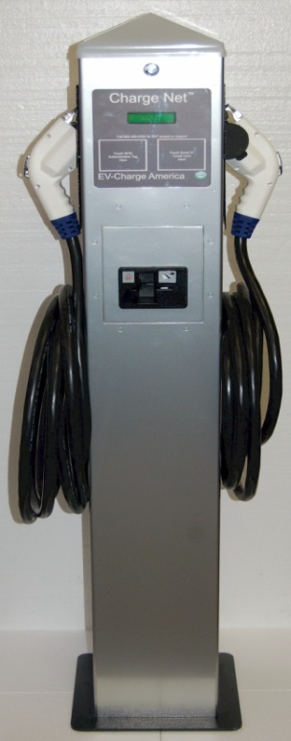



Every EV can charge from any 120v outlet
Charging stations for every EV is not sustainable at-work:
Every EV comes with a 120v charge cord
Exist or $15 each
$6000 installed
Bob Bruninga, PE
IEEE Transportation Committee
http://aprs.org/payin-to-plugin.html

Slide 5
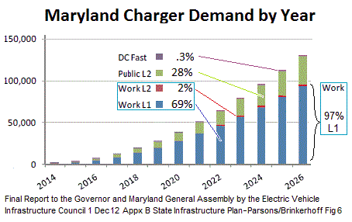

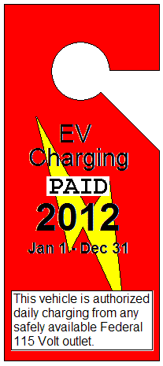
“Charging Stations” not Needed!
97% of Charging-at-work needs only a 120v outlet
And a local means to reimburse for electricity used.
Bob Bruninga, PE
IEEE Transportation Committee
http://aprs.org/payin-to-plugin.html

Slide 6
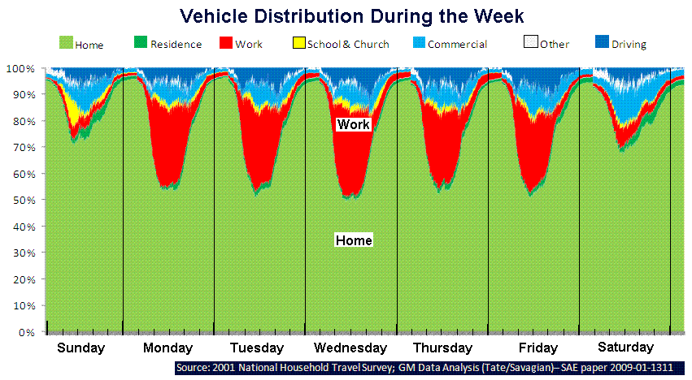
Cars are parked 21 hrs/day at home and work
Gas station fill
opportunity.
5 min impact
10 sec/day
impact
20 Hrs charging opportunity = 90 mi/day
Bob Bruninga, PE
IEEE Transportation Committee
http://aprs.org/payin-to-plugin.html

Slide 7
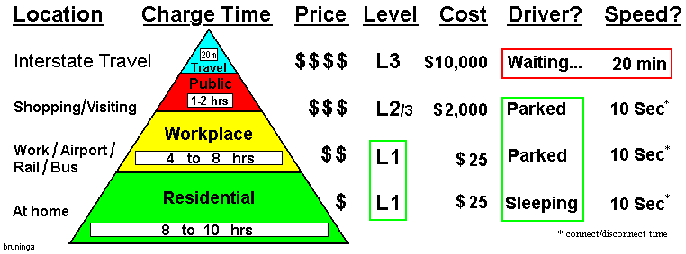
Charging-at-work is most important to EV future
Public Charging is like looking for $10 gas!
Nice to have when you need it, but impractical for routine use!
Bob Bruninga, PE
IEEE Transportation Committee
http://aprs.org/payin-to-plugin.html

Slide 8
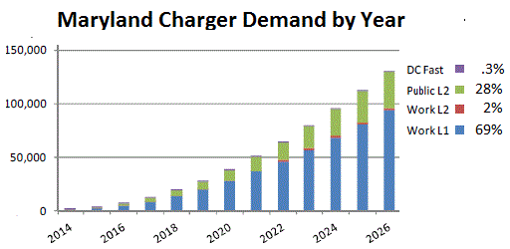

120v Charging satisfies 97% at work!
Maryland EV Council concluded 97% of charging-at-work can use 120v
Bob Bruninga, PE
IEEE Transportation Committee
http://aprs.org/payin-to-plugin.html

Slide 9
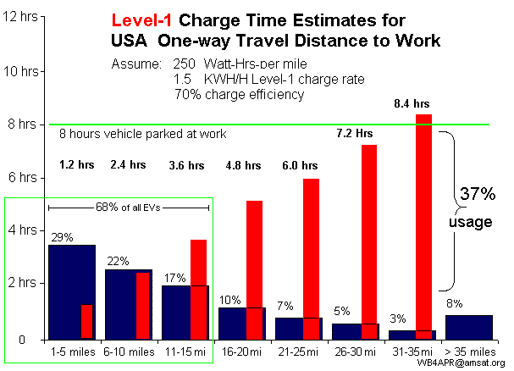
120v can fully charge 92% of all commuters in under 8 hours (at home & work)
Bob Bruninga, PE
IEEE Transportation Committee
http://aprs.org/payin-to-plugin.html

Slide 10


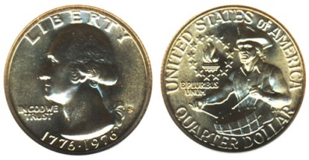
Oh the
Horror!
Paying for it…
Our Legacy experience
People see this
And think $50
Reality with EV’s is
20¢/hr
50 cents a day
Bob Bruninga, PE
IEEE Transportation Committee
http://aprs.org/payin-to-plugin.html

Slide 11
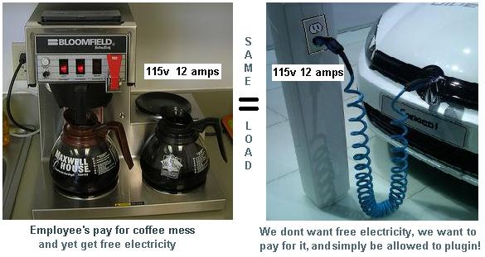
Charging Load at L1 (120v):
1 Coffee Pot = 1 EV!
Virtually no impact on the grid!
Bob Bruninga, PE
IEEE Transportation Committee
http://aprs.org/payin-to-plugin.html

Slide 12
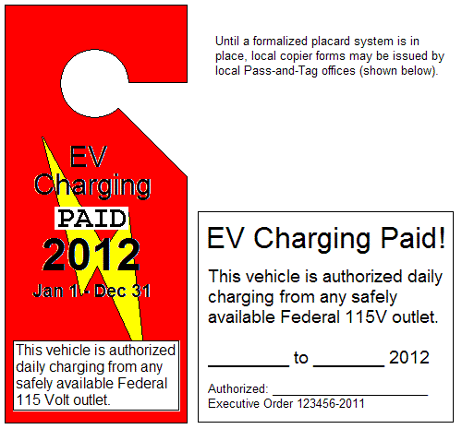
Charging at work L1:
Payin-to-Plugin
Employees purchase a monthly Charging Pass for the same cost of charging per day.
About $12 to $24 per month for 12 to 24 mile commuters.
$12/mo
For 12 mi commute
Bob Bruninga, PE
IEEE Transportation Committee
http://aprs.org/payin-to-plugin.html
Notes:
Title: 40 pt. Arial Bold
Use this slide template for a chart, graph, image, or other visual element.

Slide 13
Charging at work L1:
Payin-to-Plugin
Cannot be abused!
120v charging cord & outlet limited to 12 amps
Employees arrive 1-way from full charge at home
Cannot Draw more than $1.60 in 8 hours
Cannot grab-and-run… takes 8 hours!
Beyond full charge, no more power can be drawn
Government, State and Corporate parking controls already exist
As easy to monitor as Handicapped or other illegal parking
Bob Bruninga, PE
IEEE Transportation Committee
http://aprs.org/payin-to-plugin.html
Notes:
Title: 40 pt. Arial Bold
Use this slide template for a chart, graph, image, or other visual element.

Slide 14
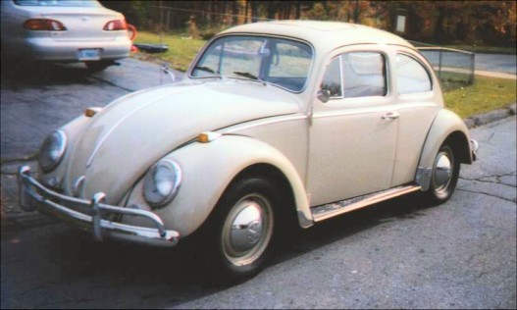

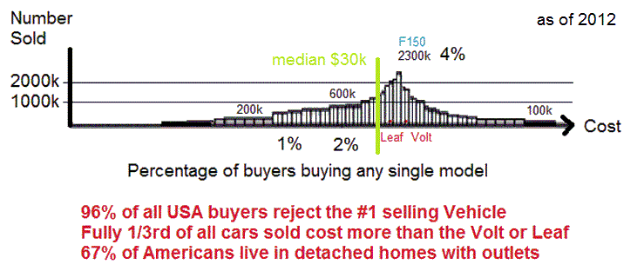
EV Cost comparable to all other cars
405 models of gas cars

Slide 15
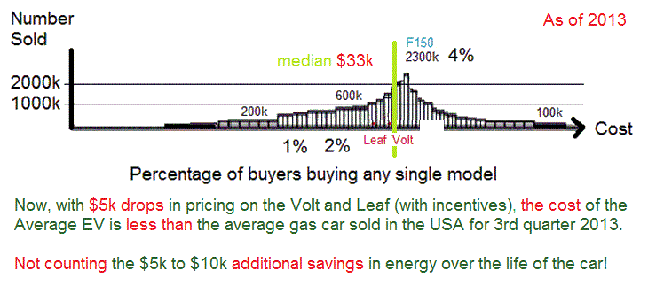
EV Cost Now Less Than Average!

Slide 16
EV emissions from coal plant are minor
The truth is:
An EV only uses 1/4th the energy of a gas car.
Most EV’ers buy an EV for the environmental benefits…. And 45% purchase only solar or wind electricity.
RESULT Today for Evs, 25% x 50% x 45% =
6% comes from Coal!
43.5% | Coal
22.2% | Natural Gas
19.1% | Nuclear
8.9% | Hydroelectric
5.4% | Solar,Wind,Geo
0.7% | Petroleum
And it will only get better!
Bob Bruninga, PE
IEEE Transportation Committee
http://aprs.org/payin-to-plugin.html

Slide 17


Don’t waste precious oil commuting every day when we can do it better/cheaper electrically
Save oil for Airplanes and highway travel!
Most commuters have access to another family car
Use EV’s where it makes Cents! Not everywhere!!!
Bob Bruninga, PE
IEEE Transportation Committee
http://aprs.org/payin-to-plugin.html

Slide 18
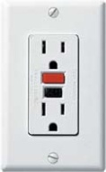
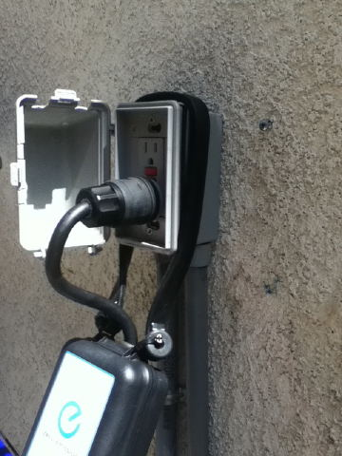
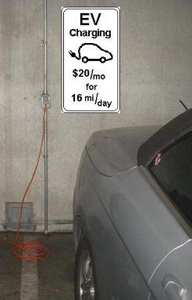
The EV concept!
Leave Home Fully Charged
Leave Work Fully Charged
Charge at home 8 hrs
Charge at work 8 hrs
So Why would you want to:
Stop at Walgreens’ every day for a 30 min charge
to get home?
(and pay triple?)
Leave home FULL
Leave Work FULL
Bob Bruninga, PE
IEEE Transportation Committee
http://aprs.org/payin-to-plugin.html

Slide 19
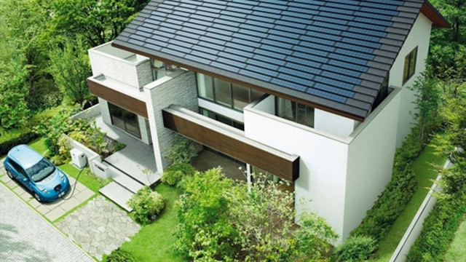
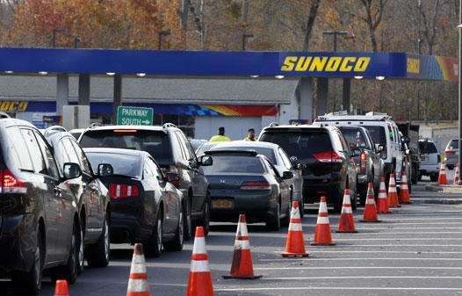
EVs can power homes during blackouts
Power out?
Power your house
From your Car!
EV’s don’t wait
in gas lines
Bob Bruninga, PE
IEEE Transportation Committee
http://aprs.org/payin-to-plugin.html

Slide 20
Time to charge vanishes as an issue
Every EV comes with a standard 120v charging cord And is parked more than 21 hours a day at home and work!
Instead of showing Hours to charge at L1:
Show L1 Miles in 8 Hrs:
Vehicle | Hours
Prius PHEV | 4
Volt | 11
Leaf | 17
Tesla | 36
Vehicle | Miles
Prius PHEV | 15
Volt | 32
Leaf | 32
Tesla | 32
(4 hrs)
Double this L1 range by charging at home and work
Bob Bruninga, PE
IEEE Transportation Committee
http://aprs.org/payin-to-plugin.html

Slide 21
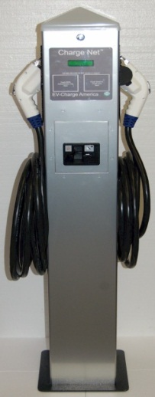
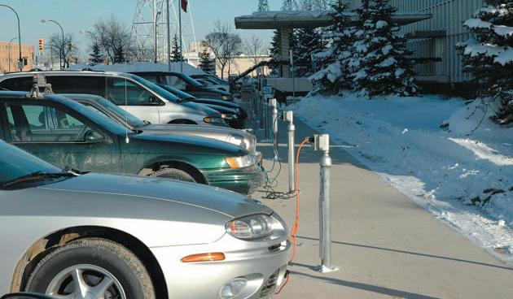
Parking spots already have outlets up North
L2
Level-2 charges 32 mile trip in 2 hours.
Level-1 charges 32 mile trip in 8 hours.
Level-1 8 hr charge (overnight and at work)
L1
Bob Bruninga, PE
IEEE Transportation Committee
http://aprs.org/payin-to-plugin.html

Slide 22
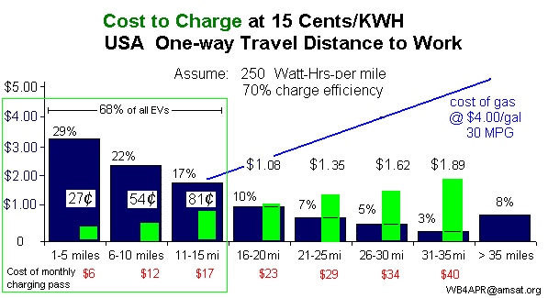
Charging Cost at Work at L1:
Charging for 8 hours:
70% of all commuters (<16 mi) could charge for < $1/day
Bob Bruninga, PE
IEEE Transportation Committee
http://aprs.org/payin-to-plugin.html

Slide 23
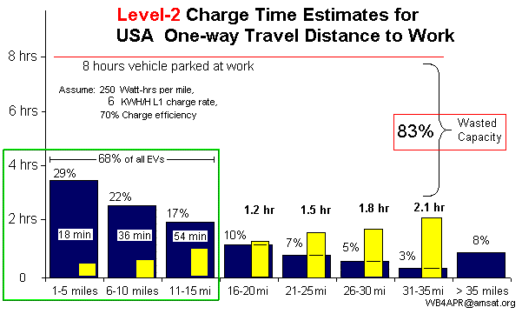

Charging Times at Work L2:
70% of all commuters (< 16 mi) could charge for < $1
Meaning Level-2 chargers would be idle 83% of the time
Bob Bruninga, PE
IEEE Transportation Committee
http://aprs.org/payin-to-plugin.html

Slide 24
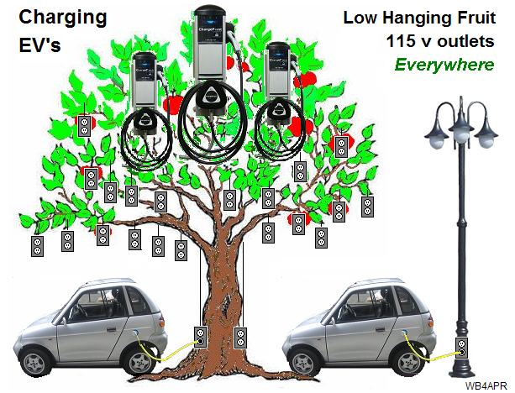
120v outlets (L1) already exist!
This is the low hanging fruit of EV Infrastructure!
Bob Bruninga, PE
IEEE Transportation Committee
http://aprs.org/payin-to-plugin.html

Slide 25

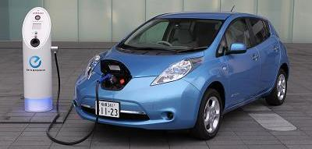
Charging at L2 – significant issues:
Level-2 = Half-a-House
Significant Issues apply!
Issues depend on what you are talking about!
Bob Bruninga, PE
IEEE Transportation Committee
http://aprs.org/payin-to-plugin.html

Slide 26
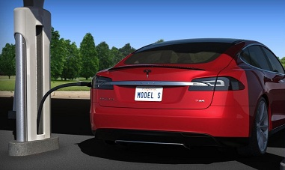

Charging Load at L3 (DC Fast Charge):
15 minutes
Level-3 = 24 Houses
Unbelievable Issues apply!
But remember, only 0.3% of need!
Bob Bruninga, PE
IEEE Transportation Committee
http://aprs.org/payin-to-plugin.html

Slide 27
Charging at 120v – No issues
1 Coffee Pot = 1 EV!
Virtually no impact on the grid!
Bob Bruninga, PE
IEEE Transportation Committee
http://aprs.org/payin-to-plugin.html

Slide 28
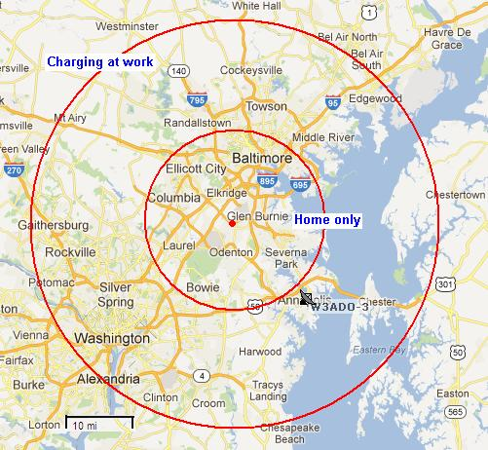
Charge-at-work = 4x range area
Charge at home only = 16 mi range
Charge L1 at work/home = 64 mi range

Slide 29
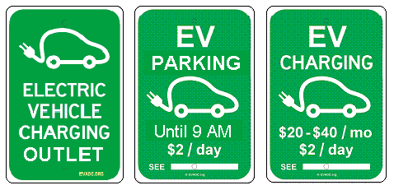
Some Signs
Decide on Payment (yes, no)
Payin-to-Plugin recommended
Bob Bruninga, PE
IEEE Transportation Committee
http://aprs.org/payin-to-plugin.html

Slide 30
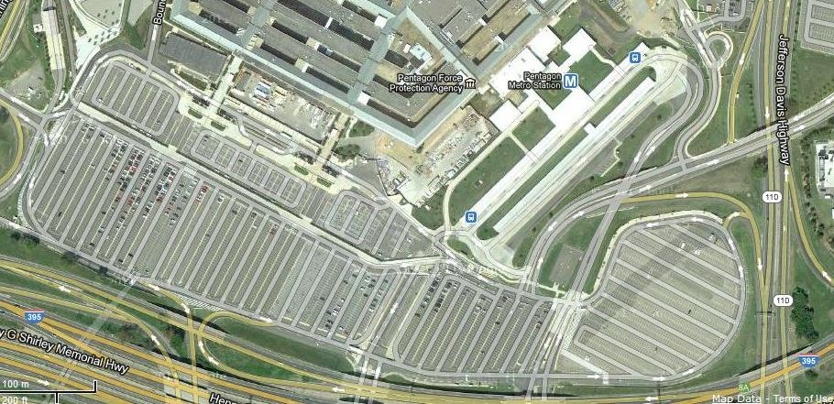
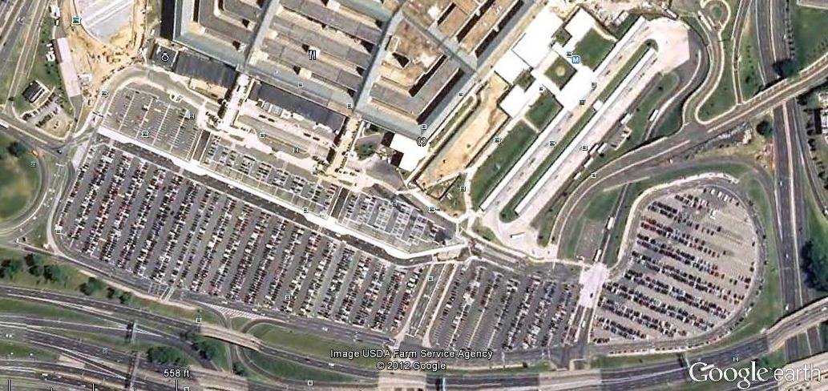
National Security!
$1,000,000,000/day Foreign Oil
Workforce dependent on oil
National Imperative for EVs
99% American Energy
⬅Pentagon parking (no oil)
EV’s charge ANYWHERE and EVERYWHERE!
Pentagon with gas shortage
And EVs with L1 outlets ➔
Bob Bruninga, PE
IEEE Transportation Committee
http://aprs.org/payin-to-plugin.html

Slide 31
Need More info?
http://aprs.org/EV-charging-everywhere.html
Get a Gold Star for your Boss
Enacting Payin-to-Plugin is a WIN-WIN for him
If you have success where you work,
let us know! bruninga@usna.edu
Others will follow!
Bob Bruninga, PE
IEEE Transportation Committee
http://aprs.org/payin-to-plugin.html

