Slide 1

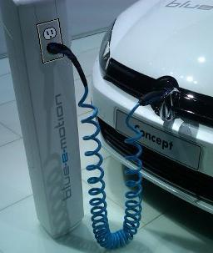
A Battery is not a TANK!
-or-
Most of what we think we know about EV’s might be wrong
One Million EVs by 2015 is the goal.
The Infrastructure Response is great!...
But are we doing it right?
(Rev 5)
Bob Bruninga, PE
IEEE Transportation Committee
http://aprs.org/payin-to-plugin.html

Slide 2
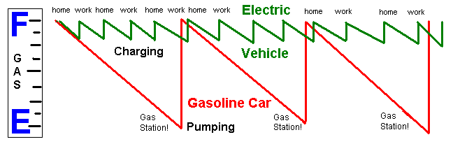
A Battery is not a Tank!
Gas cars drive-to-empty, then fill-to-full
EV’s charge daily at home and (eventually) at work
Not to-full for best battery life
Not to-empty for best battery life
Bob Bruninga, PE
IEEE Transportation Committee
http://aprs.org/payin-to-plugin.html

Slide 3
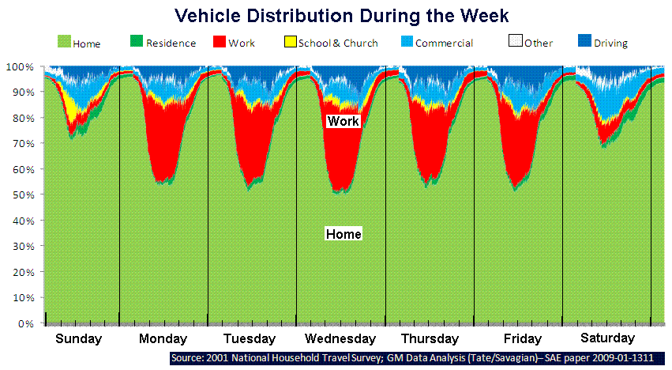
Where are the Cars?
Parked at home and at work
More than 90% of time!
This is GM’s data on CARS!
Bob Bruninga, PE
IEEE Transportation Committee
http://aprs.org/payin-to-plugin.html

Slide 4
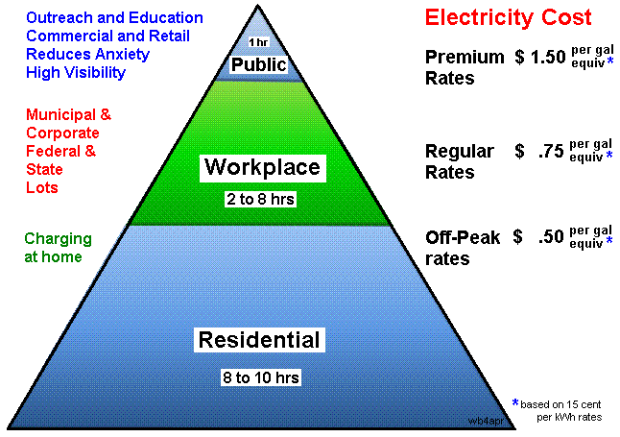
Why not Charge Them There?
3x
Public Charging is like looking for $10 gas!
This is GM’s Slide!
Bob Bruninga, PE
IEEE Transportation Committee
http://aprs.org/payin-to-plugin.html

Slide 5
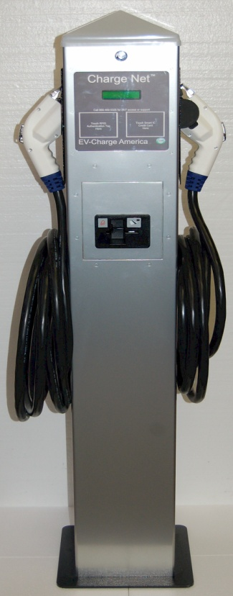

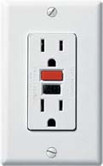
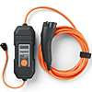
Charging at Home
Level-2
gives 2 hr charge
67% of all Americans live in single family homes
That’s 205 million potential chargers.
Level-1 takes 8 hr charge (overnight and at work)
$300 cord comes with all EVs and Outlets exist
$3000 installed
Bob Bruninga, PE
IEEE Transportation Committee
http://aprs.org/payin-to-plugin.html

Slide 6
Charging at Level-1
Every EV comes with a standard 115v charging cord!
Instead of showing Hours to charge at L1:
Show L1 Miles in 8 Hrs:
Vehicle | Hours
Prius PHEV | 4
Volt | 11
Leaf | 17
Tesla | 36
Vehicle | Miles
Prius PHEV | 15
Volt | 32
Leaf | 32
Tesla | 32
(4 hrs)
Double this L1 range by charging at home and work
Bob Bruninga, PE
IEEE Transportation Committee
http://aprs.org/payin-to-plugin.html

Slide 7
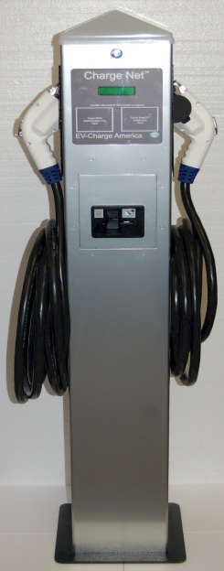
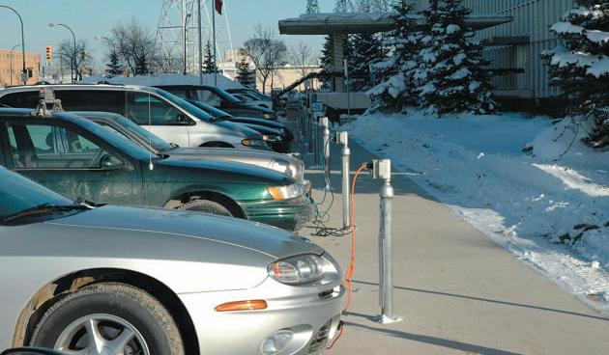
Charging at Work:
L2
Level-2 charges 32 mile trip in 2 hours.
Level-1 charges 32 mile trip in 8 hours.
Level-1 8 hr charge (overnight and at work)
L1
Bob Bruninga, PE
IEEE Transportation Committee
http://aprs.org/payin-to-plugin.html

Slide 8
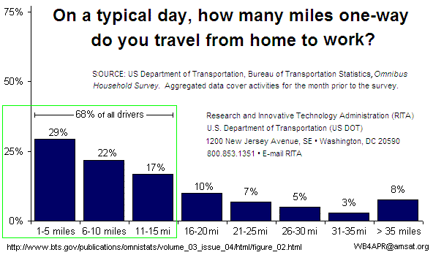
Charging at Work:
Employees cars sit for 8 hours. Why not charge?
75% of all commuters drive to work less than 20 mi
Bob Bruninga, PE
IEEE Transportation Committee
http://aprs.org/payin-to-plugin.html

Slide 9
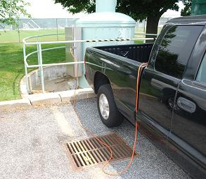
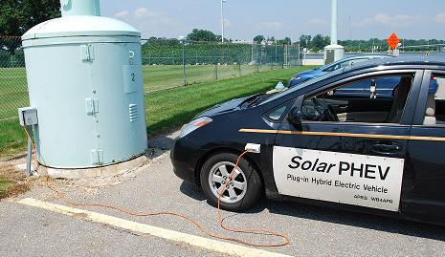
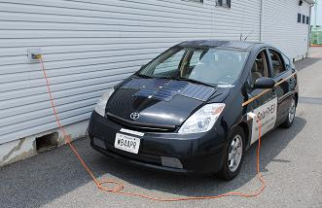
Charging at Work L1 for Early Adopters:
Many outlets already exist
Just give us permission to. . .
Payin-to-Plugin
Bob Bruninga, PE
IEEE Transportation Committee
http://aprs.org/payin-to-plugin.html

Slide 10
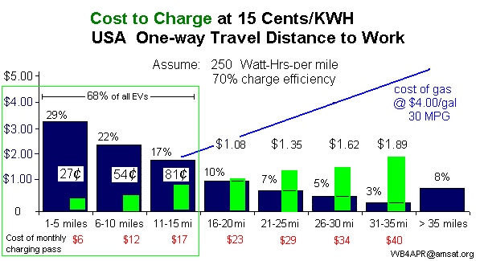
Charging at Work at L1:
Charging for 8 hours:
75% of all commuters (<20 mi) could charge for < $1/day
Bob Bruninga, PE
IEEE Transportation Committee
http://aprs.org/payin-to-plugin.html

Slide 11
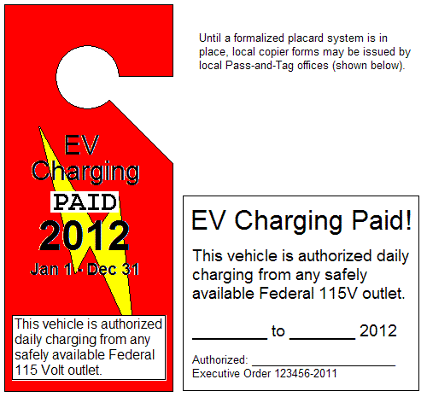
Charging at work L1:
Payin-to-Plugin
Simply let us purchase a monthly Charging Pass for the same cost of 8hr charging per day.
About $12 to $24 per month for 10 to 20 mile commuters.
$12/mo
For 10 mi commute
Bob Bruninga, PE
IEEE Transportation Committee
http://aprs.org/payin-to-plugin.html
Notes:
Title: 40 pt. Arial Bold
Use this slide template for a chart, graph, image, or other visual element.

Slide 12
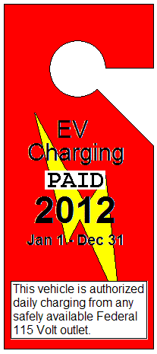
Charging at work L1:
Payin-to-Plugin
Cannot be abused!
115v charging cord & outlet limited to 12 amps
Employees arrive 1-way from full charge at home
Cannot Draw more than $1.50 in 8 hours
Cannot grab-and-run… takes 8 hours!
Beyond full charge, no more power can be drawn
Government, State and Corporate parking controls already exist
As easy to monitor as Handicapped or other illegal parking
Bob Bruninga, PE
IEEE Transportation Committee
http://aprs.org/payin-to-plugin.html
Notes:
Title: 40 pt. Arial Bold
Use this slide template for a chart, graph, image, or other visual element.

Slide 13
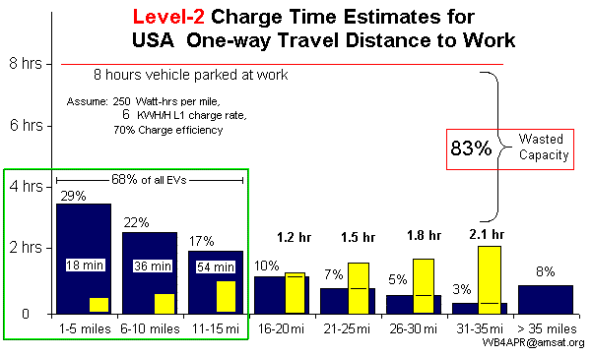
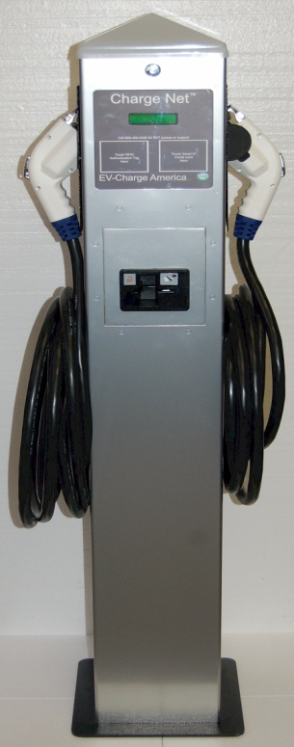
Charging at Work L2:
75% of all commuters (< 20 mi) could charge for < $1
Meaning Level-2 chargers would be idle 83% of the time
Bob Bruninga, PE
IEEE Transportation Committee
http://aprs.org/payin-to-plugin.html

Slide 14
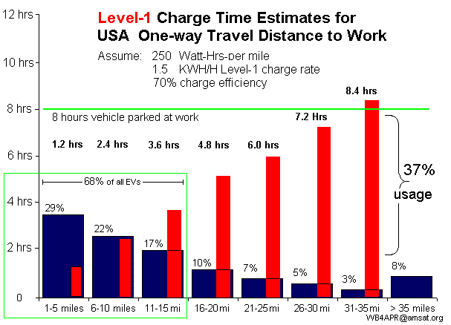
Level-1 can fully charge 92% of all commuters in 8 hours (at home & work)
Bob Bruninga, PE
IEEE Transportation Committee
http://aprs.org/payin-to-plugin.html

Slide 15
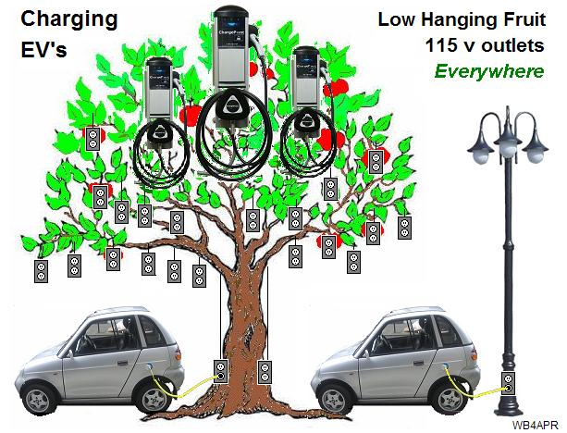
Many 115v outlets (L1) already exist!
This is the low hanging fruit of EV Infrastructure!
Bob Bruninga, PE
IEEE Transportation Committee
http://aprs.org/payin-to-plugin.html

Slide 16
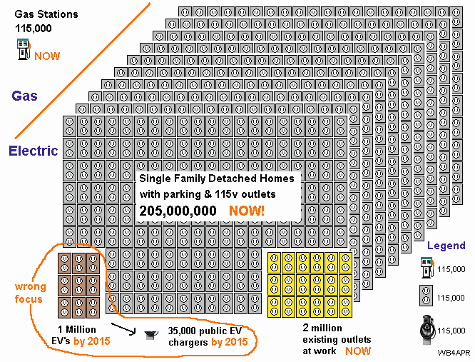
There are millions of 115v Level-1 outlets!
Bob Bruninga, PE
IEEE Transportation Committee
http://aprs.org/payin-to-plugin.html

Slide 17

L1 Charging is good for your Battery
L1 charging should not be overlooked:
Five of the ideas for good battery life benefit by L1 charging:
1.* Avoid full charging when you can.
2.* Avoid deep discharging your battery pack.
4.* Minimize the time spent at a high state of charge.
6.* … plug in whenever you can.
8.* To maximize battery life, minimize use of DC quick charge.
Bob Bruninga, PE
IEEE Transportation Committee
http://aprs.org/payin-to-plugin.html

Slide 18
Charging Infrastructure Issues, concerns, Problems, Obstacles, & Challenges:
Charging Equipment Cost
Installation Cost
New high current wiring Costs
New larger circuit breaker box often required
Metering (Payment System) Costs
Neighborhood Clustering
Neighborhood Utility Transformer upgrade
Grid Loading
Time-of-use and Peak Demands at Peak load
Charging Speed
High rates reduce battery life
Fact or Fiction?
Bob Bruninga, PE
IEEE Transportation Committee
http://aprs.org/payin-to-plugin.html

Slide 19
Charging Infrastructure Issues concerns, Problems, Obstacles, Challenges:
It depends on what you are talking about!
Level 2 = FACTs
High Charging Equipment Cost
High Installation Cost
New high current wiring Costs
New larger circuit breaker box often required
Metering (Payment System) Costs
Neighborhood Clustering issues
Neighborhood Utility Transformer upgrade
Grid Peak Loading issues
Time-of-use and Peak Demands at Peak load
Charging Speed demands peak loads
High rates reduce battery life
Level 1 = No Problem
Few Issues apply!
Free – usually exists
Uses standard wiring
Costs from 50 cents to $1.50 / day
No Utility issues. Same as a coffee pot
Charge overnight at off-peak
Or at work for an hour or so
Best battery life
Bob Bruninga, PE
IEEE Transportation Committee
http://aprs.org/payin-to-plugin.html

Slide 20

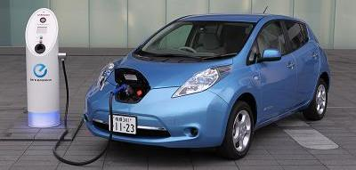
Charging Load at L2:
Level-2 = Half-a-House
Significant Issues apply!
It depends on what you are talking about!
Bob Bruninga, PE
IEEE Transportation Committee
http://aprs.org/payin-to-plugin.html

Slide 21
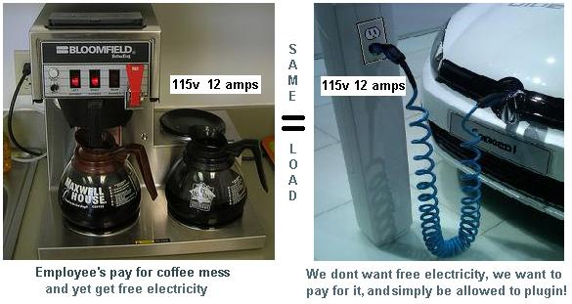
Charging Load at L1:
1 Coffee Pot = Level 1 Few Issues apply!
It depends on what you are talking about!
Bob Bruninga, PE
IEEE Transportation Committee
http://aprs.org/payin-to-plugin.html

Slide 22

Charging Infrastructure Issues concerns, Problems, Obstacles, Challenges:
We must clarify at every level of discussion and Public Policy,
WHAT WE ARE TALKING ABOUT
Level 2 FACTS
Lots of Issues
Level 1 Facts
Few Issues apply!
Bob Bruninga, PE
IEEE Transportation Committee
http://aprs.org/payin-to-plugin.html

Slide 23



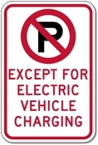
EV Incentives, Help ?
Federal and local tax credits for purchase.
HOV lane and other incentives.
Prime parking spaces.
Incentives for charging stations.
Just being good for You and the Planet
What Else?
Bob Bruninga, PE
IEEE Transportation Committee
http://aprs.org/payin-to-plugin.html

Slide 24
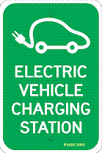
EV incentives at Work !
Can we get Permission to Plugin?
Why can’t we Payin-to-Plugin for Electricity used?
Do we wait for an act of Congress or Legislature?
No. We simply need an executive order!
From the President, Governor, Mayor and/or CEO
Costs Nothing to Implement!
Doubles range of all EV’s instantly
Easier to manage and lower loading
Eliminates most Charging issues
Bob Bruninga, PE
IEEE Transportation Committee
http://aprs.org/payin-to-plugin.html

Slide 25
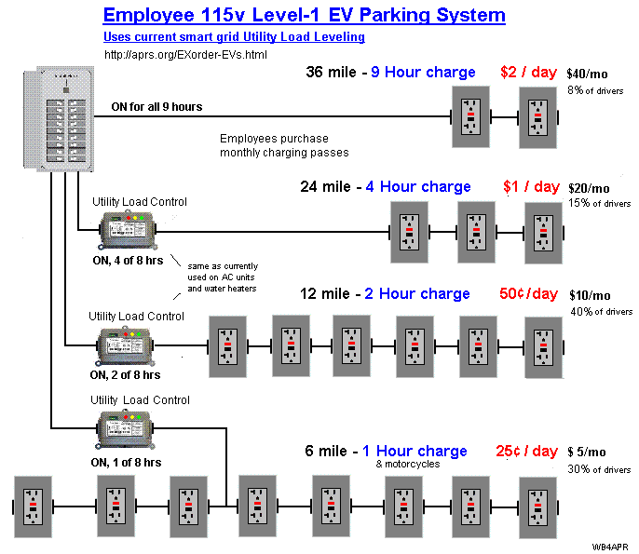
Easy to add L1 charging in Daily Parking lots at a flat rate of $1/day added to Parking Fee!
This includes utility load control to manage peak loads.
Bob Bruninga, PE
IEEE Transportation Committee
http://aprs.org/payin-to-plugin.html

Slide 26
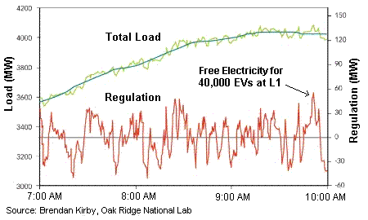
EV Charging - Utility Load Management
EV Charging-at-Work is counter to the utility’s desire for off-peak charging at-night.
But Peak demand is regulated per minute and EV charging can respond instantly to load-control signals from the Utility.
As shown here, the excess capacity of 60 MW over a 10 minute window can charge 40,000 EV’s at level-1.
Utility load control is easier to implement in bulk at Employer installations than at every home and garage. (Some employers with peak-load billing problems can implement their own employee EV controls to minimize their dynamic peaks.)
But unless we talk about L1 charging, nothing is going to happen!
Bob Bruninga, PE
IEEE Transportation Committee
http://aprs.org/payin-to-plugin.html

Slide 27
Need More info?
http://aprs.org/payin-to-plugin.html
Get a Gold Star for your Boss
Enacting Payin-to-Plugin is a WIN-WIN for him
If you have success where you work,
let us know!
Others will follow!
Bob Bruninga, PE
IEEE Transportation Committee
http://aprs.org/payin-to-plugin.html

Slide 28
Backups and other info
Carbon and Emissions Issues
Cost of vehicles
Maryland Commute statistics

Slide 29
Where does EV Electricity come from?
The truth is:
Most EV’ers buy an EV for the environmental benefits and to reduce fossil fuel dependency.
So, many, (1/3rd) install Solar or Wind, or sign up for Clean Currents or other zero fossil fuel electricity source.
RESULT Today for EVs:
43.5% | Coal
22.2% | Natural Gas
19.1% | Nuclear
8.9% | Hydroelectric
5.4% | Solar,Wind,Geo
0.7% | Petroleum
37 % | Solar,Wind,Geo
16 % | Natural Gas
8 % | Nuclear
7 % | Hydroelectric
31 % | Coal
0.5% | Petroleum
And it will only get better!
Bob Bruninga, PE
IEEE Transportation Committee
http://aprs.org/payin-to-plugin.html

Slide 30
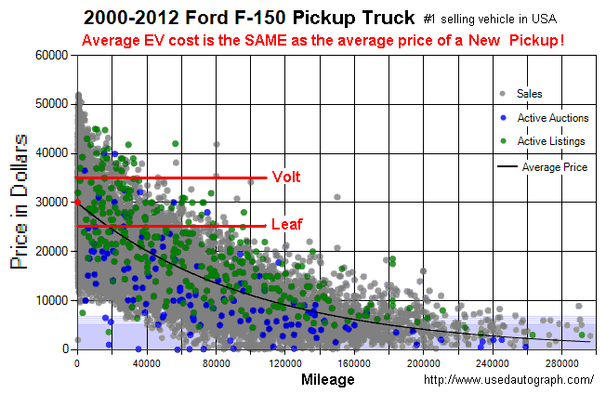
EV’s Cost Too Much!....?
Imagine if Lincolns, Cadilacs and Lexus were included!

Slide 31
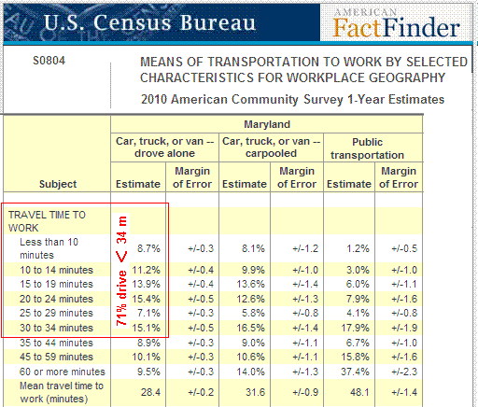
Nationally, 68% drive less than 15 miles to work

