Slide 1

Field Day Power
Ham Radio depends on Emergency Power!
It’s a whole new world of Power

Slide 2
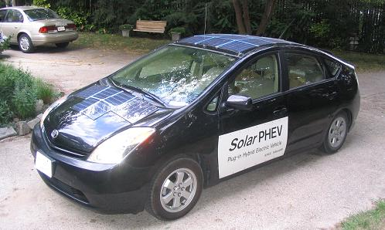
Prius / Power / Energy / Solar
Bob Bruninga
12 March 2010
www.aprs.org/APRS-SPHEV.html

Slide 3
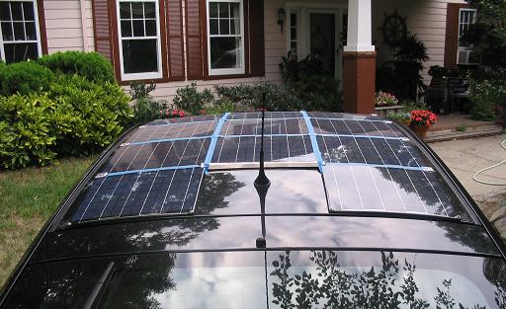
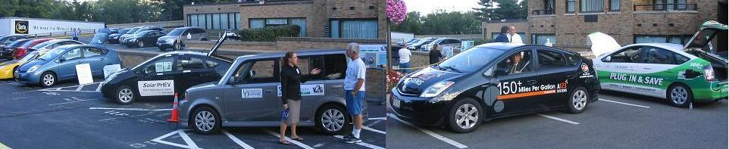
My Car
2004 Prius
w $4000 of door/frame damage
200 W added Solar Panels
100 LBs of added Batteries
On display at the IEEE PHEV Symposium in Wash DC 2007.

Slide 4

Getting Good Gas Mileage
42 HP
The best way. Just drive
smaller cars!... Cheap!

Slide 5

Getting Good Gas Mileage?
10-16 MPG
USA Demand…
Or is it Detroit Marketing?

Slide 6
Why Fuel Efficiency?
Who was key-note speaker to Electric Vehicle Association?
  Ex-head of CIA
Why is government interested in Fuel Economy?
  $200,000,000 per day for Middle East Oil
  How many Terrorists does that support?
  Gas costs us $400/gallon in Afghanastan!
We *must* cut our dependence on Foreign Oil!
  Iraq, Iran, etc
  Venezuella, Russia

Slide 7
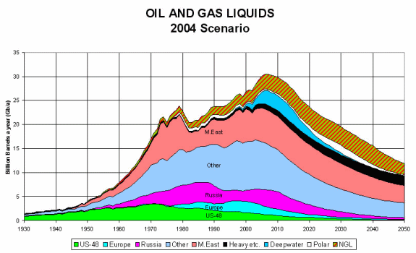
Why Getting off Gas?
“Peak Oil”

Slide 8
What can we do about it?
Last century millions were killed for Salt
  Salt was a global commodity
  War-Lords controlled Salt Empires
What ended their reign?
  Refrigerators!
Simple Technology can change Global Empires
Eliminating our addiction to Foreign Oil is how.
Electric Vehicles/ Solar can do it!

Slide 9
Electric Vs Gas
70% of our gas comes from overseas (bad!)
99% of our electricity comes from USA! (good!)
At night we can charge 150,000,000 electric cars for only 7% of the total USA energy grid.
At night, electricity is cheaper (50% or less) and more plentiful
During Day Peak demand, electricity costs 10 times more
But those same 150,000,000 car batteries contain more peak power than FIVE TIMES the entire USA power generating capacity!
V2G (Vehicle-to-Grid) could offset $2000 per car in energy savings by letting the power companies buy some back during brief peak demands but still charge your car!

Slide 10
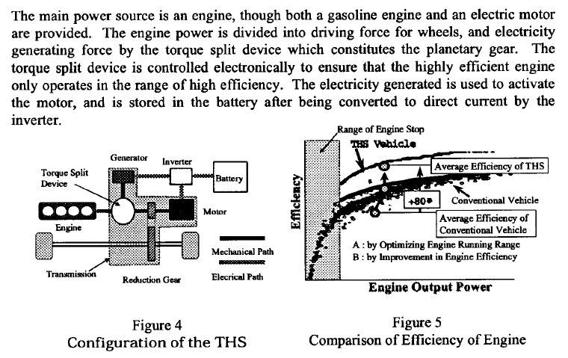
Hybrid Efficiency VS Gas

Slide 11
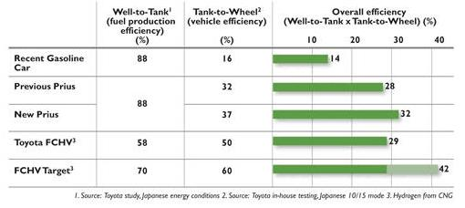
Well-to-Wheel Efficiency

Slide 12
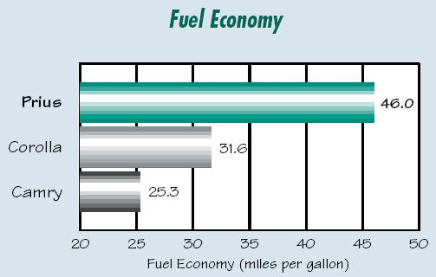
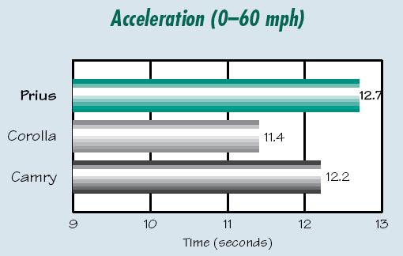
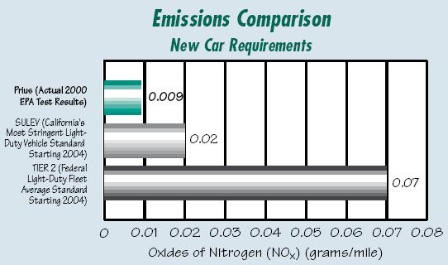
Prius Comparisons

Slide 13
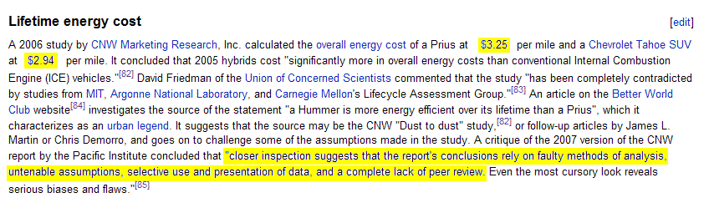
Don’t Believe Nay-Sayers or other rabid deniers and miss-information from entrenched status-quo

Slide 14
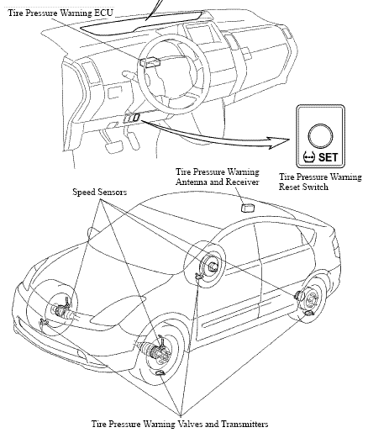
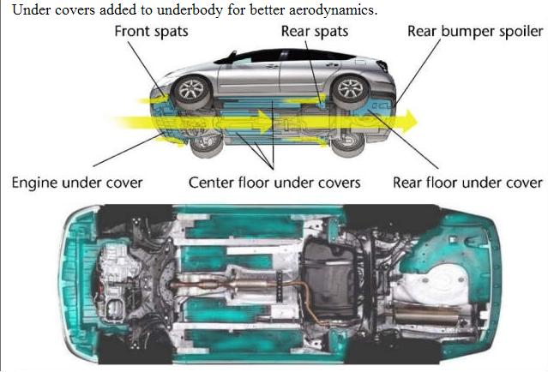
Everything Counts
Good Tire Pressure
Air Flow underneath

Slide 15
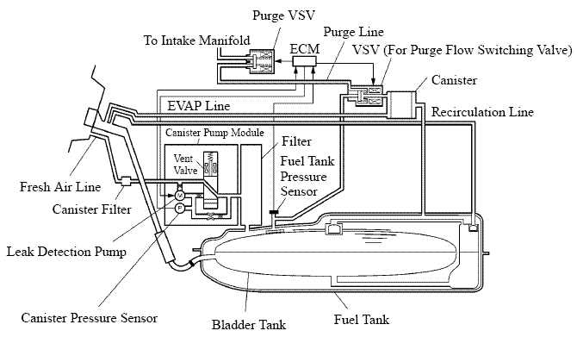
Low Emissions (Tank)

Slide 16
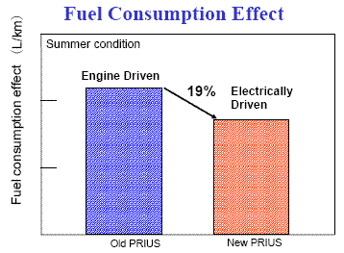
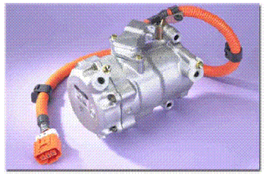
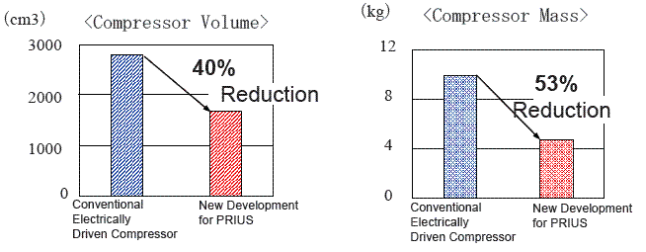
Saving Energy
(in the air-conditioner)

Slide 17
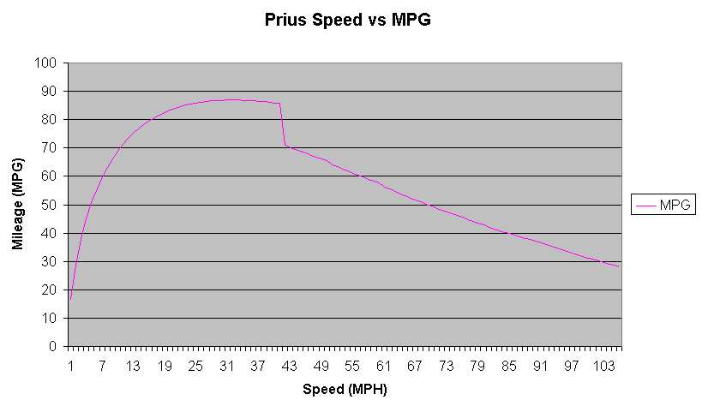
Impact of Speed on Air Drag
Gas Engine Cars:
  The main energy waste in town driving is stopping.
  Low power demands is where gas engine is most inefficient
  Hence better MPG on the open road.
Hybrid:
  Regenerative Braking saves most stopping energy for re-use.
  Electric motors for optimum power at low speeds and power
  Better mileage in town where AIR resistance is lowest.
Electric limit

Slide 18
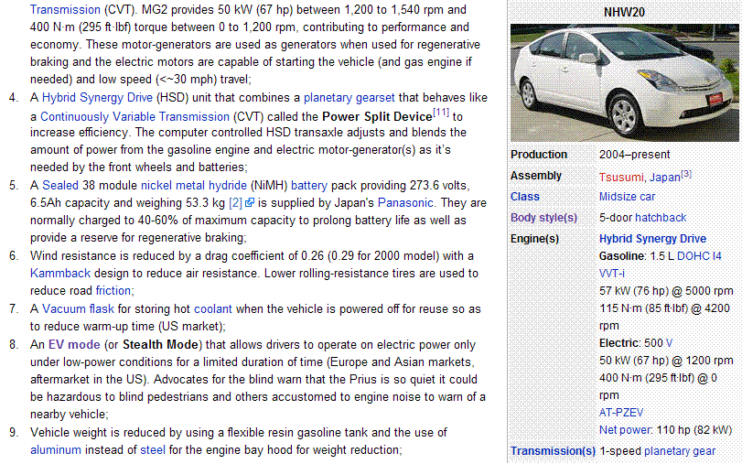

Slide 19
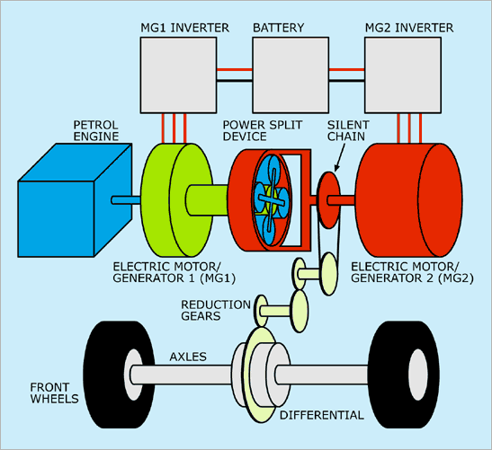
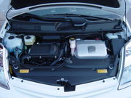
The Hybrid Synergy Drive
76 Hp ICE
50 kW MG1
50 kW MG2
Planetary Gear System
50 kW Battery

Slide 20
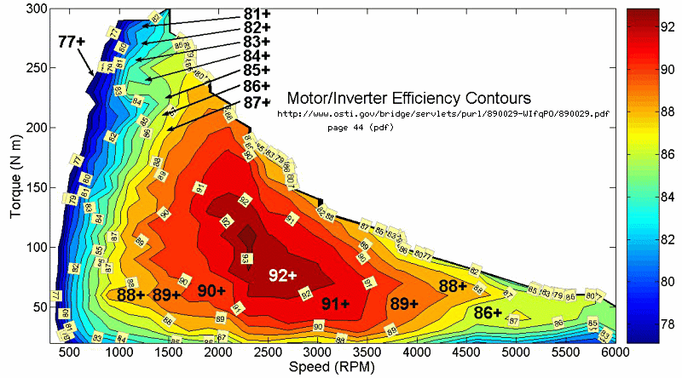
Atkinson Cycle Engine

Slide 21
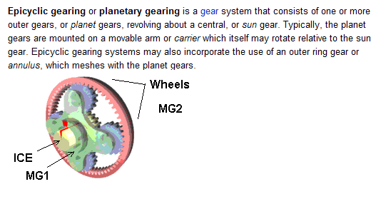
Planetary Gear System
Three shafts
Power sharing/balancing
Any input, any output

Slide 22
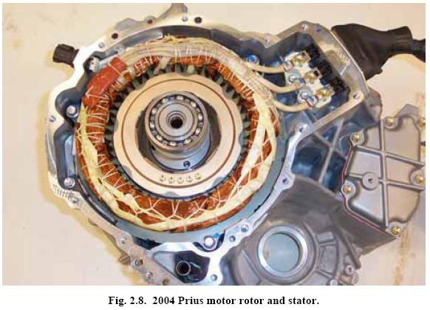
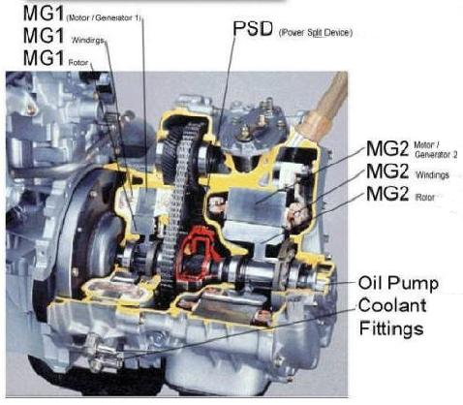
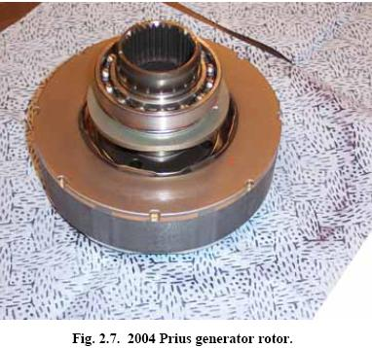
Motor/Generator

Slide 23
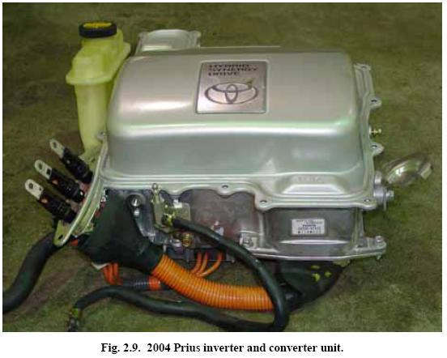
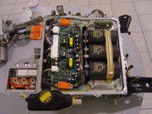
The 50 kW
Inverter
220 VDC to 500 VDC
220 VDC to 12 VDC at 100 amps
220 VDC to any motor voltage as needed
Water cooled

Slide 24
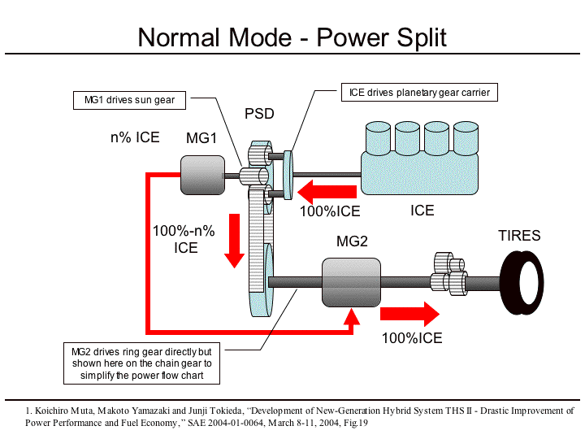
(low gear)

Slide 25
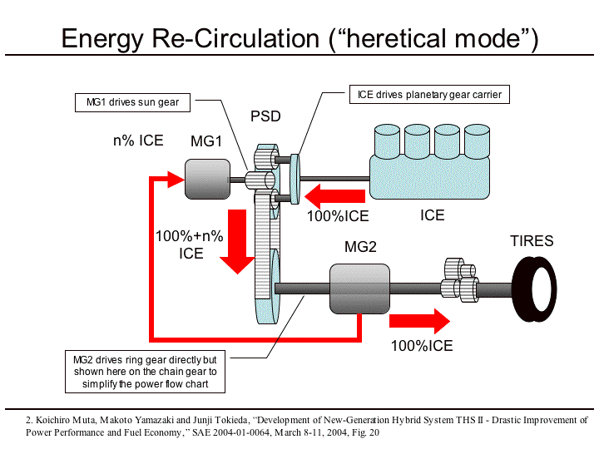
(High Gear)

Slide 26
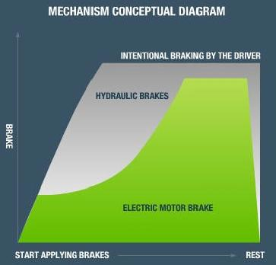
Regenerative Braking
65% of all Prius Electric Power comes from Braking
Typically 35 amps at 250 volts
That’s almost 9,000 Watts
But NO brakes is even better!

Slide 27
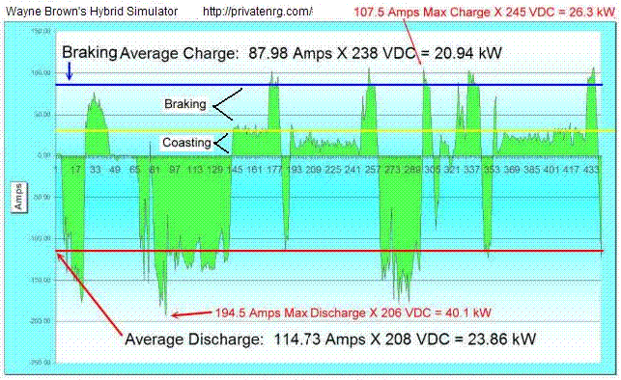
Regenerative Braking

Slide 28
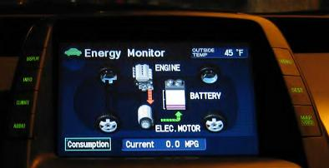
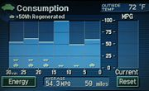
Displays
In 30 min commute,
Engine runs only 11 mins
Energy Flow
Consumption
Avoid Turtles!

Slide 29

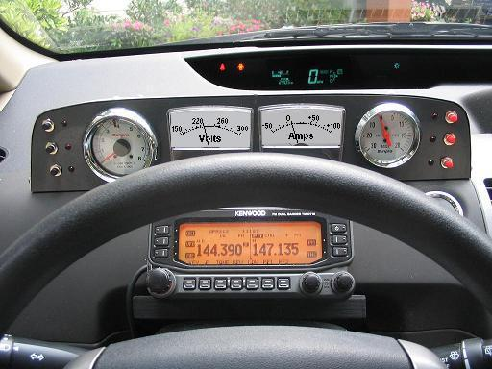
Instrument Panel (not)!
No Tach
No Vacuum
No temperature
No volts
No current
No power
My add-on solution –
an Analog panel

Slide 30
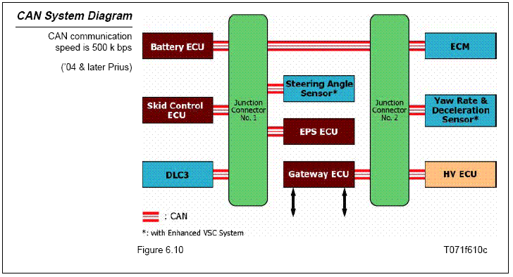
Computers and CAN Bus

Slide 31
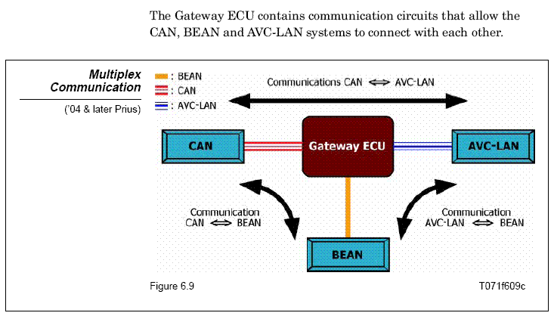
Computers and CAN Bus

Slide 32
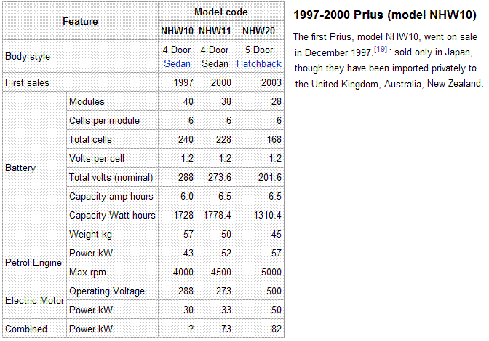
Battery Specs

Slide 33
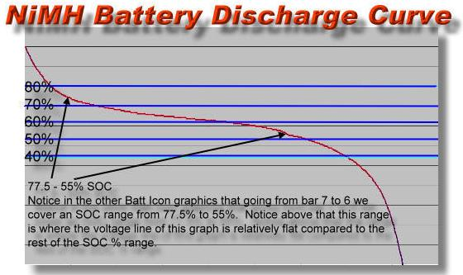
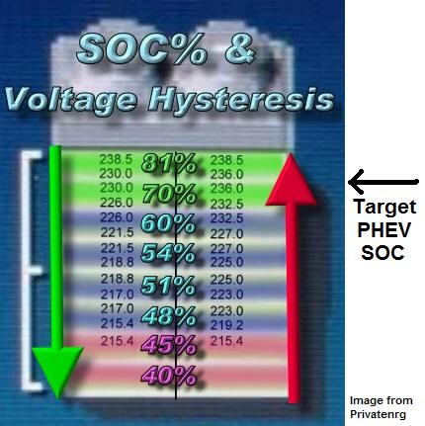
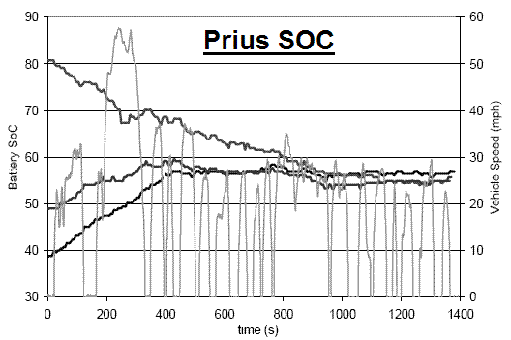
Protecting the Battery
Prius likes to keep the battery at 58% charge

Slide 34
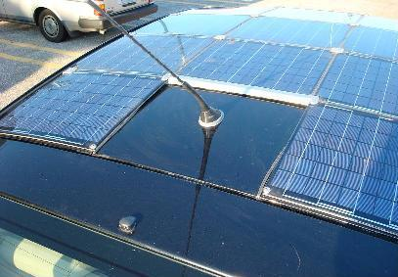
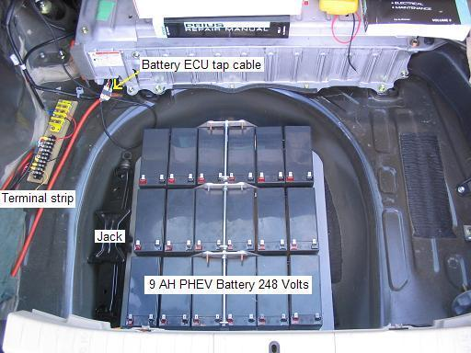
Solar PHEV & Battery
200 Watts of Solar Panels
200 W-hrs per hour in Sun
$2400 cost.
200 W-hrs per mile needed
Solar power while parked all day, gives half my electric need.
My PHEV battery only needs to be half as big for the same EV range.
Eighteen 12V batteries
9 Amp-Hours each
225 Volts
2025 Watt-Hours
Solar - 4 Hrs per day. 4 Miles EV per trip. 40 mile commute = 10% improvement
PHEV - 8 Hrs at night. 4 Miles EV per trip. 40 mile commute = 10% improvement

Slide 35
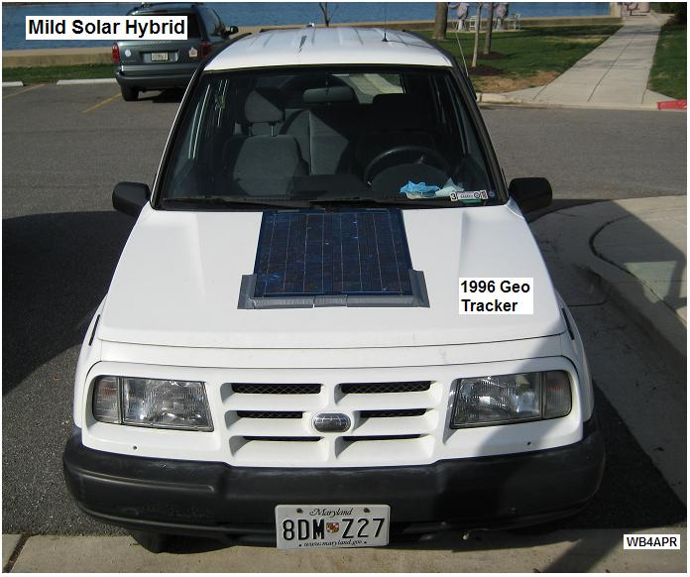
Any Car can Benefit from Electric
Geo Tracker
Gains 15% from 26
to 33 MPG
Disconnect Fan belt (fan, alternator and water pump)

Slide 36

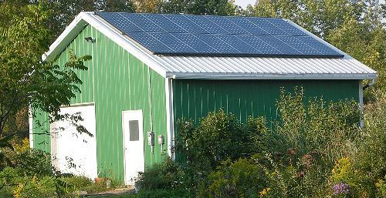

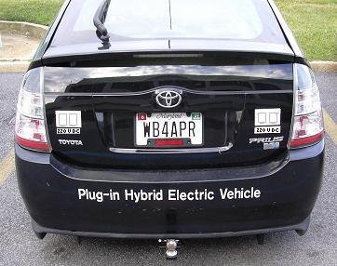
Home Power Generation
Home Solar 4 kW
Gas 4 kW
Wind 5 Kw
Prius 50 kW peak (10 kW average)

Slide 37
I was so wrong!
I’ve been interested in solar power all my life
But never had a real need other than just-for-fun
No way was it cost effective
Unless you had no other access to power…

Slide 38
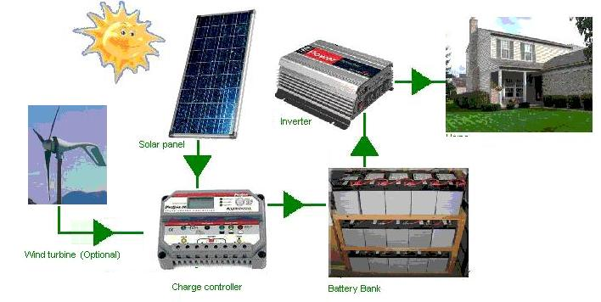
I was so wrong!
My concept of solar power was this:
Battery Storage (off Grid)

Slide 39
I was so wrong!
The problem is the Batteries!
My first energy system (1990) was Time-of-Use Metering
  2 cent electricity at night
  10 cent electricity during the day!
  Why not charge batteries at night
  Run from batteries during the day
  Result: Breakeven – due to battery replacement every 5 yrs
Compared to 2 CENTS at night, solar never breakeven!
  (if batteries lasted 5 years.. Not likely)
Conclusion…
  Since solar power is NOT free,
  seemed impossible to ever break even
  (due to battery replacement cost)

Slide 40
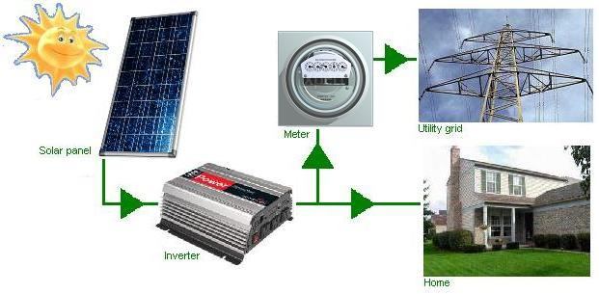
It’s a Whole New World!
Get rid of the Batteries!
Grid-Tie
Look AGAIN at the new economics!

Slide 41
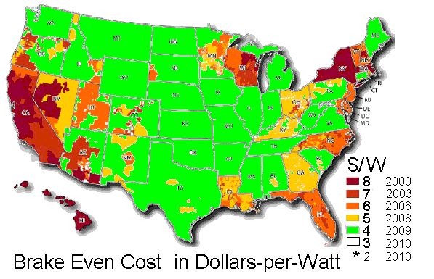
It’s a Whole New World!
Grid-Tie
Cost effective in EVERY state now!

Slide 42
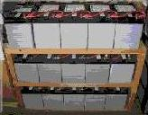


Grid-Tie Economics!
The problem is the Batteries
  (Only 70% EFFICIENT)!
  Grid-tie IS 95% EFFICIENT! Improvement (factor of 1.35)
  No battery replacement costs $1000 per year (factor of 2)
Economics in 2010 compared to 2007
  Electricity cost has doubled! Factor of 2.0
  Solar panels cost has halved! Factor of 2.0
Therefore It’s 11 times better NOW to go Solar
But Wait, there’s more!
  Government Incentives!
Grid-tie
inverter

Slide 43

Government Incentives!
Federal gives 30% tax credit. No limit
  As much as $15,000 right into your pocket
  Factor of 1.43!
State of Maryland Grant
  For my 8kW system that’s a $7000 check in my pocket
  $1.25 / W for first 2 kw, $.075 / W for next 6 kW
  Factor of 1.3
AA County Real Estate Tax credit
  up to 50% of total remaining after above (Maybe $3000)
  Factor of 1.13
Total Gov’t Incentive Factors = 2.0

Slide 44
Total Cost Factors!
Grid-Tie versus no Batteries
  Better by Factor of 2.7!
Economics of Electricity and Solar
  X 2 (for higher rates) X 2 (for lower costs) = Factor of 4
Tax credits and incentives
  Factor of 2
CONCLUSION: It makes 22 times more sense to go solar now than it did 3 years ago (if you think in terms of Battery Storage systems (typical for hams) like I did).

Slide 45
But there’s more!
(Return on Investment)
Solar Energy Credits (sell your Green energy credits)
  About $250 /year /KW 10% return/yr
Electric Bill
  Free Electricity for life 10% return /yr
  Cost of 0-net-grid-tie - 5% cost /yr
  (you still have to pay about $10 fixed costs even if you use no electricity)
Maintenance
  Practically zero
  Total Return on Investment… about 12% per year
  Compare that to the banks (2% ?) or stock market (- 30% ?!)
  PLUS: your 12% only goes up as energy costs go up!

Slide 46
But there’s more!
(Do it yourself!)
Commercial system: $25,000 for a 4kW system?
Cost of solar panels $12,600 (18 at $700 vs $1000)
Cost of inverter $2100 versus $3000
Cost of wire, disconnects, breakers, etc $200
Cost of Master Electrician to certify system $200
TOTAL about $15,000
Savings (DIY) $10,000
Tax credits, Grants, SREC’s etc $ 7,500
NET COST TO YOU… $ 7,500
Pays for itself in 4 years. Then FREE POWER for LIFE!

Slide 47
But I’m a ham!
I want Battery Backup…!
Why?....
At what cost? $12,000?
For the 2 hours every 2 years you lose power?
For the 2 days you lose once every 10 years?
Makes practically zero economic sense!
You pay about $240 / KWH over 10 years (compared to $0.12)
(2000 times more!)

Slide 48
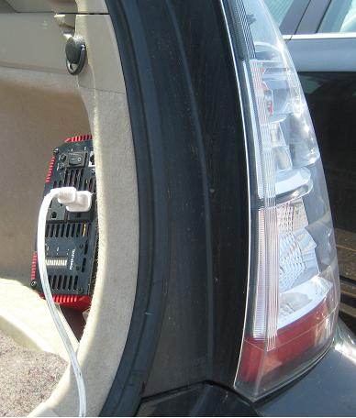
But I’m a ham!
I want Battery Backup…!
You can have it!
EASY AND CHEAP!
$ 120
Spend $120 for a 1200 Watt Inverter
Hook to your car battery
Power Refrigerator and lights in your house for days!
You do use CFL bulbs, right?

Slide 49

But I’m a ham!
You do use CFL bulbs, right?
25% of the power!
10 times the life
+ Air Conditioning savings of 5%!
= 5:1 savings!
EER of 1-to-1
is 3.412 BTU/ watt. So with EER of 10, 100W bulb takes 30W of AC!
Down to $1 each

Slide 50

Use of Piers for Solar/Wind prohibited

Slide 51

Use of Piers for Solar/Wind prohibited
Rejected by MDE due to Pier Laws

Slide 52

Solar Pier Argument
My house uses
10 MWHrs / yr
Coal Plant (for me)
produces:
  22,000 Lbs CO2
  350 lbs sulfur dioxide
  1 Oz Uranium and Thorium
  .02g of Mercury
With 10 KW Array, pollutes Zero.

Slide 53


2.8 kW Solar Boat Work-around
Approved by DNR as Boat under 26’

Slide 54

Efficiency must > 80%
To get Gov’t Credits
Free Home Estimate includes sky survey

Slide 55




Efficiency using PVwatts
Grid-Tie implies surprising results!
100% South
94% SE
96% SW
85% FLAT!
120%
125%
(battery system 65% worse and must be South)

Slide 56


Portable Power Generation
350 W aux power
1200W AC inverter
$120
Invert to 115 VAC
For distribution
95% efficiency
Saves 100:1 in wire losses

Slide 57


Modern Power Distribution
Power
Systems
have
CHANGED!
9 amp
8 amp
18 amp
Switching supply takes up 8% of the space
and only 10% of the mass and works 100-240 VAC
AND 150-330 VDC

Slide 58

Power Distribution 330 VDC
Nearly ALL modern switching supplies will run on VDC
Double to 230 VAC at source
Rectify to 330 VDC for delivery
Eliminate 75% of
Distribution losses

Slide 59


Power Distribution 330 VDC
Nearly ALL modern switching supplies will run on VDC
Kenwood 115 VAC only supply
Actually has internal jumper
Eliminate 75% of
Distribution losses

Slide 60

Power Distribution ?
Problem: 6 Hr ops from Hill top 3200’ from car

Slide 61

Power Distribution SWER
Single
Wire
Earth
Return
Not
approved
by NEC
Double to 230 VAC at source
Rectify to 330 VDC for delivery

Slide 62

Power Distribution SWER
Single
Wire
Earth
Return
Not
approved
by NEC
2 Laptops, 50W dual band, 2 HT’s and APRS – 6 Hours

Slide 63

Golden Packet Event
26 July
2010
14 Hops
Alabama to Maine!
2 Laptops, 50W dual band, 2 HT’s and APRS – 6 Hours

Slide 64


Golden Packet Event
26 July 2010
14 Hops
Alabama to Maine!
Visit with Google Earth and Path tool

Slide 65

Power Distribution SWER
Emergency Power: Use Single Wire Earth Return
Double to 230 VAC at source
Rectify to 330 VDC for delivery
Not approved by NEC

Slide 66

Power Distribution SWER
Emergency Power: Use Single Wire Earth Return
3200’ system fits in laptop bag
Not approved by NEC

Slide 67


Power Distribution SWER
Emergency Power: Use Single Wire Earth Return
Not approved by NEC

Slide 68


Power Distribution SWER
Emergency Power: Use Single Wire Earth Return
Not approved by NEC

Slide 69


Home Power Generation
50 kW peak (10 kW average)
Safe, cheap connectors
(Modified to prevent incorrect use.)
Greater distances
At half the current
At twice the power
#18 zip cord can carry 1000 watts easily

Slide 70

Salvage Prius Toys
2004 in 2007
Cost $10k
29k Miles
P1
$2000 of solar panels
Prius Inn

Slide 71



Other Salvage Prius Toys
2005 in 2008
$7k, 19k miles
P2
2005 in 2010
$6k, 90k miles
P2
Prius Hotel
P3

