Slide 1
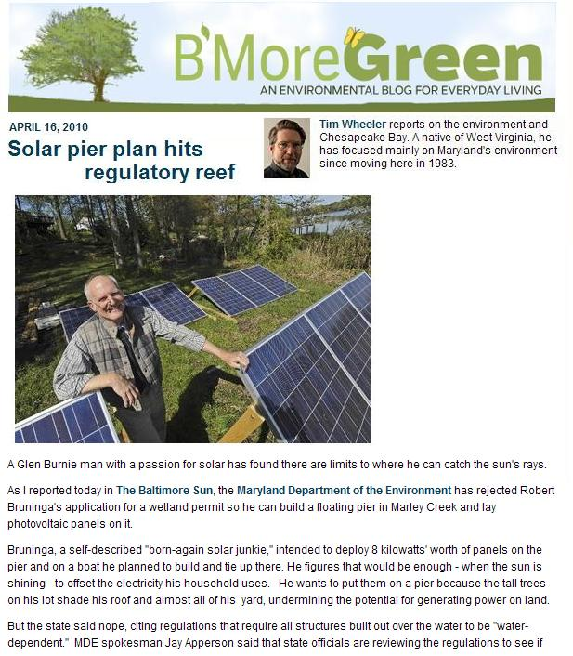
Why
We’re
Here?
Bob Bruninga, PE
19 Jan 2012
www.aprs.org/alternative-energy.html

Slide 2
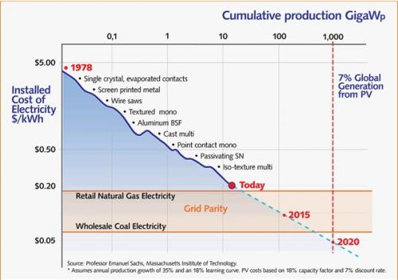
Solar is HERE!
Cheaper than BG&E!
2010

Slide 3
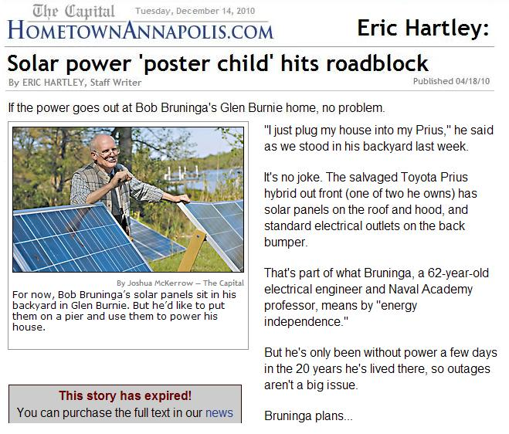
Why
We’re
Here?
www.aprs.org/alternative-energy.html

Slide 4
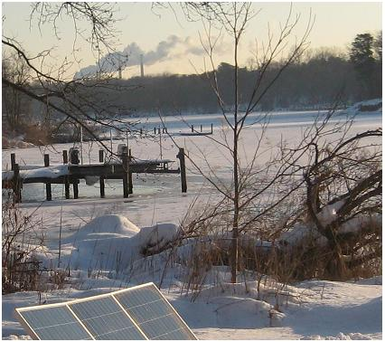
My Coal Burning View of the Bay
www.aprs.org/alternative-energy.html

Slide 5
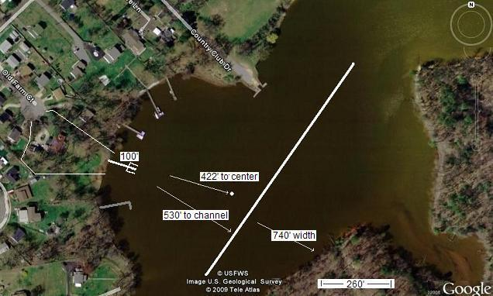
My Pier on Marley Creek is the only sunny place I own

Slide 6
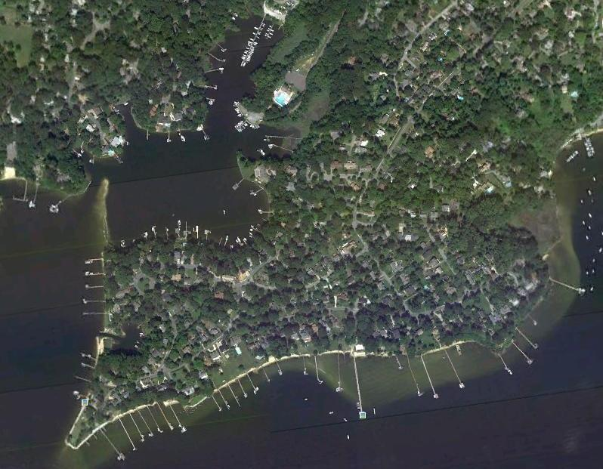
100,000 piers in Maryland = 500 Megawatts

Slide 7
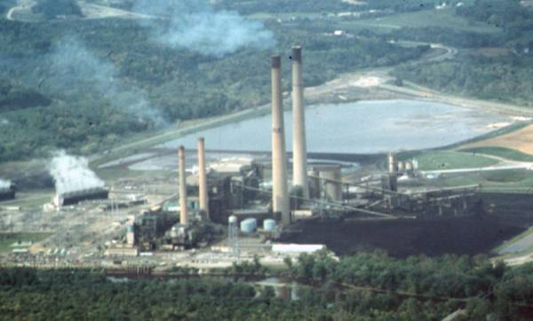
A. H. Wagner Coal Plant = 500 Megawatts
100,000 piers in Maryland = 500 Megawatts

Slide 8
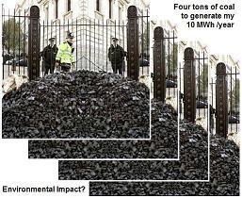
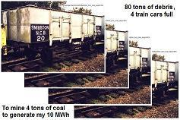
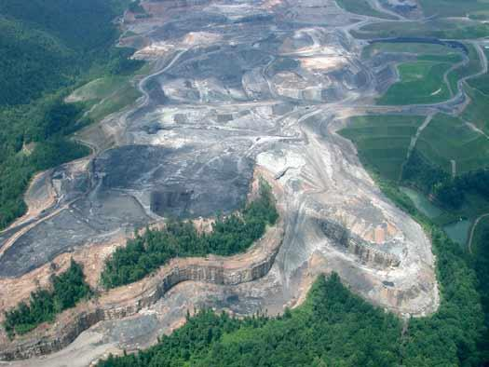
1 House, 1 Year
4 Tons of Coal
Yes, we have 100 years of coal, but there won’t be anything left!

Slide 9
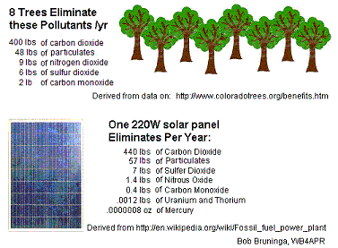
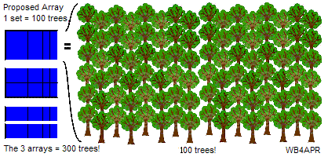
One Solar Pier = 200 Mature Trees
= 2 Acres of Forest!
One Solar Panel
Eliminates as much Coal Pollutants as do 8 Mature Trees

Slide 10
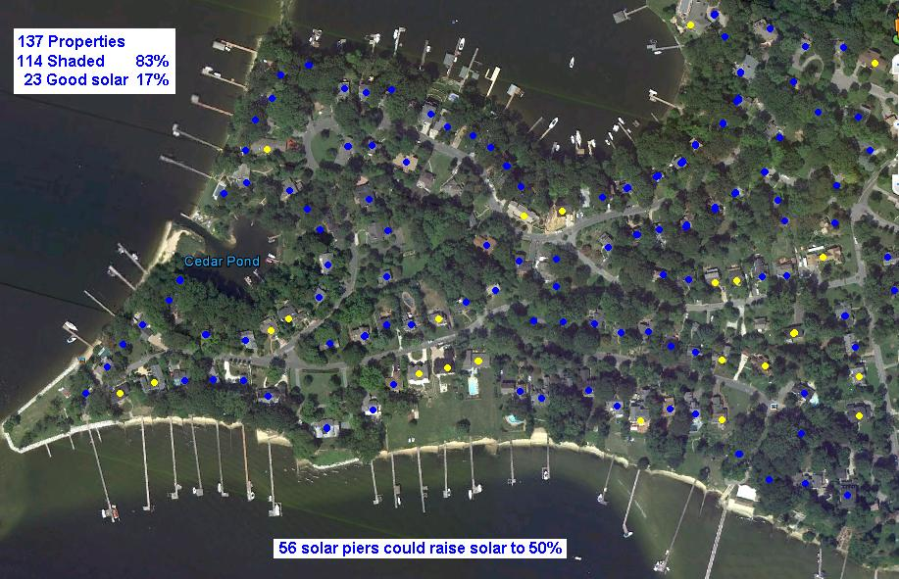
Most homes have too much shade for solar. But Piers are always Sunny!

Slide 11
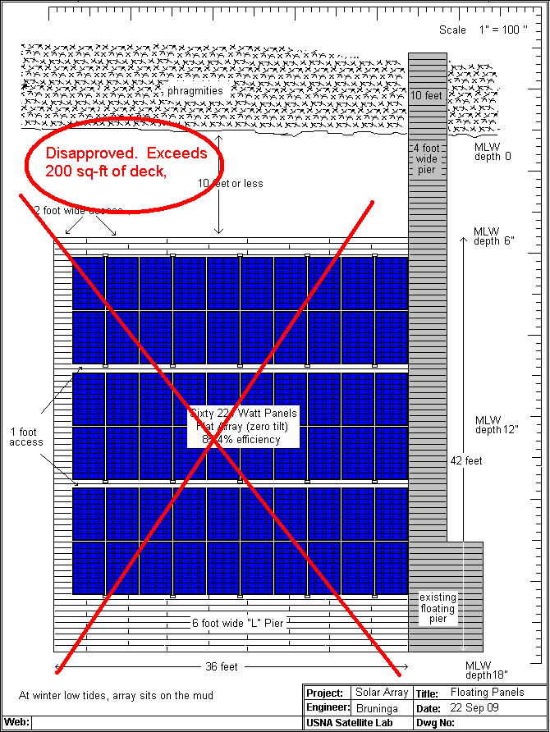

Plan A
MDE

Slide 12
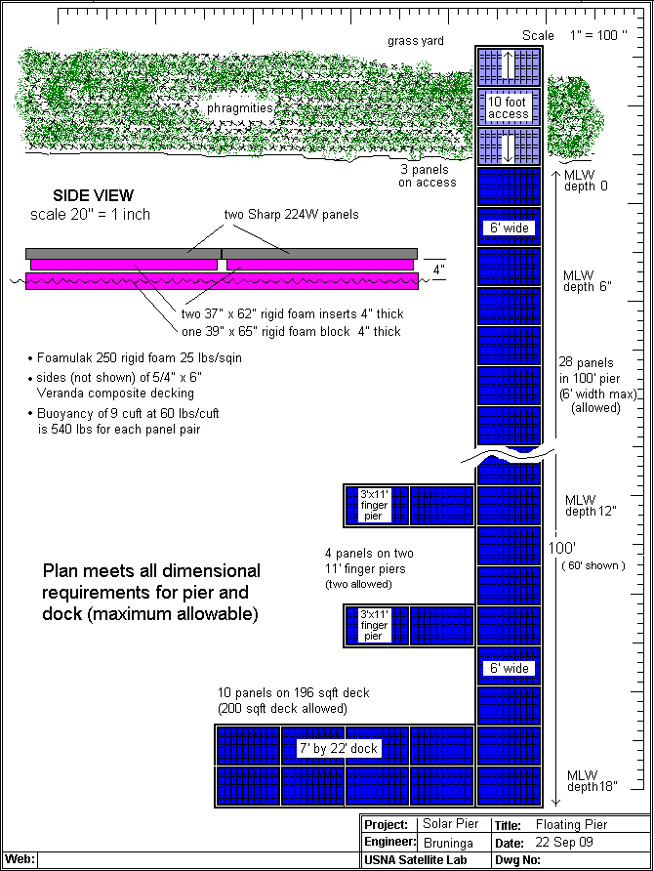
Plan B
MDE

Slide 13
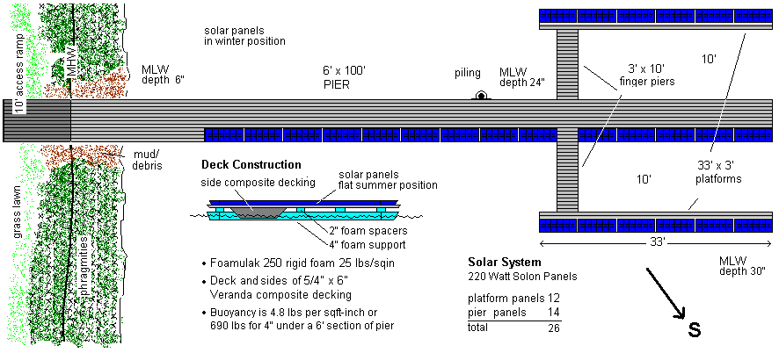
After $2000 Applications and Fees
This standard pier APPROVED by MDE but only WITHOUT the solar panels
MDE

Slide 14
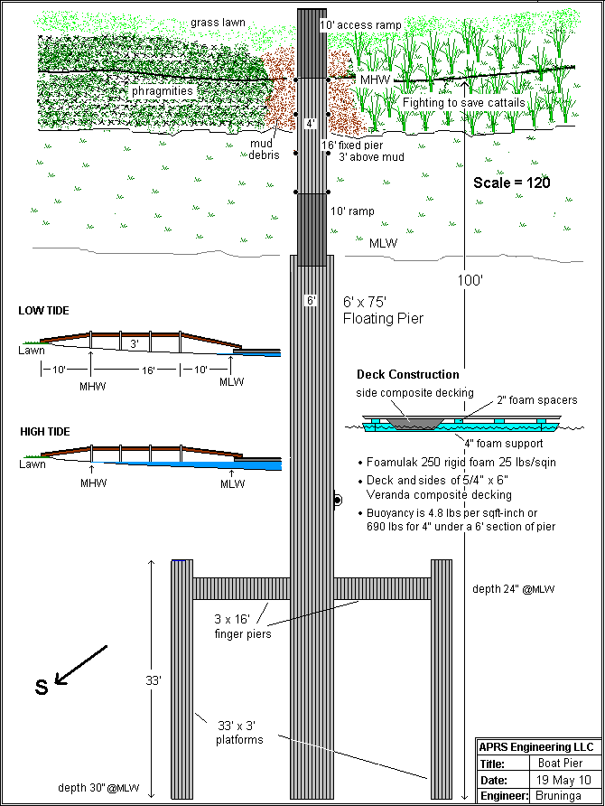
After $2000 Applications, Plan E
Approved!
(no panels)

Slide 15
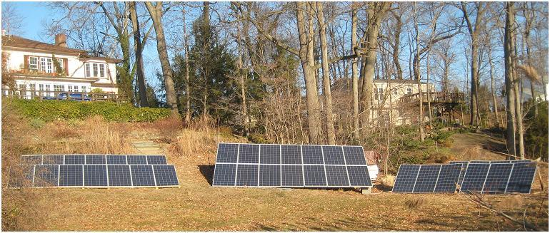
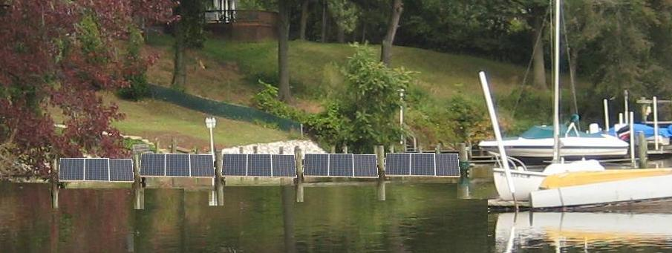
MDE recommended an Upland Alternative
Pier Preferred:

Slide 16
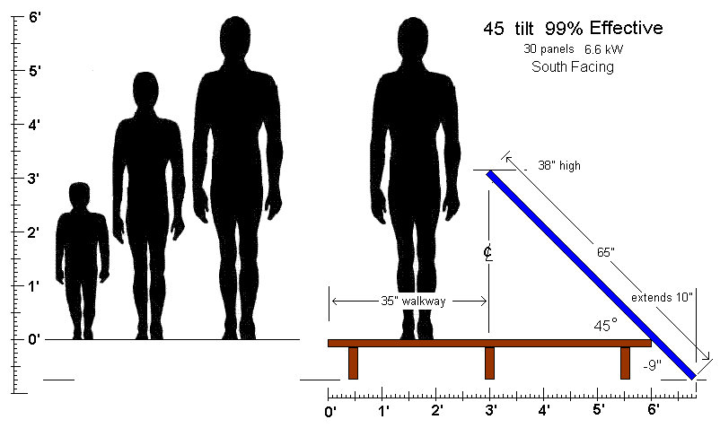
The Ideal Pier Array (at our latitude)

Slide 17
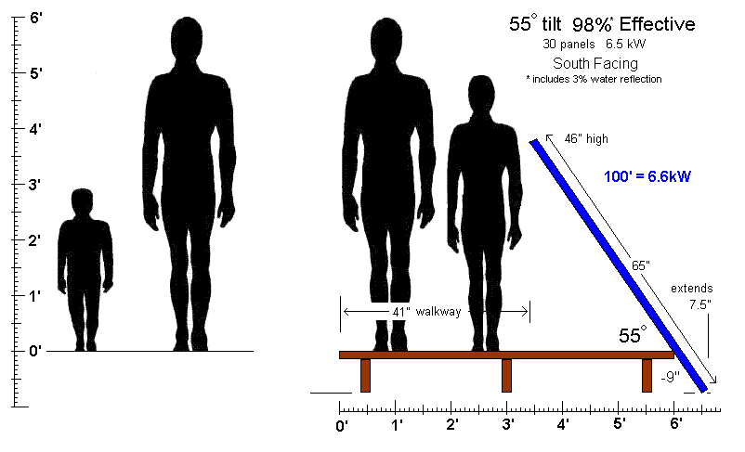
Pier Optimized for walking

Slide 18
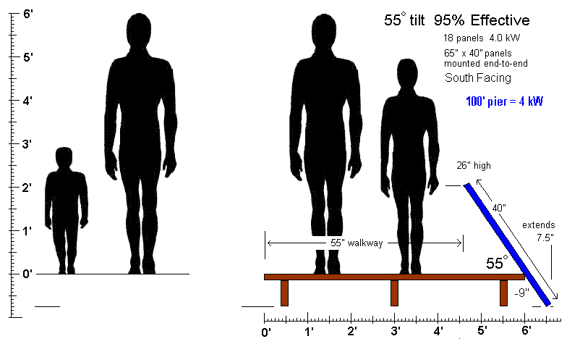
Lower Profile – 2/3rds Power

Slide 19
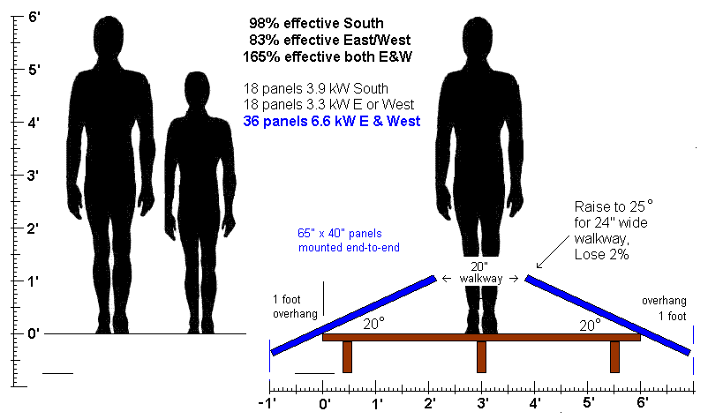
Optimum East/West Arrays

Slide 20

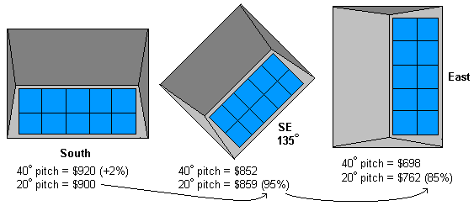
Angles - less important with Grid-Tie
Amazing, even due East, you still get 85% effectiveness!

Slide 21
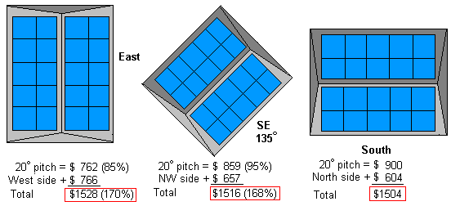
Angles - less important with Grid-Tie
Amazing! Increase power by 60% to 100% on other side!

Slide 22
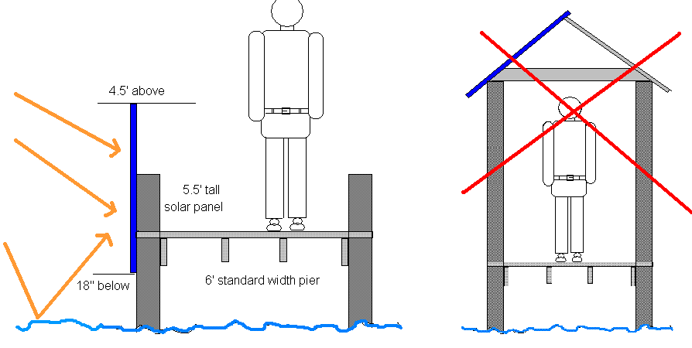
Options
Even vertical mount is possible:
64% Efficient
+ 5% Reflection
~70%
Not Wanted

Slide 23
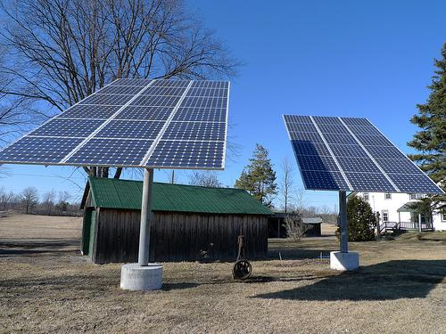
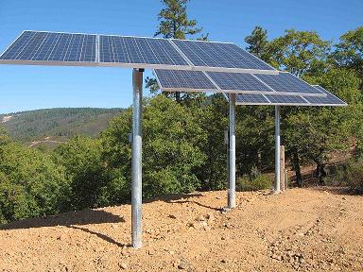
Pole Mounts
⬅ To maximize area, pole mounts are often large square arrays (too bulky for waterfront aesthetics).
However, single-row ➔
pole-mounts could be a means of supporting a long linear array, along a pier, though disjoint arrangements would be un-attractive, maybe and add significant costs.

Slide 24
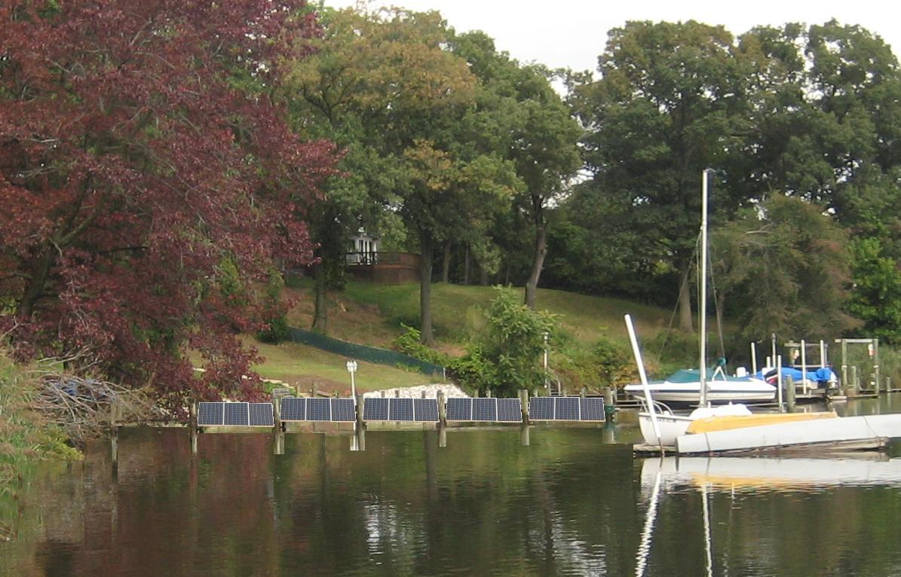
What we Want
Low panels along the edge of the pier – Discussion?

Slide 25
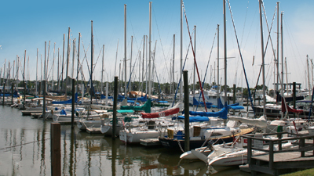
Wind Noise Levels?
Wind generators should be allowed at least up to the noise level of sailboats klanking away all night long! Sailboat noise level is well established.

