Slide 1
Universal Ham Radio Contact via Callsign
Presenters:
Bob Bruninga, WB4APR
Mark Braunstein WA4KFZ – Dstar ? Astar?
John Gorkos, AB0OO - Atlanta Progress on AVRS
Ken Heitner , ALE (Automatic Link Establishment on HF)
Anyone else?

Slide 2
Universal Ham Radio Contact via Callsign
GOAL:
Any device, Anytime, Anywhere
Universal contact with any other ham
. . . BY CALLSIGN ALONE

Slide 3
Universal Ham Radio Contact via Callsign
Comments from:
PU7ISS ADALBERTO - AVRS
Steve Dimse, K4HG – Iphone
Pete Loveall, AE5PL – APRS-IS
Jonathan Taylor, K1RFD – EchoLink
Thomas Osterried, DL9SAU? - Global Messaging Initiative
Curt Bartholomew,? - Catastrophic Communications
Lor Kutchins, W3QA - Winlink Development Team
Hardware:
Rich Painter - uSmartDigi
Georg Lukas, D01GL – APRSdroid
Antony Chazapis, SW1OAN - PocketPacket for Mac
Jason Rausch, ke4nyv - The YAG Tracker By Remi VE2YAG

Slide 4
Universal Ham Radio Contact via Callsign
The original Goal of APRS was never vehicle tracking…
It was
PRESENCE!
(Who, What, Where and Why) of being on the air
People complained of duplicate packets ad infinitum.
They just did not get it…
Repeated dupes of the same beacon: I’M STILL HERE ON THE AIR!

Slide 5
Universal Ham Radio Contact via Callsign
The original Goal of APRS was never vehicle tracking…
APRS =
Automatic
Presence
Reporting
System

Slide 6
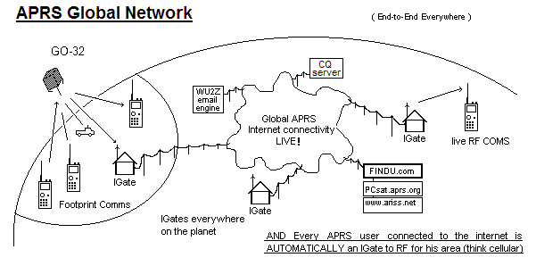
APRS Ham Radio Contact via Callsign
APRS-IS
1997 Sproul Brouthers WU2Z, KB2ICI and Steve Dimse K4HG

Slide 7
APRS Ham Radio Contact via Callsign
APRS-IS
5%
1997 Sproul Brouthers WU2Z, KB2ICI and Steve Dimse K4HG

Slide 8

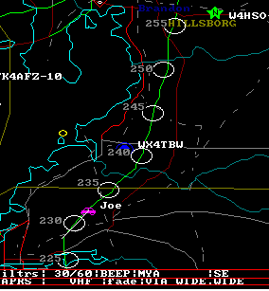
APRS Ham Radio Contact via Callsign
Everyone else uses DTMF Keypad!
Position reporting
by Mile Marks
95%

Slide 9
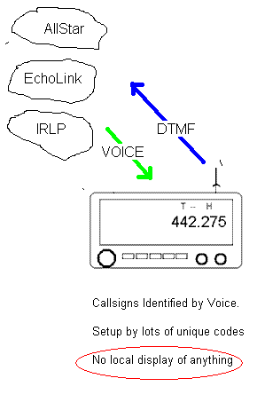
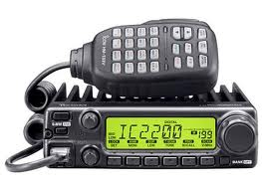
APRS Ham Radio Contact via Callsign
Everyone else
uses DTMF
Autopatch
Including VOIP
95%

Slide 10
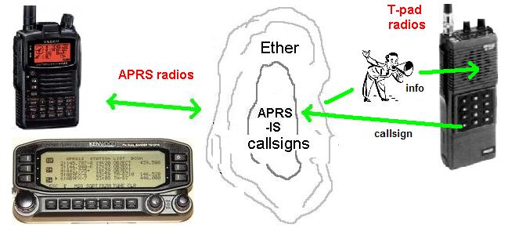
APRStt (touchtone) for Everyone!
95%
95%
With APRStt, everyone’s “presence” exists within APRS globally!
2001 APRStt.exe with external DTMF decoder and Resistor Voice

Slide 11
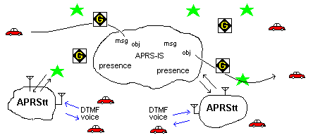
APRStt (touchtone) for Everyone!

Slide 12
APRStt (touchtone) for Everyone!
DTMF Transmission
DTMF Callsign (WB4APR)
B045*3 (3 mi at 45 deg)
NQ (nearest Query)
(pushed reports during event)
MQ (message query)
R3 (read message 3)
QSO W3APC (AVRS)
(incoming)
Voice Responses:
Welcome WB4APR
WB4APR 3.5 mi NE (of reference)
W3XYZ is 2.5 mi NE (of reference)
LEAD is 1.2 mi SW of Finish
You have 3 messages
[message = text-to-speech]
QSY 147.075 T107
Call From W3ABC, QSY 147.075 T107

Slide 13
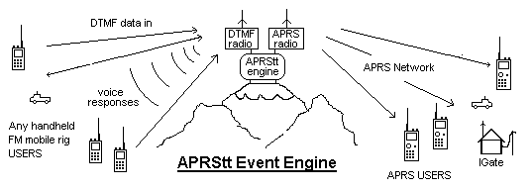
APRStt (touchtone) for Everyone!
DTMF users Hear APRS Info APRS see DTMF

Slide 14
APRStt (touchtone) for Everyone!
Versions:
APRStt.exe Hdw DTMF, parallel port Voice
2005 APRStt France
2009 Rick W4PC Radio Operations Center
APRSpeak Doug Quagliana W2UPW
Allstar *Jim Dixon, WB6NIL
Echolink? *Jonathan, K1RFD EchoLink
Still waiting for Prime Time

Slide 15
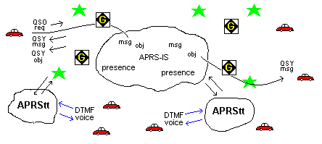
APRStt (touchtone) for Everyone!

Slide 16
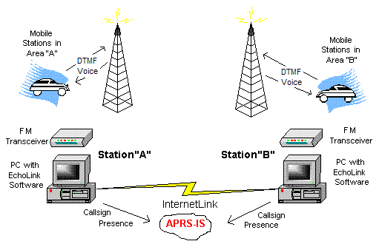
EchoLink Ham Radio Contact via Callsign
If Echolink adds DTMF Callsign Detection and sends info to APRS-IS

Slide 17
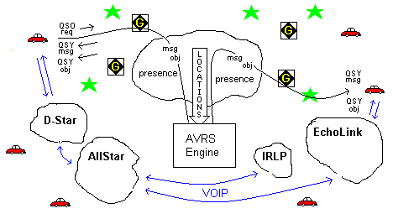
AVRS Ham Radio Contact via Callsign
APRS is the signaling chanel

Slide 18
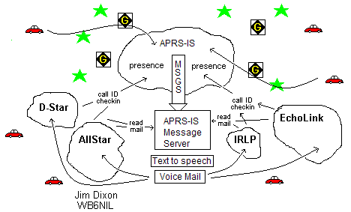
Texting → Voice Mail

Slide 19
AB0OO John Gorkos,
Atlanta Progress on AVRS
Has about 2500 lines of code to monitor the APRS-IS stream,
track node status for both echolink and IRLP, and maintain
real-time position information for active APRS stations.
Also have CMD/ACK code for commands sent to the
AVRS daemon via the APRS-IS stream.
IRLP and Echolink nodes will show up as Objects on the users' radio.
Example: John, AB0OO wishes to make an Echolink connection to
his home repeater. He sends a "?" query to "AVRS" via APRS,
and the AVRS server causes the local I-Gate to send two APRS objects
with the position and QSY information for the two closest EchoLink nodes.
He selects one of those objects, hits the Tune button on his D710,D72, or FTM350, and his radio QSYs to the local echolink frequency/offset and tone.
He is then able to connect to his home repeater over echolink.

Slide 20

Mark Braunstein WA4KFZ [wa4kfz@cox.net]
Intro to D-Star Digital Voice and Data
I think the technology could be made to work …
1. D-Star 'purists' abhor the idea of …any type of analog signal,
thus my comment on the need for further testing.
2. D-Star supports callsign routing, but I have increasingly seen the use of reflector connections instead of specific (i.e.,station-to-station) callsign routing.
3. Icom's poor user interface could slow adoption of the A*star concept.
4. Would the A*star concept be better served with 'outboard' digital voice boxes connected to the 9600bps packet port on existing analog radios? Perhaps starting with the APRS Text Messaging concept, and building from there, would help to get users acquainted with the A*star concept.
I look forward to discussing the A*star concept at DCC;
I think you're on to an interesting idea!

Slide 21
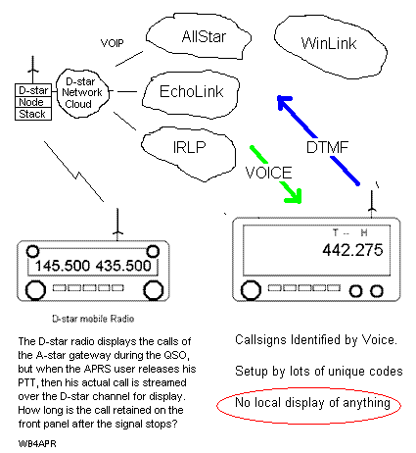
D-Star –to-
VOIP Links
ALE (HF)
Callsign
I think the technology could be made to work …

Slide 22
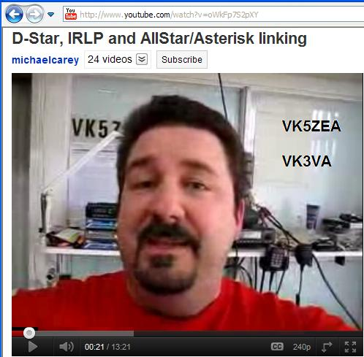
D-Star, IRLP and AllStar/Asterisk linking VK5ZEA VK3VA 27871
http://www.youtube.com/watch?v=oWkFp7S2pXY

Slide 23
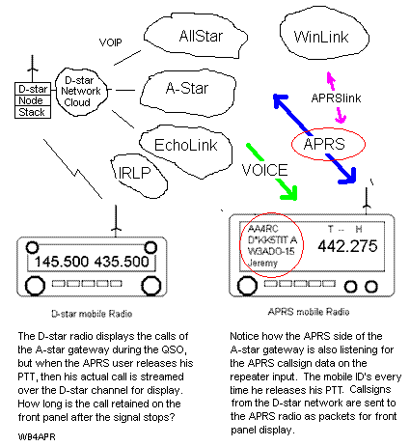
D-Star –to-
A-Star
I think the technology could be made to work …

Slide 24
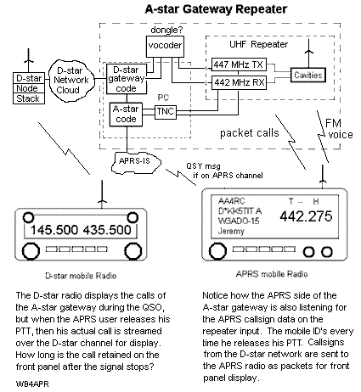
D-Star –to-
A-Star
I think the technology could be made to work …

Slide 25
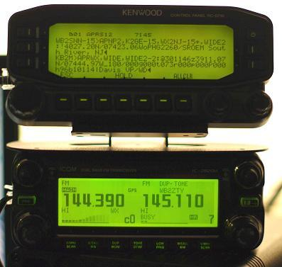
APRS text/calling on any radio
RC-D710 Full APRS on D-Star Radio
D-Star does not have any keypad or DTMF or other texting…
OK, so add it:
RC-D710,
YAGtracker

Slide 26
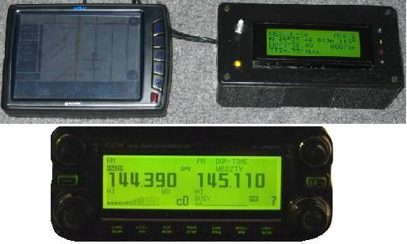
APRS text/calling on any radio
TinyTrack-4 on D-Star radio

Slide 27
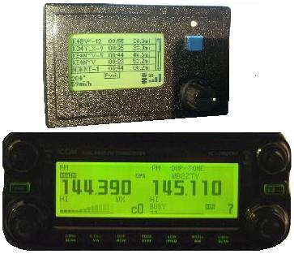
APRS text/calling on any radio
YAGtracker on D-Star Radio
D-Star does not have any keypad or DTMF or other texting…
OK, so add it:
RC-D710,
YAGtracker

Slide 28
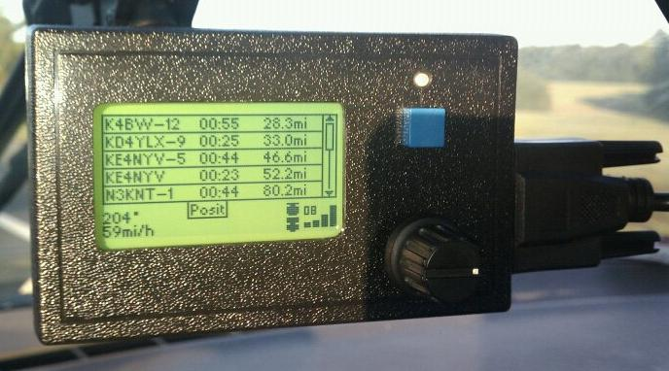
Jason Rausch
[jason@RPC-Electronics.com]
The YAG Tracker
By Remi VE2YAG
Kenwood lookout!
$GPWPL waypoint output string (map stations on GPS)
Holds a station list of last 50 heard stations in EEPROM
Station list sorting by last heard or distance
Digipeat histogram shows digipeat "health" of your own station and others
Map plot screen plots all in station list
Full messaging with on-board keyboard-like layout
Messaging "chat" screen for quick replies
Stores up to 10 canned messages (can be edited by user)

Slide 29
Pete Loveall AE5PL [pete@ae5pl.net]
javAPRSserver and APRS-IS Tier-2
People "using" a system don't want to have their operation hindered because someone else decided to send them a text message on APRS. If I am using D-STAR I don't want to have the repeater interrupt my conversation with incessant "you have mail" messages.
Unlike DTMF triggered functions like the other systems, there is no
equivalence in D-STAR or IRLP, for that matter.
You are looking for a 1980’s store/forward BBS system with text-to-speech to go onto voice repeaters. I’m "ok" in concept from a "pull" standpoint (I query if I have messages),
it stinks from a "push" standpoint (I use a repeater for voice, and I get messages).
Having each system monitor the APRS-IS for messages with the t/m filter is a waste of bandwidth (99.99999% of the messages ignored by any one end node) and would require each node to maintain a database of all messages passed on APRS. ( "how long?" and "why?“).
Agree,.No texting to D-Star
Agree
Jim Dixon is working on Voice Mail Server now!
Agree. So central voice mail server

Slide 30
Pete Loveall AE5PL [pete@ae5pl.net]
javAPRSserver and APRS-IS Tier-2
D-STAR radios are not text-enabled nor are your FM radios. D-STAR repeater
owners are not going to put AMBE codecs at each repeater site to do text
to speech nor is there any common method for D-STAR radios to communicate using text.
We have the D-PRS Interface but most don't use it…(they would rather
talk to them than text them) and text would be interfering on the voice repeater systems.
D-STAR people have made it clear that they do not want every transmission
they make show up on APRS (it would quickly overload the APRS-IS network).
The D700 and D7 are horrific to message… using the microphone keypad;
Echolink user is not going to stop their car and DTMF to send a message.
And there is a reason; texting and driving is dangerous and deadly.
Is this a toy that will be played with for 5 minutes and then forgotten?
Will it be disabled because it becomes the transmitter control, not the operator?
To use a DTMF pad to check messages, then subscribe to such a central server that
remote nodes could access (like accessing an Echolink/Allstar conference bridge)
and that server could collect messages just for subscribers.
Not all technologies have DTMF (D-STAR, for instance)
Agree,.No texting to D-Star
Agree
Presaved DTMF Callsign
Everyone wants to link across systems
Jim Dixon is working on it now!

Slide 31

Jim Dixon WB6NIL (AllStar * Asterix)
Texting to VOIP end User:
The Texting to Voice Synthesizer (Text-to-Speech) needs to be at one central location:
Uses one Text-to-Speech code so that every client of every system does not have to implement it
Watches APRS-IS for all messages to any callsign on any of its clients. If seen, captures and stores as VoiceMail. Again, so not every client has to…
Only one copy, so only one Has-Been-Read Flag
Can Read from any POTS telephone (any device)

Slide 32
Heiki Hannikainen OH7LZB
APRS.FI Server
- My biggest worry about this is authentication
Also special licensing requirements of digipeaters and igates
So most Igates are 1-way RX only and so little gets back to RF
Therefore APRS-IS global messaging works quite poorly in the Finland…
Really, the hardest part is security from non-hams…
- I don’t see APRS.FI being the clearinghouse for global messaging…
- The texting network should be supported by a larger organisation than me
- New infrastructure for text chat might be XMPP servers such as OpenFire.
- They're what the Internet uses for such things with rather large scale.
  built-in support for UTF-8 international text
  presence information (availability for chat: on-line, idle, or off-line).

Slide 33
Jonathan Taylor, K1RFD [k1rfd@k1rfd.com]
EchoLink
EchoLink has an API that can be used to inject and monitor the text stream, but it’s designed for desktop programs not external sources.
We don't allow any form of cross-linking, (security concerns).
Another headache of text streams: machine-messages that spam large conference servers, (all messages to all stations connected).
Text capability in EchoLink is really an ancillary feature rather than a core feature, and only visible to non-RF PC users, (the minority)
However, on your second point, I think the "I'm here" DTMF callsign
is a good idea and could certainly be implemented. But I have been focusing on the smartphone platforms…
it would be possible to develop the texting using the API in the interim.

Slide 34
Rich Painter [painterengr@gmail.com]
uSmartDigi
My uSmartDigi D-Gate does the D-STAR to APRS RF gateway.
Nonetheless, keep me on the email list so I can keep abreast.
If there is a need for some enhancement for uSmartDigi to support any new initiative I can make it happen.

Slide 35
PU7ISS ADALBERTO - [zz2sbx@hotmail.com]
I'm on the APRS over 12 years in Brazil and wanted to tell you if it is possible besides the geographical location it is possible to make a program for communication via radio frequency and also voip, I know that the main objective of this system is its location, but if communication via voice there will be many users in the world!
Hugs from your friend here in Brazil

Slide 36
Steve Dimse [steve@dimse.com]
(FINDU.COM)
One thing I want, … notification on my iPhone when I get a message via APRS.
The programming is quite easy with Apple's notification infrastructure,
there would be a simple background app on the iPhone that would receive the notification and give people the option of going to findU to reply.
This could support other systems like Echolink et. al, and I would probably open it up to them, but that is still a good 18 months away, but I'll let you know. It could be a large piece of the backbone for your system.

Slide 37
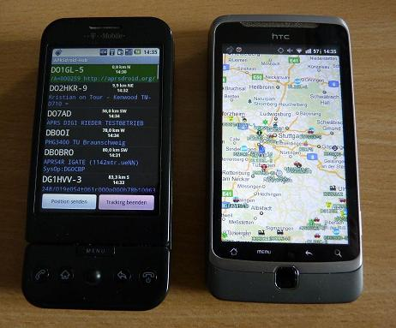
Georg Lukas [georg@op-co.de]
Android APRS App

Slide 38
Georg Lukas [georg@op-co.de]
APRSdroid
Open-source APRS-IS application.
* preliminary Bluetooth TNC support (beta)
* APRS Messaging (TX retry and Android notifications for RX;
the tracking service has to be active all the time)
* New option to "Keep screen awake"
* Improved performance on the the Hub and Map.
You can support APRSdroid development… https://market.android.com/details?id=org.aprsdroid.app
download the binary from http://aprsdroid.org/download/
follow @APRSdroid on twitter for updatea
The APRSdroid home page is at http://aprsdroid.org/m

Slide 39
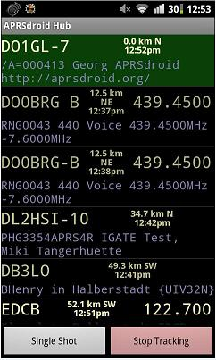
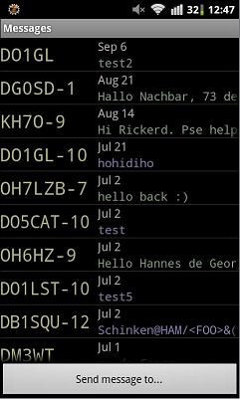
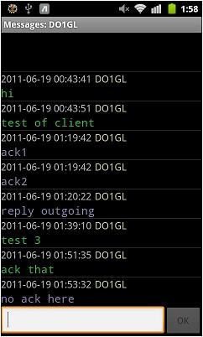
Georg Lukas [georg@op-co.de]
Android APRS App

Slide 40
Antony Chazapis [chazapis@cslab.ece.ntua.gr]
PocketPacket for Mac
Hello Bob and thanks for forwarding this.
I have released PocketPacket for the mac platform as well and will be more than excited to implement any messaging system decided by the workshop or following meetings.
Antony
73 de SW1OAN

Slide 41
Thomas Osterried [thomas@osterried.de]
Global Messaging Initiative
Nice idea!
For the "International Packet-Radio Meeting" in Darmstadt two years ago I held at talk for bringing all those things together.
http://dk0bln.de/wiki/doku.php?id=users:dl9sau:start
IPRT Darmstadt 2009
Vortrag „Global Messaging Initiative - how it all fits together“.

Slide 42
Curt Bartholomew [Curt.Bartholomew@fcc.gov]
Catastrophic Communications –
Which Digital Emission Would You Use?
Your Sunday workshop is a great idea.
Because of my experience at FEMA HQ during 9/11/01 and its aftermath, my focus in Amateur Radio over the past decade has been interoperable and efficient EmComm. I am [am an] FCC employee working Amateur Radio EmComm (when I can).
I believe the key is to get as many of [modes] as possible to talk to each other. A (low cost) hardware/software solution that allows a ham to receive a message in one emission type/mode and then pass it along in another one would be a godsend. Doing it by callsign would add a great element of security and simplicity.

Slide 43
Lor Kutchins W3QA - Winlink Development Team
I think there is merit for general-purpose use of the callsign database ircDDB used in DStar networks. Hans, DL5DI is a good one for information on this.
See http://groups.yahoo.com/group/ircddb/
and http://www.ircddb.net/

