Slide 1
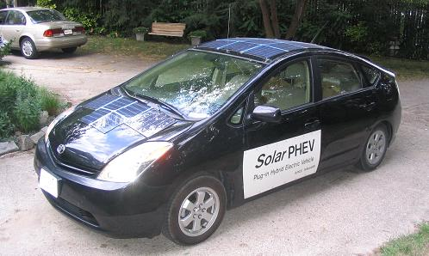
Prius / Power / Energy
Bob Bruninga
Severn School Physics
21 Feb 2008
http://www.ew.usna.edu/~bruninga/APRS-SPHEV.html

Slide 2
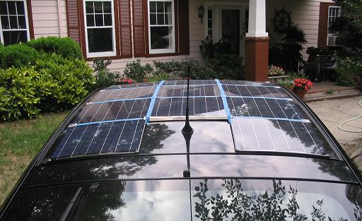
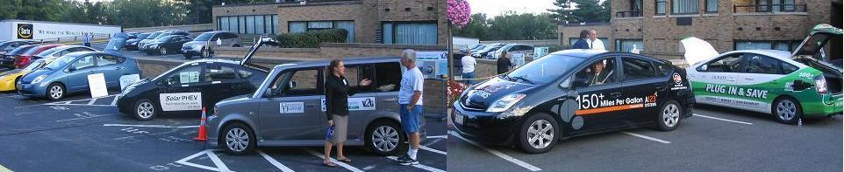
My Car
2004 Prius
w $4000 of door/frame damage
200 W added Solar Panels
100 LBs of added Batteries
On display at the IEEE PHEV Symposium in Wash DC 2007.

Slide 3
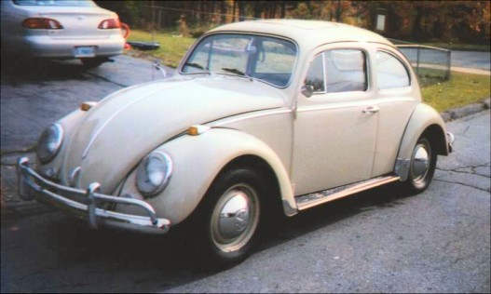
Getting Good Gas Mileage
42 HP
The best way. Just drive
smaller cars!... Cheap!

Slide 4

Getting Good Gas Mileage?
10-16 MPG
USA Demand…
Or is it Detroit Marketing?

Slide 5
Why Fuel Efficiency?
Who was key-note speaker to Electric Vehicle Association?
  Ex-head of CIA
Why is government interested in Fuel Economy?
  $200,000,000 per day for Middle East Oil
  How many Terrorists does that support?
We *must* cut our dependence on Foreign Oil!
  Iraq, Iran, etc
  Venezuella, Russia

Slide 6
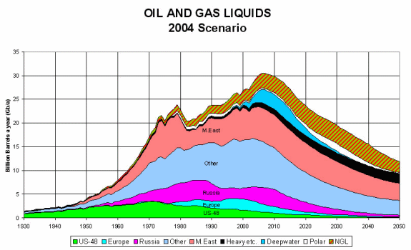
Why Getting off Gas?
“Peak Oil”

Slide 7
What can we do about it?
Last century millions were killed for Salt
  Salt was a global commodity
  War-Lords controlled Salt Empires
What ended their reign?
  Refrigerators!
Simple Technology can change Global Empires
Eliminating our addiction to Foreign Oil is how.
Electric Vehicles can do it!

Slide 8
Electric Vs Gas
70% of our gas comes from overseas (bad!)
99% of our electricity comes from USA! (good!)
At night we can charge 150,000,000 electric cars for only 7% of the total USA energy grid.
At night, electricity is cheaper (50% or less) and more plentiful
During Peak demand, electricity costs 10 times more
But those same 150,000,000 car batteries contain more peak power than FIVE TIMES the entire USA power generating capacity!
V2G (Vehicle-to-Grid) could offset $2000 per car in energy savings by letting the power companies buy some back during brief peak demands

Slide 9
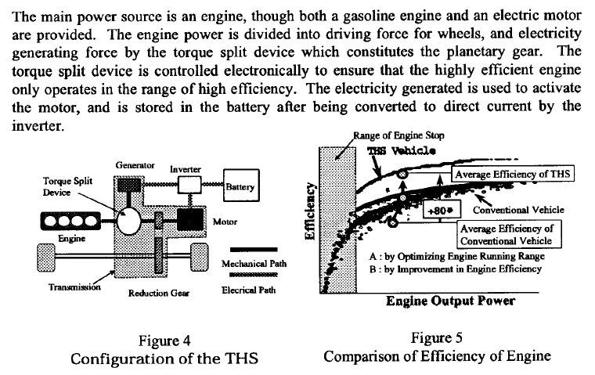
Hybrid Efficiency VS Gas

Slide 10
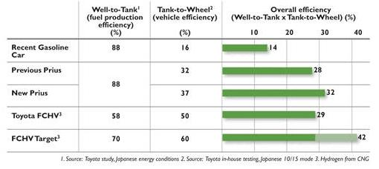
Well-to-Wheel Efficiency

Slide 11
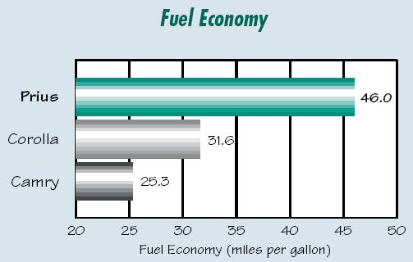
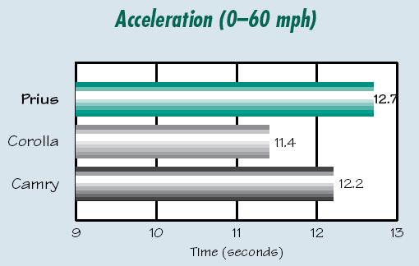
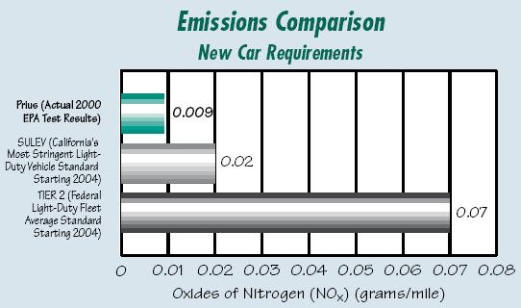
Prius Comparisons

Slide 12
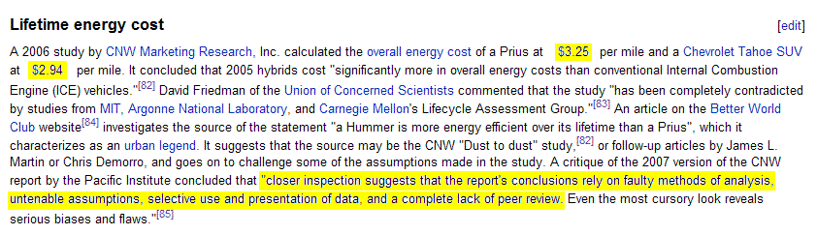
Don’t Believe Detroit

Slide 13
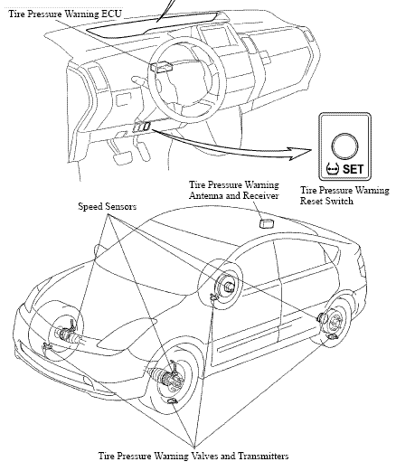
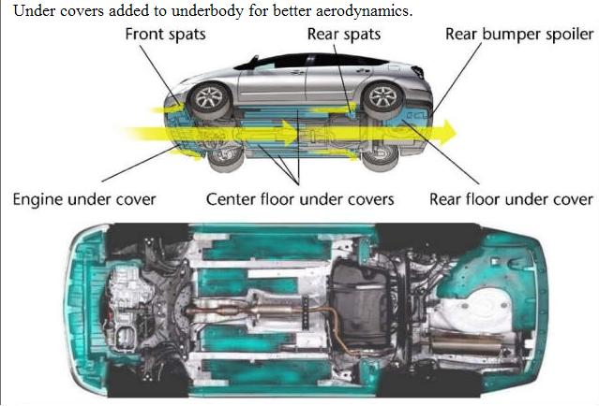
Everything Counts
Good Tire Pressure
Air Flow underneath

Slide 14
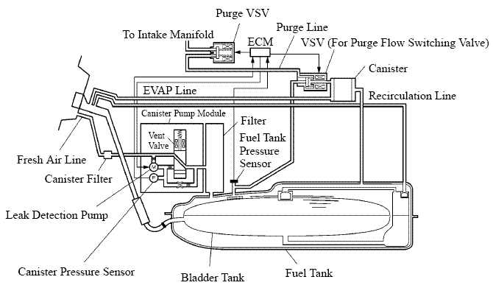
Low Emissions (Tank)

Slide 15
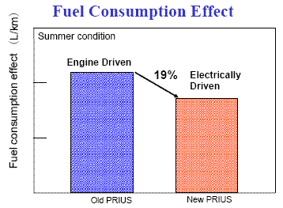
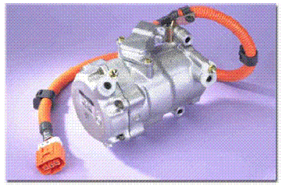
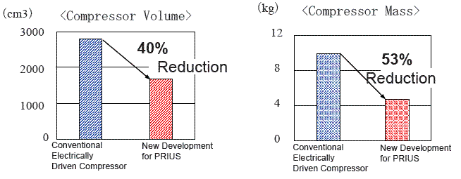
Saving Energy
(in the air-conditioner)

Slide 16
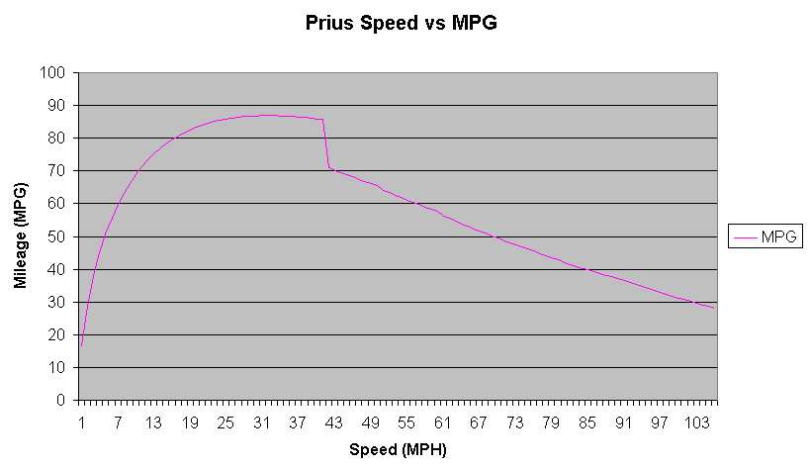
Impact of Speed on Air Drag
Gas Engine Cars:
  The main energy waste in town driving is stopping.
  Low power demands is where gas engine is most inefficient
  Hence better MPG on the open road.
Hybrid:
  Regenerative Braking saves most stopping energy for re-use.
  Electric motors for optimum power at low speeds and power
  Better mileage in town where AIR resistance is lowest.
Electric limit

Slide 17
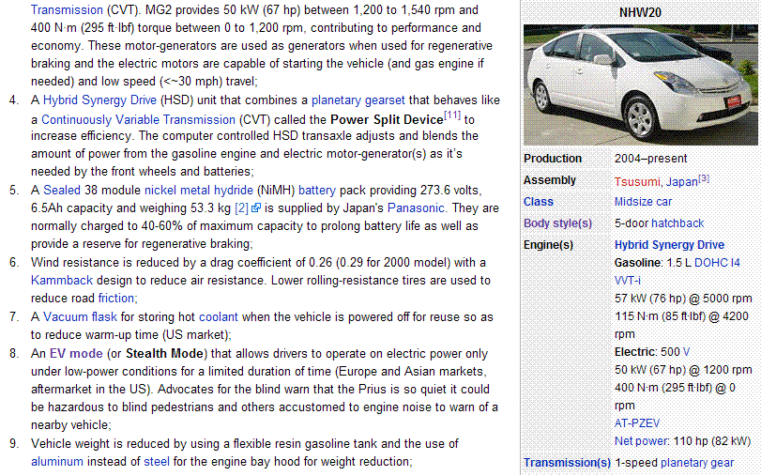

Slide 18
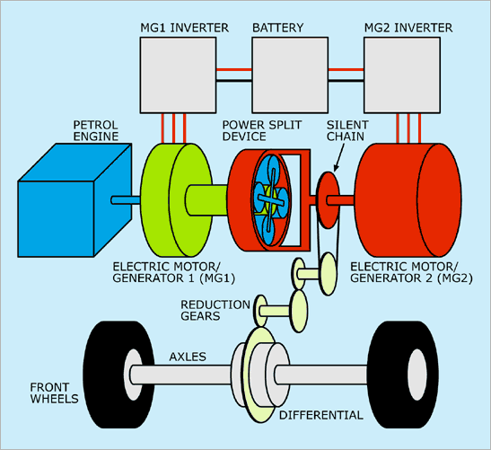
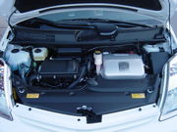
The Hybrid Synergy Drive
76 Hp ICE
50 kW MG1
50 kW MG2
Planetary Gear System
50 kW Battery

Slide 19
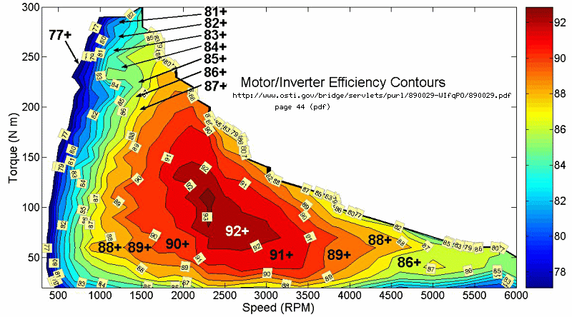
Atkinson Cycle Engine

Slide 20
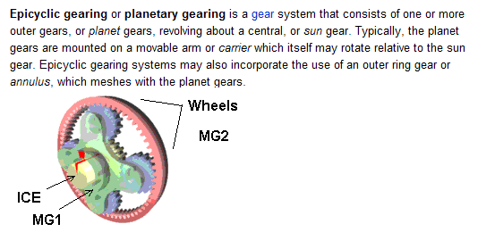
Planetary Gear System
Three shafts
Power sharing/balancing
Any input, any output

Slide 21
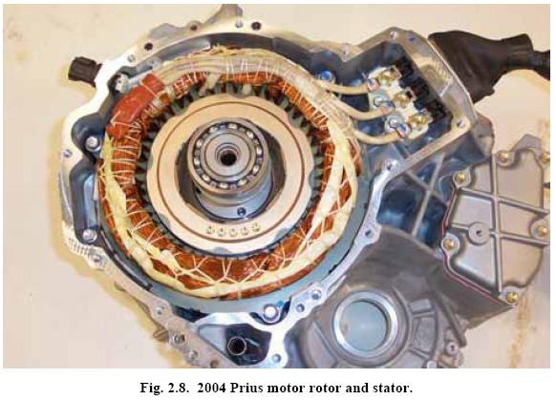
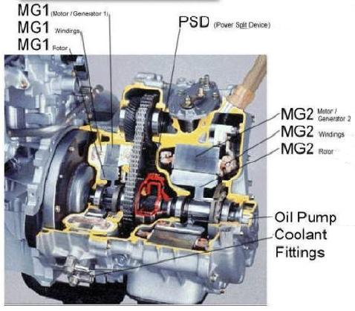
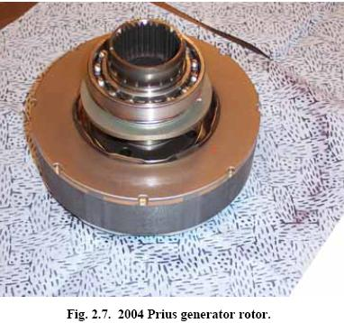
Motor/Generator

Slide 22
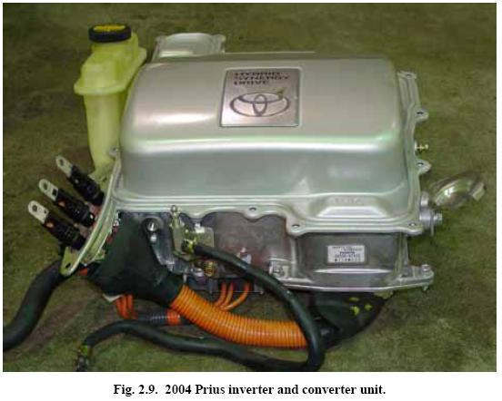
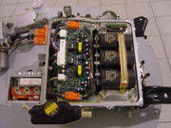
The 50 kW
Inverter
220 VDC to 500 VDC
220 VDC to 12 VDC at 100 amps
220 VDC to any motor voltage as needed
Water cooled

Slide 23
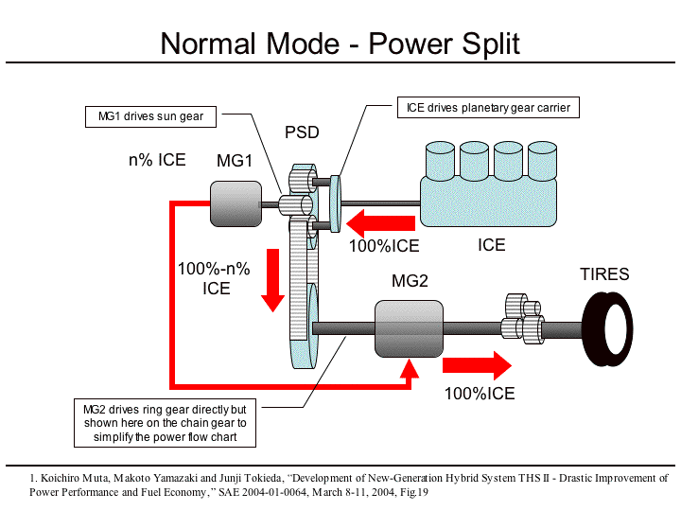
(low gear)

Slide 24
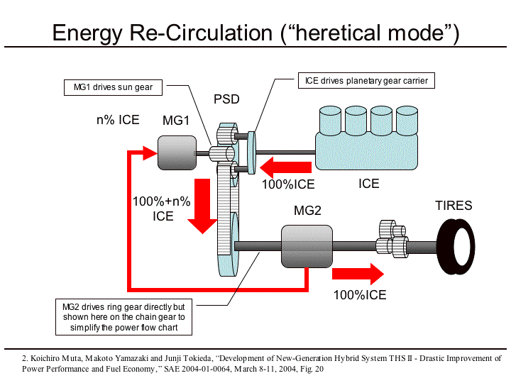
(High Gear)

Slide 25
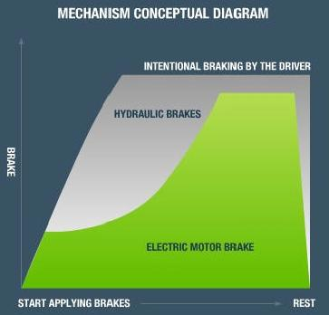
Regenerative Braking
65% of all Prius Electric Power comes from Braking
Typically 35 amps at 250 volts
That’s almost 9,000 Watts

Slide 26
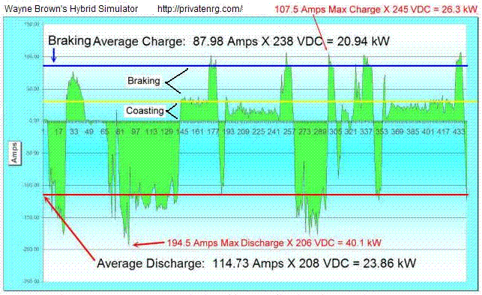
Regenerative Braking

Slide 27
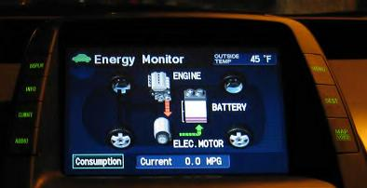
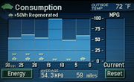
Displays
Energy Flow
Consumption

Slide 28
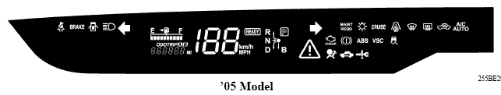
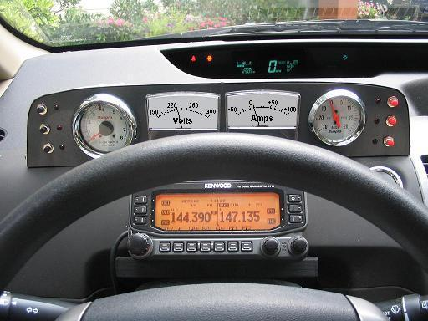
Instrument Panel (not)!
No Tach
No Vacuum
No temperature
No volts
No current
No power
My add-on solution –
an Analog panel

Slide 29
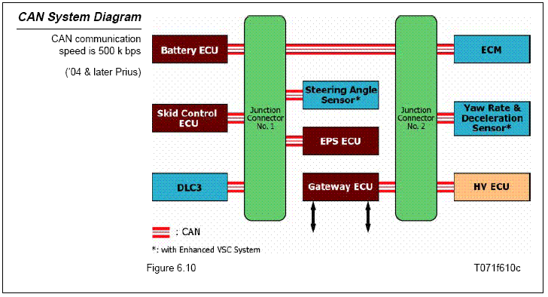
Computers and CAN Bus

Slide 30
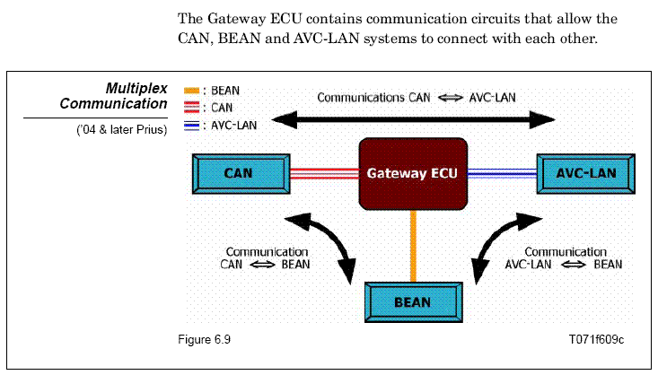
Computers and CAN Bus

Slide 31
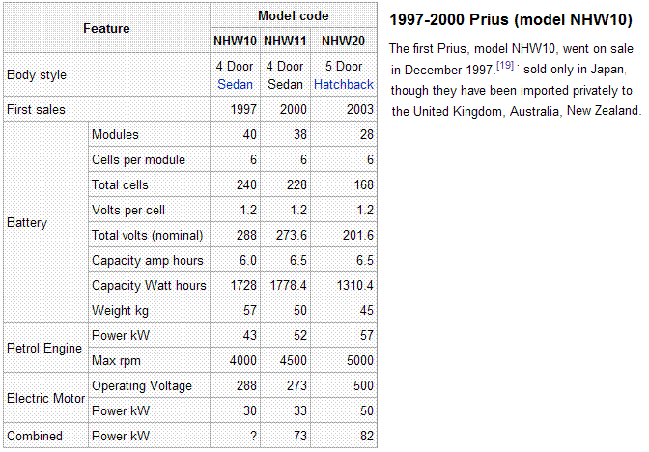
Battery Specs

Slide 32
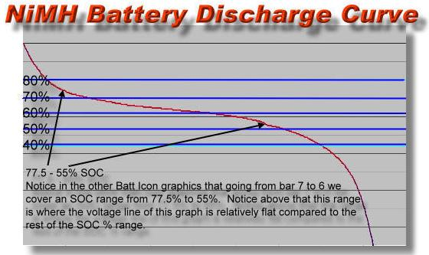
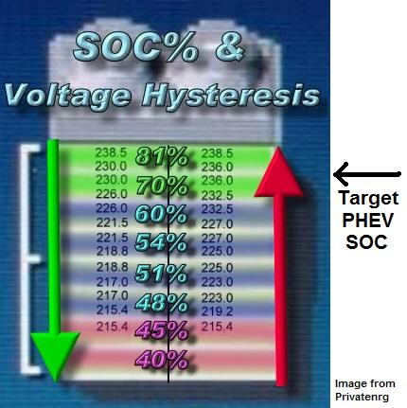
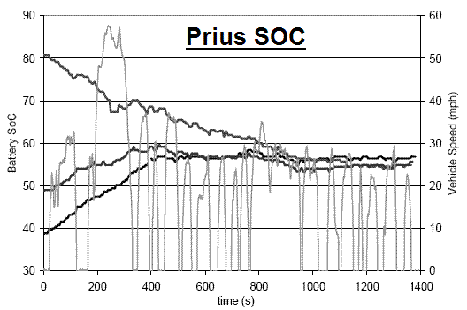
Protecting the Battery
Prius likes to keep the battery at 58% charge

Slide 33
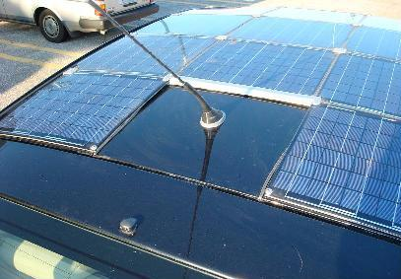
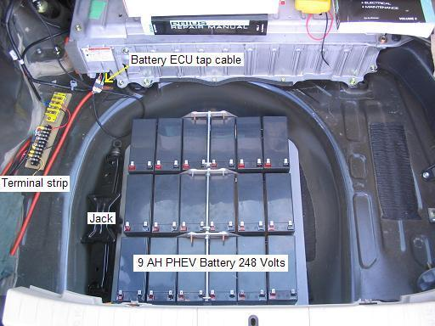
Solar PHEV & Battery
200 Watts of Solar Panels
200 W-hrs per hour in Sun
$2400 cost.
200 W-hrs per mile needed
Solar power while parked all day, gives half my electric need.
My PHEV battery only needs to be half as big for the same EV range.
Eighteen 12V batteries
9 Amp-Hours each
225 Volts
2025 Watt-Hours
Solar - 4 Hrs per day. 4 Miles EV per trip. 40 mile commute = 10% improvement
PHEV - 8 Hrs at night. 4 Miles EV per trip. 40 mile commute = 10% improvement

Slide 34



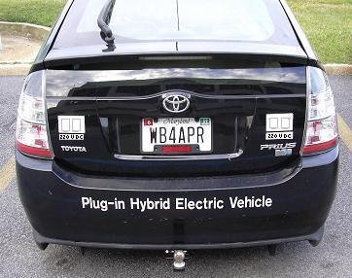
Home Power Generation
Home Solar 4 kW
Gas 4 kW
Wind 5 Kw
Prius 50 kW peak (10 kW average)

Slide 35
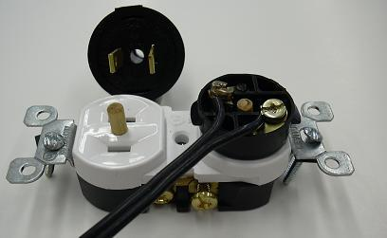
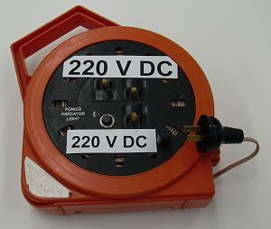
Home Power Generation
50 kW peak (10 kW average)
Safe, cheap connectors
(Modified to prevent incorrect use.)
Greater distances
At half the current
At twice the power
#18 zip cord can carry 1000 watts easily

