Slide 1
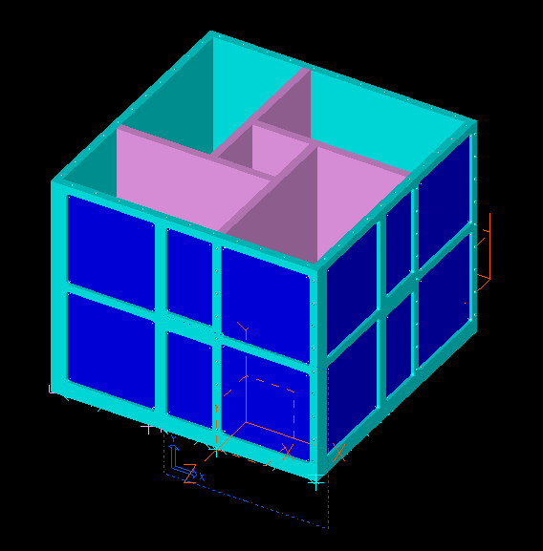
PARKINSON-SAT
EA 469 Spacecraft Design
Joe Campbell
Thomas Dendinger
Greg Lewis
Paul Lwin

Slide 2
ABSTRACT
PRIMARY MISSION
  Amateur satellite built for data exfoliation
  Serve as a public transponder in space for free relay of data
    Joint project with Aerospace Engineering Dept. and Oceanography Dept.
    Gather data from buoy network together about sea condition
SECONDARY MISSION
  House the MidN Experiment
    Experiment to measure radiation levels in orbit using dosimeter
  RFI mitigation
    Locate and identify unauthorized users of specific military frequencies

Slide 3
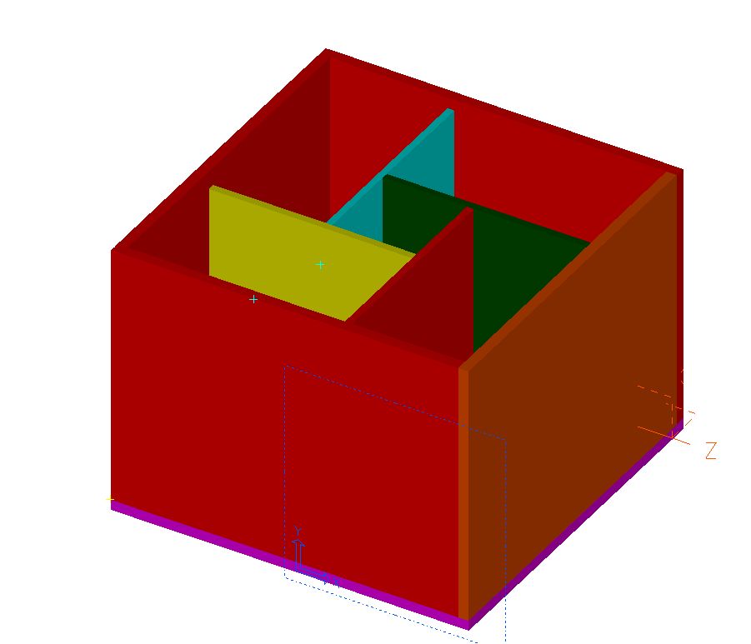
Initial overall design
Bulkheads below side panels
Pinwheel layout
No solar panel layout
Resting on bottom panel

Slide 4
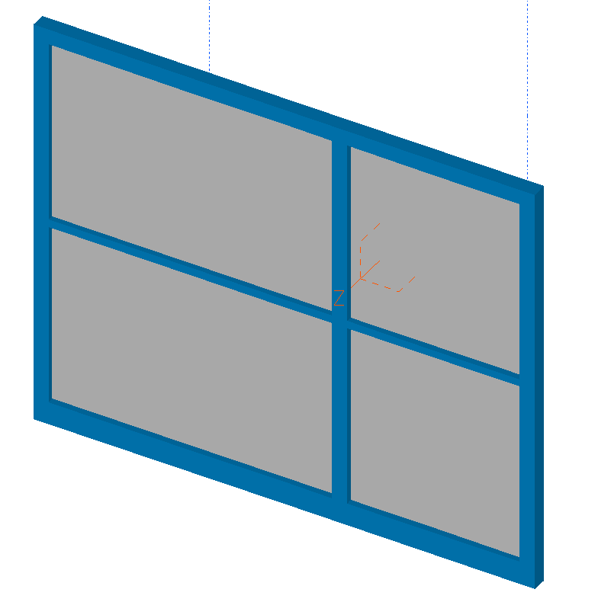
PARKINSON SAT
Preliminary side panel
Each side panel interchangeable
Recessions to fit solar panels
Initial design of side panel
Single boss to attach to bulkhead
4 solar panels

Slide 5
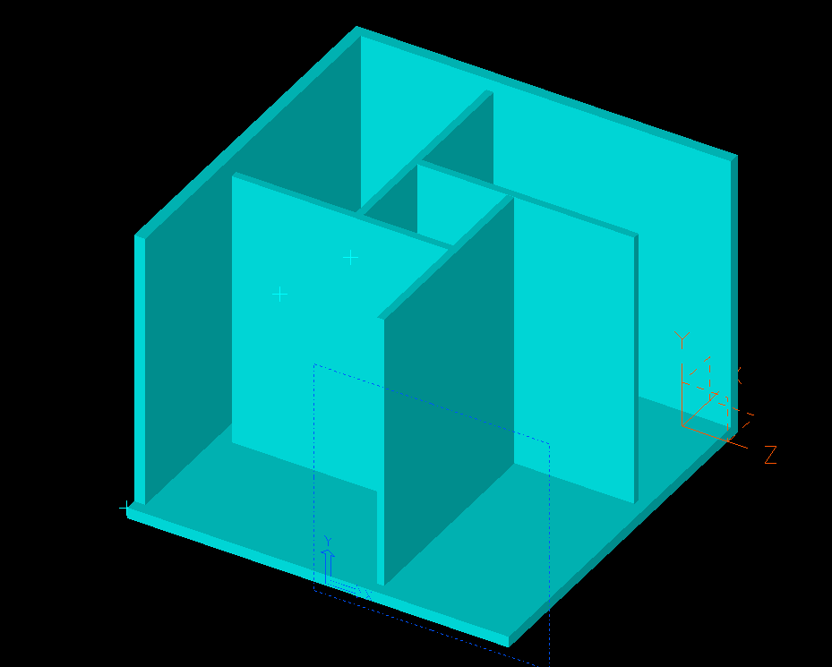
Internal layout
Bulkhead below side panel
Center battery house

Slide 6
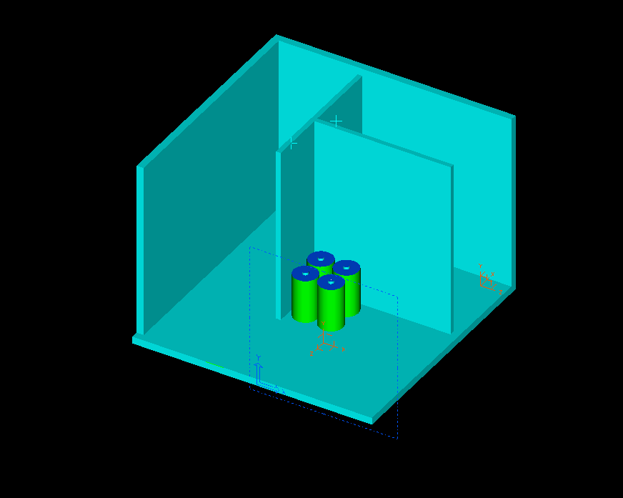
1st course of batteries
3 total courses

Slide 7
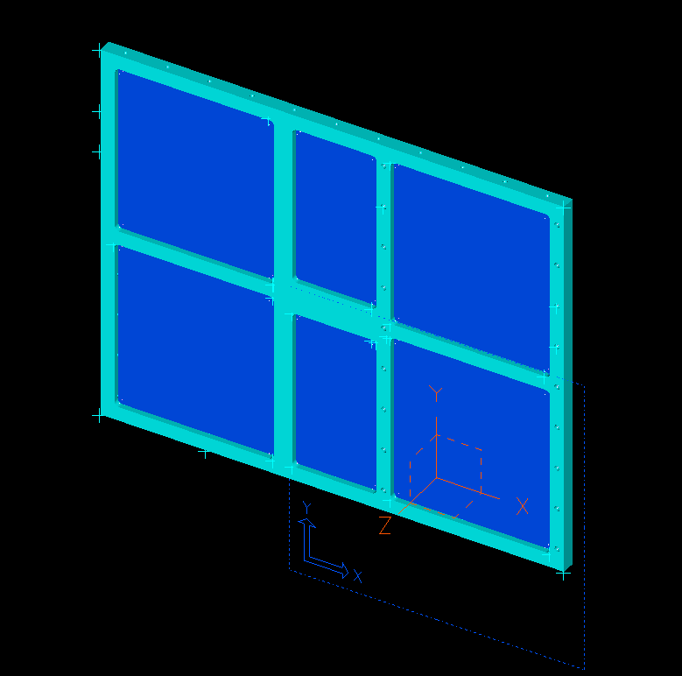
Updated side panel
6 solar panels
Boss to attach to bulkhead
Top fastens above side panel

Slide 8
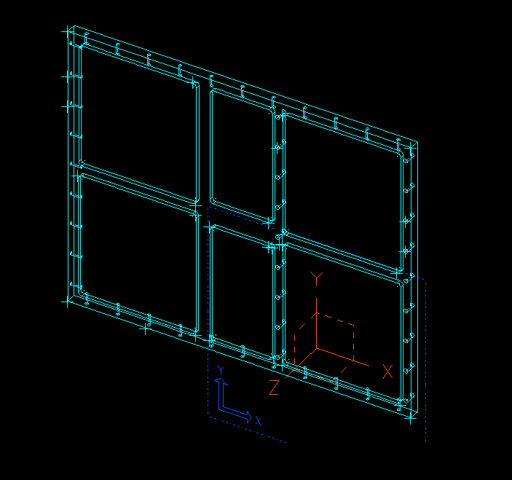

Slide 9
Most recent update
Bulkhead flush with side panel

Slide 10
Proposed Propulsion System
Possible Launch on STS ISS mission
ISS orbit altitude 360 km
  Using STK, this gives about 300 days on orbit before re-entry
  Longer mission life is desired
Propulsion system would be used to raise orbit to 615km altitude to give a mission life of 24.5 years

Slide 11
Propulsion System Requirements
STS mission, system needs to meet man safety requirements
  No explosives
  No compressed gasses
Low complexity, weight and power requirements

Slide 12
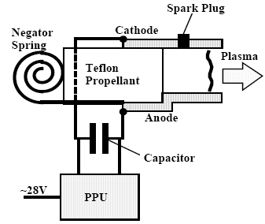
Pulsed Plasma Thruster
Small, electric propulsion system
Charges a capacitor to ~3,000V
Discharges across the face of a Teflon bar
The arc ablates a portion of Teflon which is then accelerated by Lorentz forces to ~4,000 m/s

Slide 13
Pulsed Plasma Thruster
High Specific Impulse ~500-1200 sec
Low thrust, ~70-200 μN
Can be pulsed for long durations to achieve a desired ΔV
Low complexity, only moving part is the Teflon bar

Slide 14
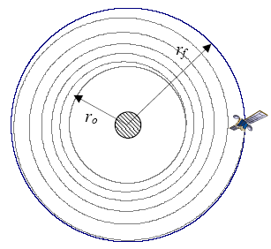

P-Sat Requirements
Low, constant thrust orbit changes require spiral transfer
The simplified equations for this is:

Slide 15
P-Sat Requirements
From Dawgstar PPT
  T=.14mN
  Propellant Mass per ΔV=2 g-s/m
  Operating power ~10W
Orbit change requires a ΔV of .1415 km/s
  Requires 283.1 g of Teflon
    ρ_{Teflon}=2.2 g/cm³
    Teflon bar would be ~128.6 cm³
  Takes ~175 days of continuous pulsing to raise orbit to 615 km

Slide 16
Potential Challenges
Teflon Geometry
  Optimizing the shape of the Teflon bar could enable higher thrust, thus lower burn duration
Power Processing Unit
  Stepping up voltage from vehicle bus to ~3,000V
  Potentially could be a significant source of heat

Slide 17
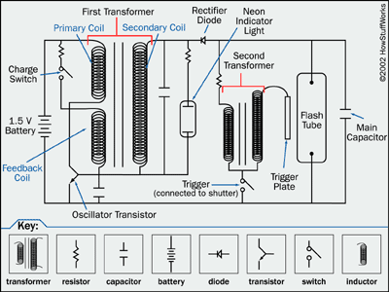
Sample Diagram of PPU

Slide 18
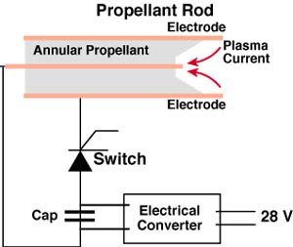
Teflon Geometry

Slide 19
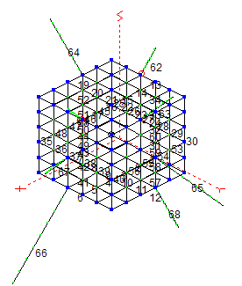
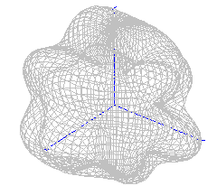
Antenna Design

Slide 20
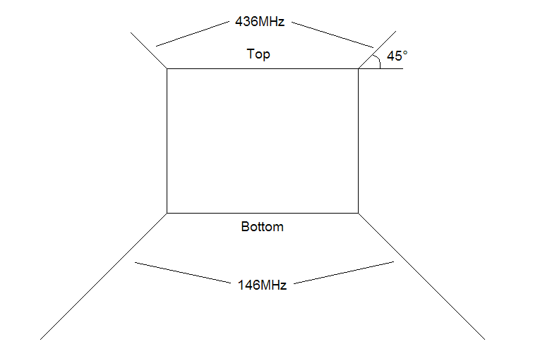
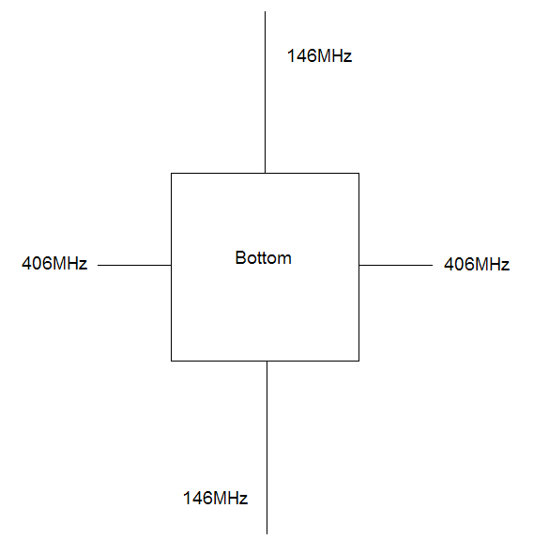
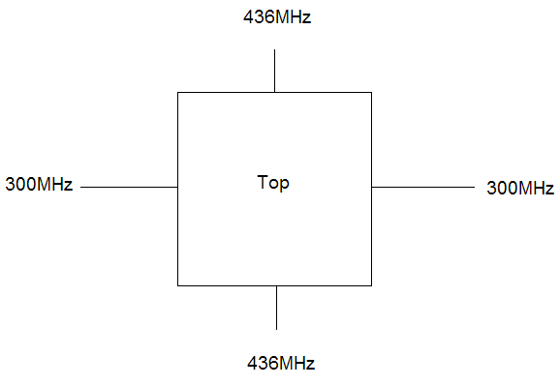
Basic Diagram

Slide 21
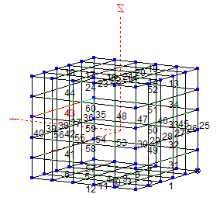
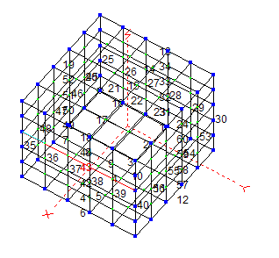
EZNEC P-Sat Model

Slide 22
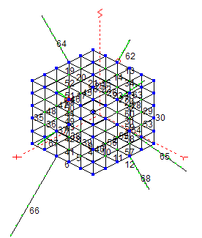
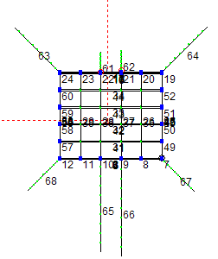
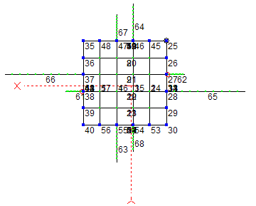
EZNEC Antenna Model

Slide 23
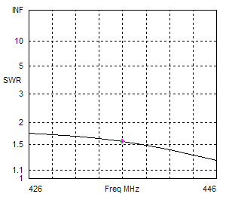
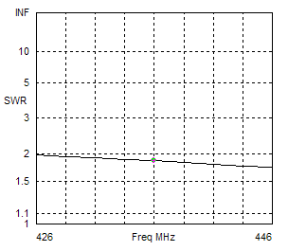
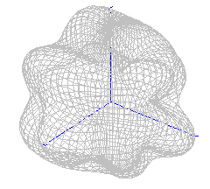
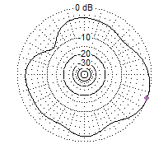
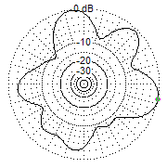
436Mhz UHF Receiver Antenna

Slide 24
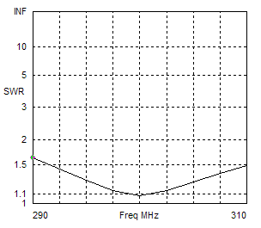
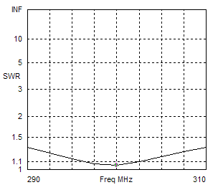
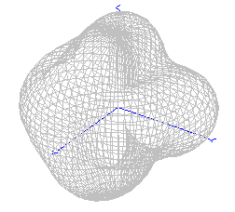
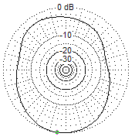
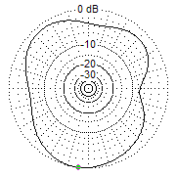
300Mhz UHF RFI Receiver Antenna

Slide 25
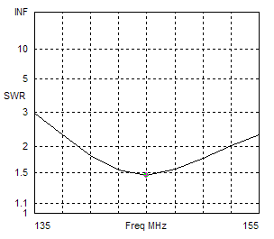
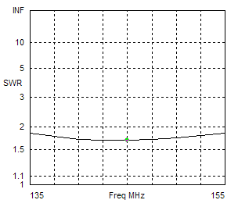
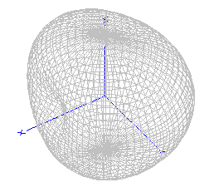
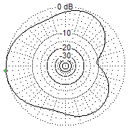
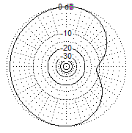
146Mhz VHF Receive/Transmit Antenna

Slide 26
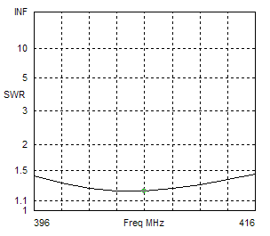
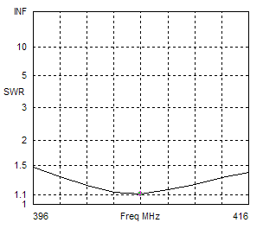
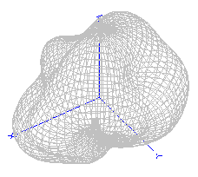
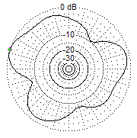
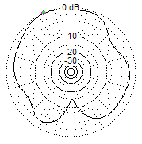
406Mhz ODTML Mission Antenna

Slide 27
Results
Frequency Avg. Gain Peak Gain Min. Gain
436 MHz 1.49 dB 4.72 dB -6.69 dB
300 MHz 0.20 dB 3.72 dB -4.27 dB
146 MHz 0.37 dB 1.82 dB -10.0 dB
406 MHz -0.36 dB 2.61 dB -11.9 dB

Slide 28
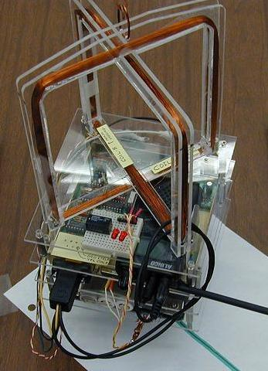
Magnetic Torquer Attitude Control

Slide 29
Matlab Model
Model uses Prof. Engle’s code for determining the magnetic field at any latitude
Calculates the dipoles necessary to provide a specific pointing capability or a angular rate
The model shows that the control law can handle tip-off rates

Slide 30
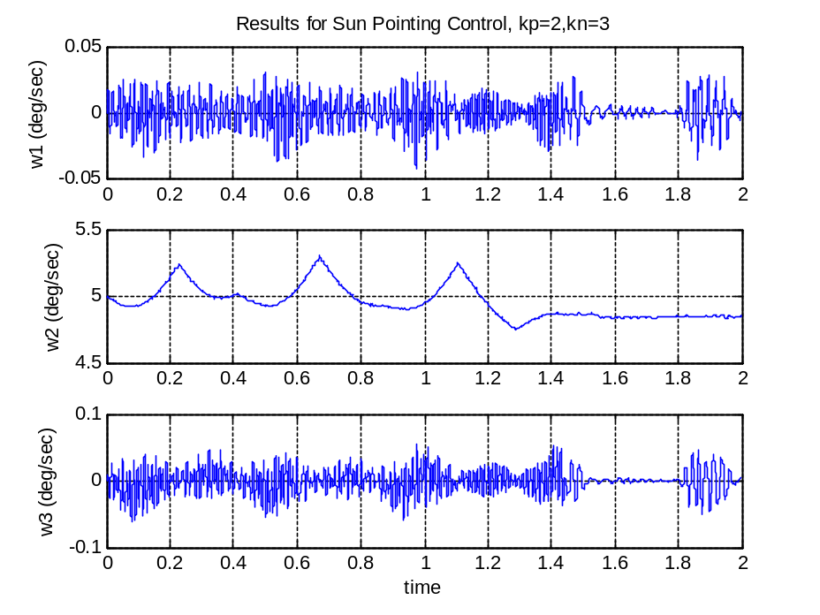
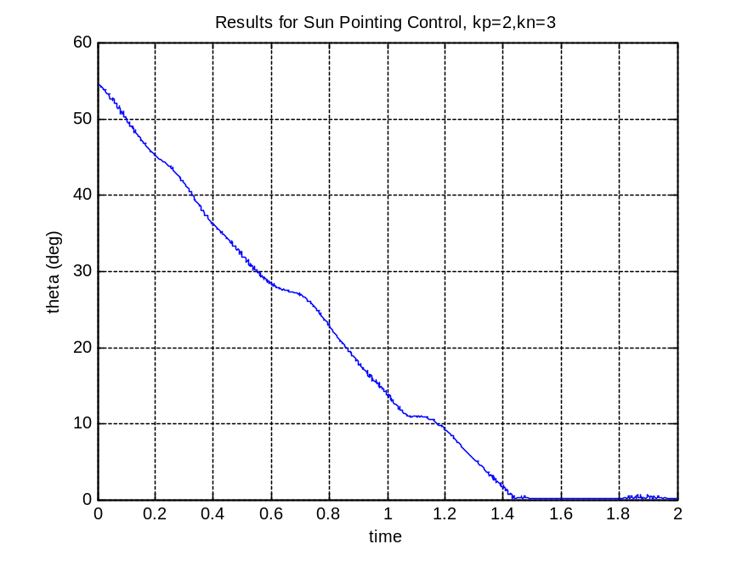
Sample Plots

