Slide 1
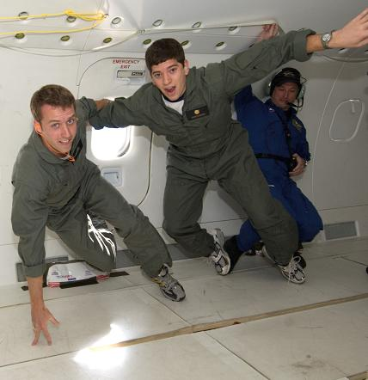
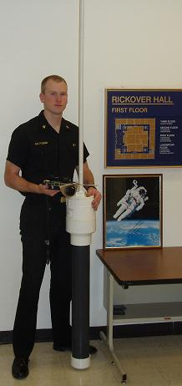
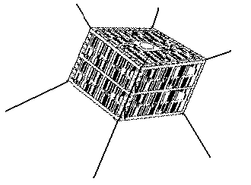
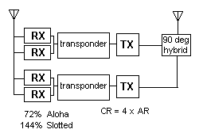
ParkinsonSAT
CDR Bruninga
USN (ret)
David Koeppel
Matt Lovick
James Paquette
Brian Piggrem
Jeff Robeson
Kyle Vandegriff
http://www.ew.usna.edu/~bruninga/buoy.html
Lovick

Slide 2
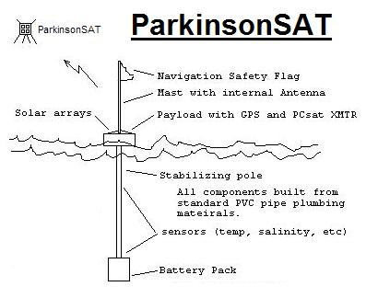
ParkinsonSAT
$50k gift funds from Aerospace Corp.
Environmental sensor satellite data transponder
Satellite Launch Opportunities - TBD
This semester, Preliminary Design options --> SRR
Lovick

Slide 3
Proposed Mission
Relay data from simple environmental sensors – buoys – in the Chesapeake Bay or oceans or onshore. Providing position/ status and telemetry about 2 to 4 times a day to the Internet.
Including Buoys elsewhere around the world as long as Internet linked ground stations are in the footprint.
Establish this channel/system as a global resource for other such experiments in the Amateur Satellite Service. Inspire other schools and universities to participate with additional low cost satellite transponders and buoy and sensor systems.
Serve as a technology demonstrator for various spacecraft subsystems including basic attitude control, follow-ons to PCSAT experiments and other student projects such as the MIDN sensor.
Support an Ocean Data Telemetry Microsat Link (ODTML) UHF transponder for DOD and maybe UHF RFI Mitigation
Lovick

Slide 4
Low Cost Buoy System
Low Cost ~ $800
Standard plumbing hardware
Off-the-shelf radios/modems
Operates under FCC rules for Amateur Satellite Service
USNA Buoy
Piggrem

Slide 5
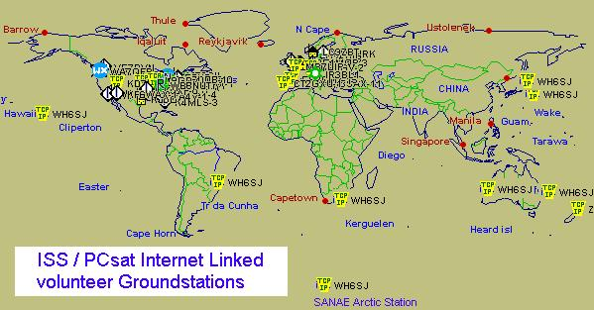
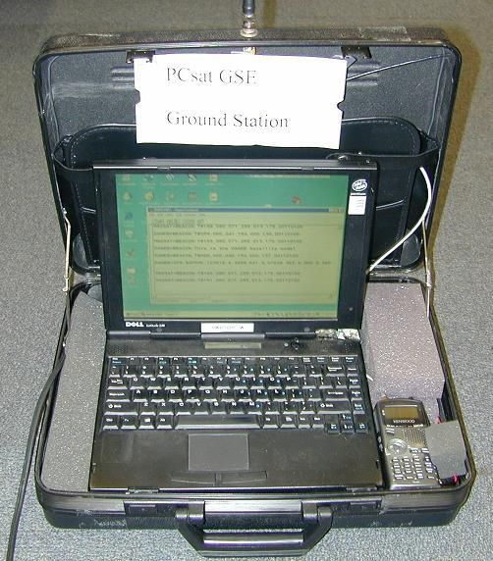
Global Ground Station Network
And PCSAT2
Needs only a Radio, Modem, PC and Internet
Piggrem

Slide 6
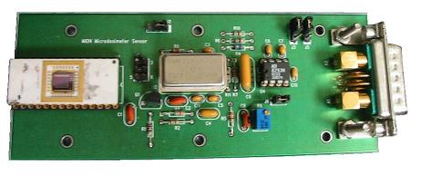
Micro Dosimeter (MIDN) Requirements
Auxiliary USNA Aerospace Student Project Payload
Size – 2.5” x 2.5” x 6”
Weight – .215 kg
Power – 1W (@ 5v)
Measures radiation dosage in human cell sized detectors
Vandegriff

Slide 7




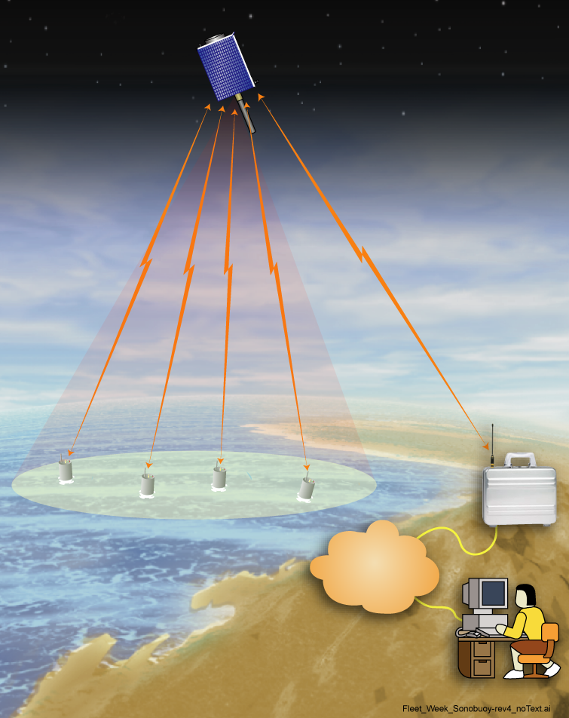
Ocean Data Telemetry
Microsat Link, ODTML
Concept of Operations
CONOPS: “Internet-Like” Services on Global Basis to Support Ocean Platform Monitoring (e.g., Free-Floating Buoys)
SPACE SEGMENT:
  Hosted Aboard TacSat-3 and TacSat-4
  Autonomous “Router in the Sky” Allows User Commanding and Telemetry Receipt (Peer-to-Peer and Store/Forward)
  Compatible With Service ARGOS; >50,000 Bits/Day per Buoy; <0.1 Joule/Bit With Global Access and Position Determination
  UHF Uplink/Downlink With GMSK Modulation
GROUND SEGMENT: Low-Cost Portable and Fixed Ground Stations Provide Virtual Internet Access
ODTML PAYLOAD: SCP
Multiple UHF Frequencies
FPGA Controller
ODTML Space Segment
Ocean Buoys w/ RF Terminals
GROUND
STATION
Standby” CMD
UHF XCVR
INTERNET
Temperature
FPGA
Power
Ground Segment
In-Theater Downlink to Portable Ground Station With Gateway to Internet, OR
Store & Forward to Fixed Ground Stations
Memory
USER
TacSat-4 BUS
SCP
Vandegriff

Slide 8
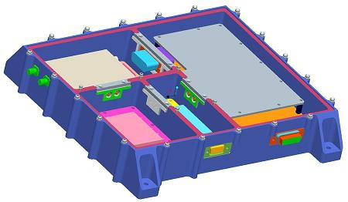
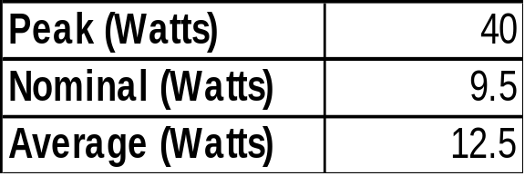
ONR ODTML
Size, Weight and Power
Size – 10” X 10” X 1.8”
Weight – 3.7 kg
Power
For a 28v bus regulated down to 5v.
For our 8v bus and with some conservation, maybe 10W average.
Vandegriff

Slide 9
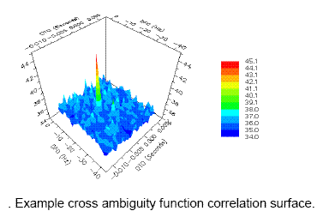
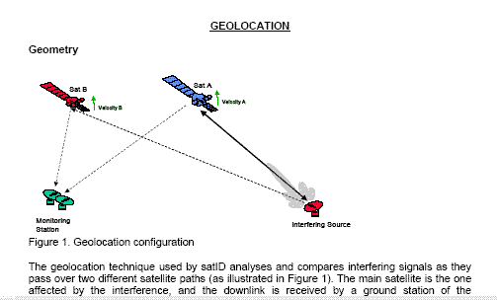
UFO RFI Mitigation

Slide 10
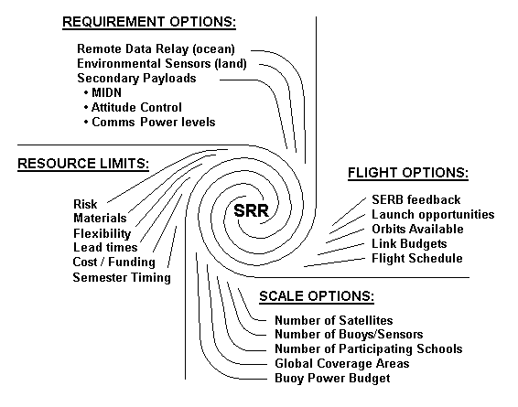
ParkinsonSAT
Spiral Design Approach
Lovick

Slide 11
ParkinsonSAT
Link Budget is Known
Buoy to Satellite (VHF)
  Pr (90° el) = -101 dBm
  Pr ( 0° el) = -117 dBm
Satellite to Buoy (UHF)
  Pr (90° el) = -110 dBm
  Pr (20° el) = -117 dBm
  Satellite to Buoy (VHF) aux TX
  Pr (90° el) = -101 dBm
  Pr ( 0° el) = -117 dBm
Satellite to Groundstation (UHF)
  Pr (90° el) = -110 dBm
  Pr (20° el) = -117 dBm
Satellite to Trackingstation (UHF) +8 dB
  Pr (90° el) = -102 dBm
  Pr ( 0° el) = -117 dBm
Challenge: All using OMNI antennas
RX sensitivity -117 dBm
Vandegriff

Slide 12
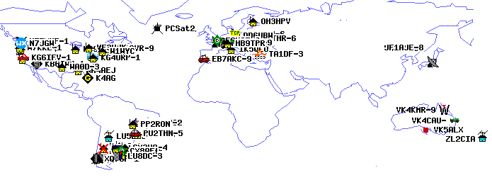
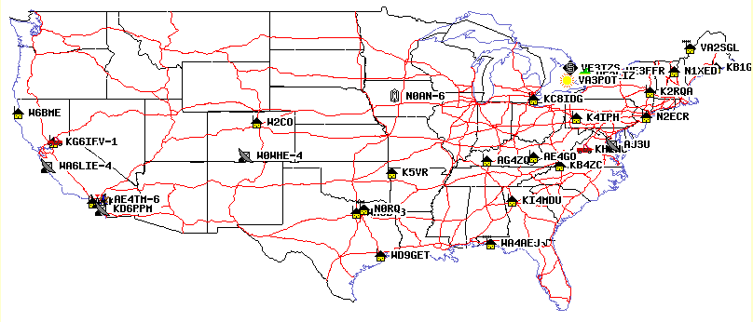
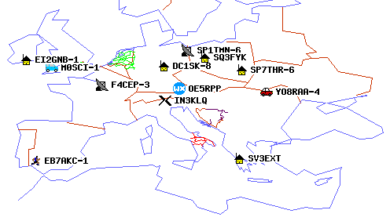
Sensor Buoy Baseline
PCSAT2 User Plot 18 Apr 06
PCSAT validates our links
Vandegriff

Slide 13
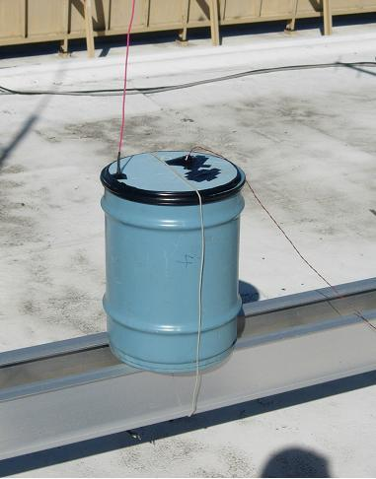
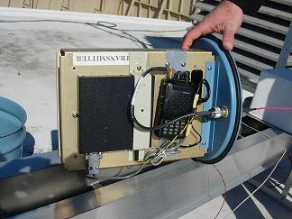
Sensor Buoy Baseline
Our RF prototype on Roof
GOES data collection platform container
Paquette, Robeson

Slide 14
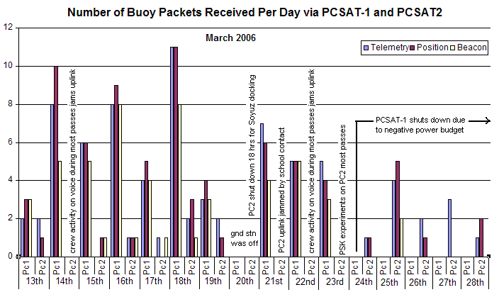
Sensor Buoy Baseline
Paquette

Slide 15
Launch Opportunities
Free Flyer (comms orbit) - Desired
Attached Payload – OK
Space Shuttle – too low, no life…
  Available Launcher – 5” picosat (minimum system)
  Requires a Propulsion system (H₂O₂ man-safe)
Robeson

Slide 16
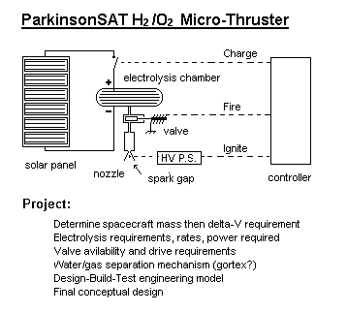
H₂/O₂ Man Safe Propulsion
The only practical way to get a student built propulsion system on board Space Shuttle. Inherently SAFE.
Possible Future Project…

Slide 17
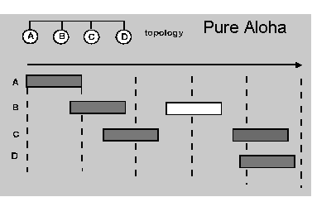
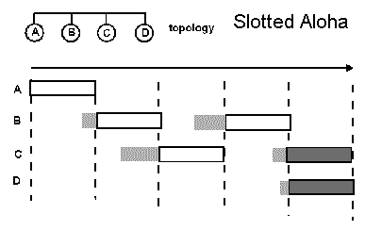
Mission Scale - Channel Capacity
Time Division Multiple Access (TDMA)
  Pure ALOHA 18% channel capacity
  CSMA ALOHA 36% channel capacity (not via sat)
  Slotted ALOHA 36% (uses GPS timing)
Lovick

Slide 18
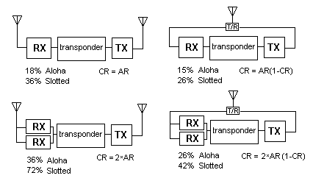
Mission Scale - Receivers
Channel Rate = TDMA Aloha Rate
Full-duplex, Crossband
Simplex / In-band
Lovick

Slide 19
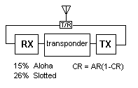
Mission Scale – Options
Minimum System:
32 Buoys/footprint
5” Picosat
Maximum system:
144 Buoys/footprint
Dual redundant
12” Microsat
AT 1200 BAUD
(2 x if 2 RX at 9600)
Lovick

Slide 20
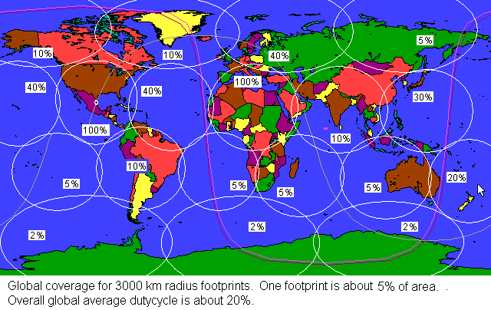
Mission Scale – Buoy Demographics
Theoretical capacity: 2880
Expected capacity: 720
144/5%
144/20%
Lovick

Slide 21
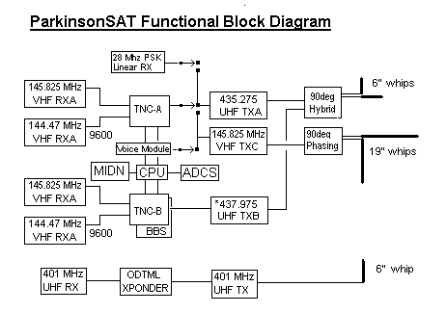
Architecture
Vandegriff

Slide 22
Small Satellite Structural Options
Primary factor is solar panel sizing
Next is Antenna requirements
Separation System
Attitude Control requirements
Koeppel

Slide 23
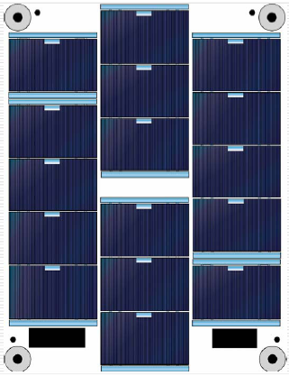
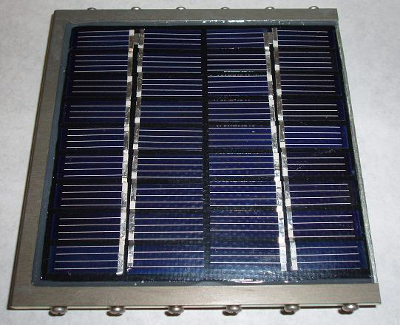
Solar Cell Options
$500 / Watt
EMCOR University Cells
PCsat Panel
$20 / Watt
15%
23%
Koeppel

Slide 24
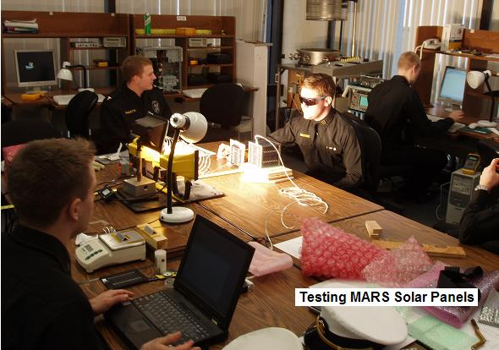
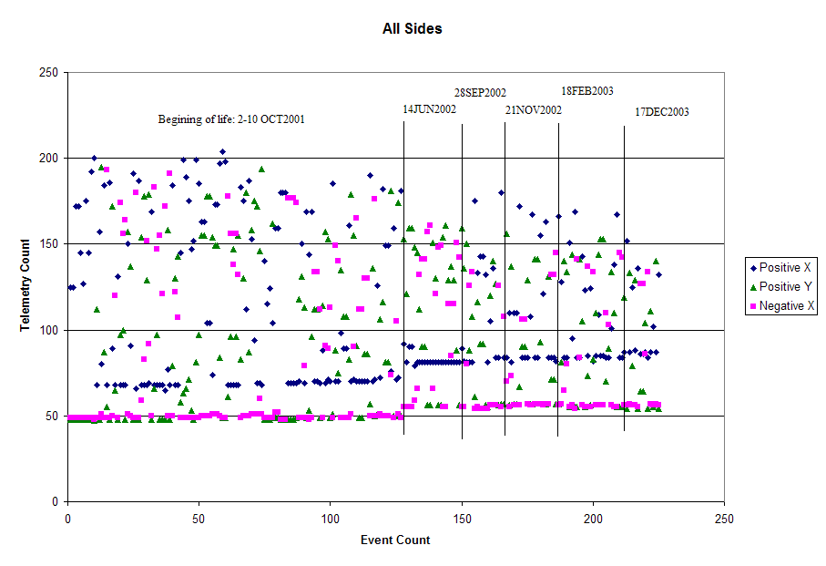
PCSat Solar
Panel Data
5 year degradation 35%
Koeppel

Slide 25
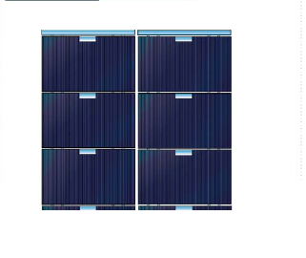
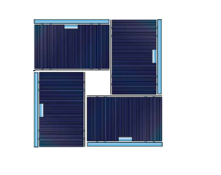
Emcor University Cell Options
6 cell 12v set
4 cell 8V set
Koeppel

Slide 26
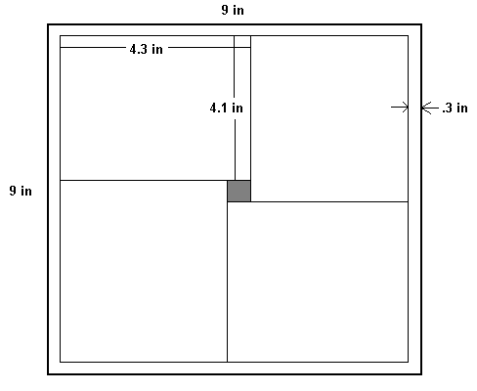
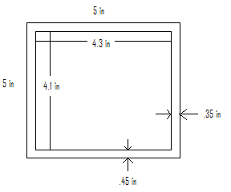
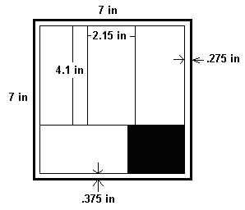
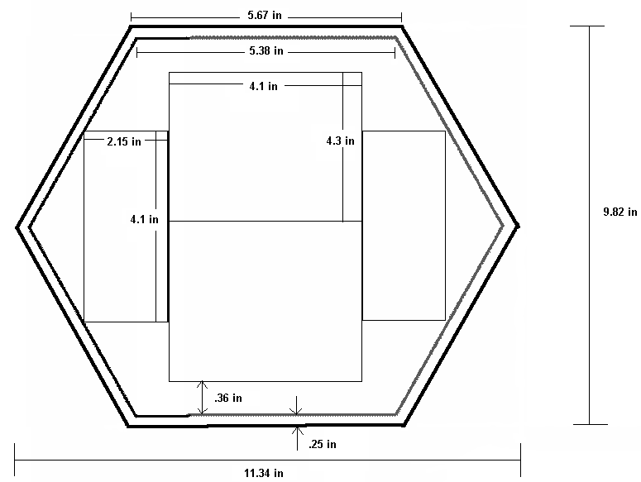
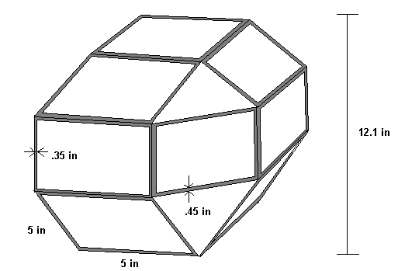
ParkinsonSAT
Shape / size Constraints
5in Cube
7in Cube
9in Cube
Rhombicuboctahedron
Hexagonal
Vandegriff

Slide 27
ParkinsonSAT
Shape / Size Constraints
Shape | Solar Panels | Max Power (W) | Min Power (W) | Volume (in^3) | Surface Area (in^2)
5in Cube | 6 | 3.49 | 2.03 | 125 | 150
7in Cube | 12 | 7.04 | 4.06 | 343 | 294
9in Cube | 24 | 14.1 | 8.13 | 729 | 486
Hexagonal | 9 | 6.10 | 1.67 | 208.8 | 252
Octagonal | 12 | 8.13 | 2.45 | 273.5 | 314
Rombicub octahedron | 18 | 9.15 | 7.78 | 1061 | 518
Vandegriff

Slide 28
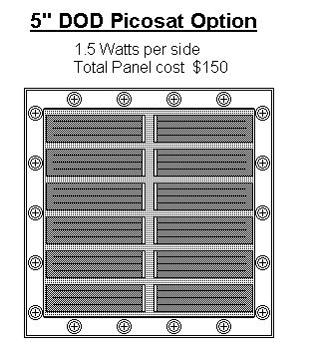
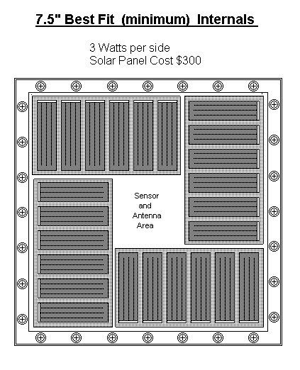
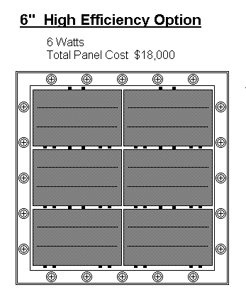
ParkinsonSAT
Straw-man Options
Discrete sizes
Vandegriff

Slide 29
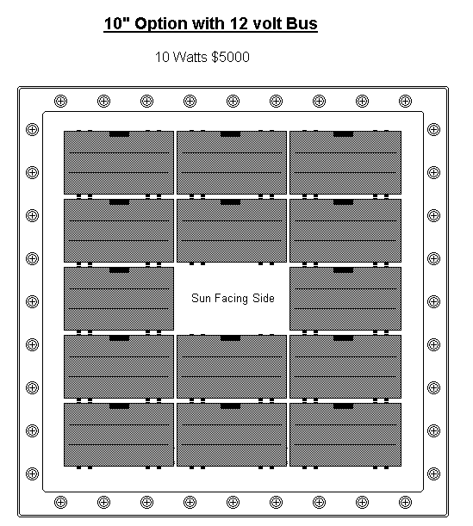
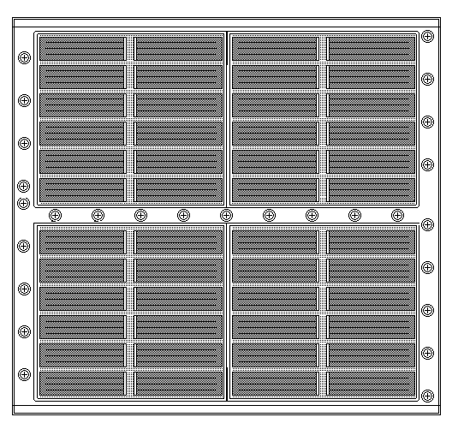
ParkinsonSAT
Sun Pointing
Straw-man Designs
X 6 = $30,000
Side View 6W $100
Vandegriff

Slide 30
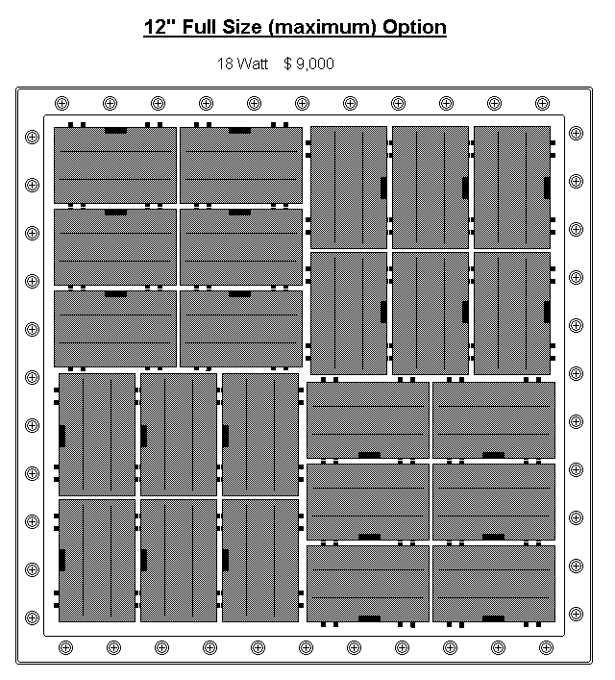
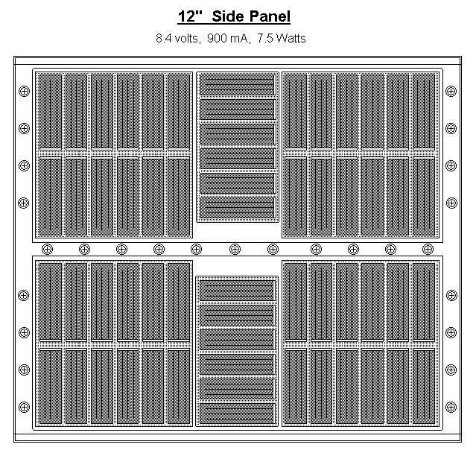
ParkinsonSAT
Sun Pointing
Full System Design
Vandegriff

Slide 31
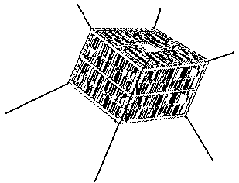
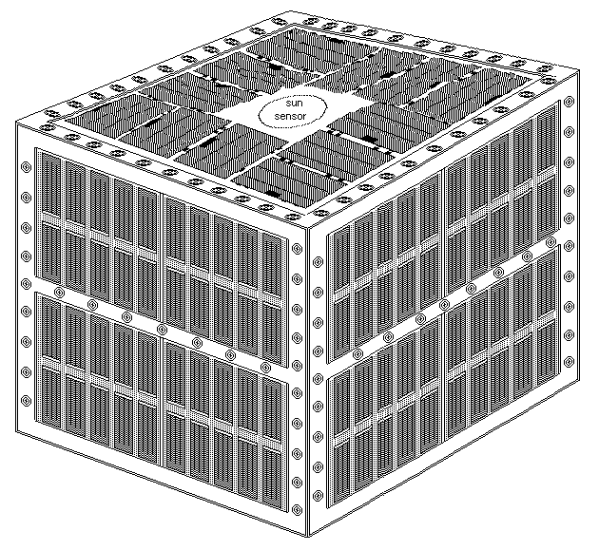
ParkinsonSAT
Sun Pointing Design
Full capacity mission transponders
ODTML Transponder
MIDN Payload
ADCS advantage
Vandegriff

Slide 32
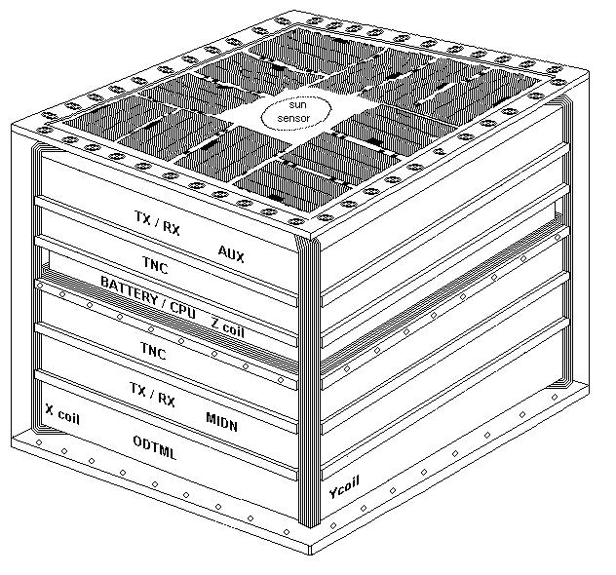
ParkinsonSAT
Internal Stack
Full capacity mission transponders
ODTML Transponder
MIDN Payload
ADCS advantage
Vandegriff

Slide 33
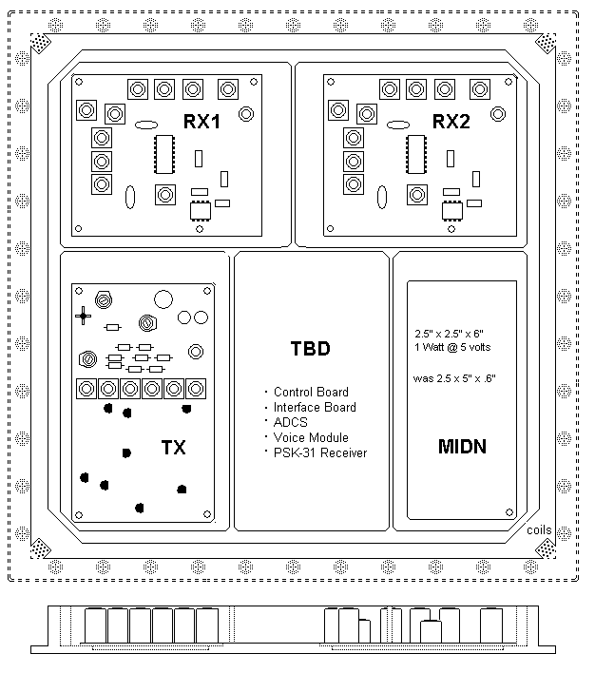
ParkinsonSAT
TX-RX Tray
2 VHF receivers
1 or 2 XMTRS
MIDN Payload
Support Boards
Koeppel

Slide 34
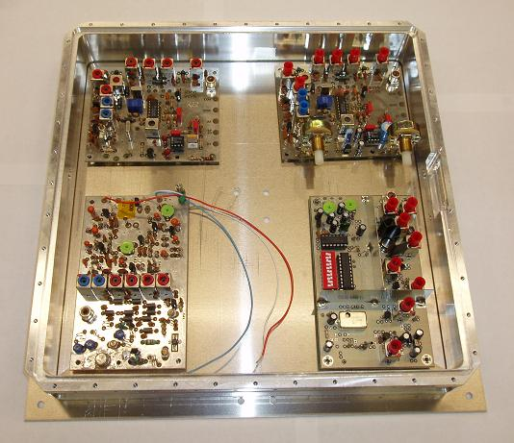

Representative Tray Designs
TX-RX Tray
Layout favors +Z
maximum moment of inertia
TNC / Battery Tray
Koeppel

Slide 35
Preliminary Mass Budget
Part | Mass (g) | Quantity | Total (g)
Structure
Side Panel | 696 | 4 | 2787
PCSAT Solar Panel | 77 | 25 | 1940
Top/Bottom Panel | 796 | 2 | 1592
EMCOR Solar Panel | 24 | 24 | 57
Mounting Tray | 669 | 6 | 4015
Battery Box | 354 | 1 | 354
Comms
VHF RX | 78 | 4 | 313
Linear RX | 78 | 1 | 78
VHF TX | 80 | 1 | 80
UHF TX | 80 | 2 | 161
Voice Module | 10 | 1 | 10
TNC | 204 | 2 | 409
Vandegriff

Slide 36
Preliminary Mass Budget (cont)
Payloads | Mass (g) | Quantity | Total (g)
MiDn | 529 | 1 | 529
ODTML Transponder | 3700 | 1 | 3700
ADCS
x-coil | 127 | 1 | 127
y-coil | 127 | 1 | 127
z-coil | 110 | 1 | 110
CPU | 62 | 1 | 62
Power
Battery | 23 | 36 | 856
Overall Total |  |  | 17.3 kg
Vandegriff

Slide 37
Preliminary Required Power Budget
4 RX / 2 TX | Current (mA) | Duty Cycle | Avg (mA)
VHF FM TX1 | 500 | 15% | 75
VHF FM TX2 | 500 | 15% | 75
VHF FM RX1 | 30 | 100% | 30
VHF FM RX2 | 30 | 100% | 30
VHF FM RX3 | 30 | 100% | 30
VHF FM RX4 | 30 | 100% | 30
TNC1 | 30 | 100% | 40
TNC2 | 30 | 100% | 40
W/o MiDn/ODTML
20% Reserve | 40 |  | 40
Avg (mA) |  |  | 390
 | Current (mA) | Duty Cycle | Avg (mA)
With MiDn only | 119 | 100% | 119
20% Reserve (tot) | 64 |  | 64
Avg(mA) |  |  | 533
With MiDn and with | 119 | 100% | 119
ODTML transponder (10W) | 1200 | 100% | 1200
20% Reserve (tot) |  |  | 361
Avg (mA) |  |  | 2040
Minimum of 4.5W
Maximum of 17 W
Vandegriff

Slide 38


ParkinsonSAT Battery Tests
For a typical COMM orbit at 500 miles, satellite will require 630 mAh. Based on 20% DoD this requires either 27 AA’s, 12 C’s or 7 D cell NiCads.
Dual Voltage Bus for best efficiency / simplicity
Koeppel

Slide 39


Sun Pointing Attitude Control System
Attitude Vector
Reduces solar panel cost, $54,000 to $9000.
Pointing requirements are relaxed +/- 40 deg
Attitude sensing will need simple magnetometer
Table derived magnetic field data
High precision vector math not required
Paquette

Slide 40


Sun Pointing Attitude Control System
Pointing requirements are relaxed +/- 40 deg
High precision vector math not required
ODTML on (18W)
ODTML off (4.5 W)
Paquette

Slide 41

Magnetic Field Vector
Prof Ingle, Physics
76 deg W
Paquette

Slide 42

Magnetic Field Vector
Prof Ingle, Physics
Paquette

Slide 43
Magnetic Torque Requirement
Worst Case Disturbance Torques:
Gravity Gradient (~balanced MOI from RAFT model)
  T_{g}=3*μ/(2*r³)*|I_{z}-I_{y}|*sin(2*θ) T_{g}=6.30*10⁻²⁵ N-m ≈ 0 N-m
Solar Radiation
  T_{sp}=F*(C_{ps}-C_{g}) w/ F=F_{s}/C*A_{s}*(1+q)*cos(i) T_{sp}=1.03*10⁻⁷ N-m
Aerodynamic Drag (Assumed 500 km)
  T_{a}=1/2*ρ*C_{D}*A*V²*(C_{pa}-C_{g}) T_{a}=1.48*10⁻⁶ N-m
Total Disturbance Torque
  T_{d}=1.58*10⁻⁶ N-m
Dipole Needed to Cancel Torques (weakest Earth field at 500 km):
  D=T^{d}/B B=0.31*10⁻⁴ T D=0.051 A-m²
Paquette

Slide 44

Magnetic Torque Coils
Torque Lab Experiment
200 turns #30
42 Ohms, 200 mA
1.3 Amp * M²
1.4 kg
Results in 5 deg / sec
Suggests for ParkinsonSAT
200 turns #30
4 Amp * M²
14 kg
Results in 1.5 deg / sec
Using 10% dutycycle pulsing still gives 10 dB margin
Paquette

Slide 45



Launcher Separation Devices
NEA
Robeson

Slide 46


CPU Design
Adding CPU to basic PCSAT type design for:
- Collect and transmit whole orbit data telemetry
- Event scheduler
- Data logger
- Attitude control system
- Store and Forward
Includes…
-Serial port, 9600 or 1200 baud
-8-bit parallel I/O
-5 or more analog inputs
Development Board
CPU Module
Piggrem

Slide 47
Prototype Buoy Design
Design aspects similar to spacecraft:
  Power System (EPS) (low-power & efficiency)
  Communications System (link budget)
  Sensor system (collaborating with Oceanography)
  Telemetry System
  Antenna System (antenna patterns)
Structure
  Collaborating with Hydro Lab
Piggrem

Slide 48



Sensor Buoy Baseline
See Buoy Location and Telemetry at
http://www.ew.unsa.edu/~bruninga/buoy.html
Piggrem

Slide 49
Buoy Power Budget
Energizer 6V Lantern Battery (No. 529) | Voltage (V) | Resistance (Ω) | Current (mA) | Time On (h) | Capacity (mAh/day) | Published Battery Capactity (Ah) | Battery Life (days)
 | 6 | 110 | 54.55 | 2.4 | 130.91 | 26 | 199
Component | Current (mA) | Time On (min/hr) | Required Energy (mAm/h) | Required Energy (mAh/Day) | Total Energy (mAh/Day) | Published Battery Capactity (Ah) | Battery Life (days)
Garmin GPS-18 | 110 | 2 | 220 | 88 | 128 | 26 | 203
Transmitter | 500 | 0.2 | 100 | 40
* 2 batteries required to get 12v BOL and 7v EOL
Piggrem, Koeppel

Slide 50

Buoy Power Budget
Piggrem, Koeppel

Slide 51
Buoy Logic Timing Design
Prescribed Timing Requirements for Bay Mission
GPS – 1.4 minutes on every 23.4 minutes
Transmits every 10 minutes
TNC – 11 seconds on every 11 minutes
Prescribed Timing Requirements for Ocean Mission
TNC – 22 seconds on every 2.9 minutes
GPS – 1.4 minutes every 46.9 minutes
Transmits every 2.9 minutes
Lovick

Slide 52


Buoy Logic Timing Hardware Integration
Astable Operating 555 Timer (Clock Input)
54HC4040 12-Stage Binary Ripple Counter
Triple 3-Input Positive Nand Gate Chip
Quadruple 2-Input Positive Nand Gate Chip
Lovick

Slide 53

Buoy Telemetry
Battery Volts
Air Temp
Water Temp
Sun luminosity
Conductivity
Flooding
Paquette

Slide 54

ParkinsonSAT Thermister Calibration Curve
Paquette

Slide 55






Buoy Antenna Design
70%
Paquette

Slide 56



ParkinsonSAT
5” Option microgravity Separation Test
March 30th – April 8th
(“Test of Opportunity”)
Robeson

Slide 57



Test 5” cubesat separation system
Robeson

Slide 58


Slide 59

Questions?

Slide 60



PCSat2 Operations
  Daily Antenna Pointing
  Low Power Shutdown
  Soyuz Docking
  EVA’s
    SuitSAT deployment

