Slide 1
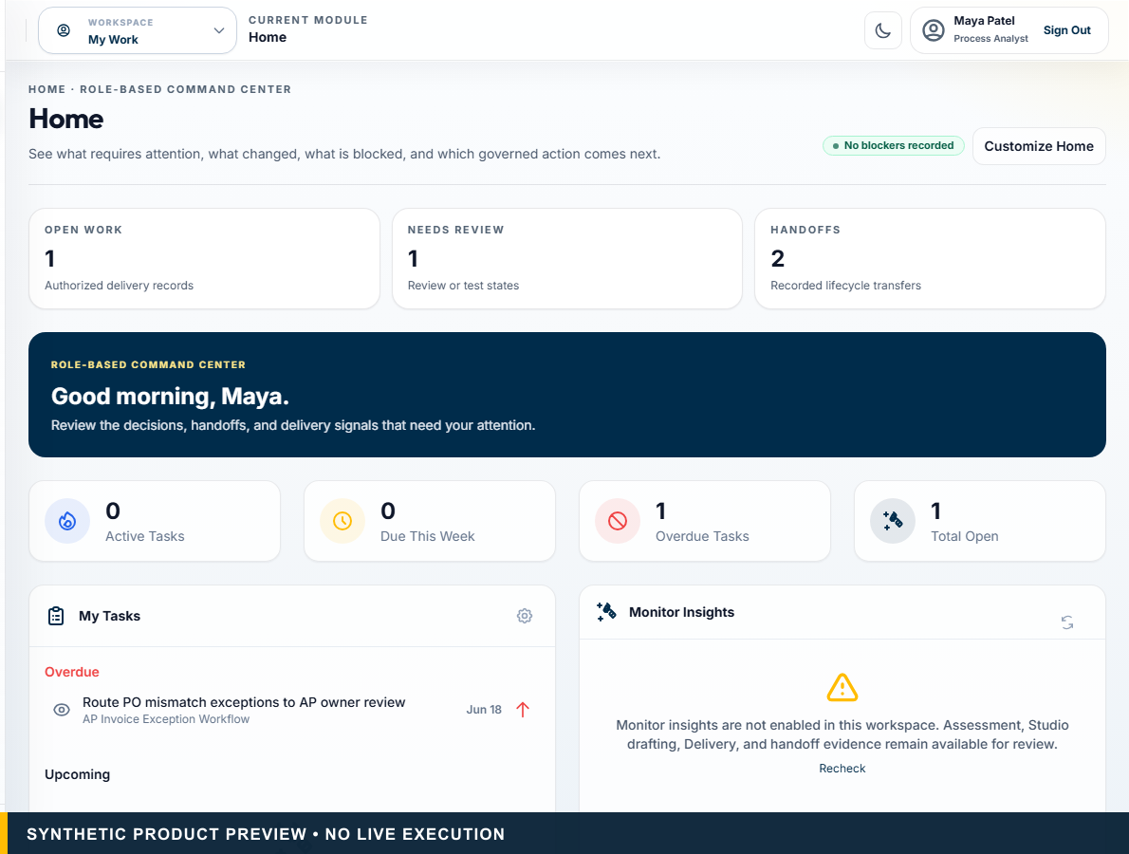
CLIENT DISCUSSION DRAFT
From process evidence to governed delivery.
AvalaOS — the governed decision and delivery layer around AI, automation, and human work.
EVIDENCE • HUMAN AUTHORITY • TRACEABLE HANDOFF
From Process Evidence to Governed Delivery • CIO/COO, Automation or AI leadership, Process Owners, BA/PMO, Risk and delivery leaders
Synthetic product preview. No client relationship or live execution implied.
01
Notes:
PRIMARY TALK TRACK (45–75 seconds)
Use this slide to establish that from process evidence to governed delivery. AvalaOS — the governed decision and delivery layer around AI, automation, and human work. The key distinction is that AvalaOS governs the decision and handoff while authorized systems execute. State the boundary plainly: Synthetic product preview. No client relationship or live execution implied. Pause on the consequence for this audience before advancing to the next stage of the story.
KEY POINT
From process evidence to governed delivery.
AUDIENCE-SPECIFIC EMPHASIS
Orient the buyer around the operating outcome.
CLAIMS USED
CL-001, CL-002, CL-003, CL-024
CURRENT VS ROADMAP
Current unless otherwise labelled.
LIKELY OBJECTION
Is this a customer case study?
SUGGESTED RESPONSE
No. This is a configurable discussion draft using synthetic product data.
AP INPUT REQUIRED
Client name and logo remain unsupplied.
[Sources]
- CL-001: docs/00_SOURCE_OF_TRUTH.md — product identity; docs/01_PRODUCT_STRATEGY.md — Positioning
- CL-002: docs/00_SOURCE_OF_TRUTH.md — canonical tagline
- CL-003: docs/design/avalaos-enterprise-ui-rebaseline.md — Purpose
- CL-024: docs/design/avalaos-enterprise-ui-rebaseline.md — Isolated marketing capture
- Asset: public/marketing/screenshots/ (synthetic committed product captures)
- Fonts: Outfit and Inter, SIL Open Font License 1.1; bundled under docs/marketing/decks/assets/fonts/
[/Sources]

Slide 2
THE BUYER PROBLEM
Automation portfolios fail before development begins.
Technology-first selection
Inconsistent assessment methods
Incomplete evidence
Spreadsheet decisions
Approval by email
Context lost at handoff
From Process Evidence to Governed Delivery • CIO/COO, Automation or AI leadership, Process Owners, BA/PMO, Risk and delivery leaders
Recognizable operating pattern; no quantified buyer performance claim.
02
Notes:
PRIMARY TALK TRACK (45–75 seconds)
Use this slide to establish that automation portfolios fail before development begins. Walk through Technology-first selection, Inconsistent assessment methods, Incomplete evidence, and Spreadsheet decisions. The remaining signals — Spreadsheet decisions and Approval by email — matter because they keep authority and evidence visible. State the boundary plainly: Recognizable operating pattern; no quantified buyer performance claim. Pause on the consequence for this audience before advancing to the next stage of the story.
KEY POINT
Automation portfolios fail before development begins.
AUDIENCE-SPECIFIC EMPHASIS
Frame decision quality as a portfolio-control problem.
CLAIMS USED
CL-001, CL-003, CL-008
CURRENT VS ROADMAP
Current unless otherwise labelled.
LIKELY OBJECTION
Do you have benchmark failure rates?
SUGGESTED RESPONSE
No benchmark number is used; the slide describes the problem the product addresses.
AP INPUT REQUIRED
None.
[Sources]
- CL-001: docs/00_SOURCE_OF_TRUTH.md — product identity; docs/01_PRODUCT_STRATEGY.md — Positioning
- CL-003: docs/design/avalaos-enterprise-ui-rebaseline.md — Purpose
- CL-008: docs/00_SOURCE_OF_TRUTH.md — Product and Security Law
- Fonts: Outfit and Inter, SIL Open Font License 1.1; bundled under docs/marketing/decks/assets/fonts/
[/Sources]

Slide 3
TECHNOLOGY FIT
Not every process needs AI.
Stable + structured
Rules / workflow
Deterministic controls
Repetitive UI work
RPA
Only where stronger interfaces are unavailable
Unstructured content
AI assistance
Extraction, classification, summarisation
Context-heavy inquiry
Bounded agent assistance
Evidence synthesis with controls
Material-risk judgment
Human / HITL
Accountable approval
Mixed end-to-end work
Hybrid model
A governed combination
From Process Evidence to Governed Delivery • CIO/COO, Automation or AI leadership, Process Owners, BA/PMO, Risk and delivery leaders
AvalaOS evaluates evidence and controls; authorized systems execute.
03
Notes:
PRIMARY TALK TRACK (45–75 seconds)
Use this slide to establish that not every process needs ai. Walk through Stable + structured: Rules / workflow: Deterministic controls, Repetitive UI work: RPA: Only where stronger interfaces are unavailable, Unstructured content: AI assistance: Extraction, classification, summarisation, and Context-heavy inquiry: Bounded agent assistance: Evidence synthesis with controls. The remaining signals — Context-heavy inquiry: Bounded agent assistance: Evidence synthesis with controls and Material-risk judgment: Human / HITL: Accountable approval — matter because they keep authority and evidence visible. State the boundary plainly: AvalaOS evaluates evidence and controls; authorized systems execute. Pause on the consequence for this audience before advancing to the next stage of the story.
KEY POINT
Not every process needs AI.
AUDIENCE-SPECIFIC EMPHASIS
Use the AP Invoice Exception pattern to make hybrid fit concrete.
CLAIMS USED
CL-006, CL-007, CL-008
CURRENT VS ROADMAP
Current unless otherwise labelled.
LIKELY OBJECTION
Does the system prefer AI?
SUGGESTED RESPONSE
No. It selects the least-complex eligible mix under deterministic rules.
AP INPUT REQUIRED
None.
[Sources]
- CL-006: docs/architecture/assess-v2-decision-intelligence-architecture.md — Purpose and Deterministic Decision Layers
- CL-007: docs/architecture/assess-v2-decision-intelligence-architecture.md — Canonical AP Invoice Exception Outcome
- CL-008: docs/00_SOURCE_OF_TRUTH.md — Product and Security Law
- Fonts: Outfit and Inter, SIL Open Font License 1.1; bundled under docs/marketing/decks/assets/fonts/
[/Sources]

Slide 4
FRAGMENTED VS GOVERNED
The decision trail breaks when every phase starts over.
Fragmented path
AvalaOS path
Workshop
Evidence
Spreadsheet
Deterministic decision
Opinion
Human governance
Document
Governed artifact
Email approval
Delivery handoff
Delivery tool
Outcome visibility
Lost context
From Process Evidence to Governed Delivery • CIO/COO, Automation or AI leadership, Process Owners, BA/PMO, Risk and delivery leaders
The fragmented path is an operating pattern, not a claim about a named client.
04
Notes:
PRIMARY TALK TRACK (45–75 seconds)
Use this slide to establish that the decision trail breaks when every phase starts over. Walk through Workshop, Spreadsheet, Opinion, and Document. The remaining signals — Document and Email approval — matter because they keep authority and evidence visible. State the boundary plainly: The fragmented path is an operating pattern, not a claim about a named client. Pause on the consequence for this audience before advancing to the next stage of the story.
KEY POINT
The decision trail breaks when every phase starts over.
AUDIENCE-SPECIFIC EMPHASIS
Contrast handoff loss with retained reasoning.
CLAIMS USED
CL-003
CURRENT VS ROADMAP
Current unless otherwise labelled.
LIKELY OBJECTION
Can existing tools be retained?
SUGGESTED RESPONSE
Yes. AvalaOS complements the execution ecosystem.
AP INPUT REQUIRED
None.
[Sources]
- CL-003: docs/design/avalaos-enterprise-ui-rebaseline.md — Purpose
- Fonts: Outfit and Inter, SIL Open Font License 1.1; bundled under docs/marketing/decks/assets/fonts/
[/Sources]

Slide 5
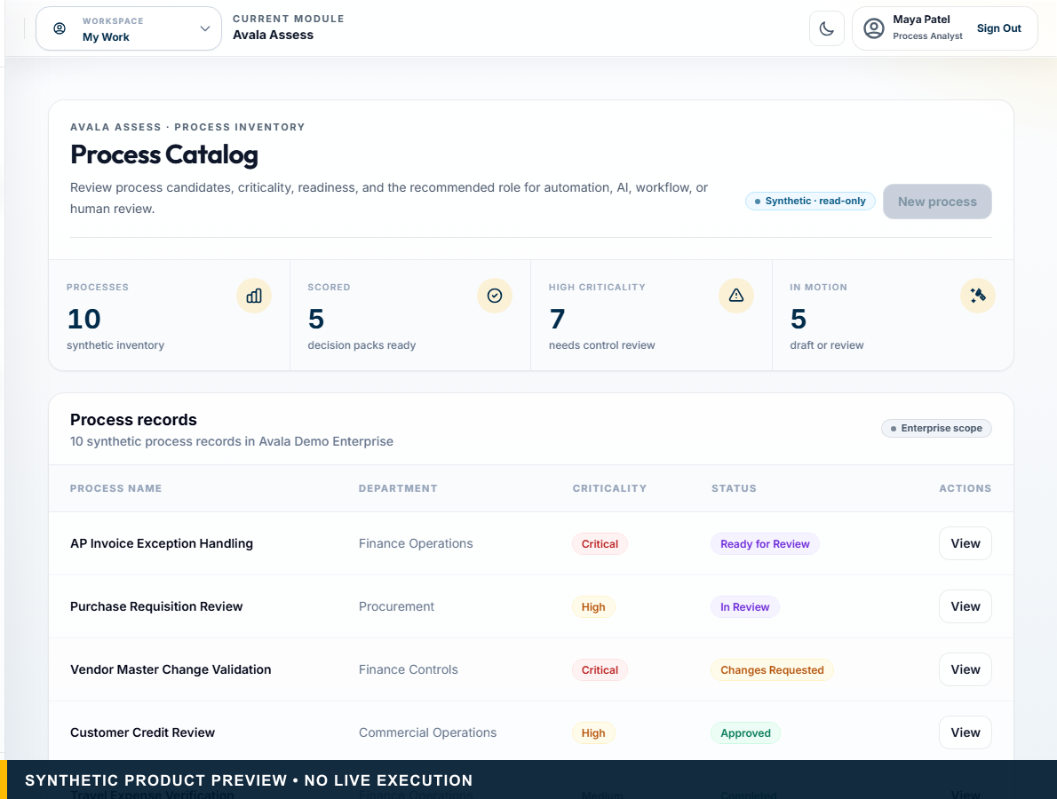
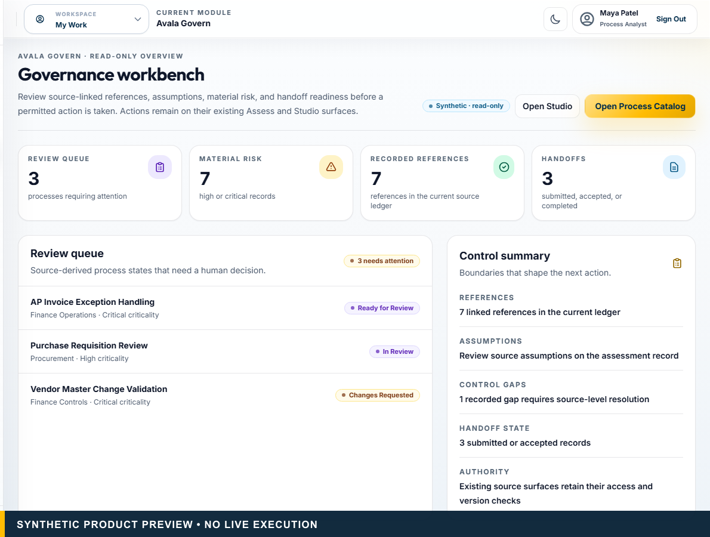
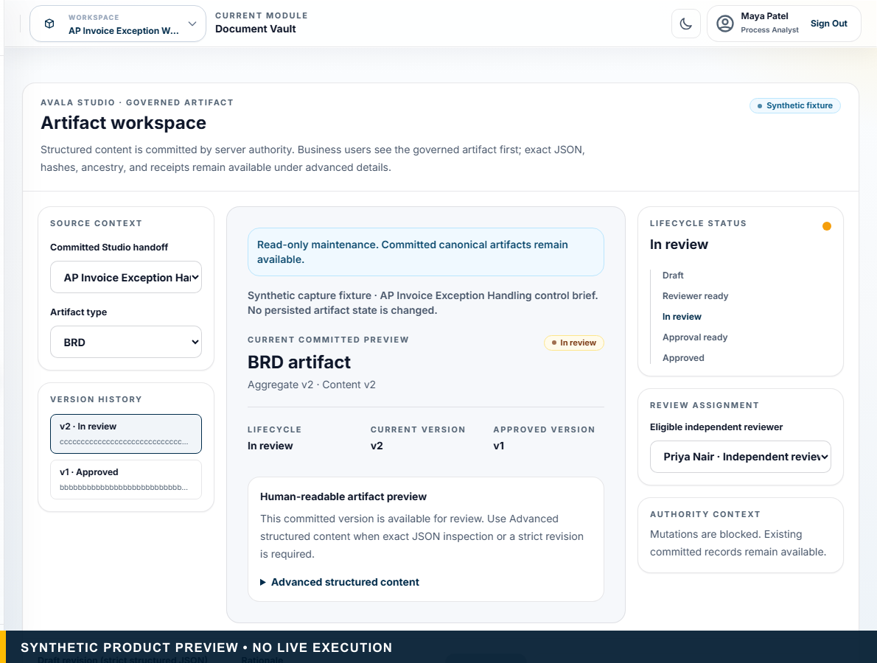
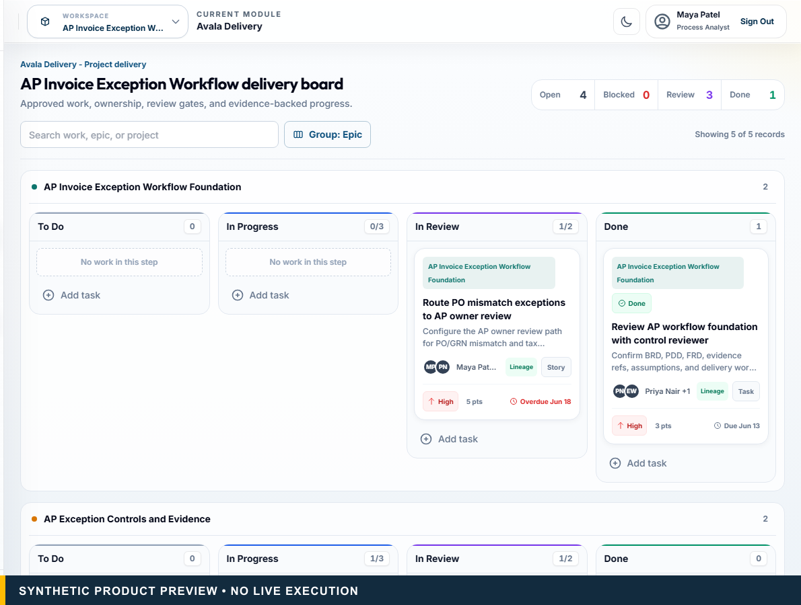
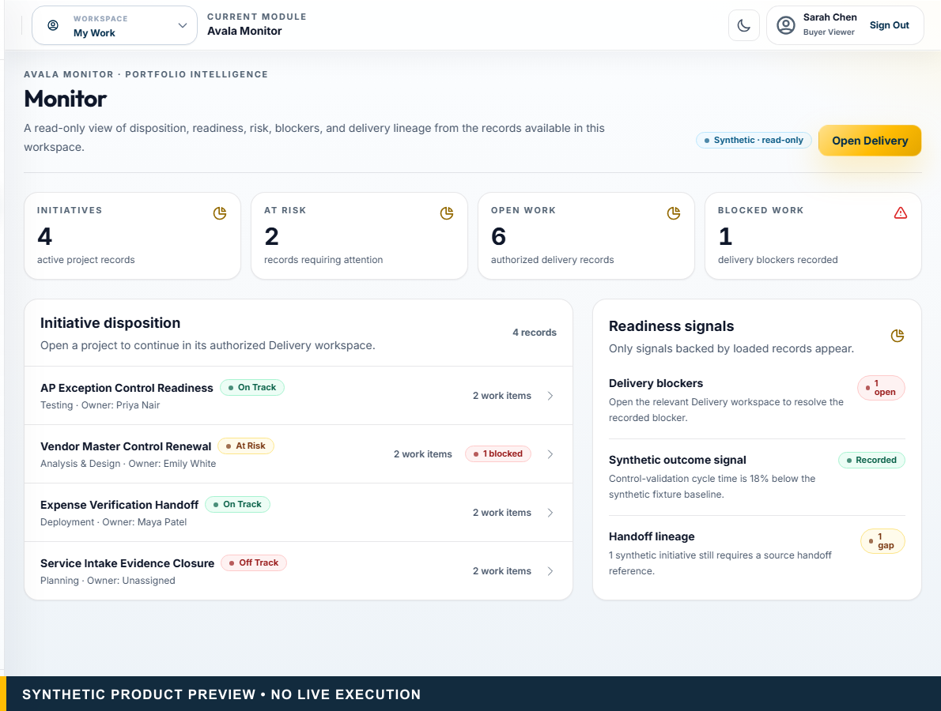
THE AVALAOS LIFECYCLE
One governed lifecycle keeps evidence and accountability attached.
01
Assess
02
Govern
03
Studio
04
Delivery
05
Monitor
Evidence-qualified recommendation
Human-owned controls
Approved artifacts
Source-linked work
Outcome visibility
From Process Evidence to Governed Delivery • CIO/COO, Automation or AI leadership, Process Owners, BA/PMO, Risk and delivery leaders
Synthetic product previews. Execution remains with authorized systems.
05
Notes:
PRIMARY TALK TRACK (45–75 seconds)
Use this slide to establish that one governed lifecycle keeps evidence and accountability attached. Walk through Assess: Evidence-qualified recommendation, Govern: Human-owned controls, Studio: Approved artifacts, and Delivery: Source-linked work. The remaining signals — Delivery: Source-linked work and Monitor: Outcome visibility — matter because they keep authority and evidence visible. State the boundary plainly: Synthetic product previews. Execution remains with authorized systems. Pause on the consequence for this audience before advancing to the next stage of the story.
KEY POINT
One governed lifecycle keeps evidence and accountability attached.
AUDIENCE-SPECIFIC EMPHASIS
Explain the cumulative output of each stage.
CLAIMS USED
CL-003, CL-004, CL-024
CURRENT VS ROADMAP
Current unless otherwise labelled.
LIKELY OBJECTION
Does the lifecycle replace our existing stack?
SUGGESTED RESPONSE
No. It preserves decision context around the systems that execute.
AP INPUT REQUIRED
None.
[Sources]
- CL-003: docs/design/avalaos-enterprise-ui-rebaseline.md — Purpose
- CL-004: docs/design/avalaos-enterprise-ui-rebaseline.md — Authenticated information architecture
- CL-024: docs/design/avalaos-enterprise-ui-rebaseline.md — Isolated marketing capture
- Asset: public/marketing/screenshots/ (synthetic committed product captures)
- Fonts: Outfit and Inter, SIL Open Font License 1.1; bundled under docs/marketing/decks/assets/fonts/
[/Sources]

Slide 6
WHAT THE CLIENT RECEIVES
Avala Assess turns evidence into an explainable recommendation.
Process inventory
Primitive-level decomposition
Evidence confidence and gaps
Versioned deterministic recommendation
Hybrid operating model
Decision Pack
From Process Evidence to Governed Delivery • CIO/COO, Automation or AI leadership, Process Owners, BA/PMO, Risk and delivery leaders
Economics are scenario-based; calibration is Insufficient Data. No live estate scanning.
06
Notes:
PRIMARY TALK TRACK (45–75 seconds)
Use this slide to establish that avala assess turns evidence into an explainable recommendation. Walk through Process inventory, Primitive-level decomposition, Evidence confidence and gaps, and Versioned deterministic recommendation. The remaining signals — Versioned deterministic recommendation and Hybrid operating model — matter because they keep authority and evidence visible. State the boundary plainly: Economics are scenario-based; calibration is Insufficient Data. No live estate scanning. Pause on the consequence for this audience before advancing to the next stage of the story.
KEY POINT
Avala Assess turns evidence into an explainable recommendation.
AUDIENCE-SPECIFIC EMPHASIS
Describe tangible buyer outputs, not features alone.
CLAIMS USED
CL-005, CL-006, CL-009, CL-010, CL-024
CURRENT VS ROADMAP
Current unless otherwise labelled.
LIKELY OBJECTION
How accurate are the economics?
SUGGESTED RESPONSE
They are traceable scenarios from explicit evidence and assumptions, not guaranteed outcomes.
AP INPUT REQUIRED
None.
[Sources]
- CL-005: docs/00_SOURCE_OF_TRUTH.md — Accepted Capabilities
- CL-006: docs/architecture/assess-v2-decision-intelligence-architecture.md — Purpose and Deterministic Decision Layers
- CL-009: docs/architecture/assess-v2-economics-calibration-architecture.md — Formula Architecture and Calibration
- CL-010: docs/architecture/application-portfolio-assessment-architecture.md — Dimensions and Dispositions
- CL-024: docs/design/avalaos-enterprise-ui-rebaseline.md — Isolated marketing capture
- Asset: public/marketing/screenshots/ (synthetic committed product captures)
- Fonts: Outfit and Inter, SIL Open Font License 1.1; bundled under docs/marketing/decks/assets/fonts/
[/Sources]

Slide 7
HUMANS APPROVE RISK
Govern resolves material risk before handoff.
Evidence attestations
Assumptions and gaps
Action-specific controls
Approval conditions
Handoff readiness
From Process Evidence to Governed Delivery • CIO/COO, Automation or AI leadership, Process Owners, BA/PMO, Risk and delivery leaders
Govern is a control-plane record, not runtime enforcement.
07
Notes:
PRIMARY TALK TRACK (45–75 seconds)
Use this slide to establish that govern resolves material risk before handoff. Walk through Evidence attestations, Assumptions and gaps, Action-specific controls, and Approval conditions. The remaining signals — Approval conditions and Handoff readiness — matter because they keep authority and evidence visible. State the boundary plainly: Govern is a control-plane record, not runtime enforcement. Pause on the consequence for this audience before advancing to the next stage of the story.
KEY POINT
Govern resolves material risk before handoff.
AUDIENCE-SPECIFIC EMPHASIS
Use resolves conditions, not eliminates risk.
CLAIMS USED
CL-008, CL-011, CL-012, CL-024
CURRENT VS ROADMAP
Current unless otherwise labelled.
LIKELY OBJECTION
Can the system enforce agent behavior live?
SUGGESTED RESPONSE
Not in the current baseline. Authorized execution platforms retain runtime control.
AP INPUT REQUIRED
None.
[Sources]
- CL-008: docs/00_SOURCE_OF_TRUTH.md — Product and Security Law
- CL-011: docs/07_AVALA_GOVERN_FRAMEWORK.md — Current Scope
- CL-012: docs/00_SOURCE_OF_TRUTH.md — Product and Security Law
- CL-024: docs/design/avalaos-enterprise-ui-rebaseline.md — Isolated marketing capture
- Asset: public/marketing/screenshots/ (synthetic committed product captures)
- Fonts: Outfit and Inter, SIL Open Font License 1.1; bundled under docs/marketing/decks/assets/fonts/
[/Sources]

Slide 8
EDITABLE BUSINESS + DELIVERY DOCUMENTATION
Studio turns approved context into an artifact people can revise and approve.
BRD
FRD
PDD
Human-readable preview
Immutable revisions
Independent review
Separate approval
From Process Evidence to Governed Delivery • CIO/COO, Automation or AI leadership, Process Owners, BA/PMO, Risk and delivery leaders
Structured artifacts are accepted. Private rendition and brokered download remain candidate-only.
08
Notes:
PRIMARY TALK TRACK (45–75 seconds)
Use this slide to establish that studio turns approved context into an artifact people can revise and approve. Walk through BRD, FRD, PDD, and Human-readable preview. The remaining signals — Human-readable preview and Immutable revisions — matter because they keep authority and evidence visible. State the boundary plainly: Structured artifacts are accepted. Private rendition and brokered download remain candidate-only. Pause on the consequence for this audience before advancing to the next stage of the story.
KEY POINT
Studio turns approved context into an artifact people can revise and approve.
AUDIENCE-SPECIFIC EMPHASIS
Keep current structured authority distinct from candidate private files.
CLAIMS USED
CL-013, CL-014, CL-015, CL-024
CURRENT VS ROADMAP
Current unless otherwise labelled.
LIKELY OBJECTION
Can we download approved files today?
SUGGESTED RESPONSE
Private Markdown/PDF/DOCX and brokered download remain release- and deployment-dependent.
AP INPUT REQUIRED
None.
[Sources]
- CL-013: docs/architecture/studio-governed-artifact-authority.md — Scope and trust boundary
- CL-014: docs/architecture/studio-governed-artifact-authority.md — Lifecycle and people
- CL-015: docs/architecture/studio-private-artifact-authority.md — Objective and boundary
- CL-024: docs/design/avalaos-enterprise-ui-rebaseline.md — Isolated marketing capture
- Asset: public/marketing/screenshots/ (synthetic committed product captures)
- Fonts: Outfit and Inter, SIL Open Font License 1.1; bundled under docs/marketing/decks/assets/fonts/
[/Sources]

Slide 9
AVALA DELIVERY
One governed handoff carries the why into delivery.
Source-linked work items
Tasks and acceptance context
Ownership and blockers
Delivery Pack
Evidence and lineage
From Process Evidence to Governed Delivery • CIO/COO, Automation or AI leadership, Process Owners, BA/PMO, Risk and delivery leaders
One governed handoff prepares source-linked work; AvalaOS neither executes the automation nor replaces Jira.
09
Notes:
PRIMARY TALK TRACK (45–75 seconds)
Use this slide to establish that one governed handoff carries the why into delivery. Walk through Source-linked work items, Tasks and acceptance context, Ownership and blockers, and Delivery Pack. The remaining signals — Delivery Pack and Evidence and lineage — matter because they keep authority and evidence visible. State the boundary plainly: One governed handoff prepares source-linked work; AvalaOS neither executes the automation nor replaces Jira. Pause on the consequence for this audience before advancing to the next stage of the story.
KEY POINT
One governed handoff carries the why into delivery.
AUDIENCE-SPECIFIC EMPHASIS
Show what the delivery team receives.
CLAIMS USED
CL-016, CL-017, CL-018, CL-024
CURRENT VS ROADMAP
Current unless otherwise labelled.
LIKELY OBJECTION
Does it sync to Jira or Azure DevOps?
SUGGESTED RESPONSE
No connector or synchronization is promised in this deck.
AP INPUT REQUIRED
None.
[Sources]
- CL-016: docs/02_PRODUCT_REQUIREMENTS.md — Avala Delivery
- CL-017: docs/design/avalaos-enterprise-ui-rebaseline.md — Delivery and Monitor
- CL-018: docs/01_PRODUCT_STRATEGY.md — Product Boundaries
- CL-024: docs/design/avalaos-enterprise-ui-rebaseline.md — Isolated marketing capture
- Asset: public/marketing/screenshots/ (synthetic committed product captures)
- Fonts: Outfit and Inter, SIL Open Font License 1.1; bundled under docs/marketing/decks/assets/fonts/
[/Sources]

Slide 10
AVALA MONITOR
Monitor shows what is ready — and what is not recorded.
Initiative disposition
Readiness and risk
Open work and blockers
Source lineage
Outcome recording state
From Process Evidence to Governed Delivery • CIO/COO, Automation or AI leadership, Process Owners, BA/PMO, Risk and delivery leaders
Read-only visibility over recorded data. No live runtime telemetry; fixture percentages are not client outcomes.
10
Notes:
PRIMARY TALK TRACK (45–75 seconds)
Use this slide to establish that monitor shows what is ready — and what is not recorded. Walk through Initiative disposition, Readiness and risk, Open work and blockers, and Source lineage. The remaining signals — Source lineage and Outcome recording state — matter because they keep authority and evidence visible. State the boundary plainly: Read-only visibility over recorded data. No live runtime telemetry; fixture percentages are not client outcomes. Pause on the consequence for this audience before advancing to the next stage of the story.
KEY POINT
Monitor shows what is ready — and what is not recorded.
AUDIENCE-SPECIFIC EMPHASIS
Make the absence of evidence a visible state.
CLAIMS USED
CL-019, CL-024
CURRENT VS ROADMAP
Current unless otherwise labelled.
LIKELY OBJECTION
Is Monitor real-time?
SUGGESTED RESPONSE
No. It is a read-only view over recorded data.
AP INPUT REQUIRED
None.
[Sources]
- CL-019: docs/design/avalaos-enterprise-ui-rebaseline.md — Delivery and Monitor
- CL-024: docs/design/avalaos-enterprise-ui-rebaseline.md — Isolated marketing capture
- Asset: public/marketing/screenshots/ (synthetic committed product captures)
- Fonts: Outfit and Inter, SIL Open Font License 1.1; bundled under docs/marketing/decks/assets/fonts/
[/Sources]

Slide 11
BUILT AROUND ENTERPRISE WORK
Familiar roles and artifacts reduce adoption friction.
Process owner
Delivery lead
Process analyst
Executive / buyer
Business analyst
Platform admin
Control reviewer
Process catalog • Decision Pack • BRD / FRD / PDD • Work items • Delivery Pack • Portfolio views
From Process Evidence to Governed Delivery • CIO/COO, Automation or AI leadership, Process Owners, BA/PMO, Risk and delivery leaders
Designed to reduce adoption friction; no zero-training claim.
11
Notes:
PRIMARY TALK TRACK (45–75 seconds)
Use this slide to establish that familiar roles and artifacts reduce adoption friction. Walk through Process owner, Process analyst, Business analyst, and Control reviewer. The remaining signals — Control reviewer and Delivery lead — matter because they keep authority and evidence visible. State the boundary plainly: Designed to reduce adoption friction; no zero-training claim. Pause on the consequence for this audience before advancing to the next stage of the story.
KEY POINT
Familiar roles and artifacts reduce adoption friction.
AUDIENCE-SPECIFIC EMPHASIS
Show shared evidence with role-specific views.
CLAIMS USED
CL-027
CURRENT VS ROADMAP
Current unless otherwise labelled.
LIKELY OBJECTION
How much training is needed?
SUGGESTED RESPONSE
Familiar roles and artifacts reduce friction, but training is not claimed to be unnecessary.
AP INPUT REQUIRED
None.
[Sources]
- CL-027: docs/01_PRODUCT_STRATEGY.md — Personas
- Fonts: Outfit and Inter, SIL Open Font License 1.1; bundled under docs/marketing/decks/assets/fonts/
[/Sources]

Slide 12
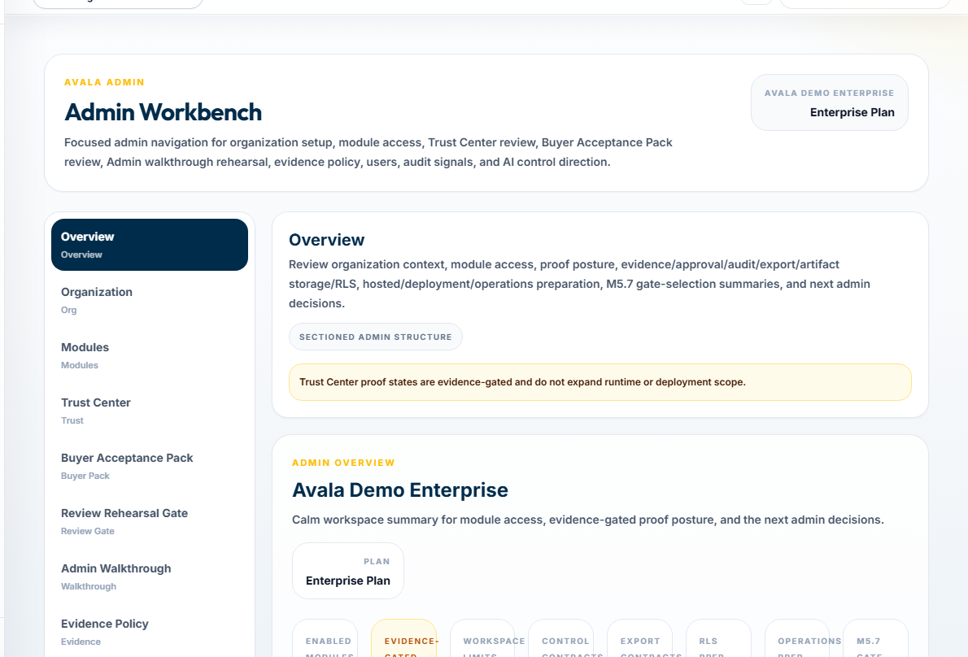
TRUST, AUTHORITY + BYOK
Control boundaries keep model authority and decision authority separate.
BYOK-ready architecture
Designed for customer-controlled model access
Server-side secret boundary
Human approval
Evidence and audit
Fail-closed behavior
From Process Evidence to Governed Delivery • CIO/COO, Automation or AI leadership, Process Owners, BA/PMO, Risk and delivery leaders
Provider availability is deployment-dependent. Hosted tenant isolation and compliance readiness remain unproven.
12
Notes:
PRIMARY TALK TRACK (45–75 seconds)
Use this slide to establish that control boundaries keep model authority and decision authority separate. Walk through BYOK-ready architecture, Designed for customer-controlled model access, Server-side secret boundary, and Human approval. The remaining signals — Human approval and Evidence and audit — matter because they keep authority and evidence visible. State the boundary plainly: Provider availability is deployment-dependent. Hosted tenant isolation and compliance readiness remain unproven. Pause on the consequence for this audience before advancing to the next stage of the story.
KEY POINT
Control boundaries keep model authority and decision authority separate.
AUDIENCE-SPECIFIC EMPHASIS
Use proof-safe trust wording.
CLAIMS USED
CL-008, CL-021, CL-022, CL-026
CURRENT VS ROADMAP
Current unless otherwise labelled.
LIKELY OBJECTION
Is BYOK available now?
SUGGESTED RESPONSE
The current claim is BYOK-ready architecture, dependent on a validated deployment.
AP INPUT REQUIRED
None.
[Sources]
- CL-008: docs/00_SOURCE_OF_TRUTH.md — Product and Security Law
- CL-021: docs/design/avalaos-enterprise-ui-rebaseline.md — Product surfaces
- CL-022: components/public/PublicWebsite.tsx — TrustPage BYOK direction
- CL-026: docs/00_SOURCE_OF_TRUTH.md — Maturity Verdict and Not Accepted Or Proven
- Asset: public/marketing/screenshots/ (synthetic committed product captures)
- Fonts: Outfit and Inter, SIL Open Font License 1.1; bundled under docs/marketing/decks/assets/fonts/
[/Sources]

Slide 13
SUGGESTED ENGAGEMENT PATH
Start with one decision, then earn the right to scale.
Candidate process + evidence discovery
Governed assessment + Decision Pack
Studio artifact + approval
1
2
3
Delivery-handoff validation
Monitor + outcome review
Controlled scale-out decision
4
5
6
From Process Evidence to Governed Delivery • CIO/COO, Automation or AI leadership, Process Owners, BA/PMO, Risk and delivery leaders
No timeline promise. Later pilot and scale stages depend on separately accepted readiness evidence.
13
Notes:
PRIMARY TALK TRACK (45–75 seconds)
Use this slide to establish that start with one decision, then earn the right to scale. Walk through 1: Candidate process + evidence discovery, 2: Governed assessment + Decision Pack, 3: Studio artifact + approval, and 4: Delivery-handoff validation. The remaining signals — 4: Delivery-handoff validation and 5: Monitor + outcome review — matter because they keep authority and evidence visible. State the boundary plainly: No timeline promise. Later pilot and scale stages depend on separately accepted readiness evidence. Pause on the consequence for this audience before advancing to the next stage of the story.
KEY POINT
Start with one decision, then earn the right to scale.
AUDIENCE-SPECIFIC EMPHASIS
Every stage produces an auditable output.
CLAIMS USED
CL-003, CL-005, CL-011, CL-013, CL-017, CL-019
CURRENT VS ROADMAP
Current unless otherwise labelled.
LIKELY OBJECTION
How quickly can we deploy?
SUGGESTED RESPONSE
This deck does not promise a timeline; it sequences the decisions and proof required.
AP INPUT REQUIRED
None.
[Sources]
- CL-003: docs/design/avalaos-enterprise-ui-rebaseline.md — Purpose
- CL-005: docs/00_SOURCE_OF_TRUTH.md — Accepted Capabilities
- CL-011: docs/07_AVALA_GOVERN_FRAMEWORK.md — Current Scope
- CL-013: docs/architecture/studio-governed-artifact-authority.md — Scope and trust boundary
- CL-017: docs/design/avalaos-enterprise-ui-rebaseline.md — Delivery and Monitor
- CL-019: docs/design/avalaos-enterprise-ui-rebaseline.md — Delivery and Monitor
- Fonts: Outfit and Inter, SIL Open Font License 1.1; bundled under docs/marketing/decks/assets/fonts/
[/Sources]

Slide 14
NEXT STEP
Select one process before committing build budget.
Bring a named process owner, a candidate process, available evidence, and known constraints. Leave with a reviewed Decision Pack, control requirements, and an explicit next-step disposition.
1
2
3
Run a governed assessment
Review the recommendation
Then decide whether to build
From Process Evidence to Governed Delivery • CIO/COO, Automation or AI leadership, Process Owners, BA/PMO, Risk and delivery leaders
Success is a defensible decision, not a deployed automation.
14
Notes:
PRIMARY TALK TRACK (45–75 seconds)
Use this slide to establish that select one process before committing build budget. Bring a named process owner, a candidate process, available evidence, and known constraints. Leave with a reviewed Decision Pack, control requirements, and an explicit next-step disposition. The key distinction is that AvalaOS governs the decision and handoff while authorized systems execute. State the boundary plainly: Success is a defensible decision, not a deployed automation. Pause on the consequence for this audience before advancing to the next stage of the story.
KEY POINT
Select one process before committing build budget.
AUDIENCE-SPECIFIC EMPHASIS
Close on a bounded, buyer-owned action.
CLAIMS USED
CL-001, CL-005, CL-008
CURRENT VS ROADMAP
Current unless otherwise labelled.
LIKELY OBJECTION
What must the client provide?
SUGGESTED RESPONSE
One process, accountable owners, current evidence, and known constraints.
AP INPUT REQUIRED
None.
[Sources]
- CL-001: docs/00_SOURCE_OF_TRUTH.md — product identity; docs/01_PRODUCT_STRATEGY.md — Positioning
- CL-005: docs/00_SOURCE_OF_TRUTH.md — Accepted Capabilities
- CL-008: docs/00_SOURCE_OF_TRUTH.md — Product and Security Law
- Fonts: Outfit and Inter, SIL Open Font License 1.1; bundled under docs/marketing/decks/assets/fonts/
[/Sources]

Slide 15
MODULAR INSERT • CONSULTING PARTNER
Turn discovery into a repeatable, evidence-backed client method.
Reusable assessment structure
DECISION CONTRACT
Client-specific evidence and Decision Pack
Governed BRD/FRD/PDD package
Evidence
+
Authority
Delivery-handoff preparation
Repeatable review and control language
From Process Evidence to Governed Delivery • CIO/COO, Automation or AI leadership, Process Owners, BA/PMO, Risk and delivery leaders
Proposed partner operating model; no current white-label, reseller, or client-branding claim.
15
Notes:
PRIMARY TALK TRACK (45–75 seconds)
Use this slide to establish that turn discovery into a repeatable, evidence-backed client method. Walk through Reusable assessment structure, Client-specific evidence and Decision Pack, Governed BRD/FRD/PDD package, and Delivery-handoff preparation. The remaining signals — Delivery-handoff preparation and Repeatable review and control language — matter because they keep authority and evidence visible. State the boundary plainly: Proposed partner operating model; no current white-label, reseller, or client-branding claim. Pause on the consequence for this audience before advancing to the next stage of the story.
KEY POINT
Turn discovery into a repeatable, evidence-backed client method.
AUDIENCE-SPECIFIC EMPHASIS
Focus on method repeatability, not an unproven reseller program.
CLAIMS USED
CL-005, CL-013, CL-017, CL-029
CURRENT VS ROADMAP
Commercial discussion strategy requiring AP and legal confirmation.
LIKELY OBJECTION
How does this change the next decision?
SUGGESTED RESPONSE
It makes the evidence, authority, and handoff condition visible before execution begins.
AP INPUT REQUIRED
White-label rights, licensing structure, branding rules, pricing, support, and retained IP.
[Sources]
- CL-005: docs/00_SOURCE_OF_TRUTH.md — Accepted Capabilities
- CL-013: docs/architecture/studio-governed-artifact-authority.md — Scope and trust boundary
- CL-017: docs/design/avalaos-enterprise-ui-rebaseline.md — Delivery and Monitor
- CL-029: docs/marketing/decks/source/deck-inputs.yaml — AP-confirmable discussion inputs
- Fonts: Outfit and Inter, SIL Open Font License 1.1; bundled under docs/marketing/decks/assets/fonts/
[/Sources]

Slide 16
MODULAR INSERT • CONSULTING PARTNER
Define the partner model before making a commercial promise.
Partner
AvalaOS + joint boundary
Client relationship
Platform IP
Discovery
Decision law
Implementation
Product releases
Enablement
Change control
Approved customisation
Support and evidence ownership
From Process Evidence to Governed Delivery • CIO/COO, Automation or AI leadership, Process Owners, BA/PMO, Risk and delivery leaders
REQUIRES AP / LEGAL INPUT — licensing, territory, branding, pricing, support, and IP terms.
16
Notes:
PRIMARY TALK TRACK (45–75 seconds)
Use this slide to establish that define the partner model before making a commercial promise. Walk through Client relationship, Discovery, Implementation, and Enablement. The remaining signals — Enablement and Approved customisation — matter because they keep authority and evidence visible. State the boundary plainly: REQUIRES AP / LEGAL INPUT — licensing, territory, branding, pricing, support, and IP terms. Pause on the consequence for this audience before advancing to the next stage of the story.
KEY POINT
Define the partner model before making a commercial promise.
AUDIENCE-SPECIFIC EMPHASIS
Keep the visible copy polished while making the approval boundary explicit.
CLAIMS USED
CL-029
CURRENT VS ROADMAP
Proposed model, not current capability.
LIKELY OBJECTION
How does this change the next decision?
SUGGESTED RESPONSE
It makes the evidence, authority, and handoff condition visible before execution begins.
AP INPUT REQUIRED
All commercial and legal partner terms.
[Sources]
- CL-029: docs/marketing/decks/source/deck-inputs.yaml — AP-confirmable discussion inputs
- Fonts: Outfit and Inter, SIL Open Font License 1.1; bundled under docs/marketing/decks/assets/fonts/
[/Sources]

Slide 17
MODULAR INSERT • ENTERPRISE AI / AUTOMATION COE
Build portfolio discipline before technology becomes the default.
Process and application inventory
DECISION CONTRACT
Evidence and accountable owners
Governed dispositions
Evidence
+
Authority
Application-readiness bands
Dependency waves
Risk, control, and economics ranges
From Process Evidence to Governed Delivery • CIO/COO, Automation or AI leadership, Process Owners, BA/PMO, Risk and delivery leaders
No live CMDB scanning, automatic roadmap approval, or operational telemetry.
17
Notes:
PRIMARY TALK TRACK (45–75 seconds)
Use this slide to establish that build portfolio discipline before technology becomes the default. Walk through Process and application inventory, Evidence and accountable owners, Governed dispositions, and Application-readiness bands. The remaining signals — Application-readiness bands and Dependency waves — matter because they keep authority and evidence visible. State the boundary plainly: No live CMDB scanning, automatic roadmap approval, or operational telemetry. Pause on the consequence for this audience before advancing to the next stage of the story.
KEY POINT
Build portfolio discipline before technology becomes the default.
AUDIENCE-SPECIFIC EMPHASIS
Show a repeatable portfolio decision contract.
CLAIMS USED
CL-006, CL-009, CL-010, CL-011
CURRENT VS ROADMAP
Current unless otherwise labelled.
LIKELY OBJECTION
Does this discover the estate automatically?
SUGGESTED RESPONSE
No. Current capability uses governed inventory, import, evidence, and review.
AP INPUT REQUIRED
None.
[Sources]
- CL-006: docs/architecture/assess-v2-decision-intelligence-architecture.md — Purpose and Deterministic Decision Layers
- CL-009: docs/architecture/assess-v2-economics-calibration-architecture.md — Formula Architecture and Calibration
- CL-010: docs/architecture/application-portfolio-assessment-architecture.md — Dimensions and Dispositions
- CL-011: docs/07_AVALA_GOVERN_FRAMEWORK.md — Current Scope
- Fonts: Outfit and Inter, SIL Open Font License 1.1; bundled under docs/marketing/decks/assets/fonts/
[/Sources]

Slide 18
MODULAR INSERT • ENTERPRISE AI / AUTOMATION COE
Give every initiative the same decision-to-handoff contract.
Evidence + assumptions
Versioned deterministic recommendation
Human review + controls
1
2
3
Approved artifact
Source-linked handoff
Executive visibility
4
5
6
From Process Evidence to Governed Delivery • CIO/COO, Automation or AI leadership, Process Owners, BA/PMO, Risk and delivery leaders
A standard decision contract, not autonomous execution or direct tool integration.
18
Notes:
PRIMARY TALK TRACK (45–75 seconds)
Use this slide to establish that give every initiative the same decision-to-handoff contract. Walk through 1: Evidence + assumptions, 2: Versioned deterministic recommendation, 3: Human review + controls, and 4: Approved artifact. The remaining signals — 4: Approved artifact and 5: Source-linked handoff — matter because they keep authority and evidence visible. State the boundary plainly: A standard decision contract, not autonomous execution or direct tool integration. Pause on the consequence for this audience before advancing to the next stage of the story.
KEY POINT
Give every initiative the same decision-to-handoff contract.
AUDIENCE-SPECIFIC EMPHASIS
End the appendix on the scalable governance pattern.
CLAIMS USED
CL-003, CL-008, CL-013, CL-017, CL-019
CURRENT VS ROADMAP
Current unless otherwise labelled.
LIKELY OBJECTION
How does this change the next decision?
SUGGESTED RESPONSE
It makes the evidence, authority, and handoff condition visible before execution begins.
AP INPUT REQUIRED
None.
[Sources]
- CL-003: docs/design/avalaos-enterprise-ui-rebaseline.md — Purpose
- CL-008: docs/00_SOURCE_OF_TRUTH.md — Product and Security Law
- CL-013: docs/architecture/studio-governed-artifact-authority.md — Scope and trust boundary
- CL-017: docs/design/avalaos-enterprise-ui-rebaseline.md — Delivery and Monitor
- CL-019: docs/design/avalaos-enterprise-ui-rebaseline.md — Delivery and Monitor
- Fonts: Outfit and Inter, SIL Open Font License 1.1; bundled under docs/marketing/decks/assets/fonts/
[/Sources]

