Slide 1
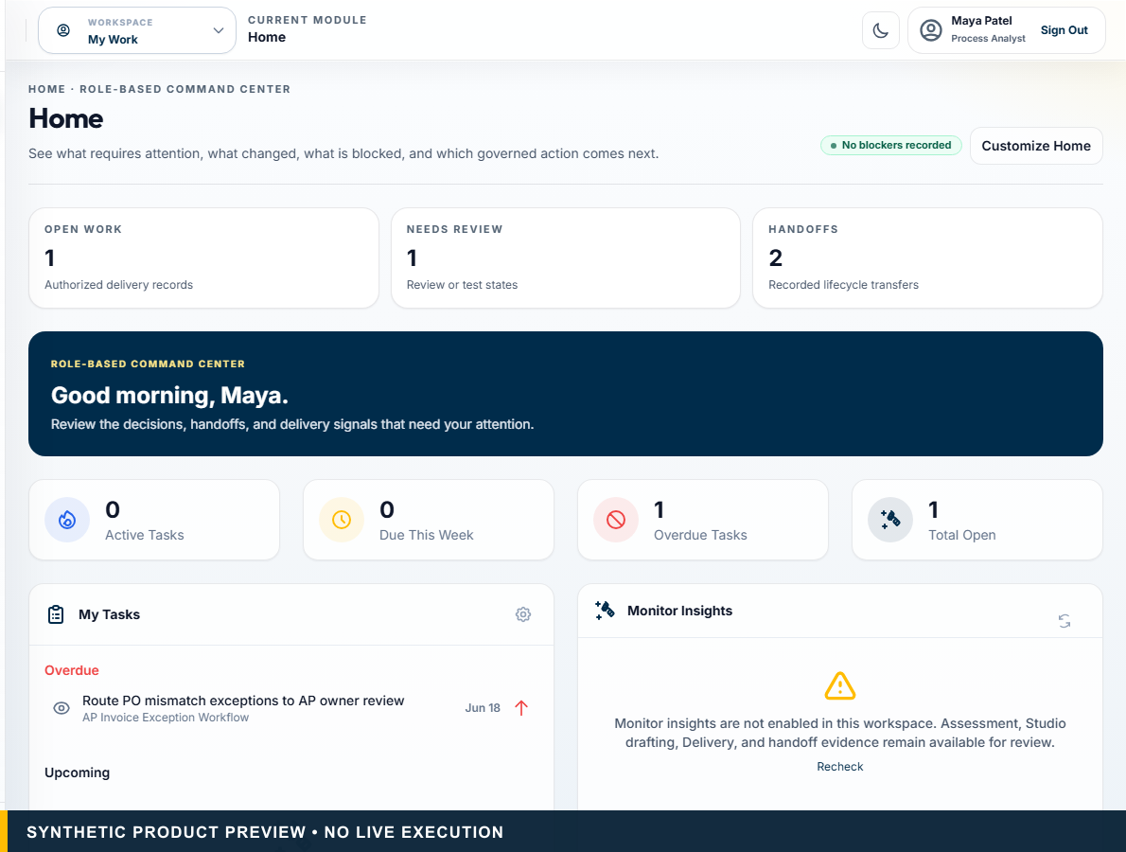
AVALAOS • INVESTOR DISCUSSION DRAFT
The operating system for governed AI and automation decisions.
Evaluate before you automate. Govern before you execute.
EVIDENCE • HUMAN AUTHORITY • TRACEABLE HANDOFF
The Operating System for Governed AI and Automation Decisions • Pre-seed enterprise software, automation, workflow, and AI-governance investors
Synthetic product preview. No live execution or commercial traction implied.
01
Notes:
PRIMARY TALK TRACK (45–75 seconds)
Use this slide to establish that the operating system for governed ai and automation decisions. Evaluate before you automate. Govern before you execute. The key distinction is that AvalaOS governs the decision and handoff while authorized systems execute. State the boundary plainly: Synthetic product preview. No live execution or commercial traction implied. Pause on the consequence for this audience before advancing to the next stage of the story.
KEY POINT
The operating system for governed AI and automation decisions.
AUDIENCE-SPECIFIC EMPHASIS
Open with category ambition and immediate proof discipline.
CLAIMS USED
CL-001, CL-002, CL-024
CURRENT VS ROADMAP
Current unless otherwise labelled.
LIKELY OBJECTION
How does this change the next decision?
SUGGESTED RESPONSE
It makes the evidence, authority, and handoff condition visible before execution begins.
AP INPUT REQUIRED
Founder, round, contact, and confidentiality inputs remain unsupplied.
[Sources]
- CL-001: docs/00_SOURCE_OF_TRUTH.md — product identity; docs/01_PRODUCT_STRATEGY.md — Positioning
- CL-002: docs/00_SOURCE_OF_TRUTH.md — canonical tagline
- CL-024: docs/design/avalaos-enterprise-ui-rebaseline.md — Isolated marketing capture
- Asset: public/marketing/screenshots/ (synthetic committed product captures)
- Fonts: Outfit and Inter, SIL Open Font License 1.1; bundled under docs/marketing/decks/assets/fonts/
[/Sources]

Slide 2
THE PROBLEM
Enterprises have automation tools. They lack one governed decision path.
Tool-first selection
Fragmented assessment
Missing evidence
Inconsistent governance
Handoff loss
Weak outcome visibility
The Operating System for Governed AI and Automation Decisions • Pre-seed enterprise software, automation, workflow, and AI-governance investors
Strategic thesis; no quantified market-size or failure-rate claim.
02
Notes:
PRIMARY TALK TRACK (45–75 seconds)
Use this slide to establish that enterprises have automation tools. they lack one governed decision path. Walk through Tool-first selection, Fragmented assessment, Missing evidence, and Inconsistent governance. The remaining signals — Inconsistent governance and Handoff loss — matter because they keep authority and evidence visible. State the boundary plainly: Strategic thesis; no quantified market-size or failure-rate claim. Pause on the consequence for this audience before advancing to the next stage of the story.
KEY POINT
Enterprises have automation tools. They lack one governed decision path.
AUDIENCE-SPECIFIC EMPHASIS
Define the missing layer without attacking named competitors.
CLAIMS USED
CL-001, CL-003
CURRENT VS ROADMAP
Current unless otherwise labelled.
LIKELY OBJECTION
How does this change the next decision?
SUGGESTED RESPONSE
It makes the evidence, authority, and handoff condition visible before execution begins.
AP INPUT REQUIRED
None.
[Sources]
- CL-001: docs/00_SOURCE_OF_TRUTH.md — product identity; docs/01_PRODUCT_STRATEGY.md — Positioning
- CL-003: docs/design/avalaos-enterprise-ui-rebaseline.md — Purpose
- Fonts: Outfit and Inter, SIL Open Font License 1.1; bundled under docs/marketing/decks/assets/fonts/
[/Sources]

Slide 3
THE KEY INSIGHT
One business process is a portfolio of different work types.
Stable + structured
Rules / workflow
Deterministic controls
Repetitive UI work
RPA
Only where stronger interfaces are unavailable
Unstructured content
AI assistance
Extraction, classification, summarisation
Context-heavy inquiry
Bounded agent assistance
Evidence synthesis with controls
Material-risk judgment
Human / HITL
Accountable approval
Mixed end-to-end work
Hybrid model
A governed combination
The Operating System for Governed AI and Automation Decisions • Pre-seed enterprise software, automation, workflow, and AI-governance investors
The right answer is usually a governed mix, not one technology winner.
03
Notes:
PRIMARY TALK TRACK (45–75 seconds)
Use this slide to establish that one business process is a portfolio of different work types. Walk through Stable + structured: Rules / workflow: Deterministic controls, Repetitive UI work: RPA: Only where stronger interfaces are unavailable, Unstructured content: AI assistance: Extraction, classification, summarisation, and Context-heavy inquiry: Bounded agent assistance: Evidence synthesis with controls. The remaining signals — Context-heavy inquiry: Bounded agent assistance: Evidence synthesis with controls and Material-risk judgment: Human / HITL: Accountable approval — matter because they keep authority and evidence visible. State the boundary plainly: The right answer is usually a governed mix, not one technology winner. Pause on the consequence for this audience before advancing to the next stage of the story.
KEY POINT
One business process is a portfolio of different work types.
AUDIENCE-SPECIFIC EMPHASIS
Make the decision model the core insight.
CLAIMS USED
CL-006, CL-007, CL-008
CURRENT VS ROADMAP
Current unless otherwise labelled.
LIKELY OBJECTION
How does this change the next decision?
SUGGESTED RESPONSE
It makes the evidence, authority, and handoff condition visible before execution begins.
AP INPUT REQUIRED
None.
[Sources]
- CL-006: docs/architecture/assess-v2-decision-intelligence-architecture.md — Purpose and Deterministic Decision Layers
- CL-007: docs/architecture/assess-v2-decision-intelligence-architecture.md — Canonical AP Invoice Exception Outcome
- CL-008: docs/00_SOURCE_OF_TRUTH.md — Product and Security Law
- Fonts: Outfit and Inter, SIL Open Font License 1.1; bundled under docs/marketing/decks/assets/fonts/
[/Sources]

Slide 4
WHY CURRENT APPROACHES BREAK
The decision path crosses categories that stop at their own boundary.
01
02
03
04
05
06
Process mining
Consulting
AI governance
Requirements
Delivery
Runtime
Discovers work
Assesses and recommends
Frames controls
Documents the change
Plans the build
Executes the work
AvalaOS governs the connective path; authorized systems execute.
The Operating System for Governed AI and Automation Decisions • Pre-seed enterprise software, automation, workflow, and AI-governance investors
AvalaOS governs the connective path; authorized systems execute.
04
Notes:
PRIMARY TALK TRACK (45–75 seconds)
Use this slide to establish that the decision path crosses categories that stop at their own boundary. Walk through Process mining: Discovers work, Consulting: Assesses and recommends, AI governance: Frames controls, and Requirements: Documents the change. The remaining signals — Requirements: Documents the change and Delivery: Plans the build — matter because they keep authority and evidence visible. State the boundary plainly: AvalaOS governs the connective path; authorized systems execute. Pause on the consequence for this audience before advancing to the next stage of the story.
KEY POINT
The decision path crosses categories that stop at their own boundary.
AUDIENCE-SPECIFIC EMPHASIS
Position between categories, not as a replacement for each.
CLAIMS USED
CL-001, CL-003, CL-018
CURRENT VS ROADMAP
Current unless otherwise labelled.
LIKELY OBJECTION
How does this change the next decision?
SUGGESTED RESPONSE
It makes the evidence, authority, and handoff condition visible before execution begins.
AP INPUT REQUIRED
None.
[Sources]
- CL-001: docs/00_SOURCE_OF_TRUTH.md — product identity; docs/01_PRODUCT_STRATEGY.md — Positioning
- CL-003: docs/design/avalaos-enterprise-ui-rebaseline.md — Purpose
- CL-018: docs/01_PRODUCT_STRATEGY.md — Product Boundaries
- Fonts: Outfit and Inter, SIL Open Font License 1.1; bundled under docs/marketing/decks/assets/fonts/
[/Sources]

Slide 5
THE SOLUTION
AvalaOS carries evidence into delivery without losing authority.
Evidence
Deterministic decision
Human governance
1
2
3
Governed artifact
Delivery handoff
Outcome visibility
4
5
6
The Operating System for Governed AI and Automation Decisions • Pre-seed enterprise software, automation, workflow, and AI-governance investors
Execution remains with systems and teams already authorized to perform it.
05
Notes:
PRIMARY TALK TRACK (45–75 seconds)
Use this slide to establish that avalaos carries evidence into delivery without losing authority. Walk through 1: Evidence, 2: Deterministic decision, 3: Human governance, and 4: Governed artifact. The remaining signals — 4: Governed artifact and 5: Delivery handoff — matter because they keep authority and evidence visible. State the boundary plainly: Execution remains with systems and teams already authorized to perform it. Pause on the consequence for this audience before advancing to the next stage of the story.
KEY POINT
AvalaOS carries evidence into delivery without losing authority.
AUDIENCE-SPECIFIC EMPHASIS
Show how authority survives the handoff.
CLAIMS USED
CL-003, CL-008
CURRENT VS ROADMAP
Current unless otherwise labelled.
LIKELY OBJECTION
How does this change the next decision?
SUGGESTED RESPONSE
It makes the evidence, authority, and handoff condition visible before execution begins.
AP INPUT REQUIRED
None.
[Sources]
- CL-003: docs/design/avalaos-enterprise-ui-rebaseline.md — Purpose
- CL-008: docs/00_SOURCE_OF_TRUTH.md — Product and Security Law
- Fonts: Outfit and Inter, SIL Open Font License 1.1; bundled under docs/marketing/decks/assets/fonts/
[/Sources]

Slide 6
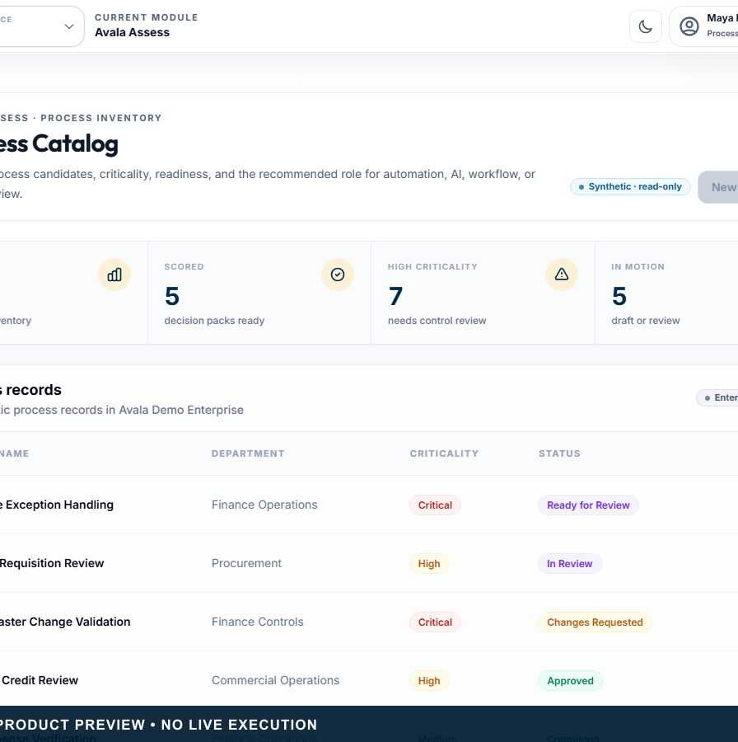
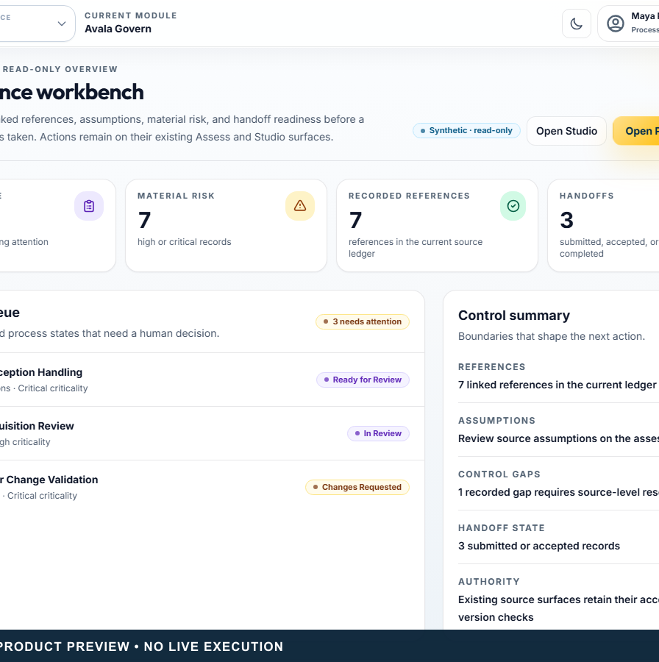
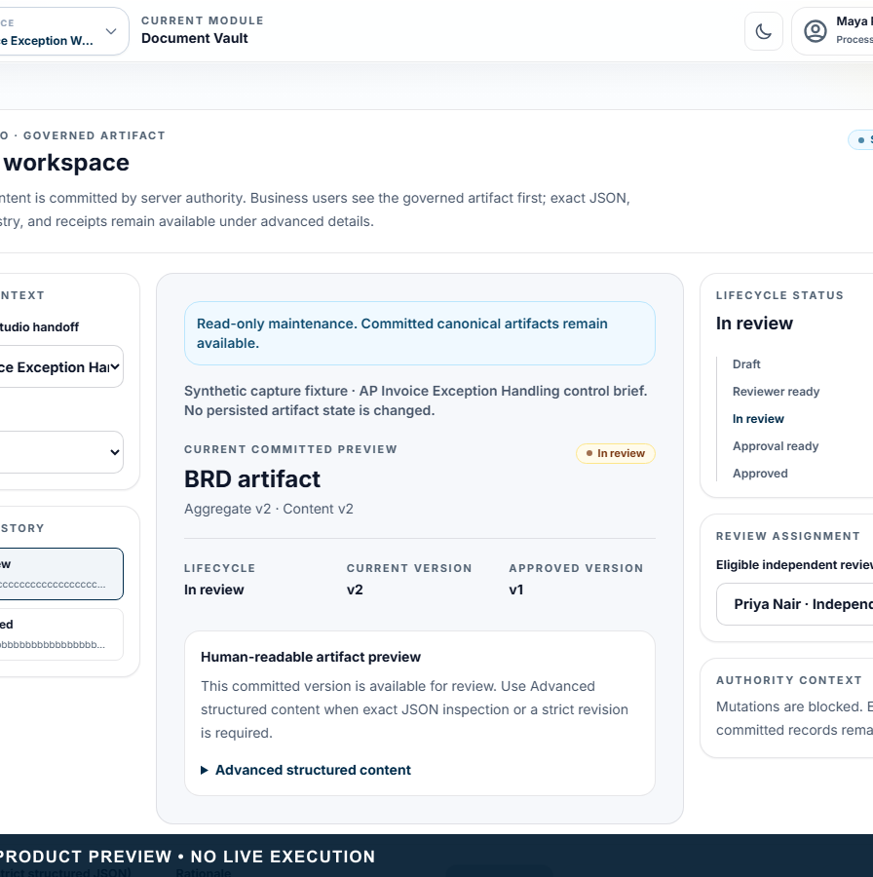
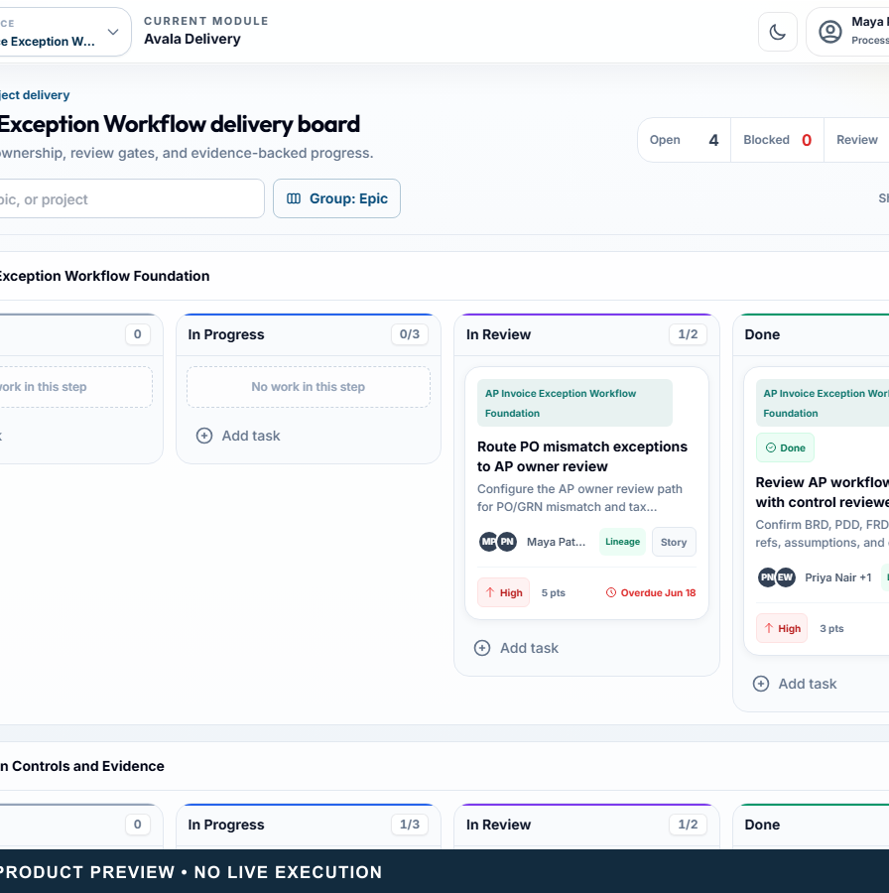
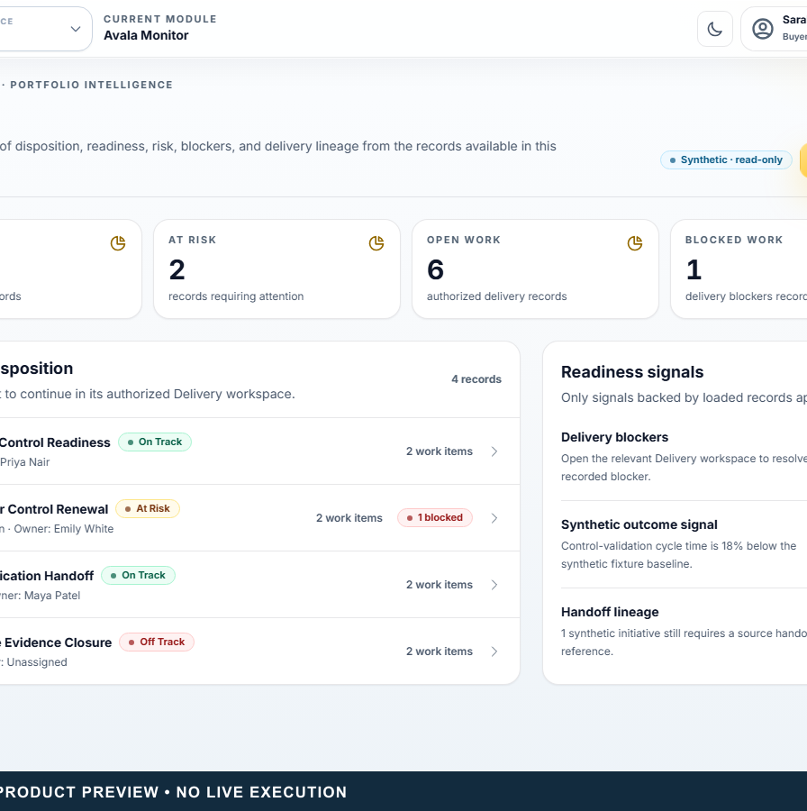
PRODUCT PROOF
The synthetic AP Invoice Exception journey proves the product model end to end.
01
Assess
02
Govern
03
Studio
04
Delivery
05
Monitor
Evidence-qualified recommendation
Human-owned controls
Approved artifacts
Source-linked work
Outcome visibility
The Operating System for Governed AI and Automation Decisions • Pre-seed enterprise software, automation, workflow, and AI-governance investors
Synthetic reference journey • source and CI proof • no live execution or customer outcome.
06
Notes:
PRIMARY TALK TRACK (45–75 seconds)
Use this slide to establish that the synthetic ap invoice exception journey proves the product model end to end. Walk through Assess: Evidence-qualified recommendation, Govern: Human-owned controls, Studio: Approved artifacts, and Delivery: Source-linked work. The remaining signals — Delivery: Source-linked work and Monitor: Outcome visibility — matter because they keep authority and evidence visible. State the boundary plainly: Synthetic reference journey • source and CI proof • no live execution or customer outcome. Pause on the consequence for this audience before advancing to the next stage of the story.
KEY POINT
The synthetic AP Invoice Exception journey proves the product model end to end.
AUDIENCE-SPECIFIC EMPHASIS
Separate product proof from commercial proof.
CLAIMS USED
CL-004, CL-005, CL-011, CL-013, CL-016, CL-019, CL-024
CURRENT VS ROADMAP
Current unless otherwise labelled.
LIKELY OBJECTION
How does this change the next decision?
SUGGESTED RESPONSE
It makes the evidence, authority, and handoff condition visible before execution begins.
AP INPUT REQUIRED
None.
[Sources]
- CL-004: docs/design/avalaos-enterprise-ui-rebaseline.md — Authenticated information architecture
- CL-005: docs/00_SOURCE_OF_TRUTH.md — Accepted Capabilities
- CL-011: docs/07_AVALA_GOVERN_FRAMEWORK.md — Current Scope
- CL-013: docs/architecture/studio-governed-artifact-authority.md — Scope and trust boundary
- CL-016: docs/02_PRODUCT_REQUIREMENTS.md — Avala Delivery
- CL-019: docs/design/avalaos-enterprise-ui-rebaseline.md — Delivery and Monitor
- CL-024: docs/design/avalaos-enterprise-ui-rebaseline.md — Isolated marketing capture
- Asset: public/marketing/screenshots/ (synthetic committed product captures)
- Fonts: Outfit and Inter, SIL Open Font License 1.1; bundled under docs/marketing/decks/assets/fonts/
[/Sources]

Slide 7
INITIAL CUSTOMER WEDGE
Start where recurring automation decisions already exist.
Automation and transformation consultancies
LAND + EXPAND
Small and mid-sized enterprise AI / Automation CoEs
Land with one high-value process
Process Excellence teams
Expand to multiple processes
Enterprise Architecture teams
Add portfolio and application context
The Operating System for Governed AI and Automation Decisions • Pre-seed enterprise software, automation, workflow, and AI-governance investors
Go-to-market hypothesis for AP confirmation; not evidence of customers, segment size, or willingness to pay.
07
Notes:
PRIMARY TALK TRACK (45–75 seconds)
Use this slide to establish that start where recurring automation decisions already exist. Walk through Automation and transformation consultancies, Small and mid-sized enterprise AI / Automation CoEs, Process Excellence teams, and Enterprise Architecture teams. The remaining signals — Enterprise Architecture teams — matter because they keep authority and evidence visible. State the boundary plainly: Go-to-market hypothesis for AP confirmation; not evidence of customers, segment size, or willingness to pay. Pause on the consequence for this audience before advancing to the next stage of the story.
KEY POINT
Start where recurring automation decisions already exist.
AUDIENCE-SPECIFIC EMPHASIS
Keep the beachhead focused and testable.
CLAIMS USED
CL-029
CURRENT VS ROADMAP
Proposed commercial wedge.
LIKELY OBJECTION
How does this change the next decision?
SUGGESTED RESPONSE
It makes the evidence, authority, and handoff condition visible before execution begins.
AP INPUT REQUIRED
ICP validation, buyer interviews, design partners, and pipeline evidence.
[Sources]
- CL-029: docs/marketing/decks/source/deck-inputs.yaml — AP-confirmable discussion inputs
- Fonts: Outfit and Inter, SIL Open Font License 1.1; bundled under docs/marketing/decks/assets/fonts/
[/Sources]

Slide 8
BEACHHEAD + EXPANSION
The wedge expands along the same governed context.
CURRENT
NEAR TERM
VISION
Process assessment
Delivery lineage authority
Reusable solution patterns
Decision intelligence
Monitor / Admin / Trust server models
Governed software assembly
Governed review
Controlled deployment
Company-owned applications
BRD / FRD / PDD
Design-partner pilot
Application modernization assessment
The Operating System for Governed AI and Automation Decisions • Pre-seed enterprise software, automation, workflow, and AI-governance investors
Current, near-term, and vision status are deliberately separated.
08
Notes:
PRIMARY TALK TRACK (45–75 seconds)
Use this slide to establish that the wedge expands along the same governed context. Walk through Process assessment, Decision intelligence, Delivery lineage authority, and Monitor / Admin / Trust server models. The remaining signals — Monitor / Admin / Trust server models and Reusable solution patterns — matter because they keep authority and evidence visible. State the boundary plainly: Current, near-term, and vision status are deliberately separated. Pause on the consequence for this audience before advancing to the next stage of the story.
KEY POINT
The wedge expands along the same governed context.
AUDIENCE-SPECIFIC EMPHASIS
Show expansion through retained context, not unrelated modules.
CLAIMS USED
CL-005, CL-010, CL-013, CL-017, CL-021, CL-028
CURRENT VS ROADMAP
Current unless otherwise labelled.
LIKELY OBJECTION
How does this change the next decision?
SUGGESTED RESPONSE
It makes the evidence, authority, and handoff condition visible before execution begins.
AP INPUT REQUIRED
None.
[Sources]
- CL-005: docs/00_SOURCE_OF_TRUTH.md — Accepted Capabilities
- CL-010: docs/architecture/application-portfolio-assessment-architecture.md — Dimensions and Dispositions
- CL-013: docs/architecture/studio-governed-artifact-authority.md — Scope and trust boundary
- CL-017: docs/design/avalaos-enterprise-ui-rebaseline.md — Delivery and Monitor
- CL-021: docs/design/avalaos-enterprise-ui-rebaseline.md — Product surfaces
- CL-028: components/shared/brand.tsx — AvalaLifecycleLockup; approved master brief — Avala Assemble vision
- Fonts: Outfit and Inter, SIL Open Font License 1.1; bundled under docs/marketing/decks/assets/fonts/
[/Sources]

Slide 9
PRODUCT + DATA MOAT
Defensibility grows from context that survives every stage.
Versioned deterministic logic
Human authority for material risk
Primitive-level operating models
GOVERNED
CONTEXT
Immutable review and artifact ancestry
Claim-linked evidence and assumptions
Cross-module application and economics context
The Operating System for Governed AI and Automation Decisions • Pre-seed enterprise software, automation, workflow, and AI-governance investors
No patent, proprietary-algorithm, scientific-validation, calibrated-model, or uncopyable-moat claim.
09
Notes:
PRIMARY TALK TRACK (45–75 seconds)
Use this slide to establish that defensibility grows from context that survives every stage. Walk through Versioned deterministic logic, Primitive-level operating models, Claim-linked evidence and assumptions, and Human authority for material risk. The remaining signals — Human authority for material risk and Immutable review and artifact ancestry — matter because they keep authority and evidence visible. State the boundary plainly: No patent, proprietary-algorithm, scientific-validation, calibrated-model, or uncopyable-moat claim. Pause on the consequence for this audience before advancing to the next stage of the story.
KEY POINT
Defensibility grows from context that survives every stage.
AUDIENCE-SPECIFIC EMPHASIS
Present defensibility as accumulated governed context.
CLAIMS USED
CL-006, CL-008, CL-009, CL-010, CL-013, CL-014
CURRENT VS ROADMAP
Current unless otherwise labelled.
LIKELY OBJECTION
How does this change the next decision?
SUGGESTED RESPONSE
It makes the evidence, authority, and handoff condition visible before execution begins.
AP INPUT REQUIRED
None.
[Sources]
- CL-006: docs/architecture/assess-v2-decision-intelligence-architecture.md — Purpose and Deterministic Decision Layers
- CL-008: docs/00_SOURCE_OF_TRUTH.md — Product and Security Law
- CL-009: docs/architecture/assess-v2-economics-calibration-architecture.md — Formula Architecture and Calibration
- CL-010: docs/architecture/application-portfolio-assessment-architecture.md — Dimensions and Dispositions
- CL-013: docs/architecture/studio-governed-artifact-authority.md — Scope and trust boundary
- CL-014: docs/architecture/studio-governed-artifact-authority.md — Lifecycle and people
- Fonts: Outfit and Inter, SIL Open Font License 1.1; bundled under docs/marketing/decks/assets/fonts/
[/Sources]

Slide 10
COMMERCIAL MODEL • AP CONFIRMATION REQUIRED
A services-assisted license can land the platform before recurring hosting.
Initial strategy
Future strategy
Upfront enterprise or white-label license
Hosted enterprise offering
Implementation and enablement
BYOK and provider controls
Paid customisation and enhancements
Recurring tiers after deployment and pilot readiness
Optional support and update agreement
The Operating System for Governed AI and Automation Decisions • Pre-seed enterprise software, automation, workflow, and AI-governance investors
Discussion strategy. Pricing, margins, customers, revenue, and contract terms are not supplied.
10
Notes:
PRIMARY TALK TRACK (45–75 seconds)
Use this slide to establish that a services-assisted license can land the platform before recurring hosting. Walk through Upfront enterprise or white-label license, Implementation and enablement, Paid customisation and enhancements, and Optional support and update agreement. The remaining signals — Optional support and update agreement and Hosted enterprise offering — matter because they keep authority and evidence visible. State the boundary plainly: Discussion strategy. Pricing, margins, customers, revenue, and contract terms are not supplied. Pause on the consequence for this audience before advancing to the next stage of the story.
KEY POINT
A services-assisted license can land the platform before recurring hosting.
AUDIENCE-SPECIFIC EMPHASIS
Keep the monetization path plausible without inventing numbers.
CLAIMS USED
CL-022, CL-029
CURRENT VS ROADMAP
Proposed commercial strategy.
LIKELY OBJECTION
How does this change the next decision?
SUGGESTED RESPONSE
It makes the evidence, authority, and handoff condition visible before execution begins.
AP INPUT REQUIRED
License range, implementation range, support model, hosted pricing, and target gross margin.
[Sources]
- CL-022: components/public/PublicWebsite.tsx — TrustPage BYOK direction
- CL-029: docs/marketing/decks/source/deck-inputs.yaml — AP-confirmable discussion inputs
- Fonts: Outfit and Inter, SIL Open Font License 1.1; bundled under docs/marketing/decks/assets/fonts/
[/Sources]

Slide 11
GO-TO-MARKET • AP CONFIRMATION REQUIRED
Founder-led assessments create the first route to repeatable distribution.
Targeted process assessment
Synthetic reference journey
Design-partner learning
1
2
3
Consulting / automation partners
White-label licensing
Module + portfolio expansion
4
5
6
The Operating System for Governed AI and Automation Decisions • Pre-seed enterprise software, automation, workflow, and AI-governance investors
Planned route only. No current partnership, pilot, customer, or pipeline claim.
11
Notes:
PRIMARY TALK TRACK (45–75 seconds)
Use this slide to establish that founder-led assessments create the first route to repeatable distribution. Walk through 1: Targeted process assessment, 2: Synthetic reference journey, 3: Design-partner learning, and 4: Consulting / automation partners. The remaining signals — 4: Consulting / automation partners and 5: White-label licensing — matter because they keep authority and evidence visible. State the boundary plainly: Planned route only. No current partnership, pilot, customer, or pipeline claim. Pause on the consequence for this audience before advancing to the next stage of the story.
KEY POINT
Founder-led assessments create the first route to repeatable distribution.
AUDIENCE-SPECIFIC EMPHASIS
Show a learning loop, not fictional traction.
CLAIMS USED
CL-024, CL-029
CURRENT VS ROADMAP
Proposed go-to-market strategy.
LIKELY OBJECTION
How does this change the next decision?
SUGGESTED RESPONSE
It makes the evidence, authority, and handoff condition visible before execution begins.
AP INPUT REQUIRED
Founder background, design-partner status, partner evidence, and pipeline.
[Sources]
- CL-024: docs/design/avalaos-enterprise-ui-rebaseline.md — Isolated marketing capture
- CL-029: docs/marketing/decks/source/deck-inputs.yaml — AP-confirmable discussion inputs
- Fonts: Outfit and Inter, SIL Open Font License 1.1; bundled under docs/marketing/decks/assets/fonts/
[/Sources]

Slide 12
PRODUCT PROGRESS
Product proof is ahead of commercial proof — and the boundary is explicit.
ACCEPTED SOURCE / CI
PRODUCT SURFACES
CANDIDATE / AHEAD
Tenant authority + Assess
Delivery workbench
Studio private artifacts
V2 review and Govern handoff
Monitor overview
Delivery lineage authority
Economics + Application Portfolio
Admin / Trust
Monitor / Admin / Trust server models
Studio BRD / FRD / PDD
Public enterprise UI
Deployment + pilot controls
The Operating System for Governed AI and Automation Decisions • Pre-seed enterprise software, automation, workflow, and AI-governance investors
Product verification is not customer adoption. Hosted and live validation remain unproven.
12
Notes:
PRIMARY TALK TRACK (45–75 seconds)
Use this slide to establish that product proof is ahead of commercial proof — and the boundary is explicit. Walk through Tenant authority + Assess, V2 review and Govern handoff, Delivery workbench, and Monitor overview. The remaining signals — Monitor overview and Studio private artifacts — matter because they keep authority and evidence visible. State the boundary plainly: Product verification is not customer adoption. Hosted and live validation remain unproven. Pause on the consequence for this audience before advancing to the next stage of the story.
KEY POINT
Product proof is ahead of commercial proof — and the boundary is explicit.
AUDIENCE-SPECIFIC EMPHASIS
Make proof maturity a credibility signal.
CLAIMS USED
CL-005, CL-009, CL-010, CL-011, CL-013, CL-015, CL-016, CL-019, CL-021, CL-025, CL-026
CURRENT VS ROADMAP
Current unless otherwise labelled.
LIKELY OBJECTION
How does this change the next decision?
SUGGESTED RESPONSE
It makes the evidence, authority, and handoff condition visible before execution begins.
AP INPUT REQUIRED
None.
[Sources]
- CL-005: docs/00_SOURCE_OF_TRUTH.md — Accepted Capabilities
- CL-009: docs/architecture/assess-v2-economics-calibration-architecture.md — Formula Architecture and Calibration
- CL-010: docs/architecture/application-portfolio-assessment-architecture.md — Dimensions and Dispositions
- CL-011: docs/07_AVALA_GOVERN_FRAMEWORK.md — Current Scope
- CL-013: docs/architecture/studio-governed-artifact-authority.md — Scope and trust boundary
- CL-015: docs/architecture/studio-private-artifact-authority.md — Objective and boundary
- CL-016: docs/02_PRODUCT_REQUIREMENTS.md — Avala Delivery
- CL-019: docs/design/avalaos-enterprise-ui-rebaseline.md — Delivery and Monitor
- CL-021: docs/design/avalaos-enterprise-ui-rebaseline.md — Product surfaces
- CL-025: docs/design/avalaos-enterprise-ui-rebaseline.md — Executed verification
- CL-026: docs/00_SOURCE_OF_TRUTH.md — Maturity Verdict and Not Accepted Or Proven
- Fonts: Outfit and Inter, SIL Open Font License 1.1; bundled under docs/marketing/decks/assets/fonts/
[/Sources]

Slide 13
ROADMAP
The roadmap converts source proof into controlled commercial proof.
CURRENT
NEAR TERM
EXPANSION
Assess + Govern
Accept Studio PR B
Reusable solution blocks
Application Portfolio
Delivery / Monitor / Admin / Trust authority
Governed integration patterns
Studio structured artifacts
Deployment-backed BYOK
Solution blueprints
Source-level controls + UI
Controlled pilot
Company-owned applications
The Operating System for Governed AI and Automation Decisions • Pre-seed enterprise software, automation, workflow, and AI-governance investors
Commercial milestones require AP confirmation; product roadmap items require accepted evidence.
13
Notes:
PRIMARY TALK TRACK (45–75 seconds)
Use this slide to establish that the roadmap converts source proof into controlled commercial proof. Walk through Assess + Govern, Application Portfolio, Accept Studio PR B, and Delivery / Monitor / Admin / Trust authority. The remaining signals — Delivery / Monitor / Admin / Trust authority and Reusable solution blocks — matter because they keep authority and evidence visible. State the boundary plainly: Commercial milestones require AP confirmation; product roadmap items require accepted evidence. Pause on the consequence for this audience before advancing to the next stage of the story.
KEY POINT
The roadmap converts source proof into controlled commercial proof.
AUDIENCE-SPECIFIC EMPHASIS
Show the next de-risking sequence, not a calendar promise.
CLAIMS USED
CL-013, CL-015, CL-017, CL-021, CL-022, CL-026, CL-028, CL-029
CURRENT VS ROADMAP
Current unless otherwise labelled.
LIKELY OBJECTION
How does this change the next decision?
SUGGESTED RESPONSE
It makes the evidence, authority, and handoff condition visible before execution begins.
AP INPUT REQUIRED
None.
[Sources]
- CL-013: docs/architecture/studio-governed-artifact-authority.md — Scope and trust boundary
- CL-015: docs/architecture/studio-private-artifact-authority.md — Objective and boundary
- CL-017: docs/design/avalaos-enterprise-ui-rebaseline.md — Delivery and Monitor
- CL-021: docs/design/avalaos-enterprise-ui-rebaseline.md — Product surfaces
- CL-022: components/public/PublicWebsite.tsx — TrustPage BYOK direction
- CL-026: docs/00_SOURCE_OF_TRUTH.md — Maturity Verdict and Not Accepted Or Proven
- CL-028: components/shared/brand.tsx — AvalaLifecycleLockup; approved master brief — Avala Assemble vision
- CL-029: docs/marketing/decks/source/deck-inputs.yaml — AP-confirmable discussion inputs
- Fonts: Outfit and Inter, SIL Open Font License 1.1; bundled under docs/marketing/decks/assets/fonts/
[/Sources]

Slide 14
AVALA ASSEMBLE • ROADMAP VISION
From deciding what to build to governing how software is assembled.
Assess
Validate
Assemble
Launch
Audit
Evidence
Controls
Reusable blocks
Governed handoff
Evidence + visibility
Forms • Workflows • Extraction • Validations • Approvals • Connectors • Reporting • Later-approved agent tools
ROADMAP VISION — NOT A CURRENT APPLICATION-GENERATION CAPABILITY
The Operating System for Governed AI and Automation Decisions • Pre-seed enterprise software, automation, workflow, and AI-governance investors
ROADMAP VISION — not a current production-application generation or deployment capability.
14
Notes:
PRIMARY TALK TRACK (45–75 seconds)
Use this slide to establish that from deciding what to build to governing how software is assembled. Walk through Forms, Workflows, Extraction, and Validations. The remaining signals — Validations and Approvals — matter because they keep authority and evidence visible. State the boundary plainly: ROADMAP VISION — not a current production-application generation or deployment capability. Pause on the consequence for this audience before advancing to the next stage of the story.
KEY POINT
From deciding what to build to governing how software is assembled.
AUDIENCE-SPECIFIC EMPHASIS
Differentiate the future vision by its approved evidence and control ancestry.
CLAIMS USED
CL-028
CURRENT VS ROADMAP
Roadmap only.
LIKELY OBJECTION
How does this change the next decision?
SUGGESTED RESPONSE
It makes the evidence, authority, and handoff condition visible before execution begins.
AP INPUT REQUIRED
None.
[Sources]
- CL-028: components/shared/brand.tsx — AvalaLifecycleLockup; approved master brief — Avala Assemble vision
- Fonts: Outfit and Inter, SIL Open Font License 1.1; bundled under docs/marketing/decks/assets/fonts/
[/Sources]

Slide 15
FUNDING OBJECTIVE • DISCUSSION DRAFT
Capital would convert product proof into controlled market proof.
1
2
3
4
5
Deployment-backed BYOK
Operational and pilot controls
Delivery / Monitor / Admin / Trust engineering
First design partners
Focused go-to-market
The Operating System for Governed AI and Automation Decisions • Pre-seed enterprise software, automation, workflow, and AI-governance investors
Round, amount, runway, founder credentials, traction, legal entity, and contact details are intentionally omitted until supplied.
15
Notes:
PRIMARY TALK TRACK (45–75 seconds)
Use this slide to establish that capital would convert product proof into controlled market proof. Walk through Deployment-backed BYOK, Operational and pilot controls, Delivery / Monitor / Admin / Trust engineering, and First design partners. The remaining signals — First design partners and Focused go-to-market — matter because they keep authority and evidence visible. State the boundary plainly: Round, amount, runway, founder credentials, traction, legal entity, and contact details are intentionally omitted until supplied. Pause on the consequence for this audience before advancing to the next stage of the story.
KEY POINT
Capital would convert product proof into controlled market proof.
AUDIENCE-SPECIFIC EMPHASIS
Close on the de-risking objective rather than missing numbers.
CLAIMS USED
CL-022, CL-026, CL-029
CURRENT VS ROADMAP
Proposed use-of-funds direction.
LIKELY OBJECTION
How does this change the next decision?
SUGGESTED RESPONSE
It makes the evidence, authority, and handoff condition visible before execution begins.
AP INPUT REQUIRED
Founder, team, legal entity, round, raise amount, runway, use of funds, traction, and contact details.
[Sources]
- CL-022: components/public/PublicWebsite.tsx — TrustPage BYOK direction
- CL-026: docs/00_SOURCE_OF_TRUTH.md — Maturity Verdict and Not Accepted Or Proven
- CL-029: docs/marketing/decks/source/deck-inputs.yaml — AP-confirmable discussion inputs
- Fonts: Outfit and Inter, SIL Open Font License 1.1; bundled under docs/marketing/decks/assets/fonts/
[/Sources]

