Slide 1
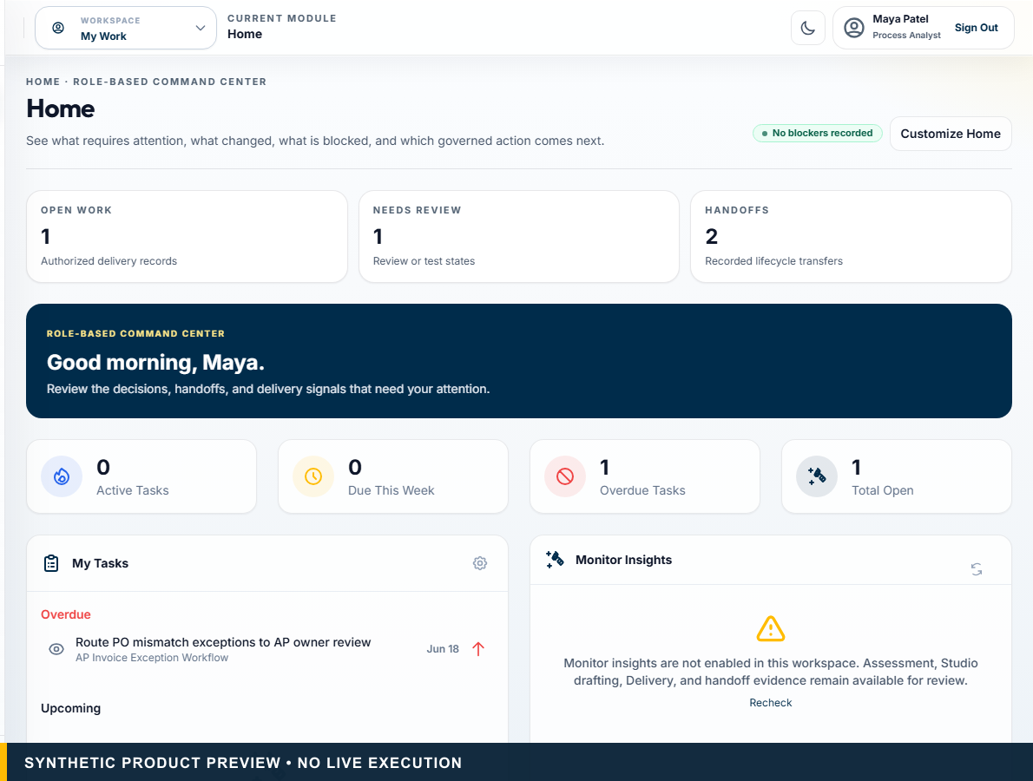
AVALAOS • DECISION BEFORE EXECUTION
Evaluate before you automate.
Govern before you execute.
The governed decision and delivery layer around AI, automation, and human work.
EVIDENCE • HUMAN AUTHORITY • TRACEABLE HANDOFF
Decision Before Execution • Automation, AI, transformation, process excellence, architecture, and consulting leaders
Synthetic product preview. No live execution.
01
Notes:
PRIMARY TALK TRACK (45–75 seconds)
Use this slide to establish that evaluate before you automate. govern before you execute. The governed decision and delivery layer around AI, automation, and human work. The key distinction is that AvalaOS governs the decision and handoff while authorized systems execute. State the boundary plainly: Synthetic product preview. No live execution. Pause on the consequence for this audience before advancing to the next stage of the story.
KEY POINT
Evaluate before you automate. Govern before you execute.
AUDIENCE-SPECIFIC EMPHASIS
Open with the decision problem, not a feature list.
CLAIMS USED
CL-001, CL-002, CL-003, CL-024
CURRENT VS ROADMAP
Current unless otherwise labelled.
LIKELY OBJECTION
Is this another automation platform?
SUGGESTED RESPONSE
AvalaOS governs the decision and handoff around execution; authorized systems execute.
AP INPUT REQUIRED
None.
[Sources]
- CL-001: docs/00_SOURCE_OF_TRUTH.md — product identity; docs/01_PRODUCT_STRATEGY.md — Positioning
- CL-002: docs/00_SOURCE_OF_TRUTH.md — canonical tagline
- CL-003: docs/design/avalaos-enterprise-ui-rebaseline.md — Purpose
- CL-024: docs/design/avalaos-enterprise-ui-rebaseline.md — Isolated marketing capture
- Asset: public/marketing/screenshots/ (synthetic committed product captures)
- Fonts: Outfit and Inter, SIL Open Font License 1.1; bundled under docs/marketing/decks/assets/fonts/
[/Sources]

Slide 2
THE AUTOMATION DECISION GAP
Enterprises are choosing tools before understanding the work.
AI applied where deterministic rules would be safer
RPA selected where APIs or workflow would be stronger
Agents introduced without sufficient evidence or control
Human accountability introduced after the design is committed
Decision Before Execution • Automation, AI, transformation, process excellence, architecture, and consulting leaders
Strategic problem framing; no quantified failure-rate claim.
02
Notes:
PRIMARY TALK TRACK (45–75 seconds)
Use this slide to establish that enterprises are choosing tools before understanding the work. Walk through AI applied where deterministic rules would be safer, RPA selected where APIs or workflow would be stronger, Agents introduced without sufficient evidence or control, and Human accountability introduced after the design is committed. The remaining signals — Human accountability introduced after the design is committed — matter because they keep authority and evidence visible. State the boundary plainly: Strategic problem framing; no quantified failure-rate claim. Pause on the consequence for this audience before advancing to the next stage of the story.
KEY POINT
Enterprises are choosing tools before understanding the work.
AUDIENCE-SPECIFIC EMPHASIS
Make the cost of a technology-first decision intuitive.
CLAIMS USED
CL-001, CL-007, CL-008, CL-012
CURRENT VS ROADMAP
Current unless otherwise labelled.
LIKELY OBJECTION
Is this a measured enterprise failure pattern?
SUGGESTED RESPONSE
It is the operating problem AvalaOS is designed to address, not a quantified market statistic.
AP INPUT REQUIRED
None.
[Sources]
- CL-001: docs/00_SOURCE_OF_TRUTH.md — product identity; docs/01_PRODUCT_STRATEGY.md — Positioning
- CL-007: docs/architecture/assess-v2-decision-intelligence-architecture.md — Canonical AP Invoice Exception Outcome
- CL-008: docs/00_SOURCE_OF_TRUTH.md — Product and Security Law
- CL-012: docs/00_SOURCE_OF_TRUTH.md — Product and Security Law
- Fonts: Outfit and Inter, SIL Open Font License 1.1; bundled under docs/marketing/decks/assets/fonts/
[/Sources]

Slide 3
TECHNOLOGY FIT
One process is not one technology.
Stable + structured
Rules / workflow
Deterministic controls
Repetitive UI work
RPA
Only where stronger interfaces are unavailable
Unstructured content
AI assistance
Extraction, classification, summarisation
Context-heavy inquiry
Bounded agent assistance
Evidence synthesis with controls
Material-risk judgment
Human / HITL
Accountable approval
Mixed end-to-end work
Hybrid model
A governed combination
Decision Before Execution • Automation, AI, transformation, process excellence, architecture, and consulting leaders
AvalaOS evaluates fit, controls, and handoff readiness. Authorized systems execute.
03
Notes:
PRIMARY TALK TRACK (45–75 seconds)
Use this slide to establish that one process is not one technology. Walk through Stable + structured: Rules / workflow: Deterministic controls, Repetitive UI work: RPA: Only where stronger interfaces are unavailable, Unstructured content: AI assistance: Extraction, classification, summarisation, and Context-heavy inquiry: Bounded agent assistance: Evidence synthesis with controls. The remaining signals — Context-heavy inquiry: Bounded agent assistance: Evidence synthesis with controls and Material-risk judgment: Human / HITL: Accountable approval — matter because they keep authority and evidence visible. State the boundary plainly: AvalaOS evaluates fit, controls, and handoff readiness. Authorized systems execute. Pause on the consequence for this audience before advancing to the next stage of the story.
KEY POINT
One process is not one technology.
AUDIENCE-SPECIFIC EMPHASIS
Show that hybrid is the normal outcome, not a compromise.
CLAIMS USED
CL-006, CL-007, CL-008
CURRENT VS ROADMAP
Current unless otherwise labelled.
LIKELY OBJECTION
Does AvalaOS autonomously select the technology?
SUGGESTED RESPONSE
No. Versioned deterministic logic produces a recommendation that accountable humans review.
AP INPUT REQUIRED
None.
[Sources]
- CL-006: docs/architecture/assess-v2-decision-intelligence-architecture.md — Purpose and Deterministic Decision Layers
- CL-007: docs/architecture/assess-v2-decision-intelligence-architecture.md — Canonical AP Invoice Exception Outcome
- CL-008: docs/00_SOURCE_OF_TRUTH.md — Product and Security Law
- Fonts: Outfit and Inter, SIL Open Font License 1.1; bundled under docs/marketing/decks/assets/fonts/
[/Sources]

Slide 4
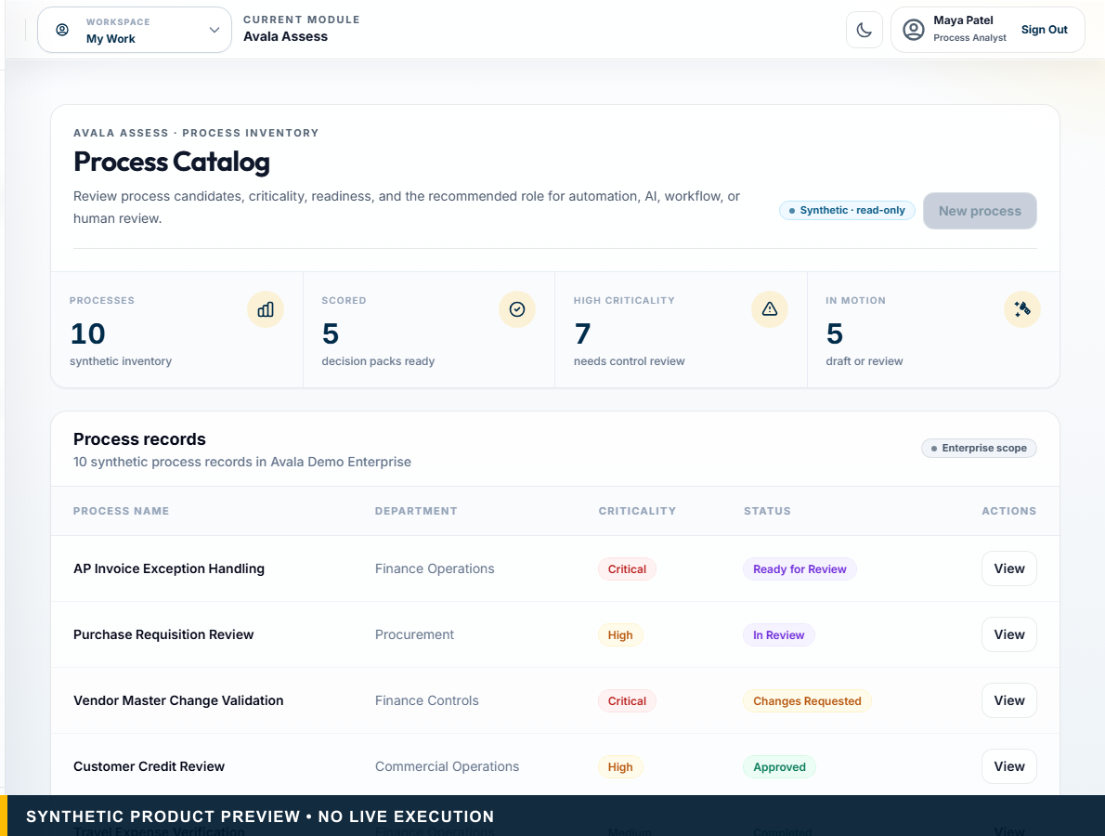
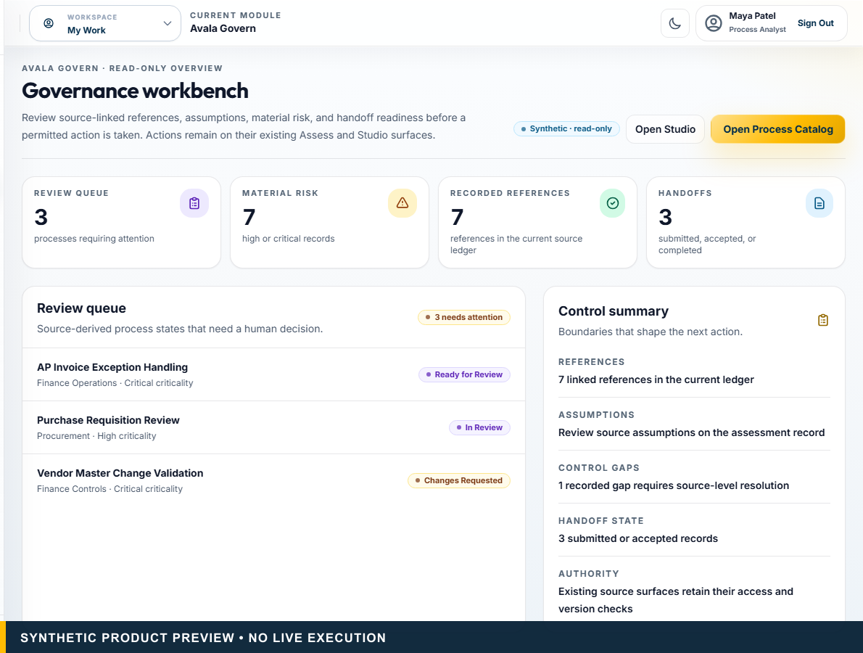
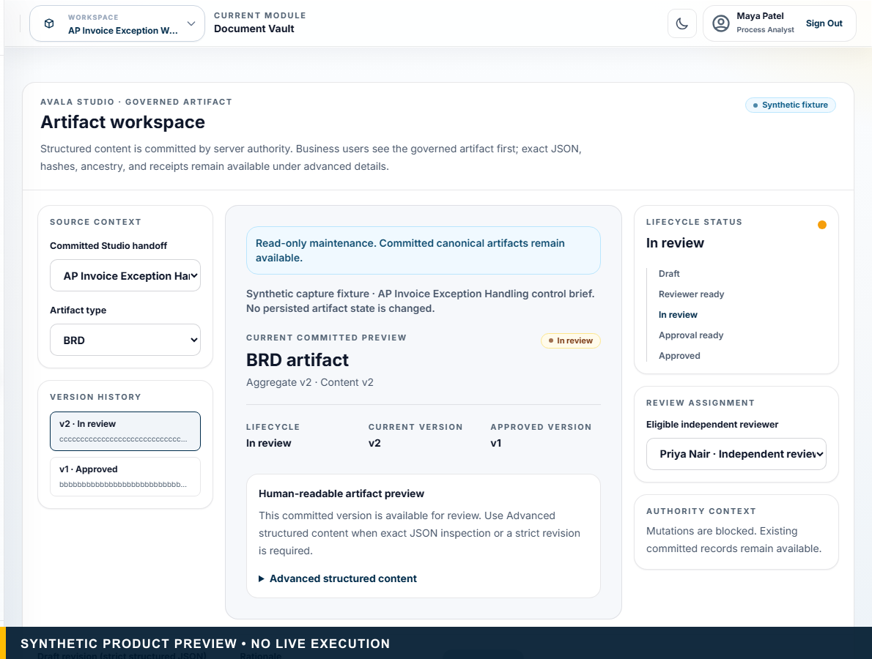
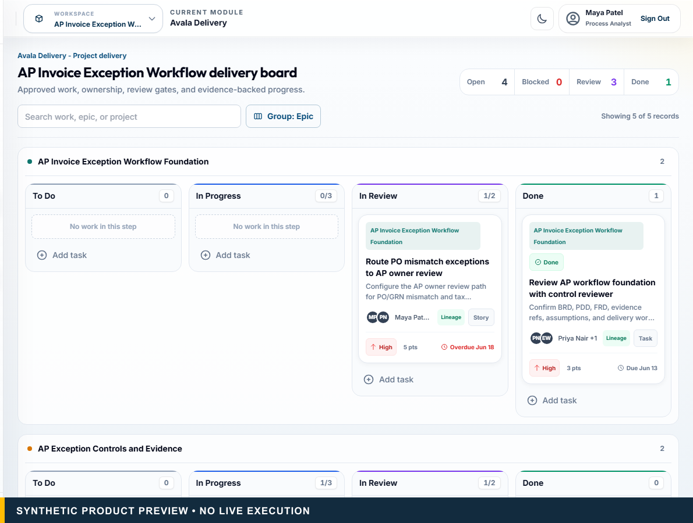
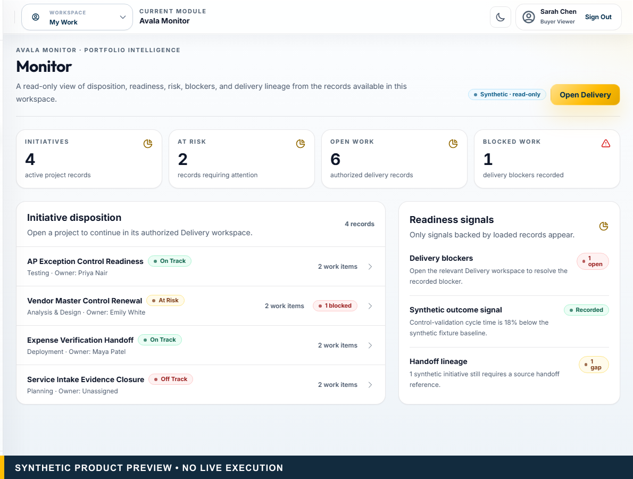
ASSESS → GOVERN → STUDIO → DELIVERY → MONITOR
One governed lifecycle keeps the evidence attached.
01
Assess
02
Govern
03
Studio
04
Delivery
05
Monitor
Evidence-qualified recommendation
Human-owned controls
Approved artifacts
Source-linked work
Outcome visibility
Decision Before Execution • Automation, AI, transformation, process excellence, architecture, and consulting leaders
Synthetic product previews. Execution remains with authorized systems.
04
Notes:
PRIMARY TALK TRACK (45–75 seconds)
Use this slide to establish that one governed lifecycle keeps the evidence attached. Walk through Assess: Evidence-qualified recommendation, Govern: Human-owned controls, Studio: Approved artifacts, and Delivery: Source-linked work. The remaining signals — Delivery: Source-linked work and Monitor: Outcome visibility — matter because they keep authority and evidence visible. State the boundary plainly: Synthetic product previews. Execution remains with authorized systems. Pause on the consequence for this audience before advancing to the next stage of the story.
KEY POINT
One governed lifecycle keeps the evidence attached.
AUDIENCE-SPECIFIC EMPHASIS
Present the lifecycle as one cumulative decision path.
CLAIMS USED
CL-003, CL-004, CL-024
CURRENT VS ROADMAP
Current unless otherwise labelled.
LIKELY OBJECTION
Is this a new project-management suite?
SUGGESTED RESPONSE
No. AvalaOS preserves governed context and complements the execution ecosystem.
AP INPUT REQUIRED
None.
[Sources]
- CL-003: docs/design/avalaos-enterprise-ui-rebaseline.md — Purpose
- CL-004: docs/design/avalaos-enterprise-ui-rebaseline.md — Authenticated information architecture
- CL-024: docs/design/avalaos-enterprise-ui-rebaseline.md — Isolated marketing capture
- Asset: public/marketing/screenshots/ (synthetic committed product captures)
- Fonts: Outfit and Inter, SIL Open Font License 1.1; bundled under docs/marketing/decks/assets/fonts/
[/Sources]

Slide 5
ASSESS + GOVERN
Evidence becomes a governed decision.
Process decomposition and deterministic recommendation meet evidence gaps, material-risk review, control conditions, and human approval.
Primitive-level fitment
Evidence and assumptions
Action-specific controls
Human-owned approval
Decision Before Execution • Automation, AI, transformation, process excellence, architecture, and consulting leaders
Source/CI authority; not hosted, pilot, or production proof.
05
Notes:
PRIMARY TALK TRACK (45–75 seconds)
Use this slide to establish that evidence becomes a governed decision. Process decomposition and deterministic recommendation meet evidence gaps, material-risk review, control conditions, and human approval. The remaining signals — Human-owned approval — matter because they keep authority and evidence visible. State the boundary plainly: Source/CI authority; not hosted, pilot, or production proof. Pause on the consequence for this audience before advancing to the next stage of the story.
KEY POINT
Evidence becomes a governed decision.
AUDIENCE-SPECIFIC EMPHASIS
Connect explainability to accountable governance.
CLAIMS USED
CL-005, CL-006, CL-008, CL-011, CL-012, CL-024
CURRENT VS ROADMAP
Current unless otherwise labelled.
LIKELY OBJECTION
Is AI approving the recommendation?
SUGGESTED RESPONSE
No. AI remains outside scoring and approval authority.
AP INPUT REQUIRED
None.
[Sources]
- CL-005: docs/00_SOURCE_OF_TRUTH.md — Accepted Capabilities
- CL-006: docs/architecture/assess-v2-decision-intelligence-architecture.md — Purpose and Deterministic Decision Layers
- CL-008: docs/00_SOURCE_OF_TRUTH.md — Product and Security Law
- CL-011: docs/07_AVALA_GOVERN_FRAMEWORK.md — Current Scope
- CL-012: docs/00_SOURCE_OF_TRUTH.md — Product and Security Law
- CL-024: docs/design/avalaos-enterprise-ui-rebaseline.md — Isolated marketing capture
- Asset: public/marketing/screenshots/ (synthetic committed product captures)
- Fonts: Outfit and Inter, SIL Open Font License 1.1; bundled under docs/marketing/decks/assets/fonts/
[/Sources]

Slide 6
AVALA STUDIO
Approved context becomes an artifact people can revise and approve.
BRD
FRD
PDD
Immutable revisions
Independent review
Separate final approval
Decision Before Execution • Automation, AI, transformation, process excellence, architecture, and consulting leaders
Common enterprise artifacts. Studio private files and brokered download remain candidate-only.
06
Notes:
PRIMARY TALK TRACK (45–75 seconds)
Use this slide to establish that approved context becomes an artifact people can revise and approve. Walk through BRD, FRD, PDD, and Immutable revisions. The remaining signals — Immutable revisions and Independent review — matter because they keep authority and evidence visible. State the boundary plainly: Common enterprise artifacts. Studio private files and brokered download remain candidate-only. Pause on the consequence for this audience before advancing to the next stage of the story.
KEY POINT
Approved context becomes an artifact people can revise and approve.
AUDIENCE-SPECIFIC EMPHASIS
Stress editability, lineage, and human separation of duty.
CLAIMS USED
CL-013, CL-014, CL-024
CURRENT VS ROADMAP
Current unless otherwise labelled.
LIKELY OBJECTION
Are these certified document standards?
SUGGESTED RESPONSE
They are common enterprise artifact types, not globally certified templates.
AP INPUT REQUIRED
None.
[Sources]
- CL-013: docs/architecture/studio-governed-artifact-authority.md — Scope and trust boundary
- CL-014: docs/architecture/studio-governed-artifact-authority.md — Lifecycle and people
- CL-024: docs/design/avalaos-enterprise-ui-rebaseline.md — Isolated marketing capture
- Asset: public/marketing/screenshots/ (synthetic committed product captures)
- Fonts: Outfit and Inter, SIL Open Font License 1.1; bundled under docs/marketing/decks/assets/fonts/
[/Sources]

Slide 7
DELIVERY + MONITOR
Approved context reaches delivery without losing the why.
One governed handoff prepares source-linked work in Delivery. Monitor provides readiness, risk, blocker, lineage, and recorded-outcome visibility.
Work items and tasks
Acceptance context
Owners and blockers
Delivery Pack lineage
Outcome recording state
Decision Before Execution • Automation, AI, transformation, process excellence, architecture, and consulting leaders
Delivery complements execution systems. Monitor does not create tasks or claim live telemetry.
07
Notes:
PRIMARY TALK TRACK (45–75 seconds)
Use this slide to establish that approved context reaches delivery without losing the why. One governed handoff prepares source-linked work in Delivery. Monitor provides readiness, risk, blocker, lineage, and recorded-outcome visibility. The remaining signals — Delivery Pack lineage and Outcome recording state — matter because they keep authority and evidence visible. State the boundary plainly: Delivery complements execution systems. Monitor does not create tasks or claim live telemetry. Pause on the consequence for this audience before advancing to the next stage of the story.
KEY POINT
Approved context reaches delivery without losing the why.
AUDIENCE-SPECIFIC EMPHASIS
Use the exact Delivery-versus-Monitor split.
CLAIMS USED
CL-016, CL-017, CL-018, CL-019, CL-024
CURRENT VS ROADMAP
Current unless otherwise labelled.
LIKELY OBJECTION
Is Avala Delivery a Jira replacement?
SUGGESTED RESPONSE
No. It prepares governed work and complements authorized delivery systems.
AP INPUT REQUIRED
None.
[Sources]
- CL-016: docs/02_PRODUCT_REQUIREMENTS.md — Avala Delivery
- CL-017: docs/design/avalaos-enterprise-ui-rebaseline.md — Delivery and Monitor
- CL-018: docs/01_PRODUCT_STRATEGY.md — Product Boundaries
- CL-019: docs/design/avalaos-enterprise-ui-rebaseline.md — Delivery and Monitor
- CL-024: docs/design/avalaos-enterprise-ui-rebaseline.md — Isolated marketing capture
- Asset: public/marketing/screenshots/ (synthetic committed product captures)
- Fonts: Outfit and Inter, SIL Open Font License 1.1; bundled under docs/marketing/decks/assets/fonts/
[/Sources]

Slide 8
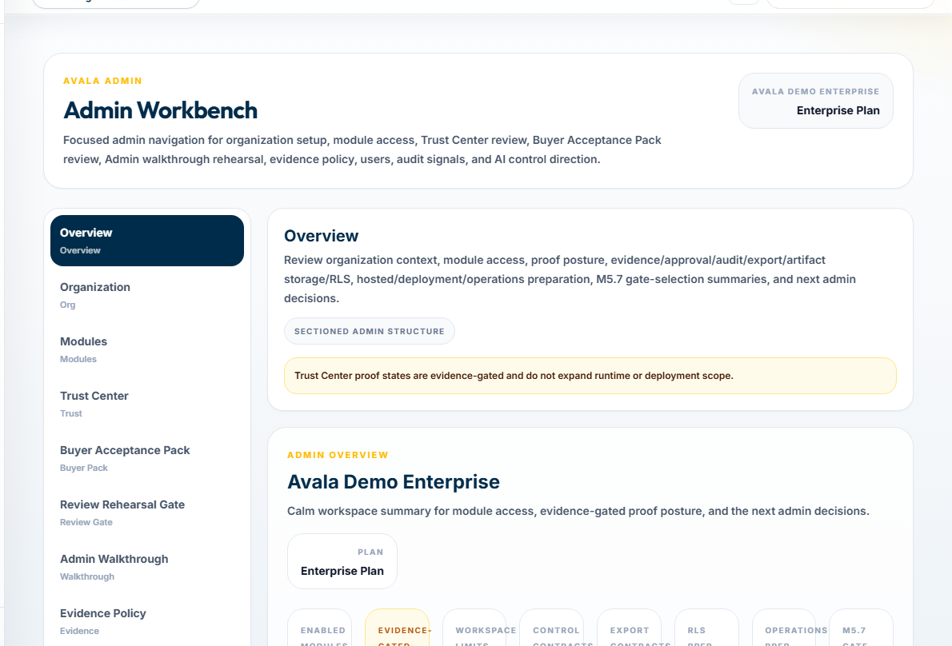
TRUST + AI CONTROLS
Enterprise control starts at the model boundary.
BYOK-ready architecture
Provider choice
Server-side secret boundary
Human authority
Evidence and audit
Fail-closed behavior
Decision Before Execution • Automation, AI, transformation, process excellence, architecture, and consulting leaders
Provider availability is deployment-dependent. No security or compliance certification claim.
08
Notes:
PRIMARY TALK TRACK (45–75 seconds)
Use this slide to establish that enterprise control starts at the model boundary. Walk through BYOK-ready architecture, Provider choice, Server-side secret boundary, and Human authority. The remaining signals — Human authority and Evidence and audit — matter because they keep authority and evidence visible. State the boundary plainly: Provider availability is deployment-dependent. No security or compliance certification claim. Pause on the consequence for this audience before advancing to the next stage of the story.
KEY POINT
Enterprise control starts at the model boundary.
AUDIENCE-SPECIFIC EMPHASIS
Separate model access from human decision authority.
CLAIMS USED
CL-008, CL-021, CL-022, CL-024, CL-026
CURRENT VS ROADMAP
Current unless otherwise labelled.
LIKELY OBJECTION
Is enterprise BYOK available today?
SUGGESTED RESPONSE
The safe current claim is BYOK-ready architecture; availability depends on a validated deployment.
AP INPUT REQUIRED
None.
[Sources]
- CL-008: docs/00_SOURCE_OF_TRUTH.md — Product and Security Law
- CL-021: docs/design/avalaos-enterprise-ui-rebaseline.md — Product surfaces
- CL-022: components/public/PublicWebsite.tsx — TrustPage BYOK direction
- CL-024: docs/design/avalaos-enterprise-ui-rebaseline.md — Isolated marketing capture
- CL-026: docs/00_SOURCE_OF_TRUTH.md — Maturity Verdict and Not Accepted Or Proven
- Asset: public/marketing/screenshots/ (synthetic committed product captures)
- Fonts: Outfit and Inter, SIL Open Font License 1.1; bundled under docs/marketing/decks/assets/fonts/
[/Sources]

Slide 9
FAMILIAR ENTERPRISE ROLES
Built for the teams making automation decisions.
Automation / AI CoE
Enterprise Architecture
Transformation Office
Risk and Control
Process Excellence
Delivery leadership
Business Analysts
Consulting partners
Decision Before Execution • Automation, AI, transformation, process excellence, architecture, and consulting leaders
Designed to reduce adoption friction; no zero-training or instant-adoption claim.
09
Notes:
PRIMARY TALK TRACK (45–75 seconds)
Use this slide to establish that built for the teams making automation decisions. Walk through Automation / AI CoE, Transformation Office, Process Excellence, and Business Analysts. The remaining signals — Business Analysts and Enterprise Architecture — matter because they keep authority and evidence visible. State the boundary plainly: Designed to reduce adoption friction; no zero-training or instant-adoption claim. Pause on the consequence for this audience before advancing to the next stage of the story.
KEY POINT
Built for the teams making automation decisions.
AUDIENCE-SPECIFIC EMPHASIS
Show shared context with role-specific next actions.
CLAIMS USED
CL-027
CURRENT VS ROADMAP
Current unless otherwise labelled.
LIKELY OBJECTION
How much change management is required?
SUGGESTED RESPONSE
The product uses familiar roles and artifacts, but it does not claim zero training.
AP INPUT REQUIRED
None.
[Sources]
- CL-027: docs/01_PRODUCT_STRATEGY.md — Personas
- Fonts: Outfit and Inter, SIL Open Font License 1.1; bundled under docs/marketing/decks/assets/fonts/
[/Sources]

Slide 10
NEXT STEP
Make one governed decision before committing to build.
Explore the synthetic product. Assess a real candidate process. Review the recommendation, evidence, and control conditions before committing automation budget.
1
2
3
4
Select a process
Bring the evidence
Review the recommendation
Decide the governed next step
Decision Before Execution • Automation, AI, transformation, process excellence, architecture, and consulting leaders
Success is a defensible decision, not a deployed automation.
10
Notes:
PRIMARY TALK TRACK (45–75 seconds)
Use this slide to establish that make one governed decision before committing to build. Explore the synthetic product. Assess a real candidate process. Review the recommendation, evidence, and control conditions before committing automation budget. The remaining signals — Decide the governed next step — matter because they keep authority and evidence visible. State the boundary plainly: Success is a defensible decision, not a deployed automation. Pause on the consequence for this audience before advancing to the next stage of the story.
KEY POINT
Make one governed decision before committing to build.
AUDIENCE-SPECIFIC EMPHASIS
Close with a bounded action the audience can take now.
CLAIMS USED
CL-001, CL-002, CL-005, CL-008, CL-024
CURRENT VS ROADMAP
Current unless otherwise labelled.
LIKELY OBJECTION
What is the smallest credible first step?
SUGGESTED RESPONSE
One candidate process, one evidence set, and one reviewed Decision Pack.
AP INPUT REQUIRED
None.
[Sources]
- CL-001: docs/00_SOURCE_OF_TRUTH.md — product identity; docs/01_PRODUCT_STRATEGY.md — Positioning
- CL-002: docs/00_SOURCE_OF_TRUTH.md — canonical tagline
- CL-005: docs/00_SOURCE_OF_TRUTH.md — Accepted Capabilities
- CL-008: docs/00_SOURCE_OF_TRUTH.md — Product and Security Law
- CL-024: docs/design/avalaos-enterprise-ui-rebaseline.md — Isolated marketing capture
- Fonts: Outfit and Inter, SIL Open Font License 1.1; bundled under docs/marketing/decks/assets/fonts/
[/Sources]

