Slide 1

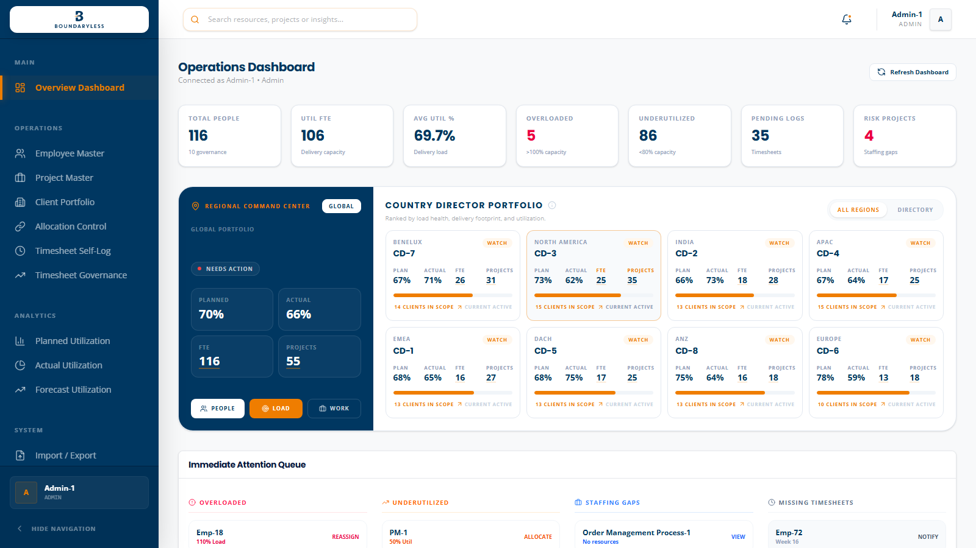
EXECUTIVE PRODUCT DEMO
Boundaryless-WorkOS
A production-oriented command center for capacity, client delivery, weekly evidence, and governance.
Signal -> drilldown -> action -> governance
Built from live localhost screenshots captured at 1600x900
01

Slide 2
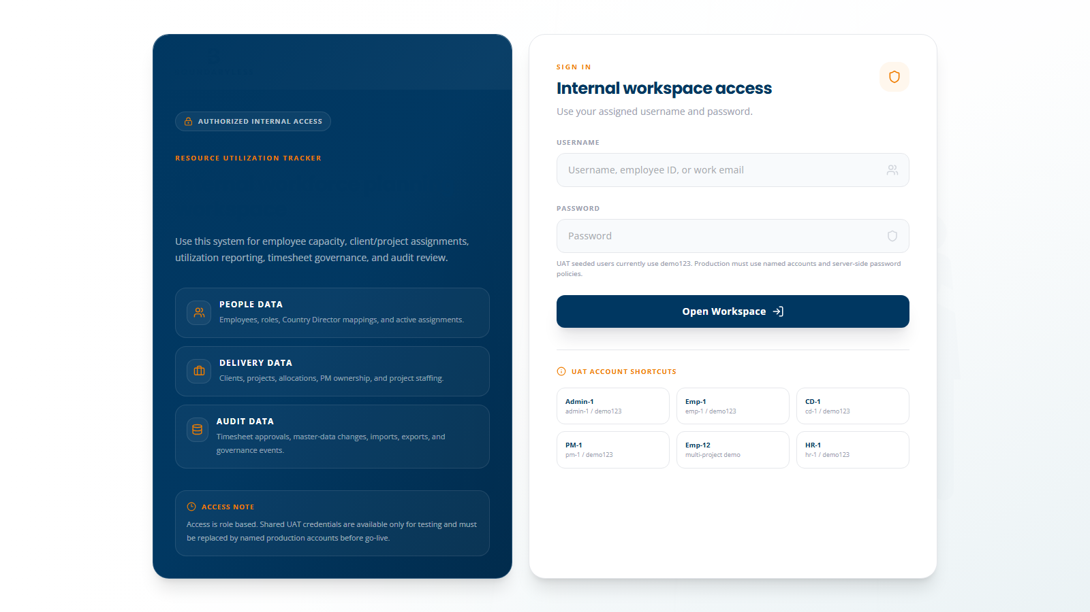
WHY THIS MATTERS
Utilization is only credible when the path from plan to approved effort is visible.
The tracker turns scattered spreadsheets into a governed operating rhythm for leadership.
ONE SOURCE OF TRUTH
People, clients, projects, allocations, timesheets, and audit all sit in one operating model.
ROLE-BASED CONFIDENCE
Admin, HR, Country Director, PM, Team Lead, and Employee screens expose the right depth of data.
PRODUCTION HANDOVER PATH
Demo data can be replaced by real records while preserving stable IDs, links, and governance flow.
Boundaryless-WorkOS | Leadership demo
02

Slide 3
COMMAND CENTER
Start every leadership review with portfolio health, not raw tables.
The dashboard surfaces load, missing logs, risk projects, and Country Director scope before anyone drills down.
SIGNAL
Global KPIs show total people, eligible delivery capacity, utilization, and pending work.
SCOPE
Country Director cards explain ownership without hiding multi-director employee mapping.
ACTION
Immediate queues turn the dashboard into a follow-up surface, not a static report.
Boundaryless-WorkOS | Leadership demo
03

Slide 4
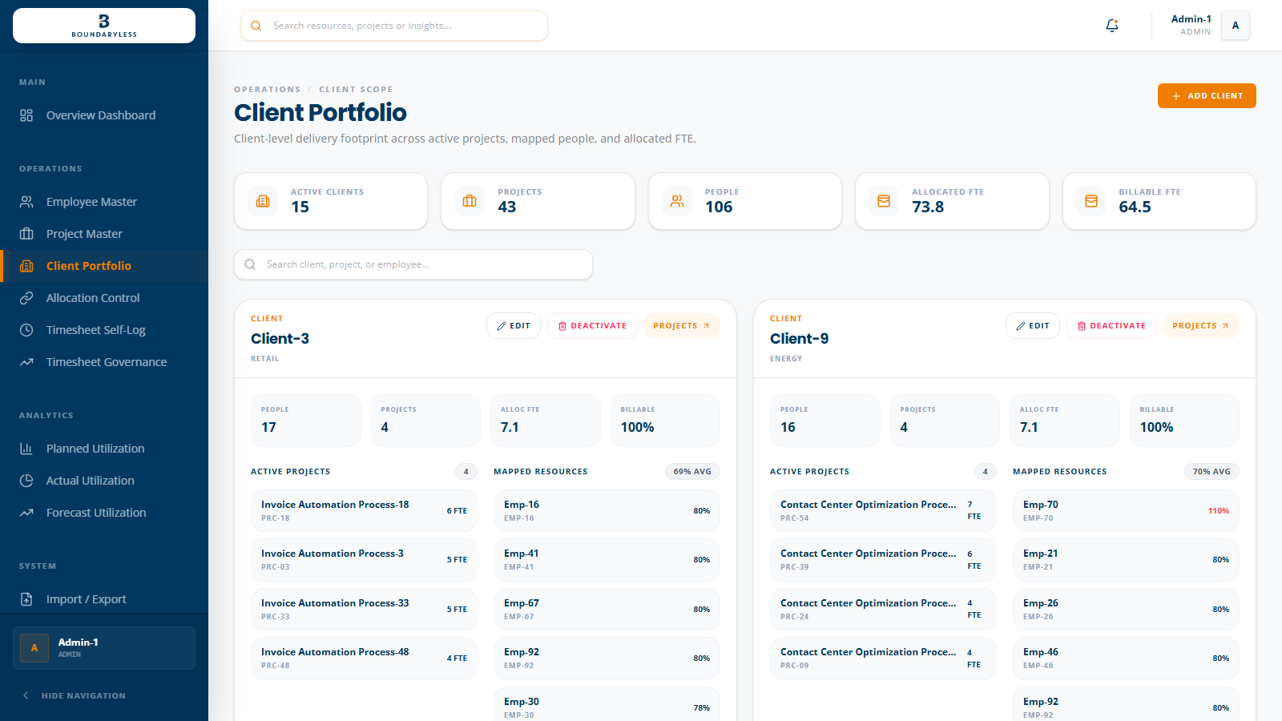
CLIENT SCOPE
Country Directors need client and project scope, not one FTE count.
This view helps leadership see where the workforce is concentrated and which clients carry the most delivery weight.
CLIENT CONCENTRATION
Shows which clients have the largest active workforce footprint.
PORTFOLIO OWNERSHIP
Country Director mappings remain visible even when employees serve multiple scopes.
EXECUTIVE READ
A better leadership question than 'how many cards exist?' is 'where is our delivery capacity exposed?'
Boundaryless-WorkOS | Leadership demo
04

Slide 5
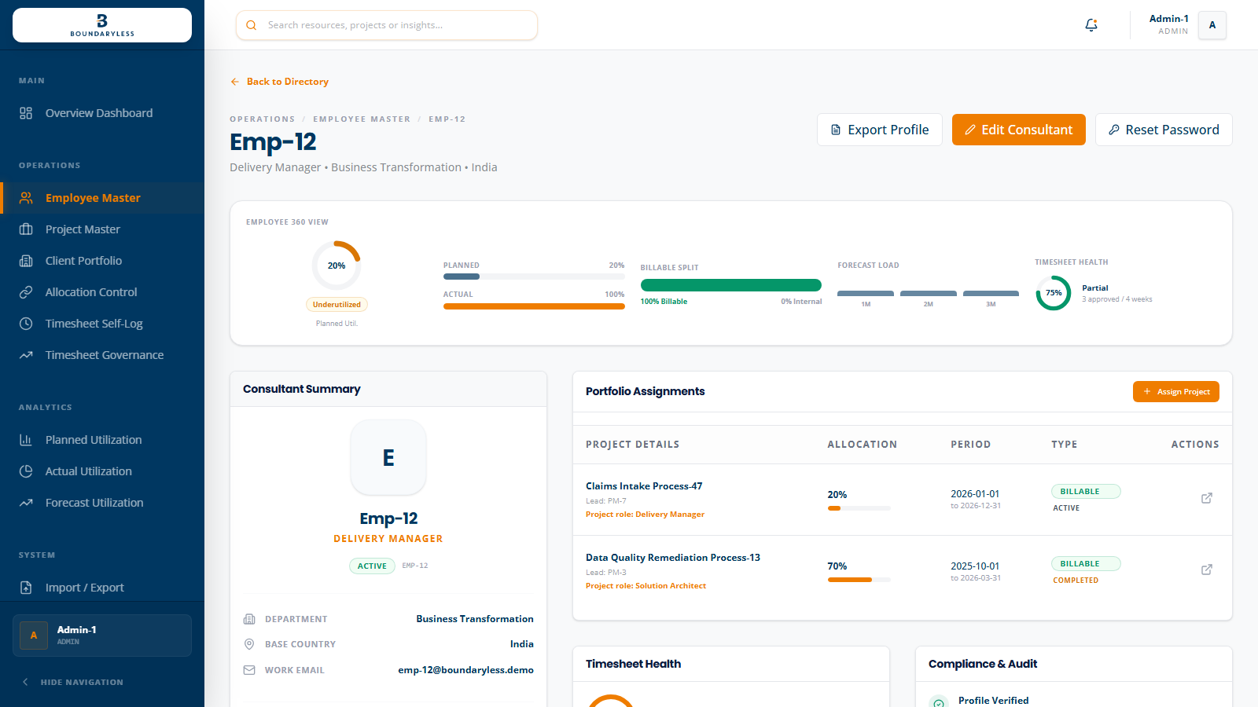
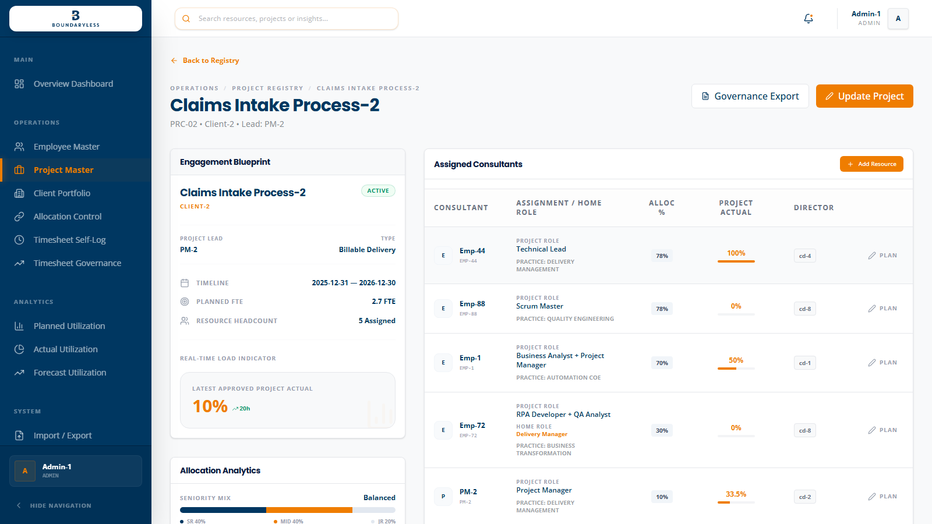
TRACEABILITY
Every hyperlink should land on the exact operational object.
Leadership trust improves when an employee, PM, project, client, or allocation link opens the owning detail screen at the right section.
PERSON VIEW
PROJECT VIEW
Employee record, home role, mapped directors, assignments, and utilization history.
PM ownership, assigned consultants, planned allocation, and project actuals.
Boundaryless-WorkOS | Leadership demo
05

Slide 6
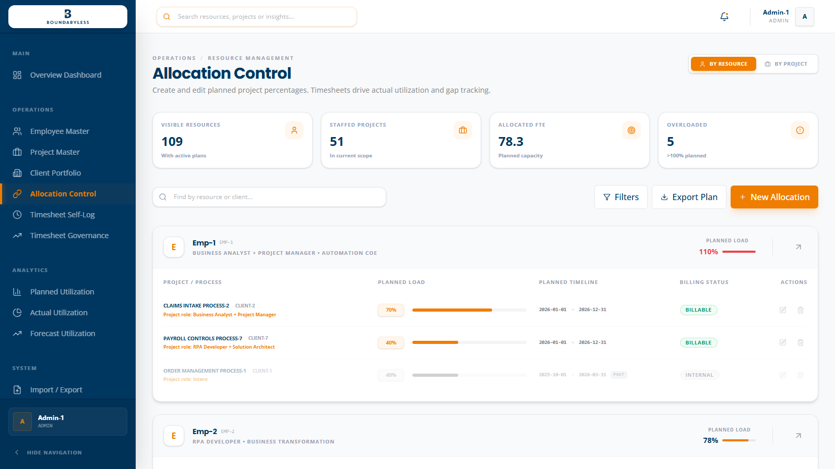
PLANNED UTILIZATION
Allocation Control is the transactional source of planned capacity.
The right user experience is simple: choose person, project, role on project, date range, and percentage.
EDITABLE WHERE IT BELONGS
Planned percentage is controlled from allocation workflows and scoped detail actions.
DATE-AWARE
Start and end dates decide whether capacity counts in current and forecast periods.
PM INCLUDED CORRECTLY
Project Managers count only when they carry active project allocation.
GOVERNANCE USERS EXCLUDED
Admin, HR, and Country Directors do not dilute delivery utilization averages.
Boundaryless-WorkOS | Leadership demo
06

Slide 7
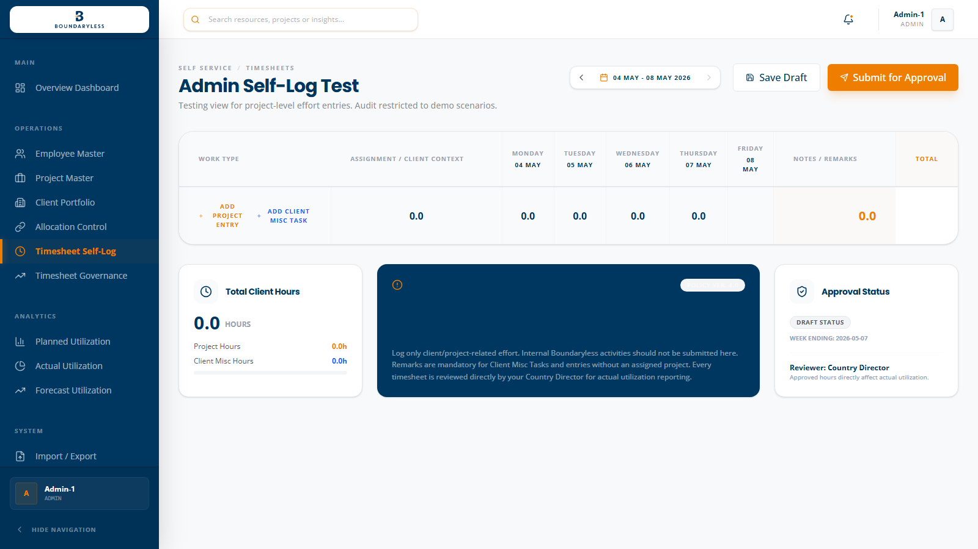
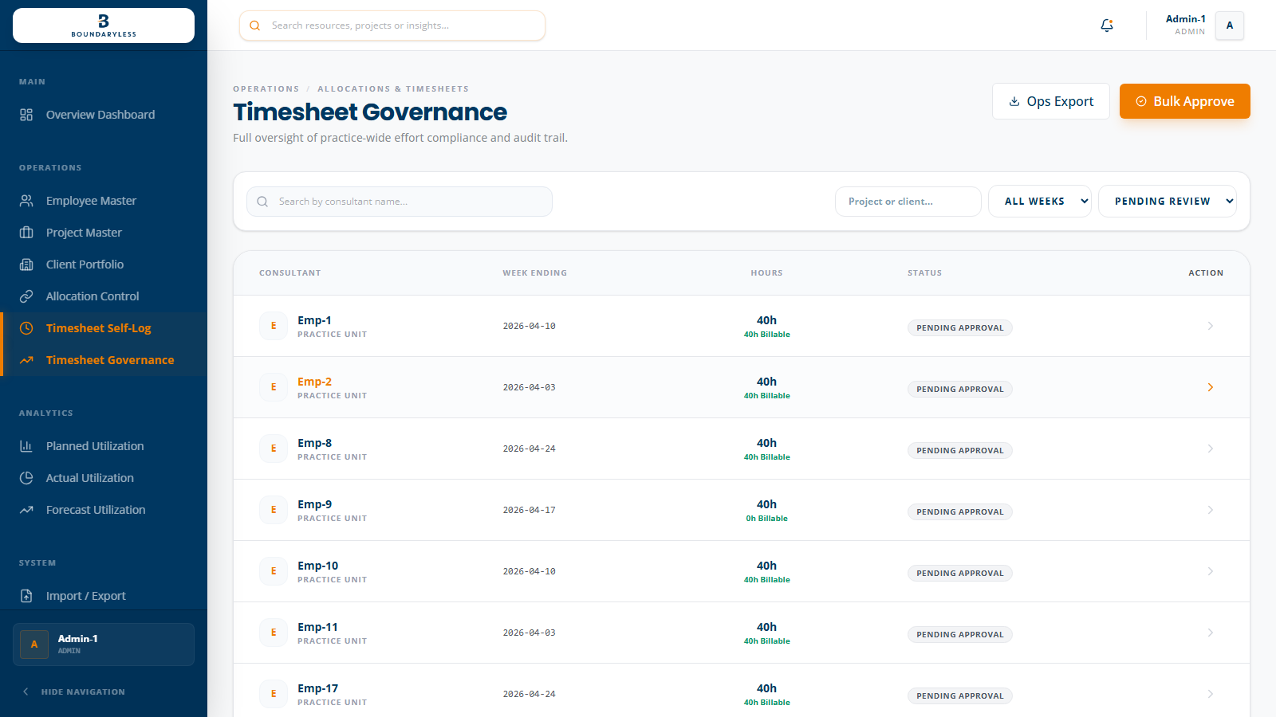
ACTUAL UTILIZATION
Weekly timesheets create approved delivery evidence.
Actual utilization should never be guessed from project status. It should come from submitted, reviewed, and approved hours.
EMPLOYEE ACTION
APPROVER ACTION
Log weekly effort against assigned projects, save draft, then submit.
Approve, reject with reason, or keep pending review before actuals are trusted.
Boundaryless-WorkOS | Leadership demo
07

Slide 8
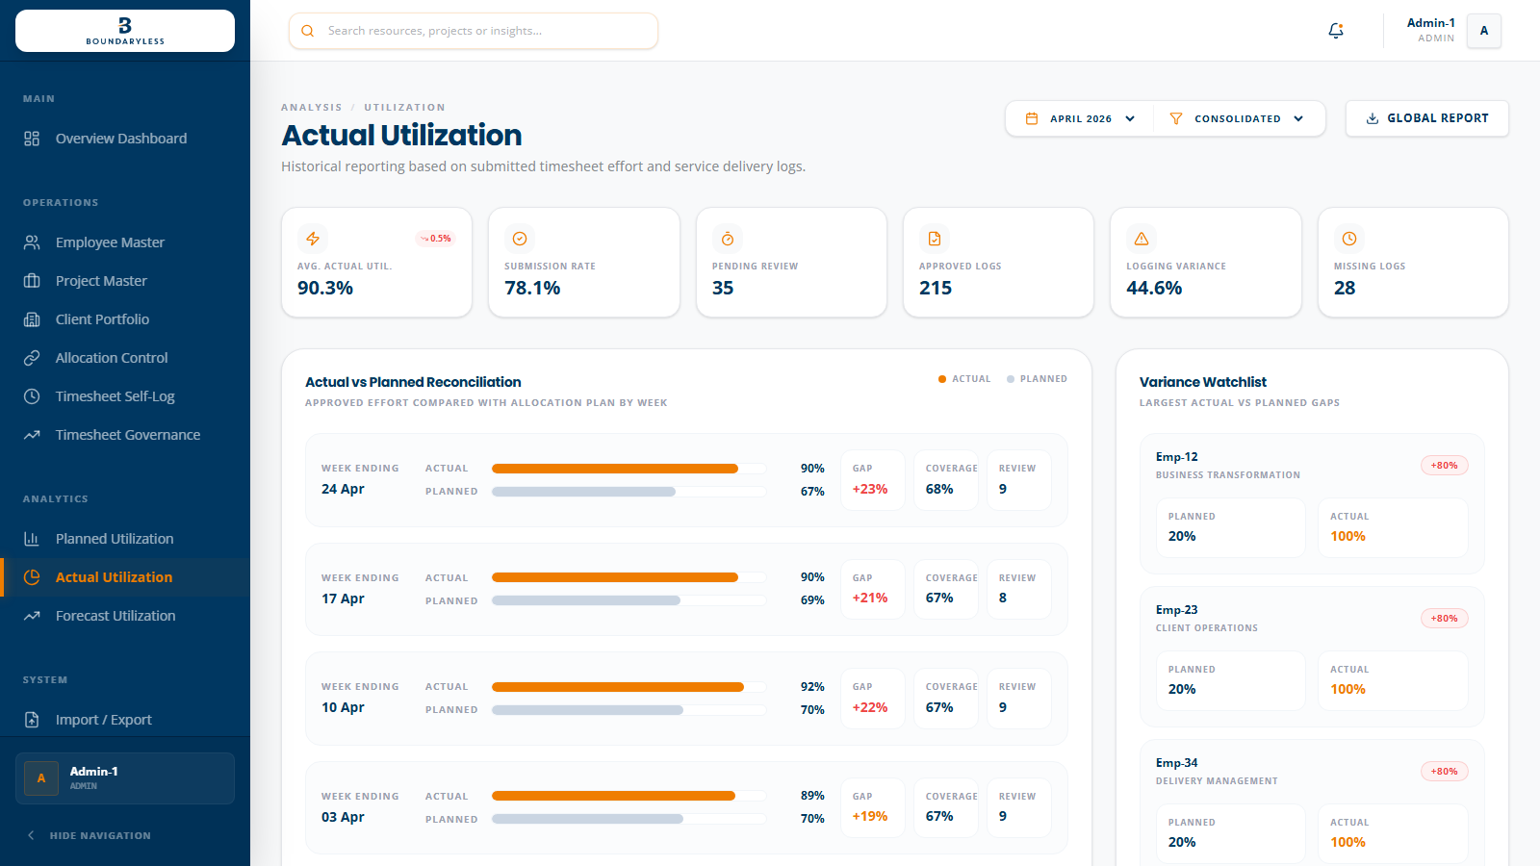
DECISION MODEL
Planned, actual, and forecast utilization answer different executive questions.
The strongest demo moment is showing that the variance view is not redundant: it reconciles expectation against approved delivery.
01
PLANNED
What have we committed through allocations?
02
ACTUAL
What approved effort did people log?
03
FORECAST
Where will overload, bench, or roll-off pressure appear next?
Boundaryless-WorkOS | Leadership demo
08

Slide 9
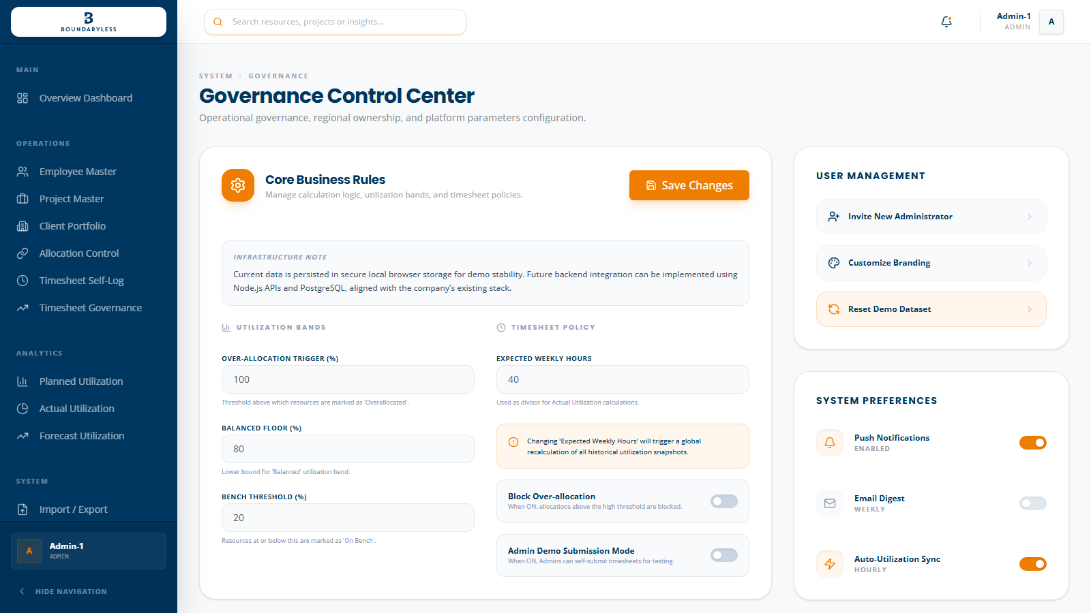
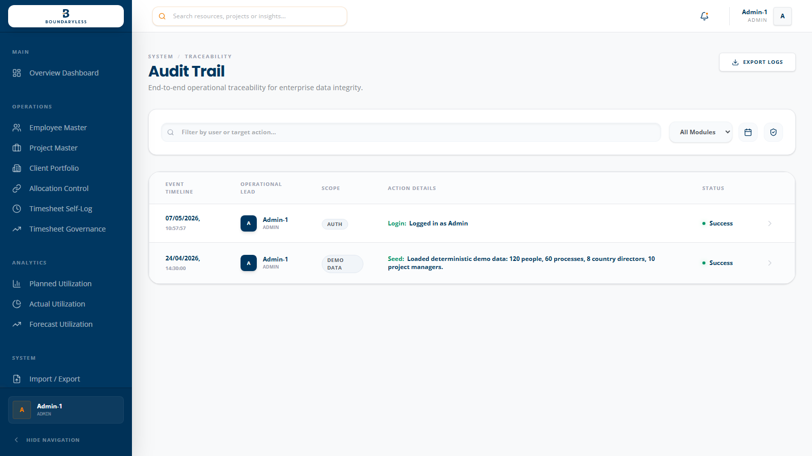
GOVERNANCE AND TRACEABILITY
Production confidence comes from controlled settings, catalogs, audit history, and exportable evidence.
This is the difference between a dashboard prototype and a product leadership can hand to operations.
CONTROLLED CHANGE
TRACEABLE EVIDENCE
Roles, catalogs, thresholds, and user management sit under governed access.
Audit and exports help leadership trust what changed, who changed it, and when.
Boundaryless-WorkOS | Leadership demo
09

Slide 10
LEADERSHIP ASK
Approve a structured UAT rollout using real operating cadence, not isolated feature testing.
The product is ready to be demonstrated as an end-to-end utilization operating system.
WEEK 1
Validate master data and ownership mapping with Admin, HR, PM, and Country Director users.
WEEK 2
Run allocations, timesheets, approvals, and planned-vs-actual review using demo-to-real data replacement.
DECISION
Confirm production database, named users, import sequence, and company SSO path after UAT.
Final leadership close: one product, one operating rhythm, one governed utilization story
10

