Slide 1
IIM NAGPUR · PGP 2026-27 · SECTION B
E-Commerce Retention &
Revenue Growth Analysis
Project Proposal · Business Data Mining & Decision Models (BDMDM)
GROUP MEMBERS
Protik Das
Abhisek Samantaray
Satyabrata Singh
Aishwarya Pratap Singh
Shekhar Yadav

Slide 2
1
Business Problem, Importance & Dataset
Protect existing customer value, cut revenue leakage, reduce dependence on two categories
39.9%
62.7%
13.7%
of orders cancelled / returned - $4.73M gross unrealized
of revenue from just 2 of 10 categories (concentration risk)
of registered users never order; 31.7% of buyers one-time
THE OPPORTUNITY
DATASET - public e-commerce data, 6 linked tables (Jan 2024 - Nov 2025)
Revenue is flat (~$529K/mo, 23-month window) - growth must come from protecting & reallocating existing value, not new demand.
Reactivating buyers and reducing returns act on money already in the funnel: cheaper and faster than acquisition.
Interventions must be targeted by customer value and risk - blanket discounts erode margin.
Events, transactions, product and review data are complementary but must not be merged without validating their links.
File | Rows | Role
users | 10,000 | customer master
products | 2,000 | catalog: category, brand, price
orders | 20,000 | header: status, date, amount
order_items | 43,525 | line items: qty, price, total
events | 80,000 | view / cart / wishlist / purchase
reviews | 15,000 | ratings + free text
DECISION PATHWAY
customer segment › inactivity / return risk › customer value › targeted offer › forecast budget › anomaly control

Slide 3
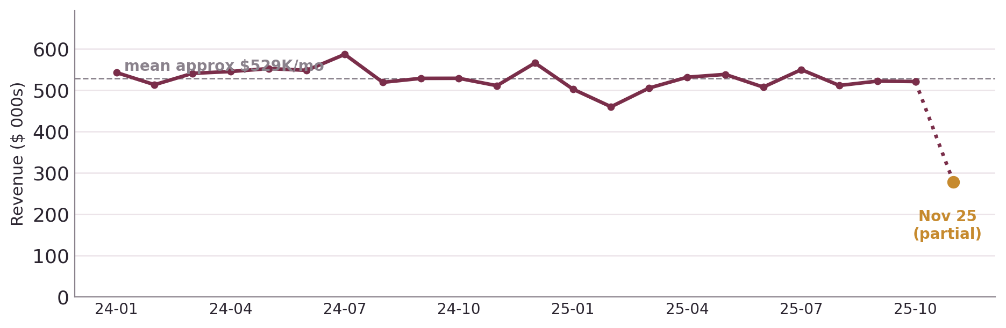
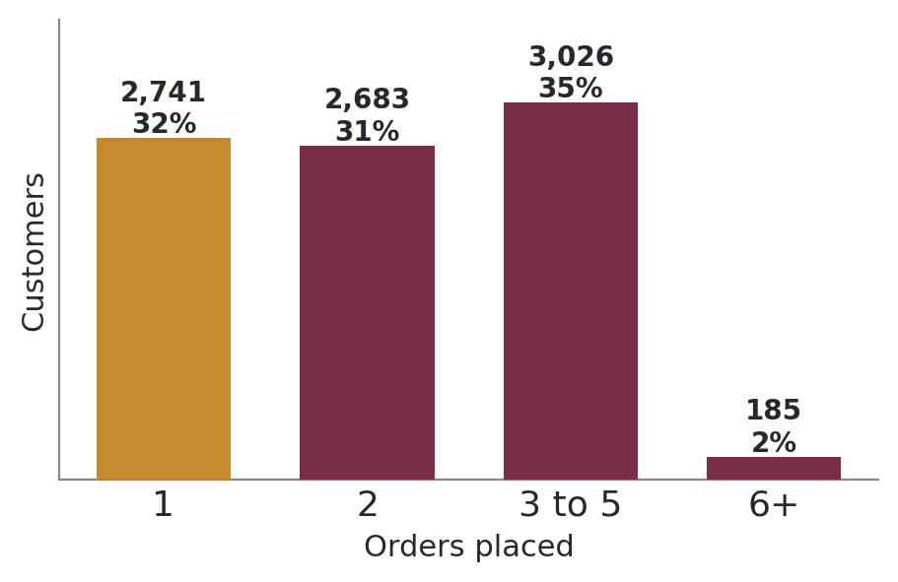
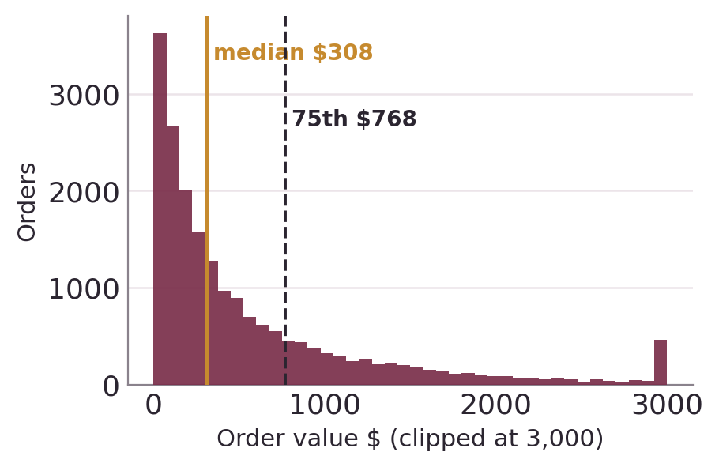
2
Descriptive Baseline - Customers, Orders & Revenue
23-month history, flat monthly revenue: the lever is reallocating value, not riding growth
$11.92M
gross order value
$595.93
avg order value (AOV)
2.32
orders per buyer (median 2)
8,635
of 10,000 users purchased
Read-outs
Base skews to low-frequency buyers: 31.7% order once, only ~2% order 6+ times.
Order value is long-tailed (median $308, 75th $768, max $7,951).
→ Prioritise by value tier; the tail seeds anomaly detection.

Slide 4
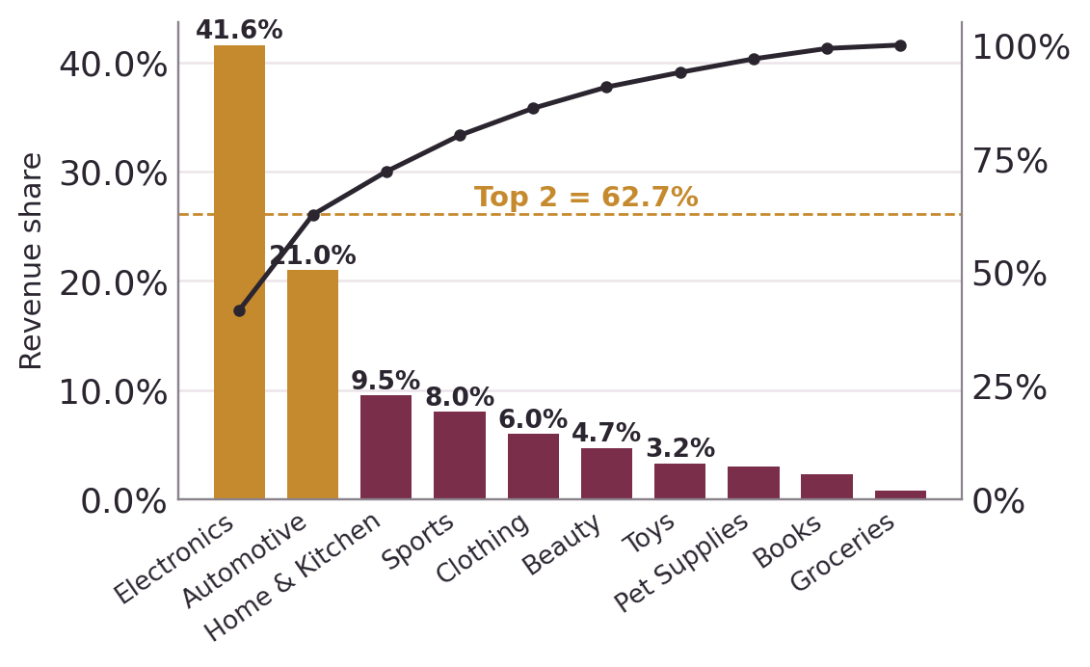
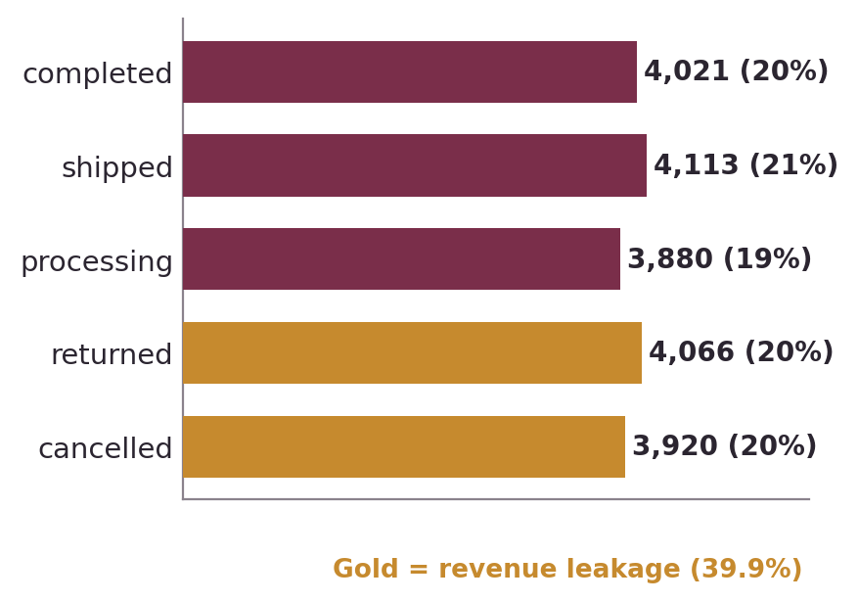
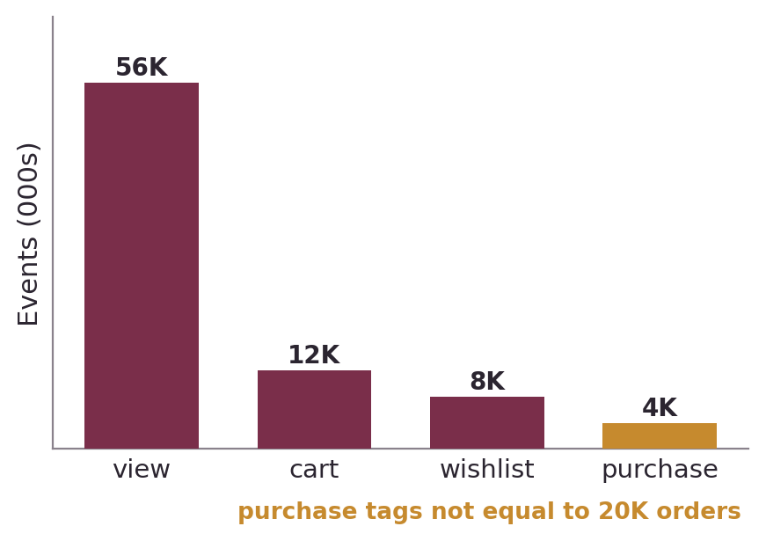
3
Descriptive Baseline - Concentration & Engagement
Revenue concentrates in two categories; engagement events are not a verified purchase funnel
Two rating fields - keep separate
Evidence boundary
products.rating: catalog score, float 2.5-4.9 (mean 3.68) → product similarity.
reviews.rating: customer score, integer 1-5 (mean 3.54, n=15,000) → feedback analysis.
Different constructs - never average or pool them.
4,006 event purchase-tags do NOT reconcile to 20,000 orders.
No clean view → cart → purchase funnel; don't use event 'purchase' as transaction truth.
Report engagement and transactions as separate analytical streams.

Slide 5
4
Data Preprocessing, Cleaning & Transformation Plan
Data is structurally clean; the real work is a broken signup timeline and correct encoding
ALREADY VERIFIED
TARGETED PLAN
No basic hygiene needed
1
Fix the tenure anchor.
4
Keep IDs as strings; drop noise.
65% of first orders predate signup_date (median tenure -107 days). Drop signup for tenure/cohorts; rebuild recency from first order_date.
U/O/P/I ids stay identifiers (never numeric). Drop city (7,755 near-unique = an ID) and name / email (PII).
0 nulls, 0 duplicate rows
All foreign keys resolve
qty × item_price = item_total (all 43,525 rows)
Order totals reconcile to line sums
2
Define the revenue rule.
5
Engineer features.
Recognised = completed + shipped; exclude cancelled + returned (39.9%); report processing separately; run a status-sensitivity check.
Customer RFM from order_date (recency, frequency, recognised spend, AOV, category/brand breadth) + engagement counts; log1p on skewed money fields.
SYNTHETIC-DATA CAVEAT
Faker-style: @example.* emails, generated names, near-uniform category/gender/status.
→ Behavioural signal & real-world generalisability are limited; expectations tempered.
3
Encode nominals as one-hot.
6
Separate event & transaction data.
gender, order_status, event_type, category, brand - never label-encode into K-means / DBSCAN / kNN.
Events as engagement predictors only - never as order ground truth.

Slide 6
5
Proposed Models & Expected Outcomes
Interpretable, syllabus-aligned models to prioritise decisions - not to promise guaranteed uplift
Business question | Model(s) | Target / features | Realistic expected outcome
Who are our segments & who's valuable? | K-means (+ hierarchical / DBSCAN validation) | RFM + breadth + engagement, standardised | 3-5 actionable cohorts; DBSCAN confirms whether dense natural clusters exist
Who will repeat / go inactive? | Logistic → decision tree / ensemble; class-imbalance handling | Repeat-purchase in window; leakage-safe RFM + engagement | Ranked risk list + drivers; expect weak signal (AUC ≈ 0.5) - stated as a data limit
What is each customer worth? | Linear + Ridge / Lasso | Future-period spend; historical spend, freq, AOV, recency | Relative value ranking; Lasso prunes drivers, Ridge stabilises correlated ones
What sells together / cold-start? | Association rules (Apriori) + content similarity | Category/brand baskets; category, brand, price, catalog rating | Cross-sell / bundle candidates by lift (≠ causal); similar-product list
Which transactions need review? | Robust z-score / IQR + Isolation Forest | total_amount, quantity, unit price, category norms | Transaction-risk queue; threshold from value exposure, not default 15%
Evaluation:
time-based split · same holdout across models · ROC-AUC / F1 (not raw accuracy) · holdout error for regression & forecast · clusters validated statistically + commercially · anomaly flags = investigation signals, not fraud. Not proposing RNN forecasting (23 monthly points, flat ~$529K) - use classical smoothing / ARIMA if shown.

