Slide 1
writing your own function.
Week 1 | Lecture 3 (1.3.1)
Notes:
Piazza link error
what do you want to learn, why are you here - who is really interested in programming hopes to do this later,
who is curious about it but maybe is in a different discipline and doesn't think they'll continue
who is totally not stoked about being here and hates computers and is just taking this course for the sake of it
what do you want to learn? what do you want to get out of this course? what would be interesting?
we'll have our first design problem today which looks at kinematics and robotics, a very similar algorithm used by the canadarm.
later we have design problems on creating Wordle from scratch. also a sports analytics themed design problem.

Slide 2
Today’s Content
Lecture 1.3.1
Defining your own function
Reading: Chapter 3
Lecture 1.3.2
Engineering design
Design Problem: Forward Kinematics

Slide 3
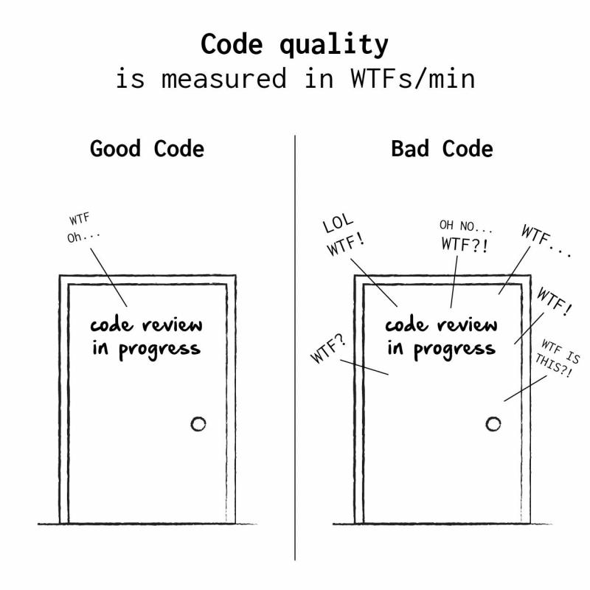
Defining Your Own Functions
The real power of functions is in defining your own.
Good programs typically consist of many small functions that call each other.
If you have a function that does only one thing (like calculate the sine of an angle), it is likely not too large.
If its not too large, it will be easy to test and maintain.

Slide 4
Defining Your Own Functions
As a general rule, you should not write functions more than a 30 or 40 lines.
Smaller is better: 10 or less is good.
If you need something bigger, break it up into multiple functions.
#cleancode

Slide 5
Function Definitions
Definition
Function Name
Colon
def function_name(parameters):
body
return
Indent
(parameter1,
parameter2, …)
What is in the body?
What are we returning?

Slide 6
Function Definitions
def function_name(parameters):
body
def - is a keyword, standing for "definition". All function definitions must begin with def. The def statement must end with a colon.
function_name - is the name you will use to call the function (like sin, abs but you need to create your own name).
parameters - are the variables that get values when you call the function. You can have 0 or more parameters, separated by commas. Must be in parenthesis.
body - body is a sequence of commands like we've already seen (assignment, multiplication, function calls).
Important: all the lines of body must be indented. That is how Python knows that they are part of the function.

Slide 7
Function Definitions
def function_name(parameters):
1. “““DOCSTRING””” (optional)
2. Code that does the thing
3. return expression
The return statement is optional and if it is not included, it’s the same as writing return None
Open your notebook
Click Link:
1. Defining Your Own Functions

Slide 8
Variable Scope
A variable is only available from inside the region it is created, which is called the variable’s scope.
Python has four different scopes, and we will discuss the two most important for this course.
Local Scope
Global Scope
Global
Local
Variable Lookup

Slide 9
Variable Scope
Local Scope
Whenever you define a variable within a function, its scope lies ONLY within the function.
It is accessible from the point at which it is defined until the end of the function and exists for as long as the function is executing.
This means its value cannot be changed or even accessed from outside the function.
Global
Local
Variable Lookup

Slide 10
Variable Scope
Local Scope
Global
def my_function():
name = ‘Sebastian’
my_function()
print(name)
Local
name is local to the function and not accessible outside.
Error: builtins.NameError: name 'name' is not defined

Slide 11
Variable Scope
Local Scope
Whenever you define a variable within a function, its scope lies ONLY within the function.
It is accessible from the point at which it is defined until the end of the function and exists for as long as the function is executing.
This means its value cannot be changed or even accessed from outside the function.
Open your notebook
Click Link:
2. Local Scope

Slide 12
Variable Scope
Global Scope
Whenever a variable is defined outside any function, it becomes a global variable, and its scope is anywhere within the program.
This means that variables and functions defined outside of a function are accessible inside of a function.
Global
Local
Variable Lookup

Slide 13
Variable Scope
Notice that name is not defined anywhere when we define the function.
Global Scope
Global
def my_function():
print(name)
name = ‘Sebastian’
my_function()
Local
name is in the global scope and is accessible inside the function.
Variable Lookup
Is name in local?
No
Is name in global?
Yes (Done)
OUTPUT: Sebastian

Slide 14
Variable Scope
Global Scope
Global
def my_function():
name = ‘Ben’
print(name)
name = ‘Sebastian’
my_function()
Local
name is in the global scope and is accessible inside the function.
Variable Lookup
Is name in local?
Yes (Done)
OUTPUT: Ben

Slide 15
Variable Scope
Global Scope
Whenever a variable is defined outside any function, it becomes a global variable, and its scope is anywhere within the program.
This means that variables and functions defined outside of a function are accessible inside of a function.
Open your notebook
Click Link:
3. Global Scope

Slide 16
Design Recipe
How do we go about writing a function?
You should follow these six steps.
Examples (What do you want your function calls to look like?)
Type Contract (Specify the type(s) of parameters and return values)
Header (Decide on the name of the function)
Description (Write a short description of what the function does)
Body (Write the code that actually does the thing that you want)
Test (Verify the function using examples)

Slide 17
Design Recipe
Write a function that converts from Fahrenheit to Celsius.
1. Examples (What do you want your function calls to look like?)
celsius = convert_to_celsius(32)
celsius = convert_to_celsius(212)
celsius = convert_to_celsius(98.6)

Slide 18
Design Recipe
Write a function that converts from Fahrenheit to Celsius.
2. Type Contract (Specify the type(s) of parameters and return values)
def convert_to_celsius(degrees_f):
"""
...
"""
... Do something
return degrees_c
What types are passed in?
What types are returned?

Slide 19
Design Recipe
Write a function that converts from Fahrenheit to Celsius.
2. Type Contract (Specify the type(s) of parameters and return values)
def convert_to_celsius(degrees_f):
"""
(number) -> number
"""
... Do something
return degrees_c
What types are passed in? Number
What types are returned?
Number

Slide 20
Design Recipe
Write a function that converts from Fahrenheit to Celsius.
3. Header (Decide on the name of the function and parameters)
(you probably already did this in step 1)
def convert_to_celsius(degrees_f):
"""
(number) -> number
"""
... Do something
return degrees_c

Slide 21
Design Recipe
Write a function that converts from Fahrenheit to Celsius.
4. Description (Write a short description of what the function does)
def convert_to_celsius(degrees_f):
"""
(number) -> number
Return the temperature in degrees Celsius corresponding to
the degrees Fahrenheit passed in.
"""
... Do something
return degrees_c

Slide 22
Design Recipe
Write a function that converts from Fahrenheit to Celsius.
5. Body (Write the code that actually does the thing that you want)
def convert_to_celsius(degrees_f):
"""
(number) -> number
Return the temperature in degrees Celsius corresponding to
the degrees Fahrenheit passed in.
"""
degrees_c = (degrees_f - 32) * 5 / 9
return degrees_c

Slide 23
Design Recipe
Write a function that converts from Fahrenheit to Celsius.
6. Test (Verify the function using examples)
- Run all the examples that you created in Step 1.
- Testing is so important.
- In industry, you’ll be expected to provide tests for everything.
celsius = convert_to_celsius(32) # celsius should be 0
celsius = convert_to_celsius(212) # celsius should be 100
celsius = convert_to_celsius(98.6) # celsius should be 37.0

Slide 24
Design Recipe
https://utoronto.zoom.us/my/bussmann
https://utoronto.zoom.us/my/bussmann
How do we do about writing a function?
You should follow these six steps.
Type
Contract
Header
Description
Body
Test
Open your notebook
Click Link:
4. Design Recipe

Slide 25
Docstring
A Python documentation string, commonly known as docstring, helps you understand the capabilities of a function (or module, class).
def convert_to_celsius(degrees_f):
"""
(number) -> number
Return the temperature in degrees Celsius corresponding to
the degrees Fahrenheit passed in.
"""
degrees_c = (degrees_f - 32) * 5 / 9
return degrees_c
This is the docstring

Slide 26
Docstring
As we saw before, help() prints information about a function.
The help function actually prints out the “docstring” that we write as part of a function definition.
For the function we just wrote, we could type:
help(convert_to_celsius)
>>>
Help on function convert_to_celsius in module __main__:
convert_to_celsius(degrees_f)
(number) -> number
Return the temperature in degrees Celsius corresponding to the degrees
Fahrenheit passed in

Slide 27
Docstring
These are the most popular Docstrings format available.
Formatting Type | Description
NumPy/SciPy docstrings | Combination of reStructured and GoogleDocstrings and supported by Sphinx
PyDoc | Standard documentation module for Python and supported by Sphinx
EpyDoc | Render Epytext as series of HTML documents and a tool for generating API documentation for Python modules based on their Docstrings
Google Docstrings | Google's Style

Slide 28
Docstring
This can be very valuable:
For other programmers to figure out what a function is supposed to do.
For you in the future when you have forgotten what you wrote (this happens a lot!).
You should write a docstring for every function!
Remember good vs bad code review.
Open your notebook
Click Link:
5. Docstring

Slide 29
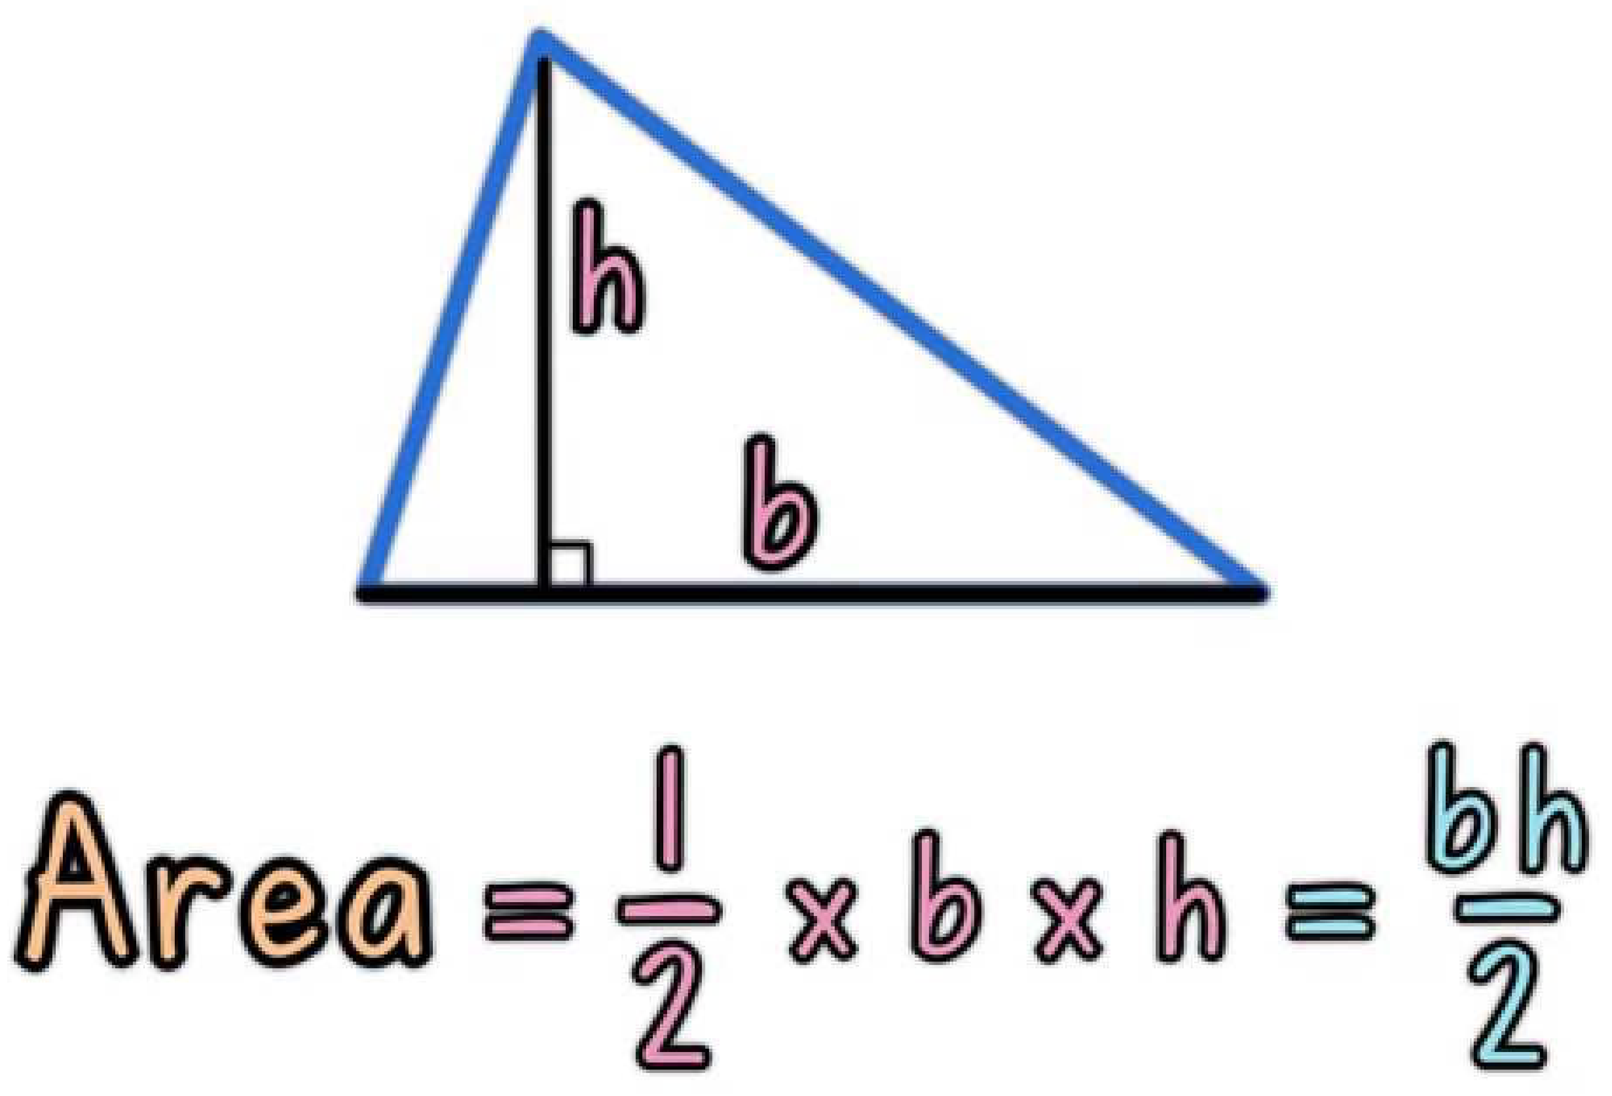
Breakout Session 1
Following the Design Recipe, write a function to calculate the area of a triangle.
Open your notebook
Click Link:
6. Breakout Session 1

Slide 30
More Stuff You Can Do With Functions
https://utoronto.zoom.us/my/bussmann
https://utoronto.zoom.us/my/bussmann
Nested Function Calls
Calling Functions within Functions
Open your notebook
Click Link:
7. Nested Function Calls
8. Calling Functions within Functions
print(3 + 7 + abs(-5))
Function
Function
Function Definition
def my_function():
print("Hello from a function")
Function

Slide 31
From Functions to Programs
The recipe we discussed earlier highlights a few of the realities about programming whether for individual functions or for large pieces of software.
1. A formal design process (or even a recipe) can help.
Especially when you are writing a large program with many programmers, it is easy to get lost.
In fact, it is more often impossible to hold the entire program in your head.
Having a process helps you to figure out where you are and what you should do next.

Slide 32
From Functions to Programs
The recipe we discussed earlier highlights a few of the realities about programming whether for individual functions or for large pieces of software.
2. Functions can be written and then their insides can be forgotten about.
Do you know how Python calculates sin()?
Do you care?
You can successfully use functions without knowing how they are implemented if you know what they take in and what they return.
This is very important for large projects.

Slide 33
From Functions to Programs
The recipe we discussed earlier highlights a few of the realities about programming whether for individual functions or for large pieces of software.
3. Start with examples.
This helps in communication with the client, helps (a lot) to figure out what the problem really is, and is the core for testing your code.

Slide 34
A Design Process for Programming
APS111/112, a key part of engineering is the design of objects, processes, and systems.
Programming is the design, implementation, testing, and documentation of a piece of software that solves a particular problem.
The software might be part of a larger system (e.g., the avionics software of an aircraft, the accounting or human resources software of a business), but it represents the solution to a design problem (or part of a design problem).

Slide 35
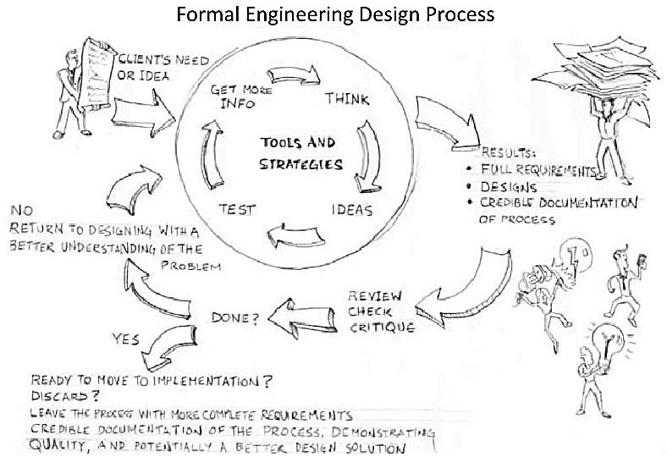
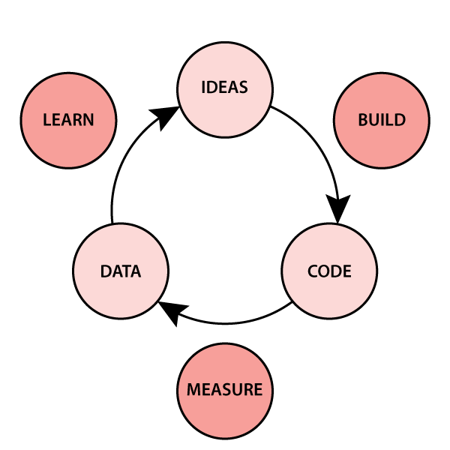
A Design Process for Programming
Taken from: Designing Engineers: An Introductory Text
We will approach programing as an engineering design process and adapt the process you have already seen in APS111/112.
Design is iterative.
users

Slide 36
A Design Process for Programming
In the next lecture, we are going to talk about a detailed design process for programming, based on the engineering design processes that are key to any engineering.
The steps are as follows:
Define the Problem.
Define Test Cases.
Generate Multiple Solutions.
Select a Solution.
Implement the Solution.
Perform Final Testing.

Slide 37
A Design Process for Programming
Define the Problem.
Write down what the problem actually is.

Slide 38
A Design Process for Programming
Define Test Cases.
Create some examples that reflect your code solving the problem: input and output.

Slide 39
A Design Process for Programming
Generate Multiple Solutions.
At this point a "solution" consists of an algorithm plan (the high-level sequence steps defining what your algorithm will do) and a programming plan (the high-level sequence of steps that you will take to code the algorithm).

Slide 40
A Design Process for Programming
Select a Solution.
Based on the different algorithm and programming plans, decide which is the most promising.

Slide 41
A Design Process for Programming
Implement the Solution.
Start to execute your programming plan.
Test as you go!
You may realize that your algorithm plan doesn't solve the problem, or even that you do not understand the problem.
If so, go back to earlier steps.

Slide 42
A Design Process for Programming
Perform Final Testing.
Make sure that your original test cases as well as any others that you have thought up work.

Slide 43
A Design Process for Programming
It is critical to realize that programming is:
Iterative: you will go back and change your algorithm/programming plan. You will write some code during Step 3: you might not be able to define a solution without writing some code to solve part of the problem. You will move back-and-forth in this process.
This process is a lot about finding your own mistakes: even for good programmers, most of their time is spent testing and debugging!

Slide 44
Lecture Recap
Practice!
The syntax of function definitions.
Variable Scope.
A design recipe for writing functions.
Nested function calls.
Calling functions from within functions.
An Engineering Design Process for Programming.
See Chapter 3 of the textbook.
More on engineering design next lecture!

Slide 45
writing your own function.
Week 1 | Lecture 3 (1.3.1)
Notes:
Piazza link error
what do you want to learn, why are you here - who is really interested in programming hopes to do this later,
who is curious about it but maybe is in a different discipline and doesn't think they'll continue
who is totally not stoked about being here and hates computers and is just taking this course for the sake of it
what do you want to learn? what do you want to get out of this course? what would be interesting?
we'll have our first design problem today which looks at kinematics and robotics, a very similar algorithm used by the canadarm.
later we have design problems on creating Wordle from scratch. also a sports analytics themed design problem.

