Slide 1
while loops.
Week 4 | Lecture 1 (4.1)

Slide 2
This Week’s Content
Lecture 4.1
while loops
Reading: Chapter 9
Lecture 4.2
More while loops, survey, midterm review
Reading: Chapter 9
Lecture 4.3
Midterm review

Slide 3
Looping (Iterating)
Looping means repeating something over and over until a particular condition is satisfied.
Looping (aka iteration) is the second key control structure in programming (if-statements/branching was the first).

Slide 4

Looping (Iterating)
List of Customers
Looping means repeating something over and over until a particular condition is satisfied.
Looping
Send Promotional Email
Email

Slide 5
Looping (Iterating)
List of Tweets
Looping means repeating something over and over until a particular condition is satisfied.
Looping
Does the Tweet contain #cleancode
Yes/No

Slide 6
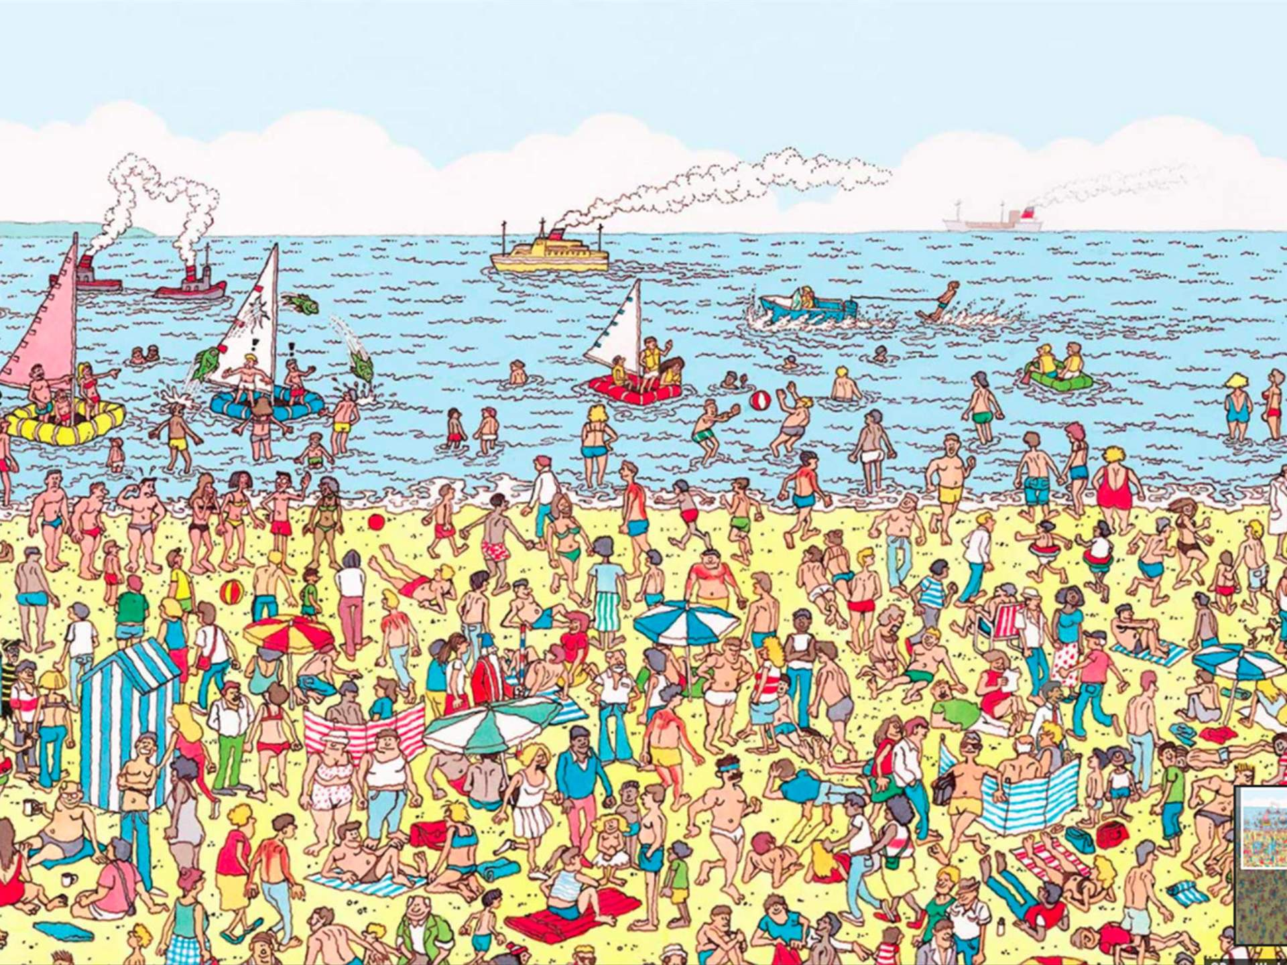
Looping (Iterating)
Looping means repeating something over and over until a particular condition is satisfied.
Check for Waldo
Looping
Yes/No

Slide 7
Looping (Iterating)
Looping means repeating something over and over until a particular condition is satisfied.
Check for Waldo
Looping
Yes/No

Slide 8
Looping (Iterating)
Looping means repeating something over and over until a particular condition is satisfied.
Check for Waldo
Looping
Yes/No

Slide 9
Looping (Iterating)
Looping means repeating something over and over until a particular condition is satisfied.
Check for Waldo
Looping
Yes/No

Slide 10
Looping (Iterating)
Looping means repeating something over and over until a particular condition is satisfied.
Check for Waldo
Looping
Yes/No

Slide 11
While Loops
Sometimes we need to keep looping as long as some condition is True, and stop when it becomes False.
Let's say you want to ask the user a question.
"Do you think the Toronto Maple Leafs will win the Stanley Cup in your lifetime?"
If the user answers 'y', print out "You are going to live for a very long time." If the user answers 'n', print out "Well, sometimes miracles happen."
Open your notebook
Click Link:
1. Asking the User a Question

Slide 12
While Loops
Oh code kinda worked but if the user makes a typo, they can’t participate in the questionnaire.
The general solution is to loop: to execute the same lines of code more than once. This is also called iteration.
We're going to talk about one loop construct today: the while-loop where you loop while some boolean expression is True.

Slide 13
While Loops
Must evaluate to
True or False
Colon
The while loop keeps executing a piece of code as long as a particular condition is True.
There must be a colon (:) at the end of the while statement.
The action to be performed must be indented.
while expression:
do something.
Indent

Slide 14
While Loops
init
The condition that gets evaluated is just an boolean expression.
In particular it can include:
Something that evaluates to True or False.
logical operators (and, or, not)
comparison operators
function calls
... really anything that evaluates to True or False.
False
Condition
True
Do Something
Exit
Loop

Slide 15
While Loops
Must evaluate to
True or False
Colon
Open your notebook
Click Link:
2. While Loops
while expression:
do something.
Indent

Slide 16
while & for Loops
In Python there are two types of loops for and while.
For loops will be introduced in Week 6.
What is the difference between for loops and while loops and when would we use one over the other?
for item in iterable:
do something.
while expression:
do something.

Slide 17
while & for Loops
for loop
The number of iterations to be done is already known.
for item in iterable:
do something.
cats = [‘Persian’, ‘Siamese’, ‘Ragdoll’]
for cat in cats:
print(cat)
>>> Persian
>>> Siamese
>>> Ragdoll
while expression:
do something.

Slide 18
while & for Loops
while loop
The number of iterations to be done is NOT known and iteration continues until a condition is met.
for item in iterable:
do something.
x = 0
while x*x < 200:
print(x)
x += 1
>>> 0
>>> …
>>> 14
while expression:
do something.
I don’t know how many times I should iterate but I know when I should stop.

Slide 19
while & for Loops
List of Customers
for loop or while loop?
Looping
Send Promotional Email
Email

Slide 20
while & for Loops
List of Tweets
for loop or while loop?
Looping
Does the Tweet contain #cleancode
Yes/No

Slide 21
while & for Loops
for loop or while loop?
Check for Waldo
Looping
Yes/No

Slide 22
Infinite Loops
x = 0
while x < 10:
print(x)
x += 1
Remember that a while loop ends when the condition is satisfied (True).
A common error when working with while loops is for the condition to never be satisfied and therefore, the loop to continue forever (till infinity).
We need some way inside the loop for the condition to become false.
True
x = 0, 1, 2, 3, 4, 5, 6, 7, 8, 9
False
x = 10

Slide 23
Infinite Loops
Remember that a while loop ends when the condition is satisfied (True).
A common error when working with while loops is for the condition to never be satisfied and therefore, the loop to continue forever (till infinity).
We need some way inside the loop for the condition to become false.
Open your notebook
Click Link:
3. Infinite Loops

Slide 24
Variable Scope and Loops
x (Global)
def func(x):
x += 1
x = 0
func(x)
x = 0
while x < 10:
x += 1
x (Local)
x (Global)
x (Global)

Slide 25
While Loops
Let’s revisit our User Input code and see if the While Loop will solve out problem.
Open your notebook
Click Link:
4. Back to User Input

Slide 26
Breakout Session 1
Write code to print all the numbers from 0 to 20 that aren’t evenly divisible by either 3 or 5.
Zero is divisible by everything and should not appear in the output.
Open your notebook
Click Link:
5. Breakout Session 1

Slide 27
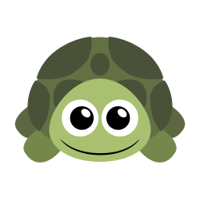
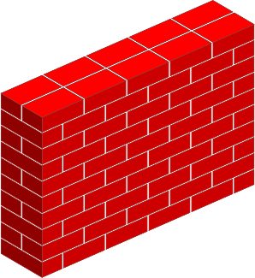
Turtles and while loops
I’m a little turtle and I want to take steps to the right until I get to the brick wall.
However, I don’t know how far away the brick wall I.
Open your notebook
Click Link:
6. Turtles and while loops

Slide 28
Random Module
This module implements pseudo-random number generators for various distributions.
Open your notebook
Click Link:
7. Random Module
import random
random.uniform()
random.random()
random.randint()
…

Slide 29
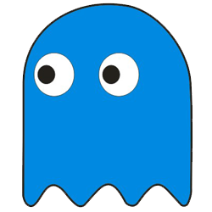
Guessing Game
Let’s build a simple guessing game.
Get the computer to choose a random integer from 0 to 100.
Ask the user for a guess and allow the user to input a guess or "q“.
If the user inputs "q" print a nice message and end the program.
If the user enters a guess, tell them if they should guess higher, lower, or if they got it right.
If they got it right, print a nice message and quit.

Slide 30
Guessing Game
Get the computer to choose a random integer from 0 to 100.
The computer selects 45.
45
0
100

Slide 31
Guessing Game
The user guesses 64.
The computer says LOWER.
Guess
64
45
0
100

Slide 32
Guessing Game
45
0
64

Slide 33
Guessing Game
The user guesses 40.
The computer says HIGHER.
Guess
40
45
0
64

Slide 34
Guessing Game
45
40
64

Slide 35
Guessing Game
The user guesses 45.
The computer says YOU WIN.
Guess
45
40
64

Slide 36
Guessing Game
Let’s build a simple guessing game.
Get the computer to choose a random integer from 0 to 100.
Ask the user for a guess and allow the user to input a guess or "q“.
If the user inputs "q" print a nice message and end the program.
If the user enters a guess, tell them if they should guess higher, lower, or if they got it right.
If they got it right, print a nice message and quit.
Open your notebook
Click Link:
8. A Simple Guessing Game

Slide 37
Lecture Recap
Practice!
Looping (aka iteration) is the second key control structure in programming (if-statements/branching was the first).
The basic idea of loops is to repeated execute the same block code.
Looping is very powerful idea.
While loops is one of two loop types in Python.

Slide 38
functions, input & output, importing modules.
Week 4 | Lecture 1 (4.1)

