Slide 1
String Comparisons and More “if” Statements.
Week 3 | Lecture 2 (3.2)

Slide 2
This Week’s Content
Lecture 3.1
Booleans, Logic, & Conditional if Statements
Lecture 3.2
String Comparisons and More on if Statements
Lecture 3.3
Design Problem: Rock, Paper, Scissors, Lizard, Spock!

Slide 3

RECAP: Relational Operators
Relational (or comparison) operators take two values (examples: int, float, str) and produce a bool value (True or False)
Description | Operator | Example | Result
Less than | < | 3<4 | True
Greater than | > | 3>4 | False
Equal to | == | 3==4 | False
Less than or equal to | <= | 3<=4 | True
Greater than or equal to | >= | 3>=4 | False
Not equal to | != | 3!=4 | True
Boolean Expressions
Boolean Values
Python uses == for equality, because = is used for assignment

Slide 4
String Comparisons
Boolean comparisons can also be applied to strings, whether single characters or sets of characters
Compare two strings by their dictionary order, comparing letter by letter
Description | Operator | Example | Result of example
equality | == | 'cat' == 'cat' | True
inequality | != | 'cat' != 'Cat' | True
less than | < | 'A' < 'a' | True
greater than | > | 'a' > 'A' | True
less than or equal | <= | 'a' <= 'a' | True
greater than or equal | >= | 'a' >= 'A' | True

Slide 5
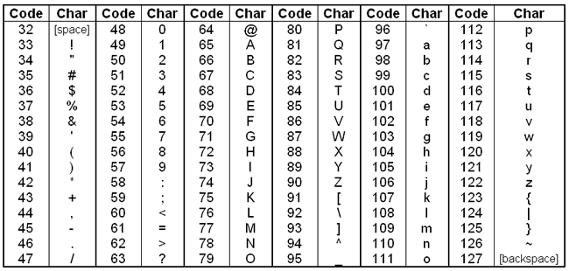
Strings as Integers (ASCII Encoding)
Each character in a string is actually represented by integers following the ASCII encoding
American Standard Code for Information Interchange
All uppercase letters come before all lowercase letters
Uppercase “Z” is less than lowercase “a”

Slide 6
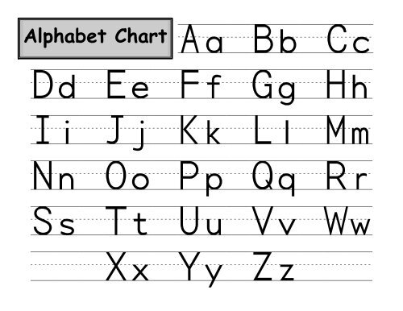
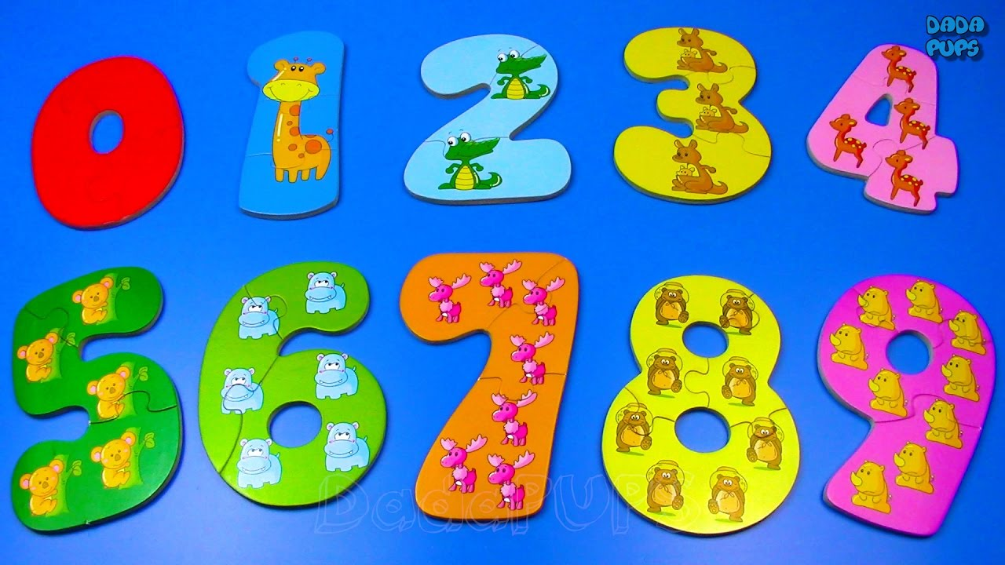
Strings as Integers (ASCII Encoding)
0-9
48-57
A-Z
65-90
a-z
97-122

Slide 7

Strings as Integers (ASCII Encoding)
When you compare two strings, what you are really doing is comparing their numerical representations
For example in ASCII the characters ‘a’ and ‘w’ are encoded as 97 and 119, respectively
The comparison ‘a’ > ‘w’ would translate to 97 > 119, evaluating to False
0-9
48-57
A-Z
65-90
a-z
97-122

Slide 8
ASCII Encoding
To obtain the ASCII (integer) representation, we use the built-in function ord
To convert from ASCII integer representation back to a string, we use the built-in function chr
Think ”character” (i.e. what is this integer’s character)
>>> ord(‘a’)
97
>>> chr(97)
‘a’

Slide 9
Strings and Logic Operators
We can use string comparisons in Boolean/logical expressions:
>>> 50 > 5 or ‘t’ > ‘a’ and ‘c’ != ‘d’
True
>>> ‘ABC’ > ‘abc’ #remember ord(‘A’) < ord(‘a’)
False
>>> ‘abcdefghijklmnopqrstuvwxyz’ > ‘z’ #compares one at a time
False
>>> ‘ab’ > ‘a’ #if first part is equal, longer is greater
True

Slide 10
Testing for Substrings
The in operator provides another way to check whether a string appears inside another string
Results in a Boolean (True or False)
>>> ‘c’ in ‘aeiou’
False
>>> ‘cad’ in ‘abracadabra’
True
>>> ‘zoo’ in ‘ooze’
False

Slide 11
Let’s Code!
Let’s take a look at how this works in Python!
String comparisons
Open your notebook
Click Link:
1. String Comparisons

Slide 12

RECAP: Making Choices
statements
Sequential structure
statements
Conditional structure
if
True
condition
statements
statements
statements
False
statements
Notes:
Sequential is what we’ve seen so far, everything runs in order that Python sees it, just like a book.
Now we’re going to enter the land of conditions, kind of like those choose your own adventure books or games now, where you can have multiple paths that produce different outputs!
Before we get into how to write these conditions, we have to understand logic, and how computers interpret this concept of True and False.

Slide 13


RECAP: Adding the else statement
A more general form of the if conditional statement is:
ONLY 1 of body1 or body2 will be executed.
if statement is True, executes body1
if statement is False, executes body2
if expression:
body1
else:
body2

Slide 14

Adding the elif (else if) statement
The most general form of the if conditional statement is:
if condition1:
body1
elif condition2:
body2
elif conditionN:
bodyN
else:
other_body
Note the colons (:) and the indents!
ONLY 1 body will be executed.
if statement is True, execute body1, exits if structure
if statement is False, continue to elif statement
elif statement is True, execute elif body, exits if structure
elif statement is False, continue to next elif statement
All if’s and elif’s are False, execute else statement

Slide 15
Multiple if vs if-elif
True
True
if
condition
if
condition
statements
Conditional structure
statements
False
False
True
True
elif
condition
if
condition
statements
statements
False
False

Slide 16
Making Choices
statements
True
if
condition
Conditional structure
False
statements
elif
True
condition
statements
False
else
statements

Slide 17
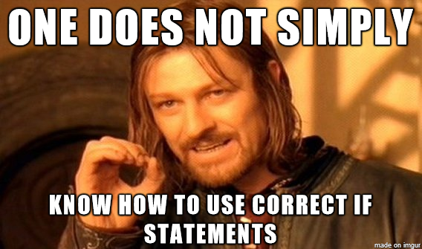
Let’s Code!
Let’s take a look at how this works in Python!
if-elif-else statements
Open your notebook
Click Link:
2. More on if Statements

Slide 18
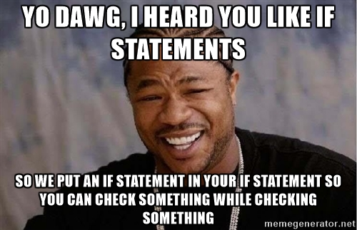
Nested if Statements
It is possible to place an if statement within the body of another if statement
Equivalent code:
if precipitation:
if temperature > 0:
print(“Bring your umbrella!”)
else:
print(“Wear your boots and winter coat!”)
if precipitation and temperature > 0:
print(“Bring your umbrella!”)
elif precipitation:
print(“Wear your boots and winter coat!”)

Slide 19
Choose your own adventure!
Let’s take a look at how this works in Python!
Nested if statements
Open your notebook
Click Link:
2. Nested ifs

Slide 20
Variables, Expressions and Operators.
Week 1 | Lecture 2 (1.2)

