Slide 1
debugging.
Week 5 | Lecture 1 (5.1)

Slide 2
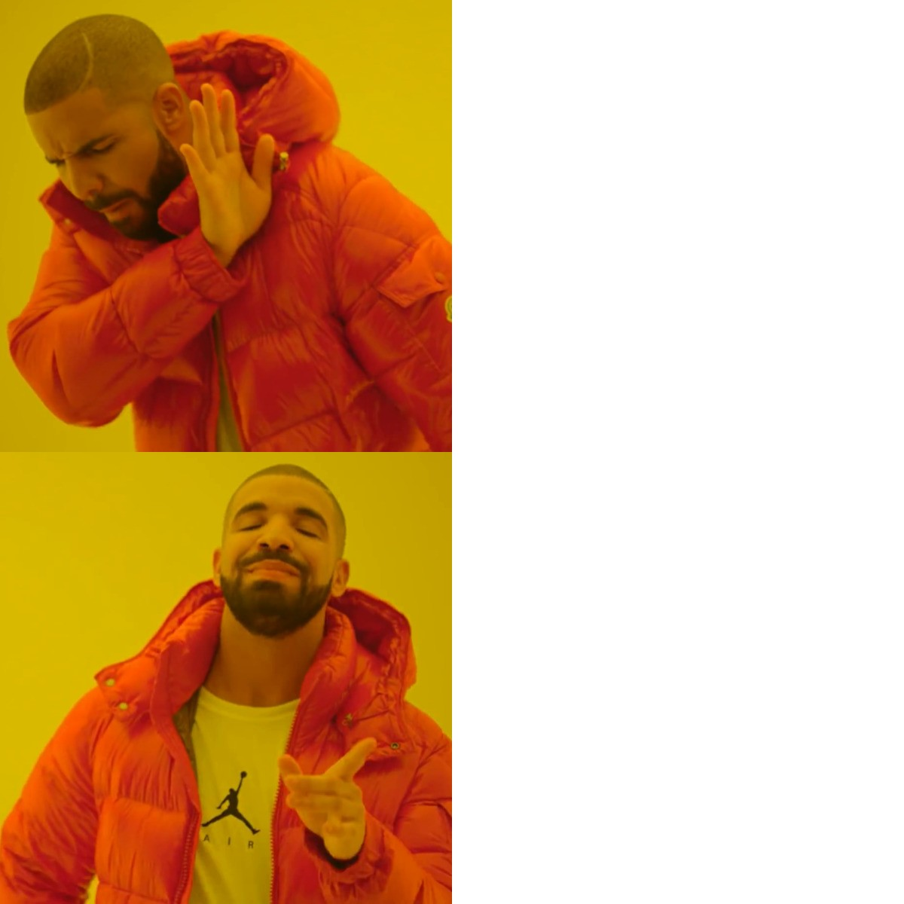
This Week’s Content
No New Friends
Lecture 4.1
Debugging
Lecture 4.2
Objects & Strings: Operators and Methods
Chapter 7
Lecture 4.3
Strings: Conversions, Indexing, Slicing, and Immutability
Chapter 7
No New Slides

Slide 3
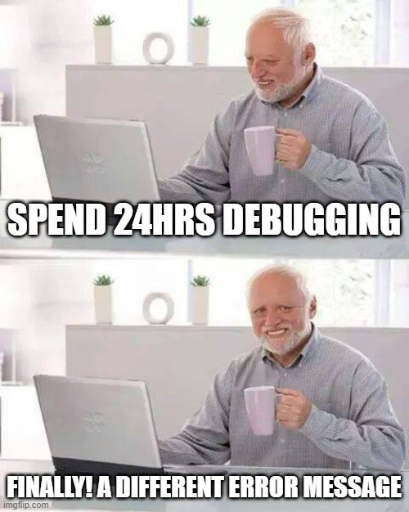
Error Reduction vs Debugging
It is pretty much impossible to write code without errors.
Error Reduction: techniques we can use to reduce the number and severity of errors.
Write Readable Code
Comment comment comment!
Test test test!
Debugging: techniques for identifying and correcting errors

Slide 4
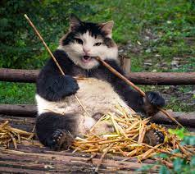
Readability Tips (#cleancode)
>>> canda = cat + panda
Use whitespace to separate variables and operators
>>> canda=cat+panda
Be consistent with spacing, too much whitespace can be bad
>>> canda = cat +panda
Pick variable names that are easy to read and interpret
>>> canda = nom + nomnomnomnomnom
Be consistent with naming schemes
>>> Canda = CAT + _panda42

Slide 5
Write readable code.
Use whitespace to separate variables and operators.
Bad
X=(1+3/2-4)*2-3**2
Good
X = (1 + 3 / 2 - 4) * 2 - 3**2

Slide 6
Write readable code.
Be consistent with spacing, too much whitespace can be a bad thing.
Bad
X= (1+3 / 2-4) *2-3** 2
Good
X = (1 + 3 / 2 - 4) * 2 - 3**2

Slide 7

Variable Names and Conventions
The rules for legal Python names:
Names must start with a letter or _ (underscore)
Names must contain only letters, digits, and _
In most situations, the convention is to use pothole_case
Lowercase letters with words separated by _ to improve readability
Try to add meaning where possible!
Ex: gas_mileage and cost_per_litre instead of nomnom and nomnomnom
Save yourself when debugging & put your TAs in a good mood when marking
Notes:
READ FIRST PART OF SLIDE - What can Python names NOT start with?
READ REST OF SLIDE
These variable names can save you a lot when trying to understand where you went wrong in your code – if the names make sense, sometimes it can be almost like reading English, and you can see the logic where you went wrong. If your code is a bunch of variations of nom, nomnom, nomnomnom, then you’ll end up confusing yourself, and it will be even harder for your TAs to follow when marking your tests, making those part marks extra hard to give. Save yourself and just use clear, meaningful, names.

Slide 8
Write readable code.
Pick variable names that are easy to read and interpret.
Bad
na = 20*12/2
fah = 100*9/5+32
Good
normalized_area = 20 * 12 / 2
degrees_fahrenheit = 100 * 9 / 5 + 32

Slide 9
Write readable code.
Try to be consistent with your naming schemes, for variables, functions, etc.
Bad
NormalizedArea = 20 * 12 / 2
degrees_fahrenheit = 100 * 9 / 5 + 32
Good
normalized_area = 20 * 12 / 2
degrees_fahrenheit = 100 * 9 / 5 + 32

Slide 10
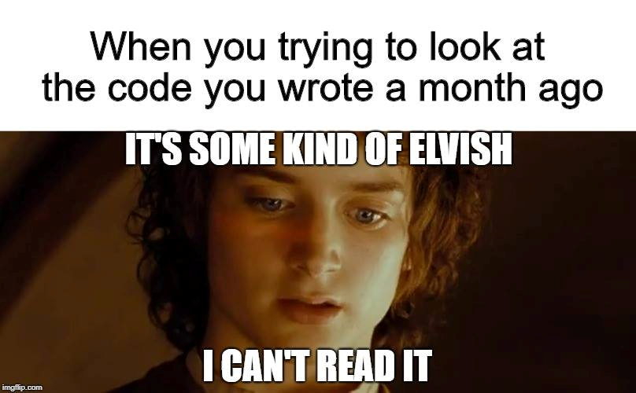
Comments
Comments are to help you, and anyone else who is reading/using your code, to remember or understand the purpose of a given variable or function in a program.
A comment begins with the number sign (#) and goes until the end of the line.
Python ignores any lines that start with the (#) character

Slide 11
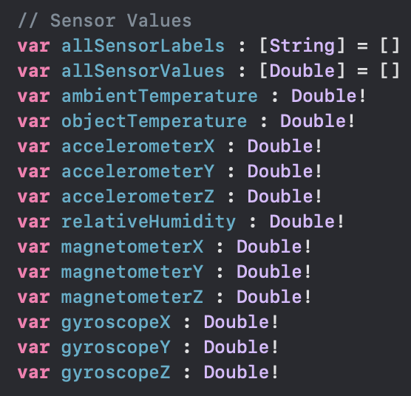
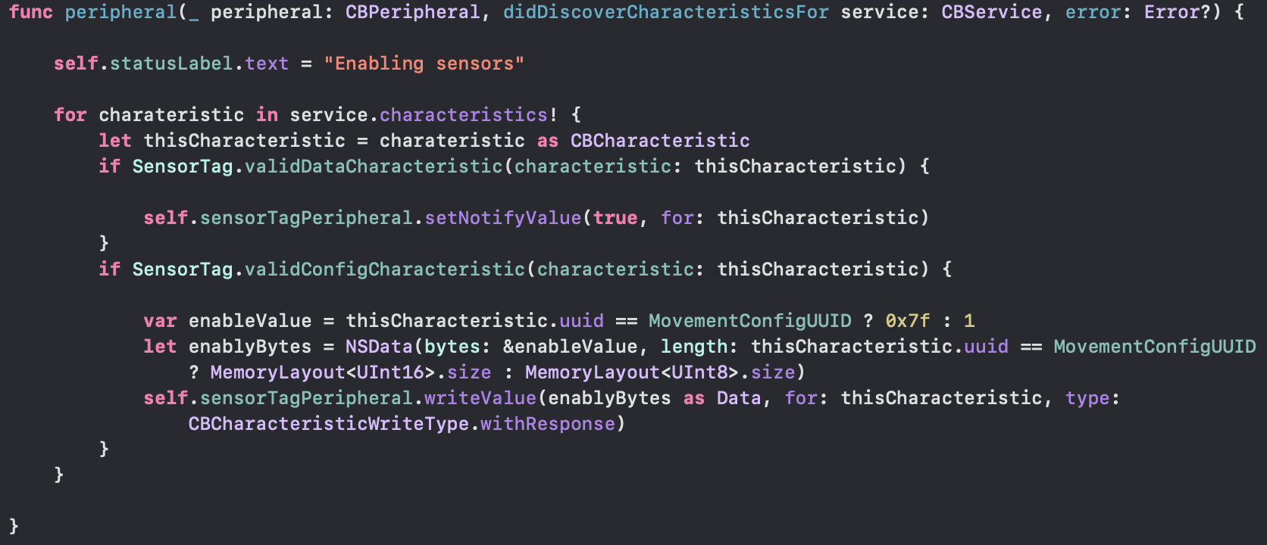
Warning! This is not Python! It is an example from one of my iOS apps I had to come back to after a few years. Comments are (//) in Swift instead of (#) in Python

Slide 12
Comment often.
Bad
fahrenheit = 212
Celsius = (fahrenheit – 32) * 5 / 9
base = 20
height = 12
area = base * height / 2

Slide 13
Comment often.
Comments
Good
# Convert degrees Fahrenheit to Celsius
fahrenheit = 212
Celsius = (fahrenheit – 32) * 5 / 9
# Calculate the area of a triangle
base = 20
height = 12
area = base * height / 2
Space

Slide 14
Testing!
The more lines of code you write, the more likely it is that you will make a mistake and the harder it will be to find the mistake
“like finding a needle in a haystack”
Test your code as you write it
Requires you understanding what specific output an input will provide
”Modular code”
Test in small chunks or “modules”
Put a test input into the beginning where you know what the output is and see what you get!
Golden Rule: Never spend more than 15 minutes programming without testing

Slide 15
Test, test, test.
exam_one = int(input("Input exam grade one: "))
exam_two = input("Input exam grade two: "))
exam_3 = str(input("Input exam grade three: "))
sum = exam_one + exam_two + exam_3
avg = sum / 3
if avg >= 90:
letter_grade = "A"
elif avg >= 80 and avg < 90
letter_grade = "B"
elif avg > 69 and avg < 80:
letter_grade = "C'
elif avg <= 69 and avg >= 65:
letter_grade = "D"
elif:
letter_grade = "F"
print("Exam 1: " + str(exam_one))
print("Exam 2: " + str(exam_two))
print("Exam 3: " + str(exam_3))
print("Average: " + str(avg))
print("Grade: " + letter_grade)
if letter-grade is "F":
print "Student is failing."
else:
print "Student is passing."
Don’t try writing this all in one shot.
How many times do you read over an essay? An email? A text? A TWEET?

Slide 16
Test, test, test.
exam_one = int(input("Input exam grade one: "))
exam_two = input("Input exam grade two: "))
exam_3 = str(input("Input exam grade three: "))
sum = exam_one + exam_two + exam_3
avg = sum / 3
if avg >= 90:
letter_grade = "A"
elif avg >= 80 and avg < 90
letter_grade = "B"
elif avg > 69 and avg < 80:
letter_grade = "C'
elif avg <= 69 and avg >= 65:
letter_grade = "D"
elif:
letter_grade = "F"
print("Exam 1: " + str(exam_one))
print("Exam 2: " + str(exam_two))
print("Exam 3: " + str(exam_3))
print("Average: " + str(avg))
print("Grade: " + letter_grade)
if letter-grade is "F":
print "Student is failing."
else:
print "Student is passing."
Instead, write a smaller section with a clear purpose.
Test it.
Move on.

Slide 17
Test, test, test.
exam_one = int(input("Input exam grade one: "))
exam_two = input("Input exam grade two: "))
exam_3 = str(input("Input exam grade three: "))
sum = exam_one + exam_two + exam_3
avg = sum / 3
if avg >= 90:
letter_grade = "A"
elif avg >= 80 and avg < 90
letter_grade = "B"
elif avg > 69 and avg < 80:
letter_grade = "C'
elif avg <= 69 and avg >= 65:
letter_grade = "D"
elif:
letter_grade = "F"
print("Exam 1: " + str(exam_one))
print("Exam 2: " + str(exam_two))
print("Exam 3: " + str(exam_3))
print("Average: " + str(avg))
print("Grade: " + letter_grade)
if letter-grade is "F":
print "Student is failing."
else:
print "Student is passing."
Instead, write a smaller section with a clear purpose.
Test it.
Move on.

Slide 18
Test, test, test.
exam_one = int(input("Input exam grade one: "))
exam_two = input("Input exam grade two: "))
exam_3 = str(input("Input exam grade three: "))
sum = exam_one + exam_two + exam_3
avg = sum / 3
if avg >= 90:
letter_grade = "A"
elif avg >= 80 and avg < 90
letter_grade = "B"
elif avg > 69 and avg < 80:
letter_grade = "C'
elif avg <= 69 and avg >= 65:
letter_grade = "D"
elif:
letter_grade = "F"
print("Exam 1: " + str(exam_one))
print("Exam 2: " + str(exam_two))
print("Exam 3: " + str(exam_3))
print("Average: " + str(avg))
print("Grade: " + letter_grade)
if letter-grade is "F":
print "Student is failing."
else:
print "Student is passing."
Instead, write a smaller section with a clear purpose.
Test it.
Move on.

Slide 19
How to Debug
Run the Code "By Hand“
You should develop the skill to run it in your head (or on paper). This is often a first step. You need to know the expected output to know if something is wrong!
Check the Python Error Output
When Python encounters an error, it will print some output that can help track down the error in you code.
Add print() Statements
you can often figure out what you are misunderstanding by giving yourself some evidence.
If you can see the values of the variables, you can then compare them against what you think they should be.
Use a Debugger
Using an IDE (like Wing101) you will see that there is an integrated debugger which allows you to do all sorts of things:
Look at the values of the variables.
Step through the code instruction by instruction.

Slide 20
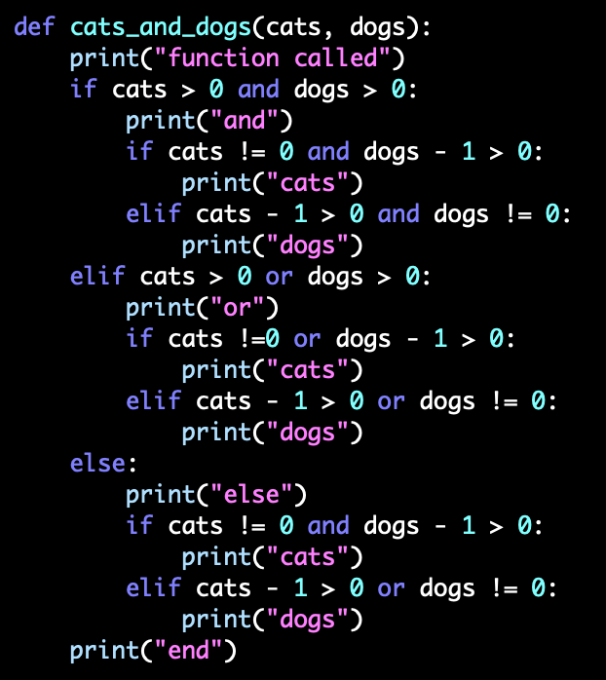
Use print to Debug!.

Slide 21
Let’s Practice Debugging
Open your notebook
Click Link:
1. Breakout Session 1

Slide 22
Lecture Recap
Unfortunately, if you are going to program, you are going to spend a lot of time finding your own mistakes.
Write small pieces of code and test.
Work on simulating the code in your head - run the code "by hand“.
Well located print() statements can really help understanding the code and finding the bug.
If you need big guns, looking into learning how to use debugger might be a good idea.

Slide 23
debugging.
Week 5 | Lecture 1 (5.1)

