Slide 1
Advanced Functions and Aliasing
Week 9 | Lecture 1 (9.1)

Slide 2
This Week’s Content
Lecture 9.1
Advanced Functions and Aliasing
Lecture 9.2
Files: Reading and Writing
Lecture 9.3
Design Problem! Real Estate

Slide 3





Midterm?

Slide 4

Taking functions to the next level!
So far we have only covered the essential concepts related to functions
In this lecture, we will discuss:
Aliasing
Creating and using default values

Slide 5
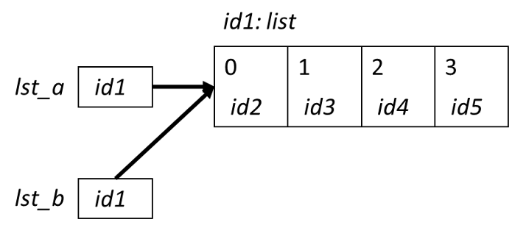

Aliasing
When two variable names refer to the same object, they are aliases.
When we modify one variable, we are modifying the object it refers to, hence also modifying the second variable.
This is common source of error when working with list objects.

Slide 6
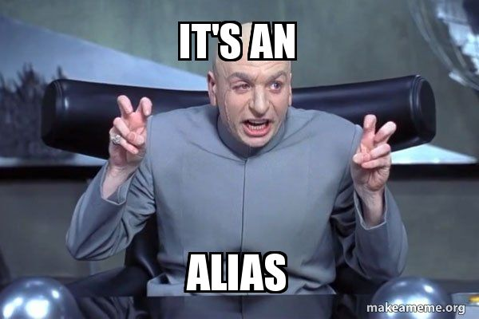
Avoiding Aliasing
>>> lst1 = [11, 12, 13, 14, 15, 16, 27]
>>> lst2 = lst1
>>> lst1[-1] = 17
>>> lst2
[11, 12, 13, 14, 15, 16, 17]
>>> id(lst1)
49012568
>>> id(lst2)
49012568
How can we copy lst1 into another list without aliasing?

Slide 7
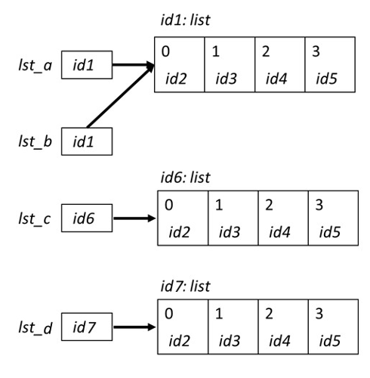
Copying Lists and Avoiding Aliasing
There are two simple ways to copy lists:
Using the list( ) function
Completely slice the list [:]
>>> lst_a = [0, 1, 2, 3]
>>> lst_b = lst_a
>>> lst_c = list(lst_a)
>>> lst_d = lst_a[:]
>>> id(lst_a)
39012510
>>> id(lst_b)
39012510
>>> id(lst_c)
54514112
>>> id(lst_d)
24514139

Slide 8


Summarizing and Revisiting Aliasing
Python passes parameters by object references
An object is not copied, its reference is passed
If the object being referenced is immutable (number, string, tuple), it is not possible to modify that object
If the object being referenced is mutable (lists, sets, dictionaries), then a change made in the function is also reflected in the referenced
This is called aliasing
Catonio Banderas
Kitty
McHandsomePants
Munchkin
Fatso
Little Predator
Baby
Furball

Slide 9
Recap: Variable Scope
A variable is only available from inside the region it is created, which is called the variable’s scope.
Python has four different scopes, and we will discuss the two most important for this course.
Local Scope
Global Scope
Global
Local
Variable Lookup

Slide 10
Variable Scope
Local Scope
Whenever you define a variable within a function, its scope lies ONLY within the function.
It is accessible from the point at which it is defined until the end of the function and exists for as long as the function is executing.
This means its value cannot be changed or even accessed from outside the function.
Global
Local
Variable Lookup

Slide 11
Variable Scope
Local Scope
Global
def my_function():
name = ‘Sebastian’
my_function()
print(name)
Local
name is local to the function and not accessible outside.
Error: builtins.NameError: name 'name' is not defined

Slide 12
Variable Scope
Global Scope
Whenever a variable is defined outside any function, it becomes a global variable, and its scope is anywhere within the program.
This means that variables and functions defined outside of a function are accessible inside of a function.
Global
Local
Variable Lookup

Slide 13
Variable Scope
Notice that name is not defined anywhere when we define the function.
Global Scope
Global
def my_function():
print(name)
name = ‘Sebastian’
my_function()
Local
name is in the global scope and is accessible inside the function.
Variable Lookup
Is name in local?
No
Is name in global?
Yes (Done)
OUTPUT: Sebastian

Slide 14
Variable Scope
Global Scope
Global
def my_function():
name = ‘Ben’
print(name)
name = ‘Sebastian’
my_function()
Local
name is in the global scope and is accessible inside the function.
Variable Lookup
Is name in local?
Yes (Done)
OUTPUT: Ben

Slide 15
Example: Immutable Type
When you pass an int to a function, the function gets a reference to the int object
If the function modifies the int object, then the change is not reflected at the global scope level
def zero(x):
x = 0
return x
>>> x = 1
>>> x_new = zero(x+5)
>>> print(x_new)
0
>>> print(x)
1

Slide 16
Example: Mutable Type (Aliasing)
When you pass a list to a function, the function gets a reference to the list
If the function modifies the list parameter, then that change is reflected at the global scope level
def zero(some_list):
’’’
(list)-> None
changes all elements of some_list to zero
’’’
for i in range(len(some_list)):
some_list[i] = 0
>>> my_list = [0, 1, 2, 3, 4]
>>> zero(my_list)
>>> print(my_list)
[0, 0, 0, 0, 0]

Slide 17
Example: Mutable Type (Aliasing)
When you pass a list to a function, the function gets a reference to the list
If the function modifies the list parameter, then that change is reflected at the global scope level
def zero(some_list):
’’’
(list)-> None
changes all elements of some_list to zero
’’’
new_list = some_list
for i in range(len(some_list)):
new_list[i] = 0
>>> my_list = [0, 1, 2, 3, 4]
>>> zero(my_list)
>>> print(my_list)
[0, 0, 0, 0, 0]
This can be corrected by ensuring the new_list does not reference to the original some_list object
How can we do this?
new_list = some_list[:]
new_list = list(some_list)

Slide 18
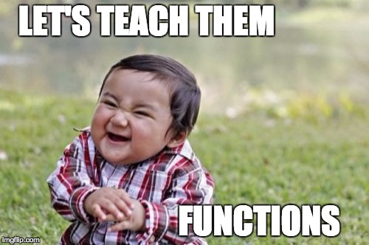
Python Visualizer
https://tinyurl.com/32k8c9p9

Slide 19
Let’s Code!
Let’s take a look at how this works in Python!
Mutation
Modification of an object
Mutable vs Immutable
Can be mutated/modified
Aliasing
Two variables are referring to the same object in memory
Mutation through one variable affects the other variables
Open your notebook
Click Link:
1. More on Mutability and Aliasing

Slide 20
Let’s Recap Functions
The general form of a function call:
Terminology
argument: a value given to a function.
pass: to provide an argument to a function.
call: ask Python to execute a function (by name).
return: give a value back to where the function was called from.
function_name(arguments)

Slide 21
Function Definitions
The general form of a function definition is:
def is a keyword, standing for definition. All function definitions must begin with def. The def statement must end with a colon.
function_name is the name you will use to call the function (like sin, abs but you need to create your own name).
parameters are the variables that get values when you call the function. You can have 0 or more parameters, separated by commas. Must be in parenthesis.
body is a sequence of commands like we've already seen (assignment, multiplication, function calls).
Important: all the lines of body must be indented. That is how Python knows that they are part of the function.
def function_name(parameters):
body
Colon
Indent
(parameter1, parameter2, …)

Slide 22
Function Definitions
The general form of a function definition is:
Definition
Function Name
Colon
def function_name(parameters):
body
Indent
(parameter1, parameter2, …)
function_name(arguments)

Slide 23
Default Values
When working with certain functions, such as range and print, you do not need to pass an argument for every parameter
If no parameter is passed, the default parameter values will be used
For example:
>>> range(2, 5)
range(2, 5)
>>> range(10)
range(0, 10)
>>> print("hello", "world", sep='')
helloworld
>>> print("hello", "world")
hello world

Slide 24
Default Values of print
Take a closer look at the print function
Here we see that print has several parameters
value, ...,: the values to be printed.
sep=' ': an optional argument that by default will be a space. When multiple values are printed, this string will be printed between pairs of values.
end='\n': an optional argument that by default will be a newline character. This string is printed after the last value.
file: an optional argument that by default is sys.stdout, which specifies where to print.
>>> help(print)
Help on built-in function print in module builtins:
print(...)
print(value, ..., sep=' ', end='\n', file=sys.stdout)
...

Slide 25
Examples: Default Values of print
Let’s look at some examples of the print function behaviour:
We see that the newline character ‘\n’ is automatically printed after ‘123’. We can also provide multiple values to the print function:
Let’s use print again, but this time pass arguments to override the default parameter values:
Notice the order does not matter:
.py FILE:
print(123)
print(456)
OUTPUT:
123
456
print(123,456)
OUTPUT:
123 456
print(123,456, sep=‘’, end=‘!’)
print(‘cats’)
OUTPUT:
123456!cats
print(123,456, end=‘!’, sep=‘’)
print(‘cats’)
OUTPUT:
123456!cats

Slide 26

Python Visualizer
https://tinyurl.com/2p9c443y

Slide 27
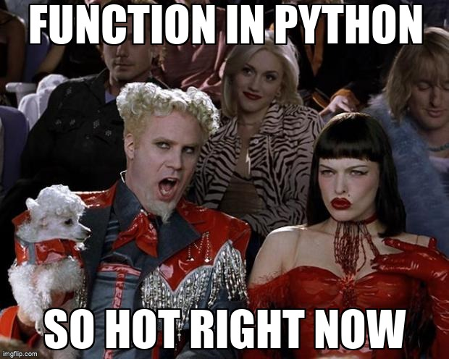
What if we want default parameters in our custom functions?

Slide 28
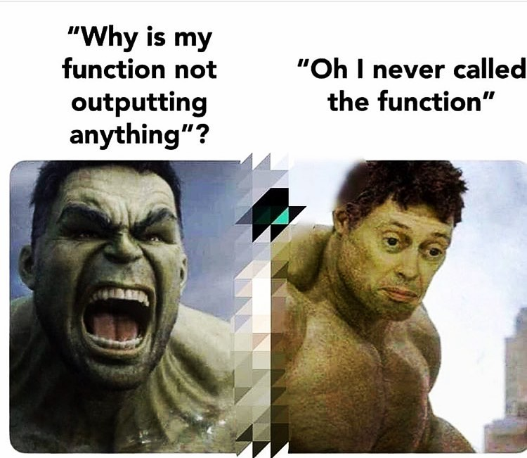
Function Definitions One More Time…
The general form of a function definition is:
Definition
Function Name
Colon
def function_name(param1, param2, …):
body
Indent
(parameter1, parameter2, …)
function_name(arg1, arg2)

Slide 29
Function Definitions One More Time…
The general form of a function definition with default values is:
Definition
Function Name
Colon
def function_name(param1=val1, param2=val2,…):
body
Indent
(parameter1, parameter2, …)
function_name(arg1, arg2)

Slide 30
Function Definitions with Default Parameters
The general form of a function definition with default values is:
Assigning a value to a parameter in the function definition indicates the default value (i.e. the value to use when no argument is provided.
Using the above example, I could call function_name() or function_name(val1, val2) and it would be identical
def function_name(parameter1=val1, parameter2=val2,…):
body

Slide 31
A Greeting Example
The general form of a function definition with default values is:
def make_greeting(title, name, surname, formal=True):
if formal:
return ("Hello " + title + " " + surname)
return ("Hey " + name)
>>> print(make_greeting("Mr.", “Neo”, ”Anderson"))
Hello Mr. Anderson
>>> print(make_greeting("Mr.", “Neo”, ”Anderson", False))
Hey Neo

Slide 32
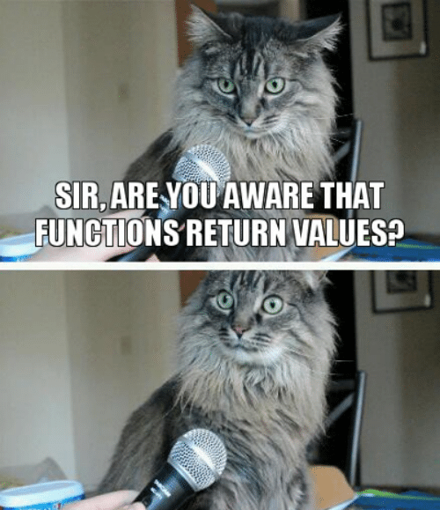
Python Visualizer
https://tinyurl.com/7x79adcw

Slide 33
Let’s Code!
Let’s take a look at how this works in Python!
Creating default parameters
Open your notebook
Click Link:
2. Default Function Values

Slide 34
Advanced Functions and Aliasing
Week 9 | Lecture 1 (9.1)

