Slide 1
The Programming Process.
Week 1 | Lecture 3 (1.3)
Notes:
Talk about chat. What do students think, is it helpful? Is it distracting? Would you like rules implemented? Hand raising?

Slide 2
This Week’s Content
Lecture 1.1
Introduction
Lecture 1.2
Variables, Expressions, and Operators
Chapters 1,2, and 3
Lecture 1.3
The Programming Process

Slide 3


The Wild Wild Chat
Positive and Respectful
Not putting others down (including departments or programs)
Not distracting others
Nothing “illegal” – 2 separate instances already of student code violations
Relevant questions (about current slide)
Not YouTube or Twitch chat
Not a stream of consciousness
Remember this is a university lecture
Notes:
Moving away from the Red dead redemption wild wild west to something a little more peaceful and manageable.
We don’t want to do a full 180 from the wild west and turn this into a british tea party where where it’s silent, or worse some 1984 big brother scenario where we need to suppress who can speak and not speak. So let’s try to be as respectful as possible to create the best learning environment for everyone.
There’s 3 of us monitoring the chat at all times, and if 3 people can’t keep up with a lecture hall of questions, then there’s a problem.

Slide 4
Recap: What is Programming?
We need to tell it what to do CORRECTLY
A way of telling a computer what to do.
A computer can’t infer (…yet).
Need to tell a computer every single step it needs to do in a language it can understand.
How would you request an egg for breakfast to a chef and to a computer/robot?
To a Chef
Sunny-side up, please!
To a Computer
“Turn on stove”
“Take out pan”
“Take one egg out of fridge”
“Crack egg”
“Pour egg into pan”
“Wait 5 minutes”
Notes:
We need to tell the computer exactly what to do, correctly.

Slide 5

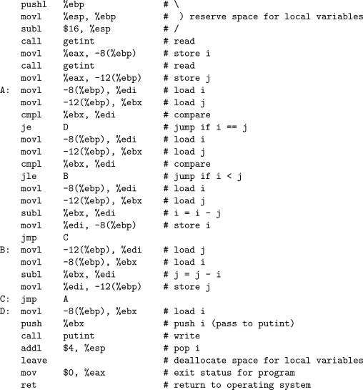
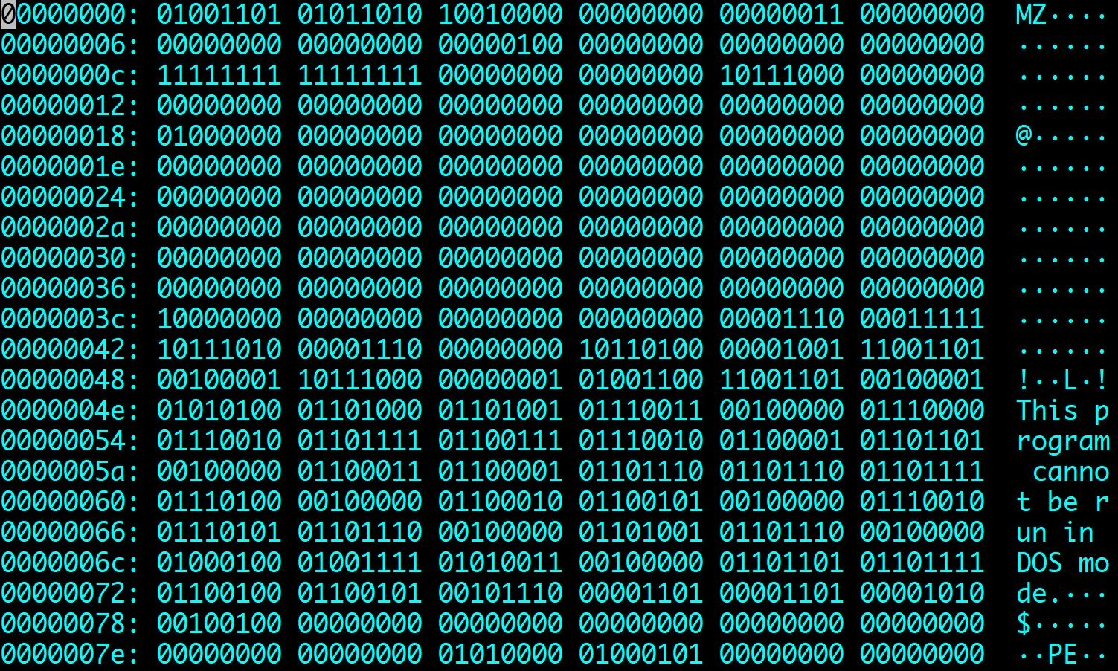
Recap: The power of programming languages
if x > 10:
print(”x is greater than 10”)
Notes:
It’s our responsibility to correctly tell the computer what to do. Machine code works. I’ve almost never come across a problem where the problem is the computer itself, and where it was – it was the computer didn’t have enough memory to do what I was asking it to because I wasn’t asking it in an efficient enough way.

Slide 6
Recap: Arithmetic Operators
Operator
Operation
Expression
English description
Result
+ | addition | 11 | + | 56 | 11 plus 56 | 67
- | subtraction | 23 | - | 52 | 23 minus 52 | -29
* | multiplication | 4 | * 5 |  | 4 multiplied by 5 | 20
** | exponentiation | 2 | ** | 5 | 2 to the power of 5 | 32
/ | division | 9 | / 2 |  | 9 divided by 2 | 4.5
// | integer division | 9 | // | 2 | 9 divided by 2 | 4
% | modulo (remainder) | 9 | % 2 |  | 9 mod 2 | 1

Slide 7
Augmented Assignment Operations
Operator | Expression | Identical Expression | English description
+= | x = 7 x += 2 | x = 7 x = x + 2 | x refers to 9
-= | x = 7 x -= 2 | x = 7 x = x - 2 | x refers to 5
*= | x = 7 x *= 2 | x = 7 x = x * 2 | x refers to 14
/= | x = 7 x /= 2 | x = 7 x = x / 2 | x refers to 3.5
//= | x = 7 x //= 2 | x = 7 x = x // 2 | x refers to 3
%= | x = 7 x %= 2 | x = 7 x = x % 2 | x refers to 1
**= | x = 7 x **= 2 | x = 7 x = x ** 2 | x refers to 49
Notes:
Addition and multiplication are commutative. Meaning order doesn’t matter. X+y is the same as y+x. Subtraction and division are not! Be careful of the order. Remember to keep what’s on the right, on the right.
Why would we do this? Well in large programs, where we want to be more efficient. By not formally calling x twice, on the left hand side of the equation and the righthand side of the equation, we can actually save a bit of time and memory space using these special operaors.

Slide 8
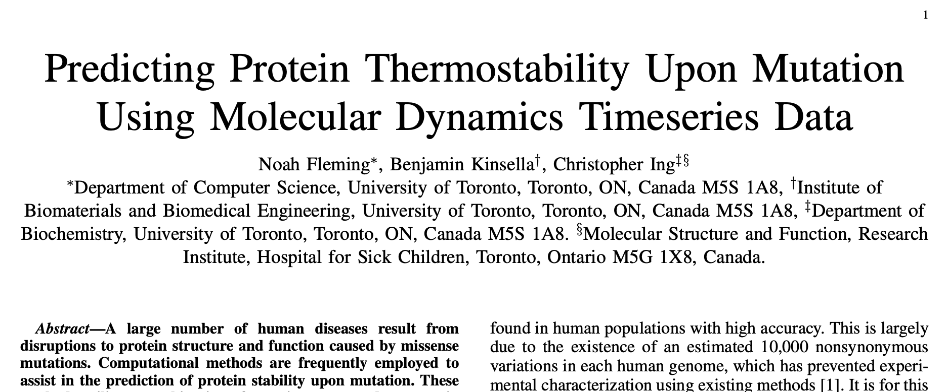

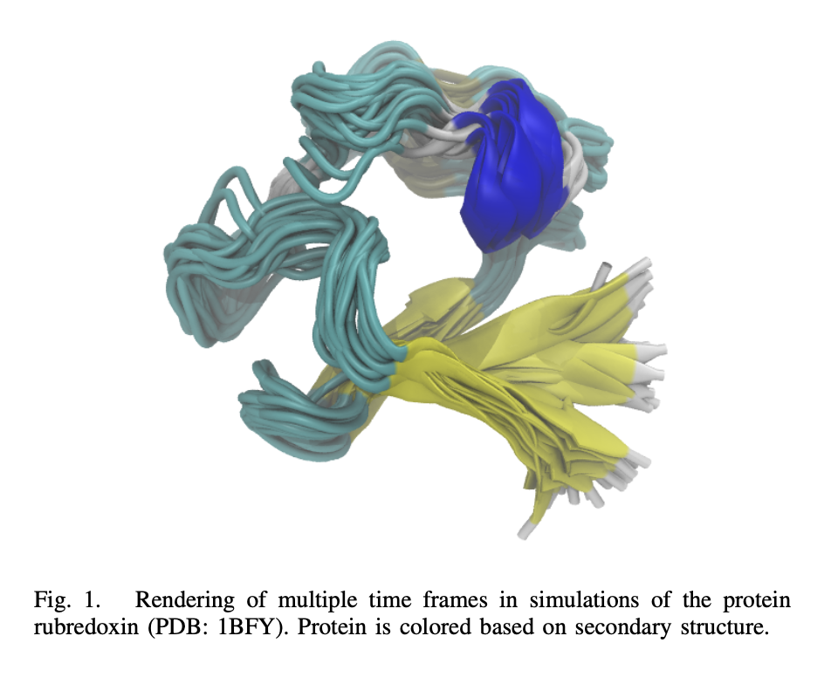
Code Efficiency
Supercomputer in Quebec
Notes:
Everything you’re running right now seems to be almost instant – which is nice. But when you get to later labs, or even when we get to loops that run many times, you might notice a lag in your results. That lag might only be a few seconds, but as that program gets bigger, or you have to run the same piece of code on multiple data points, 1 second can turn into minutes or hours. In the real world, time is money. From my personal experience, one project I worked on with a group from SickKids was predicting if a mutation was cancerous based on the stability of a protein molecule. We were using neural networks and millions of datapoints – and if I were to press run on my code on my computer I’d have to wait hours, sometimes overnight, just to get one result and see if it worked or not. How we actually got all our results, for all our thousands of datapoints was renting out server space in a supercomputer in Montreal, but every hour of server space rented might cost you hundreds or thousands of dollars, so code efficiency is super important. The more code you can get through in an hour of server space you can save money and time.

Slide 9
Augmented Assignment Operations
Operator | Expression | Identical Expression | English description
+= | x = 7 x += 2 | x = 7 x = x + 2 | x refers to 9
-= | x = 7 x -= 2 | x = 7 x = x - 2 | x refers to 5
*= | x = 7 x *= 2 | x = 7 x = x * 2 | x refers to 14
/= | x = 7 x /= 2 | x = 7 x = x / 2 | x refers to 3.5
//= | x = 7 x //= 2 | x = 7 x = x // 2 | x refers to 3
%= | x = 7 x %= 2 | x = 7 x = x % 2 | x refers to 1
**= | x = 7 x **= 2 | x = 7 x = x ** 2 | x refers to 49
Notes:
Remember to keep what’s on the right, on the right.

Slide 10
Augmented Assignment Examples
>>> x = 10
>>> x += 5
>>> print(x)
>>> y = 17
>>> y //= 3
>>> print(y)
15
#y = y // 3 NOT y = 3 // y
5

Slide 11
Bringing it all together…
>>> x = 7
>>> y = 3
>>> x += y**2 - (4 * 3) - y
>>> print(x)
1

Slide 12
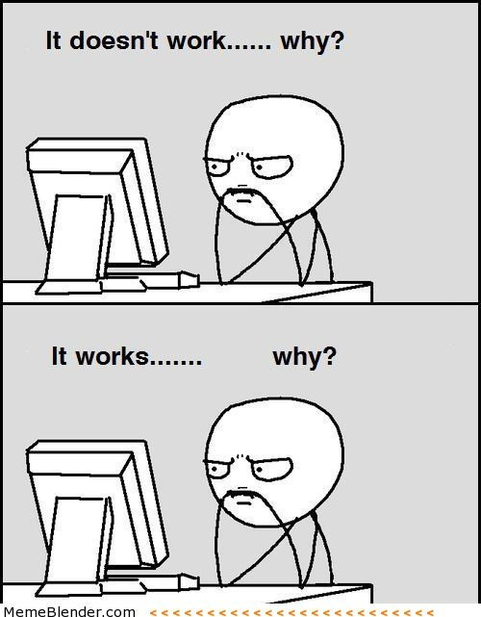
Programming Guide 101
Readability
If nothing else, write #cleancode
Comments
Save yourself from yourself
Lots of testing!
Modular code (you will learn about functions next week)
Test often and with purpose
Understanding errors
Types of errors
Error codes
Always have a plan!

Slide 13
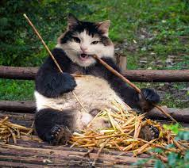
Readability Tips (#cleancode)
>>> canda = cat + panda
Use whitespace to separate variables and operators
>>> canda=cat+panda
Be consistent with spacing, too much whitespace can be bad
>>> canda = cat +panda
Pick variable names that are easy to read and interpret
>>> canda = nom + nomnomnomnomnom
Be consistent with naming schemes
>>> Canda = CAT + _panda42

Slide 14
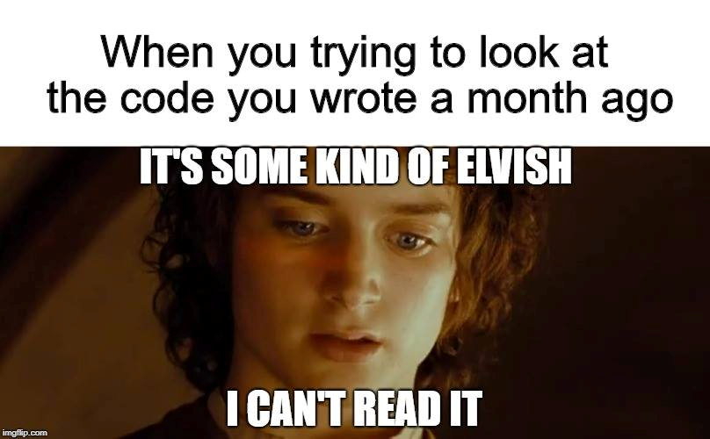
Comments
Comments are to help you, and anyone else who is reading/using your code, to remember or understand the purpose of a given variable or function in a program.
A comment begins with the number sign (#) and goes until the end of the line.
Python ignores any lines that start with the (#) character

Slide 15
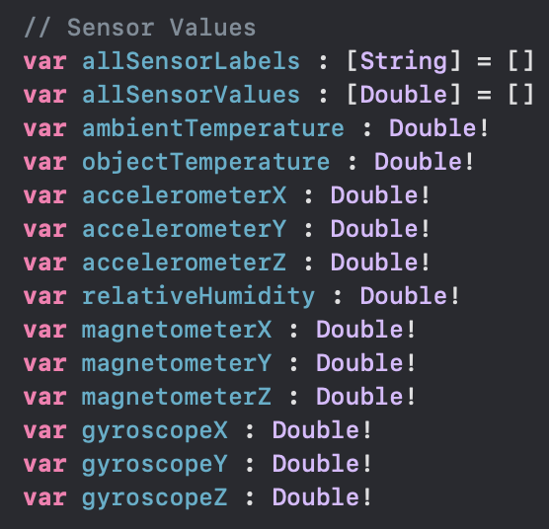
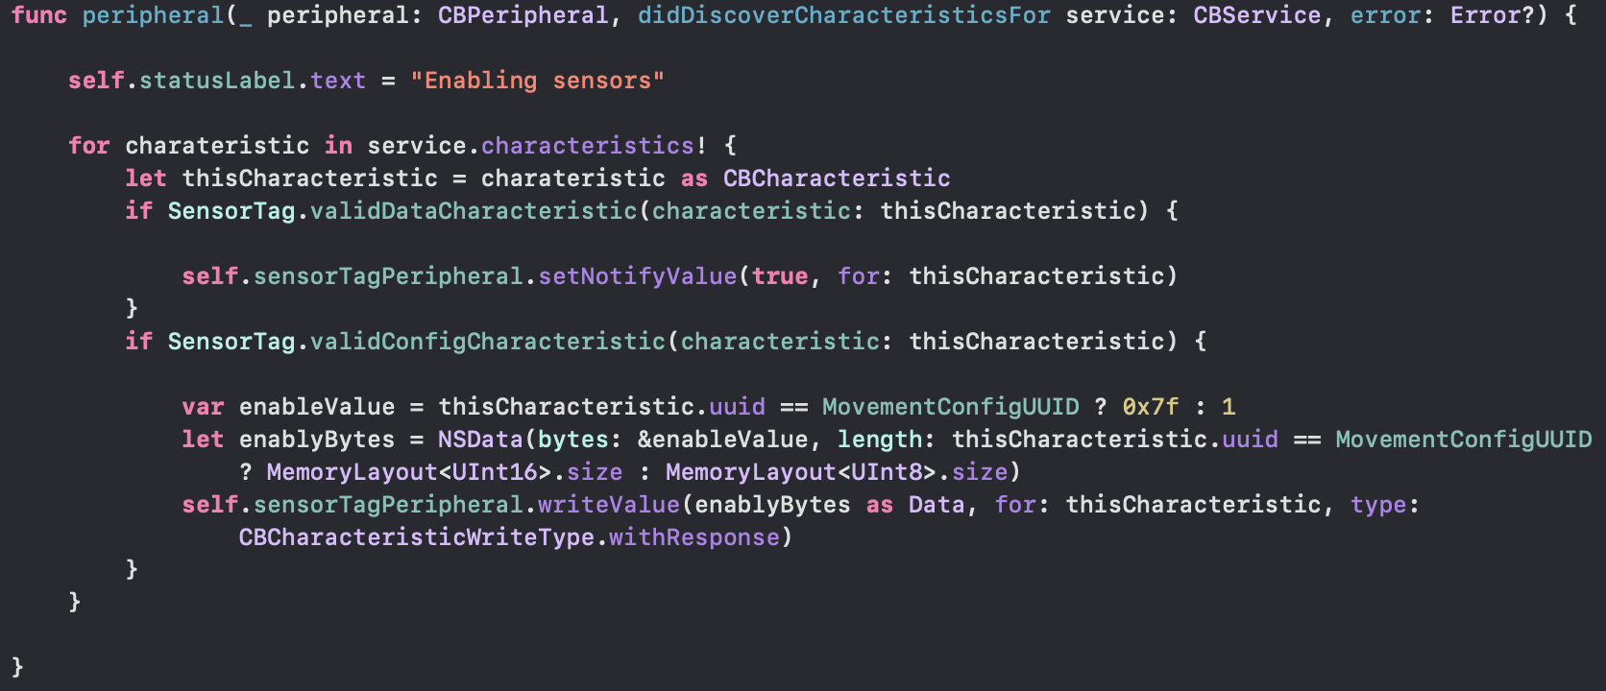
Warning! This is not Python! It is an example from one of my iOS apps I had to come back to after a few years. Comments are (//) in Swift instead of (#) in Python

Slide 16
Testing!
The more lines of code you write, the more likely it is that you will make a mistake and the harder it will be to find the mistake
“like finding a needle in a haystack”
Test your code as you write it
Requires you understanding what specific output an input will provide
”Modular code”
Test in small chunks or “modules”
Put a test input into the beginning where you know what the output is and see what you get!
Golden Rule: Never spend more than 15 minutes programming without testing

Slide 17
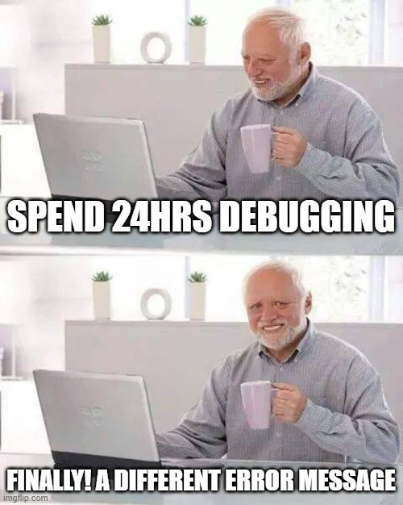
Error Reduction vs Debugging
It is pretty much impossible to write code without errors.
Error Reduction: techniques we can use to reduce the number and severity of errors.
Debugging: techniques for identifying and correcting errors

Slide 18
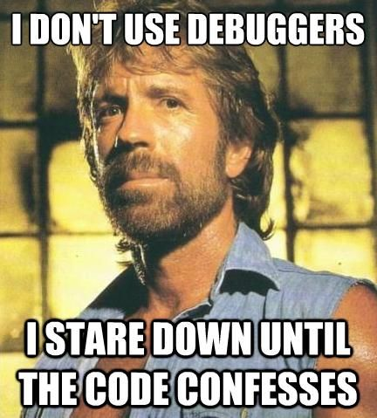
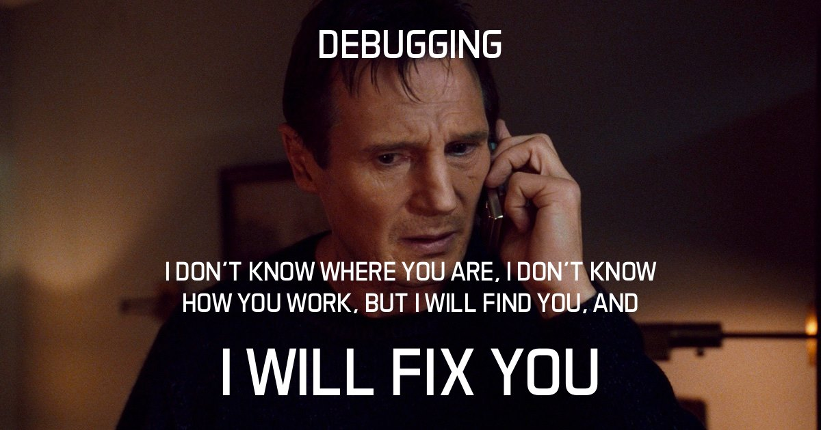
Which student will you be?
Notes:
In order to find the errors, you kind of need to know what error types could potentially be messing with you – that’s what we’ll talk about today.

Slide 19
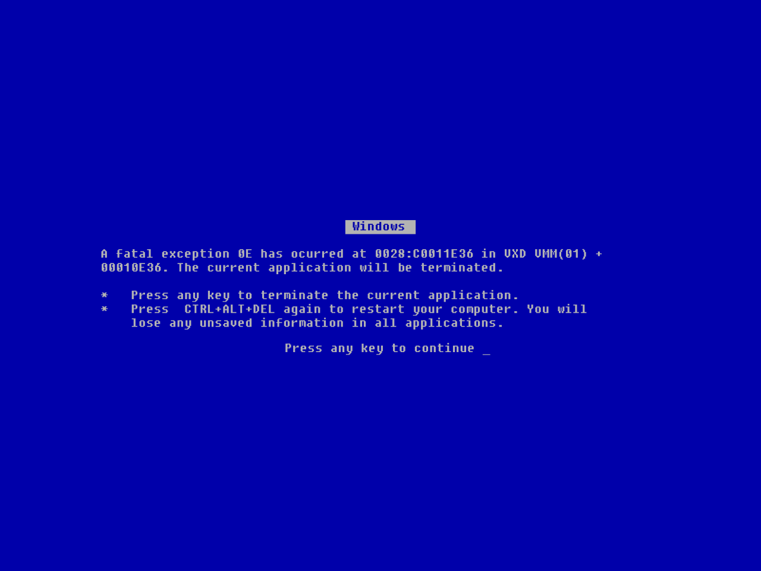

Slide 20
Types of Errors
Syntax error
Semantic error
Logical error
Runtime error

Slide 21
Syntax Errors
Syntax error: results when the programming language cannot understand your code.
Examples: missing an operator or two operators in a row, illegal character in a variable name, missing a parentheses or bracket etc.
In English, a syntax error is like a spelling error
>>> 3) + 2 * 4
Syntax Error: unmatched ')’: line 1, pos 2

Slide 22
Semantic Errors
Semantic error: results from improper use of the statements or variables.
Examples: using an operator not intended for the variable type, calling a function with the wrong argument type, or wrong number of arguments, etc.
In English, a semantic error is like a grammar error
>>> “Hello” - 4
TypeError: unsupported operand type(s) for -: 'str' and 'int’
>>> number = number * 2
NameError: name 'number' is not defined

Slide 23
Runtime Errors
Runtime error: is an error that occurs during the execution (runtime) of a program. Generally do not occur in simple programs.
The code could run fine most of the time, but in certain circumstances the program may encounter an unexpected error and crash.
Examples: infinite loops, attempting to access an index out of bounds, etc.
>>> x = 10
>>> while x > 0:
print(”This is the song that never ends”)

Slide 24
Logical Errors
Logical Error: results from unintended result due to a miscalculation or misunderstanding of specifications.
Examples: miscalculation, typo, misunderstanding of requirements, indentation mistakes, operator precedence, integer instead of floating-point division, etc.
Most difficult to fix because the code will execute without crashing. There are no error messages produced.

Slide 25
Logical Error Examples
71.6 degrees F is about 22 degrees C
>>> fahrenheit = 71.6
>>> celsius = fahrenheit – 32 * 5/9
>>> celsius
53.822222222222216
>>> fahrenheit = 716
>>> celsius = (fahrenheit – 32) * 5/9
>>> Celsius
380.0
Correct logic: celsius = (fahrenheit – 32) * 5/9
Whoops, typo! Forgot the decimal.

Slide 26
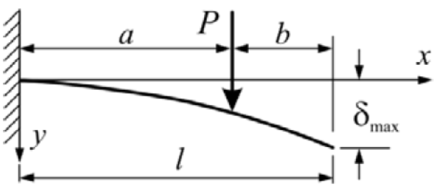


Let’s Practice!
The diagram and formula below introduces variables for the calculation of the deflection in a beam. Write a program that can calculate the $δmax$, or deflection of a beam.
Open your notebook
Click Link:
1. Calculate Deflection of a Beam

Slide 27
Planning an Essay
How do you start writing an essay?
Read the question carefully and with intent
Think about what information was provided in the topic that you should include in your answer
Brainstorm different ways to answer the question
Skim through course material to see what could help
Scaffold or quickly structure each paragraph
Figure out what you want to conclude and think of ways to get there
Make sure each section has purpose (you aren’t repeating yourself)
Think about order (what needs to be said at the beginning vs what needs to be said at the end)
Notes:
Ask chat to answer
I know this is painful

Slide 28
Planning Code
How do you start writing code?
Read the question carefully and with intent
Think about what information was provided in the topic that you should include in your answer
Brainstorm different ways to answer the question
Skim through course material to see what could help
Scaffold or quickly structure each paragraph
Figure out what you want to conclude and think of ways to get there
Make sure each section has purpose (you aren’t repeating yourself)
Think about order (what needs to be said at the beginning vs what needs to be said at the end)
Notes:
Tricked you! Samesies!

Slide 29
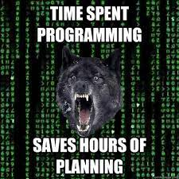
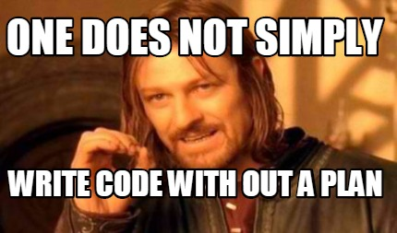
Failing to Plan is Planning to Fail!
Open your notebook
Click Link:
2. Calculating Chemical Rate Constants
HOURS
MINUTES

Slide 31
The Programming Process.
Week 1 | Lecture 2 (1.2)

