Slide 1
FINAL EXAM REVIEW
APS106

Slide 2
Rules of the GAME
Must use button on the table to answer question verbally and explain your answer – you will be called on to answer by one of the instructors
Must tell us which discipline you’re in before you answer for points (we’ll rely on the honour system)
If you get the answer right, you pick the next category
If you get the answer wrong, the next person whose hand is up can steal
Everyone is here to learn and review for the midterm so be kind to everyone who answers!

Slide 3
Panel
Goodfile-as
The class with the self tattoo
The node of wall street
12 angry methods
It’s a wonderful aps106
$250
$250
$250
$250
$250
$500
$500
$500
$500
$500
$1000
$1000
$1000
$1000
$1000

Slide 4
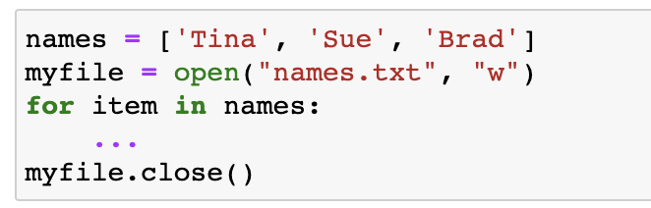
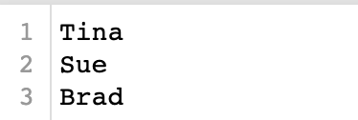
What is the missing line of code to write the names into names.txt?
Goodfile-as · $250
Question board

Slide 5
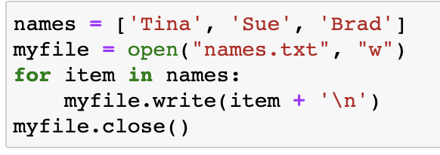
What is the missing line of code to write the names into names.txt?
Goodfile-as· $250
Modified from 2018 final exam
Question board

Slide 6
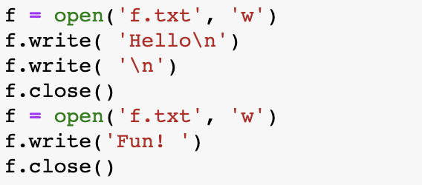
What is the result in the f.txt file?
Goodfile-as · $500
a) Fun!
c) Hello
Fun!
b) ‘Hello’
‘Fun!’
d) ‘Hello Fun!’
Question board

Slide 7
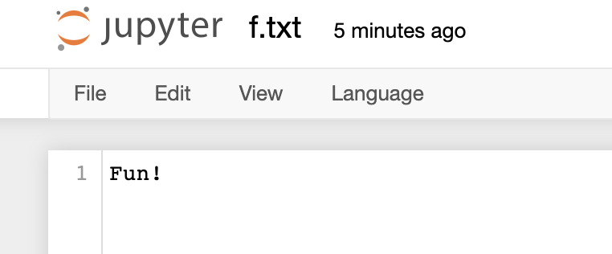
What is the result in the f.txt file?
Goodfile-as· $500
a) Fun!
Modified from 2019 final exam
Question board

Slide 8
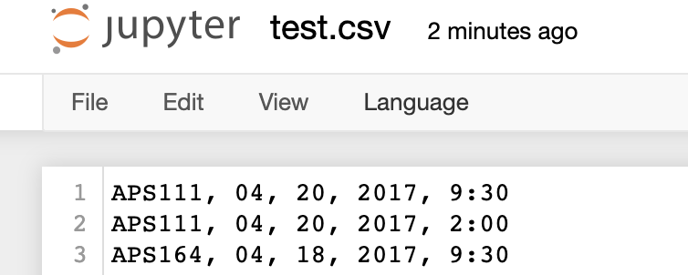
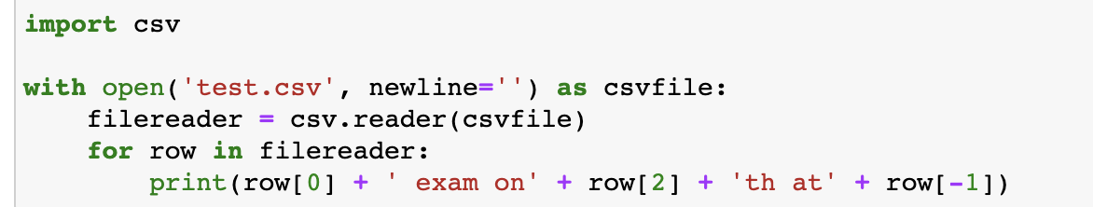
What is the output?
Goodfile-as· $1000
Question board

Slide 9
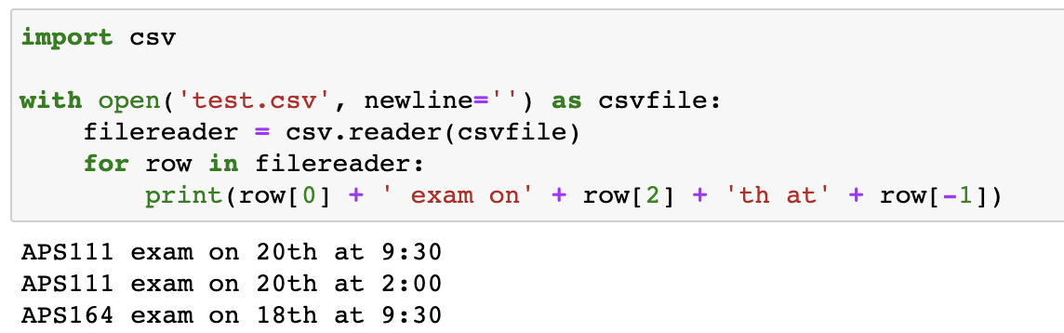
Goodfile-as· $1000
Modified from 2017 final exam
Question board

Slide 10
DOUBLE JEOPARDY QUESTION
The class with the self tattoo· $250
Question board

Slide 11
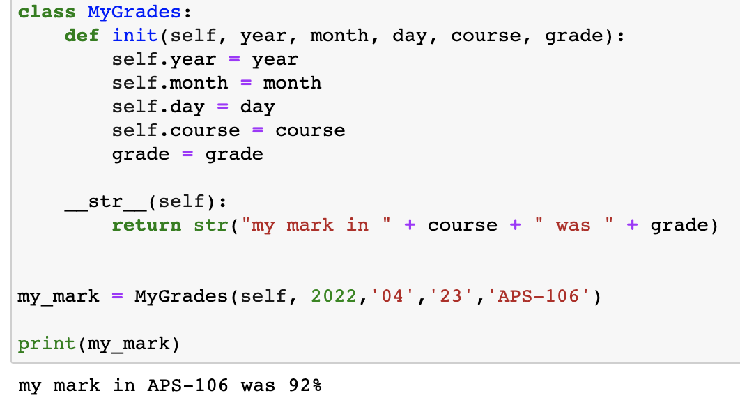
Identify at least 5 errors in this code
The class with the self tattoo· $250
Question board

Slide 12
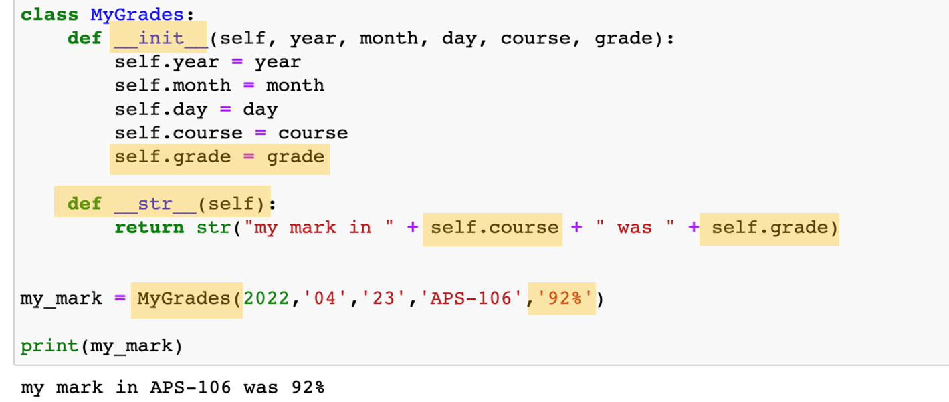
Identify at least 5 errors in this code:
The class with the self tattoo· $250
Question board

Slide 13
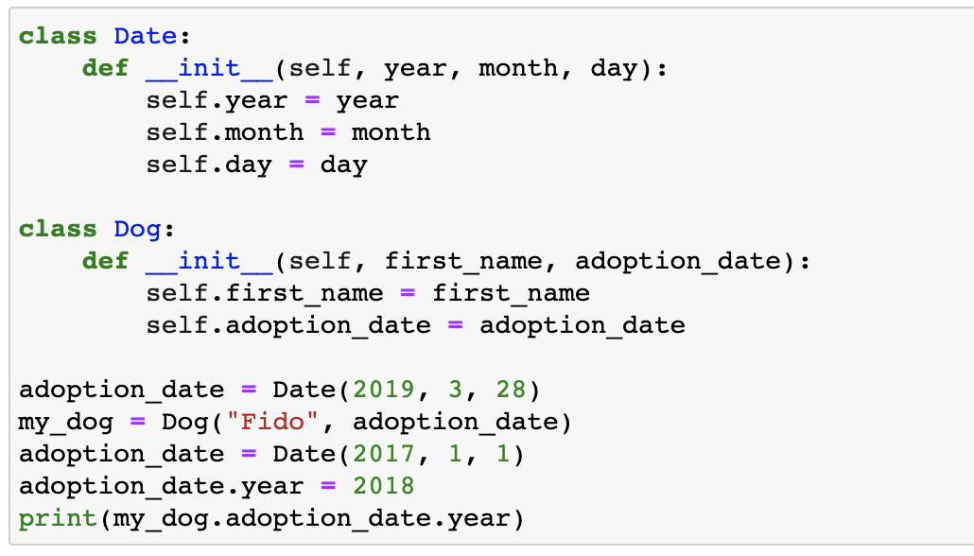
What is the output?
The class with the self tattoo· $500
2017
2018
2019
error
Question board

Slide 14
What is the output?
The class with the self tattoo· $500
2017
2018
2019
error
Modified from 2019 final exam
Question board

Slide 15
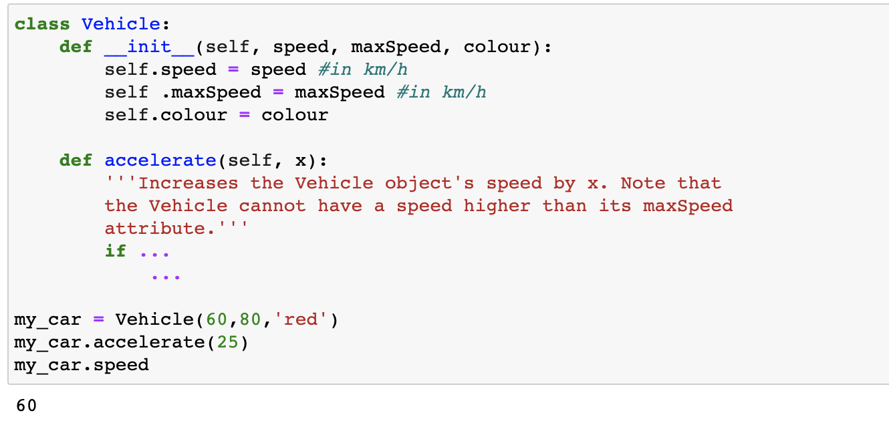
What do I need to add to def accelerate (2 lines of code)?
The class with the self tattoo· $1000
Question board

Slide 16
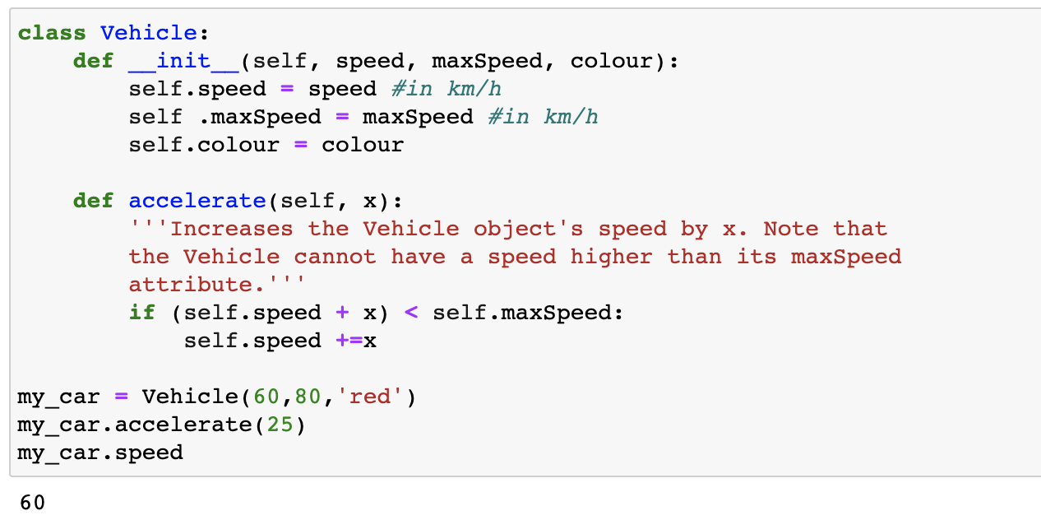
The class with the self tattoo· $1000
Modified from 2018 final exam
Question board

Slide 17
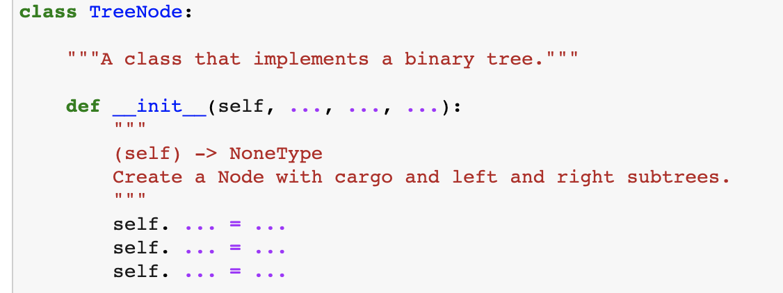
What 3 arguments (aside from self) must be added to __init__ for this binary tree?
The node of wall street· $250
Question board

Slide 18
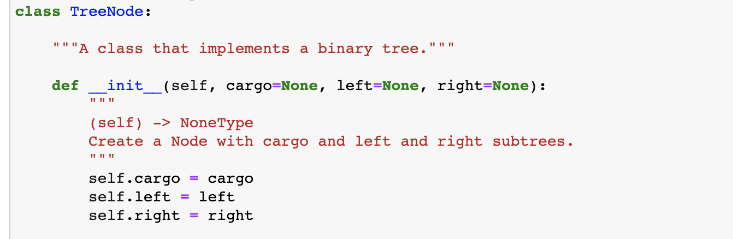
The node of wall street· $250
Question board

Slide 19
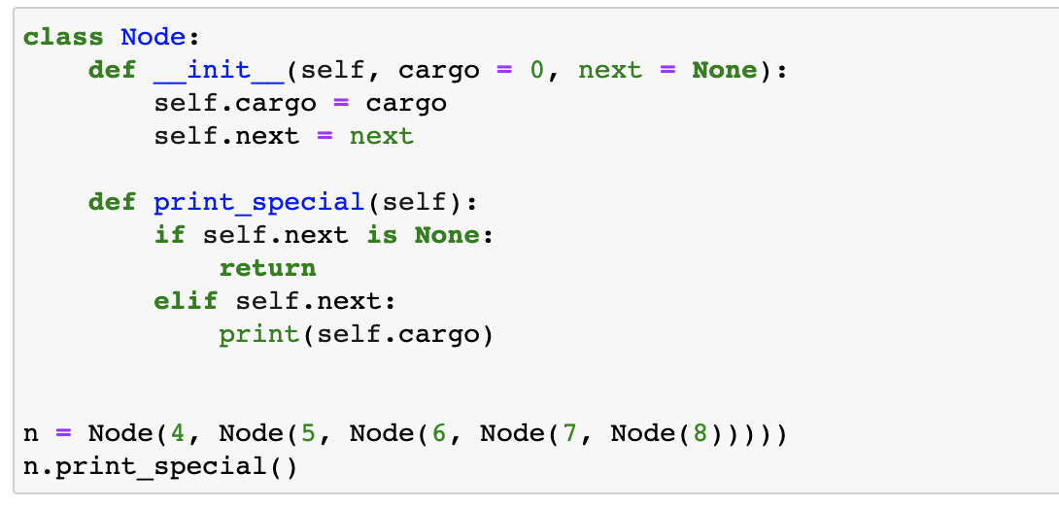
What is the output?
The node of wall street· $500
a) error
b) 0
c) 4
d) 8
Question board

Slide 20
What is the output?
The node of wall street· $500
Modified from 2019 final exam
a) error
b) 0
c) 4
d) 8
Question board

Slide 21
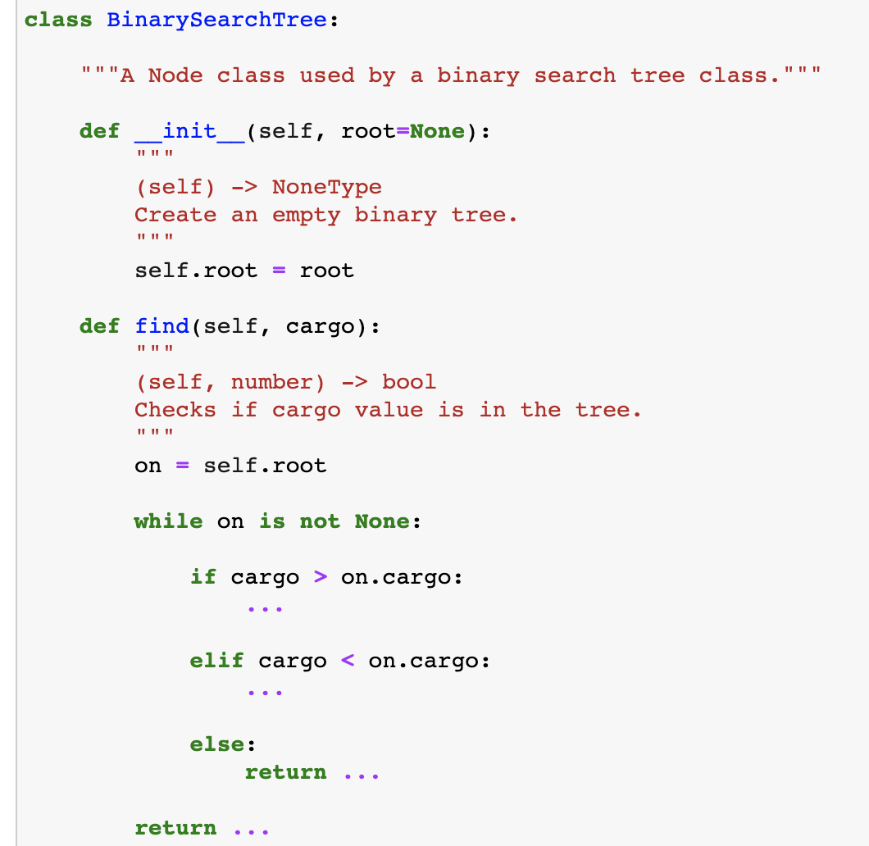
What are the missing lines of code?
The node of wall street · $1000
Question board

Slide 22
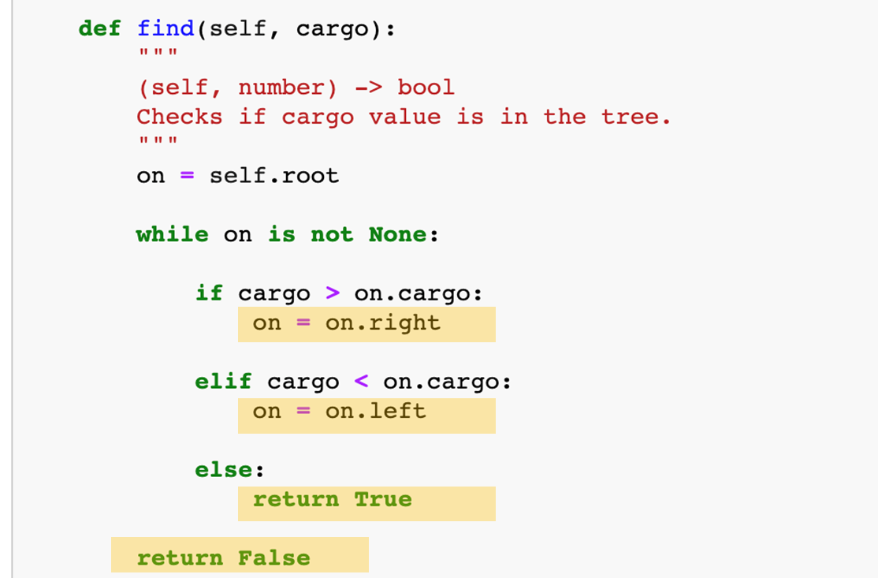
The node of wall street· $1000
Question board

Slide 23
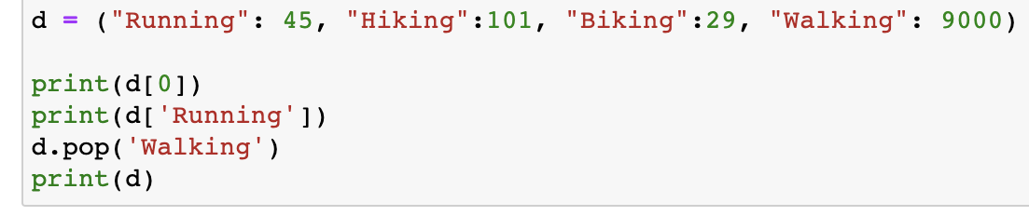
What is the output?
12 angry methods· $250
Question board

Slide 24
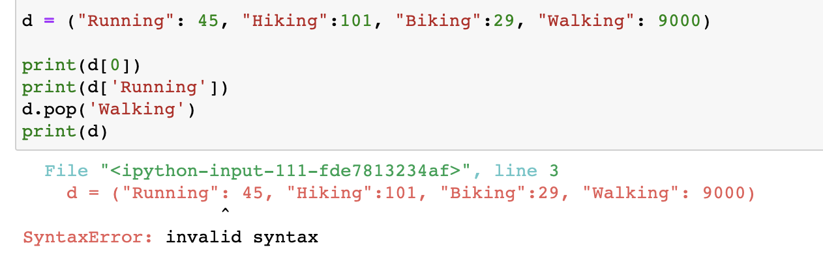
What is the output?
12 angry methods· $250
Modified from 2018 final exam
Question board

Slide 25
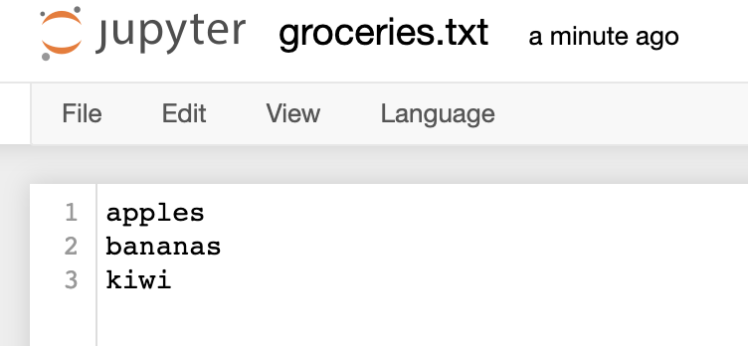
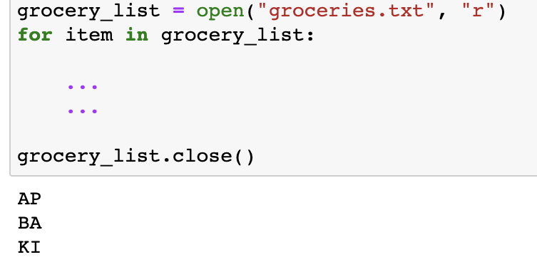
How do you print out the first two characters upper-case per item?
12 angry methods· $500
Question board

Slide 26
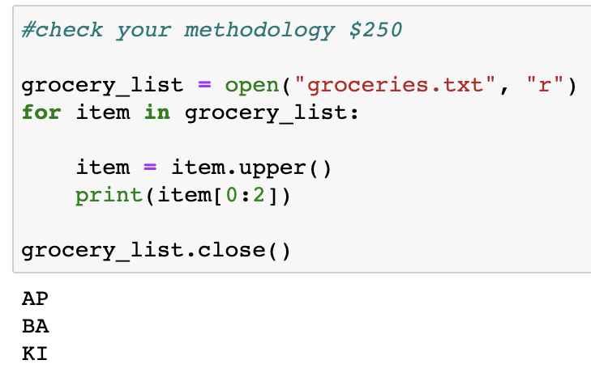
How do you print out the first two characters upper-case per item?
12 angry methods· $500
Question board

Slide 27
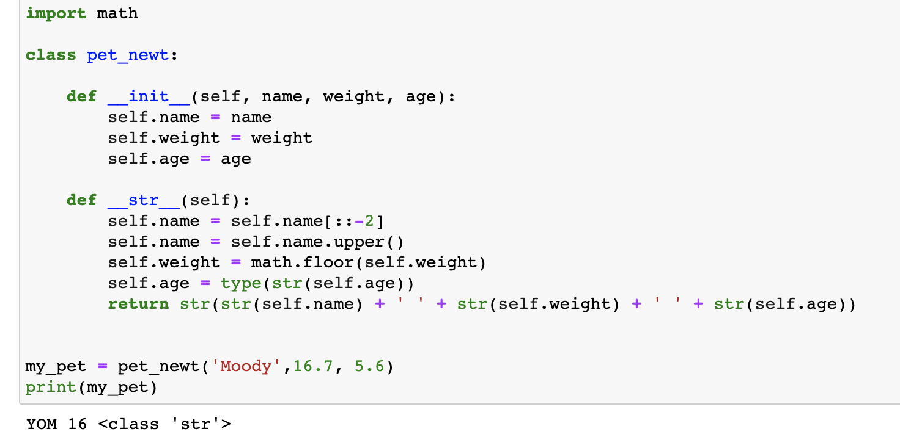
What is the output?
12 angry methods· $1000
YOM 16 <class ‘str’>
DO 16 <class ‘str’>
YOM 16 <class ‘object’>
DO 16 <class ‘object’>
YOM 17 <class ‘object’>
DO 17 <class ‘str’>
None of the above
Question board

Slide 28
What is the output?
12 angry methods· $1000
YOM 16 <class ‘str’>
DO 16 <class ‘str’>
YOM 16 <class ‘object’>
DO 16 <class ‘object’>
YOM 17 <class ‘object’>
DO 17 <class ‘str’>
None of the above
Question board

Slide 29
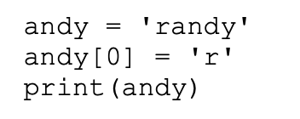
What is the output?
It’s a wonderful aps106· $250
Question board

Slide 30
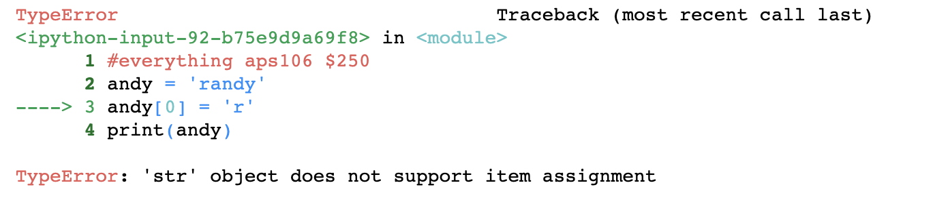
It’s a wonderful aps106· $250
Modified from 2017 final exam
Question board

Slide 31
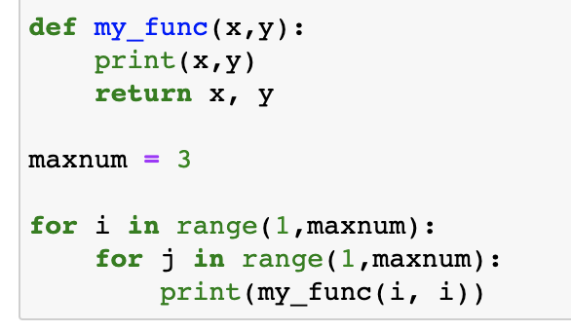
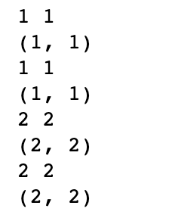
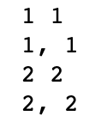
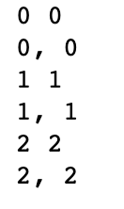
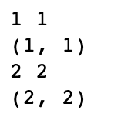
What is the output?
It’s a wonderful aps106· $500
a)
c)
b)
d)
Question board

Slide 32
DOUBLE JEOPARDY QUESTION
It’s a wonderful aps106· $500
Question board

Slide 33
What is the output?
It’s a wonderful aps106 · $500
a)
c)
b)
d)
Question board

Slide 34
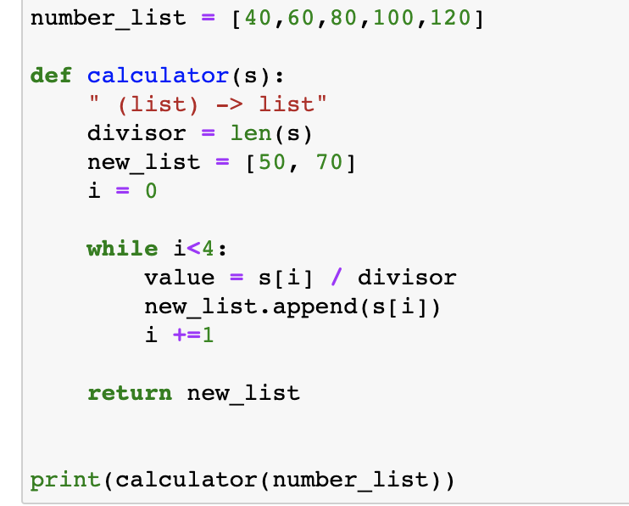
What is the output?
It’s a wonderful aps106 · $1000
Question board

Slide 35
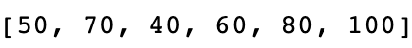
What is the output?
It’s a wonderful aps106 · $1000
Question board

Slide 36
Final Jeopardy

Slide 37
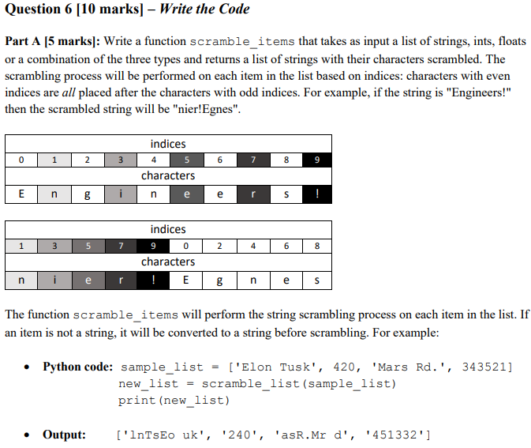
GONE WITH THE STRING· FINAL JEOPARDY

