Slide 1
FINAL EXAM REVIEW
APS106

Slide 2
Rules of the GAME
Must use button on the table to answer question verbally and explain your answer – you will be called on to answer by one of the instructors
Must tell us which discipline you’re in before you answer for points (we’ll rely on the honour system)
If you get the answer right, you pick the next category
If you get the answer wrong, the next person whose hand is up can steal
Everyone is here to learn and review for the midterm so be kind to everyone who answers!

Slide 3
Panel
Goodfile-as
The class with the self tattoo
The node of wall street
12 angry methods
It’s a wonderful aps106
$250
$250
$250
$250
$250
$500
$500
$500
$500
$500
$1000
$1000
$1000
$1000
$1000

Slide 4
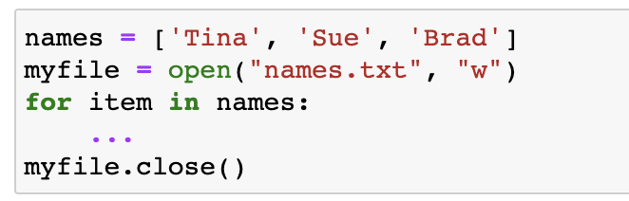
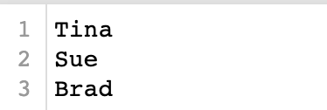
What is the missing line of code to write the names into names.txt?
things and strings · $250
Question board

Slide 5
What is the missing line of code to write the names into names.txt?
things and strings · $250
Question board

Slide 6
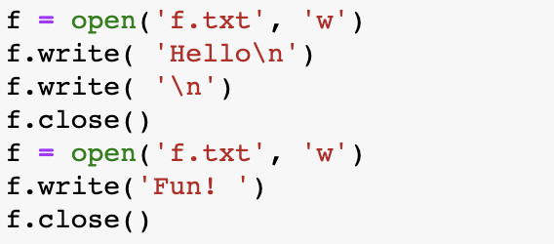
What is the result in the f.txt file?
Things and strings · $500
a) Fun!
c) Hello
Fun!
b) ‘Hello’
‘Fun!’
d) ‘Hello Fun!’
Question board

Slide 7
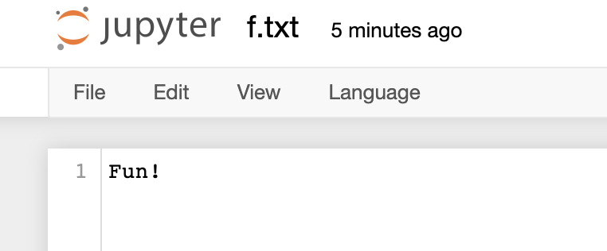
What is the result in the f.txt file?
Things and strings · $500
a) Fun!
Question board

Slide 8
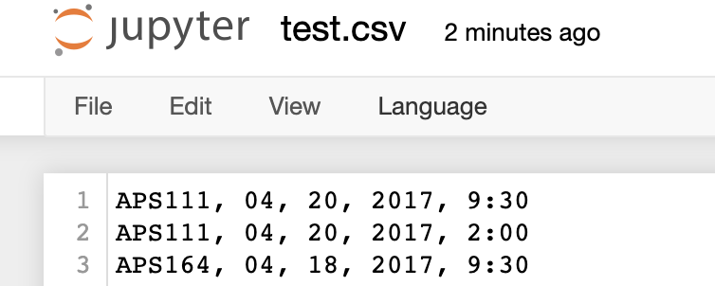
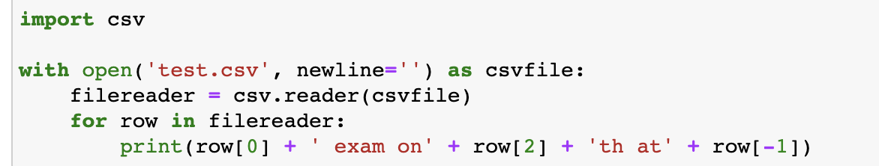
What is the output?
Things and strings · $1000
Question board

Slide 9
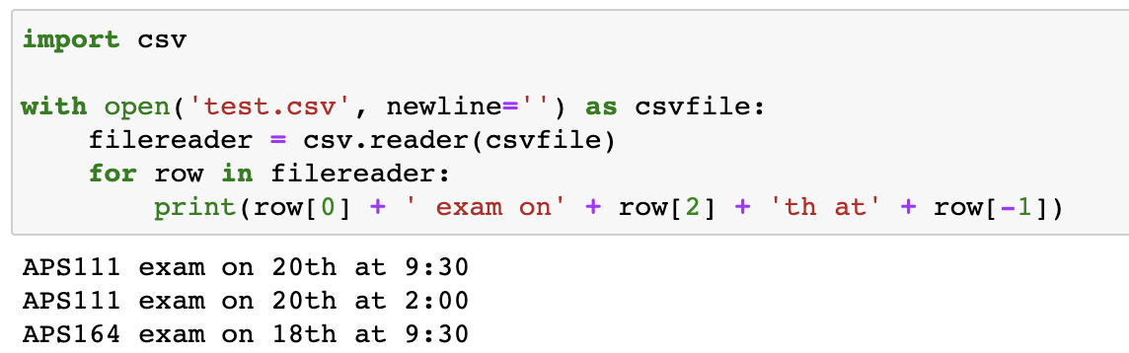
Things and strings · $1000
Question board

Slide 10
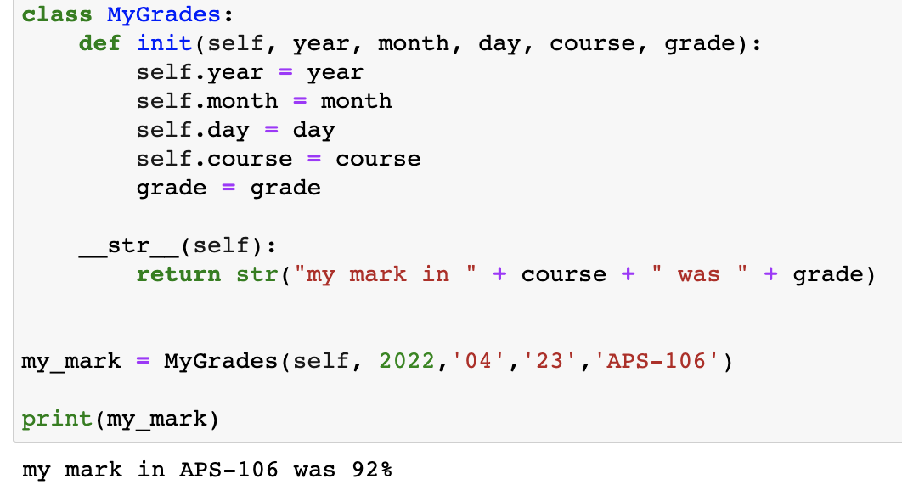
Identify at least 4 errors in this code
For a while there · $250
Question board

Slide 11
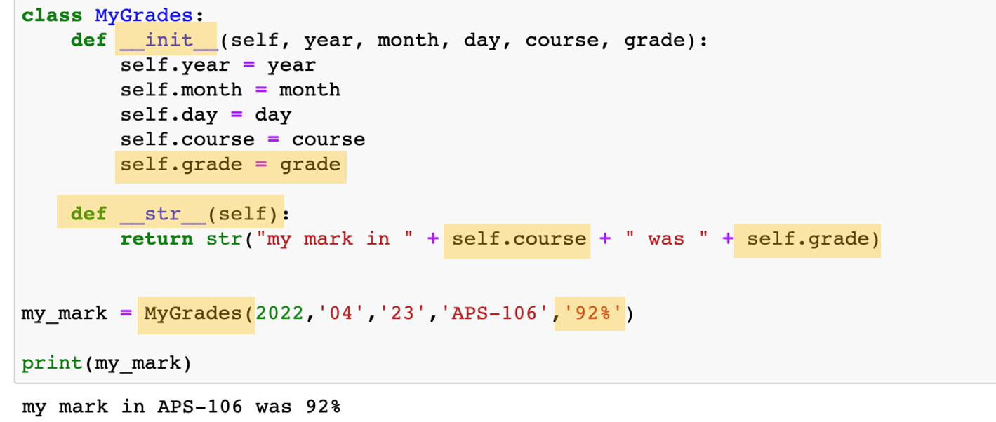
Identify at least 4 errors in this code:
For a while there · $250
Question board

Slide 12
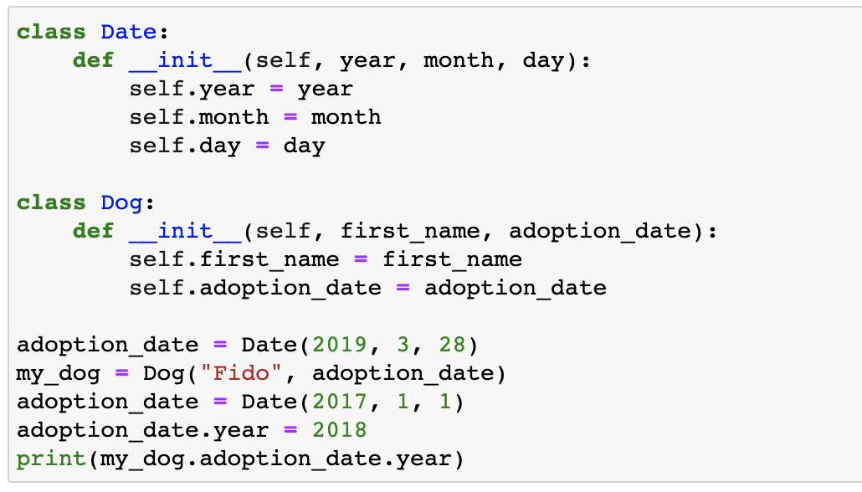
What is the output?
FOR a while there · $500
2017
2018
2019
error
Question board

Slide 13
What is the output?
FOR a while there · $500
2017
2018
2019
error
Question board

Slide 14
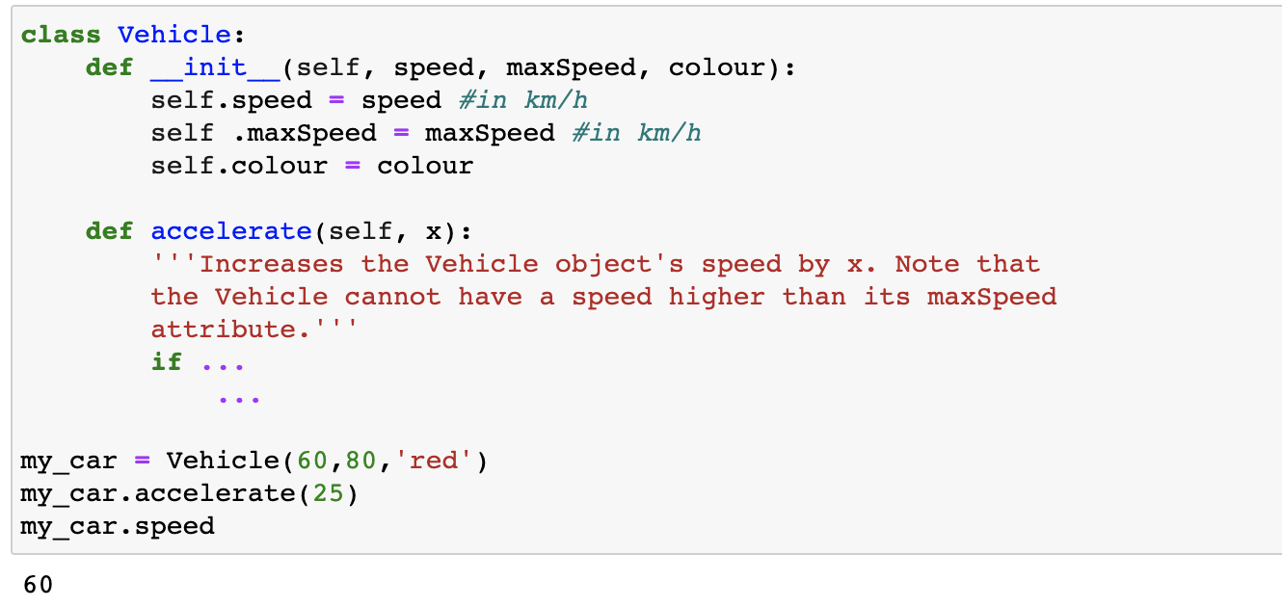
What do I need to add to def accelerate (2 lines of code)?
For a while there· $1000
Question board

Slide 15
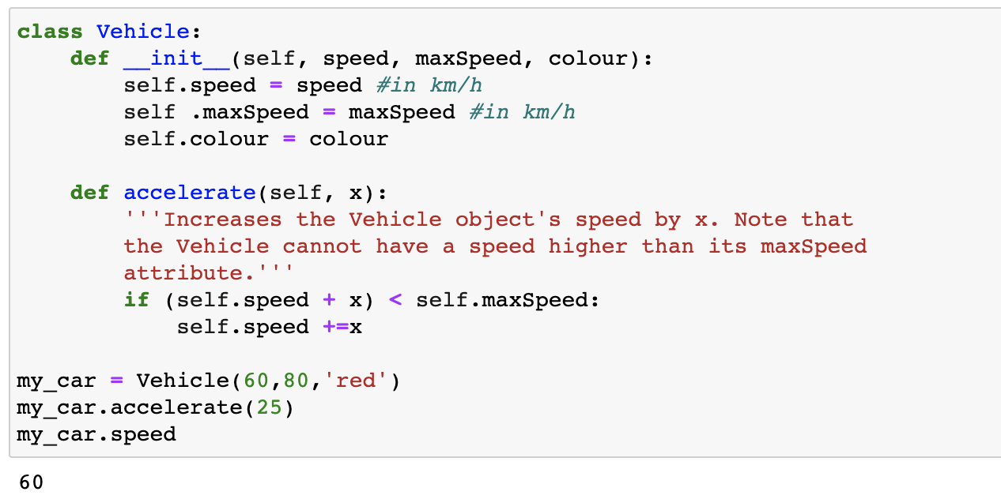
For a while there· $1000
Question board

Slide 16
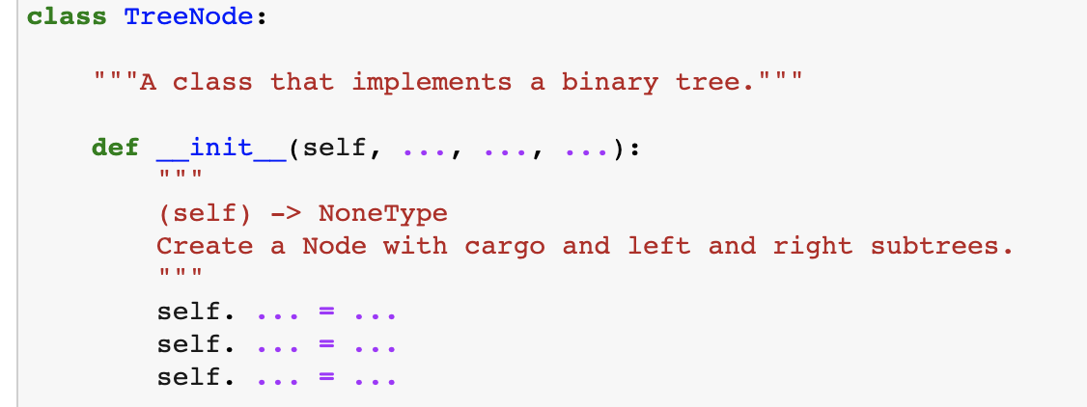
What 3 arguments (aside from self) must be added to __init__ for this binary tree?
Know your nodes · $250
Question board

Slide 17
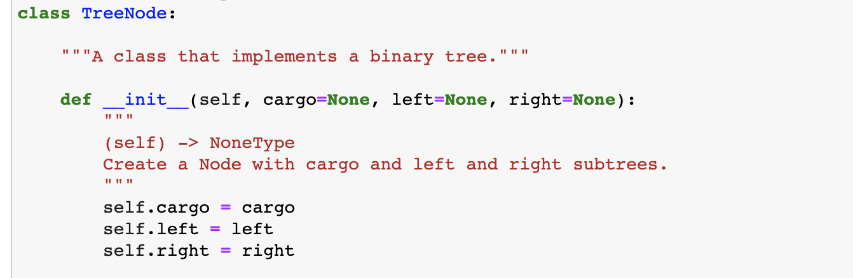
Fantastic containers and where to find them · $250
Question board

Slide 18
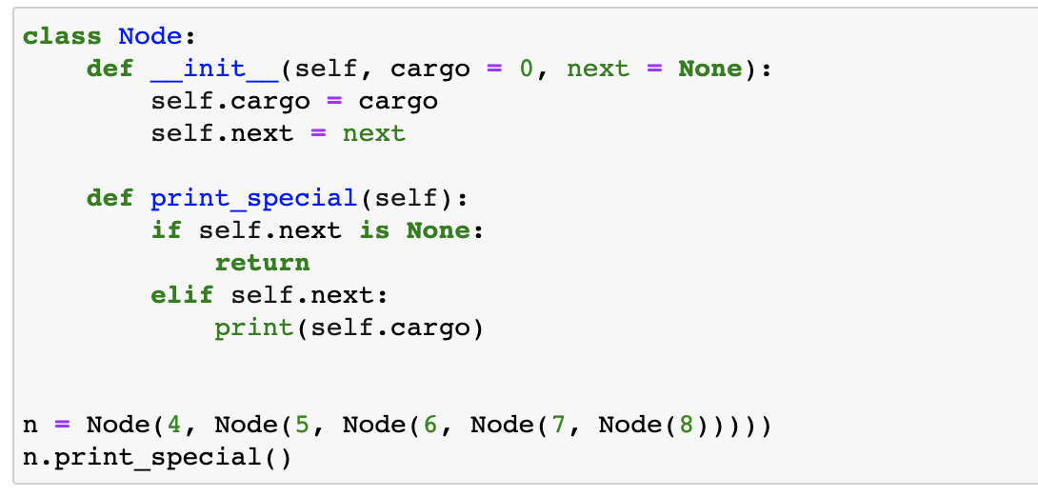
What is the output?
Fantastic containers and where to find them · $500
a) error
b) 0
c) 4
d) 8
Question board

Slide 19
What is the output?
Fantastic containers and where to find them · $500
a) error
b) 0
c) 4
d) 8
Question board

Slide 20
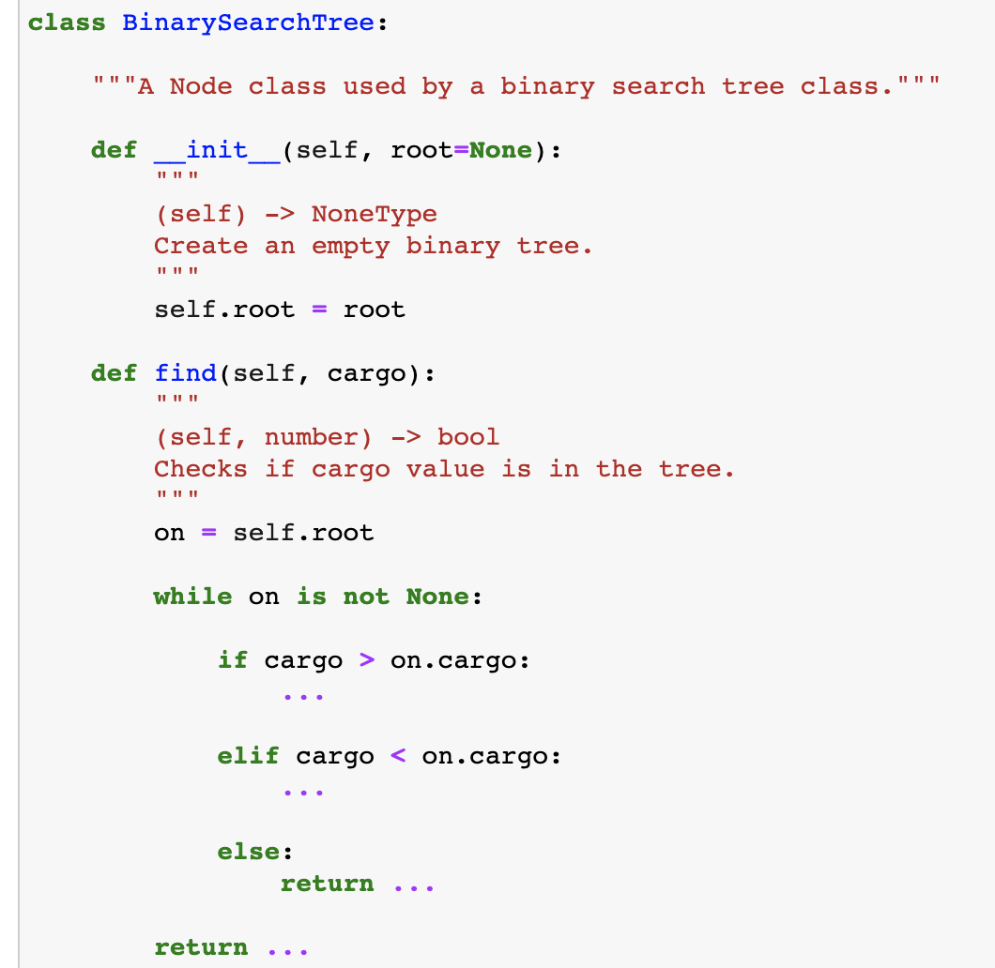
What are the missing lines of code?
Fantastic containers and where to find them · $1000
Question board

Slide 21
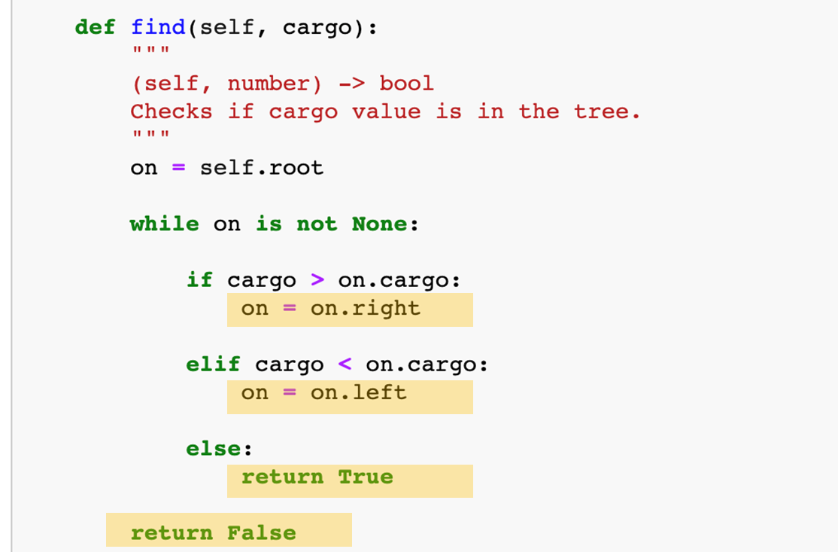
Fantastic containers and where to find them · $1000
Question board

Slide 22
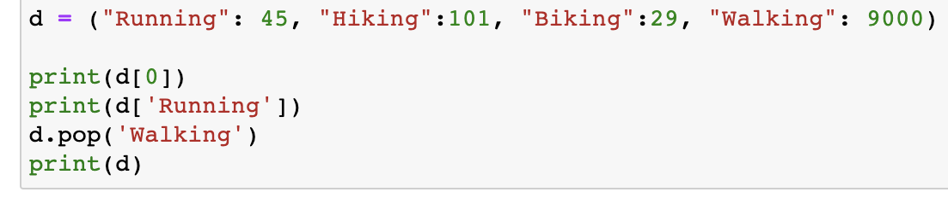
What is the output?
Check your method-ology· $250
Question board

Slide 23
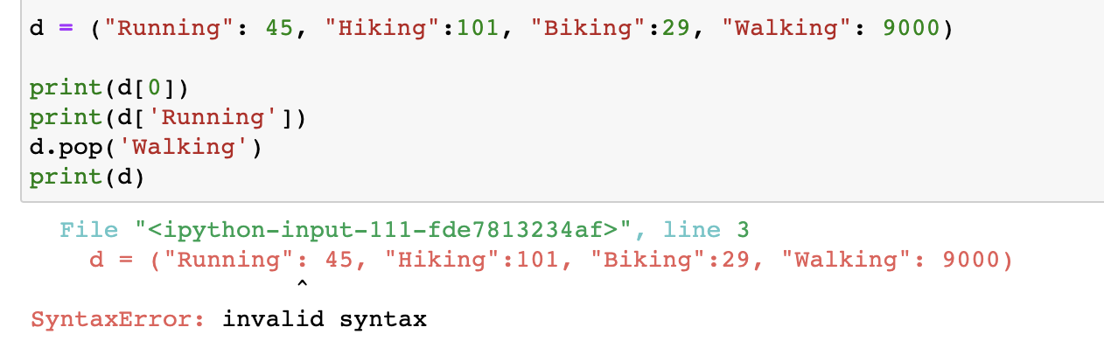
What is the output?
Check your method-ology· $250
Modified from 2018 final exam
Question board

Slide 24
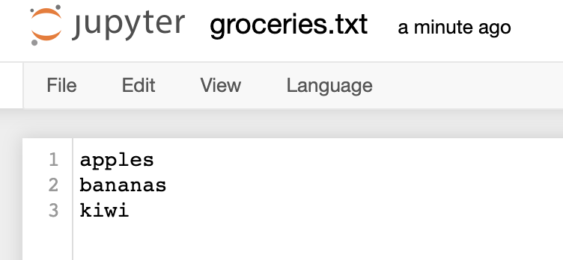
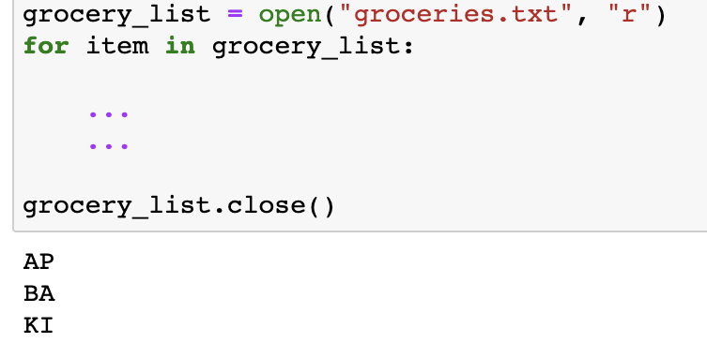
How do you print out the first two characters upper-case per item?
Check your method-ology· $500
Question board

Slide 25
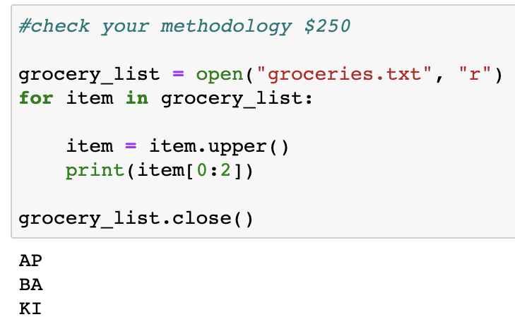
How do you print out the first two characters upper-case per item?
Check your method-ology· $500
Question board

Slide 26
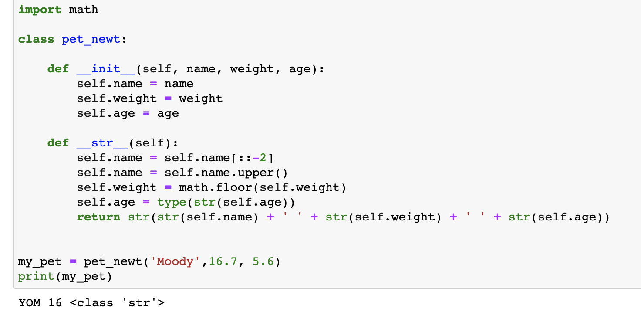
What is the output?
Check your method-ology· $1000
YOM 16 <class ‘str’>
DO 16 <class ‘str’>
YOM 16 <class ‘object’>
DO 16 <class ‘object’>
YOM 17 <class ‘object’>
DO 17 <class ‘str’>
None of the above
Question board

Slide 27
What is the output?
Check your method-ology· $1000
YOM 16 <class ‘str’>
DO 16 <class ‘str’>
YOM 16 <class ‘object’>
DO 16 <class ‘object’>
YOM 17 <class ‘object’>
DO 17 <class ‘str’>
None of the above
Question board

Slide 28
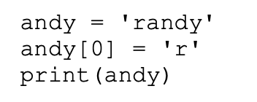
What is the output?
All things index · $250
Question board

Slide 29
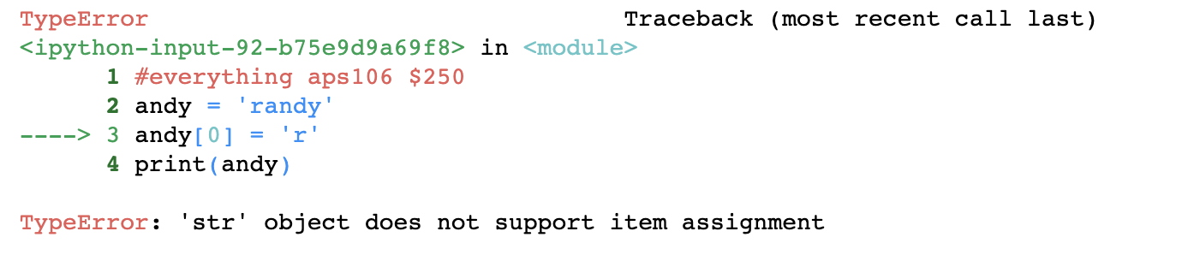
All things index · $250
Question board

Slide 30
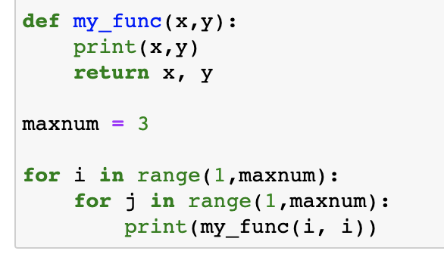
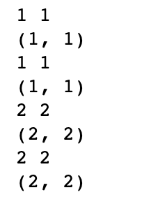
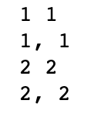
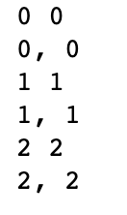
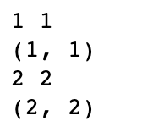
What is the output?
All things index · $500
a)
c)
b)
d)
Question board

Slide 31
What is the output?
All things index · $500
a)
c)
b)
d)
Question board

Slide 32
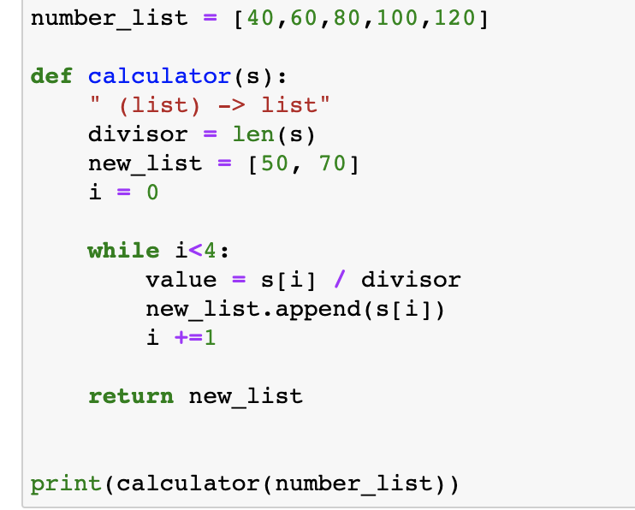
What is the output?
All things index · $1000
Question board

Slide 33
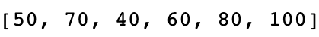
What is the output?
All things index · $1000
Question board

Slide 34
Final Jeopardy

Slide 35

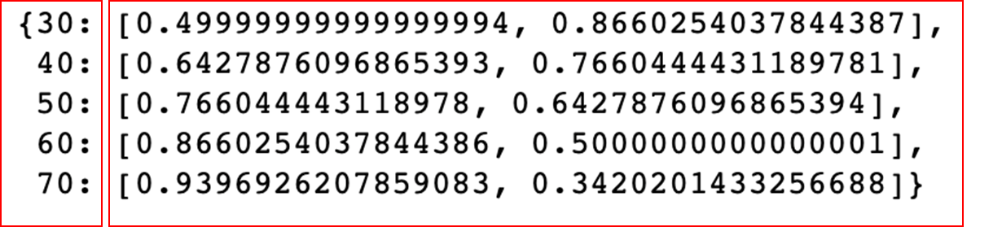
Create a function that takes an angle in degrees as the argument, and outputs a list of the sine and cosine for each angle value (hint: use math functions radians, sin and cos) Analyze a list of angles using your function: Insert the results into a dictionary that looks like this:
It is all about angles · FINAL JEOPARDY
Sine value
Cosine value

