Slide 1
APS 106
Midterm Review (Week 4)

Slide 2
APS 106
Midterm Review (Week 4) - Concepts

Slide 3
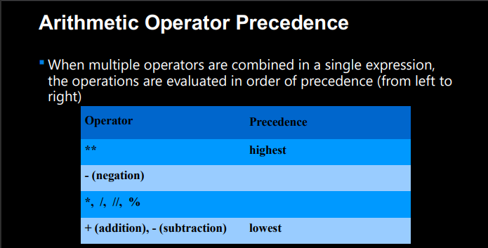

Slide 4
Function Definitions
Definition
Function Name
Colon
def function_body(parameters):
body
Indent
(parameter1,
parameter2, …)
What is in the body?

Slide 5


Adding the elif (else if) statement
The most general form of the if conditional statement is:
if condition1:
body1
elif condition2:
body2
elif conditionN:
bodyN
else:
other_body
Note the colons (:) and the indents!
ONLY 1 body will be executed.
if statement is True, execute body1, exits if structure
if statement is False, continue to elif statement
elif statement is True, execute elif body, exits if structure
elif statement is False, continue to next elif statement
All if’s and elif’s are False, execute else statement

Slide 6
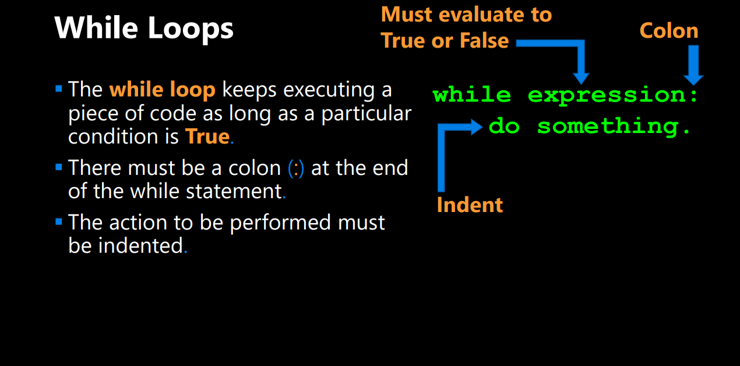

Slide 7
APS 106
Midterm Review (Week 4) – Python Jeopardy!

Slide 8
Rules
Must use raise-hand feature to answer question verbally and explain your answer – you will be called on to answer by one of the instructors’
Must tell us which discipline you’re in before you answer for points (we’ll rely on the honour system)
If you get the answer right, you pick the next category
If you get the answer wrong, the next person whose hand is up can steal
Chat answers do not count
Everyone is here to learn and review for the midterm so be kind to everyone who answers!

Slide 9
Midterm Python Jeopardy!
“Hello World” | Time to compare and get loopy | To AND OR NOT to AND | Get func-y with it | Err-ing on the side of caution
$250 | $250 | $250 | $250 | $250
$500 | $500 | $500 | $500 | $500
$1000 | $1000 | $1000 | $1000 | $1000

Slide 10
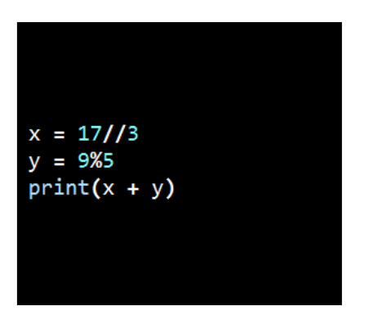
“Hello World” - $250
What is the output?
Question board
Notes:
Answer: 9
Can work through question on wing in tutorial

Slide 11
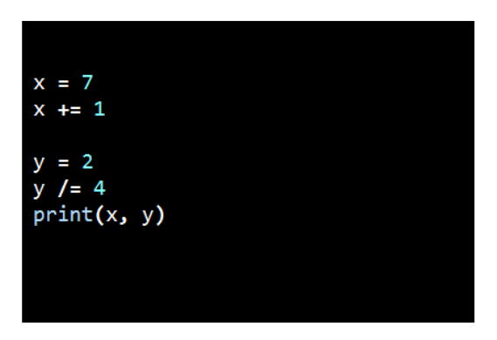
“Hello World” - $500
What is the output?
Question board
Notes:
Answer: 8 0.5
Can work through question on wing in tutorial

Slide 12
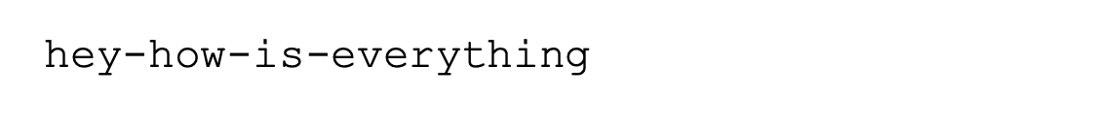
“Hello World” - $1000
Type the function call that would produce this output using a print() statement
Question board

Slide 13
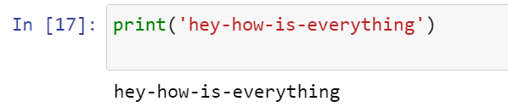
“Hello World” - $1000 (ANSWER)
Type the function call that would produce this output using a print() statement
Question board

Slide 14
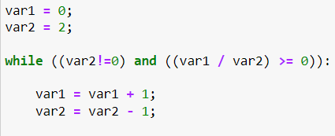
Time to compare and get loopy - $250
What are the values of var1 and var 2 after the following code segment is executed and the while loop finishes?
Question board

Slide 15
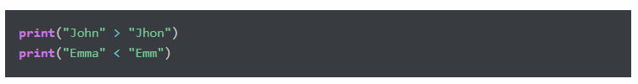
Time to compare and get loopy - $500
What is the output?
Question board
Notes:
True
False

Slide 16
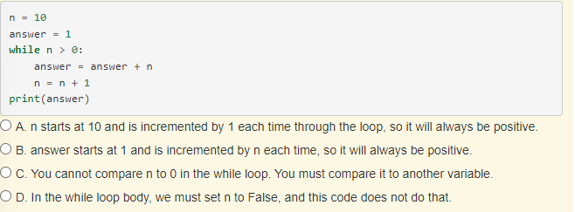
Time to compare and get loopy - $1000
The following code contains an infinite loop. Which is the best explanation for why the loop does not terminate?
Question board
Notes:
A

Slide 17
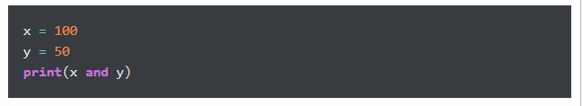
To AND OR NOT to AND- $250
What is the output?
Question board
Notes:
50

Slide 18
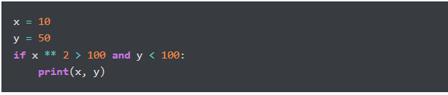
To AND OR NOT to AND- $500
What is the output?
Question board
Notes:
Nothing

Slide 19
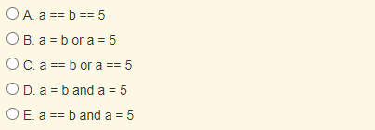
To AND OR NOT to AND- $1000
Which of the following evaluates to True when a is equal to b or when a is equal to 5?
Question board
Notes:
C

Slide 20
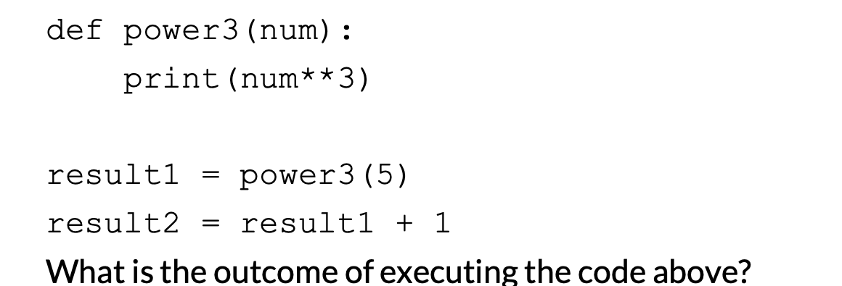
Get funcy-y with it - $250
Question board

Slide 21
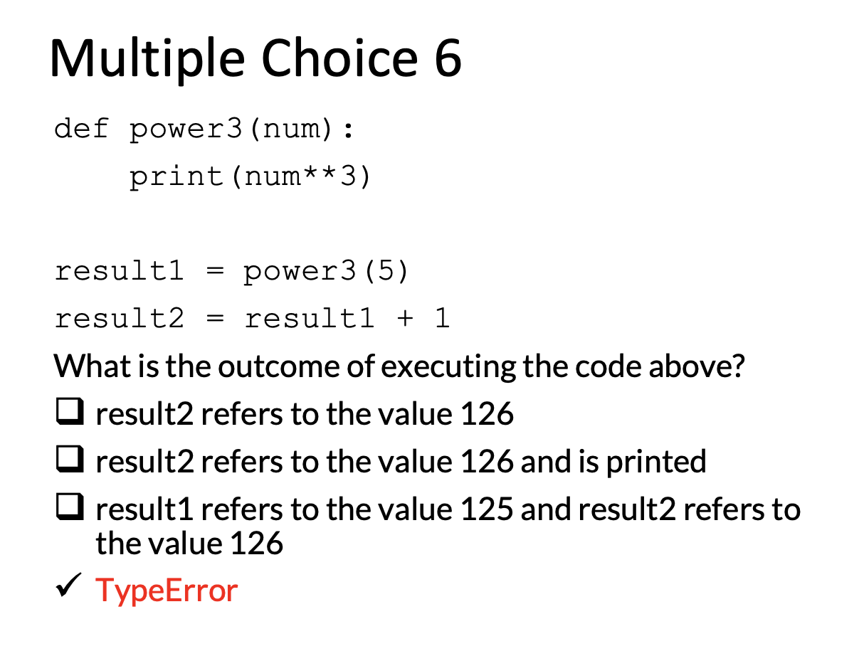
Question board

Slide 22
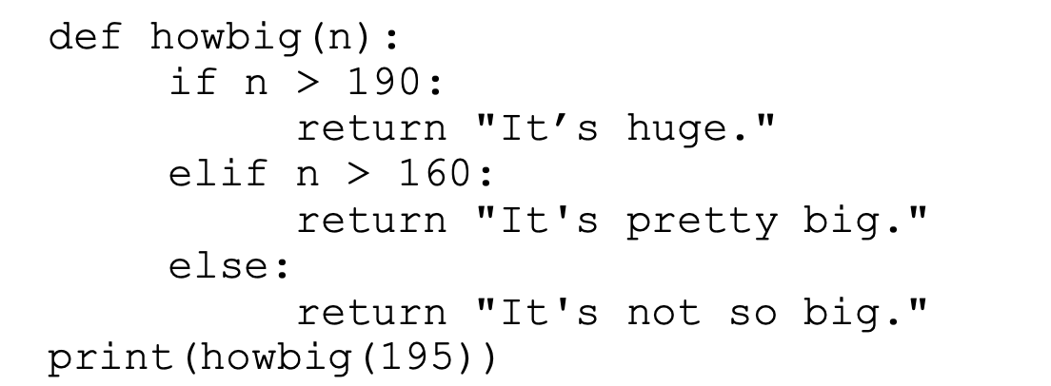
Get funcy-y with it - $500
What is the output?
Question board

Slide 23
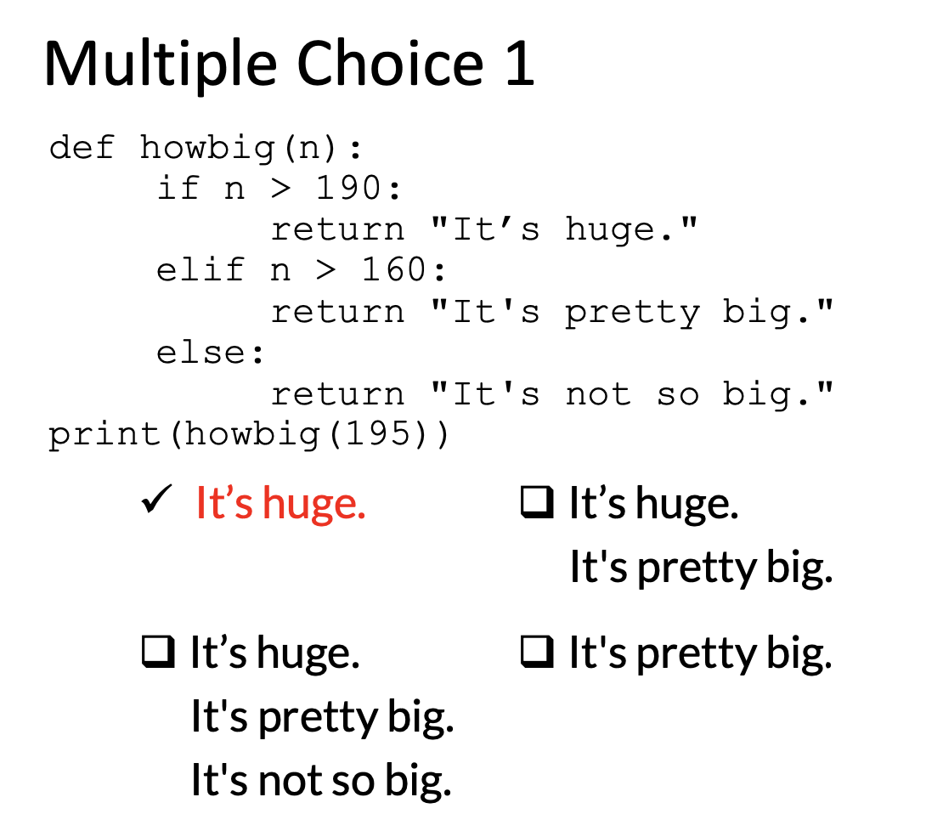
Question board

Slide 24
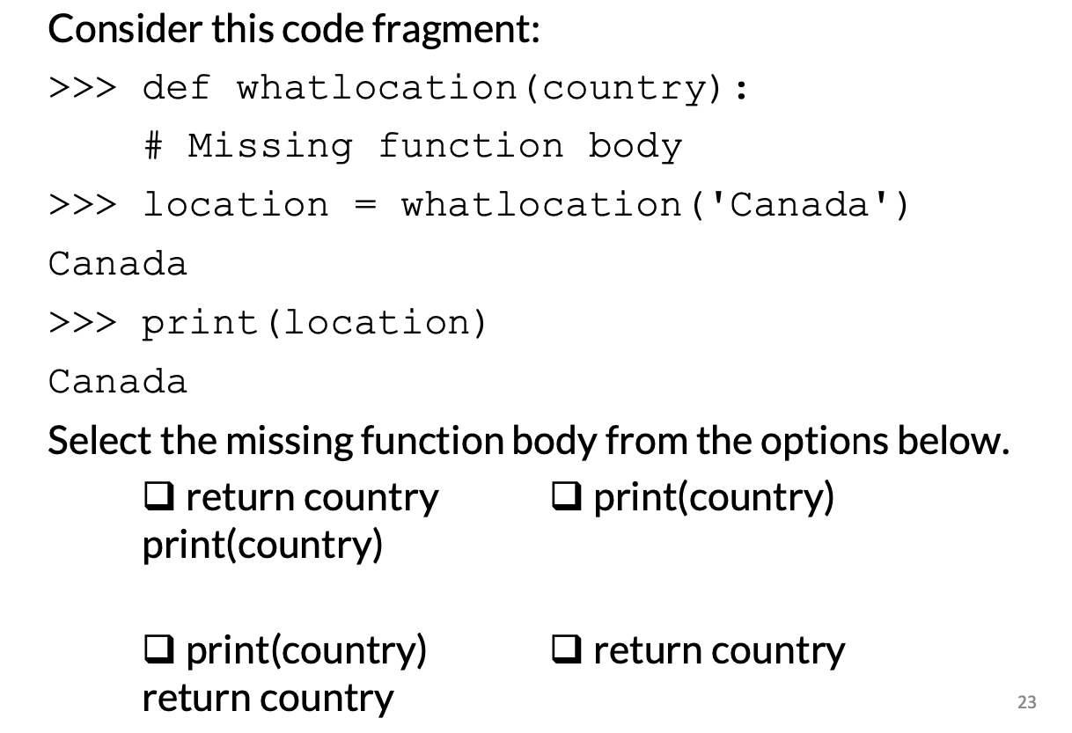
Get funcy-y with it - $1000
Question board

Slide 25
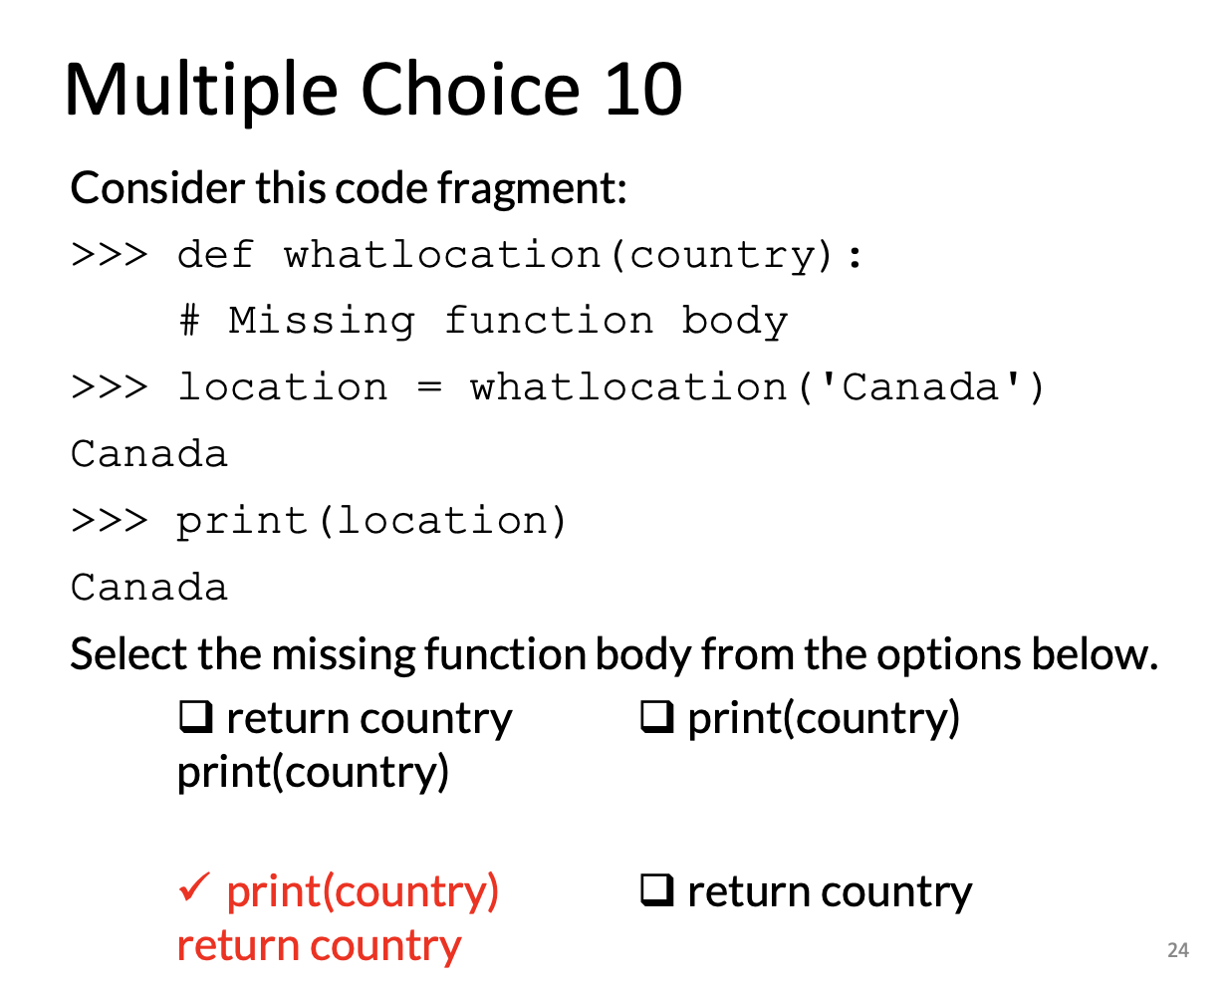
Question board

Slide 26
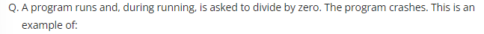
Err-ing on the side of caution - $250
Question board
Notes:
Runtime
A run-time error occurs when your program crashes. Dividing by zero or trying to open a file that doesn't exist, causing your program to crash, are both examples of run-time errors.

Slide 27

Err-ing on the side of caution - $500
Question board

Slide 28
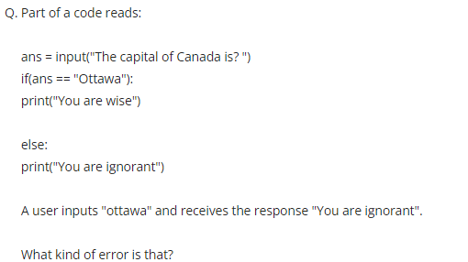
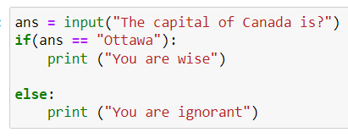
Err-ing on the side of caution - $1000
Question board
Notes:
Logic Error

Slide 29
APS 106
Midterm Review (Week 4) – Final Jeopardy!

Slide 30
Coding questions
#3. Water exists in three states- solid, liquid, and gas. Write a function that takes in the temperature in Celsius and returns a string “solid”, “liquid”, or “gas” depending on the temperature. Write a program using this function that prompts the user for a temperature and prints out the resulting state of water.
We will go over this solution!

