Slide 1
MIDTERM REVIEW
APS106

Slide 2
Rules of the GAME
Must use button on the table to answer question verbally and explain your answer – you will be called on to answer by one of the instructors
Must tell us which discipline you’re in before you answer for points (we’ll rely on the honour system)
If you get the answer right, you pick the next category
If you get the answer wrong, the next person whose hand is up can steal
Everyone is here to learn and review for the midterm so be kind to everyone who answers!

Slide 3
Panel
“HELLO WORLD”
TIME TO COMPARE AND GET LOOPY
To AND OR NOT to AND
GET FUNC-Y WITH IT
ERR-ING ON THE SIDE OF CAUTION
$250
$250
$250
$250
$250
$500
$500
$500
$500
$500
$1000
$1000
$1000
$1000
$1000

Slide 4
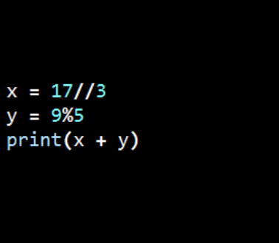
What is the output?
“HELLO WORLD” · $250
Question board

Slide 5
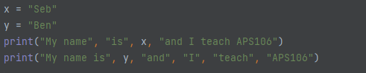
What is the output?
“HELLO WORLD” · $500
Question board

Slide 6
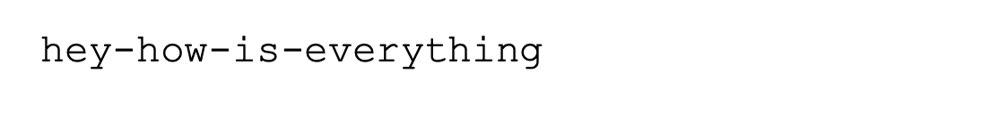
Verbally describe the function call with syntax that would product this output using a print() statement:
“HELLO WORLD” · $1000
Question board

Slide 7
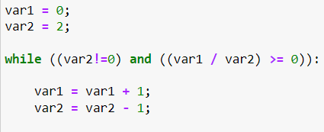
What are the values of var 1 and var 2 after the following code segment is executed and the while loop finishes?
TIME TO COMPARE AND GET LOOPY · $250
Question board

Slide 8
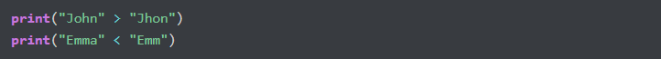
What is the output of the code?
TIME TO COMPARE AND GET LOOPY · $500
Question board

Slide 9
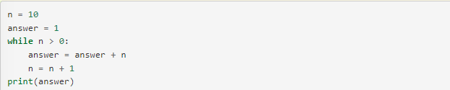
Verbally explain what happens in the following piece of code:
TIME TO COMPARE AND GET LOOPY · $1000
Question board

Slide 10
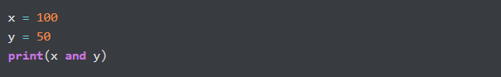
What is the output?
To AND OR NOT TO AND · $250
Question board

Slide 11
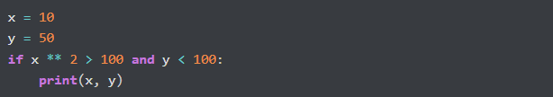
What is the output?
To AND OR NOT TO AND · $500
Question board

Slide 12
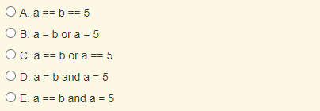
Which of the following evaluates to True when a is equal to b or when a is equal to 5?
To AND OR NOT TO AND · $1000
Question board

Slide 13
Which of the following evaluates to True when a is equal to b or when a is equal to 5?
To AND OR NOT TO AND · $1000
Question board

Slide 14
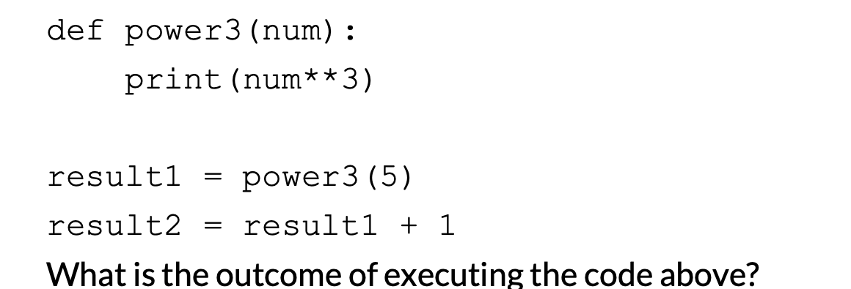
What is the output?
Get func-y with it · $250
Question board

Slide 15
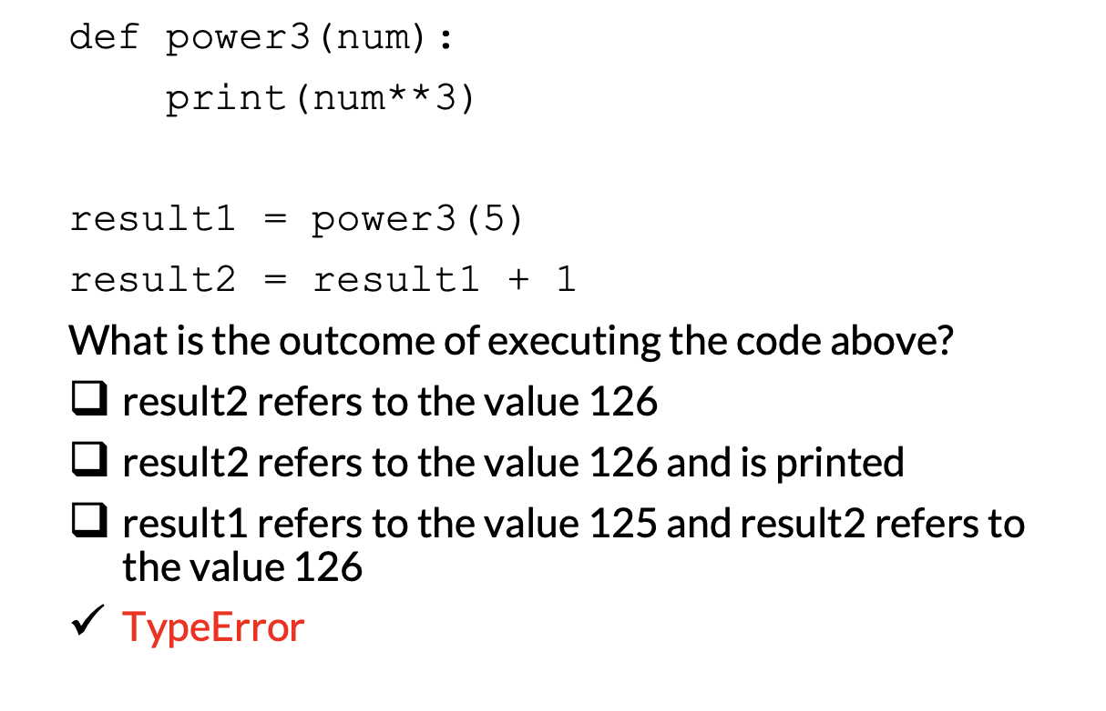
Get func-y with it · $250
Question board

Slide 16
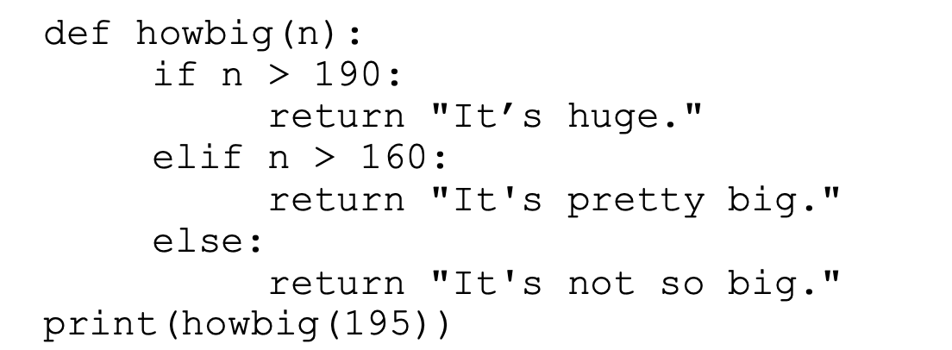
What is the output?
Get func-y with it · $500
Question board

Slide 17
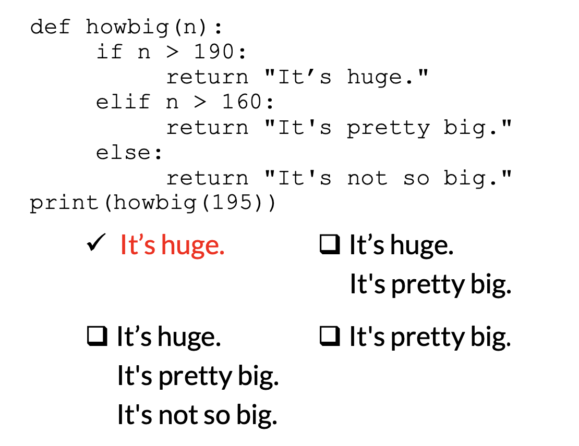
Get func-y with it · $500
Question board

Slide 18
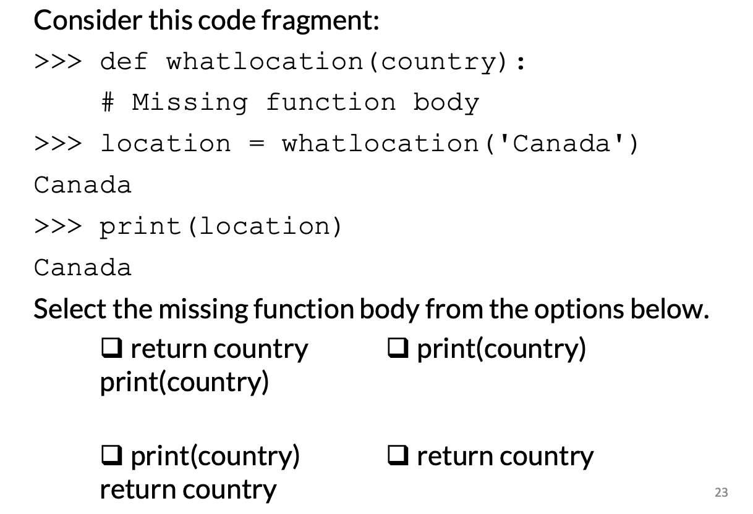
Get func-y with it · $1000
Question board

Slide 19
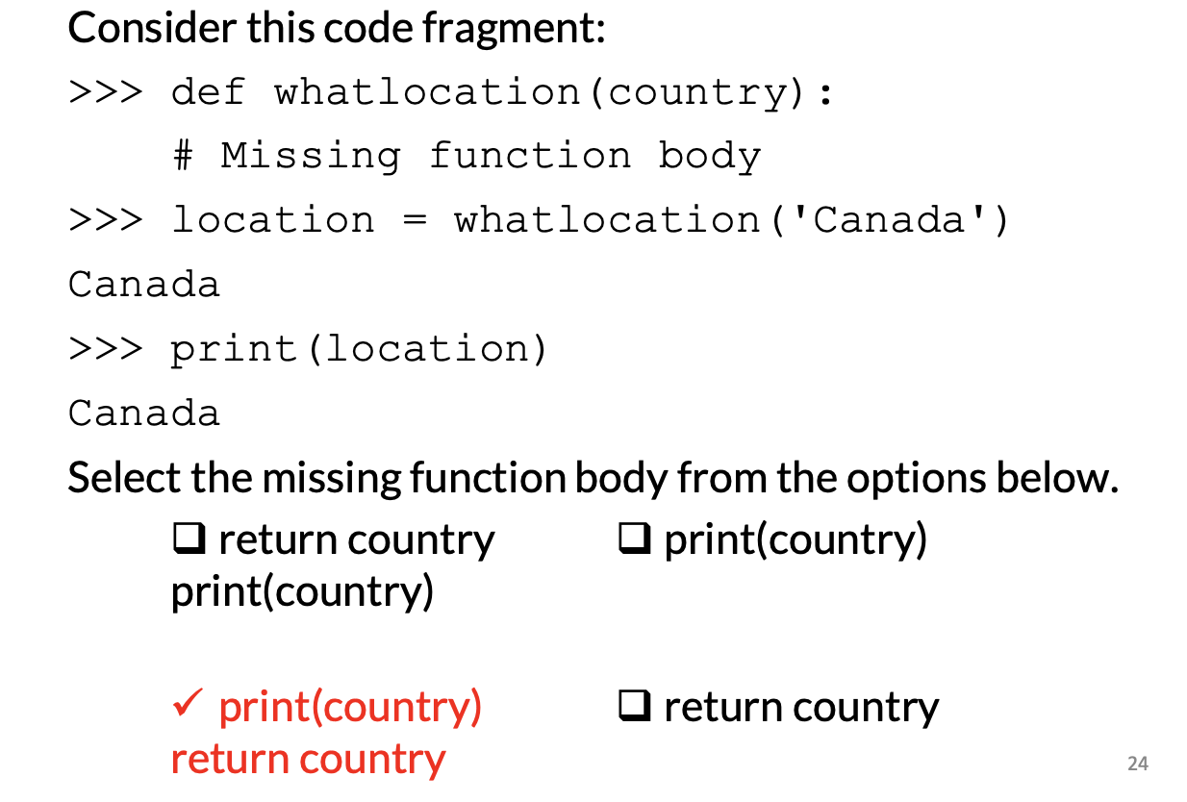
Get func-y with it · $1000
Question board

Slide 20
A program runs and, during running is asked to divide by zero. The program crashes. What type of error is this?
Err-ing on the side of caution · $250
Question board

Slide 21

What will the output be from the following code?
Err-ing on the side of caution · $500
Question board

Slide 22
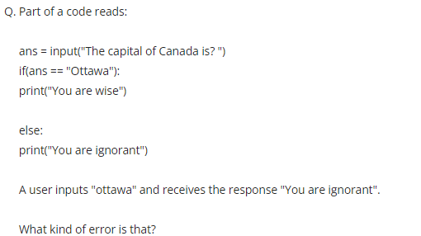
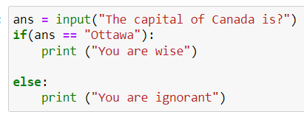
Err-ing on the side of caution · $1000
Question board

Slide 23
Final Jeopardy

Slide 24
Water exists in three states- solid, liquid, and gas. Write a function that takes in the temperature in Celsius and returns a string “solid”, “liquid”, or “gas” depending on the temperature. Write a program using this function that prompts the user for a temperature and prints out the resulting state of water.
STATES OF MATTER · FINAL JEOPARDY

