Slide 1
MIDTERM 2 REVIEW
APS106

Slide 2
Rules of the GAME
Must use button on the table to answer question verbally and explain your answer – you will be called on to answer by one of the instructors
Must tell us which discipline you’re in before you answer for points (we’ll rely on the honour system)
If you get the answer right, you pick the next category
If you get the answer wrong, the next person whose hand is up can steal
Everyone is here to learn and review for the midterm so be kind to everyone who answers!

Slide 3
Panel
Things and strings
For a while there…
Fantastic containers and where to find them
Check your
Method-ology
All things index
$250
$250
$250
$250
$250
$500
$500
$500
$500
$500
$1000
$1000
$1000
$1000
$1000

Slide 4
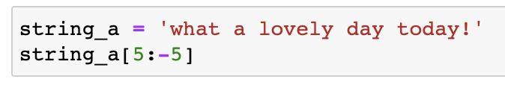
What is the output?
things and strings · $250
Question board

Slide 5
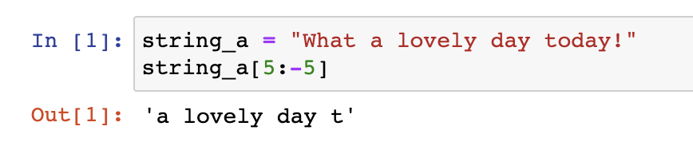
What is the output?
things and strings · $250
Question board

Slide 6
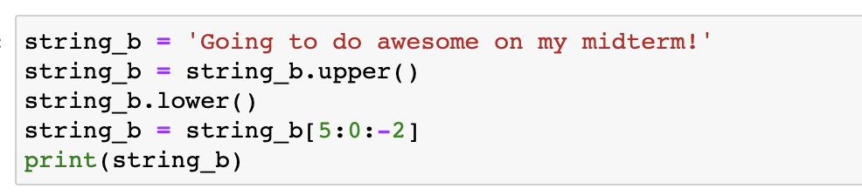
What is the output?
Things and strings · $500
Question board

Slide 7
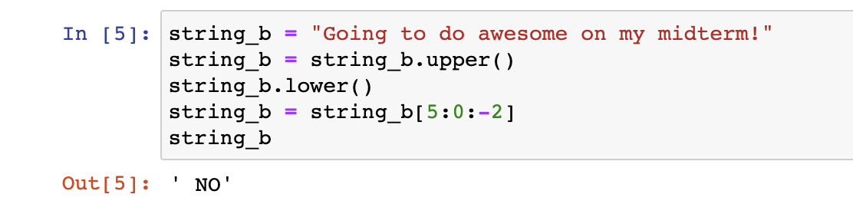
What is the output?
Things and strings · $500
Question board

Slide 8
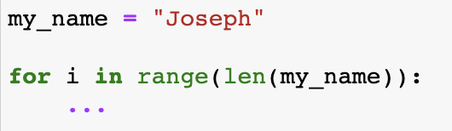
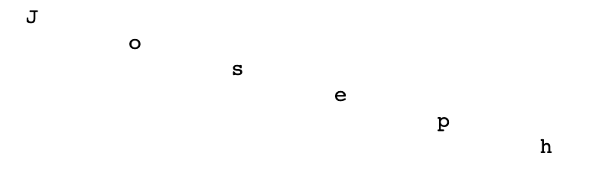
Provide the print statement that will give this output
Things and strings · $1000
Output:
Question board

Slide 9
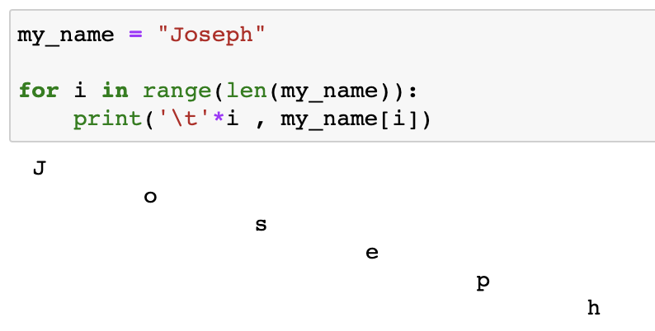
Provide the print statement that will give this output
Things and strings · $1000
Question board

Slide 10
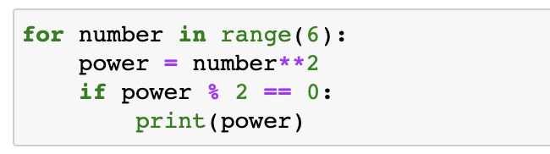
What is the output?
For a while there · $250
Question board

Slide 11
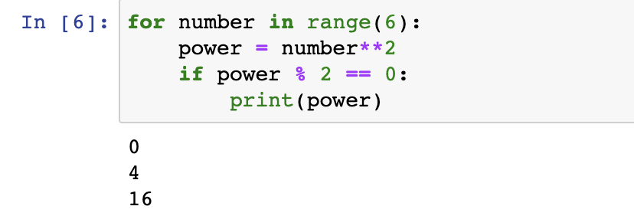
What is the output?
For a while there · $250
Question board

Slide 12
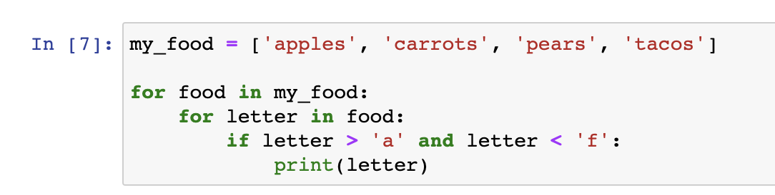
What is the output of the code?
FOR a while there · $500
Question board

Slide 13
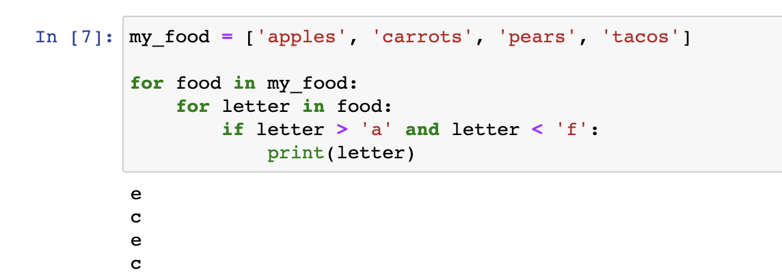
What is the output of the code?
FOR a while there · $500
Question board

Slide 14
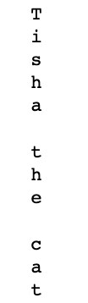
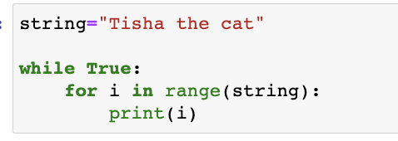
What should I do this code to make it print out the output?
For a while there· $1000
Code:
Output:
Question board

Slide 15
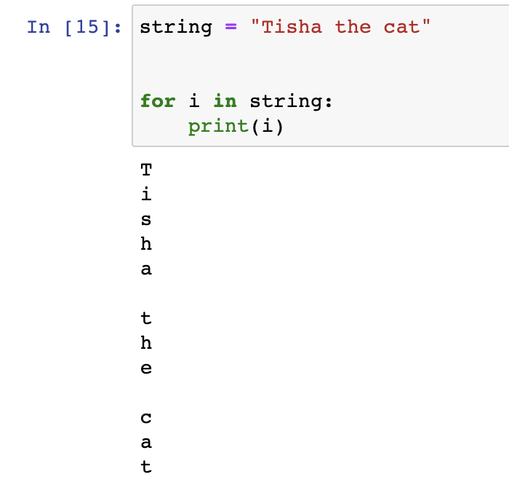
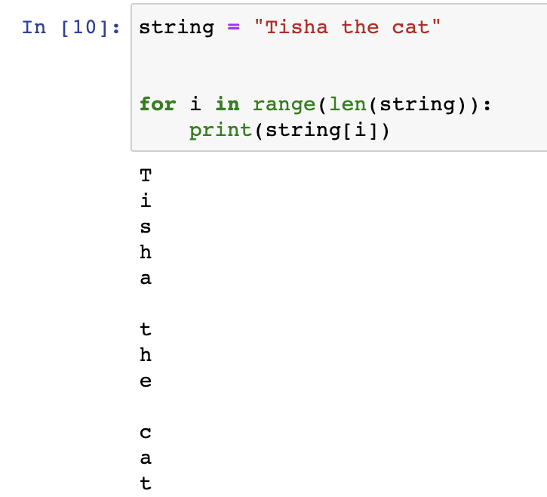
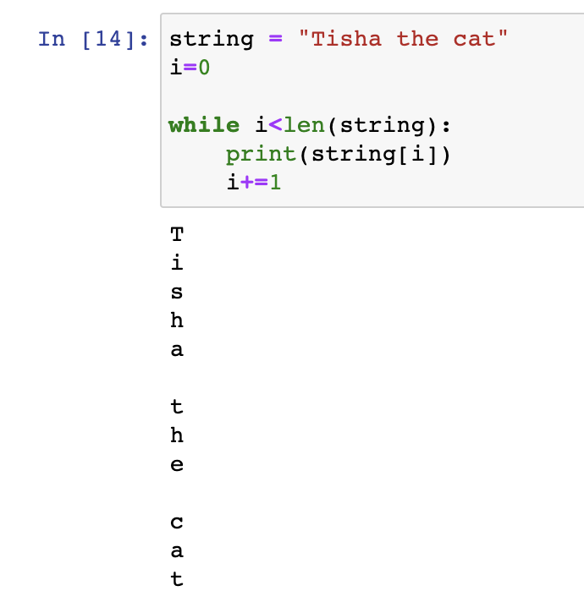
What should I do this code to make it print out the output?
For a while there· $1000
Question board

Slide 16
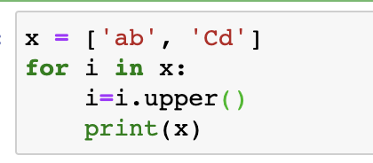
What is the output?
Fantastic containers and where to find them · $250
Question board

Slide 17

What is the output?
Fantastic containers and where to find them · $250
Modified from the
2018 final exam
Question board

Slide 18
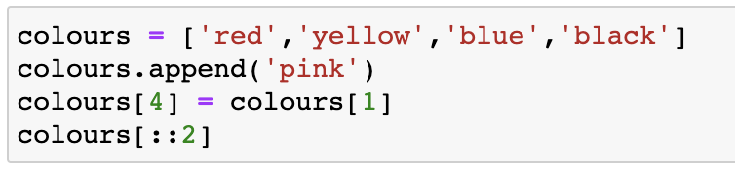
What is the output?
Fantastic containers and where to find them · $500
Question board

Slide 19

What is the output?
Fantastic containers and where to find them · $500
Question board

Slide 20
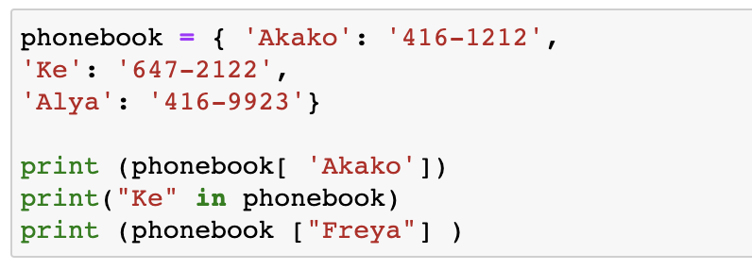
What are the outputs?
Fantastic containers and where to find them · $1000
Question board

Slide 21
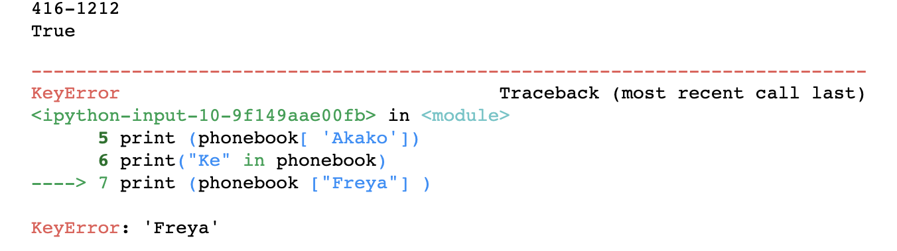
What are the outputs?
Fantastic containers and where to find them · $1000
Modified from the
2019 final exam
Question board

Slide 22
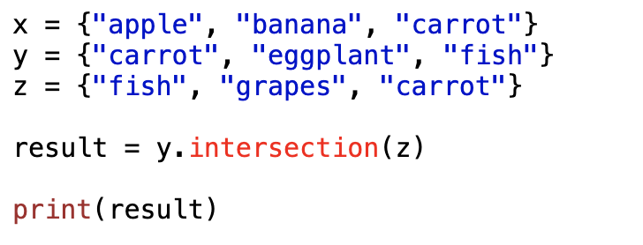
What is the output?
Check your method-ology· $250
Question board

Slide 23

What is the output?
Check your method-ology· $250
Question board

Slide 24

Check your method-ology· $500
Starting list:
How would you get to this?
Question board

Slide 25
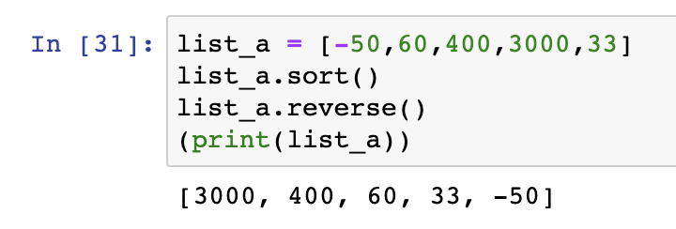
Check your method-ology· $500
Starting list:
How would you get to this?
Question board

Slide 26
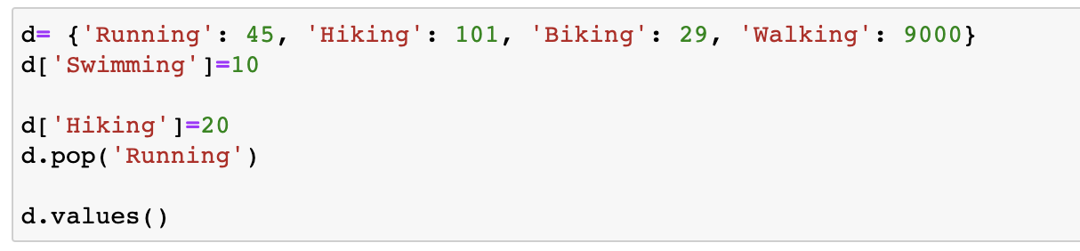
What is the output?
Check your method-ology· $1000
Question board

Slide 27
What is the output?
Check your method-ology· $1000
Modified from the
2018 final exam
Question board

Slide 28
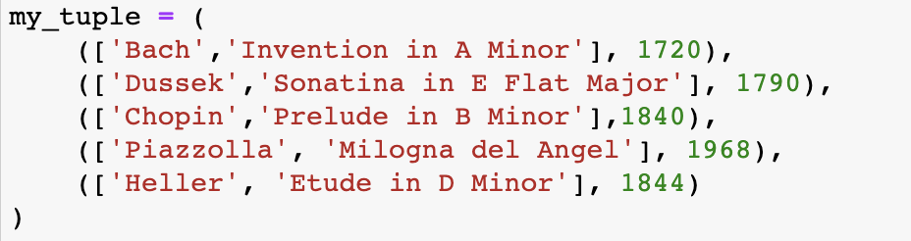




All things index · $250
a)
c)
b)
d)
Question board

Slide 29
All things index · $250
a)
c)
b)
d)
Question board

Slide 30
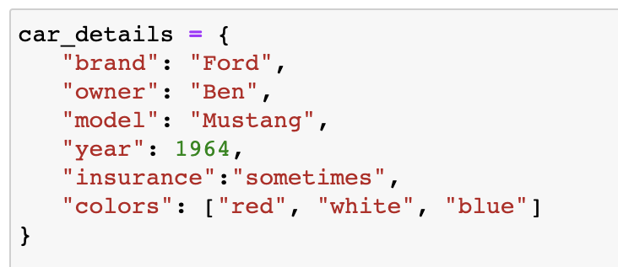
How would you print out the second color in this dictionary?
All things index · $500
Question board

Slide 31
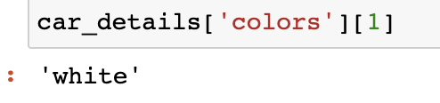
How would you print out the second color in this dictionary?
All things index · $500
Question board

Slide 32
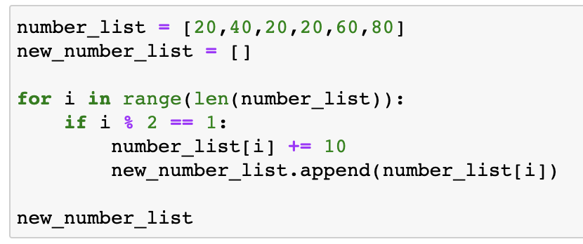
What is the result in new_number_list?
All things index · $1000
Question board

Slide 33
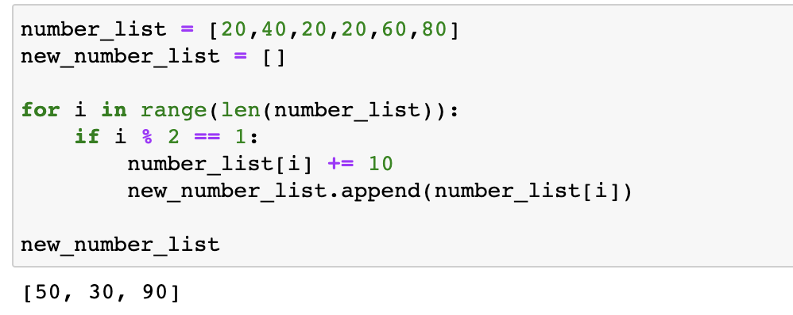
All things index · $1000
Question board

Slide 34
Final Jeopardy

Slide 35

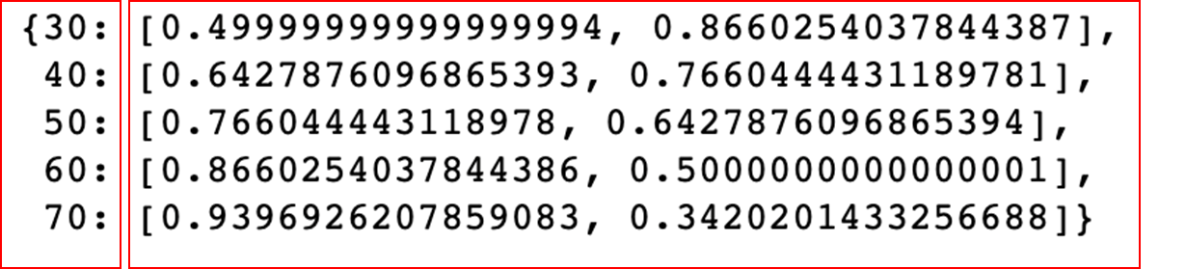
Create a function that takes an angle in degrees as the argument, and outputs a list of the sine and cosine for each angle value (hint: use math functions radians, sin and cos) Analyze a list of angles using your function: Insert the results into a dictionary that looks like this:
It is all about angles · FINAL JEOPARDY
Sine value
Cosine value

