Slide 1
Tutorial 11 - Week 12
We’ll be starting at the 10 minute mark

Slide 2

APS106 Teaching Assistant Evaluations
Please complete an evaluation for your teaching assistant(s)!
Please use QR code 🡪
Or the following link:
https://forms.office.com/r/xjf0aFbJ4k

Slide 3
Agenda
Lab 7 review
mol_form()function
Lecture review
Object-oriented programming review
Linked Data structures: Linked Lists
Practice questions

Slide 4
Learning Objectives
After this tutorial, learners should be able to:
recognize / describe / create Python classes
recognize / describe / create data attributes
recognize / describe / create class data attributes
recognize / describe / create instance data attributes
recognize / describe / create methods
recognize / describe / create class initializers (__init__)
recognize / describe / create non-initializer methods
recognize / describe / create Python objects
call methods on class / class instance objects
recognize / describe / create linked data structures

Slide 5
Review of Lab
mol_form()function

Slide 6
Lab 7 review
def mol_form(compound_formula):
"""(str) -> dictionary
When passed a string of the compound formula, returns a dictionary
with the elements as keys and the number of atoms of that element as values.
>>> mol_form("C2H6O")
{'C': 2, 'H': 6, 'O': 1}
>>> mol_form("CH4")
{'C': 1, 'H': 4}
"""
Hint: Use iteration to isolate the name of the element and its number. The following rules can be used:
If a capital character is encountered, OR the end of the string is encountered, then it marks the end of the atom-number pair so you can start parsing the atom-number string and store it into the dictionary.
If a digit character is encountered, mark it as the beginning of the atom number. Save this index since it will help you to split the string into the atom name and its number
If a new atom starts but the digit character was not encountered for the previous atom, the number for the previous atom would be 1.
As always, the solution is not unique, and this is one of the many ways you can solve this question!

Slide 7
Review of Lecture
Object-oriented programming review

Slide 8
Object Oriented Programming (OOP) Review
An object is a collection of related data and related functions
class Point:
""" A 2d point, at coordinates x, y"""
def __init__(self, x_arg = 0 y_arg = 0):
"""create a new point at x, y"""
self.x = x_arg
self.y = y_arg
def distance_from_origin(self):
"""Compute my distance from the origin"""
return (() + ()) ** 0.5
self refers to the instance of the class being manipulated
Data attributes
Method

Slide 9
Review of Lecture
Linked Data structures: Linked Lists

Slide 10
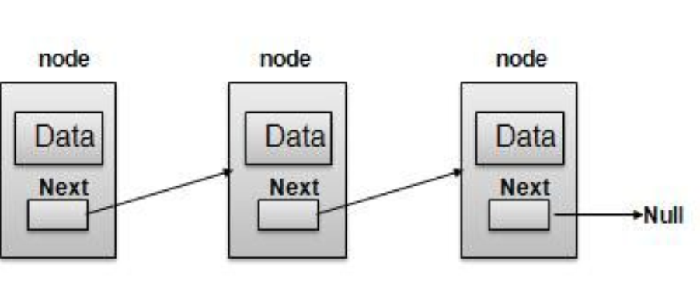
Linked Data Structures: Linked Lists
Collection of items (called nodes) each containing:
data (called cargo in lecture)
a link to the next item in the list
Node 1
Node 2
Node 3

Slide 11
What’s the Benefit of Linked Lists?
The elements of a list can be stored in non-contiguous areas of memory (unlike arrays)
Inserting and removing nodes does not require copying a large amount of memory
Items remain organized (e.g., sorted) when nodes are inserted or removed

Slide 12
Operations on Linked Lists
Insert a new node (at the head/tail, at a specific position, etc.)
Delete/remove a node (from the head/tail, from a specific position, etc.)
Update a node (modify a node’s value and/or link to the next node)
Search for/retrieve a node with a given value
Search for/retrieve a node with a given position in the list
Display/print the list

Slide 13
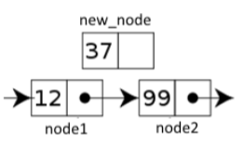
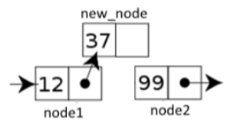
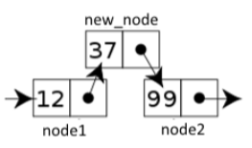
Operations on Linked Lists - Insert
Sample insert operation: insert a new node at a particular position in the list
To insert a new node at a specific position:
Go to/find the position in the list where the new node is to be inserted
Update the node before the position (node 1) to point to the node you are inserting (new_node)
Update the node you are inserting (new_node) to point to the node (node 2) previously linked to node 1

Slide 14
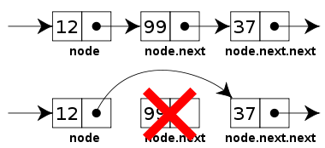
Operations on Linked Lists - Remove/Delete
Sample delete operation: delete a node with a particular value
To delete a node with a given value
Find the position in the list of the node to be deleted
Update the previous node (node 1) to point to the node that the node you need to delete is pointing to.

Slide 15
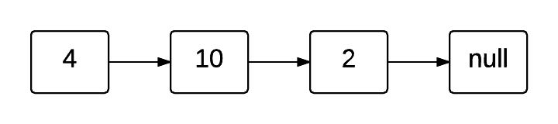
How do you set-up a linked list?

Slide 16
Option 1: use a class Node (for list elements)
We start by creating a Node class
A node has two data attributes: cargo (i.e., the data/value of the node) and next (i.e., the link to the next node in the list)
class Node:
def __init__(self, cargo_arg=None, next_arg=None):
self.cargo = cargo_arg
self.next = next_arg

Slide 17
Operations on Linked Lists
Insert a new node (at the head/tail, at a specific position, etc.)
Delete/Remove a node (from the head/tail, from a specific position, etc.)
Update a node (modify a node’s value and/or link to the next node)
Search for/Retrieve a node with a given value
Search for/Retrieve a node with a given position in the list
Display/Print the list

Slide 18
Option 1: Inserting Elements
We can create a Linked List using Node Objects
# create three nodes and assign them to variables
node1 = Node('first')
node2 = Node('second')
node3 = Node('third')
# link the nodes together
node1.next = node2 #add node2 at the end of the list
node2.next = node3 #add node3 at the end of the list

Slide 19
Operations on Linked Lists
Insert a new node (at the head/tail, at a specific position, etc.)
Delete/Remove a node (from the head/tail, from a specific position, etc.)
Update a node (modify a node’s value and/or link to the next node)
Search for/Retrieve a node with a given value
Search for/Retrieve a node with a given position in the list
Display/Print the list

Slide 20
Option 1: Printing all elements in a Linked List - 1
How do we produce a string representation of a list element (i.e., a Node object)?
We define the __str__ method of class Node !
⇒ When we pass a Node object to print(), print will call method __str__ of the object
to get its string representation. It will then print that string representation.
class Node:
def __init__(self, cargo_arg=None, next_arg=None):
self.cargo = cargo_arg
self.next = next_arg
def __str__(self):
return str(self.cargo)
__str__ returns the string representation of the cargo of tha node

Slide 21
Option 1: Printing all elements in a Linked List - 2
To print all elements in a linked list, we will iterate through the list:
# create three nodes and assign them to variables
node1 = Node('first')
node2 = Node('second’)
node3 = Node ('third')
# link the nodes together
node1.next = node2
node2.next = node3
node = node1 # position the loop variable at the head of the list
while (node != None): #move along the list until there are no more nodes
print (node)
node = node.next #follow the link to the next node

Slide 22
Option 2: use a LinkedList Class
While a linked list can be implemented using just the Node class, you can also create a class to represent linked lists.
We start by creating a LinkedList class and defining the __init__ method
class LinkedList:
def __init__ (self):
self.length = 0 #attribute to keep track of the length of the list
self.head = None #attribute to keep track of head node of the list

Slide 23
Operations on Linked Lists
Insert a new node (at the head/tail, at a specific position, etc.)
Delete/Remove a node (from the head/tail, from a specific position, etc.)
Update a node (modify a node’s value and/or link to the next node)
Search for/Retrieve a node with a given value
Search for/Retrieve a node with a given position in the list
Display/Print the list

Slide 24
Option 2: Insert elements - 1
Sample insert operation: add an element at the head of the list
class LinkedList:
def __init__ (self):
self.length = 0 #attribute to keep track of the length of the list
self.head = None #attribute to keep track of head node of the list
def add_first(self, cargo_arg):
''' Add an element with cargo cargo_arg as the first item of the list '''
node = self.head
new_node = Node(cargo_arg, node)
self.head = new_node
self.length += 1
Copy in a helper variable the head of the list
Create a new node with the value to be inserted.
Make the new node the head of the list
Increment the length of the list by 1

Slide 25
Option 2: Option 2: Insert elements - 1
Sample insert operation: add an element at the tail/end of the list
class LinkedList:
…
def add_last(self, cargo_arg):
''' Add an element with cargo cargo_arg as the last item of the list '''
node = self.head
new_node = Node(cargo_arg)
while node.next != None:
node = node.next
node.next = new_node
self.length += 1
First item of linked list
Create new Node for the item to add to the list
Find the last element of the list
Link the last element to the new node
Increment the length of the list by 1

Slide 26
Practice Problems

Slide 27
Review Practice Problem 1
a program
an operation
a method
an attribute
an object
Q1. In Python, a function within a class definition is called:

Slide 28


In Python, a function within a class definition is called:
ⓘ Start presenting to display the poll results on this slide.
Notes:
📣 This is Slido interaction slide, please don't delete it. ✅ Click on 'Present with Slido' and the poll will launch automatically when you get to this slide.

Slide 29
Review Practice Problem 1
a program
an operation
a method
an attribute
an object
Q1. In Python, a function within a class definition is called:

Slide 30
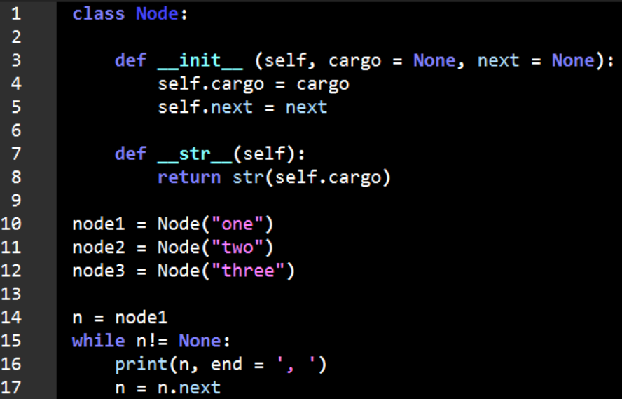
Review Practice Problem 2
Q2. What does the following code output?
one, two, three
one, two, three,
one,
An error is thrown
None of the above

Slide 31
What does the following code output?
ⓘ Start presenting to display the poll results on this slide.
Notes:
📣 This is Slido interaction slide, please don't delete it. ✅ Click on 'Present with Slido' and the poll will launch automatically when you get to this slide.

Slide 32
Review Practice Problem 2
Q2. What does the following code output?
one, two, three
one, two, three,
one,
An error is thrown
None of the above

Slide 33
Review Practice Problem 3
null
none
None
0
Q3. If a node n is the last item in a linked list, what should the next_node attribute in n be assigned to?

Slide 34
If a node n is the last item in a linked list, what should the next_node attribute in n be assigned to?
ⓘ Start presenting to display the poll results on this slide.
Notes:
📣 This is Slido interaction slide, please don't delete it. ✅ Click on 'Present with Slido' and the poll will launch automatically when you get to this slide.

Slide 35
Review Practice Problem 3
null
none
None
0
Q3. If a node n is the last item in a linked list, what should be the value of its next_node attribute?

Slide 36
Review Practice Problem 4
head is None
tail is 0
head != tail
head < tail
Q4. If a linked list is empty, which of the following statements is true?

Slide 37
If a linked list is empty, which of the following statements is true?
ⓘ Start presenting to display the poll results on this slide.
Notes:
📣 This is Slido interaction slide, please don't delete it. ✅ Click on 'Present with Slido' and the poll will launch automatically when you get to this slide.

Slide 38
Review Practice Problem 4
head is None
tail is 0
head != tail
head < tail
Q4. If a linked list is empty, which of the following statements is true?

Slide 39
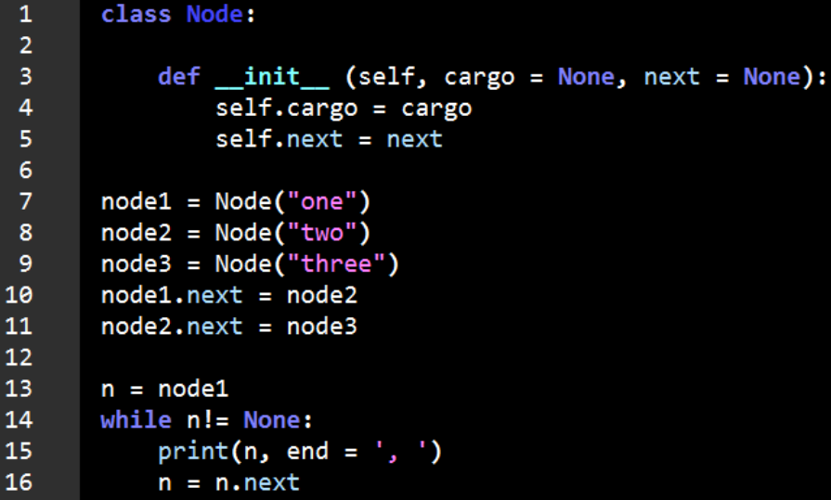
Review Practice Problem 5
Q5. What does the following code output?
one, two, three
one, two, three,
one,
An error is thrown
None of the above

Slide 40
What does the following code output?
ⓘ Start presenting to display the poll results on this slide.
Notes:
📣 This is Slido interaction slide, please don't delete it. ✅ Click on 'Present with Slido' and the poll will launch automatically when you get to this slide.

Slide 41
Review Practice Problem 5
Q5. What does the following code output?
one, two, three
one, two, three,
one,
An error is thrown
None of the above

Slide 42
Coding Question 1
Let’s work together to create a linked list of the items you ate as meals yesterday (eg, your breakfast, lunch and dinner).
Once we’ve made the list, add a new node representing an afternoon snack and insert it into the linked list.
Then print out all your meals for the day.

Slide 43
Coding Question 2
Use the starter code given for the LinkedList class to implement the following methods:
__str__ : should return a string representation of all the nodes in the list (with
the same format Python uses to convert regular lists to strings).
__len__ : should return, as an integer, how many nodes are in the list
insert : should work the same way as the insert method for the Python built-in
type list. Hint: Use help (list.insert) in Wing101 for more info.
concatenate : takes in a LinkedList object and adds its elements to the end of the
self object. Should work the same way as the concatenation
operation for the Python built-in type list.

Slide 44

Any questions?
ⓘ Start presenting to display the poll results on this slide.
Notes:
📣 This is Slido interaction slide, please don't delete it. ✅ Click on 'Present with Slido' and the poll will launch automatically when you get to this slide.

