Slide 1
Tutorial 4 - Week 5
We’ll be starting at the 10 minute mark

Slide 2
Agenda
Python built-in functions and modules
min(), max(), module random
Lab Review
using min() and max() to limit the value of a variable to a given range
Lecture Review
Iteration: while loops
Practice problems

Slide 3
Learning Objectives
After completing this tutorial, learners should be able to:
understand the semantics of Python built-in functions min(), max()and the functions in the built-in module random
understand how to use min and max to limit the value of a variable to a given range
understand the concept of iteration/looping
recognize while loops
understand the concept of “loop variable”
understand the need to initialize and update loop variables
understand the concept of “loop entry condition”
recognize the need for using/implementing an iterative structure
write syntactically and semantically correct while loops

Slide 4
Review of Python Built-in Functionality

Slide 5
Python built-in functions: min() and max()
Semantics: min() / max() return the smallest / largest value among the given inputs.
Function call syntax:
min(arg1, arg2, arg3,...)
max(arg1, arg2, arg3,...)
var_min = min(6, 3, 8, 10)
print(var_min)
var_max = max(4, 3, 5, 8)
print(var_max)

Slide 6
Python built-in module random
random implements pseudo-random number generators for various distributions
Functions defined in module random (a partial list):
randrange(start, stop, step): returns a randomly selected element from range(start, stop, step)
random(): returns the next random floating point number in the range [0.0, 1.0).
randint(a, b): returns a random integer N such that a <= N <= b
uniform(a, b): returns a random floating point number N such that a <= N <= b for a <= b and b <= N <= a for b < a.

Slide 7
Review of Lab 2

Slide 8
Limiting the value of a variable to a particular range
TASK: limit the value of a variable within given lower and upper limits
Multiple options, e.g., :
use conditional statements, i.e., IF-statements
use min() and max()
var = 10
lower = 0
upper = 20
var = max(lower, var)
var = min(upper, var)
var = 10
lower = 0
upper = 20
var = max(lower, min(upper, var))
constrain the value of var to be LARGER than lower limit
constrain the value of var to be SMALLER than the upper limit
equivalent to

Slide 9
Review of Lecture
Topic 1: Iteration
WHILE Loops

Slide 10
Iteration using while loops
When to use it?
When you want a piece of code to be executed repeatedly, as long as a particular condition is True.
Syntax (general structure) of a while loop:
while condition:
body
Must be indented !
Don’t forget the colon !

Slide 11
Flowchart representation of a generic while loop
Flowchart representation of a generic while loop
variables used in the loop-entry condition must be given a value before the condition is assessed
Initialization of loop variables
Loop entry condition
False
True
loop body
Next instruction (after the loop)

Slide 12
Notes on while loops
A while loop is particularly useful when you don’t know how many iterations will occur, but you know when the iteration should stop.
Make sure to appropriately update in the body the loop the variables that appear in the entry condition.
Failing to make sure that the condition statement becomes False at some point may result in an infinite loop.
Two useful commands for additional flow control:
continue: terminates the current iteration immediately and continue
to the next iteration
break: terminates the loop immediately

Slide 13
Practice Problems

Slide 14


What is the output of the following code?
ⓘ Start presenting to display the poll results on this slide.
Notes:
📣 This is Slido interaction slide, please don't delete it. ✅ Click on 'Present with Slido' and the poll will launch automatically when you get to this slide.

Slide 15
Review Practice Problem 1
What is the output of the following code?
0 3
1 4
2 8
A
i = 0
j = 3
while 0 < j < 10:
if j % 2 == 0:
j = j * 2
else:
j = j + 1
print(i, j)
i += 1
0 4
1 8
2 16
B
1 4
2 8
3 16
C
D
Error is thrown
E
None of the above

Slide 16
What is the result of executing the following code?
ⓘ Start presenting to display the poll results on this slide.
Notes:
📣 This is Slido interaction slide, please don't delete it. ✅ Click on 'Present with Slido' and the poll will launch automatically when you get to this slide.

Slide 17
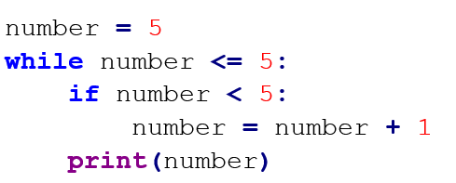
Review Practice Problem 2
What is the result of executing the following code?
A. The program will loop indefinitely
B. The value of number will be printed exactly 1 time
C. The while loop will never get executed
D. The value of number will be printed exactly 5 times

Slide 18
Coding Question 1
Problem statement
Write a Python program that:
asks the user to input an integer value (in base 10)
finds the smallest digit(s) of the representation of the integer value in base 10.
Additional requirements
Your solution should:
not cast the integer value into a string value.
use while loops

Slide 19
Coding Question 2
Problem Statement
Write a python program to find the first 9 prime numbers of the Fibonacci sequence.
Recall that:
Each number in the Fibonacci sequence is the sum of the two preceding ones. The sequence starts with 0 and 1.
>> For example: 0, 1, 1, 2, 3, 5, 8, 13, 21, 34, 55, 89, 144, …
Prime numbers are numbers that have only 2 factors: 1 and themselves
Hints: continue on the next page →

Slide 20
Coding Question 2 Hints
Take baby steps:
Write a function to check if a number is prime. Your function should take in an integer and return a boolean value (True if the input is prime and False otherwise).
a flowchart describing a strategy for primality checking is given on the next slide.
Write a while loop that:
at every iteration
generates the next number in the Fibonacci sequence
checks if the number just generated is a prime number using the function you implemented at Step 1
stops after 9 primes were generated

Slide 21
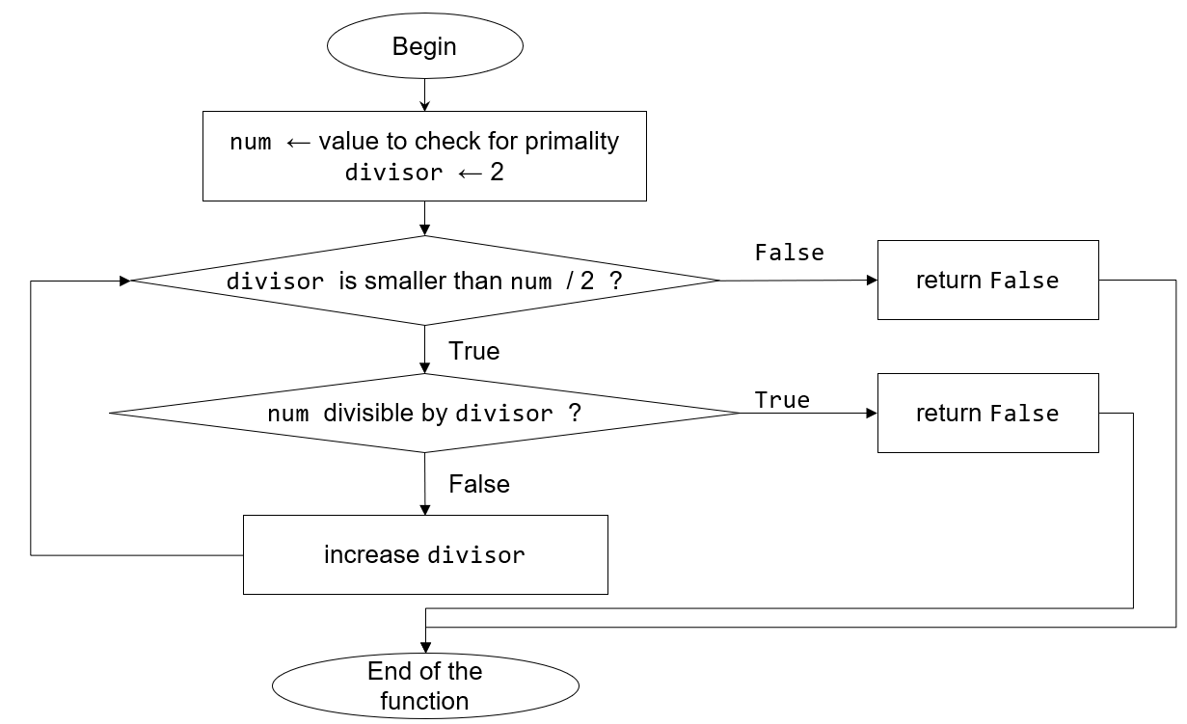

Slide 22

Any questions?
ⓘ Start presenting to display the poll results on this slide.
Notes:
📣 This is Slido interaction slide, please don't delete it. ✅ Click on 'Present with Slido' and the poll will launch automatically when you get to this slide.

