Slide 1
Tutorial 10 - Week 11
We’ll be starting at the 10 minute mark

Slide 2
Agenda
Lab 6 review
score_hand()function
Lecture review
Intro to object-oriented programming
User-defined Classes and methods
Practice questions

Slide 3
Learning Objectives
After this tutorial, learners should be able to:
recognize / describe / create Python classes
recognize / describe / create data attributes
recognize / describe / create class data attributes
recognize / describe / create instance data attributes
recognize / describe / create methods
recognize / describe / create class initializers (__init__)
recognize / describe / create non-initializer imethods
recognize / describe / create Python objects
call methods on class / class instance objects

Slide 4
Review of Lab
score_hand()function

Slide 5
score_hand function - 1
Consider a card game where each player receives five cards, i.e., “a hand”. A “hand” is scored according to the following rules:
(R1) Each pair (i.e. two cards with the same card value) scores 2 points. If a hand contains three or four of a kind, 2 points are scored for every combination of pairs: three cards of a kind are worth 6 points and four cards of a kind are worth 12 points.
(R2) All combinations of cards that sum to 15 are worth 2 points. When summing card combinations, aces are counted as one and jacks, queens, and kings are all counted as 10.
Hint: iterate over all combinations of 2, 3, 4, and 5 cards to see if the values in these combinations sum to 15. Make sure to count any value larger than 10 as 10.

Slide 6
score_hand function - 2
(R3) A group of three cards with consecutive values (called a run or a straight) scores 3 points. A run of four consecutive values scores 4 points and a run of five consecutive values scores 5 points. (The suit of the cards does not matter. )
Hint:
Step 1: Get all combinations of 3, 4, and 5 cards
Step 2: Filter through all combinations and only keeps the ones that consist of consecutive values (you can use the .sort() method of class list or use the algorithm practiced in the tutorial a few weeks ago)
Step 3: Filter out the children subsets and only keep the maximal subsets (We did one example in last week’s tutorial 😉).
Step 4: Assign scores based on the maximal subsets

Slide 7
score_hand function - 3
(R4) If all five cards in a hand are the same suit, i.e., one of hearts, tiles, clovers and pikes, 5 points are scored. If the hand has only four cards with the same suit, 4 points are scored. (A suit is one of the categories into which the cards of a deck are divided.)
Hint: iterate over all combinations of four and five cards to see if the values inside these combinations are all equal.
An easy way to check if all values in a list are all equal is to sets. For example, if you have a list of cards that have the same suit, attempting to convert the list into a set will reduce its length to 1, e.g., set(['hearts', 'hearts', 'hearts', 'hearts', 'hearts']) will return the set {'hearts'}

Slide 8
Review of Lecture
Intro to object-oriented programming

Slide 9
What is Object Oriented Programming (OOP)?
OOP is a programming paradigm where programmers build abstract data types that resemble real world objects
This enables the programmer to use the objects as they would outside the program to solve complex problems
OOP focuses on the creation of objects which contain both data and functionality together and achieving the overall program functionality through the interaction of these objects.

Slide 10
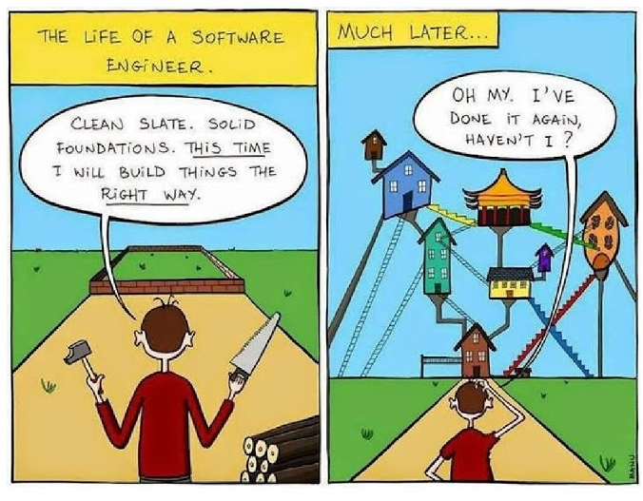
Why use OOP?
“How would you do it?” → “Translate this to Python”
As programs get larger and need to handle increasingly complex problems, it gets harder to represent the data by simply composing built-in data-types, i.e., list, dictionary, int, string, etc.
⇒An option is to create new data types that can store both information (in data attributes) and behaviour (in methods).
→In Python, methods are also referred to as method attributes.

Slide 11
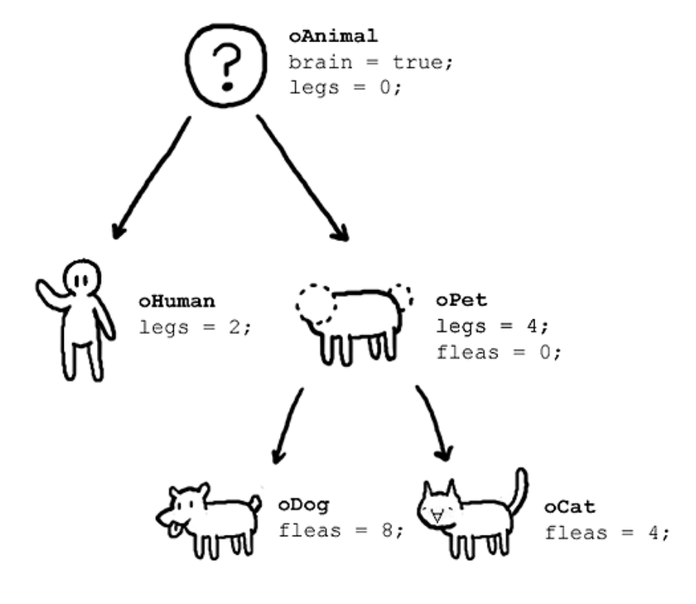
This seems like more work, why would you do this?
The real benefits of OOP manifest more clearly in programs that are complicated and large.
Usually, in a large industry project, several classes will already be defined and new programmers who join a project l write code that uses the pre-existing classes.

Slide 12
Review of Lecture
User-defined Classes

Slide 13
Review: Classes and Objects
Classes are templates for generating objects
Built-in classes: int, list, str, dict, …
Each object is an instance of a class template
Example: x = [5,5,3]
Y = list((5,6,7))
X and Y are objects, instances of class list
Note: - objects are the actual values in a program
- classes are how you would describe a type of object, and its capabilities.

Slide 14
User-Defined Classes - 1
One can expand the set of available classes by defining new classes
The general form of a class definition is:
class <class name>:
#class data attributes
…
def __init__(self, parameters):
#instance data attributes
…
def method_1(self, parameters):
…
def method_1(self, parameters):
…

Slide 15
User-Defined Classes - 2
class <class name>:
#class data attributes
…
def __init__(self, parameters):
#instance data attributes
…
The __init__ method is responsible for setting up the initial state of any new class instance. (The initializer method is automatically called whenever a new class instance is created by the class constructor. )
The class constructor, in Python, is called __new__. It is called first after a class instantiation statement and returns an instance of the class. In general, you do not need to add a method __new__ to your class. It is already available by default.
⇒ __init__ is responsible for initializing a class instance. The class instance exists at the time __init__ is called.

Slide 16
Example User Defined-Class
We can simulate multiple __init__ methods in a class by using optional parameters.
If multiple __init__ are present, the last one overrides the previous ones.
# define the class
class Point:
def __init__(self,xx=0,yy=0,zz=0):
self.x = xx
self.y = yy
self.z = zz
# instantiate some Point objects
q = Point()
p = Point(3,4,5)
__init__ is called the “initializer method”
__init__ creates three instance attributes: x, y and z
The self parameter is automatically set to reference the newly created object
___init__ sets the attributes x, y and z of an instance of class Point to 0.
___init__ sets the attributes x, y and z of an instance of class Point to 3, 4 and 5, respectively.

Slide 17
User-Defined Methods
Classes have a set of functions (aka methods) that can only be applied to objects that are instances of the class
The general form of a class with methods is:
class <class name>:
#class data attributes
….
def method_name1(self, param1):
body1
def method_name2(self, param2):
body2
Method __init__ can be one of the methods in the body of a class, but it is not mandatory. Each class has a default initializer.

Slide 18
Example User Defined-Class
# define class Point
class Point:
def __init__(self,x=0,y=0,z=0):
self.x = x
self.y = y
self.z = z
def distance_from_origin(self):
return ((self.x**2) + (self.y**2) +(self.z**2))**0.5
# instantiate some 3d Point objects
p = Point(3,4,5)
q = Point(1,2,3)
# get the distance from origin (Note the two different ways to call methods!)
Distance_p = p.distance_from_origin() # object.method()
Distance_q = Point.distance_from_origin(q) # Class.method(object)
distance_from_origin is a method

Slide 19
Practice Problems

Slide 20
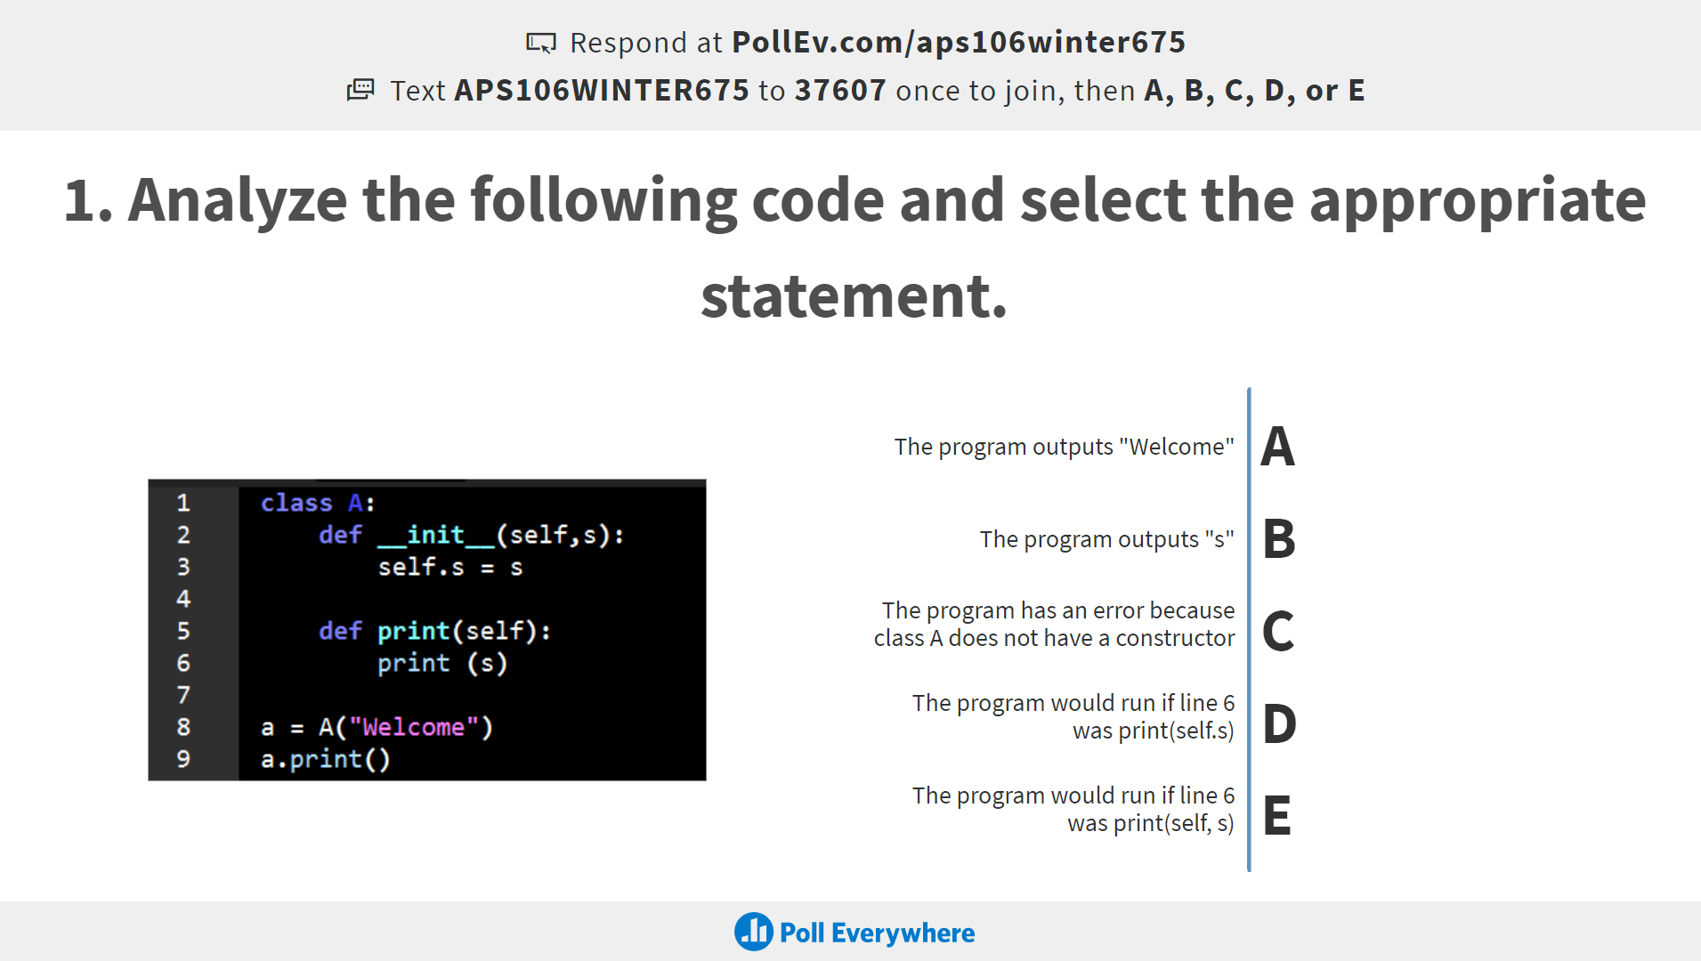
Review Practice Problem 1
Q1. Analyze the following code and select the appropriate statement
The program outputs “Welcome”
The program outputs “s”
The program has an error because class A does not have a constructor
The program would run if line 6 was print(self.s)
The program would run if line 6 was print(self, s)

Slide 21


Q1. Analyze the following code and select the appropriate statement
ⓘ Start presenting to display the poll results on this slide.
Notes:
📣 This is Slido interaction slide, please don't delete it. ✅ Click on 'Present with Slido' and the poll will launch automatically when you get to this slide.

Slide 22
Review Practice Problem 1
Q1. Analyze the following code and select the appropriate statement
The program outputs “Welcome”
The program outputs “s”
The program has an error because class A does not have a constructor
The program would run if line 6 was print(self.s)
The program would run if line 6 was print(self, s)

Slide 23
Review Practice Problem 2
a program
a method
data
a class
a function
Q2. An object is an instance of …

Slide 24
Q2. An object is an instance of …
ⓘ Start presenting to display the poll results on this slide.
Notes:
📣 This is Slido interaction slide, please don't delete it. ✅ Click on 'Present with Slido' and the poll will launch automatically when you get to this slide.

Slide 25
Review Practice Problem 2
a program
a method
data
a class
a function
Q2. An object is an instance of …

Slide 26
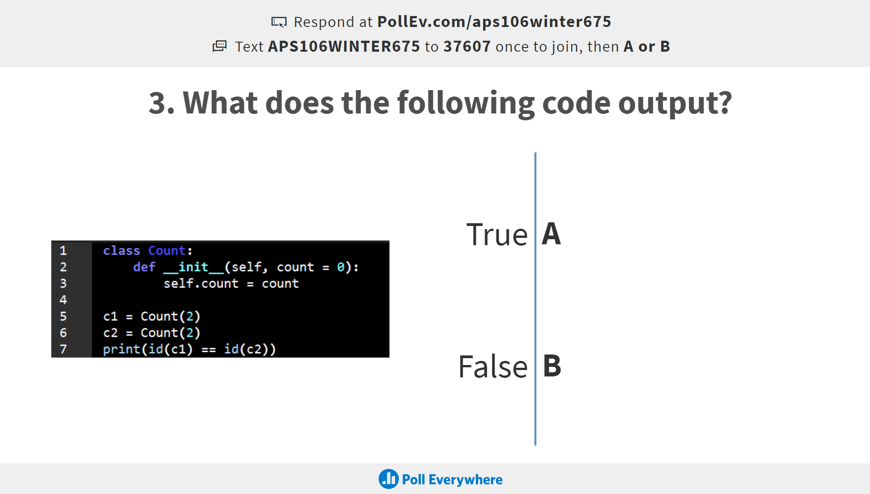
Review Practice Problem 3
Q3. What does the following code output?
True
False
An error

Slide 27
Q3. What does the following code output?
ⓘ Start presenting to display the poll results on this slide.
Notes:
📣 This is Slido interaction slide, please don't delete it. ✅ Click on 'Present with Slido' and the poll will launch automatically when you get to this slide.

Slide 28
Review Practice Problem 3
Q3. What does the following code output?
True
False
An error

Slide 29
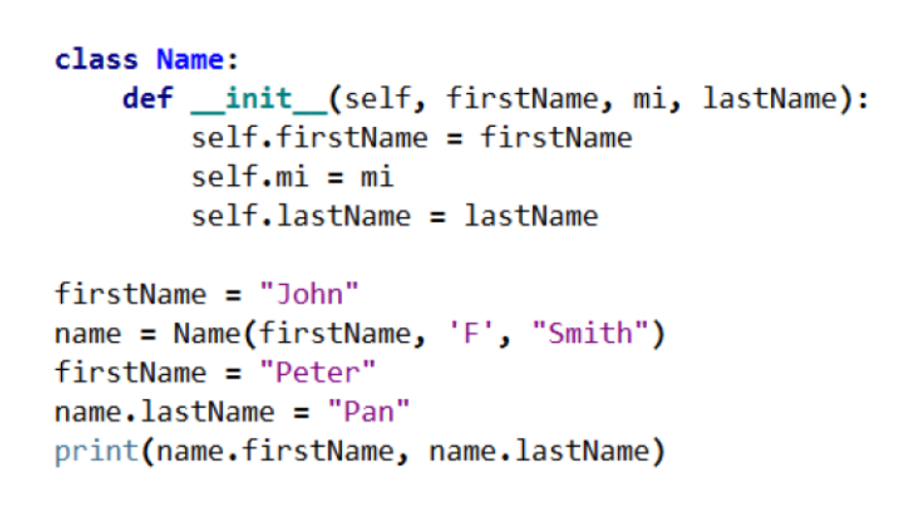
Review Practice Problem 4
Q4. What does the following code output?
Peter Pan
Peter F Smith
John Pan
John F Smith
None of the above

Slide 30
Q4. What does the following code output?
ⓘ Start presenting to display the poll results on this slide.
Notes:
📣 This is Slido interaction slide, please don't delete it. ✅ Click on 'Present with Slido' and the poll will launch automatically when you get to this slide.

Slide 31
Review Practice Problem 4
Q4. What does the following code output?
Peter Pan
Peter F Smith
John Pan
John F Smith
None of the above

Slide 32
Coding Question 1
Let’s make a simple class called Car that has three data attributes:
brand (stored as a string)
model (stored as a string
top_speed (stored as a floating point number)
Define a class Car.
Create a method is_faster(self, other_car), which returns True if self is “faster” than the other_car and False if it is slower
Create two Car objects, car1 and car2
Print out the attributes of each Car object.
Print out whether car1 is “faster” than car2

Slide 33
Coding Question 2
Define a class called Rectangle and create methods to:
compute its area
compute its perimeter
find its centre point
compare two rectangles and return the rectangle with the largest area
Instructions:
Use the starter code provided on Quercus. Go to your tutorial section and use the “open the practice problem” prompt.
Use the Point class to solve this problem.
Hint: What are some logical attributes for a rectangle? What attributes would be useful within the methods that we’re going to write?

Slide 34

Any Questions?
ⓘ Start presenting to display the poll results on this slide.
Notes:
📣 This is Slido interaction slide, please don't delete it. ✅ Click on 'Present with Slido' and the poll will launch automatically when you get to this slide.

