Slide 1
Tutorial 8 - Week 9
We’ll be starting at the 10 minute mark

Slide 2
Agenda
Lab review
More practice with iteration
Lecture review – data structures
tuples
sets
dictionaries
Practice questions

Slide 3
Learning Objectives
After this tutorial, learners should be able to:
recognize / describe / create objects of type tuple/set/dictionary
access and modify individual elements of a tuple using subscription and slicing
access and modify individual elements of a dictionary using subscription
insert and remove elements from a tuple/set/dictionary using appropriate tuple/set/dictionary methods/operators
test whether a value/object belongs to a tuple/set/dictionary using the membership operator
iterate over tuples/sets/dictionaries

Slide 4
Lab review
More practice with iteration & Strings

Slide 5
Lab 5 review¹
use .find()to obtain the position of “@” and then use string slicing to obtain last_name.
use .find() to obtain the position of “.” and then use string slicing to obtain first_name
def email_to_name(email):
"""
(str) -> str
Given a string with the format "first_name.last_name@domain.com",
return a string "LAST_NAME,FIRST_NAME" where all the characters are upper
case
>>> email_to_name("anna.conda@mail.utoronto.ca")
'CONDA,ANNA'
"""
This can be achieved by string concatenation

Slide 6
Lab 5 review²
def count_measurements(s):
"""
(str) -> int
Given s, a string representation of comma separated site-measurement
pairs, return the total number of measurements
>>> count_measurements("B, 5.6, Control, 5.5, Db, 3.2")
3
>>> count_measurements("Control, 7.5")
1
"""
Split the string up using “,” as a separator, and then count the resulting elements. The number of measurement is the number of elements divided by 2.
Alternatively, you can count the number of commas using .count()and determine the number of measurements based on the number of commas.

Slide 7
Lab 5 review³
def calc_site_average(measurements, site):
"""
(str, str) -> float
Given s, a string representation of comma separated site-measurement
pairs, return the average of the site measurements to one
decimal place
>>> calc_site_average("A, 4.2, B, 6.7, Control, 7.1, B, 6.5, Control, 7.8, Control, 6.8, A, 3.9", "Control")
7.2
"""
You can use .find(value, start, end) to identify the index of site. Multiple occurrences of site may be present. You can use a loop to find all occurrences.
Hint: specify a different start index in .find(value, start, end) in each iteration.
Alternatively, use string slicing to truncate the string in each iteration to remove the part of the string that has already been processed.

Slide 8
Review of Lecture
Tuples

Slide 9
Tuples¹
A tuple is an ordered sequence of items, similar to lists, but with some key differences:
Tuples are written using parentheses ( )
Tuples are immutable
Tuples can be indexed or sliced (like lists and strings)
Tuples elements CANNOT be replaced
>>> class_score = (['sara', 75.0], ['cris', 72.5])
>>> class_score[0] = class_score[1]
Tuples elements CAN be modified
>>> class_score[0][1] = 80.2
>>> class_score[0]
['sara', 80.2]
This assignment will result in an error since tuple objects are immutable
This assignment does not raise an error because list objects are mutable

Slide 10
Tuples²
Tuples can be used to swap the values of multiple variables in just one line of code
Let’s say we want to swap the values of variable a and b:
General strategy
Using tuple
>>> a = 1
>>> b = 2
>>> temp = a
>>> a = b
>>> b = temp
>>> print("a =", a)
a = 2
>>> print("b =", b)
b = 1
>>> a = 1
>>> b = 2
>>> (a, b) = (b, a)
>>> print("a =", a)
a = 2
>>> print("b =", b)
b = 1

Slide 11
Tuples³
def trig_calculator(deg):
'''
(float) -> (float)
calculates trig functions given an angle
'''
sin = math.sin(math.radians(deg))
cos = math.cos(math.radians(deg))
tan = math.tan(math.radians(deg))
return (sin, cos, tan)
>>> returned_values = trig_calculator(deg)
>>> print(type(returned_values))
<class 'tuple'>
Want to return multiple variables from a function?
⇒ Return them packed in a tuple object.

Slide 12
Tuple Operations - as Operators
Operation | Operator | Example
Indexing | [ ] | >>> a = (20 ,40, "apple", "ball") >>> a[0] 20
Slicing | [ : : ] | >>> a[1:3] (40, 60)
Concatenation | + | >>> c = (1, ) >>> b = (2, 4) >>> c + b (1, 2, 4)
Repetition |  | >>> b * 2 (2, 4, 2, 4)
Membership |  | >>> 20 in a True >>> "orange" in a False
Comparison |  | >>> d = (2,3,4) >>> a == b False

Slide 13
Tuple Operations - as Methods
Operation | Methods | Example
Find the index of the first occurrence of a given value in a tuple. | index(value) | >>> b = (1,2,3,2,1) >>> b.index(2) 1
Find the number of times a given value appears in a tuple. | count(value) | >>> b = (1,2,3,2,1) >>> b.count(2) 2

Slide 14
Built-in Functions that can be used on Tuples
min(): return the minimum element in a tuple
max(): return the maximum element in a tuple
len(): return the length of the tuple

Slide 15
Review of Lecture
Sets

Slide 16
Sets
A set is an unordered collection of distinct items
The set notation is similar to lists and tuples, but uses curly brackets { }
Set elements do not have a fixed position in the set
⇒ We cannot use indexing
>>> vowels = set()
>>> vowels = {'a', 'a', 'e', 'i', 'o', 'u'}
>>> vowels
{'a', 'u', 'o', 'i', 'e'}
>>> vowels
{'o', 'u', 'a', 'i', 'e'}
>>> {1, 2} == {2, 1}
True
>>> [1, 2] == [2, 1]
False
>>> (1, 2) == (2, 1)
False
An empty set
Duplicates are removed.
The items in the set may have a different order.

Slide 17
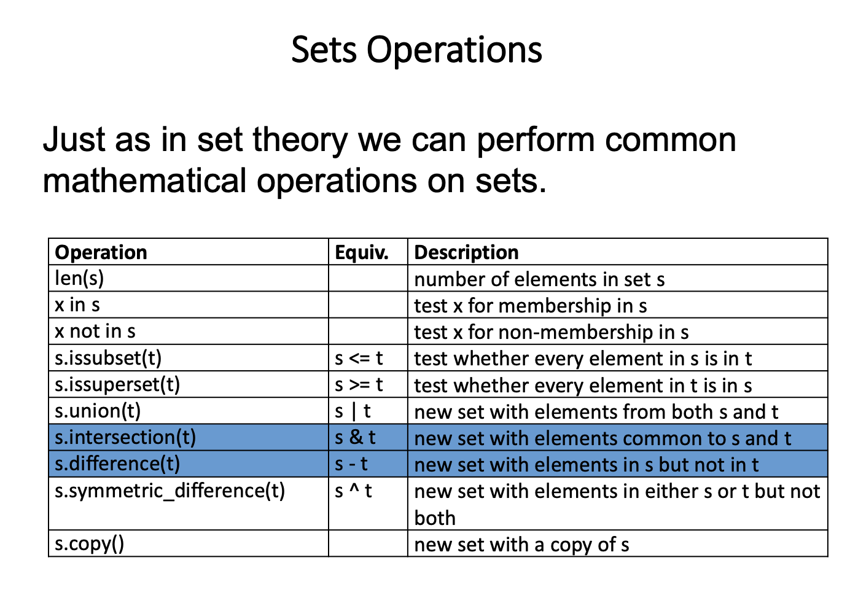

Slide 18
Review of Lecture
Dictionaries

Slide 19
Dictionaries
A dictionary is a collection of unordered, distinct key-value pairs
A common way to create dictionaries is to use curly braces, {}, around key-value pairs of literals and/or values expressed as expressions
The general syntax is: { key1 : expr1, key2 : expr2, …, keyN : exprN }
The key : value pairs of the dictionary are separated by commas.
Each pair contains a key (always a literal) and a value separated by a colon.
Unlike sequences, which are indexed by a range of numbers, dictionaries are indexed by keys.
Keys can be values of any immutable type, e.g., strings, numbers, etc.
Tuples can be used as keys if they contain only immutable elements;
If a tuple contains any mutable object either directly or indirectly, it cannot be used as a key.

Slide 20
Dictionary operations
Given: d1 = {'Tina':'A+', 'Min':'A'}
Operation | Operator / Method | Example code
Indexing: retrieve the value associated with a key. | [ ] | >>> d1['Tina'] 'A+'
Add an entry if the entry does not exist, otherwise modify the existing entry | [ ] | >>> d1['John'] = 'B+' >>> d1 {'John': 'B+', 'Tina': 'A+', 'Min':'A'}
Delete/remove a given key and its associated value from a dictionary | del, pop | >>> del d1['Tina'] >>> d1 {'John': 'B+', 'Min':'A'} >>> d1.pop('John') >>> d1 >>> {'Min':'A'}
Test if a given key is in the dictionary (it does not check the values) |  | >>> 'John' in d1 True >>> 'B+' in d1 False

Slide 21
Review of Lecture
Summary

Slide 22
 | Ordered | Mutable | Iterable
List | ✓ | ✓ | ✓
Tuple | ✓ |  | ✓
Set |  | ✓ | ✓
Dictionary |  | ✓ | ✓
String | ✓ |  | ✓

Slide 23
Operation Example | Result | String | List | Tuple | Set | Dictionary
x in s | True if an item of s is equal to x, else False | ✓ | ✓ | ✓ | ✓ | ✓ (for keys only)
x not in s | False if an item of s is equal to x, else True | ✓ | ✓ | ✓ | ✓ | ✓ (for keys only)
s + t | the concatenation of s and t | ✓ | ✓ | ✓
s * n or n * s | equivalent to adding s to itself n times | ✓ | ✓ | ✓
s[i] | ith item of s, origin 0 | ✓ | ✓ | ✓
s[i:j] | slice of s from i to j | ✓ | ✓ | ✓
s[i:j:k] | slice of s from i to j with step k | ✓ | ✓ | ✓
s1 == s2 | Equality comparison | ✓ | ✓ | ✓ | ✓ | ✓
>, >=, <, <= | Lexicographical comparison (* subset testing for set objects) | ✓ | ✓ | ✓ | ✓*
s[i] = x | item i of s is replaced by x |  | ✓ |  |  | ✓ (possible if i is one of the keys, or if key i does not exist)
del s[i] | removes the element s[i] from the iterable |  | ✓ |  |  | ✓ (possible if i is one of the keys)
s[i:j] = t | slice of s from i to j is replaced by the contents of the iterable t |  | ✓
s[i:j:k] = t | the elements of s[i:j:k] are replaced by those of t |  | ✓
del s[i:j:k] | removes the elements of s[i:j:k] from the the iterable. ( s[i:j]is the same as s[i:j] = []) |  | ✓
s *= n | updates s with its contents repeated n times | ✓ | ✓ | ✓

Slide 24
Operation Example | Result | String | List | Tuple | Set | Dictionary
s.count(x) | total number of occurrences of x in s | ✓ | ✓ | ✓
s.append(x) | appends x to the end of the sequence (same as s[len(s):len(s)] = [x]) |  | ✓
s.extend(t) or s += t | extends s with the contents of t (for the most part the same as s[len(s):len(s)] = t) |  | ✓
s.index(x[, i[, j]]) | index of the first occurrence of x in s (at or after index i and before index j) | ✓ | ✓ | ✓
s.insert(i, x) | inserts x into s at the index given by i (same as s[i:i] = [x]) |  | ✓
s.pop() or s.pop(i) | retrieves the item at i and also removes it from s |  | ✓ |  | ✓ (s.pop() removes a random element from the set. does not support s.pop(i)) | ✓ (does not support s.pop(), and i must be one of the keys)
s.remove(x) | remove the first item x from s |  | ✓ |  | ✓

Slide 25
Summary – Built-in functions
Operation | Result | String | List | Tuple | Set | Dictionary
len(s) | length of s | ✓ | ✓ | ✓ | ✓ | ✓
min(s) | smallest item of s | ✓ | ✓ | ✓ | ✓ | ✓ (for keys only)
max(s) | largest item of s | ✓ | ✓ | ✓ | ✓ | ✓ (for keys only)

Slide 26
Practice Problems

Slide 27
Coding Question 1
Write a function combine()that combines values from an input list of dictionaries of type {'item': i1, 'amount': a1 }. combine()should return a dictionary whose keys are the values associated with the keys item in the input dictionaries. The value associated with each key is the sum of the amounts corresponding to that key in the input dictionaries.
Usage example:
>>> result = combine( [{'item': 'i1', 'amount': 400}, {
{'item': 'i2', 'amount': 300}, {'item': 'i1', 'amount’: 750}])
>>> result
{'i1': 1150, 'i2': 300}

Slide 28
Coding Question 2
Complete the function body below according to its docstring description.
def get_student_class(student_to_class, myclass):
"""
(dict, list[str]) -> list[str]
In student_to_class each key is a student and each value is the lists of classes each student is enrolled in. myclass is a list of classes given as strings.Return a list of students from student_to_class who are in myclass.
>>> D = {‘Ana’: [‘csc258’, ‘aps106’, ‘mat188’],‘Frank’: [‘aps106’, ‘mat182’], ‘Rachel’: [‘mat188’]}
>>> get_student_class(D, ‘aps106’)
[‘Ana’, ‘Frank’]
"""

Slide 29


Any Questions?
ⓘ Start presenting to display the poll results on this slide.
Notes:
📣 This is Slido interaction slide, please don't delete it. ✅ Click on 'Present with Slido' and the poll will launch automatically when you get to this slide.

