Slide 1
Tutorial 9 - Week 10
We’ll be starting at the 10 minute mark

Slide 2
Agenda
Lecture review
Aliasing
Passing Mutable Objects into a Function
Passing Immutable Objects into a Function
Default function values
File I/O
Practice questions

Slide 3
Learning Objectives
After this tutorial, learners should be able to:
recognize / describe / create aliases for Python objects
recognize / describe mutable/immutable objects
use mutable/immutable objects as arguments for functions
recognize / describe / create optional function parameters
open regular files
open csv files
operate with regular file objects, e.g., iterate over, close, etc
operate with csv file objects, e.g., iterate over, close, etc
use the built-in context manager “open” (for file management)
recognize / describe / create dictionaries
recognize / describe / create sets
iterate over tuples/sets/dictionaries

Slide 4
Review of Lecture
Aliasing

Slide 5
Aliasing (Review)
Two variables are said to be aliases when they reference the same object.
If the object represents a mutable value, changes made through one variable are visible to all aliases,
Example:
>>> lst1 = [2, 4, 6, 8]
>>> lst2 = lst1
>>> lst2[0] = "hi"
>>> print(lst1)
['hi', 4, 6, 8]
>>> print(lst2)
['hi', 4, 6, 8]
You can check if two variables are aliases by using the is operator, which returns True if both variables reference the same object
>>> lst1 is lst2
True

Slide 6
Using Mutable Objects as Function Arguments¹
If an object passed to a function as argument is mutable, modification of the object made within the function may be “visible” outside the function
WHY?
The function gets a reference to the object, not a copy of it, and modifications to the object may be visible to variables outside the scope of the function via the aliasing mechanism

Slide 7
Using Mutable Objects as Function Arguments²
def func(my_input):
my_input *= 2
>>> x = [[1, 2], [2,3]]
>>> print(x)
[[1, 2], [2,3]]
>>> func(x)
>>> print(x)
[[1, 2], [3, 4], [1, 2], [3, 4]]
The list object my_input references is changed “in place”
When func is called, variables x and my_input become aliases
The value of variable x was affected by the execution of func()

Slide 8
Using Mutable Objects as Function Arguments³
def func1(my_input):
my_input = my_input + my_input
>>> x = [[1, 2], [2,3]]
>>> print(x)
[[1, 2], [2,3]]
>>> func1(x)
>>> print(x)
[[1, 2], [2,3]]
my_input will reference a NEW list object !
The value of variable x was NOT affected by the execution of func()

Slide 9
Using Immutable Objects as Function Arguments¹
If the object passed as an argument to a function is immutable, the function gets a reference to the immutable object
If the the immutable object has no mutable components, no changes to the object are possible (no “side effects” occur)
def func(my_input):
my_input *= 2
>>> x = 5
>>> func(x)
>>> print(x)
5
The value of variable x was not affected by the execution of func2()

Slide 10
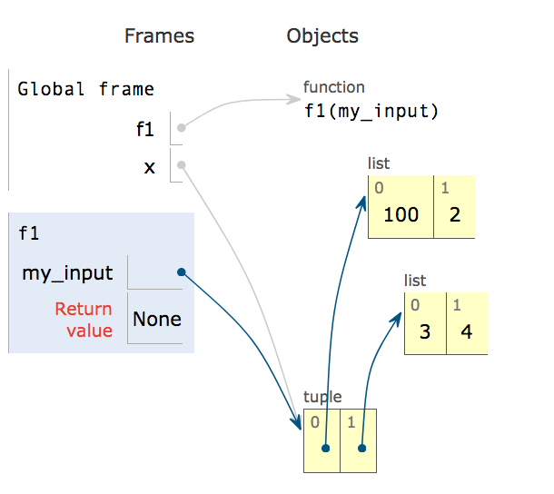
Using Immutable Objects as Function Arguments²
If the the immutable object has mutable components, changes to the mutable components are possible and these changes can become visible outside the function
def f1(my_input):
my_input[0][0] = 100
>>> x = ([1,2],[3,4])
>>> f1(x)
>>> print(x)
([100, 2], [3, 4])
The value of variable x was affected by the execution of f1()

Slide 11
Recap: Aliasing and Functions - 1
In Python, arguments are passed to functions by reference.
In other words, links to objects are passed to functions, NOT copies of the objects.
If the object being passed to a function is:
mutable (e.g., a list, dictionary, set), if a function modifies the object passed as an argument, the change is visible outside the function (the function is said to produce “side effects”);
immutable (e.g., integer, string, tuple): it is not possible to change anything about that object in the function (no side effects)

Slide 12
Recap: Aliasing and Functions - 2
Aliasing can be helpful, but if you do not intend for the function to change a mutable object, create a copy of the mutable object and pass that to functions, or use copies of the mutable object inside functions and change those.
>>> x = [1, 2, 3, 4]
>>> y = x
>>> print(x is y)
True
Aliasing:
Copying 1:
Copying 2:
Copying 3:
>>> x = [1, 2, 3, 4]
>>> y = x[:]
>>> print(x is y)
False
>>> x = [1, 2, 3, 4]
>>> y = list(x)
>>> print(x is y)
False
>>> y = [1, 2, 3, 4]
>>> x = y.copy()
>>> print(x is y)
False

Slide 13
Review of Lecture
Advanced Functions

Slide 14
Optional Parameters - Default Values
Parameters can be set up in function definitions to have default values
=> these values are optional and you don’t need to specify them when calling the function
Example: sep, end, file and flush are optional parameters in print()
>>> help (print)
print(...)
print(value, ..., sep=' ', end='\n', file=sys.stdout, flush=False)
Prints the values to a stream, or to sys.stdout by default.
Optional keyword arguments:
file: a file-like object (stream); defaults to the current sys.stdout.
sep: string inserted between values, default a space.
end: string appended after the last value, default a newline.
flush: whether to forcibly flush the stream.

Slide 15
Optional Parameters in Built-in Functions
Example: in function print(), the default values of the optional parameters sep and end are a blank space and '\n' (the newline marker), respectively:
We can specify different values for sep and end:
>>> print("one", "two", "three", "four")
one two three four
>>> print("one", "two", "three", "four", sep = '...', end = "!!!")
one...two...three...four!!!!

Slide 16
Optional Parameters in User-defined Functions
Optional parameters can also be defined in user-defined functions
def func(x, y = 2):
return x * y
# the y parameter takes on the default value 2
print('Using the default value:', func(3))
# the default value of y is overriden
print('Default value overridden:', func(3, 5))
When using the default value func() returns 6
When the default value is overridden, func() returns 15

Slide 17
Review of Lecture
Program Input and Output - Files

Slide 18
Opening Files
The general form for opening a file is:
open(file_path, mode)
mode can be:
'r' for reading
'w' for writing
'a' for appending
'r+' for reading and writing
'a+' for appending and reading
open()returns a file object.

Slide 19
Writing to a File
The following statement opens the file for writing (note parameter mode is set to 'w')
myfile = open("test.txt", "w")
To write something to the file we can use the write method of the file object:
myfile.write("My first file ...")
Once we have finished with the file, we need to close it:
myfile.close()
my_file is a file object

Slide 20
Reading a file
Approach | Code | When to use it
The read approach | myfile = open(filename, ‘r’) contents = myfile.read() myfile.close() | When you want to read the whole file at once and use it as a string
The readline approach | myfile = open(filename, ‘r’) contents = ‘’ line = myfile.readline() contents = contents + line while line != ‘’: contents += myfile.readline() myfile.close() | When you want to process only part of a file
The for line in file approach | myfile = open(filename, ‘r’) contents = ‘’ for line in myfile: contents += line myfile.close() | When you want to process every line in the file one at a time
The readlines approach | myfile = open(filename, ‘r’) lines = myfile.readlines() myfile.close() | When you want to examine each line of a file by index

Slide 21
File I/O with Context Managers - the with statement
Every time we open a file we must also close it.
Python allows us to use context managers, which will automatically close files when the context is exited.
We can create context managers using the with statement.
Example:
There’s no need to call the close()method within the with statement.
The file opened in the context manager used by the with statement will be closed automatically when the context is exited.
open() returns a context manager object
with open('test.txt', 'r') as file:
contents = file.read()
>>> contents
'Hello world!\nHello world again!'

Slide 22
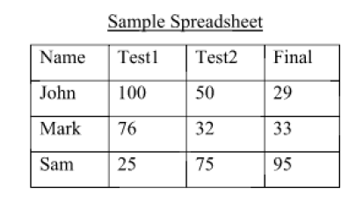
File I/O – Working with CSV Files
CSV files are text files containing values separated by commas.
To read the contents of a CSV file 'grades.csv'using a context manager:
NOTE: contents is a string containing all the data in the CSV file (the rows are separated by new line characters and the “columns” are separated by commas)
with open('grades.csv', 'r') as file:
contents = file.read()
>>> contents
'Name,Test1,Test2,Final\nJohn,100,50,29\n,Mark,76,32,33\nSam,25,75,95\n'

Slide 23
File I/O – Working with CSV Files using the CSV reader Class of the CSV module¹
The csv module provides functions that work with CSV files
Method csv.reader() takes a csv file object as input and returns a csv reader object that holds the content of the file
The csv reader object can be iterated through

Slide 24
File I/O – Working with CSV Files using the CSV reader Class of the CSV module²
import csv
with open('grades.csv', 'r') as csvfile:
grades_reader = csv.reader(csvfile)
row_num = 1
for row in grades_reader:
print('Row #', row_num, ':', row)
row_num += 1
Open the csv file and create a csv reader object
Iterate through each row in the csv reader object
Display the content of the file to the standard output
Row # 1 : ['Name', 'Test1', 'Test2', 'Final']
Row # 2 : ['John', '100', '50', '29']
Row # 3 : ['Mark', '76', '32', '33']
Row # 4 : ['Sam', '25', '75', '95']
Output

Slide 25
Practice Problems

Slide 26


What does the following code output?
ⓘ Start presenting to display the poll results on this slide.
Notes:
📣 This is Slido interaction slide, please don't delete it. ✅ Click on 'Present with Slido' and the poll will launch automatically when you get to this slide.

Slide 27
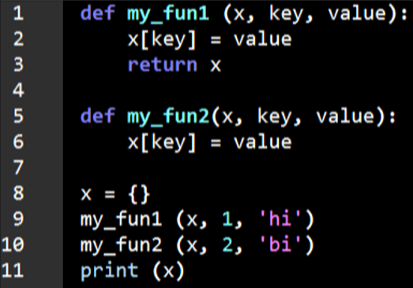
Review Practice Problem 1
Q1. What does the following code output?
{1: 'hi'}
{1: 'hi', 2: 'bi'}
{2: 'bi'}
{2: 'bi', 1: 'hi’}
None of the above

Slide 28
Review Practice Problem 1
Q1. What does the following code output?
{1: 'hi'}
{1: 'hi', 2: 'bi'}
{2: 'bi'}
{2: 'bi', 1: 'hi’}
None of the above

Slide 29
What does the following code output?
ⓘ Start presenting to display the poll results on this slide.
Notes:
📣 This is Slido interaction slide, please don't delete it. ✅ Click on 'Present with Slido' and the poll will launch automatically when you get to this slide.

Slide 30
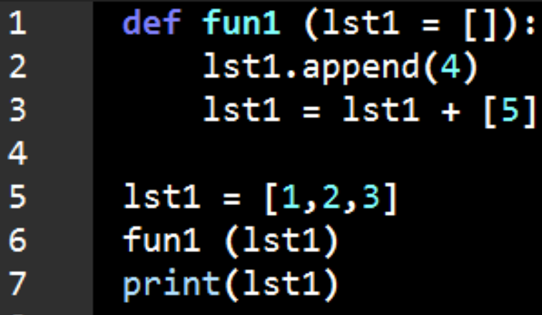
Review Practice Problem 2
Q2. What does the following code output?
[1, 2, 3]
None
[1, 2, 3, 4, 5]
[1, 2, 3, 4]
Error

Slide 31
Review Practice Problem 2
Q2. What does the following code output?
[1, 2, 3]
None
[1, 2, 3, 4, 5]
[1, 2, 3, 4]
Error

Slide 32
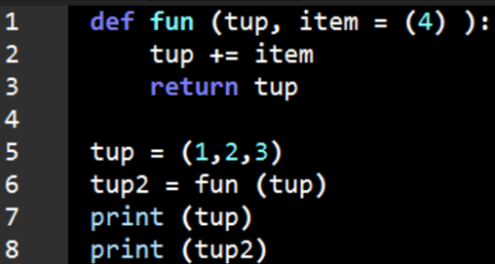
Review Practice Problem 3
Q3. What does the following code output?
(1, 2, 3) (1, 2, 3, 4)
(1, 2, 3, 4) (1, 2, 3, 4)
(1, 2, 3) (1, 2, 3, 4) (4,)
None (1, 2, 3, 4)
Error

Slide 33
What does the following code output? Note: ' | ' refers to a new line
ⓘ Start presenting to display the poll results on this slide.
Notes:
📣 This is Slido interaction slide, please don't delete it. ✅ Click on 'Present with Slido' and the poll will launch automatically when you get to this slide.

Slide 34
Review Practice Problem 3
Q3. What does the following code output?
(1, 2, 3) (1, 2, 3, 4)
(1, 2, 3, 4) (1, 2, 3, 4)
(1, 2, 3) (1, 2, 3, 4) (4,)
None (1, 2, 3, 4)
Error

Slide 35
Coding Question 1
Write a Python function count_vowels to count the frequency of vowels in a file. count_vowels takes takes as input a file path and returns a dictionary with items vowel : vowel frequency. (The input file is provided on Tutorial Quercus page. )
Usage example:
>>> count_vowels(</path/to/file>)
{'a': 29, 'e': 40, 'i': 40, 'o': 29, 'u': 4}

Slide 36
Coding Question 2
Write a Python function maximal_subsets() that takes in a string representing the path to a csv file where each line is a set of numbers and returns a list with the maximal subsets in that file. A maximal subset is a set that is not a subset of another.
For example, when run on a file with content:
1, 2, 3
1, 2, 3
1, 2
2, 3
2, 4
maximal_subsets() returns
[{1, 2, 3}, {1, 2, 3}, {2, 4}]

Slide 37
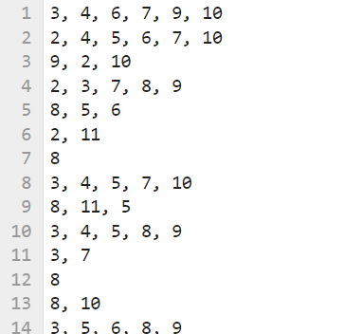
Coding Question 2: Step 1
The each line of the input is a set of numbers
Step 1: Convert the file into a list of sets.
For example:
[{3, 4, 6, 7, 9, 10}, {2, 4, 5, 6, 7, 10}, {2, 9, 10}, ... ]

Slide 38
Coding Question 2: Step 2
Step 2: Given the list of sets, find the maximal subsets (i.e. remove all sets that are subsets of other sets in the list).
Example:
the maximal subsets in:
[{1, 2, 3}, {1, 2, 3}, {1, 2}, {2, 3}, {2, 4}]
are:
[{1, 2, 3}, {1, 2, 3}, {2, 4}]

Slide 39

Any Questions?
ⓘ Start presenting to display the poll results on this slide.
Notes:
📣 This is Slido interaction slide, please don't delete it. ✅ Click on 'Present with Slido' and the poll will launch automatically when you get to this slide.

