Slide 1
Tutorial 12 - Week 13
We’ll be starting at the 10 minute mark

Slide 2
Agenda
Linked Lists review
Lecture review
Binary Trees
Practice questions

Slide 3
Learning Objectives
After this tutorial, learners should be able to:
recognize / describe / create Python classes
recognize / describe / create data attributes
recognize / describe / create class data attributes
recognize / describe / create instance data attributes
recognize / describe / create methods
recognize / describe / create class initializers (__init__)
recognize / describe / create non-initializer methods
recognize / describe / create Python objects
call methods on class / class instance objects
recognize / describe / create linked data structures:
recognize / describe / create linked binary trees

Slide 4
Review
Linked Data structures: Linked Lists

Slide 5
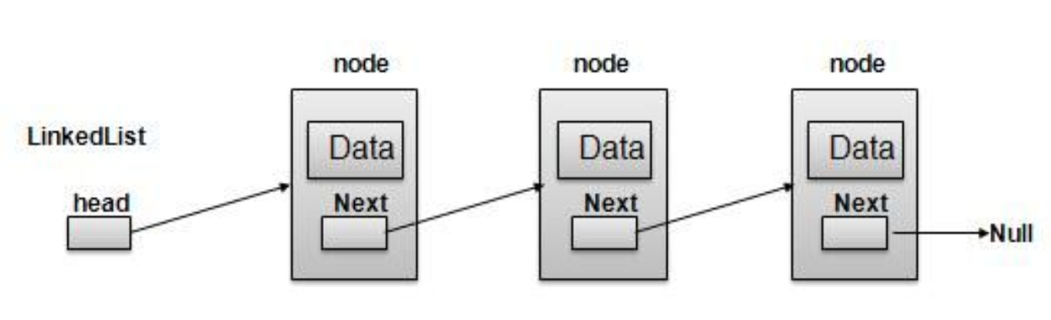
Linked Lists review
Linear collection of elements, known as of nodes
Each node contains data (called cargo in lecture) and a link to the next element in the list
Linked lists are typically implemented using a container class (called LinkedList in lecture) endowed with various operations.
A typical class for representing linked lists would have (1) an attribute to keeps track of the first element of the linked list and an attribute to store the length of the list (called head and length, respectively, in the lecture examples) and (2) methods for various operations, such as adding a first element, adding a last element and removing the first element (called add_first, add_last and remove_item in the lecture examples).
Node1
Node2
Node3
Node4
Head
Length is 4
None

Slide 6
Review of Lecture
Linked Data structures: Binary Trees

Slide 7
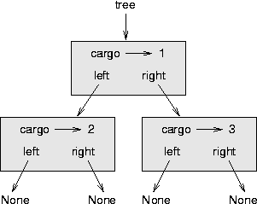
Binary Trees
Instead of organizing elements in a “chain”, aka a linked list, we can organize them in a tree !
Like linked lists, binary trees are collections of elements known as Nodes.
Each node of a binary tree contains references to two nodes, referred to as the left and right children.
A typical binary tree Node contains data attributes
to store data (called cargo in the lectures)
to store the address of the left child (called left in lectures)
to store the address of the right child (called right in lectures)
NOTE: These are the attribute naming conventions used in this course.
You can use other attribute names, if you wish.

Slide 8
Operations on Binary Trees
Insert a new node (at the root, at a specific position, etc.)
Delete/Remove a node (the root, with a given value, etc.)
Update a node (modify a node’s value and/or links to child nodes)
Search for/Retrieve a node with a given value
Display/Print the tree

Slide 9
How do you set-up a (linked) binary tree?

Slide 10
Option 1: use a class (for tree elements) - 1
We use a class for the elements of the collection and link the elements to each other.
We start by creating a Node class
A node has three data attributes: cargo (i.e., the data/value of the node), left and right (i.e., the links to the left child node and the right child node)
class Node:
def __init__(self, cargo = None, left = None, right = None):
self.cargo = cargo
self.left = left
self.right = right

Slide 11
Option 1: use a class (for tree elements) - 2
We also implement the __str__ method to return a string representation of each node
def __str__(self):
return str(self.cargo)

Slide 12
Operations on Binary Trees
Insert a new node (at the root, at a specific position, etc.)
Delete/Remove a node (from the root, from a specific position, etc.)
Update a node (modify a node’s value and/or link to the left/right child node)
Search for/Retrieve a node with a given value
Display/Print the tree

Slide 13
Option 1: Creating a Tree and Inserting Elements
Now, let’s create some nodes and link them together to create a binary tree
# create two “ independent” nodes, i.e., left and right attributes are set to None
left_node = Node(2)
right_node = Node(4)
# create a binary tree
# tree_root is the node at the root of the tree
tree_root = Node(0, left_node, right_node)
# add three more nodes to the tree
# a node with cargo 6 as the left child of the left child of the root
left_node.left = Node(6)
# a node with cargo 10 as the left child of the right child of the root
# a node with cargo 12 as the right child of the right child of the root
right_node.left = Node(10)
right_node.right = Node(12)
0
2
4
6
10
12
The nodes with cargo values 6, 10 and 12 are referred to as leaf nodes.

Slide 14
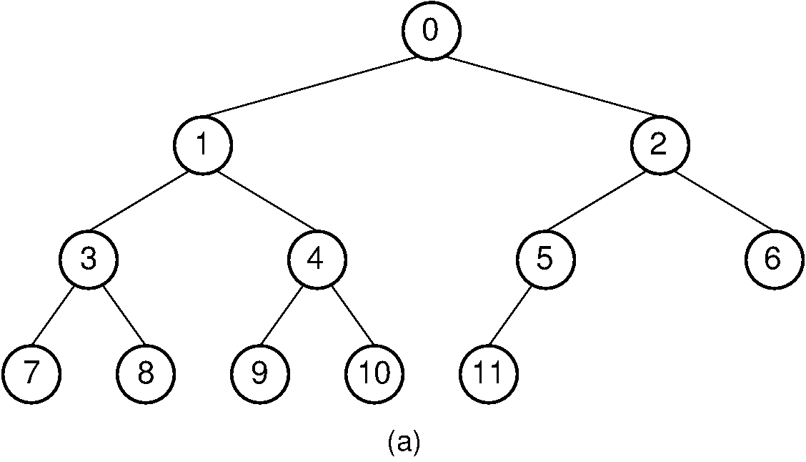
Code-along
Let’s work together to create the following binary tree in Python. We will use the Node class defined in the previous slides, including the print_tree method to visualize the tree.

Slide 15
Option 2: use a container Class
While a binary tree can be implemented using just the Node class, you can also create a class to represent binary trees. For example:
class BinaryTree:
def __init__ (self):
self.size = 0 #attribute to keep track of the size of the tree
self.root = None #attribute to keep track of root node of the tree

Slide 16
Operations on Binary Trees
Insert a new node (at the root, at a specific position, etc.)
Delete/Remove a node (from the root, from a specific position, etc.)
Update a node (modify a node’s value and/or link to the left/right child node)
Search for/Retrieve a node with a given value
Display/Print the tree

Slide 17
Displaying/Printing binary trees
Method to visualize the tree:
def print_tree(self):
…

Slide 18
Practice Problem

Slide 19
Operations on Binary Trees
Insert a new node (at the root, at a specific position, etc.)
Delete/Remove a node (from the root, from a specific position, etc.)
Update a node (modify a node’s value and/or link to the left/right child node)
Search for/Retrieve a node with a given value
Display/Print the tree

Slide 20
Coding Question
Let’s extend the BinaryTree class we created. Let’s write a method min() for the BinaryTree class that returns the element in the tree with the smallest cargo. We assume that the tree is not empty.
If there are multiple nodes that contain the lowest value,
return the one that is closest to the root.
If there are multiple nodes that have the same minimal cargo value and are at the same distance from the root.
return the left-most among them.
Note: the distance of a node n to the root r of a tree is calculated as the number of parent nodes of n on the path from the root to n, including the root itself. Nodes that are the same distance from the root of the tree are said to be on the the same level in the tree.

Slide 21

THANK YOU FOR A GREAT SEMESTER!!
Python Program to Draw Smiley Face Emoji Using Turtle

Slide 22


Any questions!?
ⓘ Start presenting to display the poll results on this slide.
Notes:
📣 This is Slido interaction slide, please don't delete it. ✅ Click on 'Present with Slido' and the poll will launch automatically when you get to this slide.

