Slide 1
The Programming Process.
Week 1 | Lecture 3 (1.3)

Slide 2
This Week’s Content
Lecture 1.1
Introduction
Lecture 1.2
Variables, Expressions, and Operators
Chapters 1,2, and 3
Lecture 1.3
The Programming Process

Slide 3
Recap: What is Programming?
We need to tell it what to do CORRECTLY
A way of telling a computer what to do.
A computer can’t infer (…yet).
Need to tell a computer every single step it needs to do in a language it can understand.
How would you request an egg for breakfast to a chef and to a computer/robot?
To a Chef
Sunny-side up, please!
To a Computer
“Turn on stove”
“Take out pan”
“Take one egg out of fridge”
“Crack egg”
“Pour egg into pan”
“Wait 5 minutes”
Notes:
We need to tell the computer exactly what to do, correctly.

Slide 4

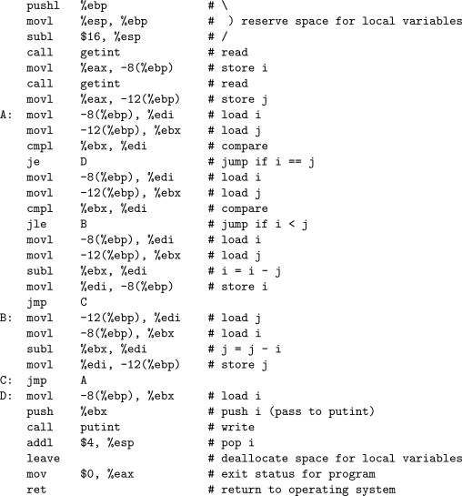
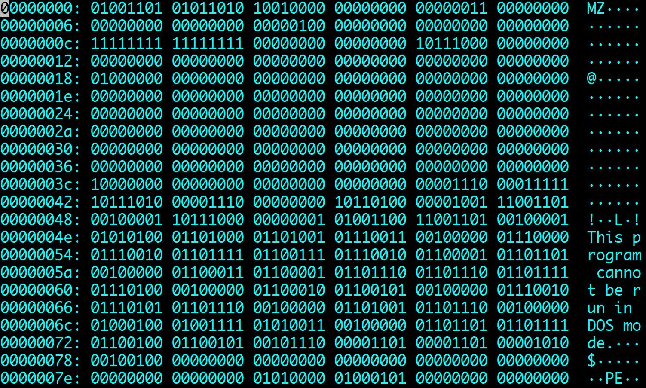
Recap: The power of programming languages
if x > 10:
print(”x is greater than 10”)
Notes:
It’s our responsibility to correctly tell the computer what to do. Machine code works. I’ve almost never come across a problem where the problem is the computer itself, and where it was – it was the computer didn’t have enough memory to do what I was asking it to because I wasn’t asking it in an efficient enough way.

Slide 5
Recap: Arithmetic Operators
Operator
Operation
Expression
English description
Result
+ | addition | 11 | + | 56 | 11 plus 56 | 67
- | subtraction | 23 | - | 52 | 23 minus 52 | -29
* | multiplication | 4 | * 5 |  | 4 multiplied by 5 | 20
** | exponentiation | 2 | ** | 5 | 2 to the power of 5 | 32
/ | division | 9 | / 2 |  | 9 divided by 2 | 4.5
// | integer division | 9 | // | 2 | 9 divided by 2 | 4
% | modulo (remainder) | 9 | % 2 |  | 9 mod 2 | 1

Slide 6
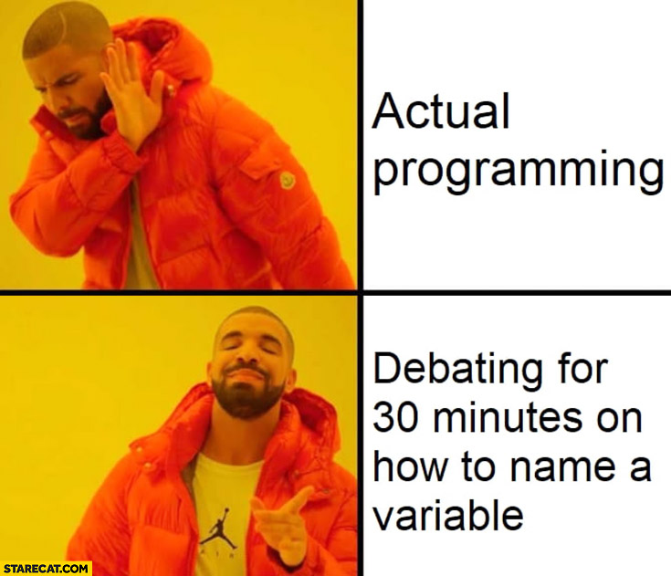
Recap: Variable Names and Conventions
The rules for legal Python names:
Names must start with a letter or _ (underscore)
Names must contain only letters, digits, and _
In most situations, the convention is to use pothole_case
Lowercase letters with words separated by _ to improve readability
Try to add meaning where possible!
Ex: gas_mileage and cost_per_litre instead of nomnom and nomnomnom
Save yourself when debugging & put your TAs in a good mood when marking

Slide 7
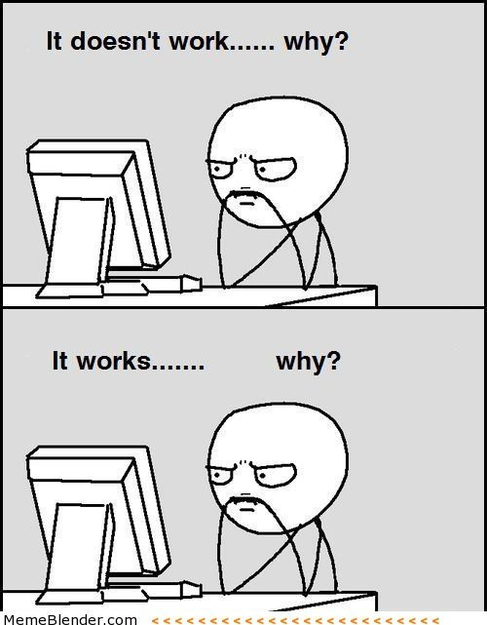
Programming Guide
Readability
If nothing else, write #cleancode
Comments
Save yourself from yourself
Lots of testing!
Modular code (you will learn about functions next week)
Test often and with purpose
Understanding errors
Types of errors
Error codes
Always have a plan!
Notes:
Tell story about getting hired back to add features to GoodVibes over a year later and coming back to absolute garbage

Slide 8
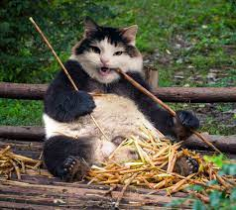
Readability Tips (#cleancode)
>>> canda = cat + panda
Use whitespace to separate variables and operators
>>> canda=cat+panda
Be consistent with spacing, too much whitespace can be bad
>>> canda = cat +panda
Pick variable names that are easy to read and interpret
>>> canda = nom + nomnomnomnomnom
Be consistent with naming schemes
>>> Canda = CAT + _panda42

Slide 9
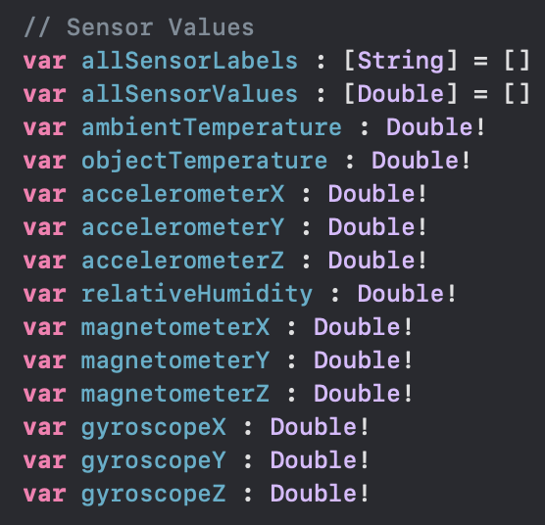
Comments
Comments are to help you, and anyone else who is reading/using your code, to remember or understand the purpose of a given variable or function in a program.
A comment begins with the number sign (#) and goes until the end of the line.
Python ignores any lines that start with the (#) character
Warning! This is not Python! It is an example from one of my iOS apps I had to come back to after a few years. Comments are (//) in Swift instead of (#) in Python

Slide 10
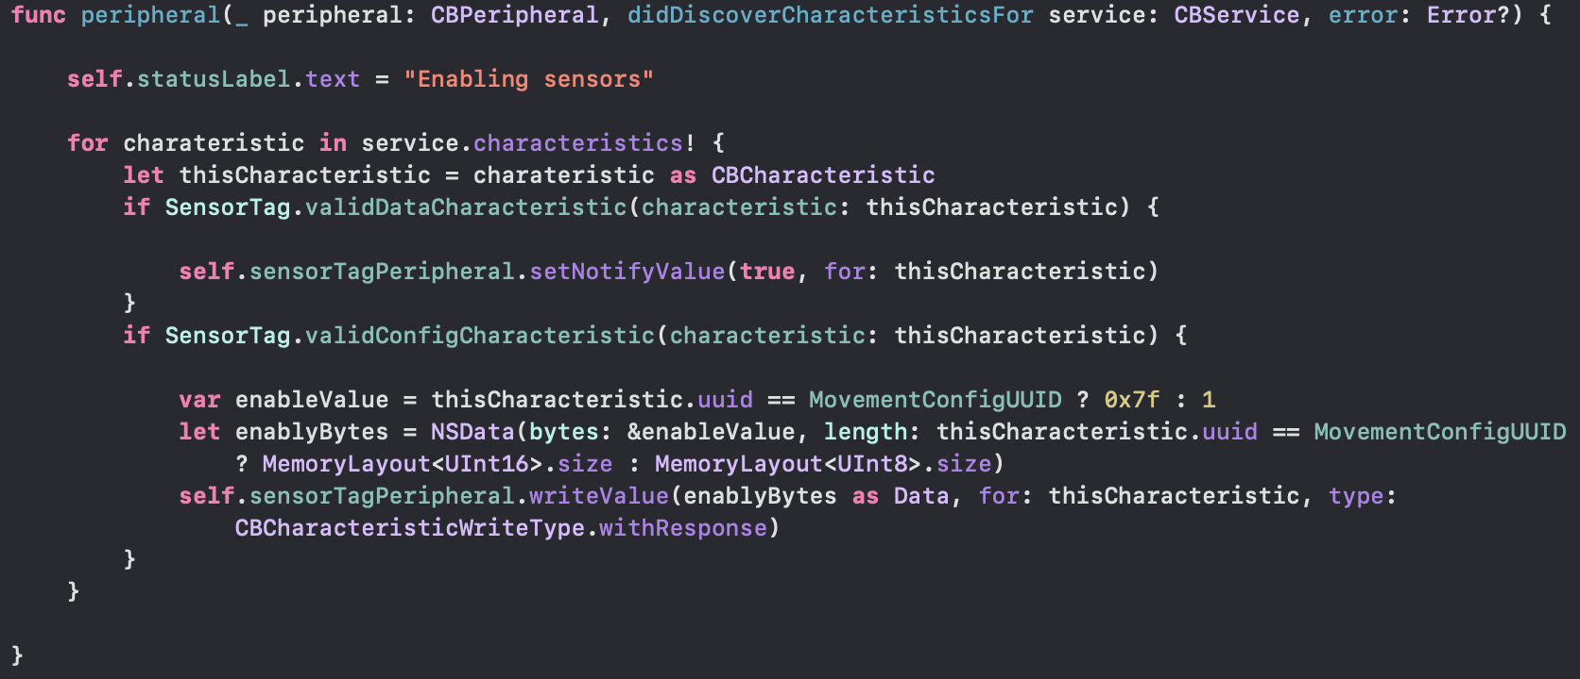
Warning! This is not Python! It is an example from one of my iOS apps I had to come back to after a few years. Comments are (//) in Swift instead of (#) in Python

Slide 11
Testing!
The more lines of code you write, the more likely it is that you will make a mistake and the harder it will be to find the mistake
“like finding a needle in a haystack”
Test your code as you write it
Requires you understanding what specific output an input will provide
”Modular code”
Test in small chunks or “modules”
Put a test input into the beginning where you know what the output is and see what you get!
Golden Rule: Never spend more than 15 minutes programming without testing

Slide 12
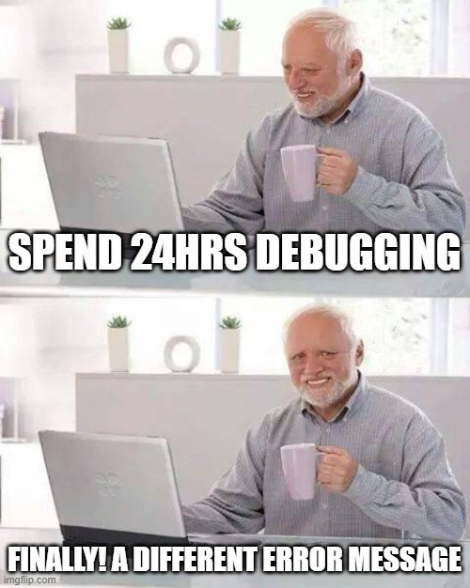
Error Reduction vs Debugging
It is pretty much impossible to write code without errors.
Error Reduction: techniques we can use to reduce the number and severity of errors.
Debugging: techniques for identifying and correcting errors

Slide 13
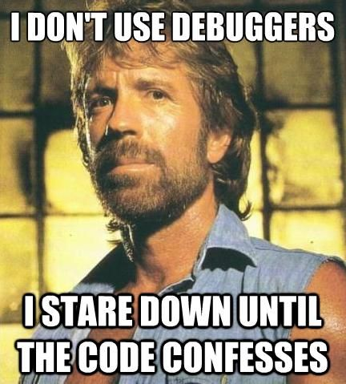
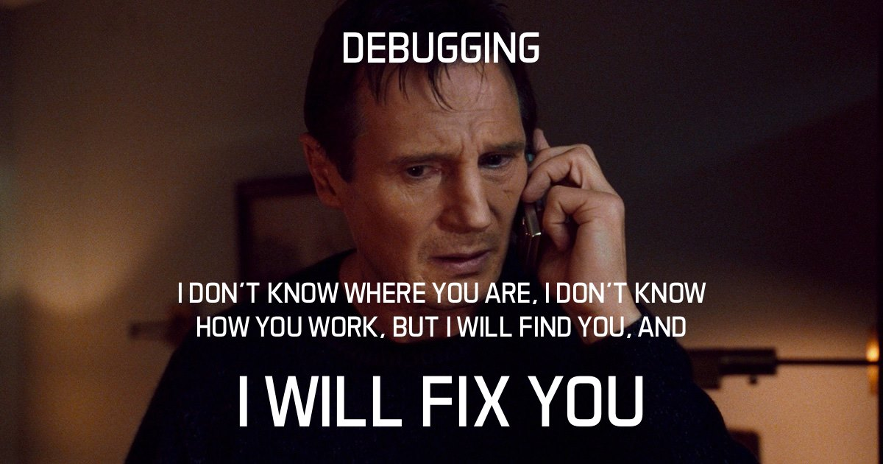
Which student will you be?

Slide 14
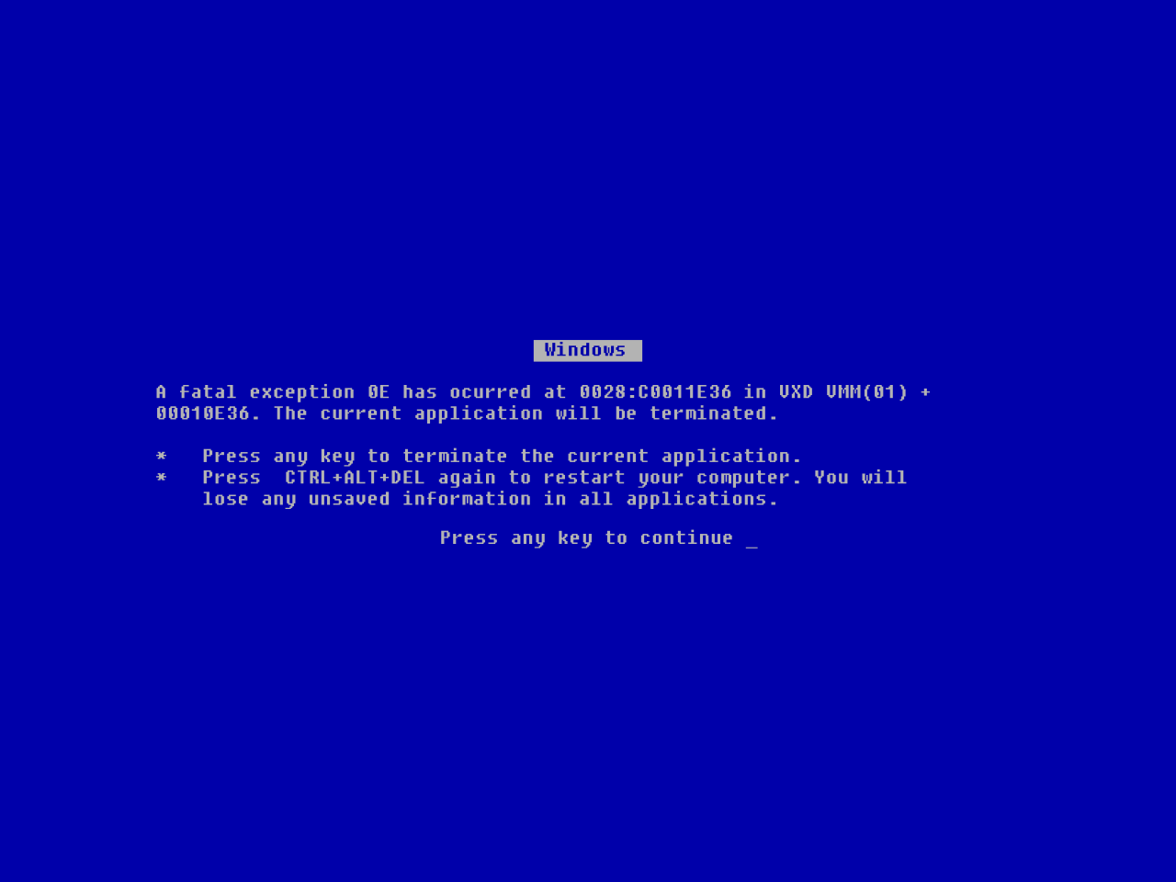

Slide 15
Types of Errors
Syntax error
Semantic error
Logical error
Runtime error

Slide 16
Syntax Errors
Syntax error: results when the programming language cannot understand your code.
Examples: missing an operator or two operators in a row, illegal character in a variable name, missing a parentheses or bracket etc.
In English, a syntax error is like a spelling error
>>> 3) + 2 * 4
Syntax Error: unmatched ')’: line 1, pos 2

Slide 17
Semantic Errors
Semantic error: results from improper use of the statements or variables.
Examples: using an operator not intended for the variable type, calling a function with the wrong argument type, or wrong number of arguments, etc.
In English, a semantic error is like a grammar error
>>> “Hello” - 4
TypeError: unsupported operand type(s) for -: 'str' and 'int’
>>> number = number * 2
NameError: name 'number' is not defined

Slide 18
Runtime Errors
Runtime error: is an error that occurs during the execution (runtime) of a program. Generally do not occur in simple programs.
The code could run fine most of the time, but in certain circumstances the program may encounter an unexpected error and crash.
Examples: infinite loops, attempting to access an index out of bounds, etc.
>>> x = 10
>>> while x > 0:
print(”This is the song that never ends”)

Slide 19
Logical Errors
Logical Error: results from unintended result due to a miscalculation or misunderstanding of specifications.
Examples: miscalculation, typo, misunderstanding of requirements, indentation mistakes, operator precedence, integer instead of floating-point division, etc.
Most difficult to fix because the code will execute without crashing. There are no error messages produced.

Slide 20
Logical Error Examples
71.6 degrees F is about 22 degrees C
>>> fahrenheit = 71.6
>>> celsius = fahrenheit – 32 * 5/9
>>> celsius
53.822222222222216
>>> fahrenheit = 716
>>> celsius = (fahrenheit – 32) * 5/9
>>> Celsius
380.0
Correct logic: celsius = (fahrenheit – 32) * 5/9
Whoops, typo! Forgot the decimal.

Slide 21
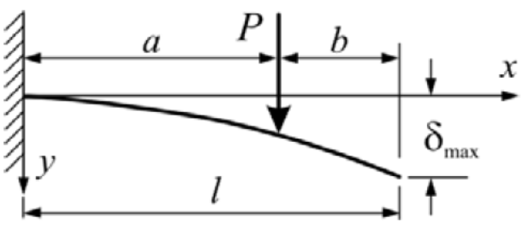


Let’s Practice!
The diagram and formula below introduces variables for the calculation of the deflection in a beam. Write a program that can calculate the $δmax$, or deflection of a beam.
Open your notebook
Click Link:
1. Calculate Deflection of a Beam

Slide 22
Planning an Essay
How do you start writing an essay?
Read the question carefully and with intent
Think about what information was provided in the topic that you should include in your answer
Brainstorm different ways to answer the question
Skim through course material to see what could help
Scaffold or quickly structure each paragraph
Figure out what you want to conclude and think of ways to get there
Make sure each section has purpose (you aren’t repeating yourself)
Think about order (what needs to be said at the beginning vs what needs to be said at the end)
Notes:
Ask chat to answer
I know this is painful

Slide 23
Planning Code
How do you start writing code?
Read the question carefully and with intent
Think about what information was provided in the topic that you should include in your answer
Brainstorm different ways to answer the question
Skim through course material to see what could help
Scaffold or quickly structure each paragraph
Figure out what you want to conclude and think of ways to get there
Make sure each section has purpose (you aren’t repeating yourself)
Think about order (what needs to be said at the beginning vs what needs to be said at the end)
Notes:
Tricked you! Samesies!

Slide 25
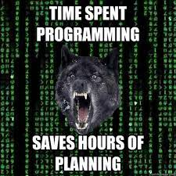

Please… please… PLEASE have a plan!
Open your notebook
Click Link:
2. Calculating Chemical Rate Constants

Slide 26
The Programming Process.
Week 1 | Lecture 2 (1.2)

