Slide 1
APS106 Design Problem Gaussian Elimination and Least Squares
Friday March 17th, 2023

Slide 2
What’s the benefit of studying for a test?

Slide 3
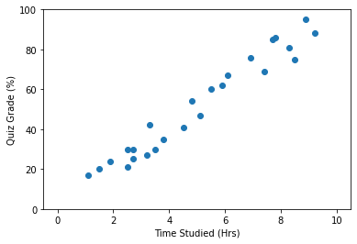
Quiz grades vs. Time spent studying
Looking at the data, there seems to be a relationship between time studied and quiz grades
More questions:
What was the expected score of students who studied 5 hours?
On average, how much higher did students score when studying an extra hour?

Slide 4
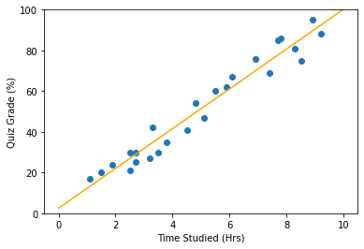

Solution: Least Squares
We can solve the linear system below to compute the line (slope and intercept) of best fit through the data!
$$X^{T}Xβ=X^{T}y$$
In today’s problem, we’ll write code to perform Gaussian elimination to solve systems of linear equations like the least squares problem
* See the starter notebook for more details on least squares

Slide 5
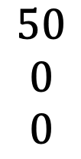
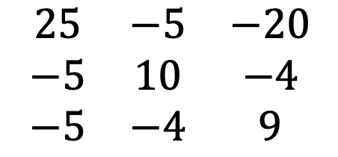
Systems of Equations
Linear system = no exponents on any variables
Systems of linear equations can be expressed in matrix form:
25𝑥₁ − 5𝑥₂ − 20𝑥₃ = 50
−5𝑥₁ + 10𝑥₂ − 4𝑥₃ = 0
−5𝑥₁ − 4𝑥₂ + 9𝑥₃ = 0
$$\begin{matrix}25 & −5 & −20 \\ −5 & 10 & −4 \\ −5 & −4 & 9\end{matrix}$$
$$\begin{matrix}50 \\ 0 \\ 0\end{matrix}$$

Slide 6
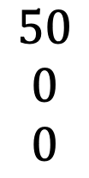
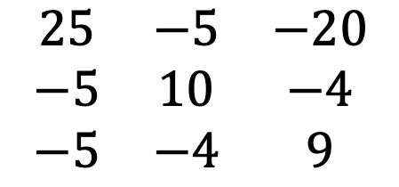

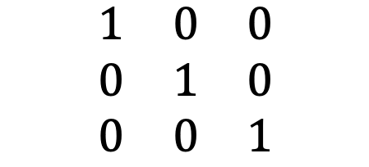
Gaussian Elimination
Method of solving system of equations
Operations Types:
Interchanging two rows
Multiplying row by non-zero constant
Add multiple of row to another row
Goal is to get our matrix into row echelon form:
$$\begin{matrix}25 & −5 & −20 \\ −5 & 10 & −4 \\ −5 & −4 & 9\end{matrix}$$
$$\begin{matrix}50 \\ 0 \\ 0\end{matrix}$$
$$\begin{matrix}1 & 0 & 0 \\ 0 & 1 & 0 \\ 0 & 0 & 1\end{matrix}$$
$$\begin{matrix}\sim 29.6 \\ 26 \\ 28\end{matrix}$$

Slide 7
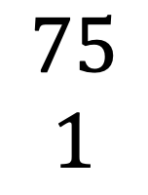
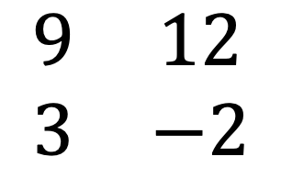
Consider this 2x2 example:
$$\begin{matrix}9 & 12 \\ 3 & −2\end{matrix}$$
$$\begin{matrix}75 \\ 1\end{matrix}$$

Slide 8
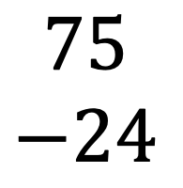
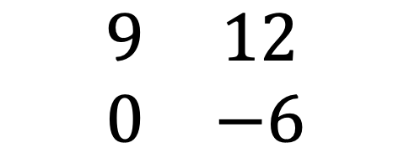
Consider this 2x2 example:
$$\begin{matrix}9 & 12 \\ 3 & −2\end{matrix}$$
$$\begin{matrix}75 \\ 1\end{matrix}$$
$$\begin{matrix}9 & 12 \\ 0 & −6\end{matrix}$$
$$\begin{matrix}75 \\ −24\end{matrix}$$
R2 – R1*(9/3)

Slide 9
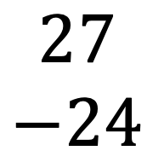
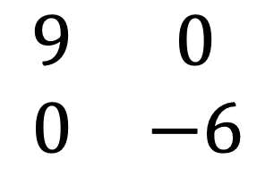
Consider this 2x2 example:
$$\begin{matrix}9 & 12 \\ 3 & −2\end{matrix}$$
$$\begin{matrix}75 \\ 1\end{matrix}$$
$$\begin{matrix}9 & 12 \\ 0 & −6\end{matrix}$$
$$\begin{matrix}75 \\ −24\end{matrix}$$
R2 – R1*(9/3)
$$\begin{matrix}9 & 0 \\ 0 & −6\end{matrix}$$
$$\begin{matrix}27 \\ −24\end{matrix}$$
R1 – R2*(-12/6)

Slide 10
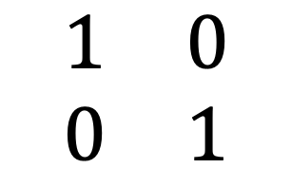
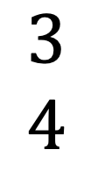
Consider this 2x2 example:
$$\begin{matrix}9 & 12 \\ 3 & −2\end{matrix}$$
$$\begin{matrix}75 \\ 1\end{matrix}$$
$$\begin{matrix}9 & 12 \\ 0 & −6\end{matrix}$$
$$\begin{matrix}75 \\ −24\end{matrix}$$
R2 – R1*(9/3)
$$\begin{matrix}9 & 0 \\ 0 & −6\end{matrix}$$
$$\begin{matrix}27 \\ −24\end{matrix}$$
R1 / 9
R2 / -6
$$\begin{matrix}1 & 0 \\ 0 & 1\end{matrix}$$
$$\begin{matrix}3 \\ 4\end{matrix}$$
R1 – R2*(-12/6)
Solution:
x1 = 3
x2 = 4

Slide 11
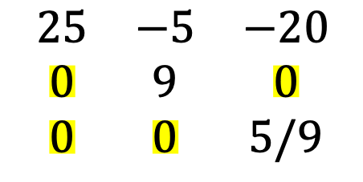
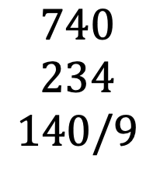
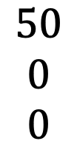
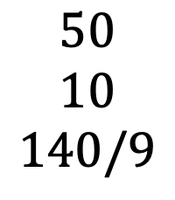
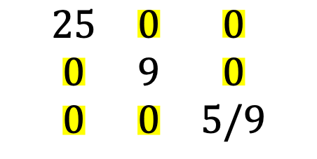
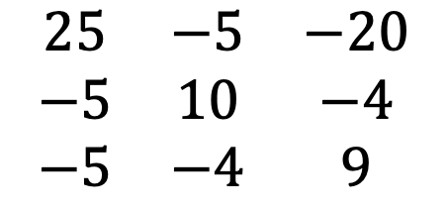
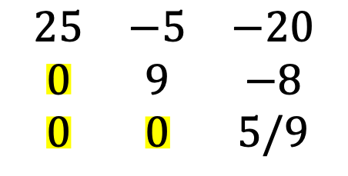
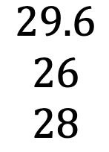
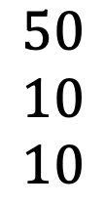
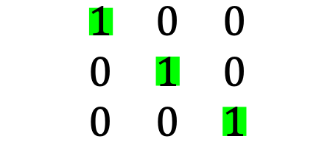
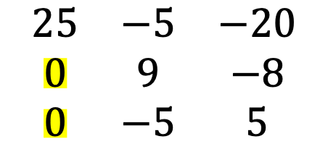
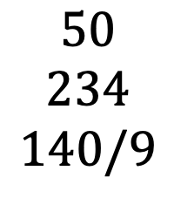
How did we do this?
$$\begin{matrix}25 & −5 & −20 \\ −5 & 10 & −4 \\ −5 & −4 & 9\end{matrix}$$
$$\begin{matrix}50 \\ 0 \\ 0\end{matrix}$$
R2 + R1/5
R3 + R1/5
$$\begin{matrix}25 & −5 & −20 \\ 0 & 9 & −8 \\ 0 & −5 & 5\end{matrix}$$
$$\begin{matrix}50 \\ 10 \\ 10\end{matrix}$$
R3 + R2 * 5/9
$$\begin{matrix}25 & −5 & −20 \\ 0 & 9 & −8 \\ 0 & 0 & 5/9\end{matrix}$$
$$\begin{matrix}50 \\ 10 \\ 140/9\end{matrix}$$
$$\begin{matrix}25 & −5 & −20 \\ 0 & 9 & 0 \\ 0 & 0 & 5/9\end{matrix}$$
$$\begin{matrix}50 \\ 234 \\ 140/9\end{matrix}$$
R2 + R3 * 14.4
R1 + R2 * 5/9
R1 + R3 * 36
R1 / 25
R2 / 9
R3 / (5/9)
$$\begin{matrix}25 & 0 & 0 \\ 0 & 9 & 0 \\ 0 & 0 & 5/9\end{matrix}$$
$$\begin{matrix}740 \\ 234 \\ 140/9\end{matrix}$$
$$\begin{matrix}1 & 0 & 0 \\ 0 & 1 & 0 \\ 0 & 0 & 1\end{matrix}$$
$$\begin{matrix}29.6 \\ 26 \\ 28\end{matrix}$$

Slide 12
Two main things happened:
To zero-out the values in individual rows, other rows are used by multiplying them by a co-efficient and subtracting them. This is true for all values in the rows, except for value n for each nth
To get to row echelon form at the end, the nth row is divided by the nth value in the equation (for example, to get the 1 coefficient for the 2nd row, the 2nd row is divided by the value in the second coefficient).

Slide 13
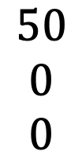
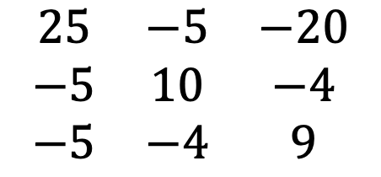
Representing a Matrix in Python
We will be using a nested list, like this:
How would you access the following elements?
The first row?
mtx1 = [[25, -5, -20, 50],
[-5, 10, -4, 0],
[-5, -4, 9, 0]]
$$\begin{matrix}25 & −5 & −20 \\ −5 & 10 & −4 \\ −5 & −4 & 9\end{matrix}$$
$$\begin{matrix}50 \\ 0 \\ 0\end{matrix}$$

Slide 14
Representing a Matrix in Python
We will be using a nested list, like this:
How would you access the following elements?
The first row? mtx1[0]
mtx1 = [[25, -5, -20, 50],
[-5, 10, -4, 0],
[-5, -4, 9, 0]]
$$\begin{matrix}25 & −5 & −20 \\ −5 & 10 & −4 \\ −5 & −4 & 9\end{matrix}$$
$$\begin{matrix}50 \\ 0 \\ 0\end{matrix}$$

Slide 15
Representing a Matrix in Python
We will be using a nested list, like this:
How would you access the following elements?
The second item in the second row?
mtx1 = [[25, -5, -20, 50],
[-5, 10, -4, 0],
[-5, -4, 9, 0]]
$$\begin{matrix}25 & −5 & −20 \\ −5 & 10 & −4 \\ −5 & −4 & 9\end{matrix}$$
$$\begin{matrix}50 \\ 0 \\ 0\end{matrix}$$

Slide 16
Representing a Matrix in Python
We will be using a nested list, like this:
How would you access the following elements?
The second item in the second row? mtx1[1][1]
mtx1 = [[25, -5, -20, 50],
[-5, 10, -4, 0],
[-5, -4, 9, 0]]
$$\begin{matrix}25 & −5 & −20 \\ −5 & 10 & −4 \\ −5 & −4 & 9\end{matrix}$$
$$\begin{matrix}50 \\ 0 \\ 0\end{matrix}$$

Slide 17
Representing a Matrix in Python
We will be using a nested list, like this:
How would you access the following elements?
The first value in every row? (i.e. the first column)
mtx1 = [[25, -5, -20, 50],
[-5, 10, -4, 0],
[-5, -4, 9, 0]]
$$\begin{matrix}25 & −5 & −20 \\ −5 & 10 & −4 \\ −5 & −4 & 9\end{matrix}$$
$$\begin{matrix}50 \\ 0 \\ 0\end{matrix}$$

Slide 18
Representing a Matrix in Python
We will be using a nested list, like this:
How would you access the following elements?
The first value in every row? (i.e. the first column) mtx1[0][0], mtx1[1][0], mtx1[2][0]
mtx1 = [[25, -5, -20, 50],
[-5, 10, -4, 0],
[-5, -4, 9, 0]]
$$\begin{matrix}25 & −5 & −20 \\ −5 & 10 & −4 \\ −5 & −4 & 9\end{matrix}$$
$$\begin{matrix}50 \\ 0 \\ 0\end{matrix}$$

Slide 19
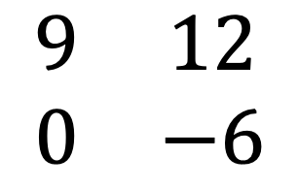
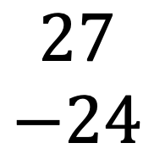
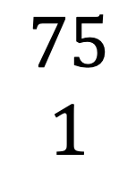
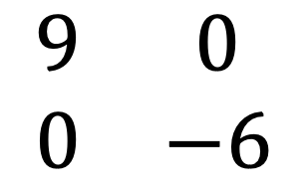
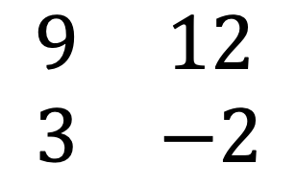
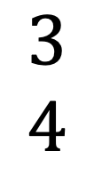
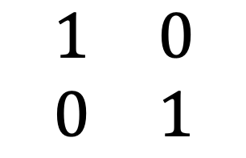
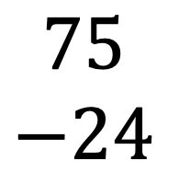
Two important functions are needed:
Get ones on diagonal:
Division by coefficient on diagonal
$$\begin{matrix}9 & 0 \\ 0 & −6\end{matrix}$$
$$\begin{matrix}27 \\ −24\end{matrix}$$
R1 / 9
R2 / -6
$$\begin{matrix}1 & 0 \\ 0 & 1\end{matrix}$$
$$\begin{matrix}3 \\ 4\end{matrix}$$
Zero-out column values (except the diagonals):
Division by coefficient product in a single column, for each value in a row
$$\begin{matrix}9 & 12 \\ 3 & −2\end{matrix}$$
$$\begin{matrix}75 \\ 1\end{matrix}$$
$$\begin{matrix}9 & 12 \\ 0 & −6\end{matrix}$$
$$\begin{matrix}75 \\ −24\end{matrix}$$
R2 - R1* (9/3)

Slide 20
Review of Lecture Content

Slide 21
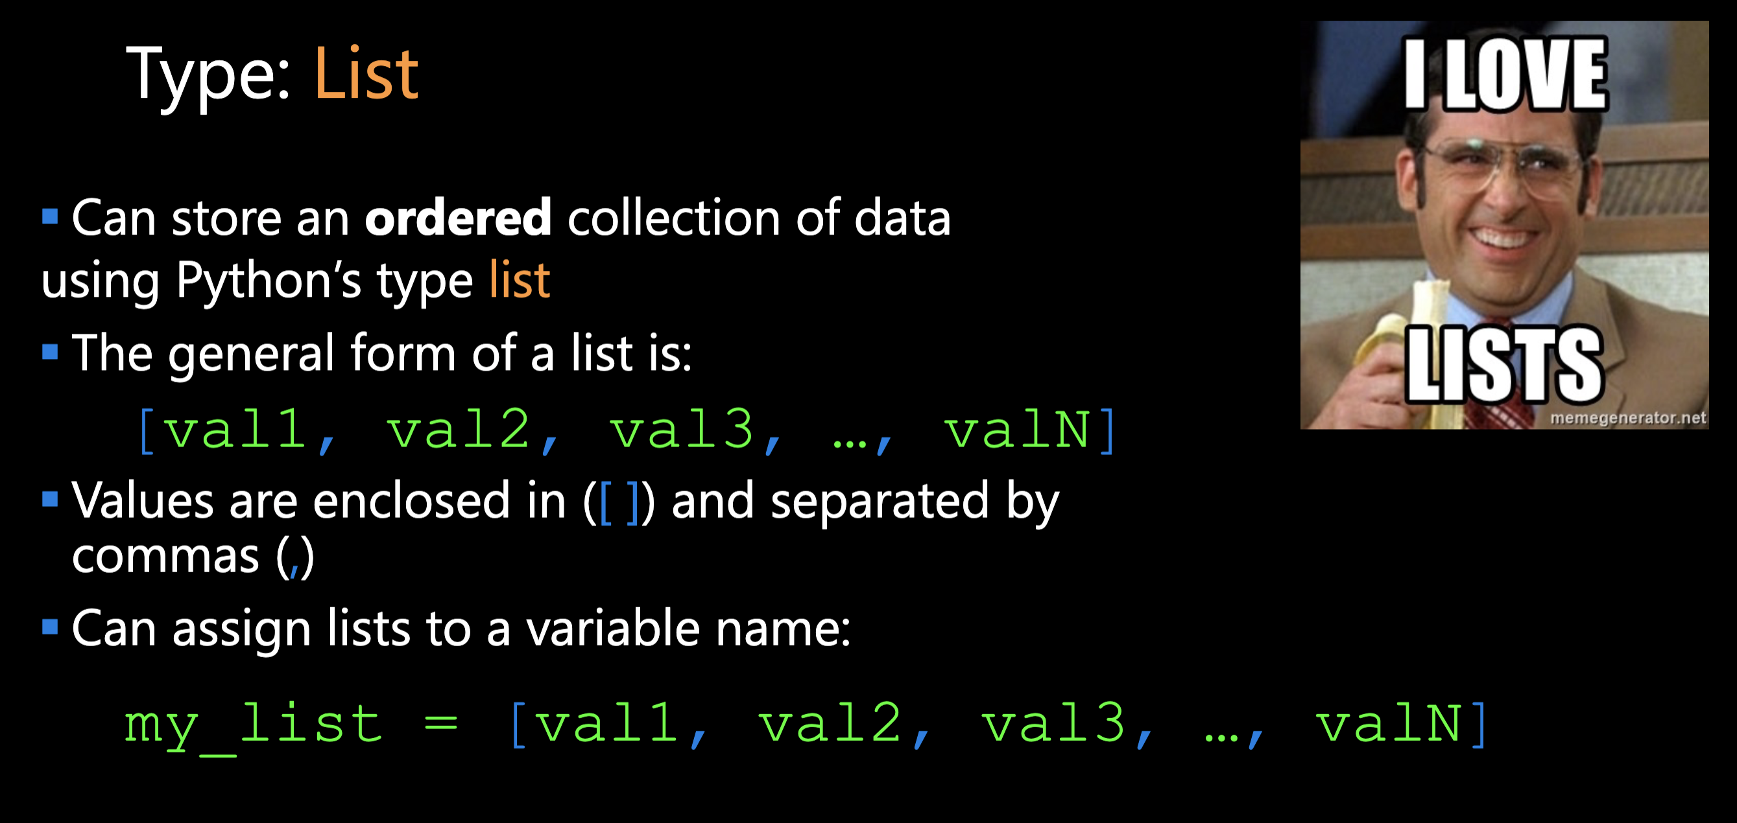

Slide 22
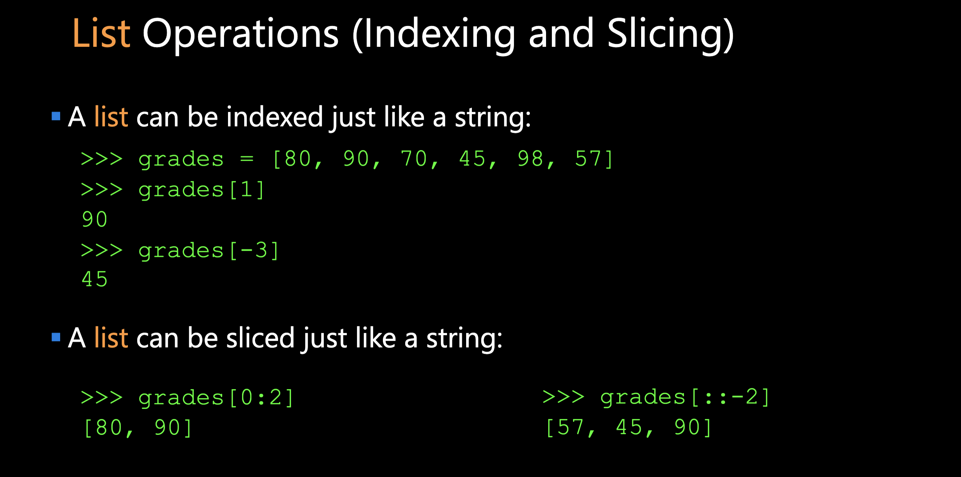

Slide 23
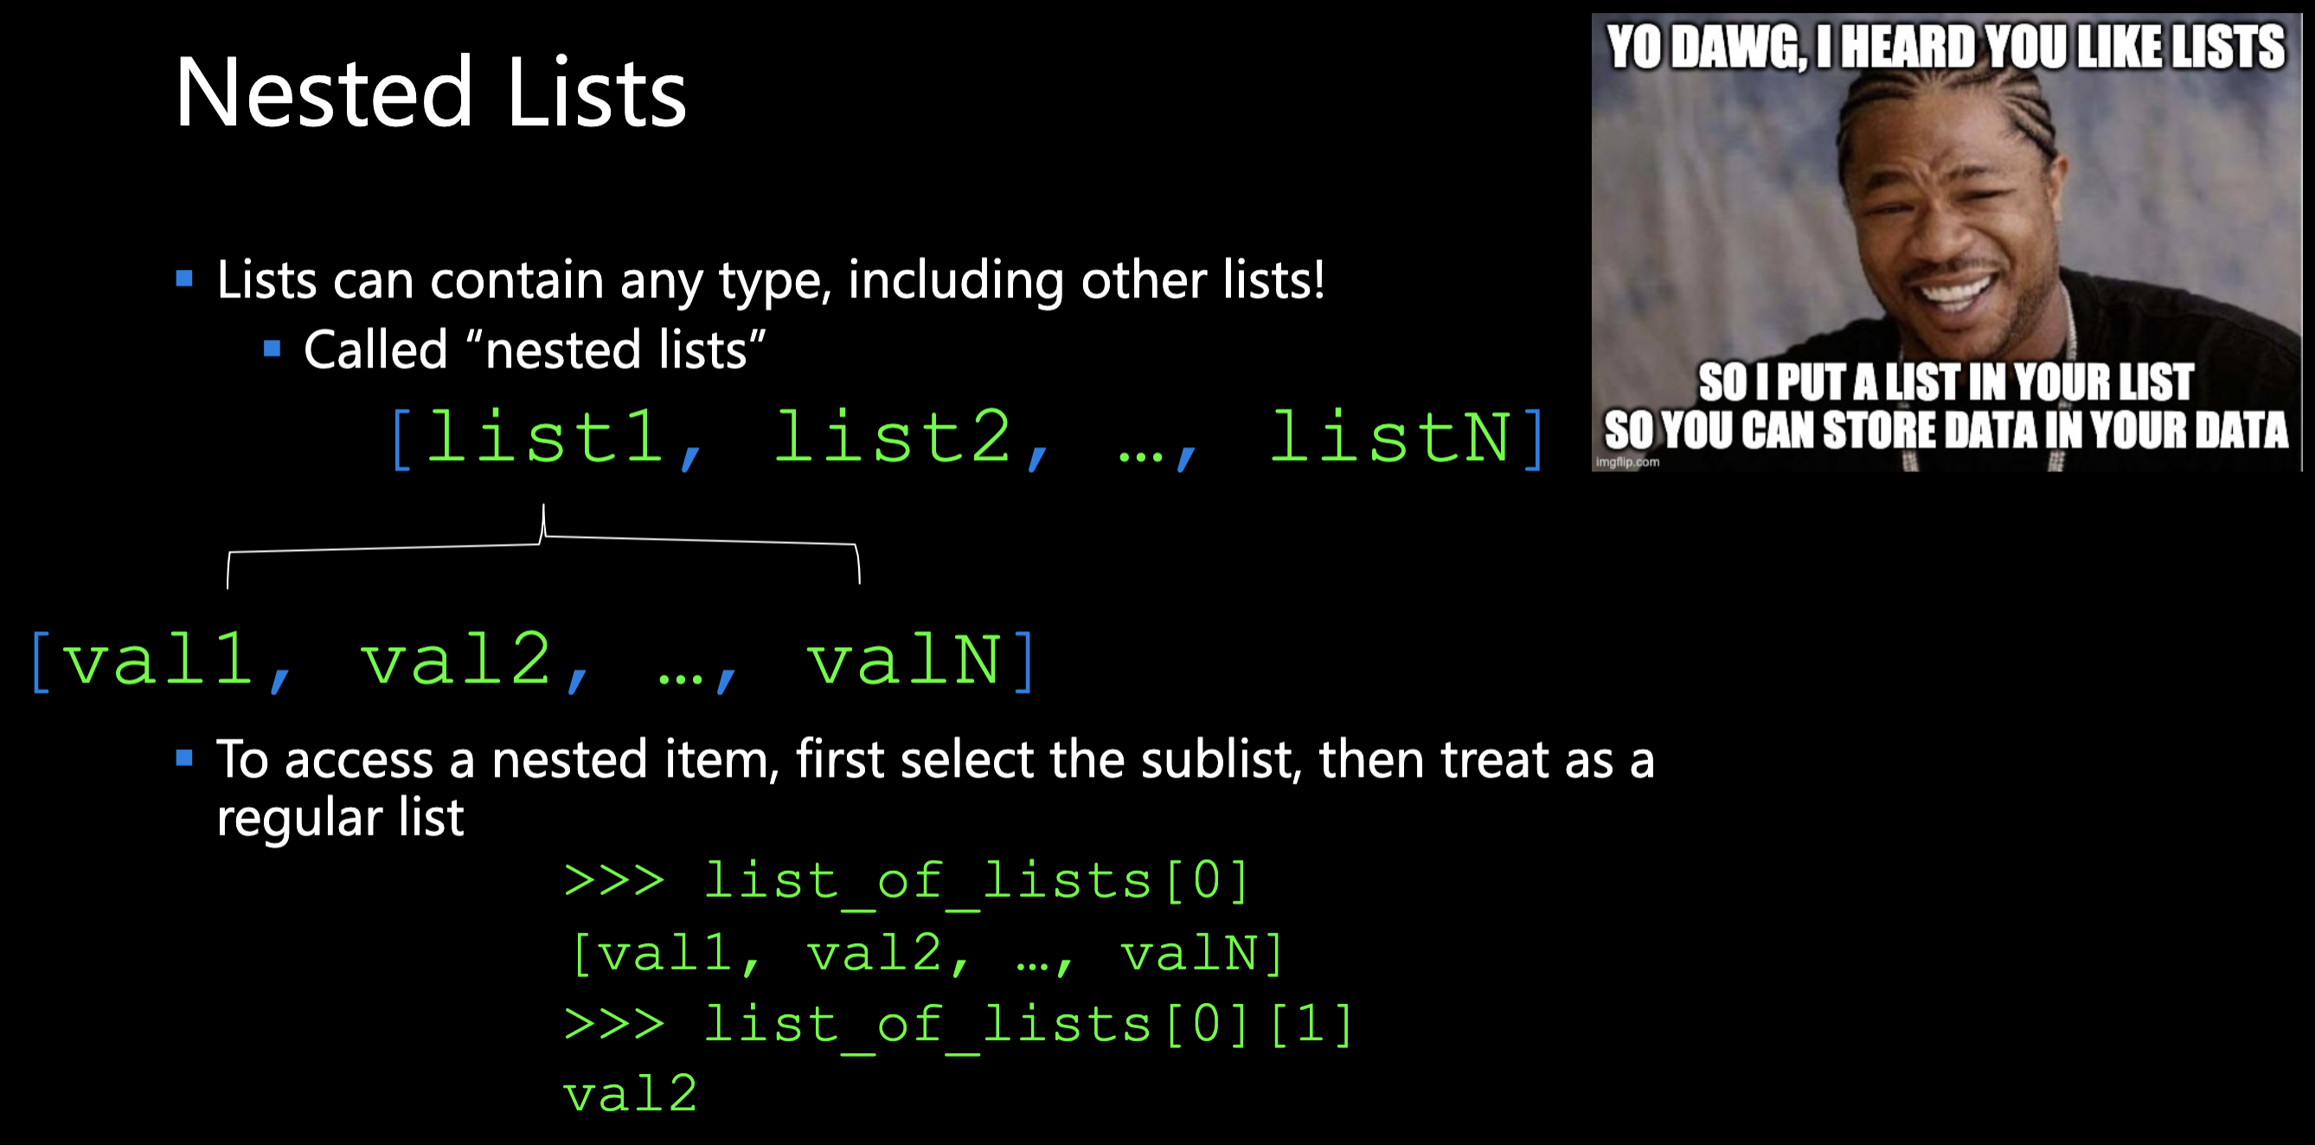

Slide 24
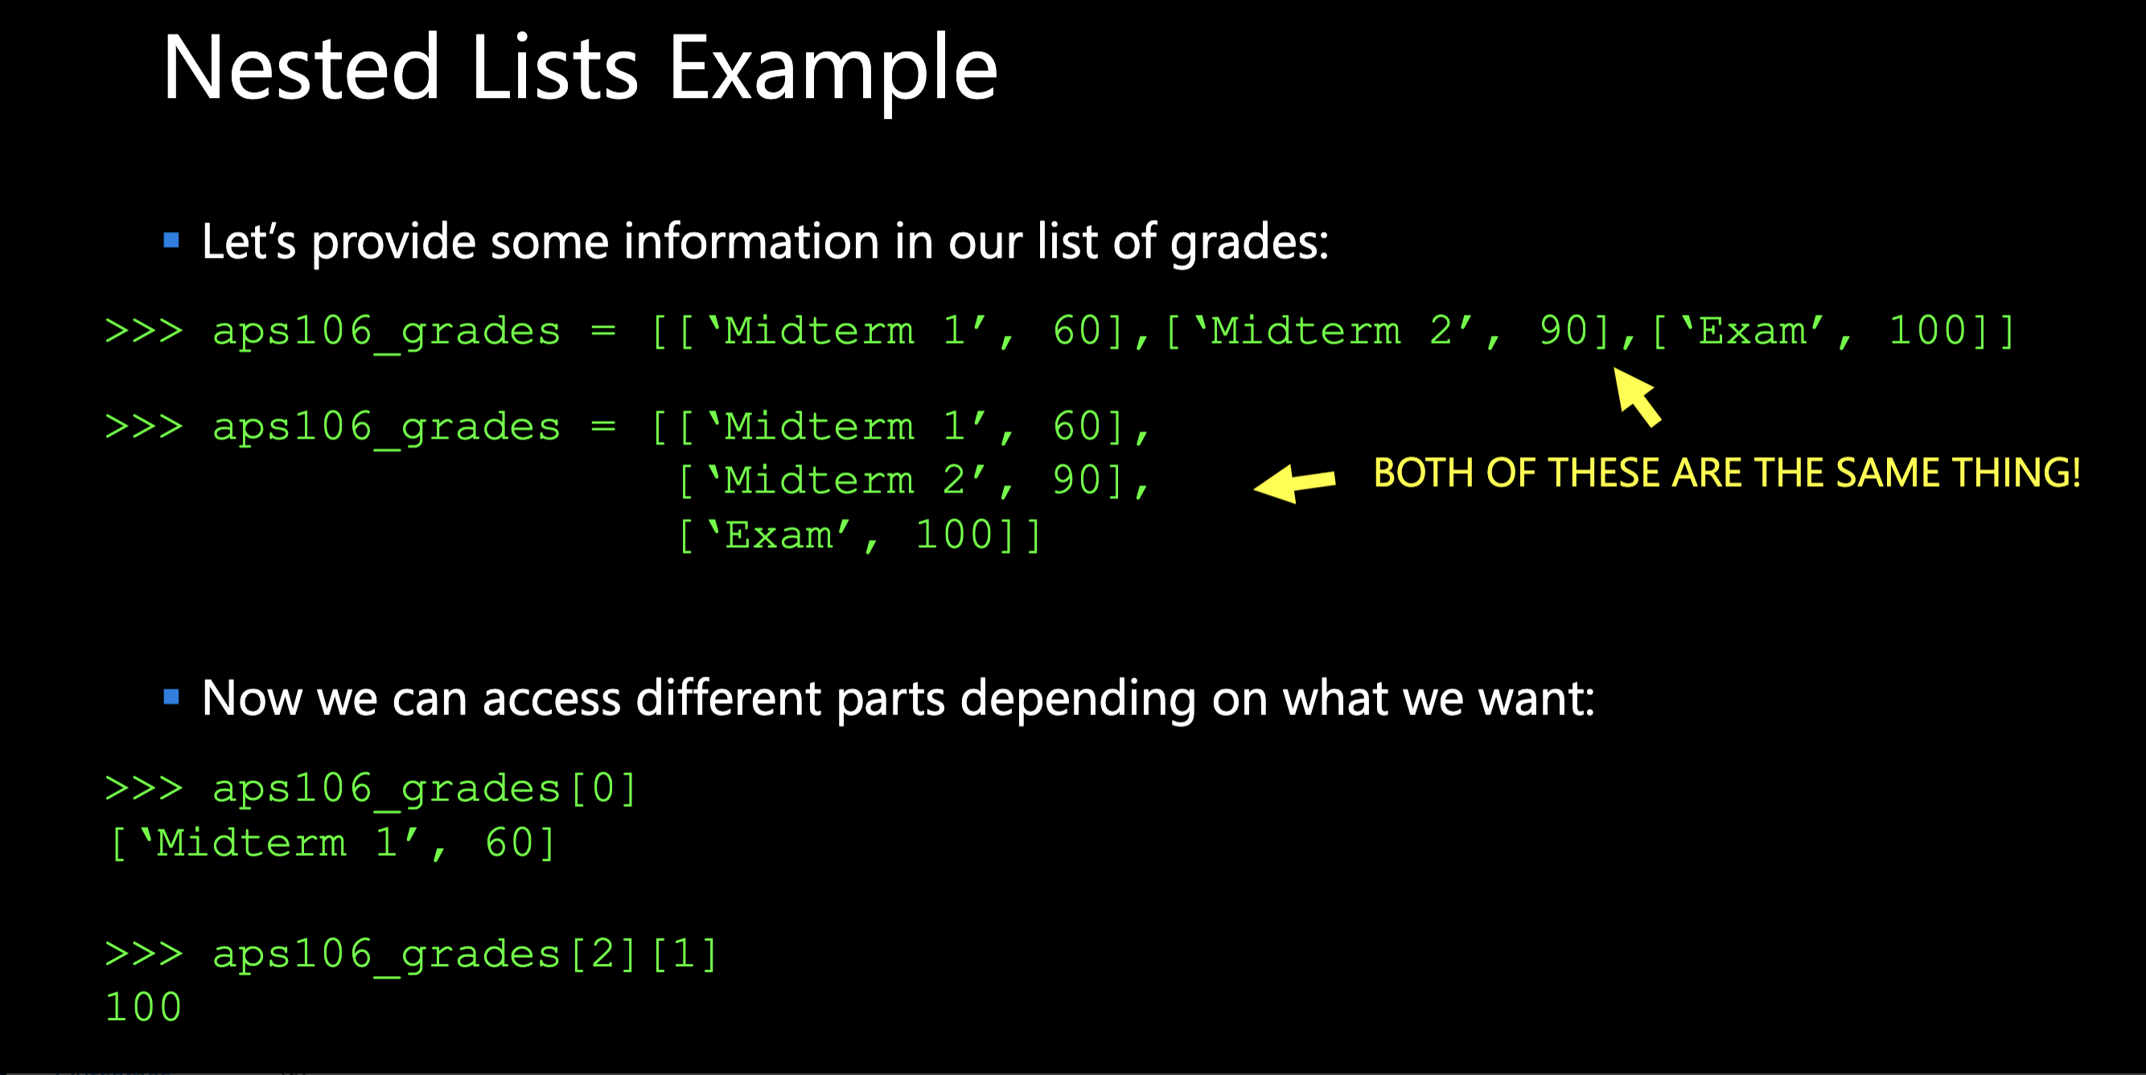

Slide 25
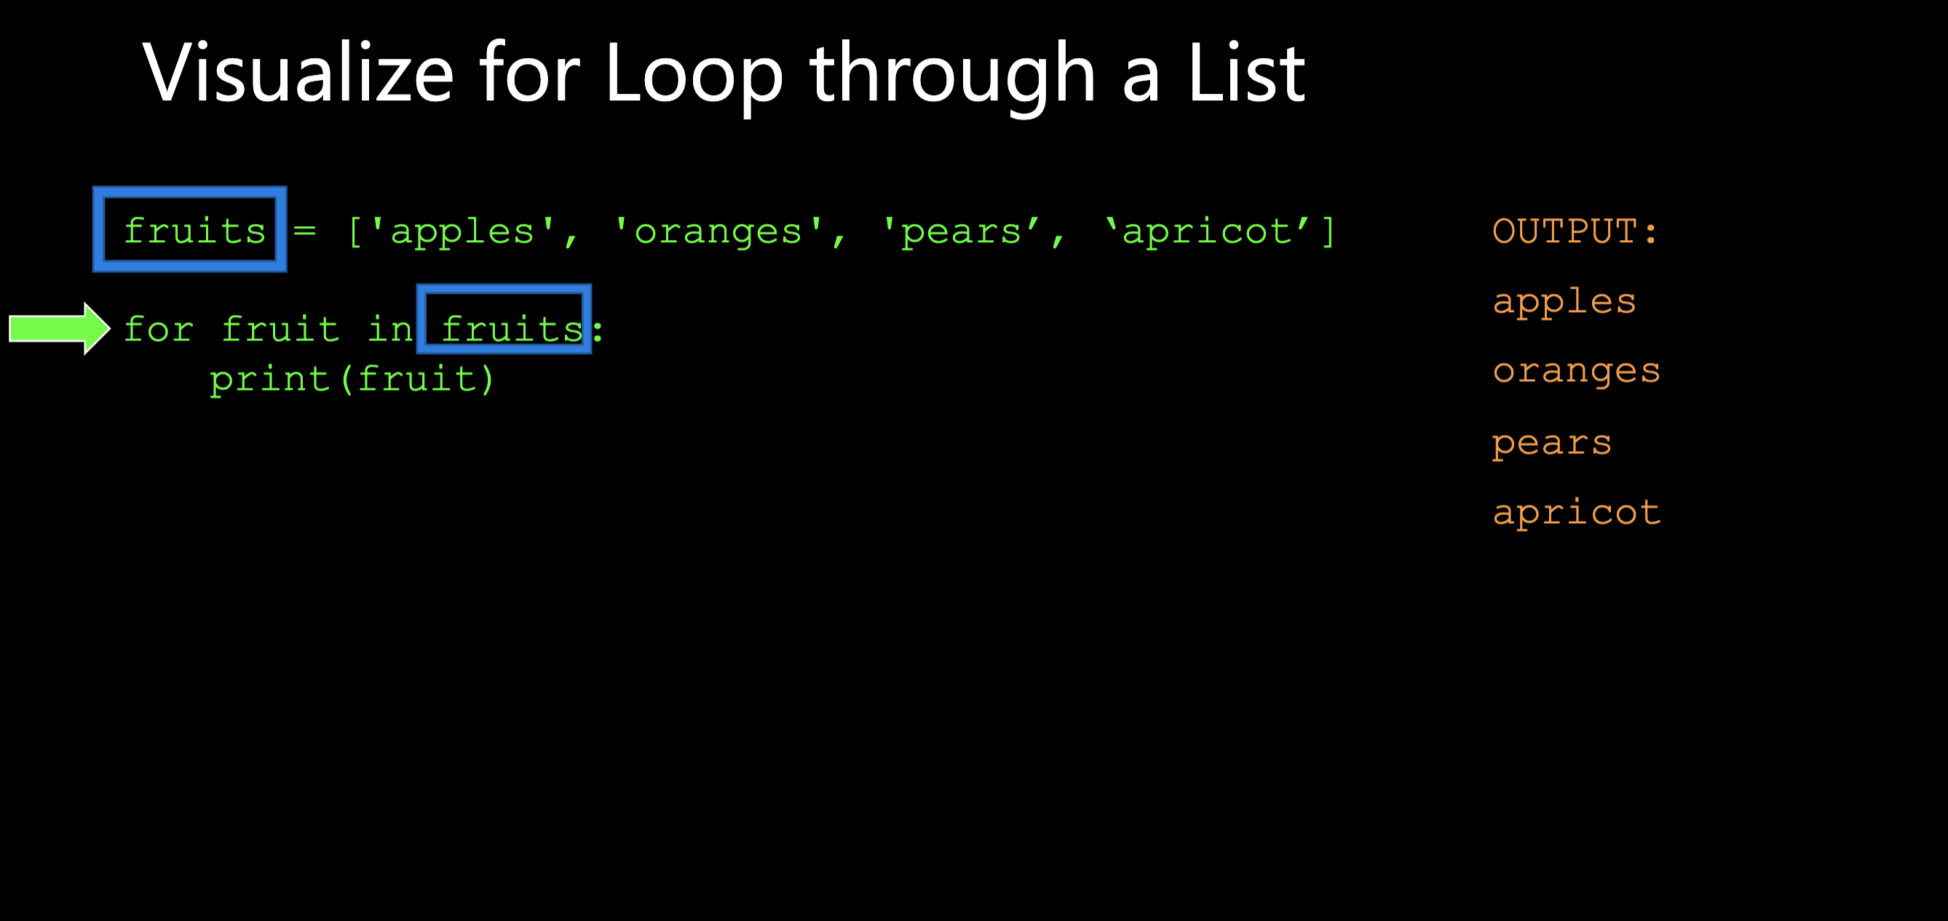

Slide 26
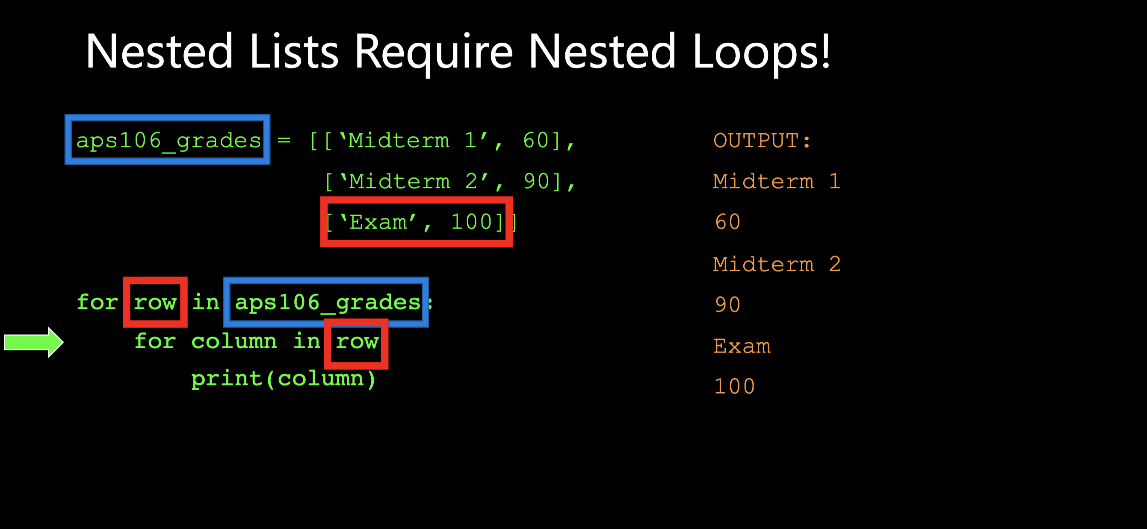

Slide 27
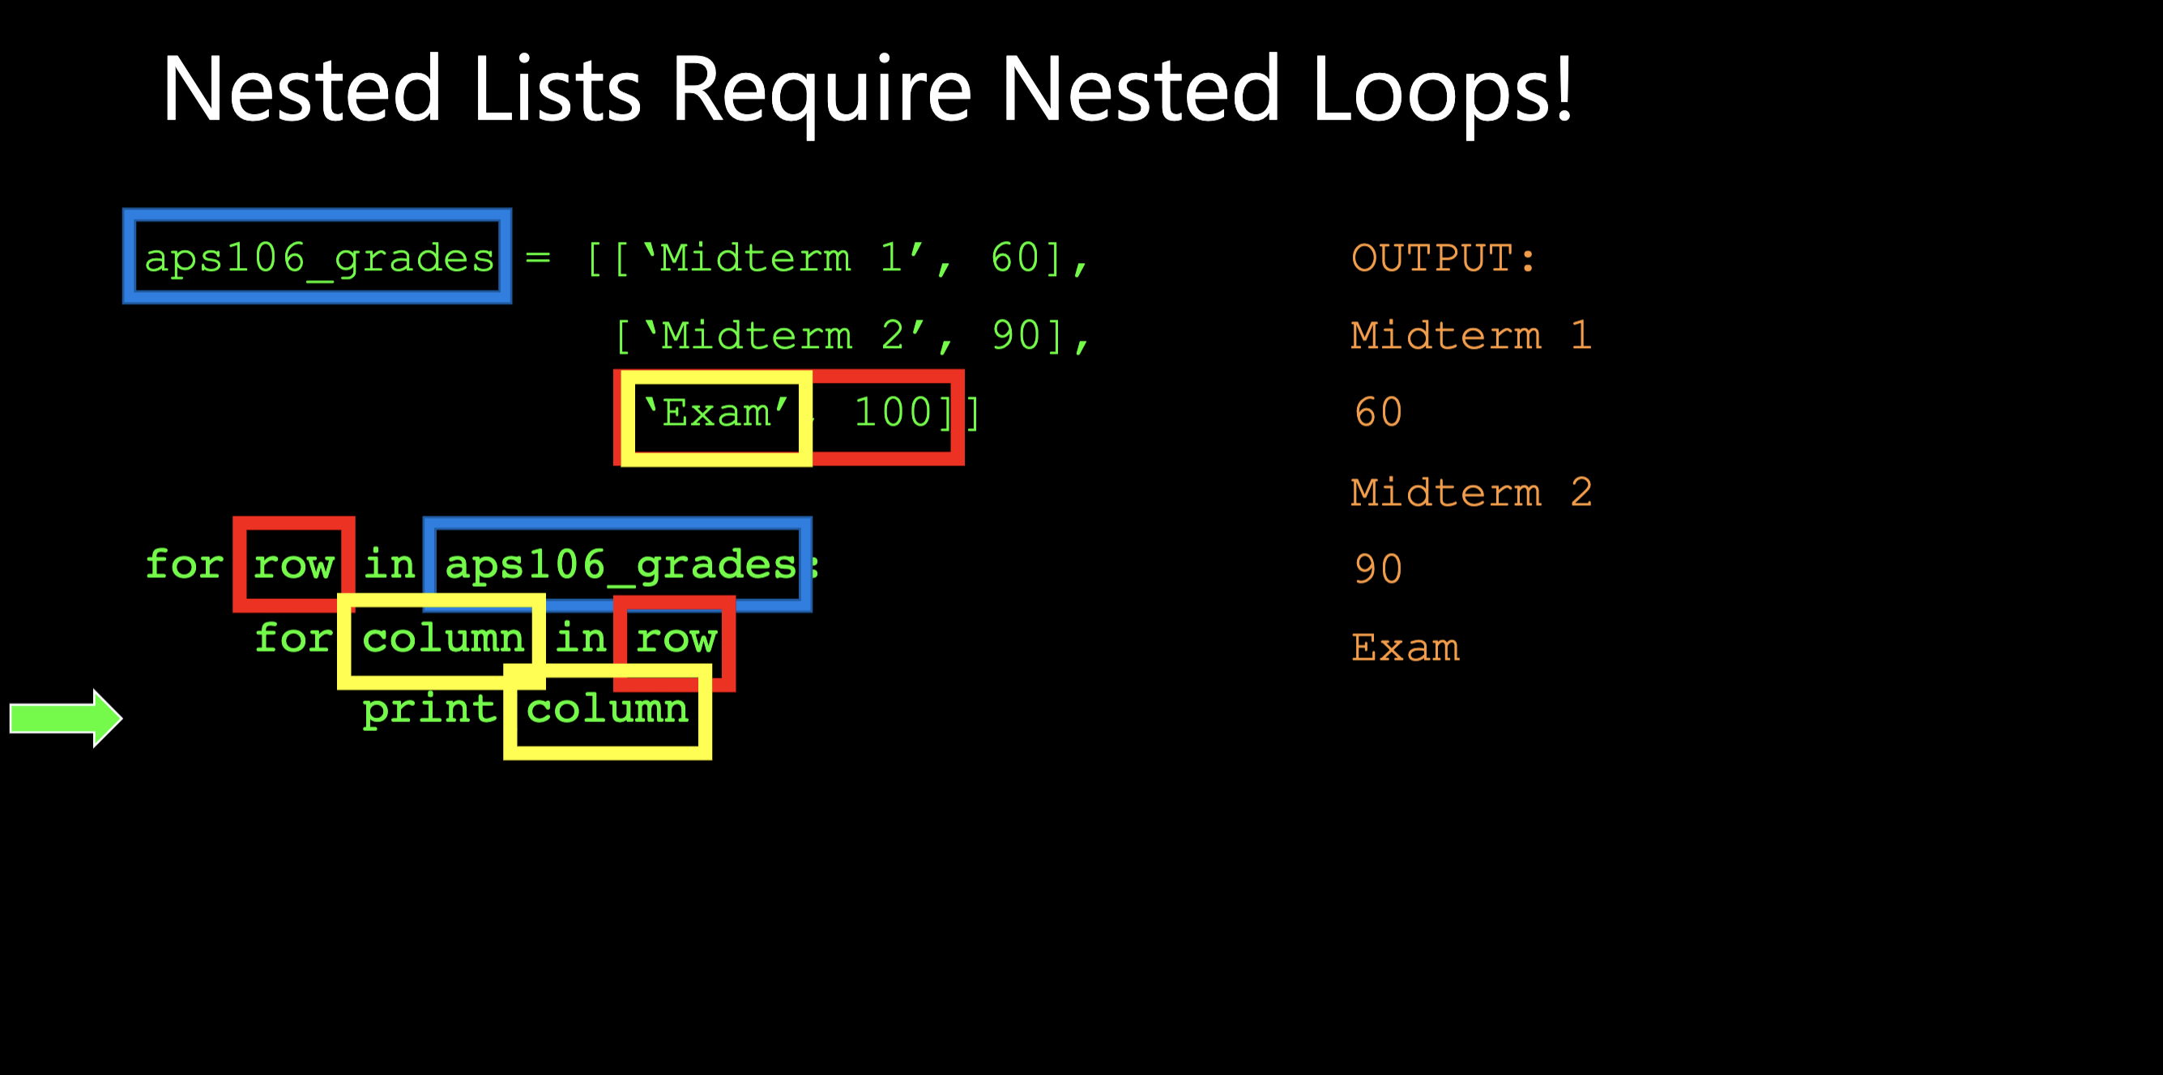

Slide 28
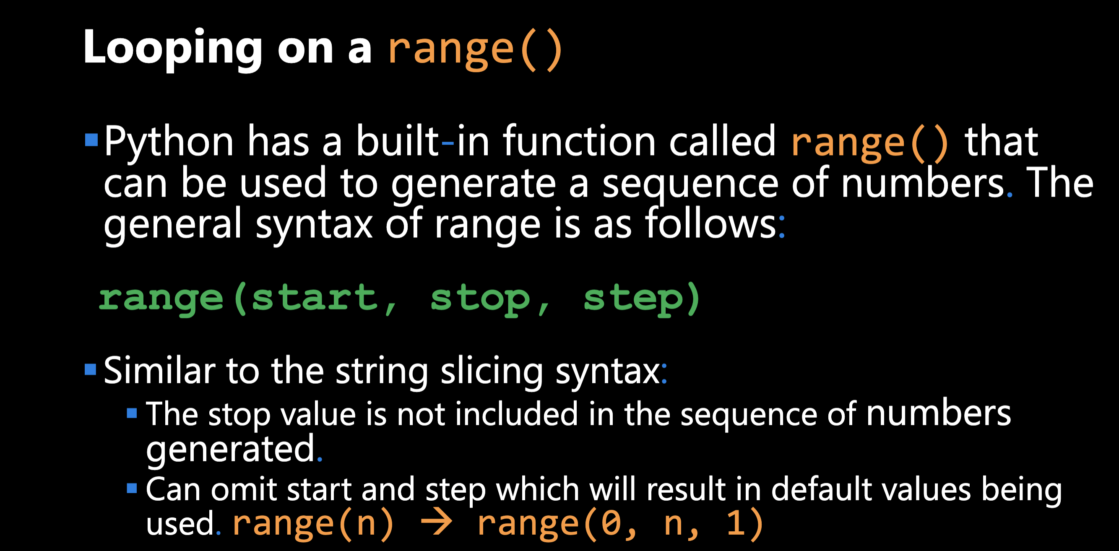

Slide 29
