Slide 1
more Pandas, NumPy, Matplotlib/Seaborn.
Week 12 | Lecture 2 (12.2)

Slide 2
This Week’s Content
Lecture 12.1
Installing third-party packages, managing environments, and Pandas.
Reading: Chapter 12
Lecture 12.2
More Pandas, NumPy, Matplotlib/Seaborn.
Reading: Chapter 12
Lecture 12.3
Design Problem: Stock Market – Part 1

Slide 3
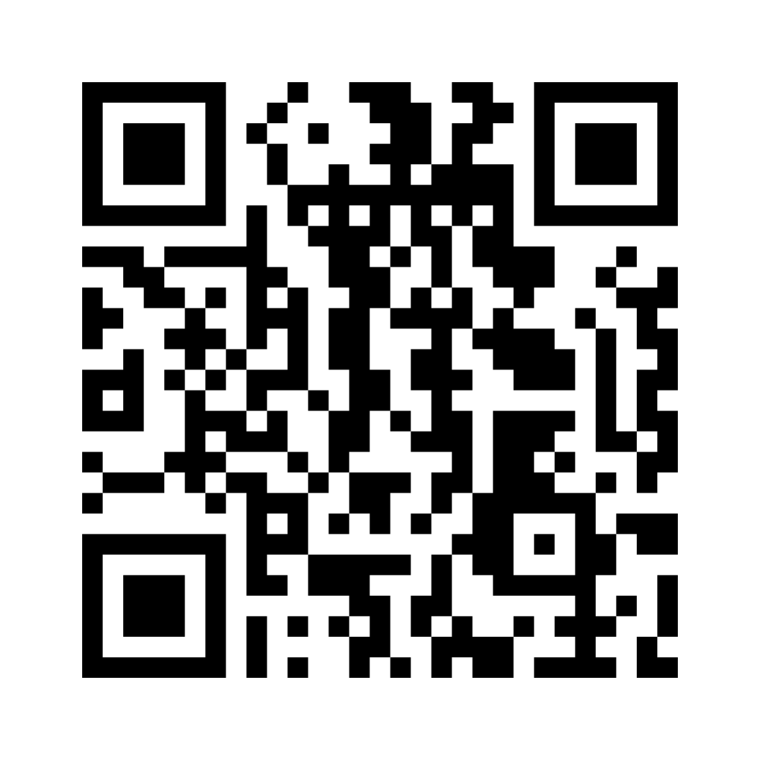
Week 13 | Exam Review
https://www.menti.com/blab1hazqqzt
Review 1 (Tuesday)
Confusing Topics.
Review 2 (Thursday)
Solving Long-Answer Questions From Past Exams.
Review 3 (Friday)
Jeopardy (Winner Takes All).
#gominsgo

Slide 4
more Pandas, NumPy, Matplotlib/Seaborn.
Week 12 | Lecture 2 (12.2)

