Slide 1
Tutorial 9 - Week 10
We’ll be starting at the 10 minute mark

Slide 2
Agenda
Lecture review
Aliasing review and mutable objects
Advanced functions
Intro to object-oriented programming
User-defined Classes and methods
Practice questions

Slide 3
Review of Lecture
Aliasing

Slide 4
Learning Objectives
After this tutorial, learners should be able to:
recognize / describe / create Python classes
recognize / describe / create data attributes
recognize / describe / create class data attributes
recognize / describe / create instance data attributes
recognize / describe / create methods
recognize / describe / create class initializers (__init__)
recognize / describe / create non-initializer imethods
recognize / describe / create Python objects
call methods on class / class instance objects

Slide 5
Aliasing (Review)
Two variables are said to be aliases when they reference the same object.
If the object represents a mutable value, changes made through one variable are visible to all aliases,
Example:
>>> lst1 = [2, 4, 6, 8]
>>> lst2 = lst1
>>> lst2[0] = "hi"
>>> print(lst1)
['hi', 4, 6, 8]
>>> print(lst2)
['hi', 4, 6, 8]
You can check if two variables are aliases by using the is operator, which returns True if both variables reference the same object
>>> lst1 is lst2
True

Slide 6
Using Mutable Objects as Function Arguments¹
If an object passed to a function as argument is mutable, modification of the object made within the function may be “visible” outside the function
WHY?
The function gets a reference to the object, not a copy of it, and modifications to the object may be visible to variables outside the scope of the function via the aliasing mechanism

Slide 7
Using Mutable Objects as Function Arguments²
def func(my_input):
my_input *= 2
>>> x = [[1, 2], [2,3]]
>>> print(x)
[[1, 2], [2,3]]
>>> func(x)
>>> print(x)
[[1, 2], [3, 4], [1, 2], [3, 4]]
The list object my_input references is changed “in place”
When func is called, variables x and my_input become aliases
The value of variable x was affected by the execution of func()

Slide 8
Using Mutable Objects as Function Arguments³
def func1(my_input):
my_input = my_input + my_input
>>> x = [[1, 2], [2,3]]
>>> print(x)
[[1, 2], [2,3]]
>>> func1(x)
>>> print(x)
[[1, 2], [2,3]]
my_input will reference a NEW list object !
The value of variable x was NOT affected by the execution of func()

Slide 9
Using Immutable Objects as Function Arguments¹
If the object passed as an argument to a function is immutable, the function gets a reference to the immutable object
If the the immutable object has no mutable components, no changes to the object are possible (no “side effects” occur)
def func(my_input):
my_input *= 2
>>> x = 5
>>> func(x)
>>> print(x)
5
The value of variable x was not affected by the execution of func2()

Slide 10
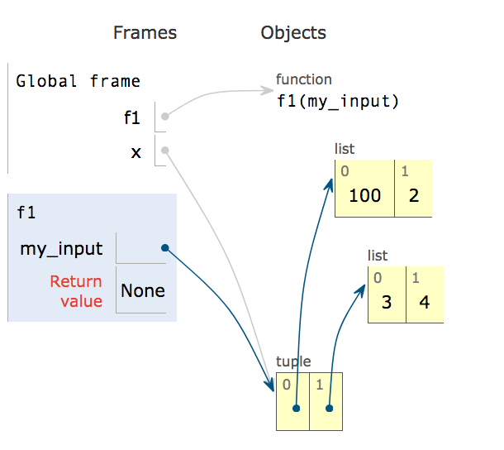
Using Immutable Objects as Function Arguments²
If the the immutable object has mutable components, changes to the mutable components are possible and these changes can become visible outside the function
def f1(my_input):
my_input[0][0] = 100
>>> x = ([1,2],[3,4])
>>> f1(x)
>>> print(x)
([100, 2], [3, 4])
The value of variable x was affected by the execution of f1()

Slide 11
Recap: Aliasing and Functions - 1
In Python, arguments are passed to functions by reference.
In other words, links to objects are passed to functions, NOT copies of the objects.
If the object being passed to a function is:
mutable (e.g., a list, dictionary, set), if a function modifies the object passed as an argument, the change is visible outside the function (the function is said to produce “side effects”);
immutable (e.g., integer, string, tuple): it is not possible to change anything about that object in the function (no side effects)

Slide 12
Recap: Aliasing and Functions - 2
Aliasing can be helpful, but if you do not intend for the function to change a mutable object, create a copy of the mutable object and pass that to functions, or use copies of the mutable object inside functions and change those.
>>> x = [1, 2, 3, 4]
>>> y = x
>>> print(x is y)
True
Aliasing:
Copying 1:
Copying 2:
Copying 3:
>>> x = [1, 2, 3, 4]
>>> y = x[:]
>>> print(x is y)
False
>>> x = [1, 2, 3, 4]
>>> y = list(x)
>>> print(x is y)
False
>>> y = [1, 2, 3, 4]
>>> x = y.copy()
>>> print(x is y)
False

Slide 13
Review of Lecture
Advanced Functions

Slide 14
Optional Parameters - Default Values
Parameters can be set up in function definitions to have default values
=> these values are optional and you don’t need to specify them when calling the function
Example: sep, end, file and flush are optional parameters in print()
>>> help (print)
print(...)
print(value, ..., sep=' ', end='\n', file=sys.stdout, flush=False)
Prints the values to a stream, or to sys.stdout by default.
Optional keyword arguments:
file: a file-like object (stream); defaults to the current sys.stdout.
sep: string inserted between values, default a space.
end: string appended after the last value, default a newline.
flush: whether to forcibly flush the stream.

Slide 15
Optional Parameters in Built-in Functions
Example: in function print(), the default values of the optional parameters sep and end are a blank space and '\n' (the newline marker), respectively:
We can specify different values for sep and end:
>>> print("one", "two", "three", "four")
one two three four
>>> print("one", "two", "three", "four", sep = '...', end = "!!!")
one...two...three...four!!!!

Slide 16
Optional Parameters in User-defined Functions
Optional parameters can also be defined in user-defined functions
def func(x, y = 2):
return x * y
# the y parameter takes on the default value 2
print('Using the default value:', func(3))
# the default value of y is overriden
print('Default value overridden:', func(3, 5))
When using the default value func() returns 6
When the default value is overridden, func() returns 15

Slide 17
Review of Lecture
Intro to object-oriented programming

Slide 18
What is Object Oriented Programming (OOP)?
OOP is a programming paradigm where programmers build abstract data types that resemble real world objects
This enables the programmer to use the objects as they would outside the program to solve complex problems
OOP focuses on the creation of objects which contain both data and functionality together and achieving the overall program functionality through the interaction of these objects.

Slide 19
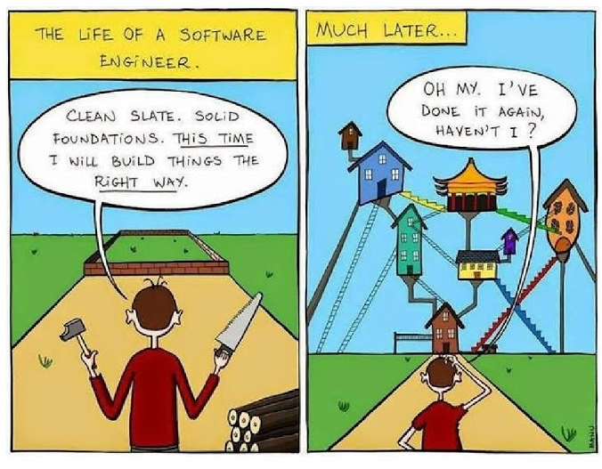
Why use OOP?
“How would you do it?” → “Translate this to Python”
As programs get larger and need to handle increasingly complex problems, it gets harder to represent the data by simply composing built-in data-types, i.e., list, dictionary, int, string, etc.
⇒An option is to create new data types that can store both information (in data attributes) and behaviour (in methods).
→In Python, methods are also referred to as method attributes.

Slide 20
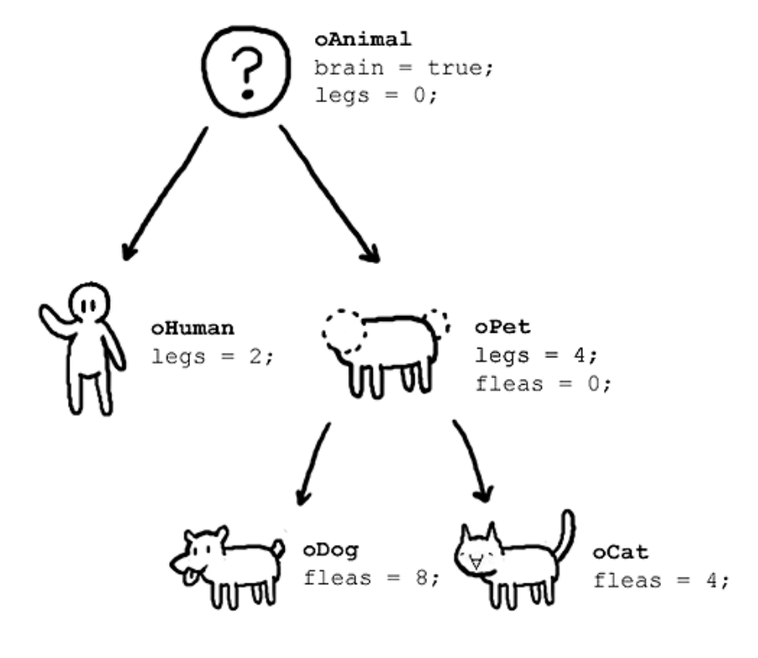
This seems like more work, why would you do this?
The real benefits of OOP manifest more clearly in programs that are complicated and large.
Usually, in a large industry project, several classes will already be defined and new programmers who join a project write code that uses the pre-existing classes.

Slide 21
Review of Lecture
User-defined Classes

Slide 22
Review: Classes and Objects
Classes are templates for generating objects
Built-in classes: int, list, str, dict, …
Each object is an instance of a class template
Example: x = [5,5,3]
Y = list((5,6,7))
X and Y are objects, instances of class list
Note: - objects are the actual values in a program
- classes are how you would describe a type of object, and its capabilities.

Slide 23
User-Defined Classes - 1
One can expand the set of available classes by defining new classes
The general form of a class definition is:
class <class name>:
#class data attributes
…
def __init__(self, parameters):
#instance data attributes
…
def method_1(self, parameters):
…
def method_1(self, parameters):
…

Slide 24
User-Defined Classes - 2
class <class name>:
#class data attributes
…
def __init__(self, parameters):
#instance data attributes
…
The __init__ method is responsible for setting up the initial state of any new class instance. (The initializer method is automatically called whenever a new class instance is created by the class constructor. )
The class constructor, in Python, is called __new__. It is called first after a class instantiation statement and returns an instance of the class. In general, you do not need to add a method __new__ to your class. It is already available by default.
⇒ __init__ is responsible for initializing a class instance. The class instance exists at the time __init__ is called.

Slide 25
Example User Defined-Class
We can simulate multiple __init__ methods in a class by using optional parameters.
If multiple __init__ are present, the last one overrides the previous ones.
# define the class
class Point:
def __init__(self,xx=0,yy=0,zz=0):
self.x = xx
self.y = yy
self.z = zz
# instantiate some Point objects
q = Point()
p = Point(3,4,5)
__init__ is called the “initializer method”
__init__ creates three instance attributes: x, y and z
The self parameter is automatically set to reference the newly created object
___init__ sets the attributes x, y and z of an instance of class Point to 0.
___init__ sets the attributes x, y and z of an instance of class Point to 3, 4 and 5, respectively.

Slide 26
User-Defined Methods
Classes have a set of functions (aka methods) that can only be applied to objects that are instances of the class
The general form of a class with methods is:
class <class name>:
#class data attributes
….
def method_name1(self, param1):
body1
def method_name2(self, param2):
body2
Method __init__ can be one of the methods in the body of a class, but it is not mandatory. Each class has a default initializer.

Slide 27
Example User Defined-Class
# define class Point
class Point:
def __init__(self,x=0,y=0,z=0):
self.x = x
self.y = y
self.z = z
def distance_from_origin(self):
return ((self.x**2) + (self.y**2) +(self.z**2))**0.5
# instantiate some 3d Point objects
p = Point(3,4,5)
q = Point(1,2,3)
# get the distance from origin (Note the two different ways to call methods!)
Distance_p = p.distance_from_origin() # object.method()
Distance_q = Point.distance_from_origin(q) # Class.method(object)
distance_from_origin is a method

Slide 28
Practice Problems

Slide 29


What does the following code output?
ⓘ
Click Present with Slido or install our Chrome extension to activate this poll while presenting.
Notes:
📣 This is Slido interaction slide, please don't delete it. ✅ Click on 'Present with Slido' and the poll will launch automatically when you get to this slide.

Slide 30
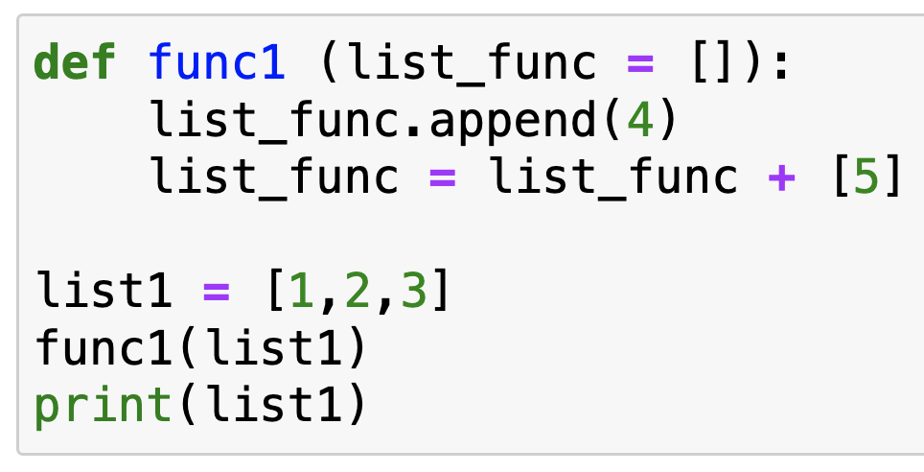
Review Practice Problem 1
Q2. What does the following code output?
[1, 2, 3]
None
[1, 2, 3, 4, 5]
[1, 2, 3, 4]
Error

Slide 31
Analyze the following code and select the appropriate statement:
ⓘ
Click Present with Slido or install our Chrome extension to activate this poll while presenting.
Notes:
📣 This is Slido interaction slide, please don't delete it. ✅ Click on 'Present with Slido' and the poll will launch automatically when you get to this slide.

Slide 32
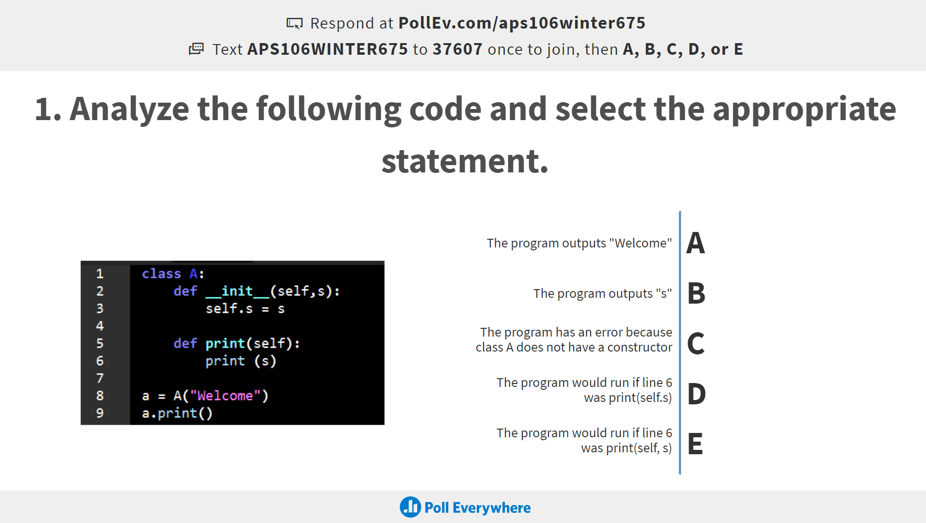
Review Practice Problem 2
Q1. Analyze the following code and select the appropriate statement
The program outputs “Welcome”
The program outputs “s”
The program has an error because class A does not have a constructor
The program would run if line 6 was print(self.s)
The program would run if line 6 was print(self, s)

Slide 33
An object is an instance of...
ⓘ
Click Present with Slido or install our Chrome extension to activate this poll while presenting.
Notes:
📣 This is Slido interaction slide, please don't delete it. ✅ Click on 'Present with Slido' and the poll will launch automatically when you get to this slide.

Slide 34
Review Practice Problem 3
a program
a method
data
a class
a function
Q2. An object is an instance of …

Slide 35
What does the following code output?
ⓘ
Click Present with Slido or install our Chrome extension to activate this poll while presenting.
Notes:
📣 This is Slido interaction slide, please don't delete it. ✅ Click on 'Present with Slido' and the poll will launch automatically when you get to this slide.

Slide 36
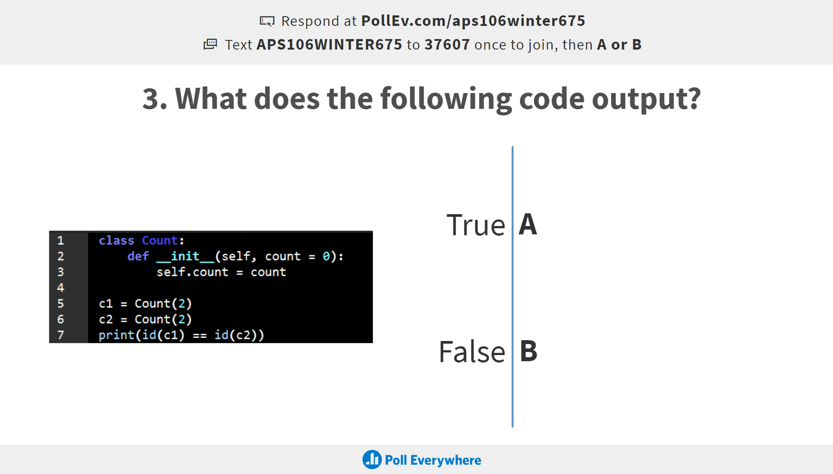
Review Practice Problem 4
Q3. What does the following code output?
True
False
An error

Slide 37
What does the following code output?
ⓘ
Click Present with Slido or install our Chrome extension to activate this poll while presenting.
Notes:
📣 This is Slido interaction slide, please don't delete it. ✅ Click on 'Present with Slido' and the poll will launch automatically when you get to this slide.

Slide 38
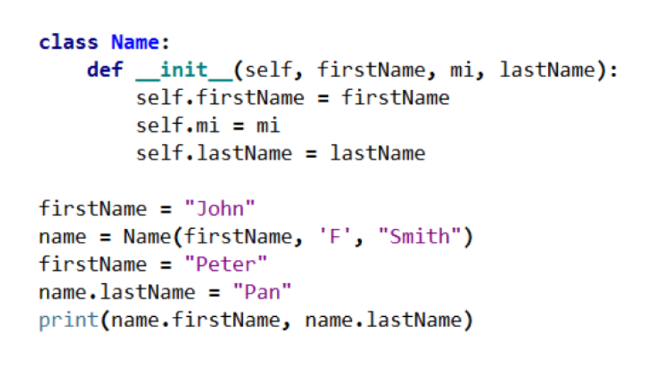
Review Practice Problem 5
Q4. What does the following code output?
Peter Pan
Peter F Smith
John Pan
John F Smith
None of the above

Slide 39
Coding Question 1
Let’s make a simple class called Car that has three data attributes:
brand (stored as a string)
model (stored as a string
top_speed (stored as a floating point number)
Define a class Car.
Create a method is_faster(self, other_car), which returns True if self is “faster” than the other_car and False if it is slower
Create two Car objects, car1 and car2
Print out the attributes of each Car object.
Print out whether car1 is “faster” than car2

Slide 40
Coding Question 2
Define a class called Rectangle and create methods to:
compute its area
compute its perimeter
find its centre point
EXTRA: compare two rectangles and return the rectangle with the largest area
Instructions:
Use the starter code provided on Quercus. Go to your tutorial section and use the “open the practice problem” prompt.
Use the Point class to solve this problem.
Hint: What are some logical attributes for a rectangle? What attributes would be useful within the methods that we’re going to write?

