Slide 1
Tutorial 10 - Week 11
We’ll be starting at the 10 minute mark

Slide 2
Agenda
Lecture review - reinforcing concepts
User-defined Classes and methods
Encapsulation, nesting classes and attributes
Practice questions

Slide 3
Review of Lecture
User-defined Classes

Slide 4
Review: Classes and Objects
Classes are templates for generating objects
Built-in classes: int, list, str, dict, …
Each object is an instance of a class template
Example: x = [5,5,3]
Y = list((5,6,7))
X and Y are objects, instances of class list
Note: - objects are the actual values in a program
- classes are how you would describe a type of object, and its capabilities.

Slide 5
User-Defined Classes - 1
One can expand the set of available classes by defining new classes
The general form of a class definition is:
class <class name>:
#class data attributes
…
def __init__(self, parameters):
#instance data attributes
…
def method_1(self, parameters):
…
def method_1(self, parameters):
…

Slide 6
User-Defined Classes - 2
class <class name>:
#class data attributes
…
def __init__(self, parameters):
#instance data attributes
…
The __init__ method is responsible for setting up the initial state of any new class instance. (The initializer method is automatically called whenever a new class instance is created by the class constructor. )
The class constructor, in Python, is called __new__. It is called first after a class instantiation statement and returns an instance of the class. In general, you do not need to add a method __new__ to your class. It is already available by default.
⇒ __init__ is responsible for initializing a class instance. The class instance exists at the time __init__ is called.

Slide 7
Example User Defined-Class
We can simulate multiple __init__ methods in a class by using optional parameters.
If multiple __init__ are present, the last one overrides the previous ones.
# define the class
class Point:
def __init__(self,xx=0,yy=0,zz=0):
self.x = xx
self.y = yy
self.z = zz
# instantiate some Point objects
q = Point()
p = Point(3,4,5)
__init__ is called the “initializer method”
__init__ creates three instance attributes: x, y and z
The self parameter is automatically set to reference the newly created object
___init__ sets the attributes x, y and z of an instance of class Point to 0.
___init__ sets the attributes x, y and z of an instance of class Point to 3, 4 and 5, respectively.

Slide 8
User-Defined Methods
Classes have a set of functions (aka methods) that can only be applied to objects that are instances of the class
The general form of a class with methods is:
class <class name>:
#class data attributes
….
def method_name1(self, param1):
body1
def method_name2(self, param2):
body2
Method __init__ can be one of the methods in the body of a class, but it is not mandatory. Each class has a default initializer.

Slide 9
Example User Defined-Class
# define class Point
class Point:
def __init__(self,x=0,y=0,z=0):
self.x = x
self.y = y
self.z = z
def distance_from_origin(self):
return ((self.x**2) + (self.y**2) +(self.z**2))**0.5
# instantiate some 3d Point objects
p = Point(3,4,5)
q = Point(1,2,3)
# get the distance from origin (Note the two different ways to call methods!)
Distance_p = p.distance_from_origin() # object.method()
Distance_q = Point.distance_from_origin(q) # Class.method(object)
distance_from_origin is a method

Slide 10
Encapsulation
Encapsulation is a fundamental concept in object-oriented programming that involves bundling data (variables) and methods (functions) that operate on the data into a single unit called an object.
For example, consider our Point class from earlier:
class rectangle:
def __inite__(self, area):
self.area = area
def compare_area(self, other_rectangle):
if self.area > other_rectangle.area:
return True
else:
return False
If other_rectangle is also a rectangle object, we can access it’s area!

Slide 11
Encapsulation cont.
This allows us to also use methods and attributes from other class templates inside another class:
For example, consider our Point class from earlier:
class rectangle:
def __init__(self, x1, y1, x2, y2):
top_left = Point(x1,y1)
bottom_right = Point(x1, y1)
def return_mid(self):
midx = (self.top_left.x + self.bottom_right.x) / 2
midy = (self.top_left.y + self.bottom_right.y) / 2
return Point(midx, midy)
class Point:
def __init__(self, x, y)
self.x = x
self.y = y
Notice how we access the x and y attributes!

Slide 12
Practice Problems

Slide 13


What is the output?
ⓘ
Click Present with Slido or install our Chrome extension to activate this poll while presenting.
Notes:
📣 This is Slido interaction slide, please don't delete it. ✅ Click on 'Present with Slido' and the poll will launch automatically when you get to this slide.

Slide 14
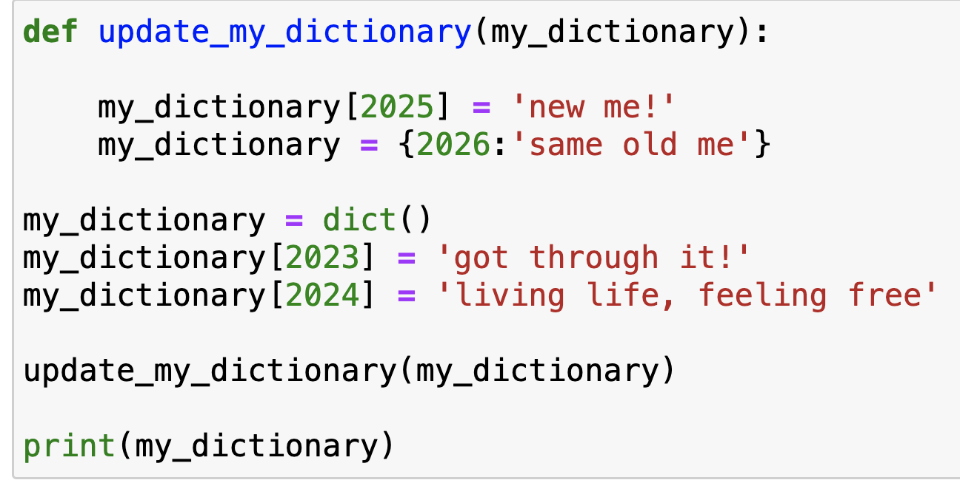
Review Practice Problem
{2023: 'got through it!', 2024: 'living life, feeling free'}
{2023: 'got through it!', 2024: 'living life, feeling free', 2025: 'new me!'}
{2023: 'got through it!', 2024: 'living life, feeling free', 2025: 'new me!', 2026:'same old me'}
{2026:'same old me'}
Error
Q1. What is the output?

Slide 15
In this code, equipment is an example of:
ⓘ
Click Present with Slido or install our Chrome extension to activate this poll while presenting.
Notes:
📣 This is Slido interaction slide, please don't delete it. ✅ Click on 'Present with Slido' and the poll will launch automatically when you get to this slide.

Slide 16
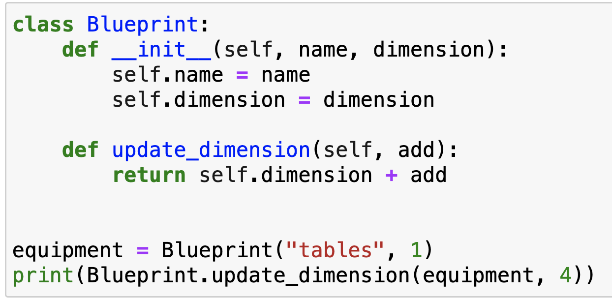
Review Practice Problem
Q2. In this code, equipment is an example of:
A class
A function
A method
An attribute
An object

Slide 17
What does the following code output?
ⓘ
Click Present with Slido or install our Chrome extension to activate this poll while presenting.
Notes:
📣 This is Slido interaction slide, please don't delete it. ✅ Click on 'Present with Slido' and the poll will launch automatically when you get to this slide.

Slide 18
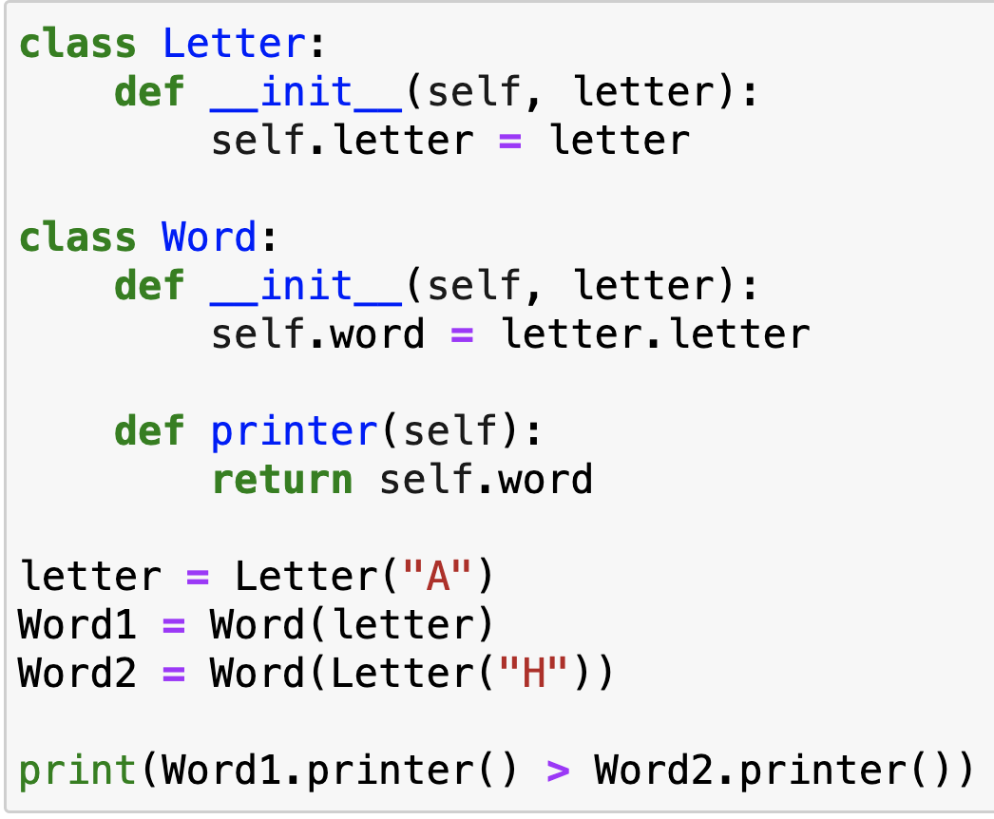
Review Practice Problem
Q3. What does the following code output?
True
False
An error

Slide 19
Coding Question 1
You are tasked with designing a simple Fridge class to help manage the inventory of food items for a household kitchen. The class should keep track of food items and their quantities. It should also have a method use_item to update the inventory when food items are used for cooking. Individual items and their quantities in the Fridge should be returned as a dictionary (keys = items, quantity = value).
my_fridge = Fridge()
my_fridge.add_item("Apples", 10)
my_fridge.add_item("Milk", 10)
my_fridge.use_item("Apples", 4)
my_fridge.use_item("Milk", 1)
print(my_fridge.inventory) # {'Apples': 6, 'Milk': 9}

Slide 20
Coding Question 2
Define a class called Book and store its title, author, genre, isbn.
Create a related class Library and create methods to:
Add a new book
Remove a book by isbn
Find all books by a specific author
Find all books of a specific genre
Instructions:
Use the starter code provided on Quercus. Go to your tutorial section and use the “open the practice problem” prompt.

Slide 21
Coding Question 3
Define a class called Circle and store its center and radius. Create methods for circle that:
Find the area
Find the circumference
Can pass in a Point object, and tells you if it is inside the circle
Determines if one circle is fully inside another circle
Instructions:
Use the starter code provided on Quercus. Go to your tutorial section and use the “open the practice problem” prompt.
NOTE: You must use the Point class, for both the check inside method, as well as for the circle radius coordinate!

